Slide 1
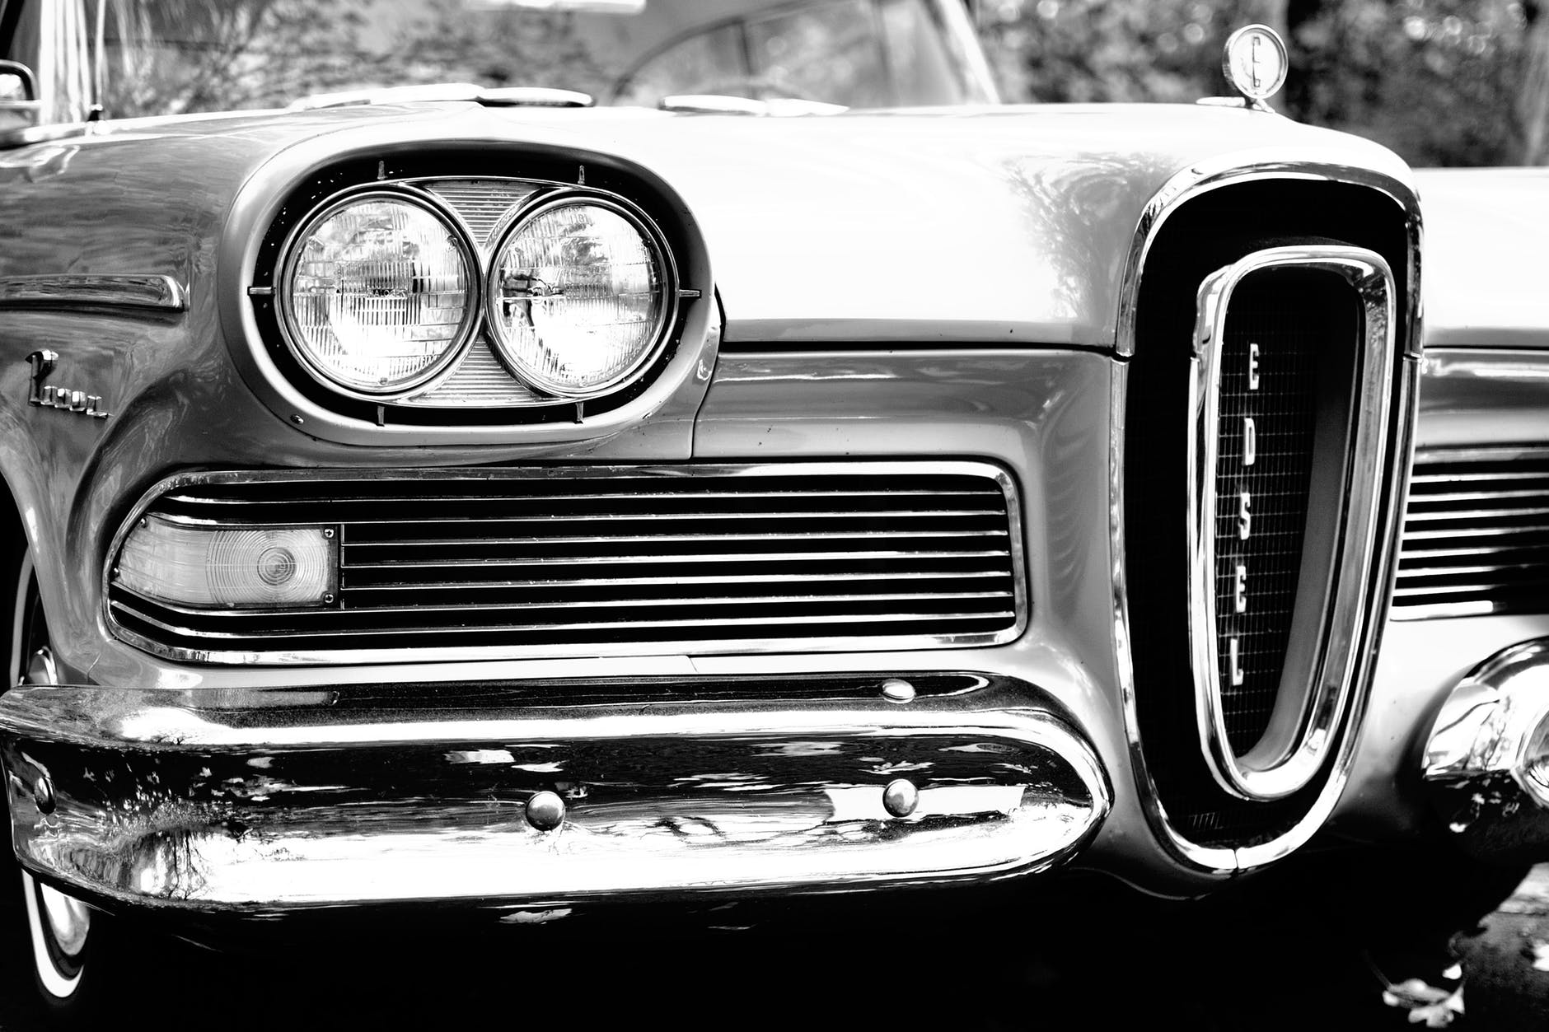
Ford Motor Case
Team 1

Slide 2
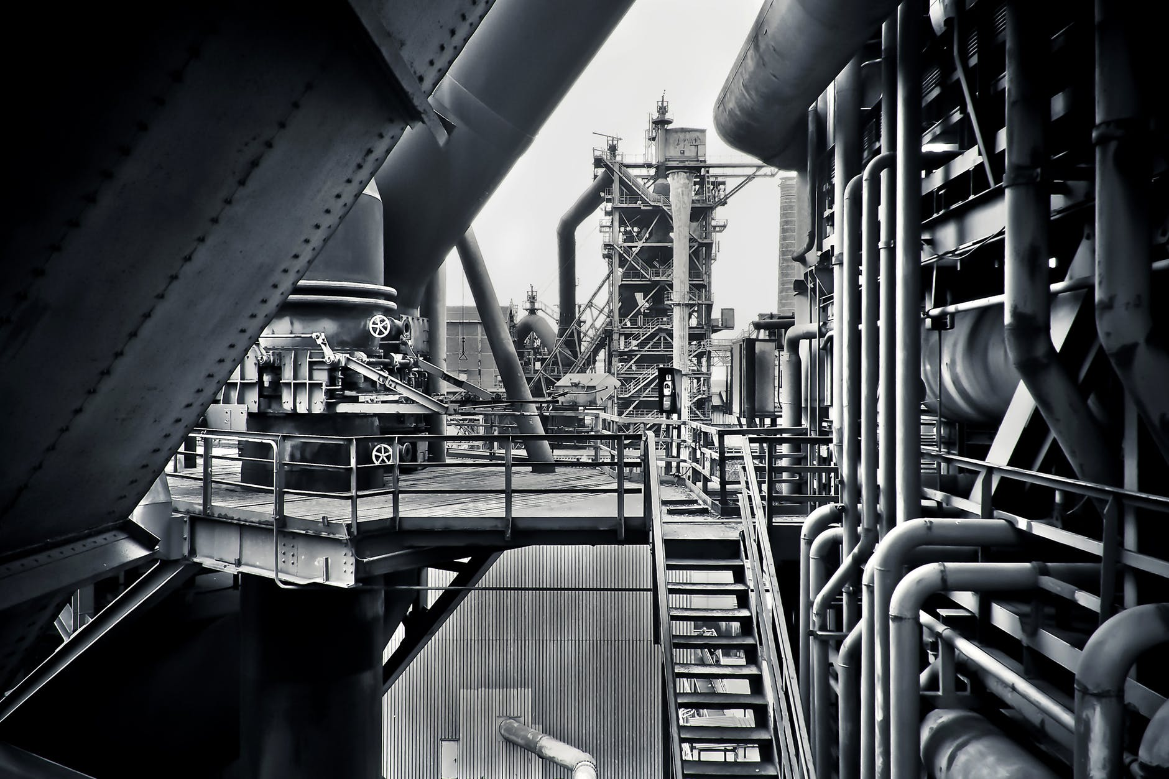
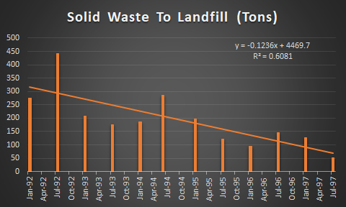
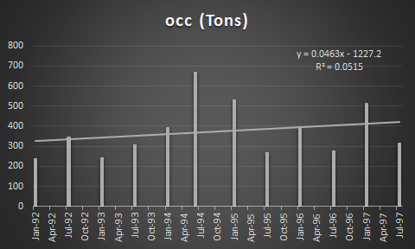
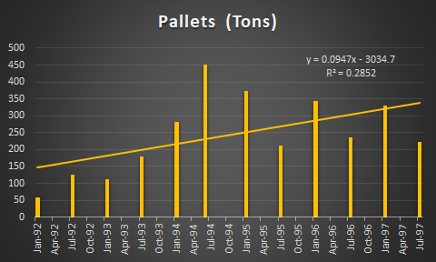
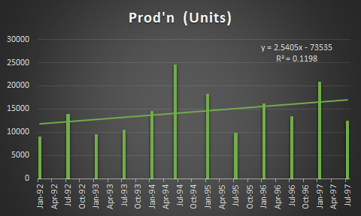
On checking the trend of the waste generated from various sources it is seen that the solid waste generation has declined over the time whereas an increase has been observed in OCC and Pallets. Additionally, the increase trend of OCC is very similar to the production units

Slide 3
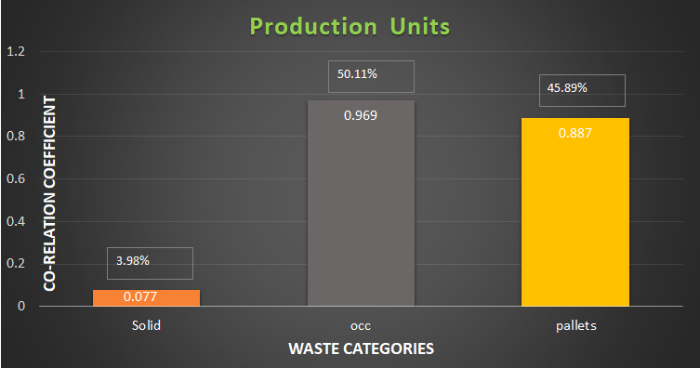
As per the graph, OCC and Pallets are highly corelated with Units produced by Ford during the time frame Jan-92 and Jul-97.
Although, the Solid Waste shows no relation with the units produced.

Slide 4
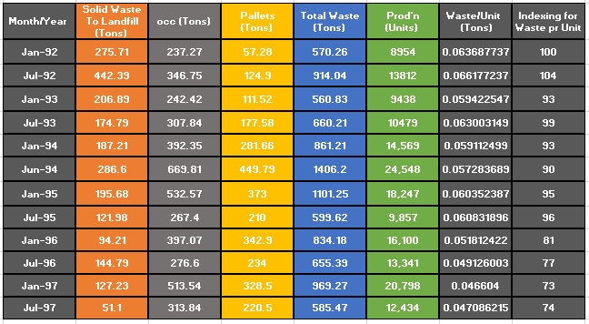
Although, the Solid Waste shows no relation with the units produced. As per the Indexed values calculated on the basis of Waste/Unit over the period of time, it can be inferred that Waste/Unit has decreased by 26%.

Slide 5
How many tugs can we remove?
Estimate according to supervisor feedback:
2 hours / tug operator wastage per shift = 25% of time.
25% of investment of 100,000$ is going in vain per tug operator.
Data matches accurately according to the supervisors observations.
As the waste per unit is being reduced, tug operators can be reduced.
5 tug operators for 100 waste/unit
1 tug operator handles 20 waste/unit.
Since we have 74 waste/unit
required tug operators is
4

Slide 6






Additional Data Required:
Gondola capacity - If we increase the gondola capacity, then we can reduce the frequency of tugs to garbage dump.
Positions of gondolas- Frequency of waste being filled – We will be able to observe the trajectory followed by tugs, and optimize the path followed by tugs per round. This will allow tug operators to cover more rounds per shift.
Volume and weight of garbage being produced per location - This is required because not all the gondolas are being filled at the same rate. If we can change the positions of gondolas strategically, so that all the gondolas are filled
nearly at same time, then we can reduce the number of trips to garbage room, as the gondolas can be stacked
behind each other in same vehicle, hence the number of operators required.
Time taken per trip to empty the gondola and replace - This is required, to check efficiency of tug operators and the gondola emptying process. If the gondola is being taken to garbage room and then returned to replace, then
there are some lags in the process and needs to be changed.
Time logs of tug operator : This is required, when tug operator is coming and leaving the work and how often
and how much time he/she is taking breaks. It is needed to calculate the efficiency of tug operator.

Slide 7
Methods to collect data:
Observing the work area and process in general: The entire process can be observed closely in person, to get better idea of what actually is happening. This may also reveal some possible lags in the process which is not obvious otherwise from the data.
Using GPS system- GPS can be used to get the trajectory of the tugs. We can see how much time the tugs are taking per gondola.
Depth sensors (SONAR): These are required to check the time in which the gondolas are being filled. The data will be recorded when the certain depth will be reached, indicating that the gondola is filled.
Weight sensors: This will check the weight of the gondolas. This information along with depth sensors will be useful to check if more pallets is being dumped in that gondola or other garbage is being dumped.

Slide 8

Possible Suggestions:
The gondolas are to be emptied at garbage room and then replaced with empty gondolas at origin. This way is inefficient as tug operator has to go to garbage room and return to replace. Tug operator can have empty gondolas at all the time which would increase the efficiency of garbage collection and also reduce the time per gondola to half.
Rather than assigning the same number of gondolas at every location, we could allocate them according to the garbage production to increase the garbage collection efficiency.
Pallets needs to be recycled efficiently as its usage has increased from 0.63 to 1.73 ~ 200% w.r.t units produced.
Pallets made from plastic, metal or composite materials are a long-lasting alternative to wooden pallets. All three materials are durable, reusable, easy to clean, and recyclable. Despite higher initial costs, these pallets save money in the long run.

Slide 9
Problems For Collecting Data:
Usage of GPS might be hard inside STAP(St Thomas Assembly Plant).
Need extra resources to monitor and gather data from multiple locations of STAP. Ford might have to consult Third party which has expertise in gathering this kind of data.
Different location has to be experimented according to the factory architecture, which makes it challenging for collecting the data and is a recursive process of getting the best model, simulation is the best option for getting Optimum solutions.

Slide 10
Thank You !

