Slide 1
Transcript verifciation
Blockchain ----
Team: NKB
Notes:
Hey MachoHackers! We’re <team name>.
<Team member introduction>

Slide 2

CURRENT problem
Verification is:
Physical
Slow (1 – 2 weeks)
Costly
Notes:
Most aspects of our lives have been digitised, but one area remains resistant to the tides of change. Most institutions still require hard copies for any official certification, because we’re reliant on physical security features such as security ink, watermarks, micro-text, or serial numbers printed on special security paper.
This reliance on hard copies is slow and inflexible. But with only 48 hours to deliver our project, we narrowed our focus to something that all six of us have struggled with as students – so we set out with the goal of digitising verified academic transcripts with blockchain.
Right now, it can be painful applying to university or college.
It can take days or up to weeks to request, receive and submit transcripts to schools of our choice. As students, we had to pay $10 to get a physical copy of our transcript, scan it, and then send the scanned image to BCIT.
Going from digital to physical and back to digital makes no sense.

Slide 3

SOLUTION
Digitised transcripts from schools
Use blockchain as immutable verification
Notes:
Our solution is to take advantage of blockchain cryptocurrencies beyond its intended use for financial transactions. We can use it to store an immutable and highly tamper resistant verification that everyone can trust.

Slide 4
Implementation
Piggyback on existing cryptocurrency
Store hashed student info on blockchain in transaction signed by school
Notes:
We decided to piggyback on an existing cryptocurrency – namely, either Bitcoin or Namecoin. They’re well established and trusted, and not as susceptible to attacks because of the size of their P2P network.
We store hashes on the blockchain after the school signs the transaction.

Slide 5
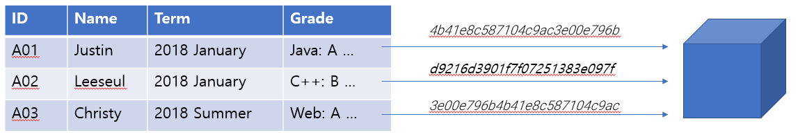
How it works (school)
Centralised Database
Notes:
Blockchain only secures hash of student info
Centralised database to protect private info
Still reliant on database security
We felt that student information was too sensitive to store publicly, so our solution still uses a centralised database.
It’s important to note that our primary goal is improving efficiency and digitising verification. Using blockchain for security is secondary. Our implementation relies on the security of the database itself.
Let’s take a closer look at the nuts and bolts.
We take information from the student database as inputs to generate a hash that is verified by the school. The school burns a small amount of money from their public address in provably unspendable commitments to store hashes in the OP_RETURN field on a blockchain.

Slide 6
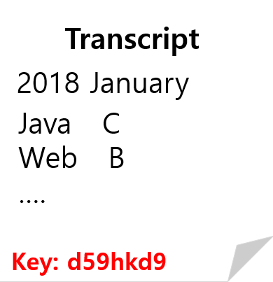
How it works (student)
Submit key alone
Send / print PDF file of transcript with key

Slide 7
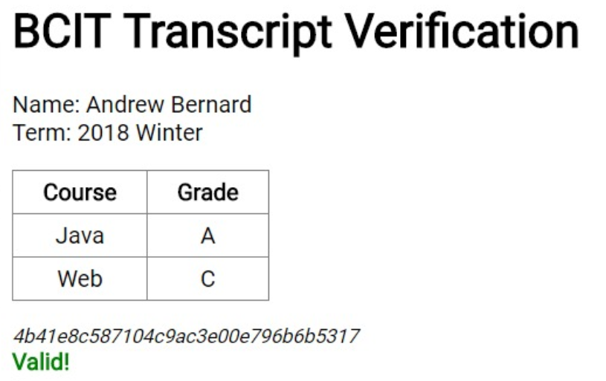
How it works (recipient)
Verification key
1. Pulls relevant transcript info
Notes:
After the hash commitment, students can log in to their school account to select the term grades they want to share. A random key and transcript file are generated based on their choice, and the random key is stored in the student database.
This key is used to (a) pull up the relevant transcript information and (b) to calculate the hash and verify that the information displayed is correct.

Slide 8
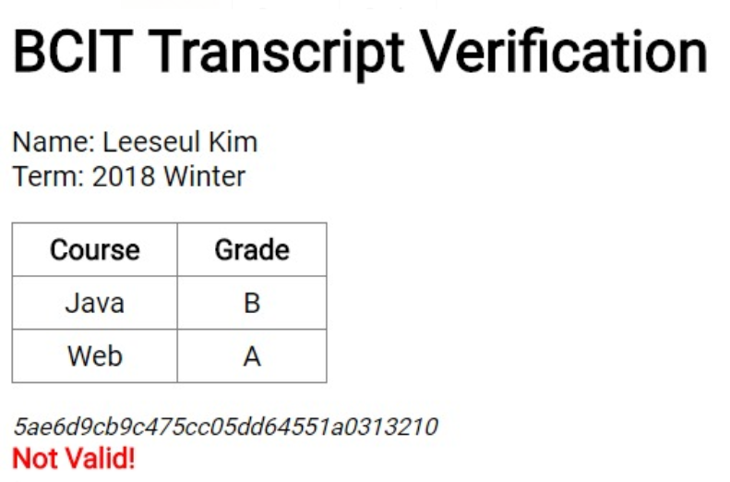
How it works (recipient)
Verification key
2. Recalculates hashed student info to verify info is correct
Notes:
After the hash commitment, students can log in to their school account to select the term grades they want to share. A random key and transcript file are generated based on their choice, and the random key is stored in the student database.
This key is used to (a) pull up the relevant transcript information and (b) to calculate the hash and verify that the information displayed is correct.

Slide 9
Future improvements
Schools can maintain their own blockchain
Optimising by collecting commitments with Merkle root hash
Notes:
Once blockchain gains further acceptance and understanding, institutions can certify documents on their own privately maintained blockchain for further customisation.
We can also optimise this by committing the hash of a Merkle root. This way, we can logically store large batches of information, like transcripts from all computer science students from the same graduating year.

Slide 10
THANK YOU!

