Slide 1
Edu Project Fate Prediction
by JAPOVS

Slide 2
Introduction
Goal: Help teachers design successful educational projects (funding)
1st step: Predict how likely a project can successfully attract enough funding

Slide 3
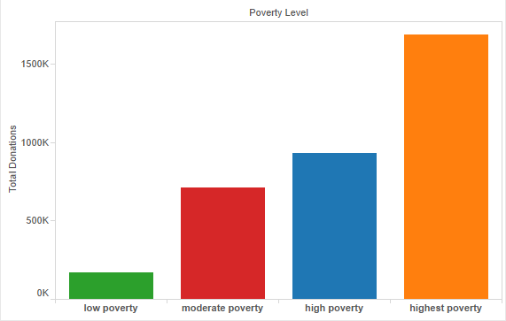
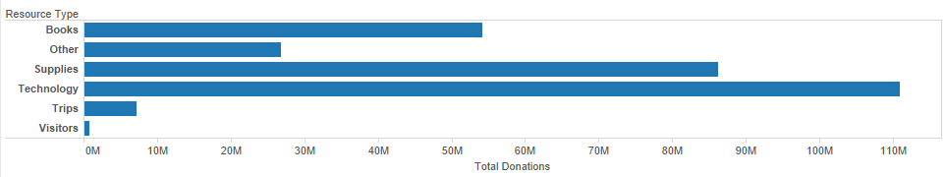
$$$ by Project Attributes

Slide 4
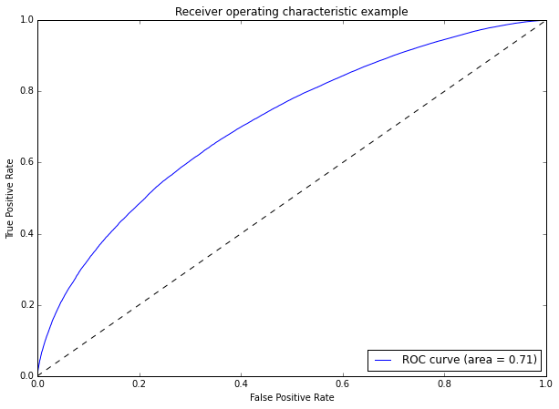
Predict Fates by Machine Learning
Attributes of Projects
Poverty level
Resource type
State
Primary focus area
Amount requested
Student reached
…..
Boosting Trees
75/25
72%

Slide 5
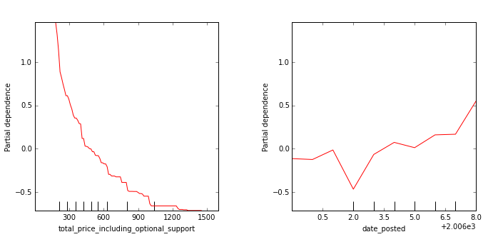
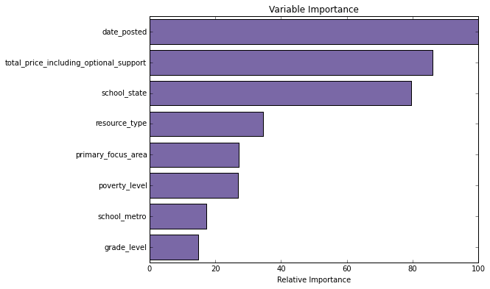
A little bit more details

