Slide 1
No School Left Behind
Team SciFund
Michael Glazer, Noel Kuriakos, Sanujit Sahoo, Abdulhakim Tlimat
Science based funding analysis

Slide 2
Motivation
Why do projects get funded?
What signals do titles of the essays convey?
Is there a correlation between Title and dollars funded?
Can the we advise schools who have not requested for funding? 32% of schools have not requested funding.
How can schools that did not get funding, get funding?

Slide 3
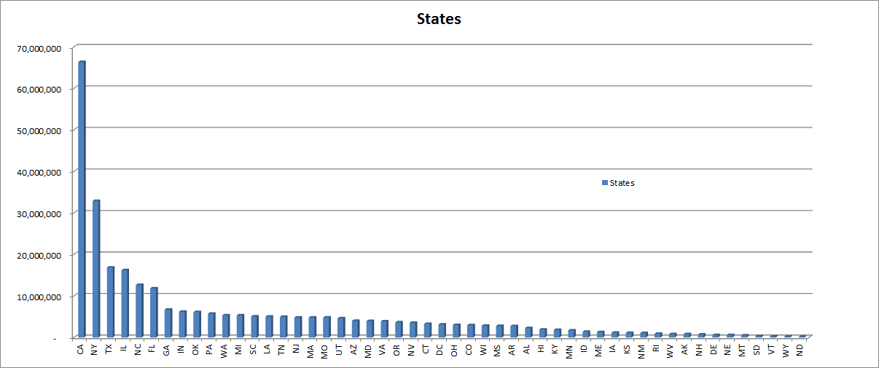
Exploratory Data Analysis-Funding By States

Slide 4
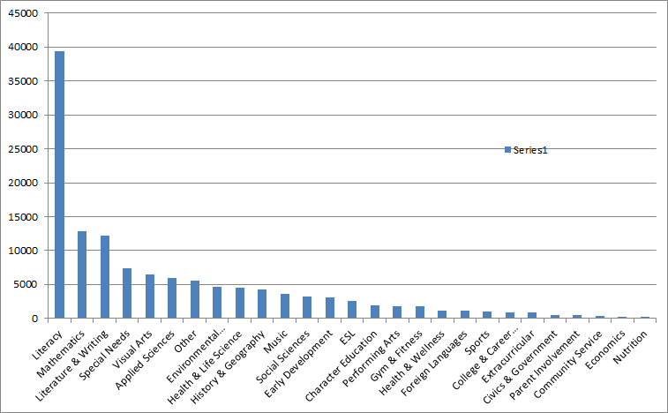
Exploratory Data Analysis Popular Areas to Fund
Count Of Subject

Slide 5
Title Keyword Mining Process
What keywords received the most funding?
Essays (Title)
Break Into Keywords
Donation by keyword
Aggregation
Analysis

Slide 6
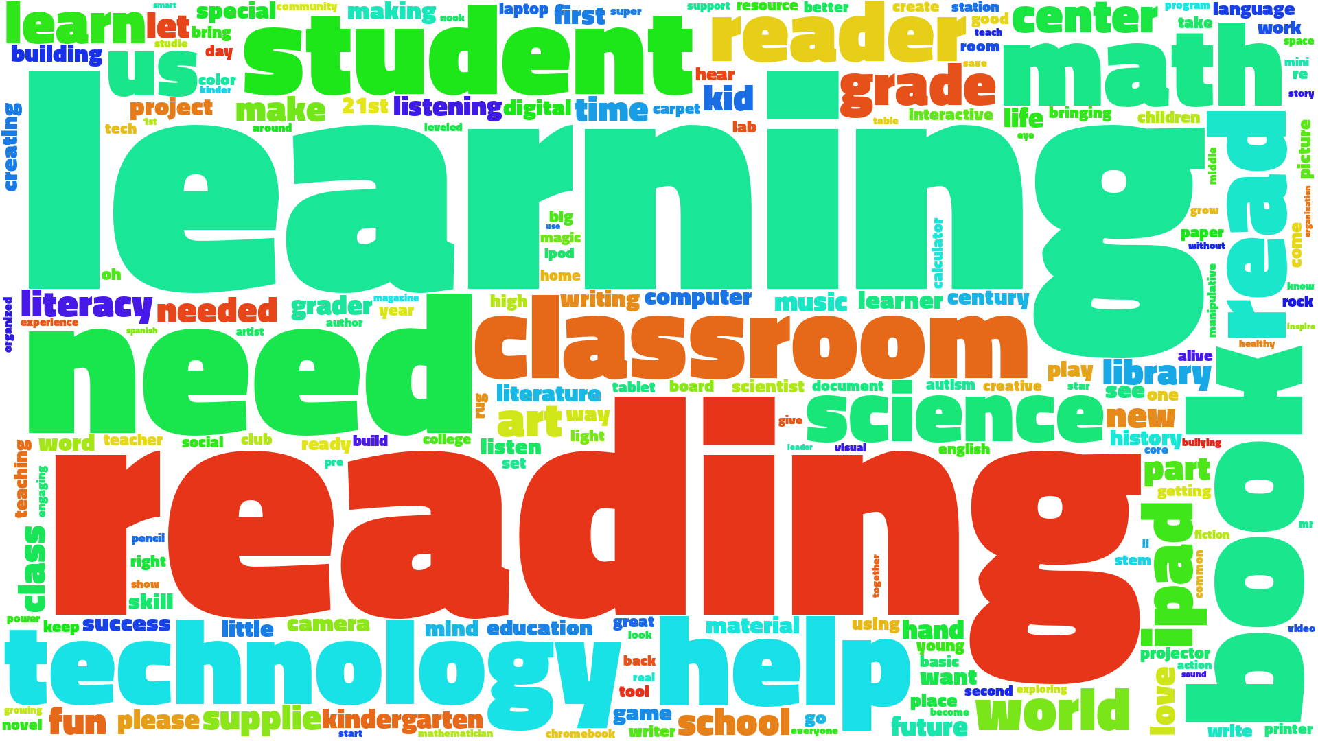
Word Frequency Of Requested Projects

Slide 7

Word Cloud by most funded

Slide 8
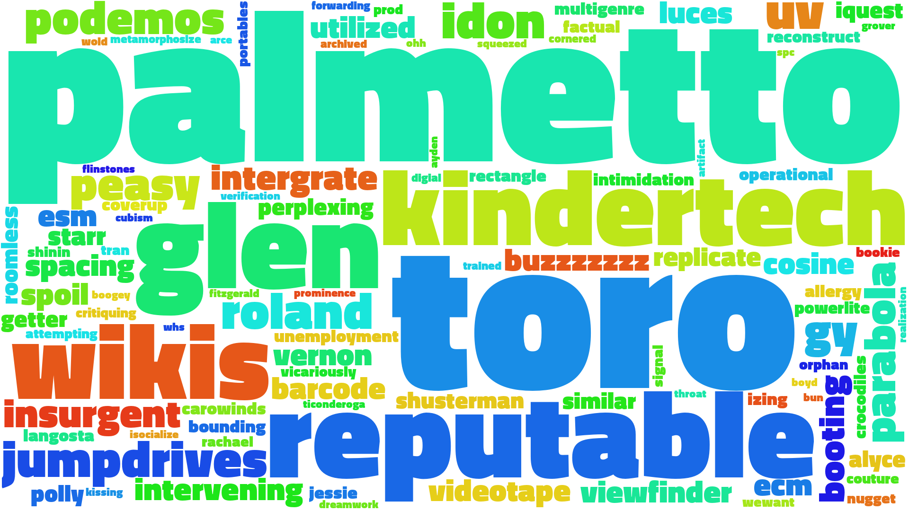
Word Cloud - Zero Donations

Slide 9
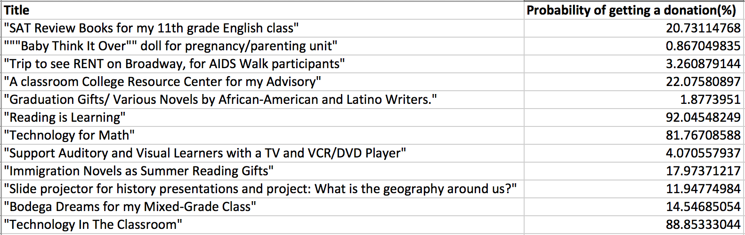
Probability of getting donations

Slide 10
Next Steps
Validate findings
Data mining of pertinent keywords relating to funding analysis-Logistic Regression, Naive Bayes
Outreach campaign to schools who have not signed up for donorschoose
One click sign up
Provide templates with keyword

Slide 11
Q&C

Slide 12
Backup

Slide 13
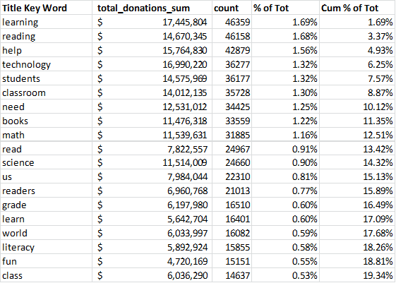
Key Findings -Top “Funding Words”

Slide 14
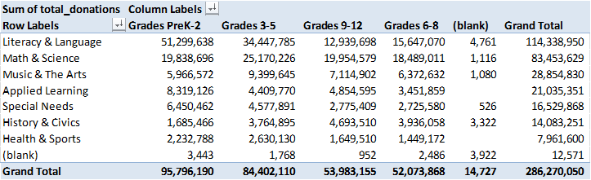

Slide 15
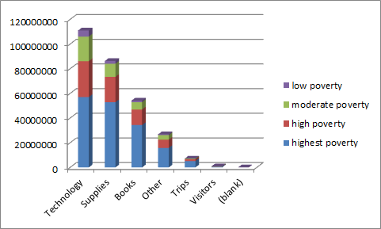
Exploratory Data Analysis- Poverty

Slide 16
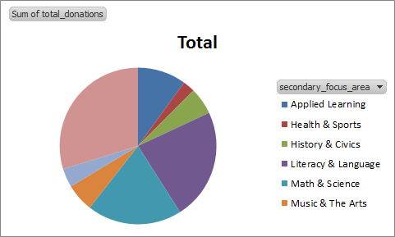
Exploratory Data Analysis
Funding By Secondary Focus Area

Slide 17
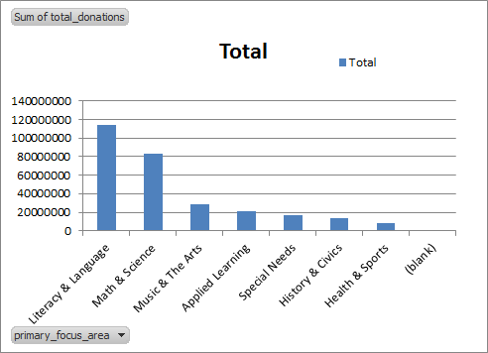
Exploratory Data Analysis Funding Primary Focus Area

