Slide 1

EDM/LA Meetup
Team 4 - RequestAdvisor
Basil Hayek, Shoko Ryu, & Abhinav Sarapure

Slide 2

Say hello to Ms Marshall’s first graders!

Slide 3
Ms Marshall’s Class
High poverty area
Students miss on activities
Zoo trip… $800 short of budget

Slide 4
Would you want to break the news to the kids that the trip isn’t happening?

Slide 5
How do we avoid disappointing Ms Marshall’s class?
We can find out:
Success rates based on project type, resources, and location
Essay themes in successful vs unsuccessful projects
Donation patterns for projects

Slide 6
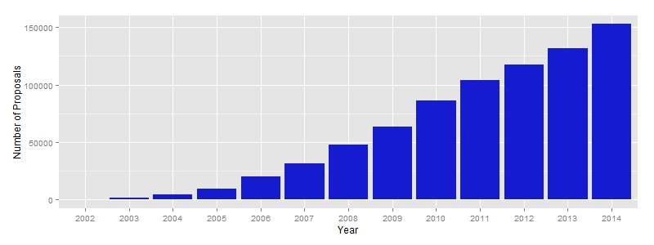
How have projects grown at DonorsChoose?

Slide 7
What does text analysis tell us about project titles?
Keyword | Estimate | Impact | Pr(>|z|)
(Intercept) | 0.66 |  | <2e-16
let | -0.07 | -10% | 0.07
make | 0.06 | +9% | 0.05
need | 0.04 | +6% | 0.05
special | 0.09 | +14% | 0.03
Keyword analysis performed on the full set of projects suggests that certain words impact the success of the project.

Slide 8
What does text analysis tell us about project descriptions?
Keyword | Estimate | Impact | Pr(>|z|)
(Intercept) | 0.69 |  | <2e-16
classroom | -0.02 | -3% | 0.05
create | -0.04 | -6% | 0.07
high | 0.05 | 7% | 0.03
home | -0.05 | -7% | 0.03
library | 0.05 | 7% | 0.01
need | -0.03 | -4% | 0.01

Slide 9
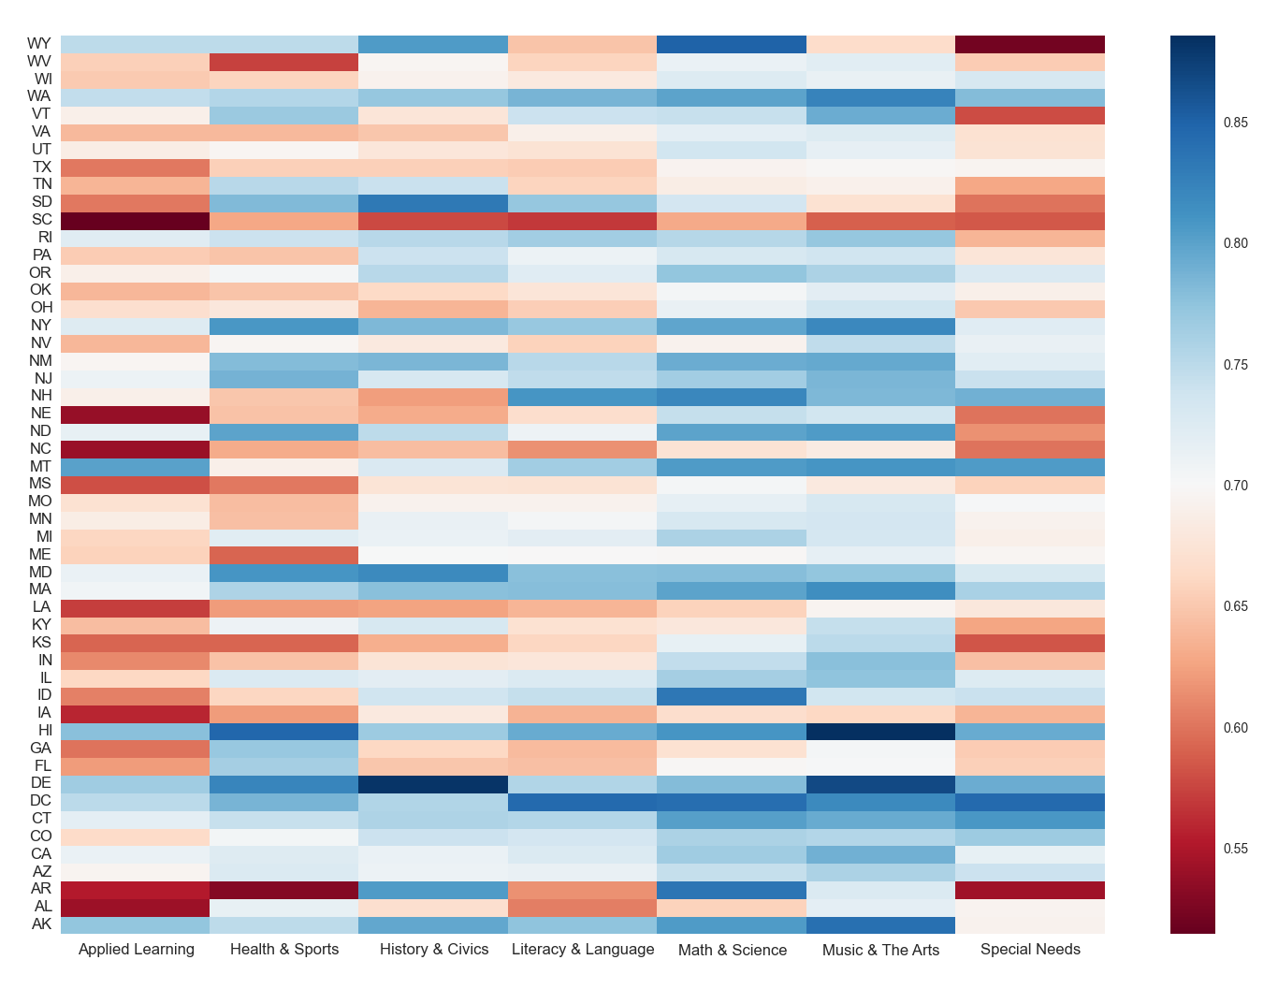
How is project success impacted by project type and location?

Slide 10
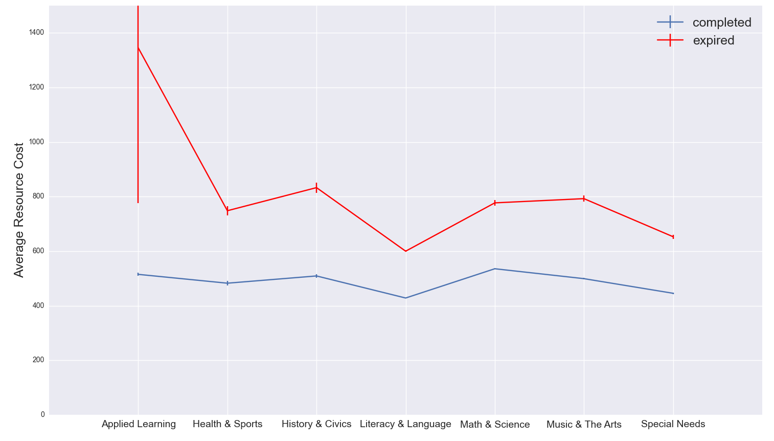
How does total project cost impact success?

Slide 11
We can put this all together:
For my project type and location:
How do I craft the best message?
What have other successful projects done?
Will I find the right donors?
What’s the best time to submit my project?

Slide 12
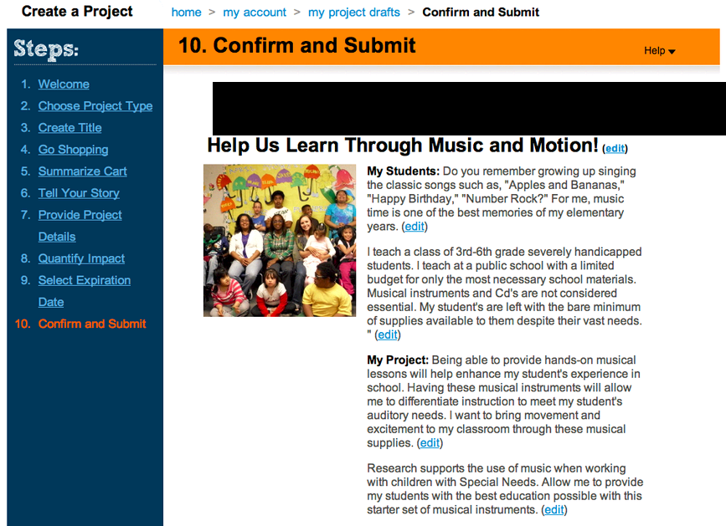
Introducing RequestAdvisor
Forecasted Success: HIGH! (80+%)

Slide 13
DEMO

Slide 14
Next Steps
Iterate on the initial findings:
What are words to use and words to avoid based on project type, location, and resources?
Should teachers reduce their ask if it improves their odds of getting funding?
Incorporate analytics to understand if project summaries for similar projects impact click throughs
Implement RequestAdvisor using an agile test-and-learn approach

Slide 15
Tools Used
Python (Pandas)
R (with TM package for text mining)
Excel (for basic analysis and prototype)

Slide 16
Team 4 - SmartRequest
Abhinav Sarapore
abhinav.sarapore@gmail.com
Data scientist
Shoko Ryu
this.shoko.ryu@gmail.com
Data scientist
Basil Hayek
basilhayek@gmail.com Product manager
Dee Kanejiya Advisor

