Slide 1
Project Name:MLHack_01: Fall Detection
Presenter: Anand Singh
Employee Id:51500730

Slide 2
Project Description
Falls are the main cause of injury for OLD People. There are different activities like Standing, Walking, Sitting, Cramps, Running and Falling
There are so many reasons for their fall - High Blood sugar, High BP, High Blood circulation etc.
This paper aims to build an automated fall detection system with the help of motion sensor units data fitted to the person’s body at six different positions. This Sensor device sends all the above mentioned six different positions in real time every 4 seconds with the help of IOT device. We apply statistical analysis and machine learning algorithms to find out insights and predict the fall detection

Slide 3
Fall Detection
FindOut Duplicate at Row level
Flow Diagram
Missing Value at Column level
Data Gathering & master data sheet preparation
Data Cleaning
Outliers at Column level
Normal Distribution
Model Building
Univariate Analysis
EDA Analysis
Data Splitting
Bivariate Analysis
Training
Test
If validation error on test data >10% then we need to do “regularization” technique otherwise error minimization
Multivariate Analysis
Variable Reduction
Model building
Model validation
Model Tuning
Final Model

Slide 4
Important Features in Model
There are three parameters we are using in our model as below
SL 2.124365
BP -0.807560
EEG 3.072483

Slide 5


Brief about used Algorithms
We used KNN classification algorithms to built our project . K nearest neighbours measured by a distance function.
We are below methods to major distance
1-Euclidean Distance
2-Manhattan Distance

Slide 6
KNN Model
Deep learning Work Flow
Model Tuning with different value of K
After Retuning, Final model accuracy as below
Training data sets .868
Test Data sets .814
Validate Accuracy on Test Data set
If Test Accuracy(K+1)> Test Accuracy(K)
Final Model
K=K+1
K=K+1

Slide 7
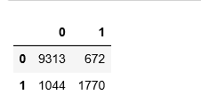
Model Evaluation Parameters
Confusion Matrix
1→Falling Activity
0→Non Falling Activity

Slide 8

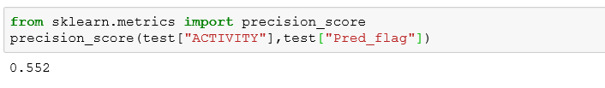
Model Evaluation Parameters..
Precession = TP/(TP+FP)

Slide 9
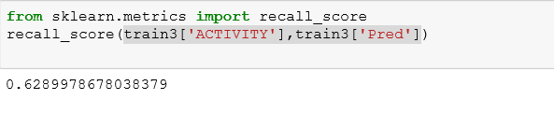

Model Evaluation Parameters..
Recall =TP/(TP+FN)

Slide 10
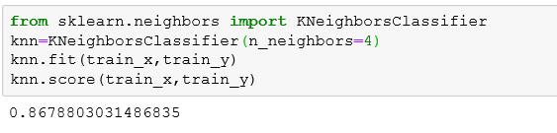

Model Evaluation Parameters..
Minimum accuracy score

Slide 11
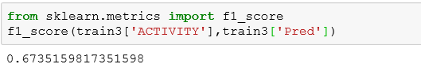

Model Evaluation Parameters..
F1 Score

Slide 12
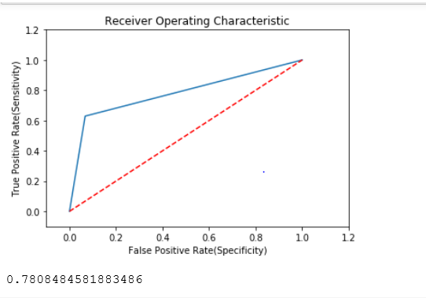
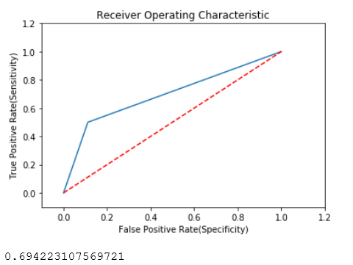
ROC Curve
Train data Set
Test data set

Slide 13
Recommendation
After statistical analysis and model result ,we have below recommendation
whenever we are getting activity code 0 or 4 ,we need to be alert
If Sugar level increases, then chance of Falling will increase
If BP level decreases, then chance of Falling will increase
If EEG level increases, then chance of Falling will increase

Slide 14


