Slide 1
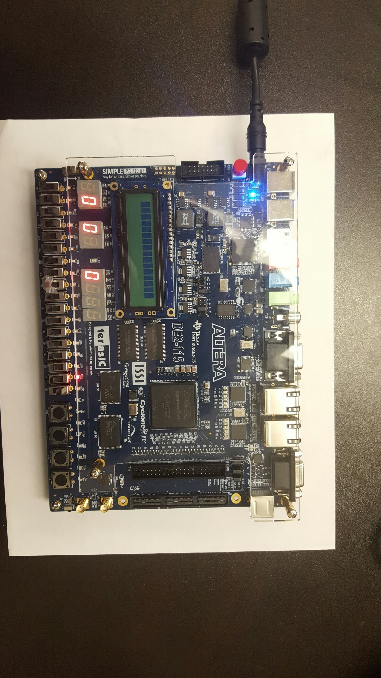
Access Control State Indicator
Reset
Password switch
Enter Button

Slide 2
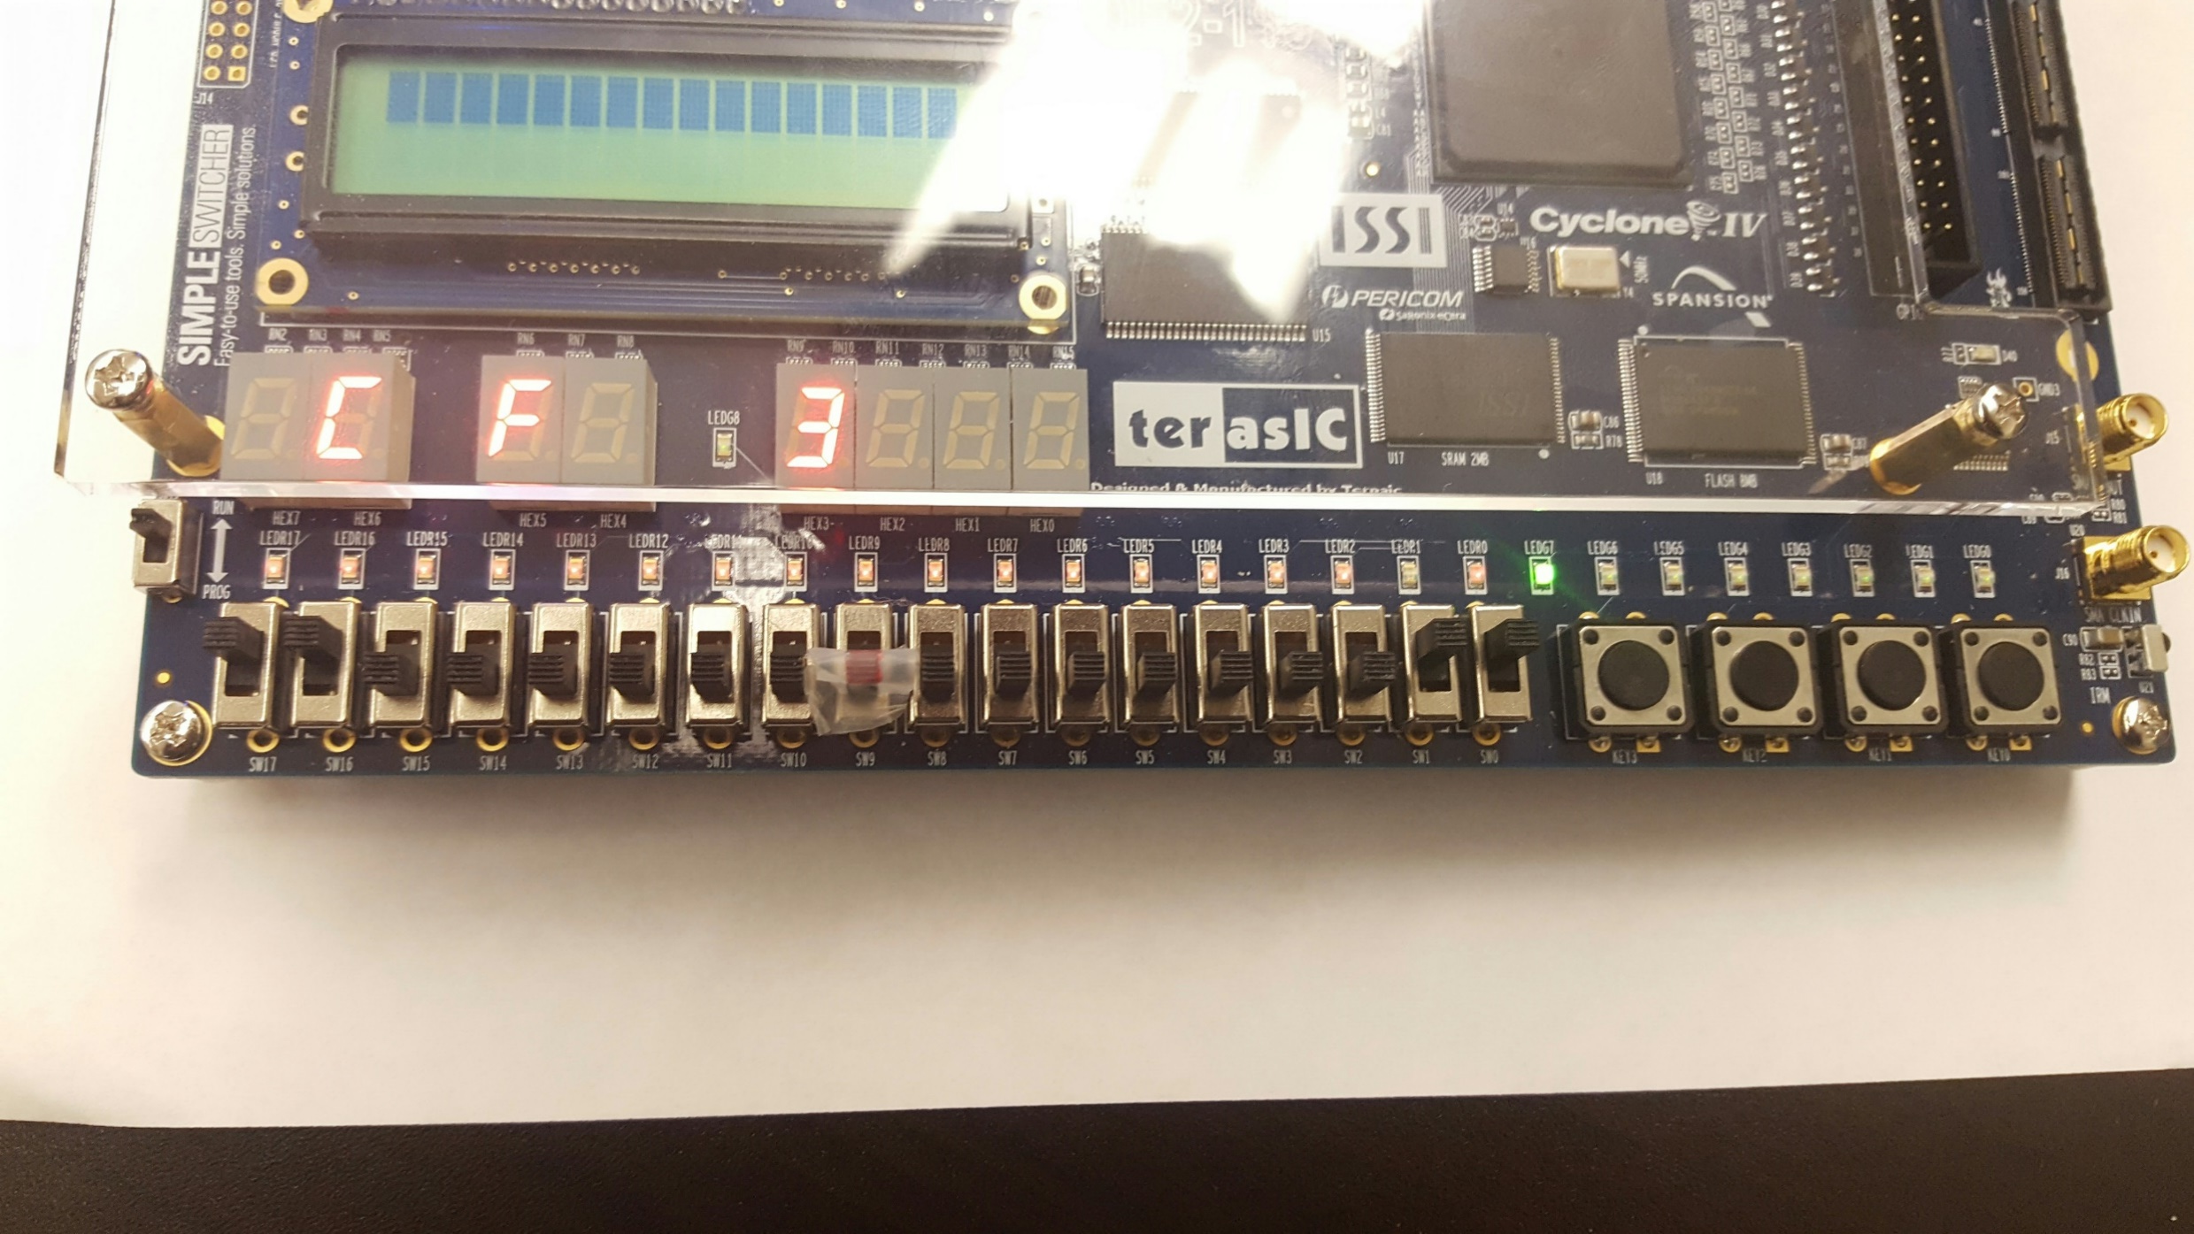
Adder Activation State Indicator
Player A
Player B
Enter
Reset

