Slide 1
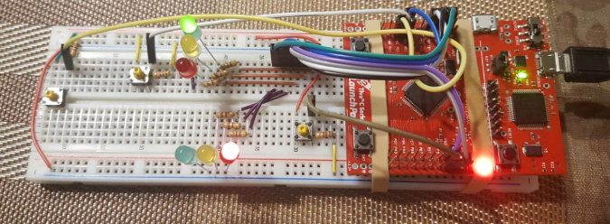
North/South
LED
Pedestrian Button
N/S Button
E/W Button
East/West
LED
Pedestrian LED

