Slide 1



A1123303_邱佑芹_PowerBI個人專案
View in Power BI
Last data refresh:
2025/6/14 上午 10:13:57 UTC
Downloaded at:
2025/6/14 上午 11:37:11 UTC

Slide 2
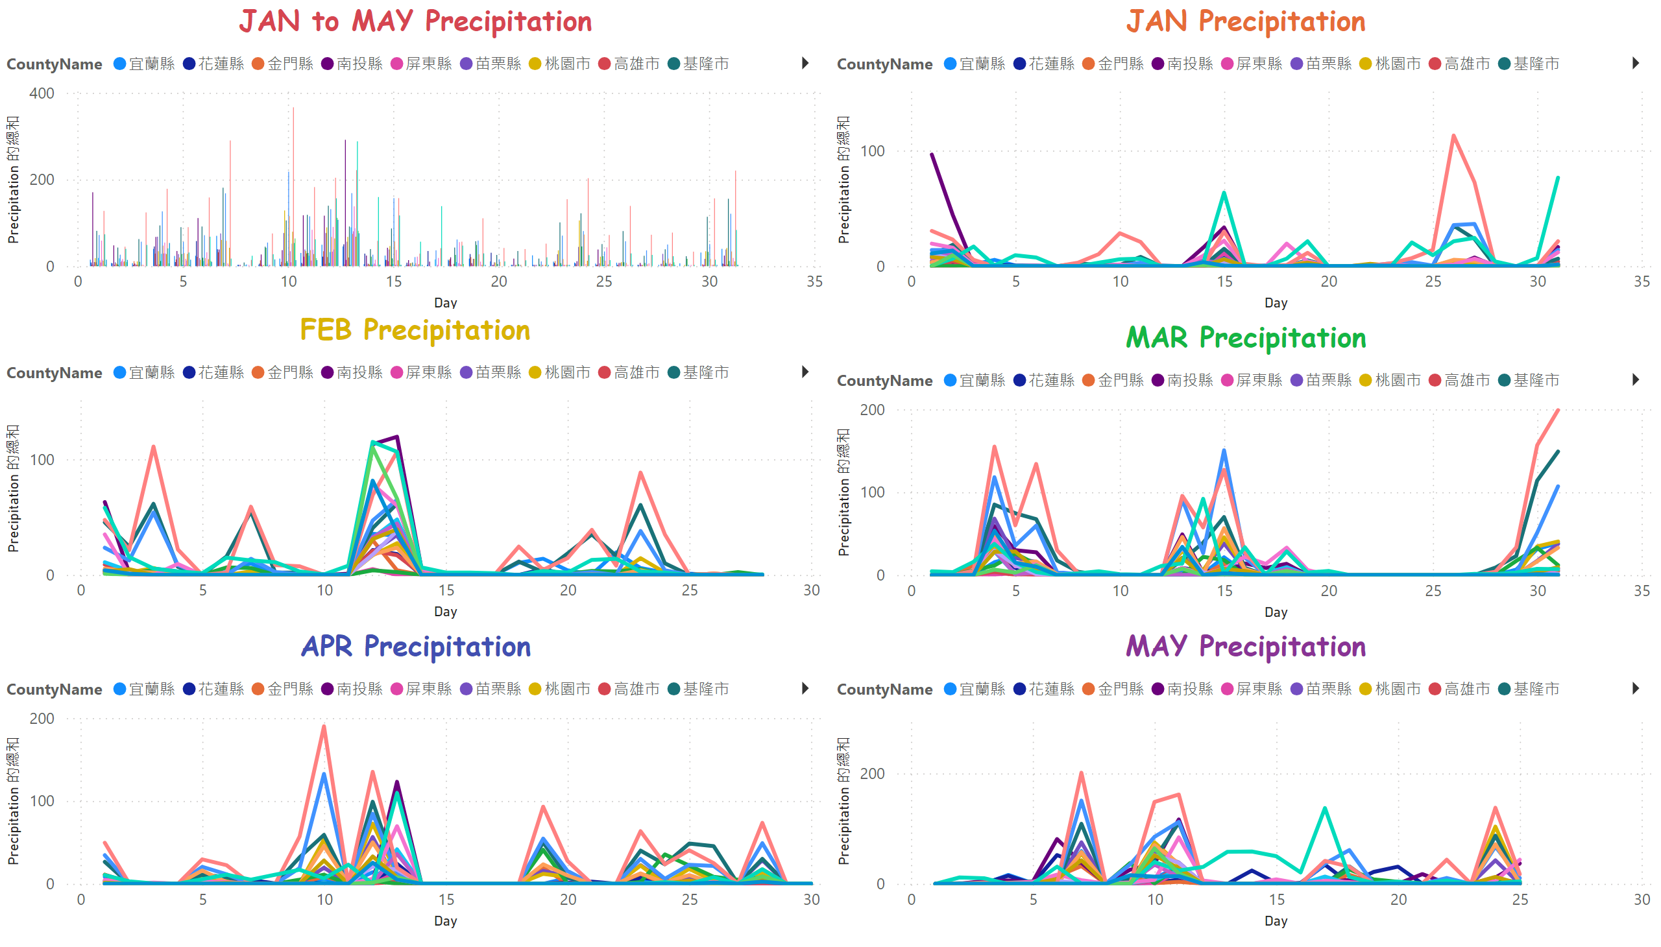
各月每日雨量圖
Notes:
JAN to MAY Precipitation
No alt text provided
FEB Precipitation
No alt text provided
APR Precipitation
No alt text provided
JAN Precipitation
No alt text provided
MAR Precipitation
No alt text provided
MAY Precipitation
No alt text provided

Slide 3
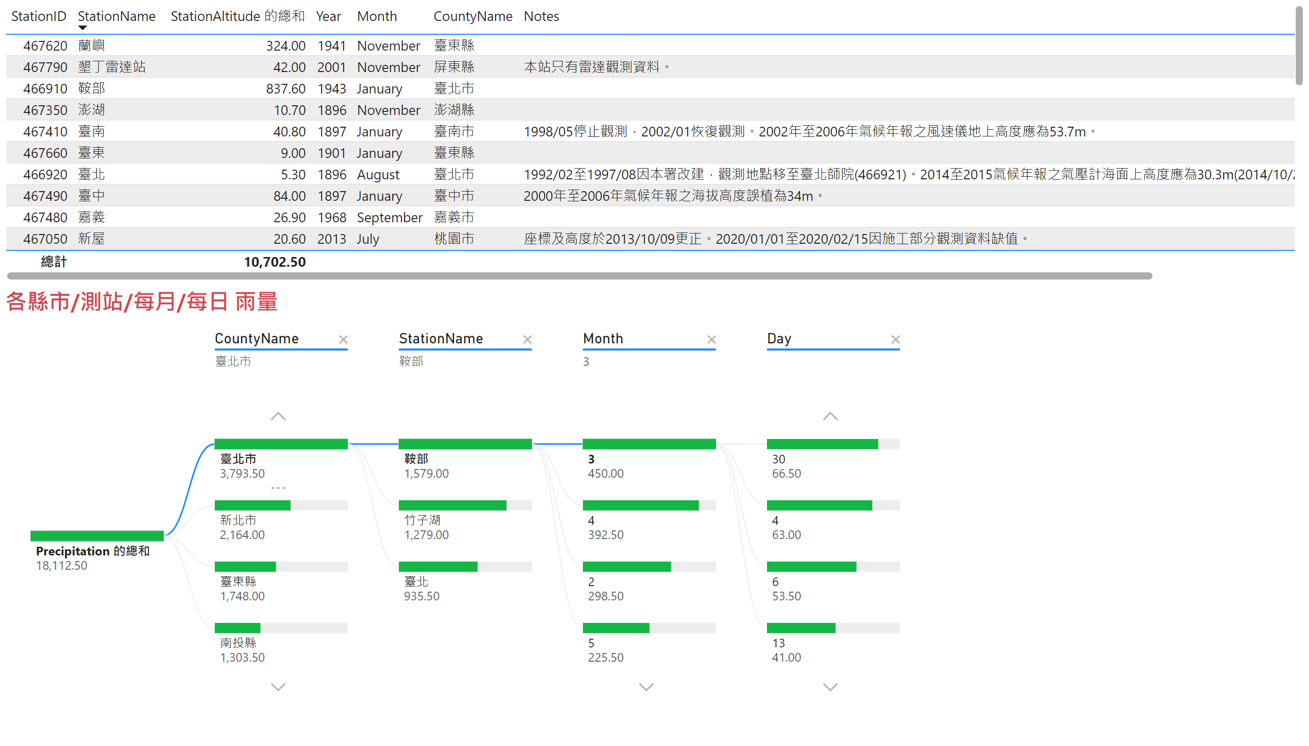
測站-分解樹狀結構
Notes:
tableEx
No alt text provided
各縣市/測站/每月/每日 雨量
No alt text provided

Slide 4
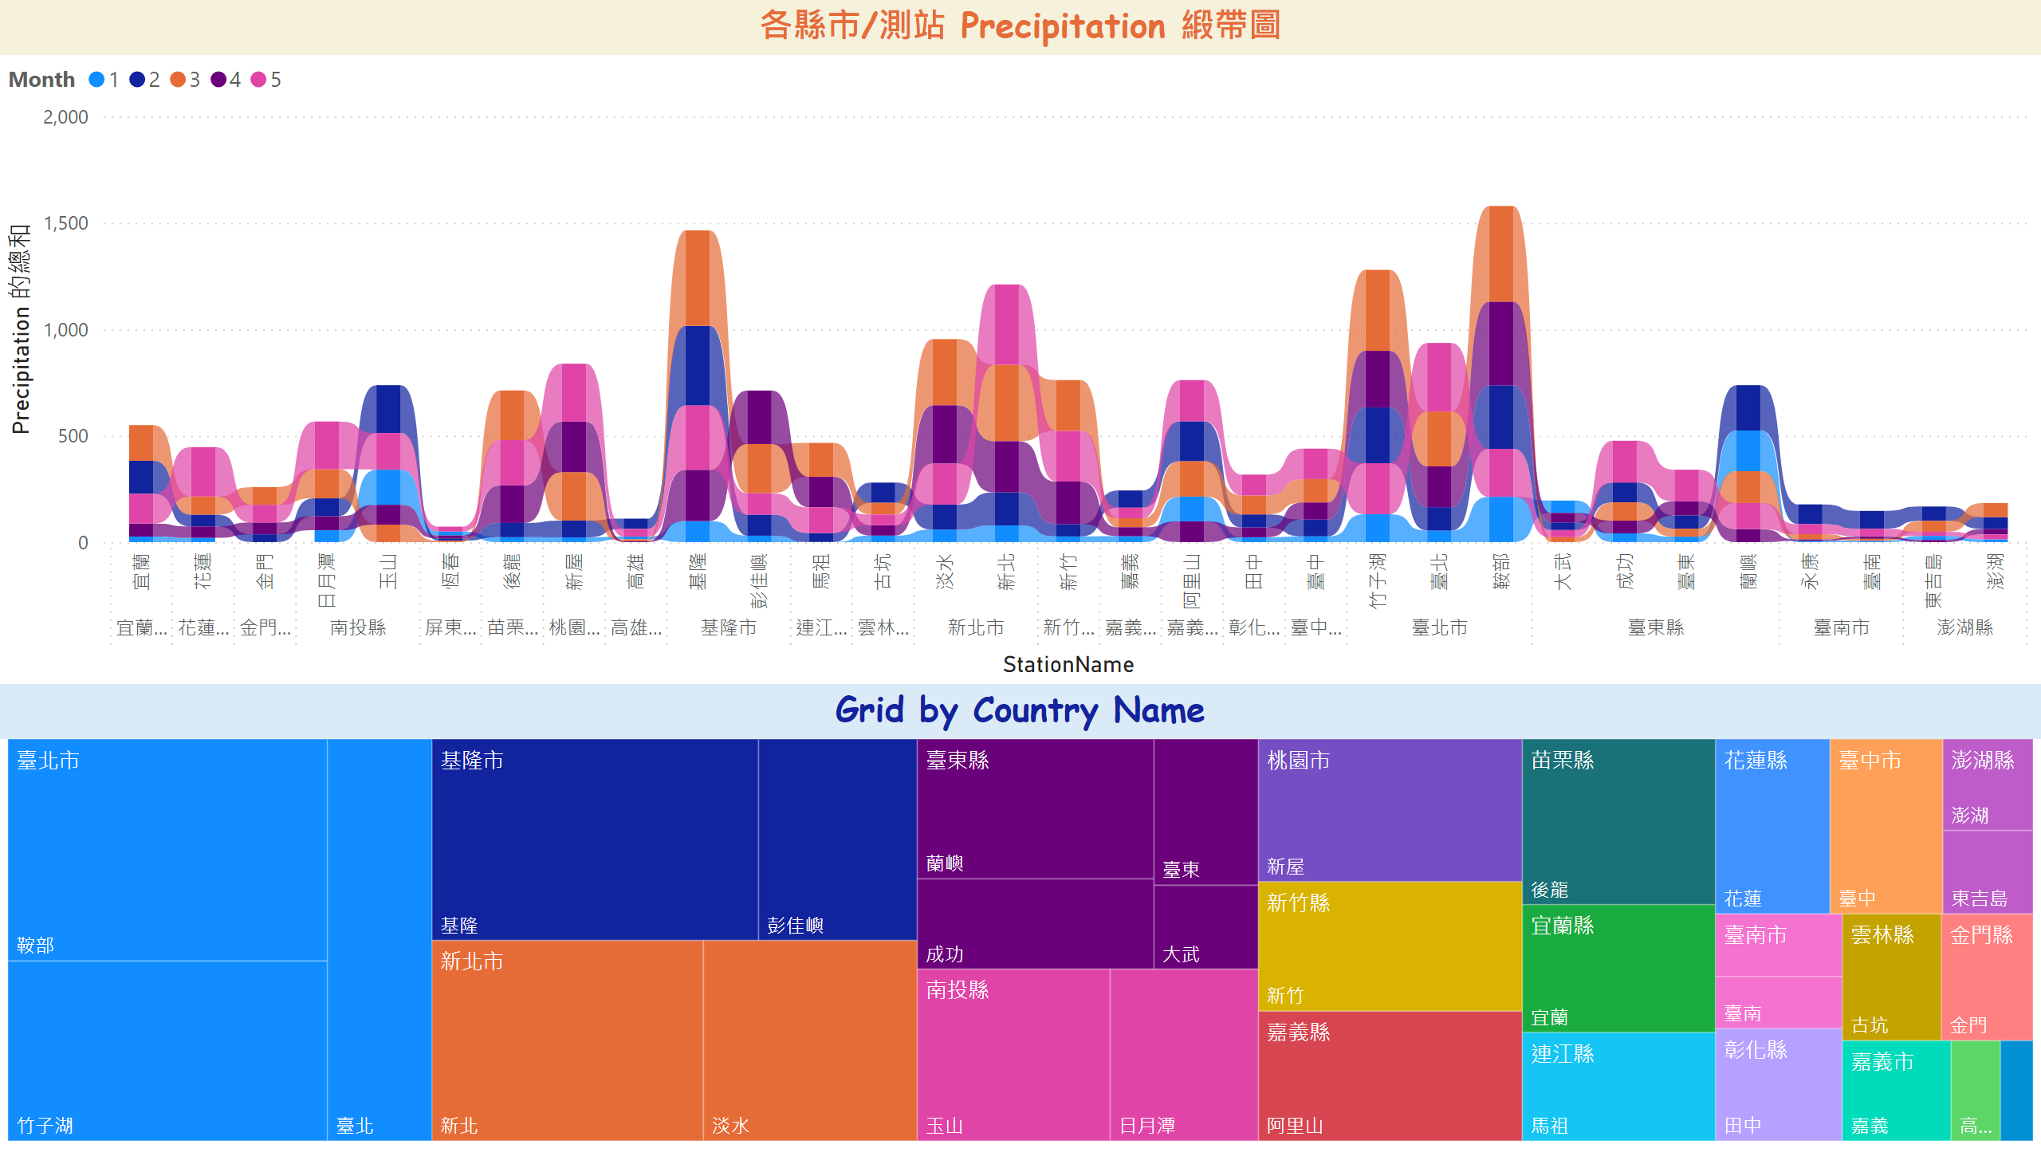
緞帶-樹狀圖
Notes:
各縣市/測站 Precipitation 緞帶圖
No alt text provided
Grid by Country Name
No alt text provided

Slide 5
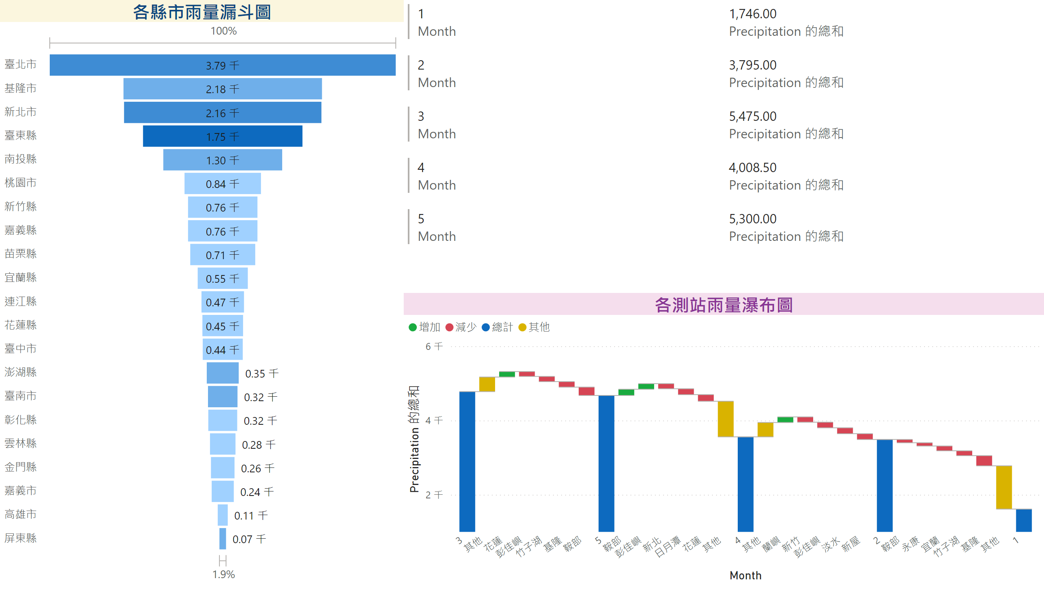
漏斗-多列卡片-瀑布圖
Notes:
各測站雨量瀑布圖
No alt text provided
multiRowCard
No alt text provided
各縣市雨量漏斗圖
No alt text provided

Slide 6
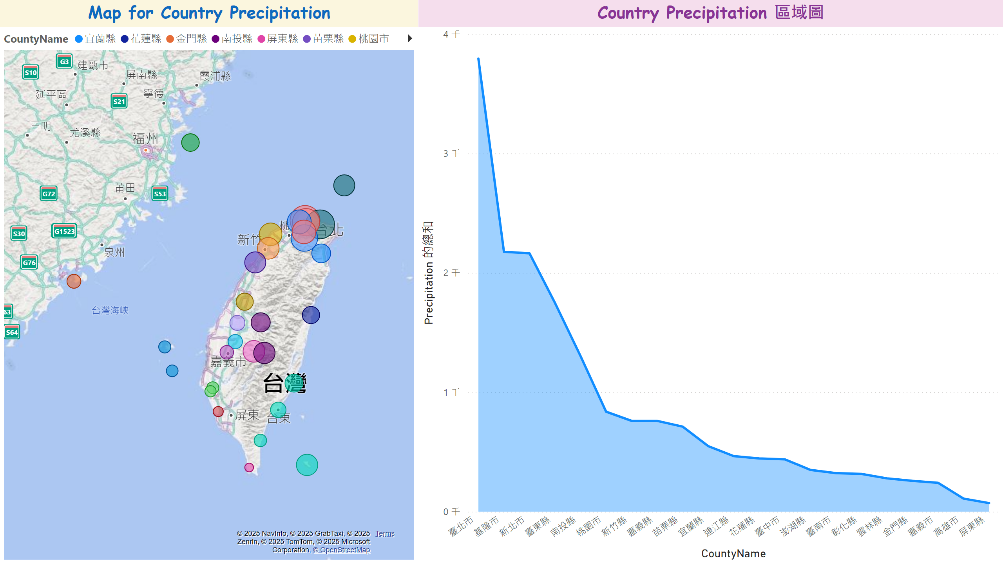
地圖-區域圖
Notes:
Country Precipitation 區域圖
No alt text provided
Map for Country Precipitation
No alt text provided

