Slide 1
Network Packet Carving for Images
Presented By: Ahmed Aziz
Supervised By: Dr. Husrev Taha Sencar

Slide 2
MOTIVATION
File carving
A process to reconstruct file data in the absence of file-metadata(headers). Could have been deleted, damaged or not present.
Packet carving
Carving files out from packets being transferred across a network.
Important for network security teams who need to check what data is going through their network
Network operators inspect their traffic by sampling it. We extend this capability to multimedia
Notes:
I will start by trying to motivate the need for the tool in this presentation. File carving is a well known problem, which basically is a process to reconstruct…. and we are expanding it to packet carving. People already deployed DPI tools but does not work on multimedia because of sampling. We extend this capability to images

Slide 3
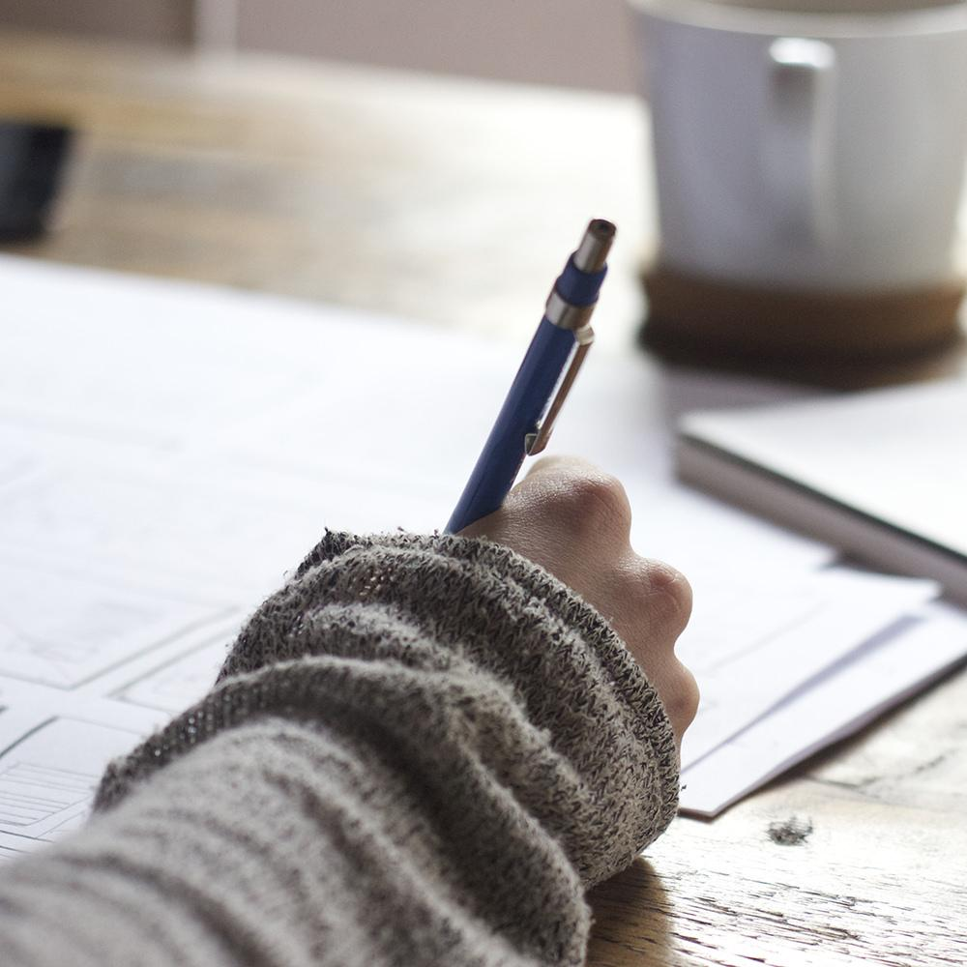
STARTING POINT AND TASKS
Starting with open-source tool created by QCRI team in C#.
Understanding jpeg compression, file carving and what is the current state of art.
C# and AvaloniaUI chosen to continue the work.
Notes:
So at the beginning of the internship, I was provided a tool called JpegRecovery created by QCRI team. The tool could classify baseline jpeg and recover if no headers were present. Added jpeg partial headers, added packets payload extraction, added desktop

Slide 4
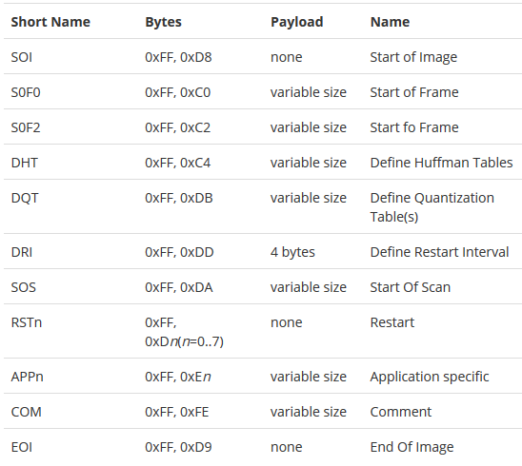
BACKGROUND: JPEG
Jpeg is a file compression format.
Composed of 4 main steps,
Transformation
DCT
Quantization
Huffman encoding
Jpeg itself has different formats. ( baseline, progressive etc.)
Notes:
Before going ahead, let me provide a bit of background perspective about Jpeg. Jpeg is a different file format than others in the sense that is a compression file format. Meaning when a file is converted to jpeg file compression occurs through four main steps occur

Slide 5
THREE FEATURES TO BE ADDED
Adding support for partial jpeg headers.
Adding network packets support (payload extracted).
Development of Desktop User Interface.
Notes:
After taking a look at the current tool and understanding jpeg’s background. It was decided that I would add three features to enhance the current tool

Slide 6
PARTIAL JPEG HEADERS
For Jpeg representation, 3 important header markers are needed (DCT, DQT, DHT).
Current tool uses most frequently used parameters.
Our strategy, if partial header are present, we extract available parameters from it.
Notes:
For jpeg decoding, current tool uses hardcode parameters based on observations from large datasets. Sometimes these partial headers could be present To get best parameters for jpeg header.

Slide 7
NETWORK PACKETS SUPPORT
IP packets can be divided into UDP or TCP packets.
Payload data extracted from packets in network flows.
Jpeg detection and recovery then applied.
Notes:
Internet protocol is the most commonly used network protocol

Slide 8
DESKTOP USER INTERFACE
Desktop interface to allow ease of use.
Can be used to preview reconstructed image right there.
Choose from three modes,
Jpeg carving
Storage carving
Packet carving

Slide 9



DESKTOP FRAMEWORKS COMPARISON
WPF
Supports Windows desktop applications
Uno Platform
Supports cross-platform mobile applications mainly.
AvaloniaUI
Supports cross- platform desktop applications
Notes:
Why did we choose AvaloniaUI

Slide 10
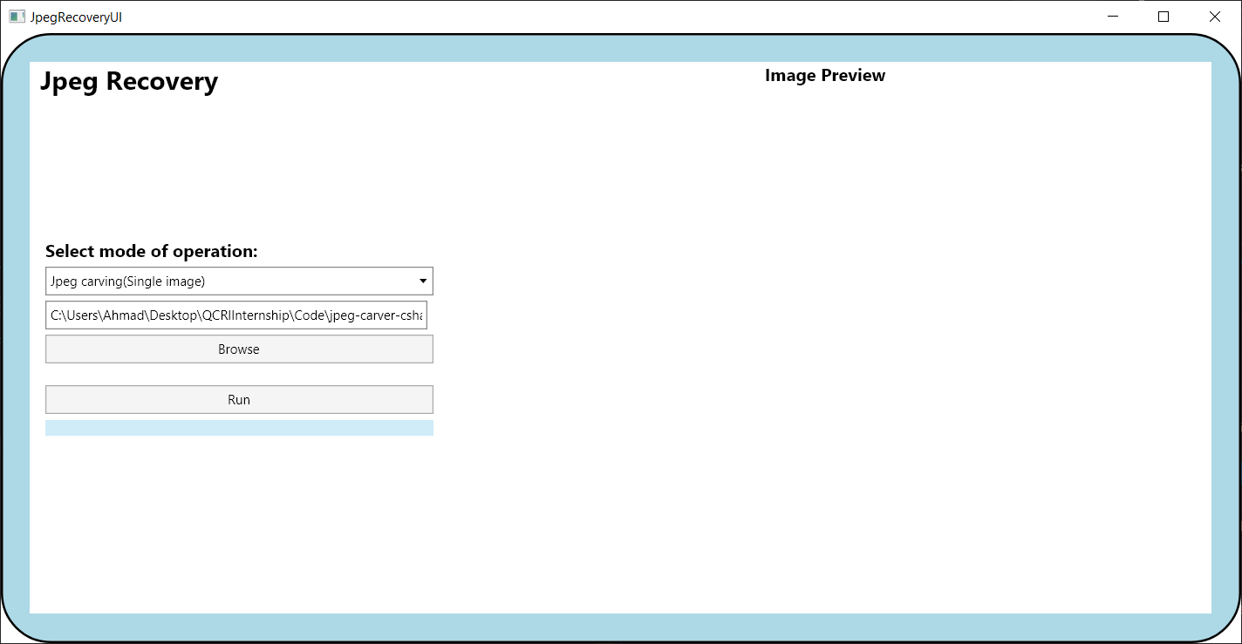
DEMO TIME

Slide 11
FUTURE WORK
Before internship ends (02/07/2020)
Three main procedures should completely run from GUI.
Refactoring the final product.
After internship
Performing tests to measure performance of the tool.
Improving project structure and code cleanup.
Adding support for multiple file formats.

Slide 12
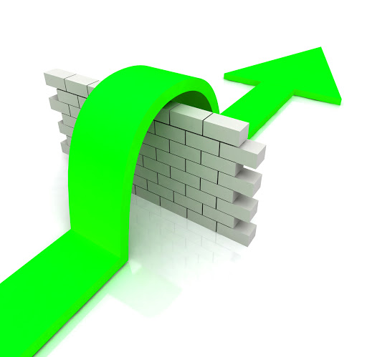
CHALLENGES FACED
Sparse documentation.
Understanding Jpeg compression is not an easy task.
.NET family has expanded into multiple frameworks. GUI is written in .NET Core, original application is in
.NET framework.

Slide 13
CONCLUSION
Data can be recovered even when file-headers are not present.
Our tool improves the previous works capability by providing three new features.
Use of Desktop User Interface simplifies ease of access.

Slide 14
THANKS!
Any questions?
You can find me at:
aaziz@hbku.edu.qa

