Slide 1
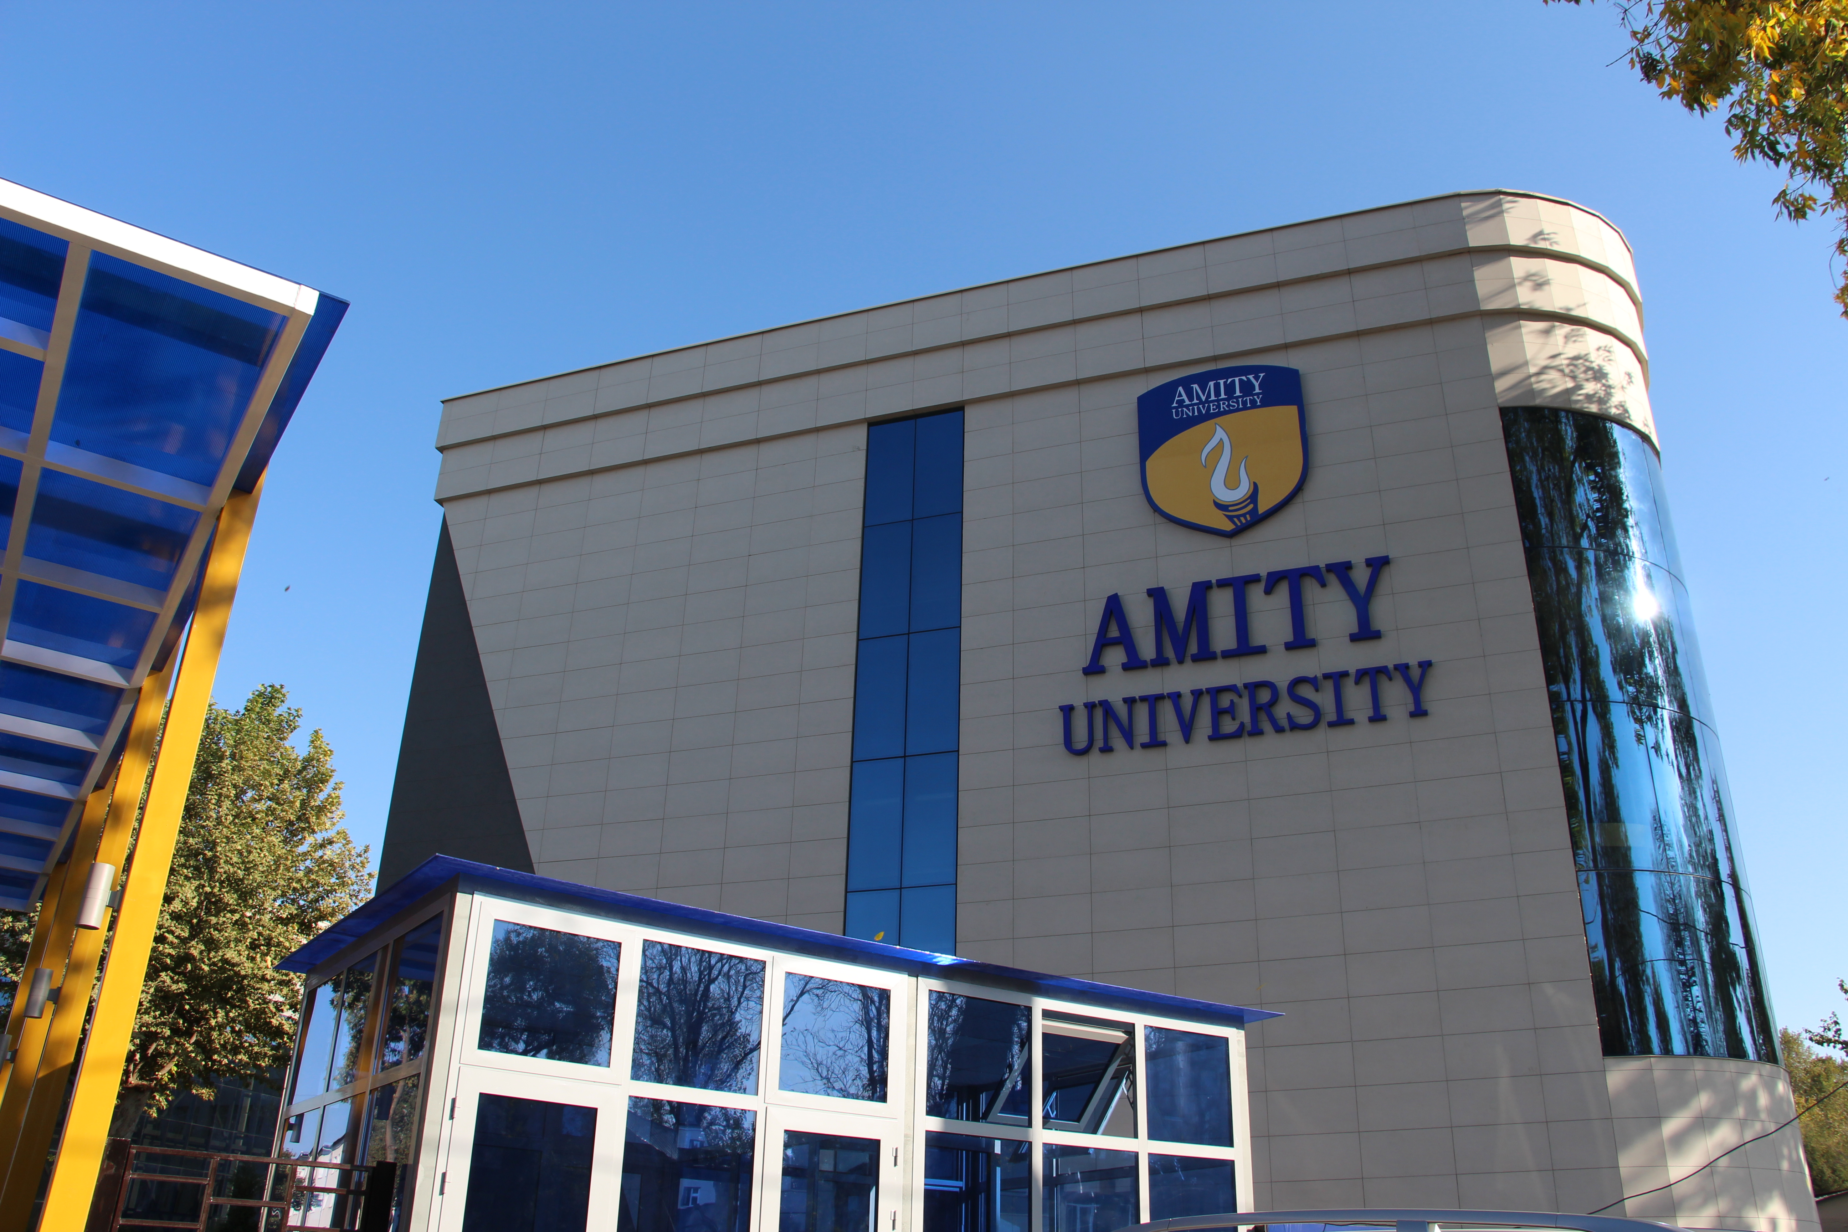

Real-Time Sign Language Recognition
Using Computer Vision and Deep Learning
3rd NTCC Presentation
Program Name: B.Sc. (IT)
NTCC Course Code: ETMN100
Batch: 2024–2027
NTCC Course Name: Minor Project
on
Name of Students:
Alisher Valiyev
Ayubxon Xolxojayev
Name of Supervisor:
Mr. Javokhir Rajapov
Notes:
Suggested timing: 15 seconds
Suggested presenter: Alisher Valiyev
Good morning. We are Alisher Valiyev and Ayubxon Xolxojayev. Our project is real-time sign language recognition using computer vision and deep learning.

Slide 2
Table of Content
Objective and background
Literature and proposed method
Implementation and current results
Conclusion and references
Notes:
Suggested timing: 5 seconds
Suggested presenter: Alisher Valiyev
We will briefly cover our objective, related work, method, and progress.

Slide 3
Synopsis
Recognize signs from camera video and display their meanings as text.
Develop the ASL pipeline first, with an RSL comparison planned.
Minor project: individual signs. Sentence-level output is a later extension.
Notes:
Suggested timing: 20 seconds
Suggested presenter: Alisher Valiyev
Our objective is to recognize signs from video and display their meanings as text. We will develop the ASL pipeline first and compare RSL later. The minor project focuses on individual signs.

Slide 4
Introduction
Signs combine hand shape, movement and position.
A webcam can provide video input for a sign-to-text system.
Recognition must handle signer variation, similar signs and missing landmarks.
Notes:
Suggested timing: 20 seconds
Suggested presenter: Alisher Valiyev
Signs involve hand shape, movement, and position. Our system will use webcam video. Similar signs and differences between people make recognition challenging.

Slide 5
Literature Review
WLASL and MS-ASL provide word-level ASL datasets [1], [2].
Slovo provides isolated Russian Sign Language examples [3].
MediaPipe models extract hand and body landmarks [4], [5].
Notes:
Suggested timing: 20 seconds
Suggested presenter: Alisher Valiyev
We reviewed ASL datasets including WLASL and MS-ASL, the Russian dataset Slovo, and MediaPipe approaches for extracting hand and body landmarks.
Reference notes:
Sources: [1] https://openaccess.thecvf.com/content_WACV_2020/html/Li_Word-level_Deep_Sign_Language_Recognition_from_Video_A_New_Large-scale_WACV_2020_paper.html
[2] https://arxiv.org/abs/1812.01053
[3] https://arxiv.org/abs/2305.14527
[4] https://arxiv.org/abs/2006.10214
[5] https://arxiv.org/abs/2006.10204
[6] https://papers.nips.cc/paper_files/paper/2023/hash/f29cf8f8b4996a4a453ef366cf496354-Abstract-Datasets_and_Benchmarks.html

Slide 6
Literature Review
No. | Authors | Year / venue | Techniques | Finding and relevance
[1] | Li et al. | 2020 / WACV | Video and pose baselines | WLASL supports word-level ASL recognition.
[6] | Desai et al. | 2023 / NeurIPS | Signer-independent evaluation | Unseen-signer testing is important for practical use.
Notes:
Suggested timing: 20 seconds
Suggested presenter: Alisher Valiyev
The WLASL study offers word-level recognition baselines. ASL Citizen emphasizes testing on signers who were not present in training. That informs our evaluation plan.
Reference notes:
[1] https://arxiv.org/abs/1910.11006
[6] https://arxiv.org/abs/2304.05934

Slide 7
Methodology
Proposed isolated-sign recognition workflow
Camera
video frames
MediaPipe
hand + pose
Preprocess
landmark sequence
GRU / LSTM
sign classifier
Output
word + confidence
Training uses labeled WLASL clips and the same landmark preprocessing. RSL is a separate comparison.
Notes:
Suggested timing: 30 seconds
Suggested presenter: Ayubxon Xolxojayev
Our proposed workflow starts with camera frames. MediaPipe extracts landmarks, preprocessing turns them into a sequence, and a GRU or LSTM predicts a sign. The application then displays the word and confidence. We will use labeled videos to train the model.
Reference notes:
Proposed architecture, not a completed recognition system. Sources: [4] https://arxiv.org/abs/2006.10214
[5] https://arxiv.org/abs/2006.10204
[8] https://aclanthology.org/D14-1179/

Slide 8
Model for Problem Solution
Input: a sequence of hand and optional body landmarks.
A GRU or LSTM classifier is the planned baseline [8].
Output: an isolated sign label with confidence.
Start with ten signs and work toward the WLASL vocabulary.
Notes:
Suggested timing: 25 seconds
Suggested presenter: Ayubxon Xolxojayev
The planned model takes a fixed sequence of landmarks and produces an isolated sign prediction. We will begin with ten signs to test the pipeline, then expand toward the full WLASL vocabulary.
Reference notes:
Proposed model; no trained model exists yet. Sources: [8] https://aclanthology.org/D14-1179/
[9] https://arxiv.org/abs/1706.03762
[10] https://openaccess.thecvf.com/content/WACV2022W/HADCV/html/Bohacek_Sign_Pose-Based_Transformer_for_Word-Level_Sign_Language_Recognition_WACVW_2022_paper.html

Slide 9
Implementation Details
Python, OpenCV, MediaPipe and PyTorch are configured.
WLASL metadata audit and video probe are implemented.
A provisional pilot split separates recorded signer IDs.
Next: verify clips, extract landmarks and train the model.
Notes:
Suggested timing: 25 seconds
Suggested presenter: Ayubxon Xolxojayev
We have configured the development environment and built tools to inspect WLASL metadata and probe videos. We also created a provisional split that separates recorded signer IDs. Clip verification and model training are next.
Reference notes:
Based on the current project implementation. The split uses unverified metadata and is not ready for training. PyTorch completed a small GPU computation on an RTX 4060; the sign model has not been trained.

Slide 10
Results & Discussion
WLASL metadata lists 2,000 glosses and 21,083 clips [1].
Pilot: 170 listed clips across ten signs; availability is unverified.
Of five direct “hello” links, two yielded a decodable first frame.
Model accuracy and live recognition have not been measured yet.
Notes:
Suggested timing: 25 seconds
Suggested presenter: Ayubxon Xolxojayev
The metadata lists two thousand glosses and over twenty-one thousand clips. Our pilot contains 170 listed entries. Of five direct hello links, two yielded a decodable first frame. We do not yet have model accuracy results.
Reference notes:
Counts are from the local WLASL v0.3 metadata (SHA-256 31ba5a5c421bdbff87494ee22ca6d4e276a8dfac44f43cc9a58b76ed1c4cd684). Five direct links were checked on 2026-11-01; these results are not representative of the whole dataset. The decoder checked the first frame only. [1] https://github.com/dxli94/WLASL

Slide 11
Conclusion
The proposed pipeline converts isolated signs to text.
Current work covers setup and dataset preparation.
Next: verify videos, extract landmarks and train a baseline.
RSL comparison and sentence-level output are later work.
Notes:
Suggested timing: 15 seconds
Suggested presenter: Ayubxon Xolxojayev
The proposed system has a clear pipeline and preliminary data analysis. Our next work is to verify clips, extract landmarks, and train a baseline.
Reference notes:
Sources: [3] https://arxiv.org/abs/2305.14527
[7] https://openaccess.thecvf.com/content/CVPR2021/html/Duarte_How2Sign_A_Large-Scale_Multimodal_Dataset_for_Continuous_American_Sign_Language_CVPR_2021_paper.html

Slide 12
References
[1] D. Li et al., “Word-level Deep Sign Language Recognition from Video: A New Large-scale Dataset and Methods Comparison,” WACV, 2020.
[2] H. R. Vaezi Joze and O. Koller, “MS-ASL: A Large-Scale Data Set and Benchmark for Understanding American Sign Language,” BMVC, 2019.
[3] A. Kapitanov et al., “Slovo: Russian Sign Language Dataset,” ICVS, 2023.
[4] F. Zhang et al., “MediaPipe Hands: On-device Real-time Hand Tracking,” arXiv:2006.10214, 2020.
[5] V. Bazarevsky et al., “BlazePose: On-device Real-time Body Pose Tracking,” arXiv:2006.10204, 2020.
[6] A. Desai et al., “ASL Citizen: A Community-Sourced Dataset for Advancing Isolated Sign Language Recognition,” NeurIPS, 2023.
[7] A. Duarte et al., “How2Sign: A Large-Scale Multimodal Dataset for Continuous American Sign Language,” CVPR, 2021.
[8] K. Cho et al., “Learning Phrase Representations using RNN Encoder–Decoder for Statistical Machine Translation,” EMNLP, 2014.
[9] A. Vaswani et al., “Attention Is All You Need,” NeurIPS, 2017.
[10] M. Boháček and M. Hrúz, “Sign Pose-Based Transformer for Word-Level Sign Language Recognition,” WACVW, 2022.
Notes:
Suggested timing: 5 seconds
Suggested presenter: Ayubxon Xolxojayev
These are the research sources used in the presentation.
Reference notes:
[1] https://arxiv.org/abs/1910.11006
[2] https://arxiv.org/abs/1812.01053
[3] https://arxiv.org/abs/2305.14527
[4] https://arxiv.org/abs/2006.10214
[5] https://arxiv.org/abs/2006.10204
[6] https://arxiv.org/abs/2304.05934
[7] https://openaccess.thecvf.com/content/CVPR2021/html/Duarte_How2Sign_A_Large-Scale_Multimodal_Dataset_for_Continuous_American_Sign_Language_CVPR_2021_paper.html
[8] https://aclanthology.org/D14-1179/
[9] https://arxiv.org/abs/1706.03762
[10] https://openaccess.thecvf.com/content/WACV2022W/HADCV/html/Bohacek_Sign_Pose-Based_Transformer_for_Word-Level_Sign_Language_Recognition_WACVW_2022_paper.html

Slide 13
Thank You
Notes:
Suggested timing: 5 seconds
Suggested presenter: Ayubxon Xolxojayev
Thank you for listening.

