Slide 1
Challenge 2 CS-EEE
Introduction to Feedback Control Systems

Slide 2

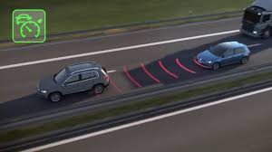
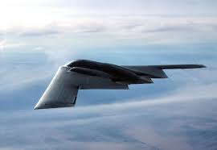
What is control
Controller
System to be controlled
Manual
Automatic
Control is used to regulate or modify the behaviour of a system so it behaves in a specific desirable way over time
Examples of control systems are everywhere, from aerospace systems and wireless networks to bioengineering and traffic control
Notes:
applies specific principles and methods to control dynamic systems so that they produce desired outcomes.

Slide 3
Example: Vehicle speed control
slope, wind, traffic…
desired velocity
accel.
actual velocity
driver
car
brake

Slide 4
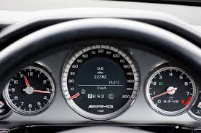

Control Scheme
Open-Loop
slope, wind, traffic…
desired velocity
accel.
actual velocity
driver
car
Less accurate!
brake
Closed-Loop
slope, wind, traffic…
desired velocity
$$e(t)$$
accel.
actual velocity
$$\text{driver}$$
car
-
brake
feedback
Measurement

Slide 5
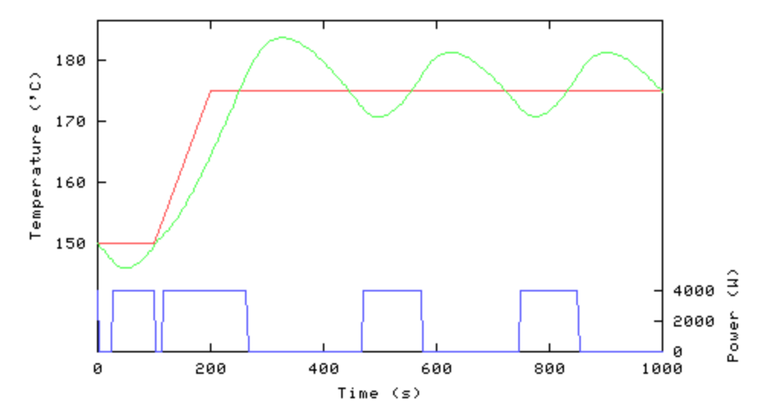
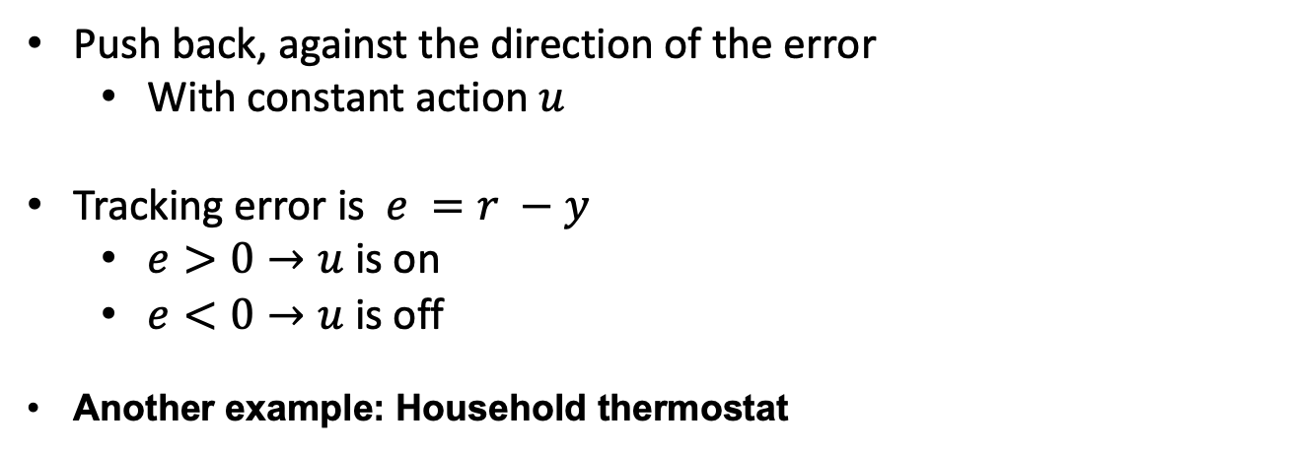
Bang-Bang Control
Push back, against the direction of the error
With constant action $u$
Tracking error is $e =r −y$
$e>0→u$ is on
$e<0→u$ is off
Another example: Household thermostat
Output: actual speed, temperature, etc.
Setpoint: desired speed, temperature, etc.
Optimal for reaching the setpoint
Not very good for staying near it
How can you prevent the chattering?

Slide 6
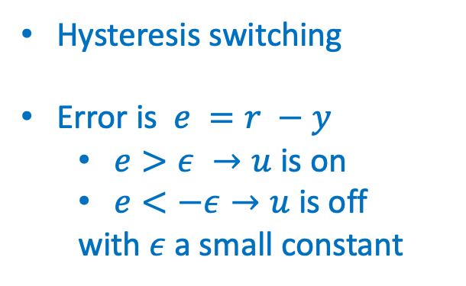
The Bang-Bang Controller
Hysteresis switching
Error is $e =r −y$
$e>ε →u$ is on
$e<−ε→u$ is off
with $ε$ a small constant

Slide 7
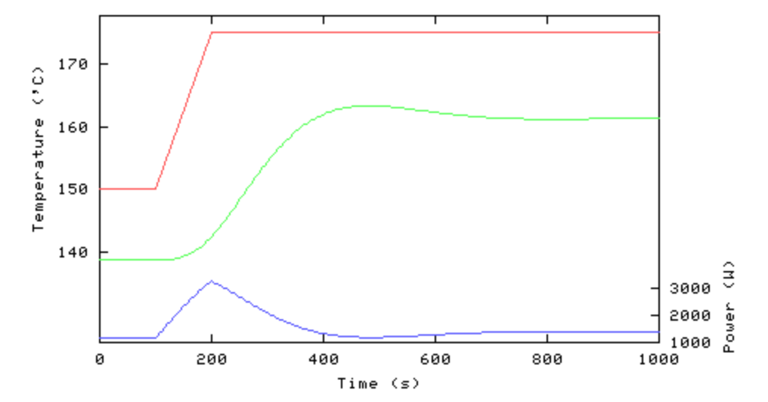
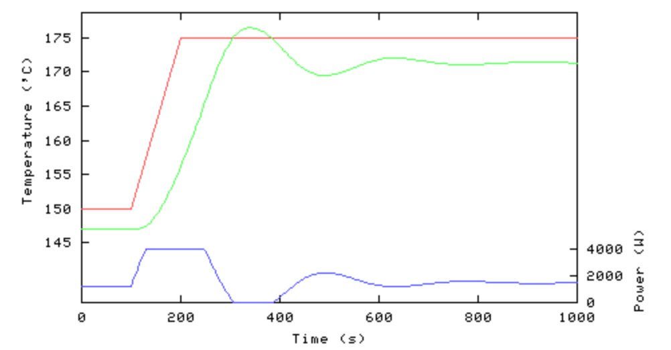
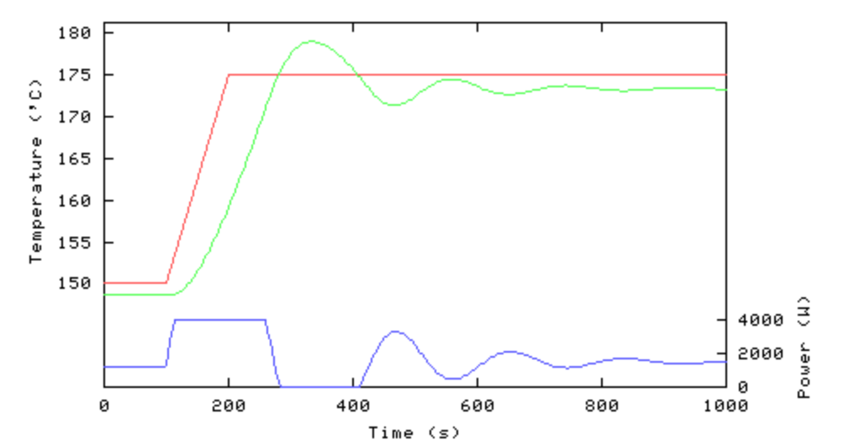
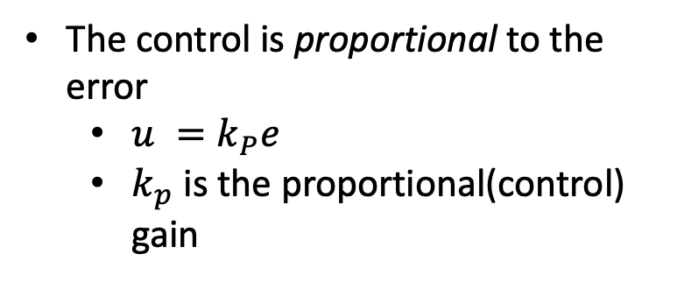

Proportional Control
The control is proportional to the error
$u =k_{P}e$
$k_{p}$ is the proportional(control) gain
Increasing gain approaches setpoint faster
Can lead to overshoot, and even instability
Steady-state offset (error) if used without an integral component
Increase $k_{p}$

Slide 8
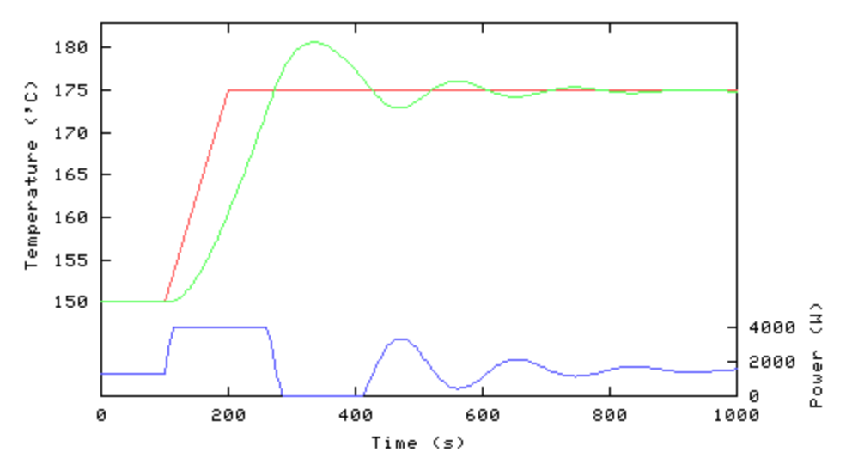
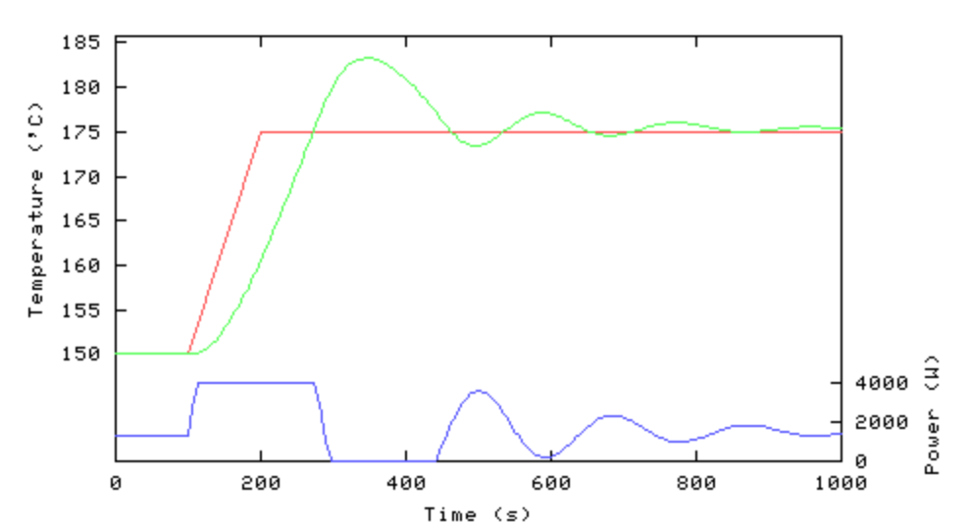
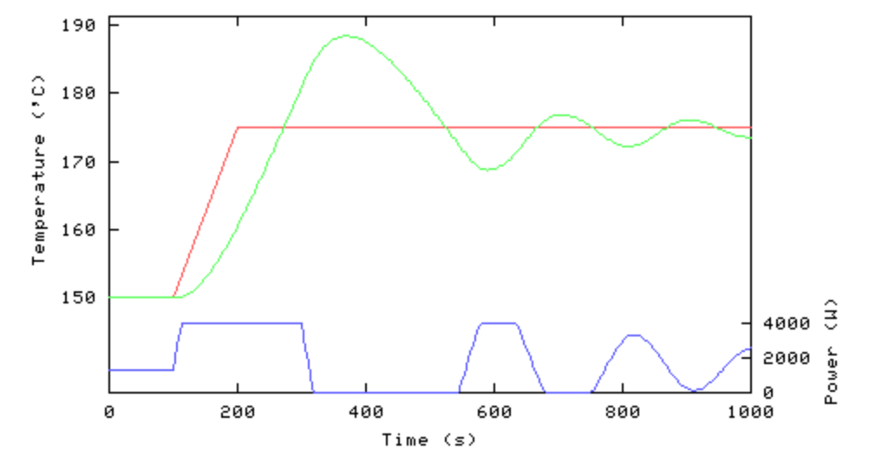

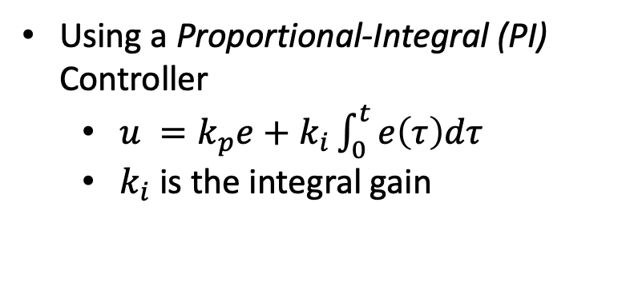
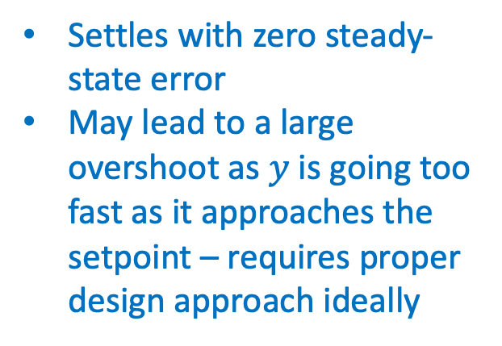
PI Control
Using a Proportional-Integral (PI) Controller
$u =k_{p}e+k_{i}\int_{0}^{t}{e\left(τ\right)dτ}$
$k_{i}$ is the integral gain
Settles with zero steady-state error
May lead to a large overshoot as $y$ is going too fast as it approaches the setpoint – requires proper design approach ideally
Increase $k_{i}$, fixed $k_{p}$

Slide 9
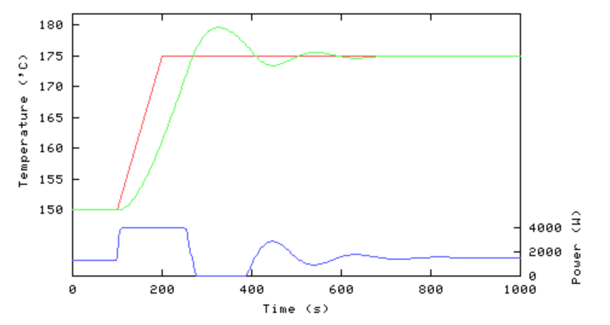
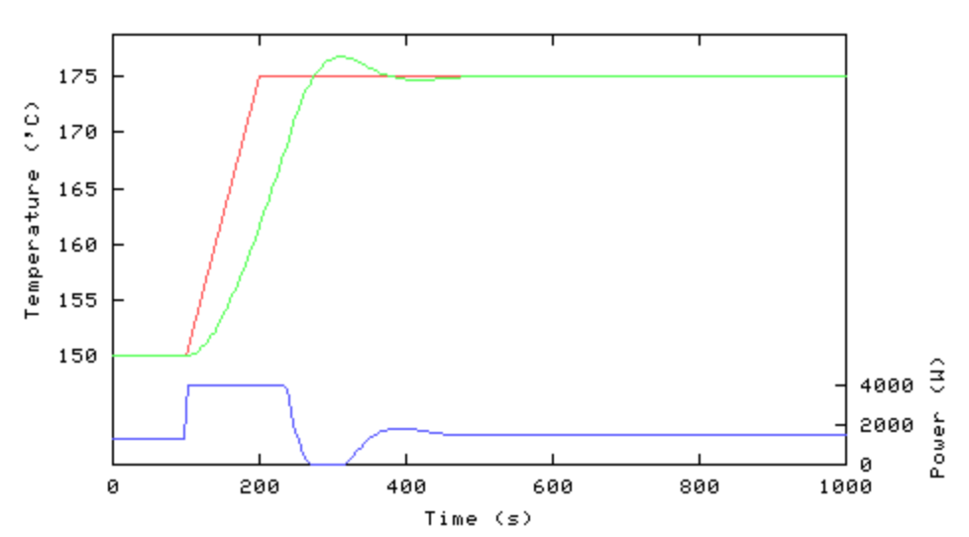
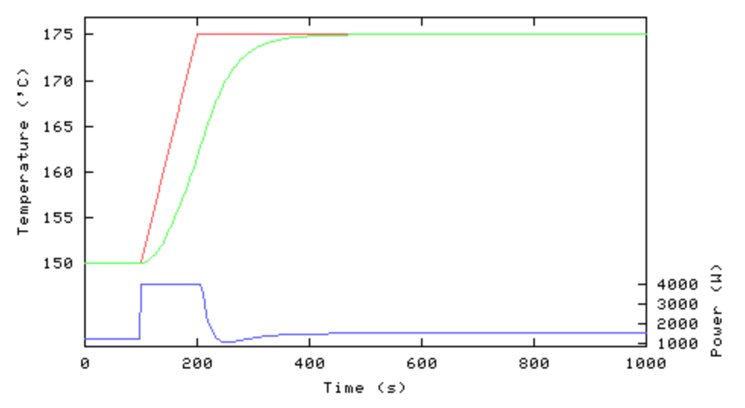
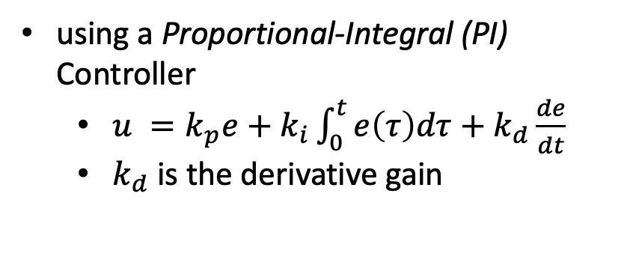

PID Control
using a Proportional-Integral (PI) Controller
$u =k_{p}e+k_{i}\int_{0}^{t}{e\left(τ\right)dτ}+k_{d}\frac{de}{dt}$
$k_{d}$ is the derivative gain
Increase $k_{d}$, fixed $k_{p}$ and $k_{i}$
derivative action can counteract the tendency to overshoot or undershoot
But it’s vulnerable to noise !!

Slide 10
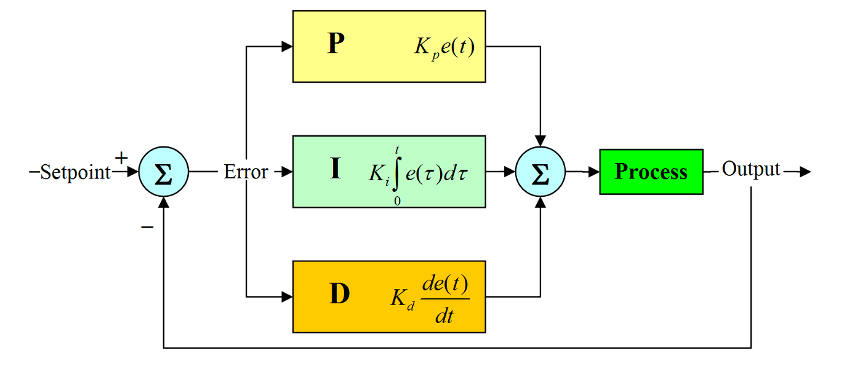
PID Control
Here is a schematic of an implementation of a typical PID controller.
In practice, we often use PI (e.g. driving a motor), or PD (e.g. balancing two-wheel vehicle), and NOT all three terms.

Slide 11
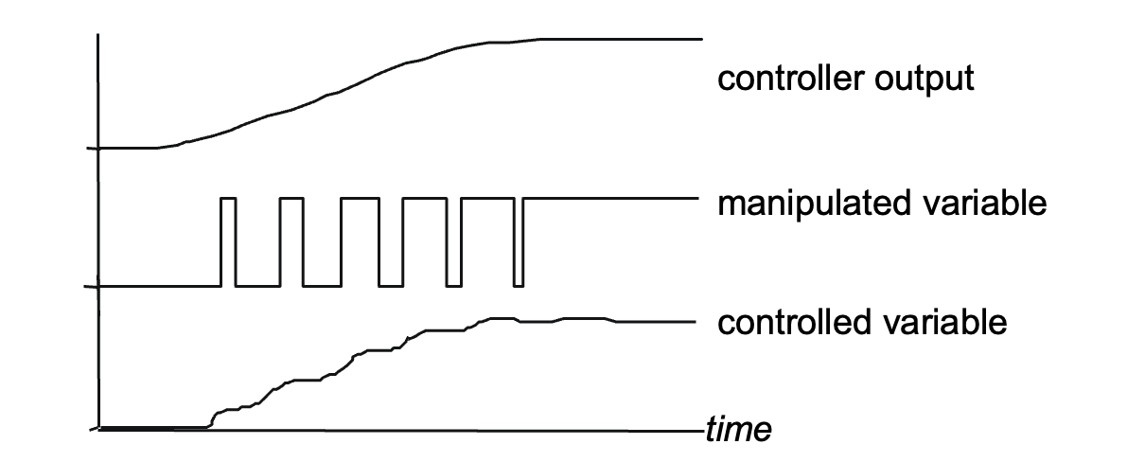
PWM control
PID output
PWM output
output
PWM module

Slide 12
Concluding remarks
The P-action is introduced to increase the speed of the response. Exaggerated P-action results in oscillation.
The I-action is introduced to obtain zero steady-state error.
The D-action is introduced for damping purposes. The disadvantage is the sensitivity to the noise.
Although a cut-and-try design may work OK, for best performance a full design, based on fundamental principles, is needed.
Good behavior depends on good tuning!!

Slide 13
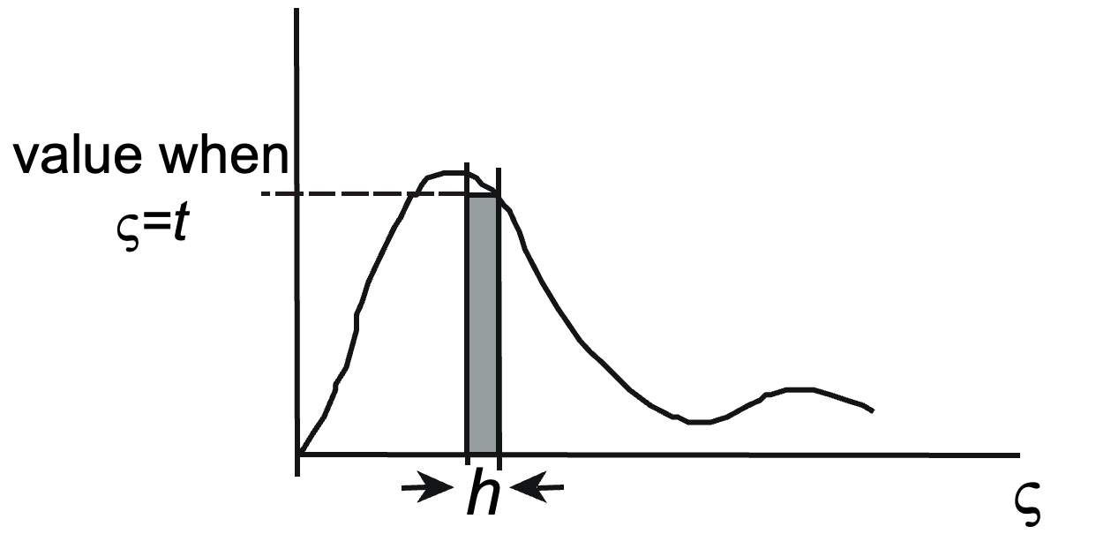
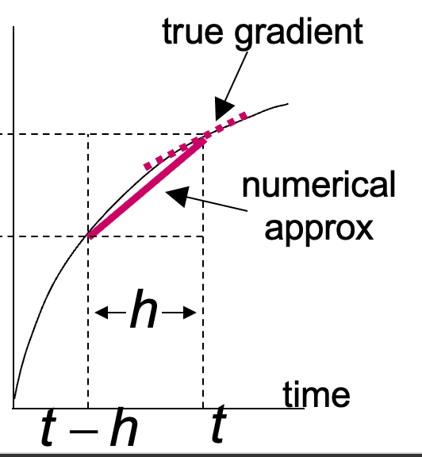



Integration and differentiation in Arduino
Numerical integration
provided $h$ sufficiently small – needs the loop time to be measured and/or regulated
Numerical differentiation

Slide 14
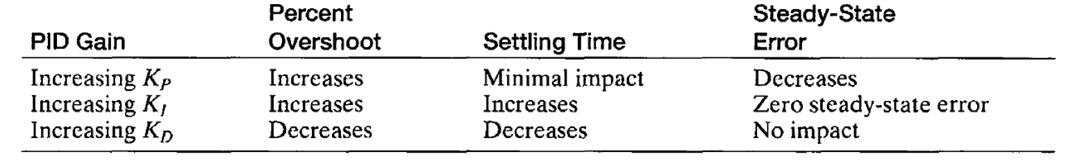
References
https://uk.mathworks.com/videos/series/understanding-pid-control.html
PID tuning
Common tunning methods:
Ziegler-Nichols method
Trial-and-error manual tuning

Slide 15
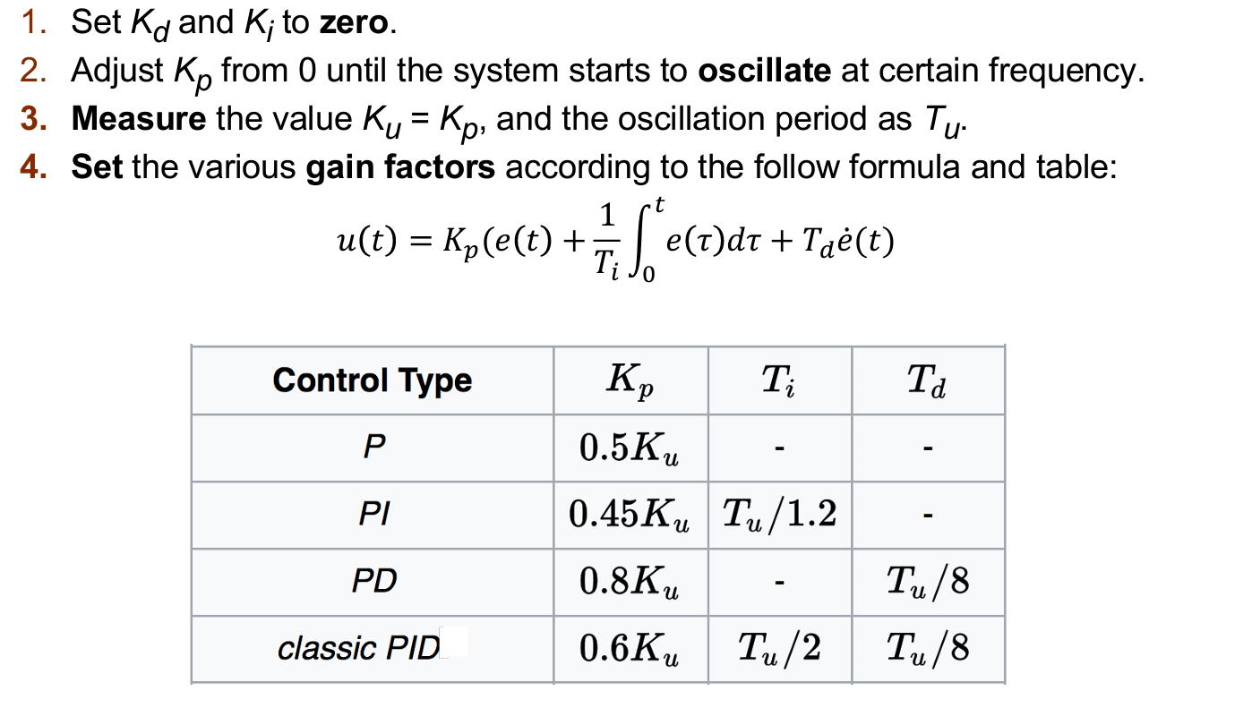
References
Ziegler-Nichols method

Slide 16
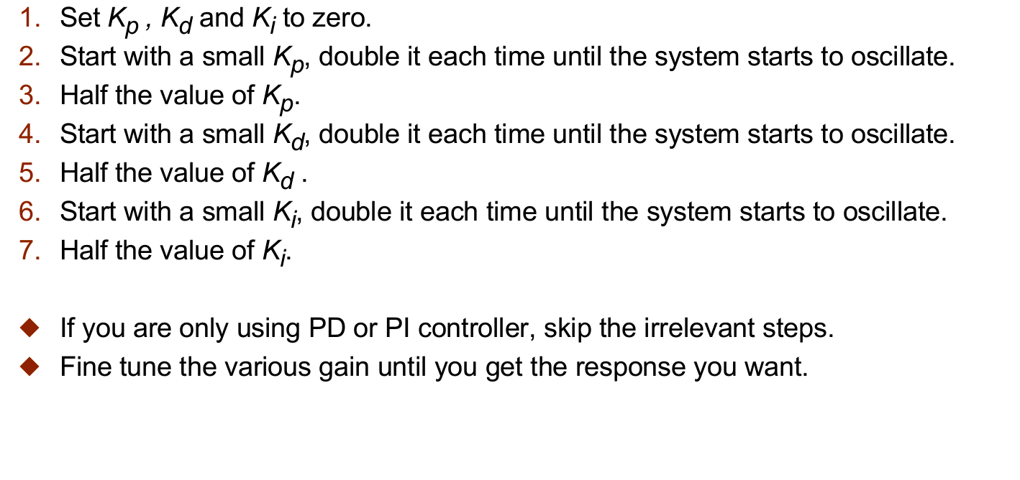
References
Trial-and-error manual tuning

