Slide 1


Maze Solver
Submitted by:
Alif Hossain
Submitted to:
Dr. Kingkar Proshad
Associate Professor

Slide 2
Introduction
The Maze Solver GUI is an interactive Java application that combines algorithmic problem-solving with visual learning. Designed as an educational tool, it generates random mazes and solves them using the Depth-First Search (DFS) algorithm, demonstrating core concepts like recursion, backtracking, and 2D array manipulation.
Key features include:
Randomized maze generation with adjustable wall density
Visual DFS implementation with color-coded paths
Interactive GUI built with Java Swing for user-friendly exploration
This project bridges theory and practice, offering insights into pathfinding algorithms while providing a foundation for future enhancements like additional algorithms (BFS, A*) and customizable maze sizes. Ideal for students and educators, it transforms abstract algorithms into tangible, visual experiences.

Slide 3

Project Overview
Objective: ✔ Develop an interactive GUI to generate and solve mazes ✔ Implement Depth-First Search (DFS) algorithm ✔ Visualize the pathfinding process
Features:
Random maze generation
Color-coded solution path
Interactive controls (Generate/Solve buttons)

Slide 4

Why Maze Solving?
Educational Value:
Teaches recursion and backtracking
Demonstrates algorithm visualization
Foundation for pathfinding in AI/games
Real-World Applications:
Robotics navigation
Game development
Network routing
Visual:
Icon array (robot, game controller, network nodes)

Slide 5
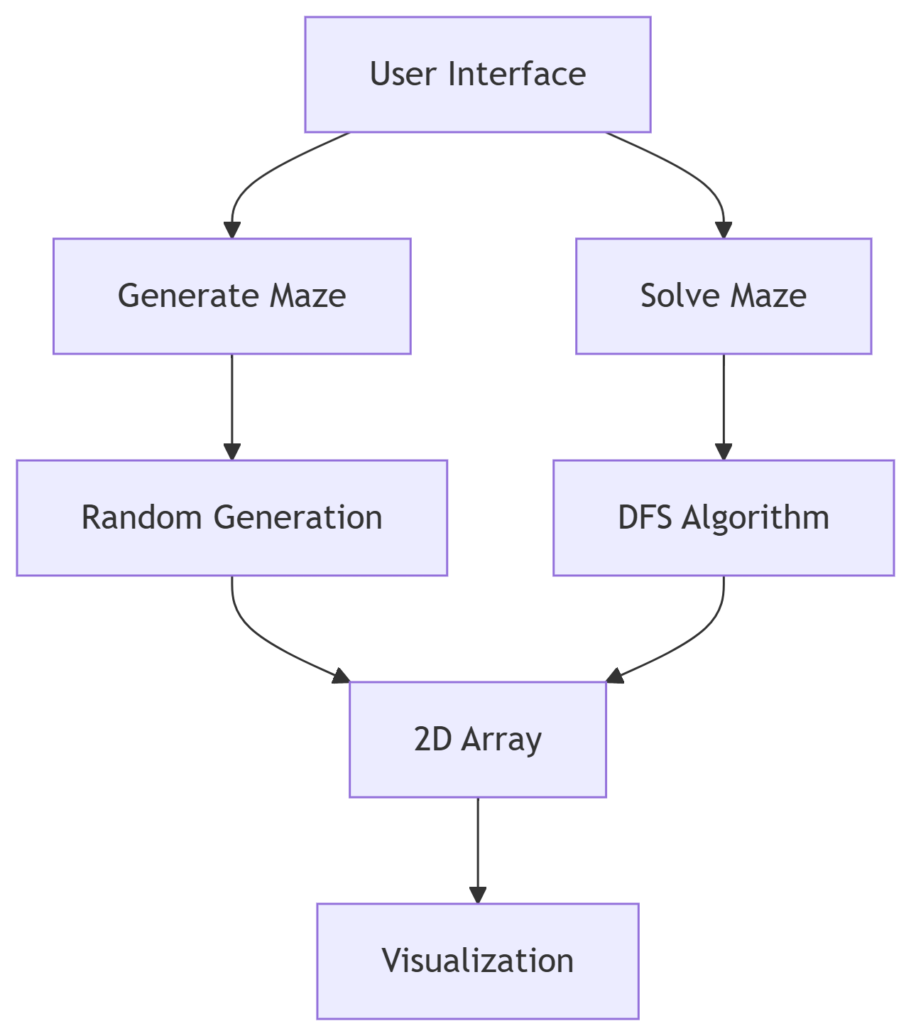
System Overview
Architecture Diagram:
Key Features:
10×10 maze grid
Color-coded elements
Interactive buttons

Slide 6
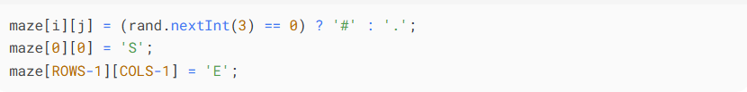
Maze Generation
Key code
Process:
Randomly assign walls (33% chance)
Set fixed start/end positions
Render grid with color coding

Slide 7
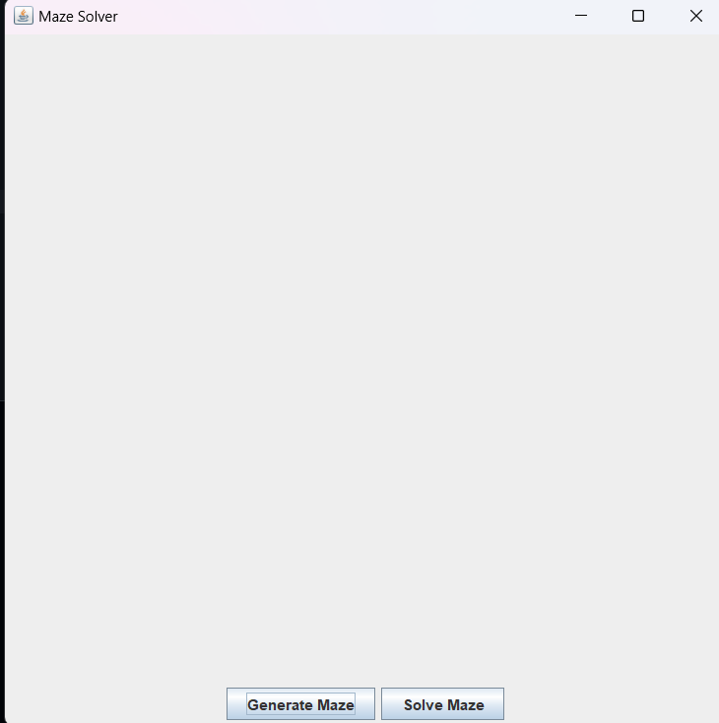
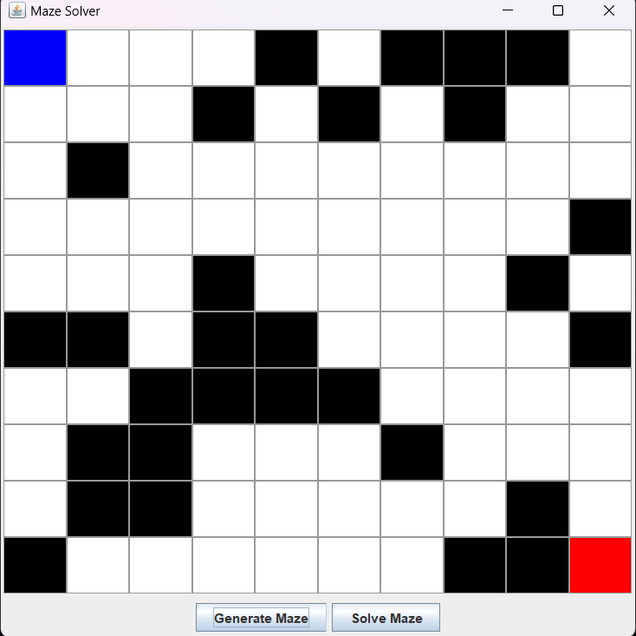
Maze Generation

Slide 8
DFS Algorithm
Pseudocode:
1. If current cell is END → return true
2. If wall/visited → return false
3. Mark cell as visited
4. Recursively check neighbors (Up→Right→Down→Left)
5. If dead end → backtrack

Slide 9
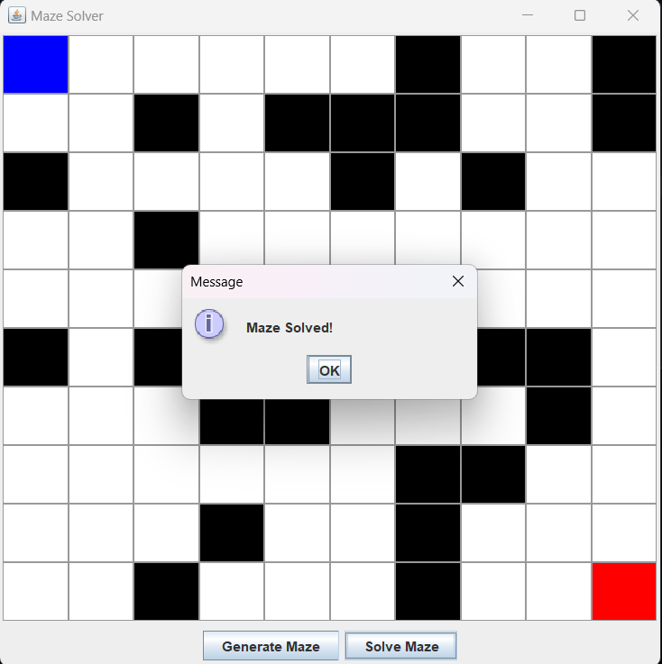
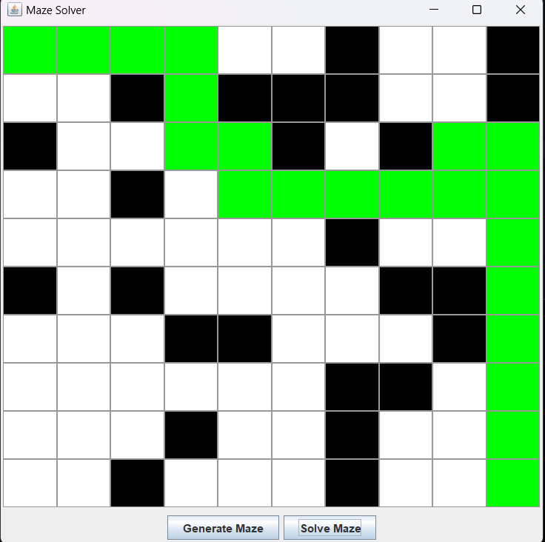
Solved Maze

Slide 10
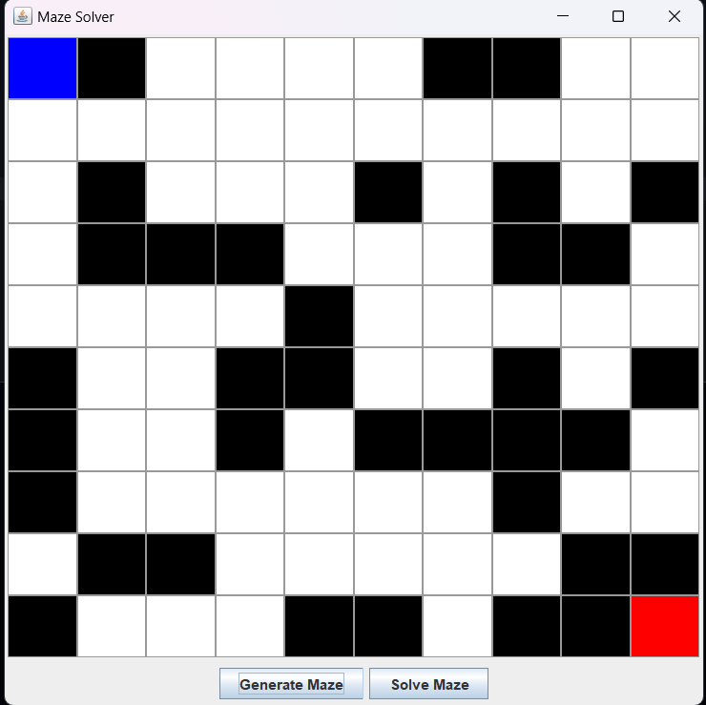
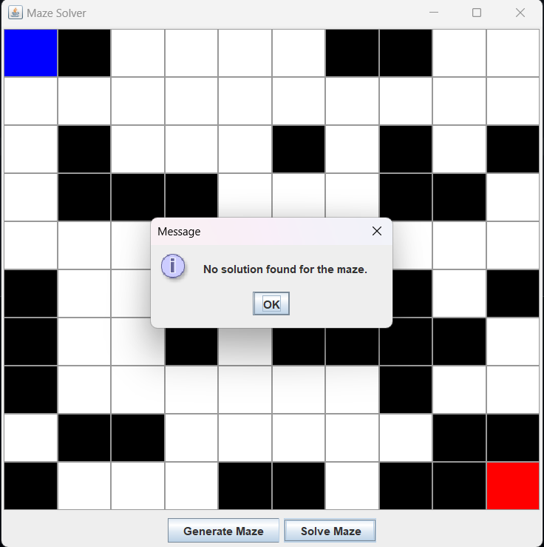
Unsolved Maze

Slide 11
GUI Implementation
Swing Components:
JFrame: Main window
JPanel: Grid layout (10x10)
JButton: Generate/Solve controls
Color Scheme:
🟦 Blue: Start
🟥 Red: End
🟩 Green: Solution path
⬛ Black: Walls

Slide 12
Challenges and Solutions
Challenge | Solution
Unsolvable mazes | Added validation checks
DFS stack overflow | Optimized recursion
GUI lag | Limited grid size

Slide 13
Conclusion
The Maze Solver GUI project successfully bridges the gap between theoretical algorithms and practical implementation, demonstrating the power of Depth-First Search (DFS) in pathfinding applications. By combining Java Swing for visualization with recursive backtracking techniques, this project achieves:
✔ Interactive Learning – Provides a hands-on way to understand DFS mechanics, recursion, and backtracking. ✔ Visual Problem-Solving – Color-coded paths and real-time updates make abstract concepts tangible. ✔ Extensible Architecture – The modular design allows for future enhancements (BFS, A*, dynamic maze sizing).

Slide 14

Thank You!

