Slide 1



Facial Recognition App on AWS

Slide 2


Problem Statement
Current Challenges:
  Traditional ID-based access systems rely on badges or PIN numbers.
  These can be lost, shared, or faked, causing multiple security issues.
  Manual verification takes time and lacks real-time intelligence.
  Businesses need automated, contactless, and intelligent systems for access control.
Use AWS Facial Recognition to identify employees using their faces making access faster, safer, and completely automated.

Slide 3



Objective
  To create a serverless facial recognition platform that automatically authenticates employees using AWS cloud services
  Register new employees via photo uploads.
  Authenticate users by matching faces against a stored collection.
  Use AWS Rekognition for face analysis and DynamoDB for employee data.
  Host everything on AWS using event-driven automation with Lambda and S3.

Slide 4


System Architecture Overview
Key Components:
  S3 Buckets: Two buckets — one for employee registration photos, one for visitor uploads.
  Lambda Functions:
    Registration Lambda → indexes new faces
    Auth Lambda → verifies identities
  Amazon Rekognition: Performs face detection and matching.
  DynamoDB: Stores employee info (Face ID, name).
  API Gateway: Connects React frontend to Lambda functions.
  React Frontend: User interface for uploading and viewing results.

Slide 5




Admin uploads photo → S3 (Employee Bucket)
Upload triggers → Registration Lambda.
Employee Registration Flow
Lambda extracts:
Bucket & file name
Employee name from filename
Lambda calls Rekognition.index_faces():
  Detects the face
  Creates a unique Face ID
  Adds to Rekognition collection "employees"
Lambda saves:
  Face ID
  First & Last Name
  Metadata
→ in DynamoDB.

Slide 6
User uploads or captures photo via React Frontend.
API request sent → API Gateway → S3 (Visitor Bucket).
Once uploaded, Auth Lambda is triggered.
Lambda fetches visitor image → converts to binary data.
User Authentication
Flow
Calls Rekognition.search_faces_by_image():
Compares uploaded face against the “employees” collection.
If match found:
  Fetch employee name from DynamoDB.
  Return success to frontend.
Else return access denied.

Slide 7

Stack Description
Layer | Tool | Description
Frontend | React.js | User interface for uploads and results
API Gateway | AWS API Gateway | Routes requests to AWS backend
Compute | AWS Lambda (Python) | Runs backend logic for registration/authentication
Image Analysis | Amazon Rekognition | Detects, indexes, and matches faces
Storage | Amazon S3 | Holds images for employees and visitors
Database | DynamoDB | Stores employee info (Face IDs, names)
Monitoring | CloudWatch | Logs and metrics for Lambda and S3
Security | IAM Roles | Controls access between AWS services

Slide 8

Advantages
Technical Benefits:
  Fully serverless — no infrastructure to manage.
  Scalable — handles any number of users automatically.
  Accurate — powered by AWS Rekognition’s deep learning models.
  Secure — IAM-based access control, S3 versioning, encrypted data.
  Low-cost — pay only per image processed and per Lambda execution.
Business Benefits:
  Saves time and improves operational efficiency.
  Enhances security through biometric authentication.
  Provides real-time logging and easy integration with dashboards.

Slide 9

Example Usage
Scenario: Office Entry Authentication
Employee approaches camera.
System captures image and checks with Rekognition collection.
Match found leads to automatic door unlock / greeting displayed.
Record stored in DynamoDB for attendance tracking.
Other Use Cases:
  Classroom attendance
  Visitor registration systems
  Retail customer behavior analytics
  Smart building security

Slide 10
Future Scope
  Integrate live video feed instead of manual uploads.
  Add multi-factor authentication (Face + OTP).
  Deploy a mobile app using React Native.
  Enable real-time analytics dashboard (Amazon QuickSight).
  Use AWS Step Functions for complex process orchestration.
  Add auto-notifications (SNS/SES) for visitor alerts.

Slide 11
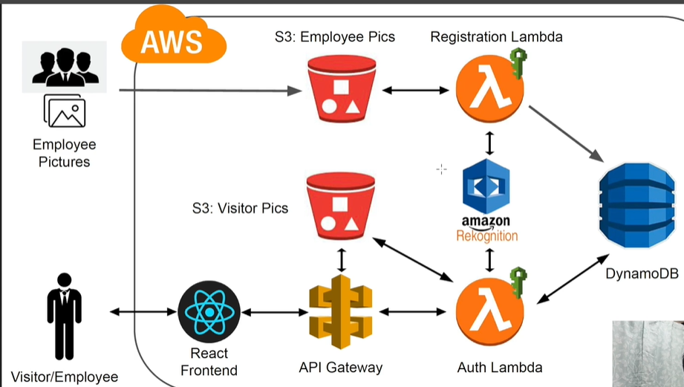
System Architecture Workflow
The above diagram shows the complete AWS-based Facial Recognition System integrating S3, Lambda, Rekognition, DynamoDB, and API Gateway with a React frontend.

