Slide 1
HiggsLens
Machine-learning classification of simulated HIGGS events

Slide 2
Project in one sentence
Reproducible benchmark for classifying simulated HIGGS signal versus background events.
Compares Logistic Regression, XGBoost and a compact PyTorch MLP.
Dashboard consumes saved artifacts; it never trains at startup.
Boundary: simulated benchmark only — no particle-discovery claim.

Slide 3
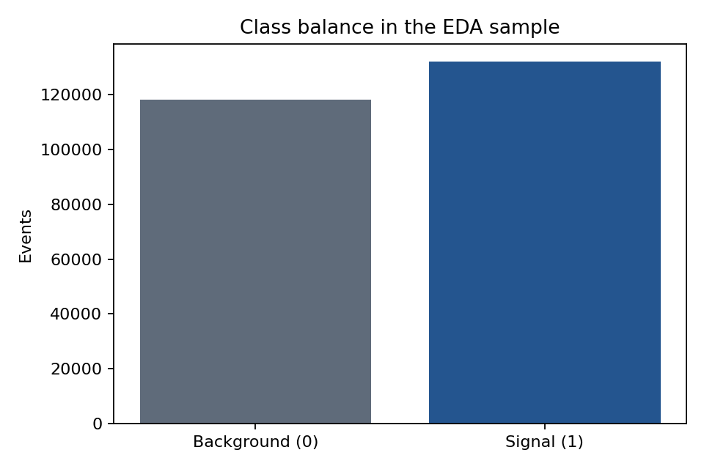
Dataset and scientific question
UCI HIGGS dataset, approximately 11 million source events.
28 inputs: 21 low-level kinematic features + 7 high-level invariant masses.
Current saved benchmark: 250,000 rows, seed 42, 70/15/15 split.
Question: do engineered invariant masses add measurable value, and can nonlinear models learn useful structure from raw kinematics?
Saved class balance

Slide 4
End-to-end pipeline
Download complete archive directly from UCI.
Validate schema, labels and finite values in chunks.
Create the fixed stratified split.
Fit preprocessing on training rows only.
Train models and select threshold on validation data.
Export metrics and predictions.
Explore the results in Streamlit.

Slide 5
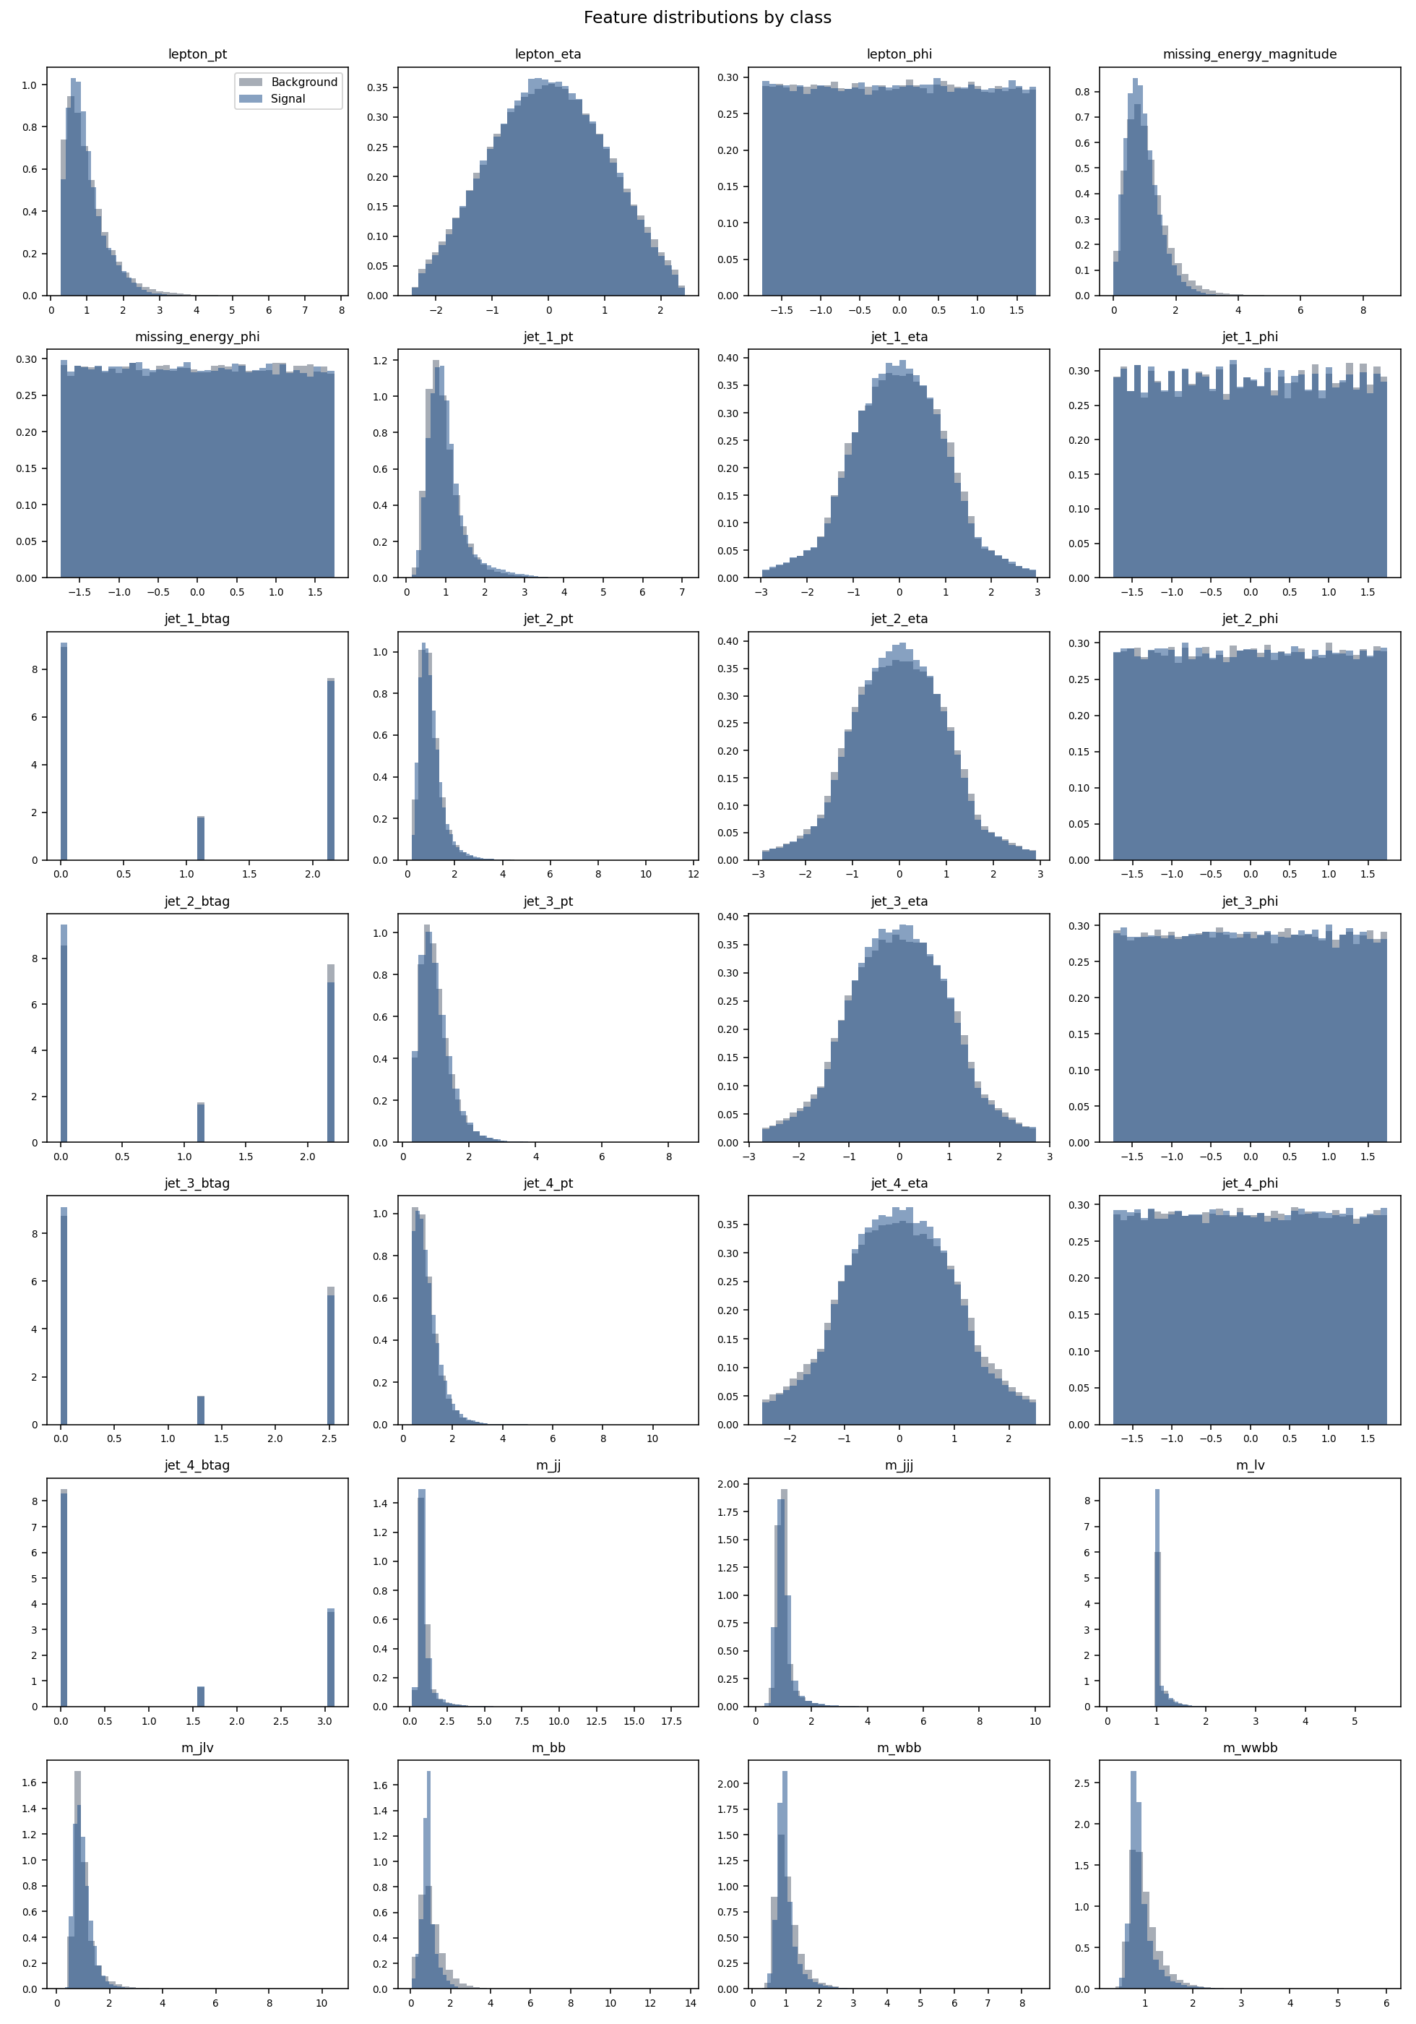
Exploratory evidence
Saved EDA: 250,000 rows.
Missing values: 0.
Non-finite values: 0.
Strongest saved correlation: m_wbb with m_wwbb.
Feature distributions

Slide 6
Model design
Logistic Regression
L-BFGS, C=1.0, training-only StandardScaler.
XGBoost
150 trees, depth 6, learning rate 0.1, histogram method.
Compact MLP
Hidden widths 64 → 32.
BatchNorm + ReLU + dropout 0.20.
AdamW, learning rate 1e-3, early stopping on validation ROC-AUC.

Slide 7
Current leaderboard
Model | Feature group | ROC-AUC | PR-AUC | Brier
XGBoost | all | 0.8123 | 0.8266 | 0.1765
Compact MLP | all | 0.8121 | 0.8270 | 0.1767
XGBoost | high_level | 0.7848 | 0.8026 | 0.1882
Compact MLP | high_level | 0.7832 | 0.8020 | 0.1892
Compact MLP | low_level | 0.7257 | 0.7366 | 0.2113
XGBoost | low_level | 0.7092 | 0.7233 | 0.2165
Logistic Regression | all | 0.6854 | 0.6817 | 0.2231
Logistic Regression | high_level | 0.6518 | 0.6217 | 0.2315
Logistic Regression | low_level | 0.5960 | 0.6222 | 0.2418
Current headline: XGBoost on all features, ROC-AUC 0.8123.

Slide 8
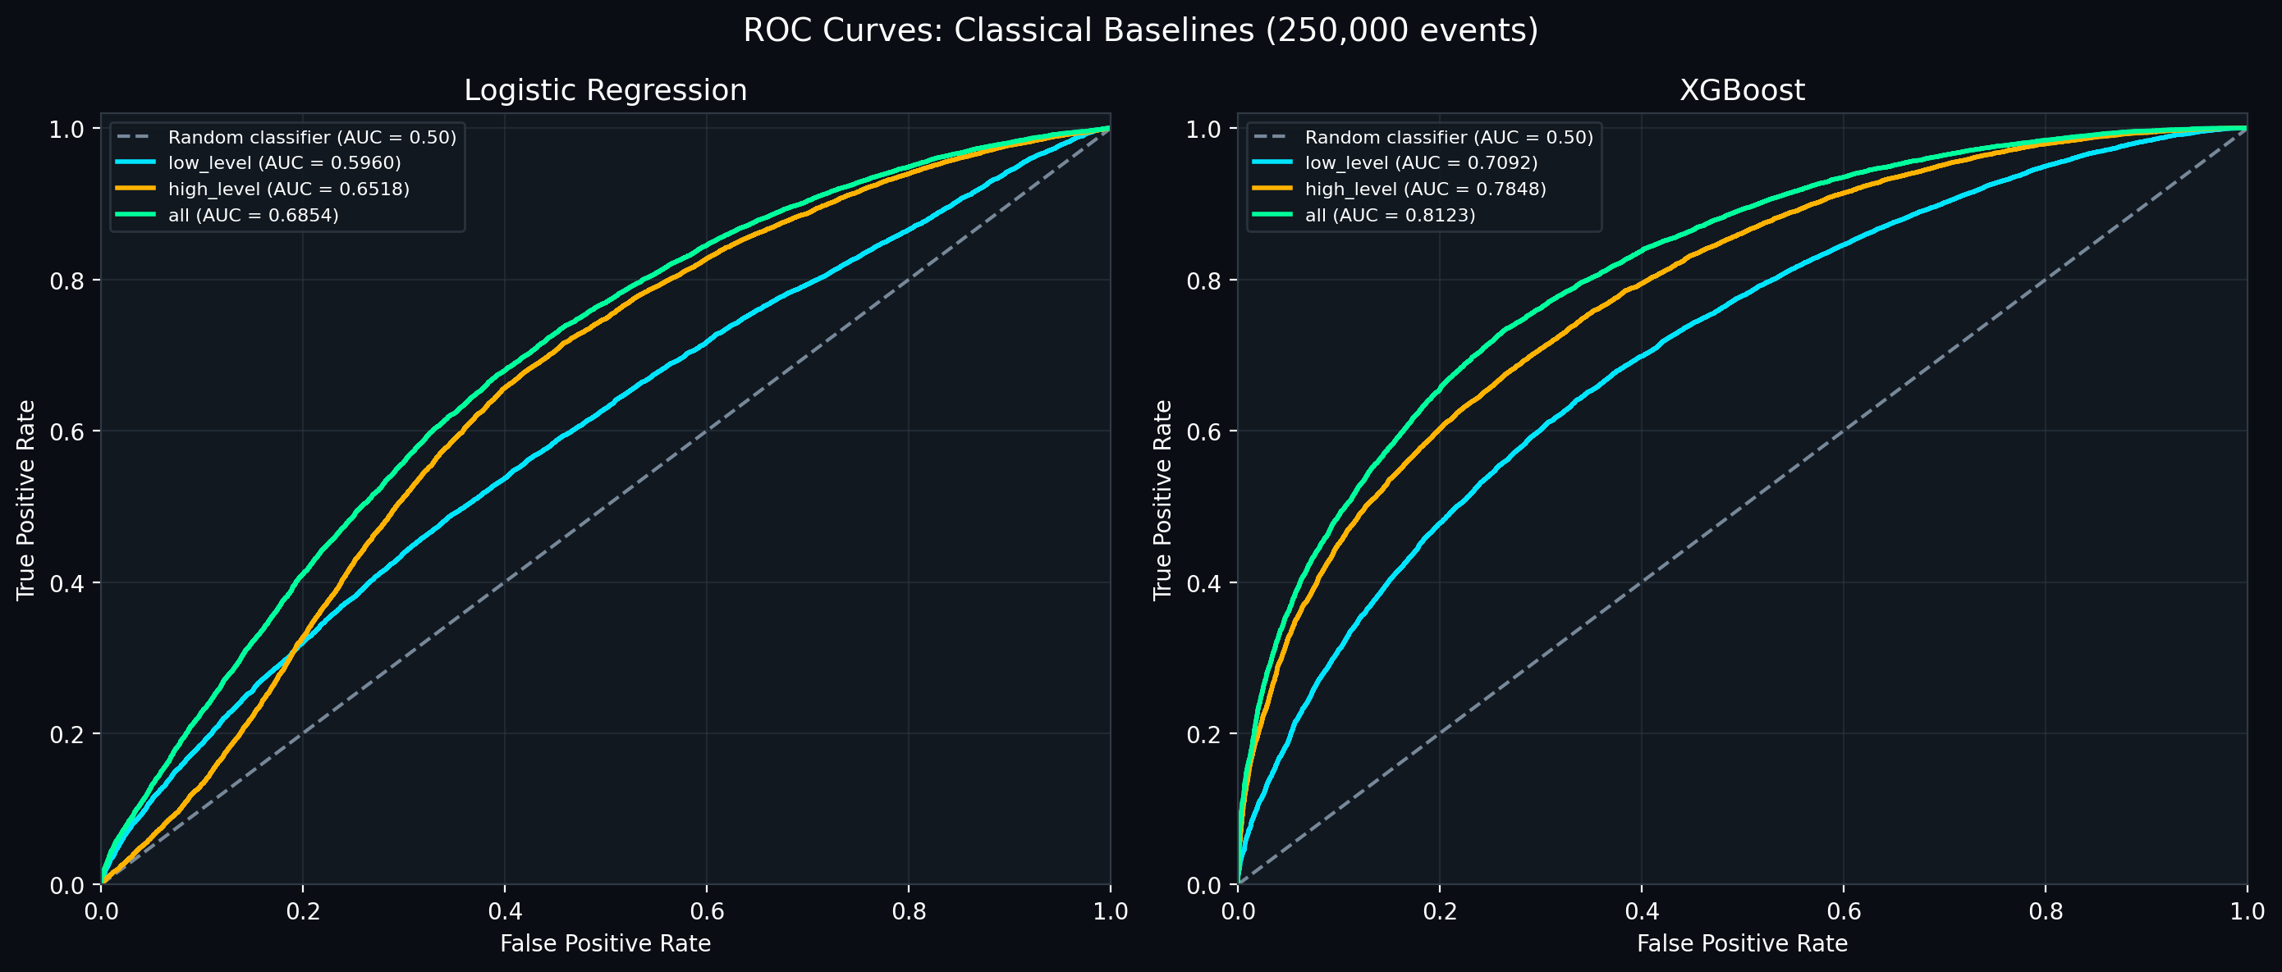
Feature-group finding
Low-level-only models are weakest in the current registry.
High-level invariant masses provide a stronger compact representation.
Combining all 28 features gives the strongest result for each model family.
Classical feature-group comparison

Slide 9
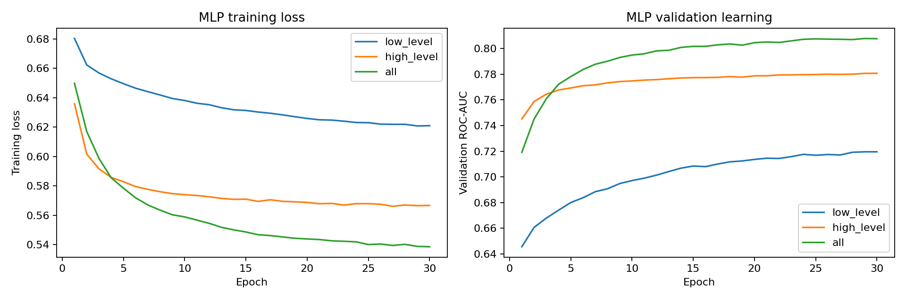
Neural training evidence
The learning curve is loaded from genuine per-epoch history in outputs/mlp_all/metrics.json.
No synthetic training history is used.
MLP learning curves

Slide 10
Operating-point view
Threshold is selected on validation data for a 50% signal-efficiency target.
It is frozen before test evaluation.
Background rejection is reported as a benchmark metric, not a significance estimate.
The dashboard exposes an interactive threshold workbench over saved test predictions.

Slide 11
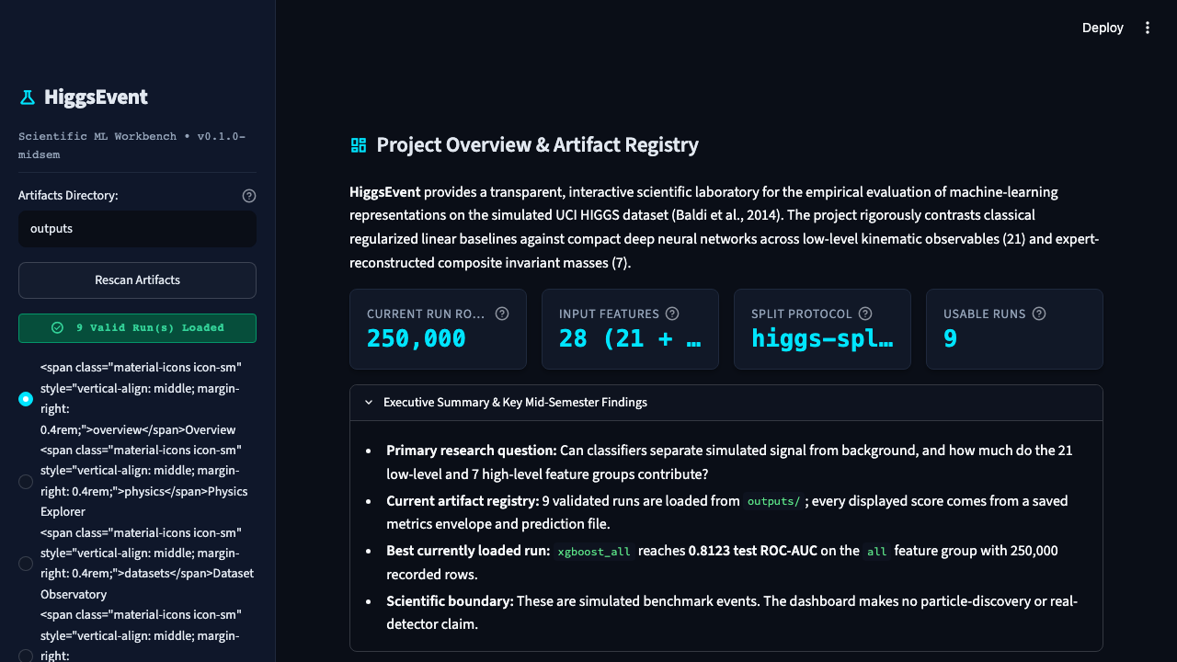
HiggsLens Streamlit dashboard
streamlit run app/main.py
Overview: artifact registry and current best run.
Dataset Observatory: saved EDA tables and figures.
Experiment Comparison: leaderboard, feature groups and runtime.
Validation: ROC, PR, calibration, learning history and thresholds.
Methods and Research: protocol, references and limitations.
Dashboard overview

Slide 12
Reproducibility and checks
Artifact contract: higgs-experiment-v1.
Split protocol: higgs-split-v1, seed 42.
Current test result: 105 passed.
Raw data is downloaded from UCI at runtime and is not committed.

Slide 13
Limitations and conclusion
HIGGS events are simulated Monte Carlo events.
The class balance is not representative of real rare-event searches.
Current saved metrics cover the 250,000-row benchmark; the historical 1M summary is kept separate because it used a different pipeline and copied timing values.
HiggsLens is an engineering and benchmark study, not a physics-discovery analysis.
Takeaway: the artifact-backed system works end to end, and the dashboard, report and slides now use the same saved evidence.

