Slide 1


Slide 2
Recurrent Neuraİ Networks
(RNNs) modeİ for sentîment
anaİysis on the IMDB movie
review dataset

Slide 3
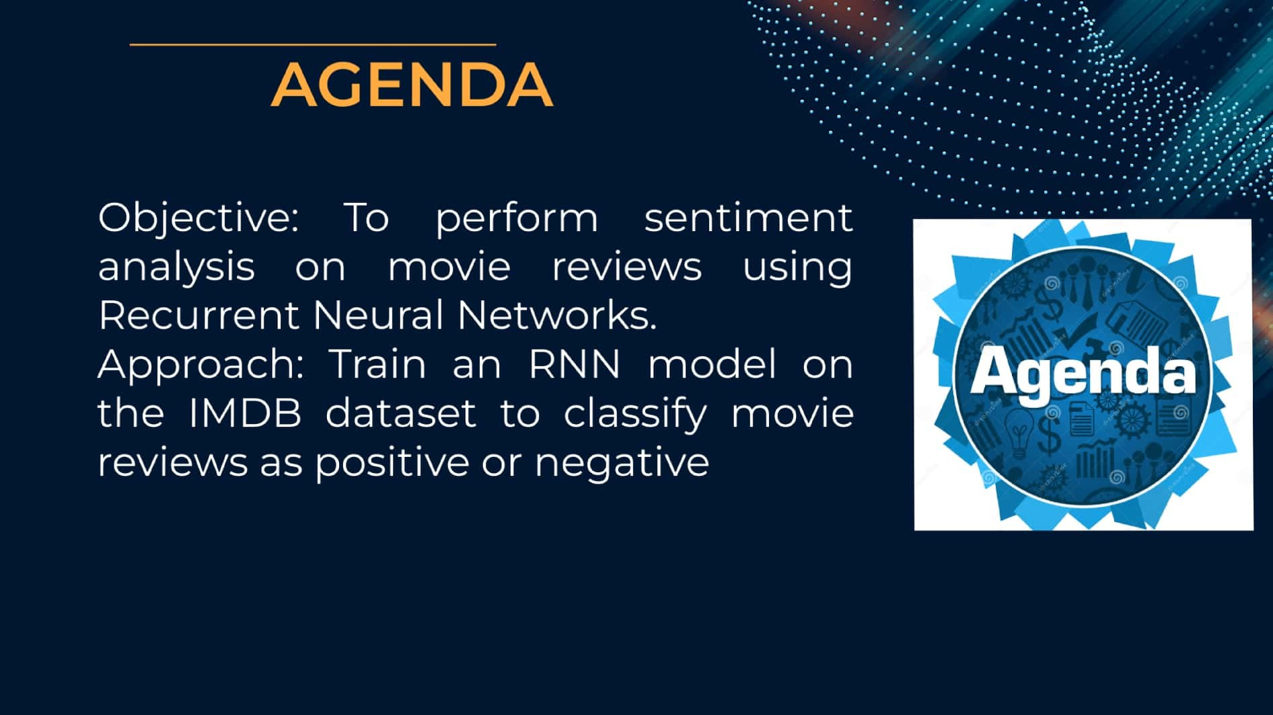

Slide 4



Sentiment analysis, also known as opinion minìn9,
involves analyzing the sentiment expressed in text •
movie reviews as positive or negative based on
their sentiment

Slide 5


machine learning model capable
The project aims to develop a
of automatically categorizing
movie reviews into positive or
negative sentiments. This can be
useful for movie studios, critics,
and consumers to understand
audience reactions and sentiments towards movies.

Slide 6
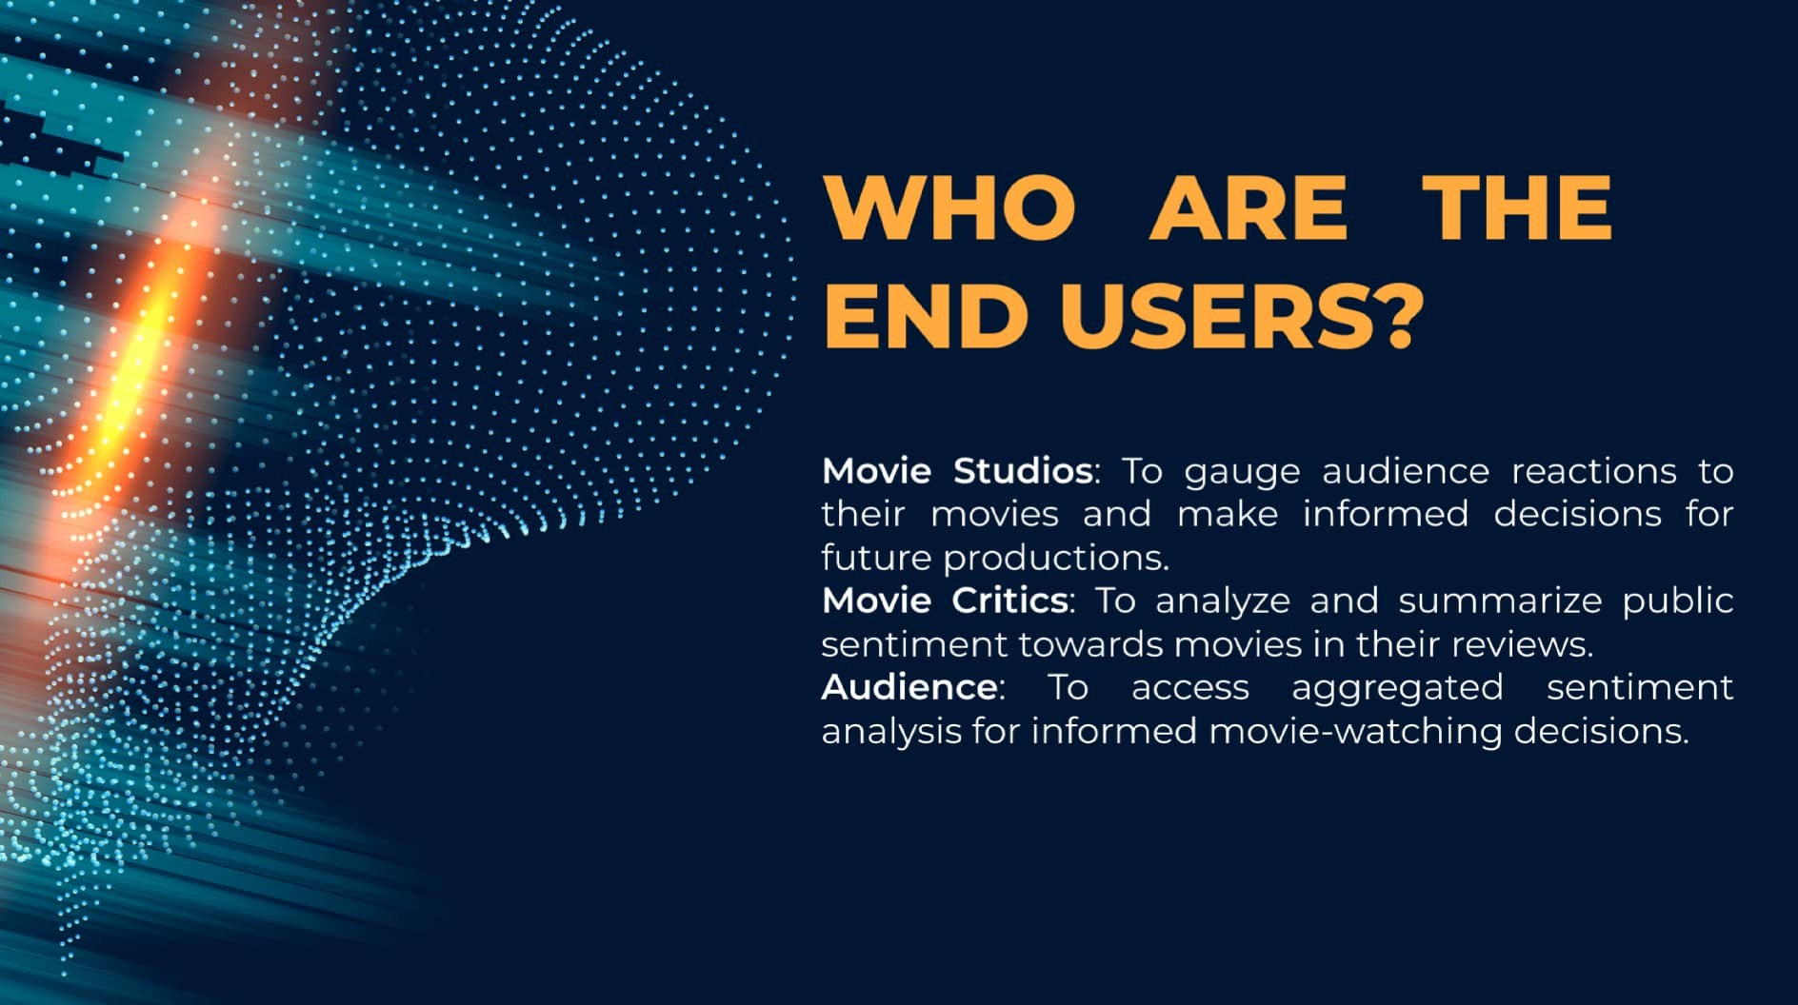

Slide 7



Add a body texOur solution involves training an RNN model on a dataset of movie reviews with associated
sentiment labels. The model learns to classify reviews as
positive or negative based on the text content. The value
proposition lies in providing an automated and ePicient
sentiment analysis tool that can process large volumes of
reviews quickly and accurately

Slide 8

The wow factor of our solution lies in its
ability to understand and analyze the
nuanced sentiment expressed in movie
reviews. By leveraging deep learning
techniques, the model can capture subtle
cues and contextual information \o make
accurate sentiment predictions.

Slide 9



We use a Recurrent Neural Network (RN N) architecture for sentiment analysis. The RNN model processes sequential input data, such as text, and learns to capture temporal dependencies in the data. We use an embedding layer to convert words into dense vectors, followed by one or more LSTM layers to process the sequential data. Finally, a dense layer with a sigmoid activation function is used for binary classification.

Slide 10


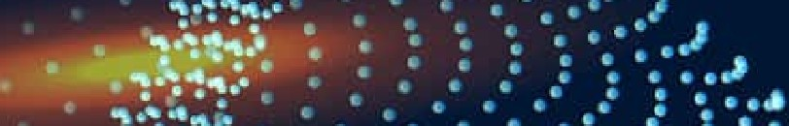




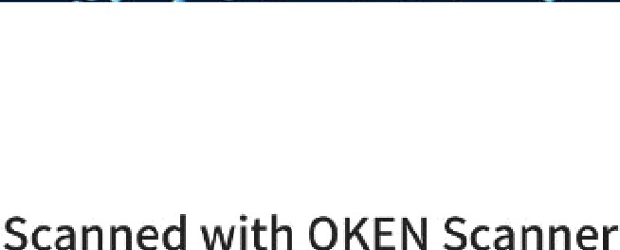
RESULTS
ARer training the RNN model on the
IM DB dataset, we achieved an
accuracy of XX% on the test set. The
model demonstrates robust performance in classifying movie reviews into positive or negative sentiments, showcasing its ePectiveness in sentiment analysis
tasks.

