Slide 1
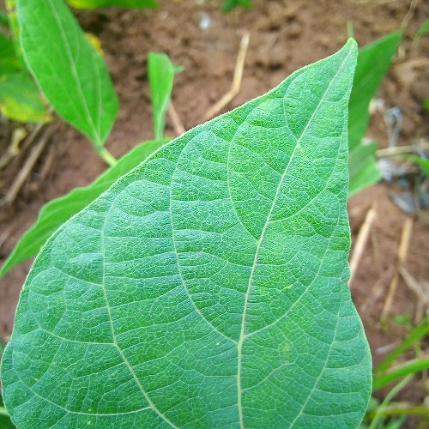
Bean-leaf disease
classification
SigLIP 2 and DINOv2
Applied Vision Transformer Report
27 October 2026
1
Notes:
This project asks whether a newer vision model improves bean-leaf disease classification. I compared SigLIP 2 with DINOv2, looking at accuracy, the benefit of fine-tuning, and the limits of the results.
Sources
Tschannen et al. (2025), SigLIP 2: https://arxiv.org/abs/2502.14786
Oquab et al. (2023), DINOv2: https://arxiv.org/abs/2304.07193
Checkpoints: https://huggingface.co/google/siglip2-base-patch16-224 and https://huggingface.co/facebook/dinov2-small
Makerere AI Lab, Beans (MIT): https://github.com/AI-Lab-Makerere/ibean and https://huggingface.co/datasets/AI-Lab-Makerere/beans
Audited image IDs and SHA-256 hashes: report/presentation/sources.json. The photographs are unaltered dataset examples.

Slide 2
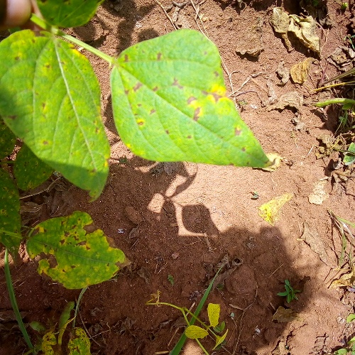
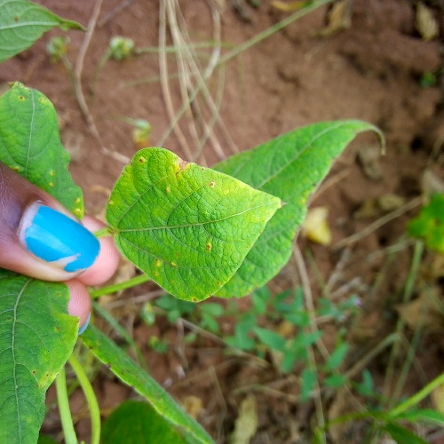
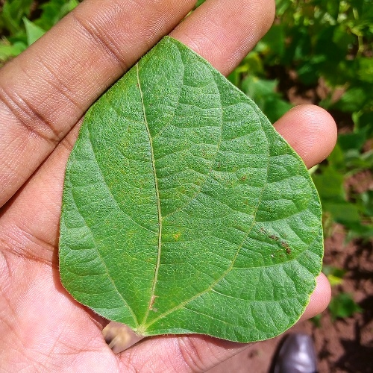
Three classes in field photographs
Angular leaf spot
Bean rust
Healthy
1,034 training
133 validation
128 test
Makerere Beans, Uganda. The published split does not identify individual farms or plants.
2
Notes:
The task has three labels: angular leaf spot, bean rust and healthy. These are real smartphone photographs from Ugandan fields, so the backgrounds, hands and lighting vary. That makes the task useful for testing transfer learning with relatively little labelled data. The audited release contains 1,295 images. I kept the published training, validation and test split. There were no corrupt files or exact duplicates. However, there are no plant or farm identifiers, so the split cannot guarantee that every test image comes from an independent farm.
Sources
Makerere AI Lab, Beans (MIT): https://github.com/AI-Lab-Makerere/ibean and https://huggingface.co/datasets/AI-Lab-Makerere/beans
Audited image IDs and SHA-256 hashes: report/presentation/sources.json. The photographs are unaltered dataset examples.
results/data_audit/audit_summary.json and manifest.csv

Slide 3
Two encoders, two adaptation settings
 | DINOv2-S/14 | SigLIP 2-B/16
Published | 2023 | 2025
Image-model parameters | 22.06 million | 92.89 million
Image representation | Class token | Attention pooling
Frozen
Partial fine-tuning
Train the new classifier
Also train the final two blocks
and final normalisation
3 seeds per setting. Maximum 10 epochs. Validation selects the checkpoint. All runs fit a 4 GB GPU.
3
Notes:
Both models start from public pretrained weights. SigLIP 2 is a 2025 vision-language model, but this experiment uses only its image encoder. DINOv2 is the smaller 2023 comparator. Each gets a new three-class classifier. In the frozen setting, only that classifier learns. In the partial setting, the final two transformer blocks and final normalisation also learn. Both models use 224-pixel images, model-specific normalisation, and matching flips and rotations. I ran three seeds for each setting, giving twelve runs, with early stopping based on validation macro-F1. The settings compare these systems, rather than each model’s best possible performance.
Sources
Tschannen et al. (2025), SigLIP 2: https://arxiv.org/abs/2502.14786
Oquab et al. (2023), DINOv2: https://arxiv.org/abs/2304.07193
Checkpoints: https://huggingface.co/google/siglip2-base-patch16-224 and https://huggingface.co/facebook/dinov2-small
src/followup_experiment.py and study_plan.json. SigLIP attention pooling remains frozen with gradient flow.

Slide 4
SigLIP 2 helped most with frozen features
96.90%
Both partial models
Mean across 3 seeds
Peak allocated memory
DINOv2: 288 MB
SigLIP 2: 722 MB
Original comparison. Three-seed means. Seed SDs appear in the backup table. Reused test set, n = 128.
4
Notes:
Macro-F1 gives each class equal weight. The frozen results are where the models differ most: DINOv2 reaches 90.71 percent, while SigLIP 2 reaches 96.90 percent, a gain of 6.18 percentage points. After partial fine-tuning, both average 96.90 percent. That is a practical tie in these runs, not proof that the models are equivalent. DINOv2 also has a smaller memory footprint. The test set has only 128 images, and earlier DINOv2 test results were already known, so this is an exploratory comparison. The reference paired confidence interval includes zero. The backup table contains the seed variation and timing details.
Sources
Original experiment: results/model_comparison/comparison_analysis.json and combined_summary.csv. The main results exclude the later notebook verification run.
Memory is maximum framework-allocated CUDA bytes across seeds, converted to decimal MB.

Slide 5
Later epochs showed overfitting or instability
Epoch 6 retained
Validation loss
0.062 at epoch 6
0.375 at epoch 9
Clean train–test F1 gap
DINOv2: 1.27 points
SigLIP 2: 2.01 points
Example curve: SigLIP 2 partial, seed 17. Gap figures average selected checkpoints over all three seeds.
5
Notes:
I also checked overfitting. This example is the partial SigLIP run with seed seventeen. Training loss generally falls, but validation loss jumps near the end. The selected checkpoint is epoch six, before that deterioration, because validation macro-F1 determines selection. Across selected checkpoints, the average clean training-to-test F1 gap is 1.27 points for DINOv2 and 2.01 for SigLIP. Those small gaps are useful diagnostics, but they do not prove an absence of overfitting. Validation already influenced checkpoint selection, and the project has no independent farm-level evaluation. The full results retain every seed’s learning history.
Sources
results/model_comparison/siglip2/runs/partial/seed_17/history.csv
results/model_comparison/combined_summary.csv. Training loss uses augmentation. Validation loss uses clean deterministic images. The editable chart rounds loss values to six decimals; the original history retains full precision.

Slide 6
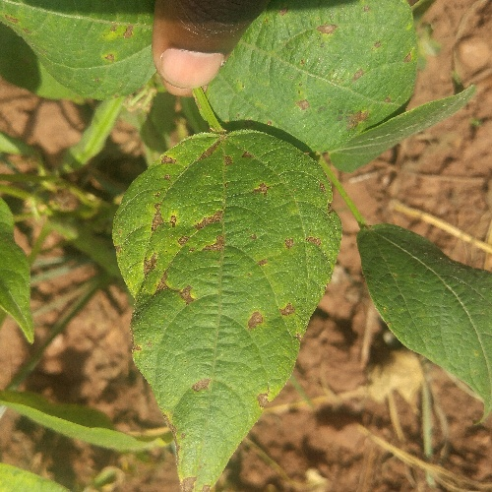
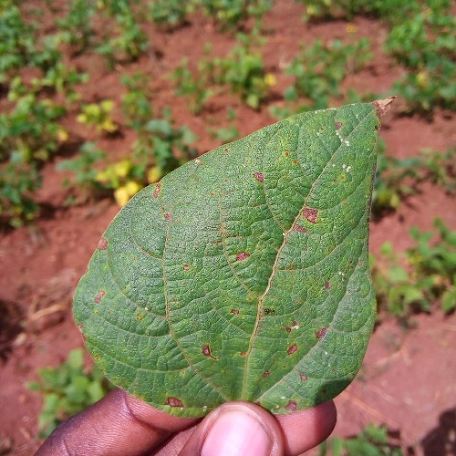
A confident prediction can still be wrong
Wrong disease labels can lead
to unsuitable intervention.
Three labels cannot cover every
disease, pest or nutrient problem.
True: angular leaf spot
Independent field tests and
expert review are still needed.
Predicted: rust
98.65% confidence
Predicted: rust
82.47% confidence
Softmax confidence is uncalibrated. Geography, phone quality and access to advice may affect who benefits.
6
Notes:
These two images show why a high average score is not enough. Both labels are angular leaf spot, but SigLIP predicts rust. One wrong prediction has 98.65 percent confidence. Confusing disease types could lead to an unsuitable intervention. Missing disease could delay advice, while false alarms could add unnecessary cost. The dataset also covers only three labels in one collection, with no evidence of equal performance across farms, devices or regions. Other damage still gets forced into those labels. A future application would need independent field testing, a validated referral policy and agricultural expert review. It should not prescribe treatment automatically.
Sources
Makerere AI Lab, Beans (MIT): https://github.com/AI-Lab-Makerere/ibean and https://huggingface.co/datasets/AI-Lab-Makerere/beans
Audited image IDs and SHA-256 hashes: report/presentation/sources.json. The photographs are unaltered dataset examples.
results/model_comparison/siglip_selected_examples.csv. Two highest-confidence errors from SigLIP 2 partial, seed 17.
Ethical implications: report/technical_report.md section7.

Slide 7
What the comparison supports
SigLIP 2 gave stronger frozen features
Partial DINOv2 reached a similar mean score
with a smaller model and memory footprint
Next: independently collected farms and validation-only tuning
AI assistance: Codex supported research, implementation, analysis, drafting and review.
7
Notes:
The main finding is that SigLIP 2 supplies stronger frozen features. Partial fine-tuning brings DINOv2 to essentially the same average score in the original study, using a smaller model and less allocated memory. This supports a useful comparison, but not a deployment claim. The next step would be validation on independently collected farms, followed by tuning that uses only validation data. Codex assisted the research, code, analysis and drafting. The report, executed notebook and saved predictions document the actual experiments and their limitations.
Sources
Original experiment: results/model_comparison/comparison_analysis.json and combined_summary.csv. The main results exclude the later notebook verification run.
AI-assistance scope: ASSISTANCE.md. Report and notebook artifacts accompany the presentation.

Slide 8
Backup: results and uncertainty
Configuration | Accuracy (%) | Macro-F1 (%) | Median epoch (s)
DINOv2 frozen | 90.62 ± 2.07 | 90.71 ± 2.05 | 11.94
DINOv2 partial | 96.88 ± 1.56 | 96.90 ± 1.55 | 12.62
SigLIP 2 frozen | 96.88 ± 1.35 | 96.90 ± 1.34 | 12.99
SigLIP 2 partial | 96.88 ± 0.78 | 96.90 ± 0.78 | 16.08
Reference partial-model difference: −0.78 percentage points
Paired 95% bootstrap interval: [−3.13, +1.57]
Mean ± sample SD, 3 seeds. Bootstrap applies to seed 17 only. Timing includes unexplained long epochs.
8
Notes:
Backup for questions about variability and cost. All values come from the original experiment. Plus/minus is sample standard deviation across three seeds. The bootstrap interval describes only the prespecified seed 17 partial-model pair, not the three-seed mean. Epoch medians pool completed epochs, so longer runs have greater weight. Raw times include unexplained long epochs, and are retained in the project. These observed laptop durations are not a controlled hardware benchmark.
Sources
Original experiment: results/model_comparison/comparison_analysis.json and combined_summary.csv. The main results exclude the later notebook verification run.

Slide 9
Backup: where the reference models failed
DINOv2 partial
SigLIP 2 partial
True / predicted | Leaf spot | Rust | Healthy
Leaf spot | 42 | 1 | 0
Rust | 0 | 43 | 0
Healthy | 0 | 1 | 41
True / predicted | Leaf spot | Rust | Healthy
Leaf spot | 40 | 3 | 0
Rust | 0 | 43 | 0
Healthy | 0 | 0 | 42
0 of 86 diseased leaves predicted healthy in either reference model
Seed 17, 128 test images. Counts describe this sample and cannot establish safety in new fields.
9
Notes:
Rows are true labels and columns are predictions. For the original reference seed 17, partial DINOv2 makes two errors, while partial SigLIP makes three. Both have zero disease-as-healthy errors among 86 diseased images. That small-sample count does not establish safety. DINOv2 mislabels one of 42 healthy images as rust. SigLIP confuses three angular-leaf-spot images with rust. Use these tables to distinguish overall correctness from disease-subtype errors.
Sources
results/model_comparison/dinov2/runs/partial/seed_17/metrics_test.json
results/model_comparison/siglip2/runs/partial/seed_17/metrics_test.json

Slide 10
Backup: preprocessing and training settings
Setting | Value
Input and augmentation | 224 × 224 RGB, flips, rotation ±15°
Optimiser | AdamW, cross-entropy, weight decay 0.01
Learning rates | Classifier 0.001, backbone 0.00001
Batch and precision | 8 images, CUDA FP16, gradient clip 1
Stopping rule | 10 epochs maximum, patience 3
Seeds | 17, 42 and 2026
Native normalisation differs by model. SigLIP pooling stays frozen.
10
Notes:
Backup for implementation questions. Both pipelines use RGB and full-image 224 × 224 resizing. SigLIP follows native bilinear resizing and 0.5 channel normalisation. DINOv2 uses bicubic and ImageNet normalisation, replacing its official centre crop to retain peripheral regions. Online augmentation uses horizontal/vertical flips each with 0.5 probability and rotation within 15 degrees. SigLIP pools patch tokens with its pretrained attention pooler, kept frozen. DINO uses its class token. Partial adaptation updates only the final two blocks, final normalisation and classifier. Backbones remain in evaluation mode with gradients for intended parameters. No model-specific hyperparameter search was performed.
Sources
src/followup_experiment.py
results/model_comparison/study_plan.json
Tschannen et al. (2025), SigLIP 2: https://arxiv.org/abs/2502.14786
Oquab et al. (2023), DINOv2: https://arxiv.org/abs/2304.07193
Checkpoints: https://huggingface.co/google/siglip2-base-patch16-224 and https://huggingface.co/facebook/dinov2-small

Slide 11
Backup: reproducibility and remaining limits
Full local notebook: 10 cells, 12 training runs, zero errors
Partial-model mean macro-F1 | DINOv2 | SigLIP 2
Original report experiment | 96.90% | 96.90%
Separate notebook verification | 97.67% | 96.90%
CUDA reruns can differ. Hosted Colab remains untested.
The report keeps the original experiment and explains the rerun.
11
Notes:
This distinguishes the original scientific comparison from a later functionality check. The unchanged full notebook completed ten code cells and twelve fresh training runs locally, with zero errors, fresh model and data acquisition, evaluation and export. The local verification reused the pinned environment. It does not verify Colab’s separate installation branch. Reproduction partial means were 97.67 percent for DINOv2 and 96.90 for SigLIP. They stay separate rather than replacing the original report numbers. Controlled seeds do not guarantee identical CUDA output. A new independent dataset, rather than further reuse of this test set, would provide stronger confirmation.
Sources
validation/full_notebook_local/execution_verification.json
validation/full_notebook_local/evidence/combined_summary.csv
results/model_comparison/notebook_bootstrap_validation.json

Slide 12
Backup: sources
SigLIP 2
DINOv2
Tschannen et al. (2025)
arxiv.org/abs/2502.14786
Oquab et al. (2023)
arxiv.org/abs/2304.07193
Bean disease photographs
Models and implementation
Makerere AI Lab
github.com/AI-Lab-Makerere/ibean
Official Google and Meta checkpoint cards
Hugging Face Transformers 4.57.1
Full references and attribution appear in the technical report and third-party notices.
12
Notes:
Selected primary references for the presentation. The technical report contains the complete bibliography and pinned processor/implementation sources. Photograph attribution: Makerere AI Lab and dataset contributors. Dataset MIT and model Apache 2.0 notices accompany the project. AI-assisted implementation and drafting are disclosed in ASSISTANCE.md. No claim is made that the project used the latest available October 2026 model or established state-of-the-art Beans performance.
Sources
Tschannen et al. (2025), SigLIP 2: https://arxiv.org/abs/2502.14786
Oquab et al. (2023), DINOv2: https://arxiv.org/abs/2304.07193
Checkpoints: https://huggingface.co/google/siglip2-base-patch16-224 and https://huggingface.co/facebook/dinov2-small
Makerere AI Lab, Beans (MIT): https://github.com/AI-Lab-Makerere/ibean and https://huggingface.co/datasets/AI-Lab-Makerere/beans
Audited image IDs and SHA-256 hashes: report/presentation/sources.json. The photographs are unaltered dataset examples.
https://github.com/huggingface/transformers/blob/v4.57.1/src/transformers/models/siglip/modeling_siglip.py

