Slide 1

Presentation Task 2 University Life
1.How is your new life at NPU
2.How is life in Penghu different from life in Taiwan?
3.Is university life like you expected?
4.Can you adjust to life in Penghu?

Slide 2



How is your new life at NPU
Hmmm… how can I describe it🤔
Sometimes I feel bored
Sometimes I feel happy
Sometimes I feel tired
1.How should I eat?
2.Where can I hang out?
3.What else is left unfinished?
Cuz I am class representative
I need
1.Receiving & transmitting information
2.Collect & submit documents
1.Make many friends
2.Eat delicious food
3.Get along well with roommates

Slide 3




How is life in Penghu different from life in Taiwan
No KFC
Not 24hr
When U EMO
U can
Jump into the
sea
(just kidding)
1.First&The most important point is food
Many restaurant closes at 8 p.m.
2.Second. You can go to the sea anytime in less than 10 minutes by motorcycle.
3.Third. The stars in Penghu are very beautiful
Cuz I never went to the mountains to watch the stars at night in Taiwan.
In Penghu u only need go to 西嶼(Xiyu) U can see beautiful stars.

Slide 4
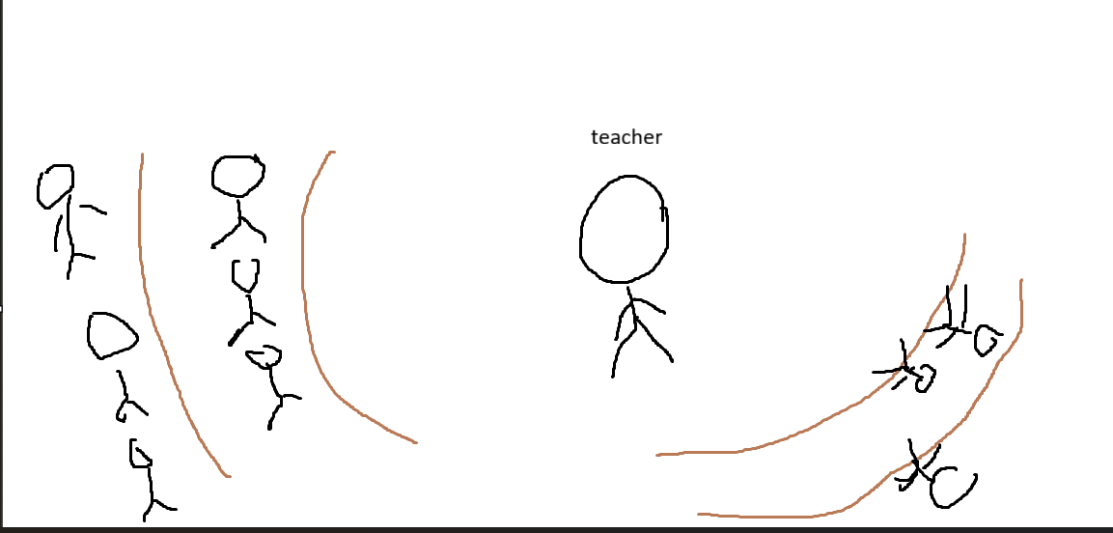
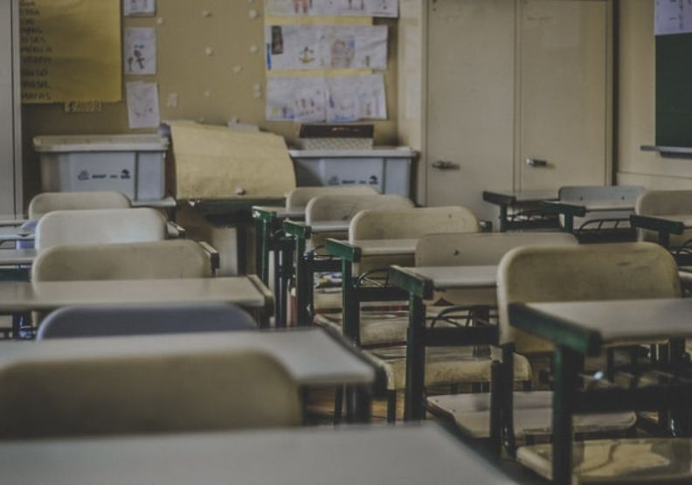
Is university life like you expected?
expect
Actually,It's like high school
I think half and half
Example:
like classroom I think is→
Honest I want say
It's pretty much like high school, but you have a lot more freedom.
That mean you need to take responsibility for your actions

Slide 5
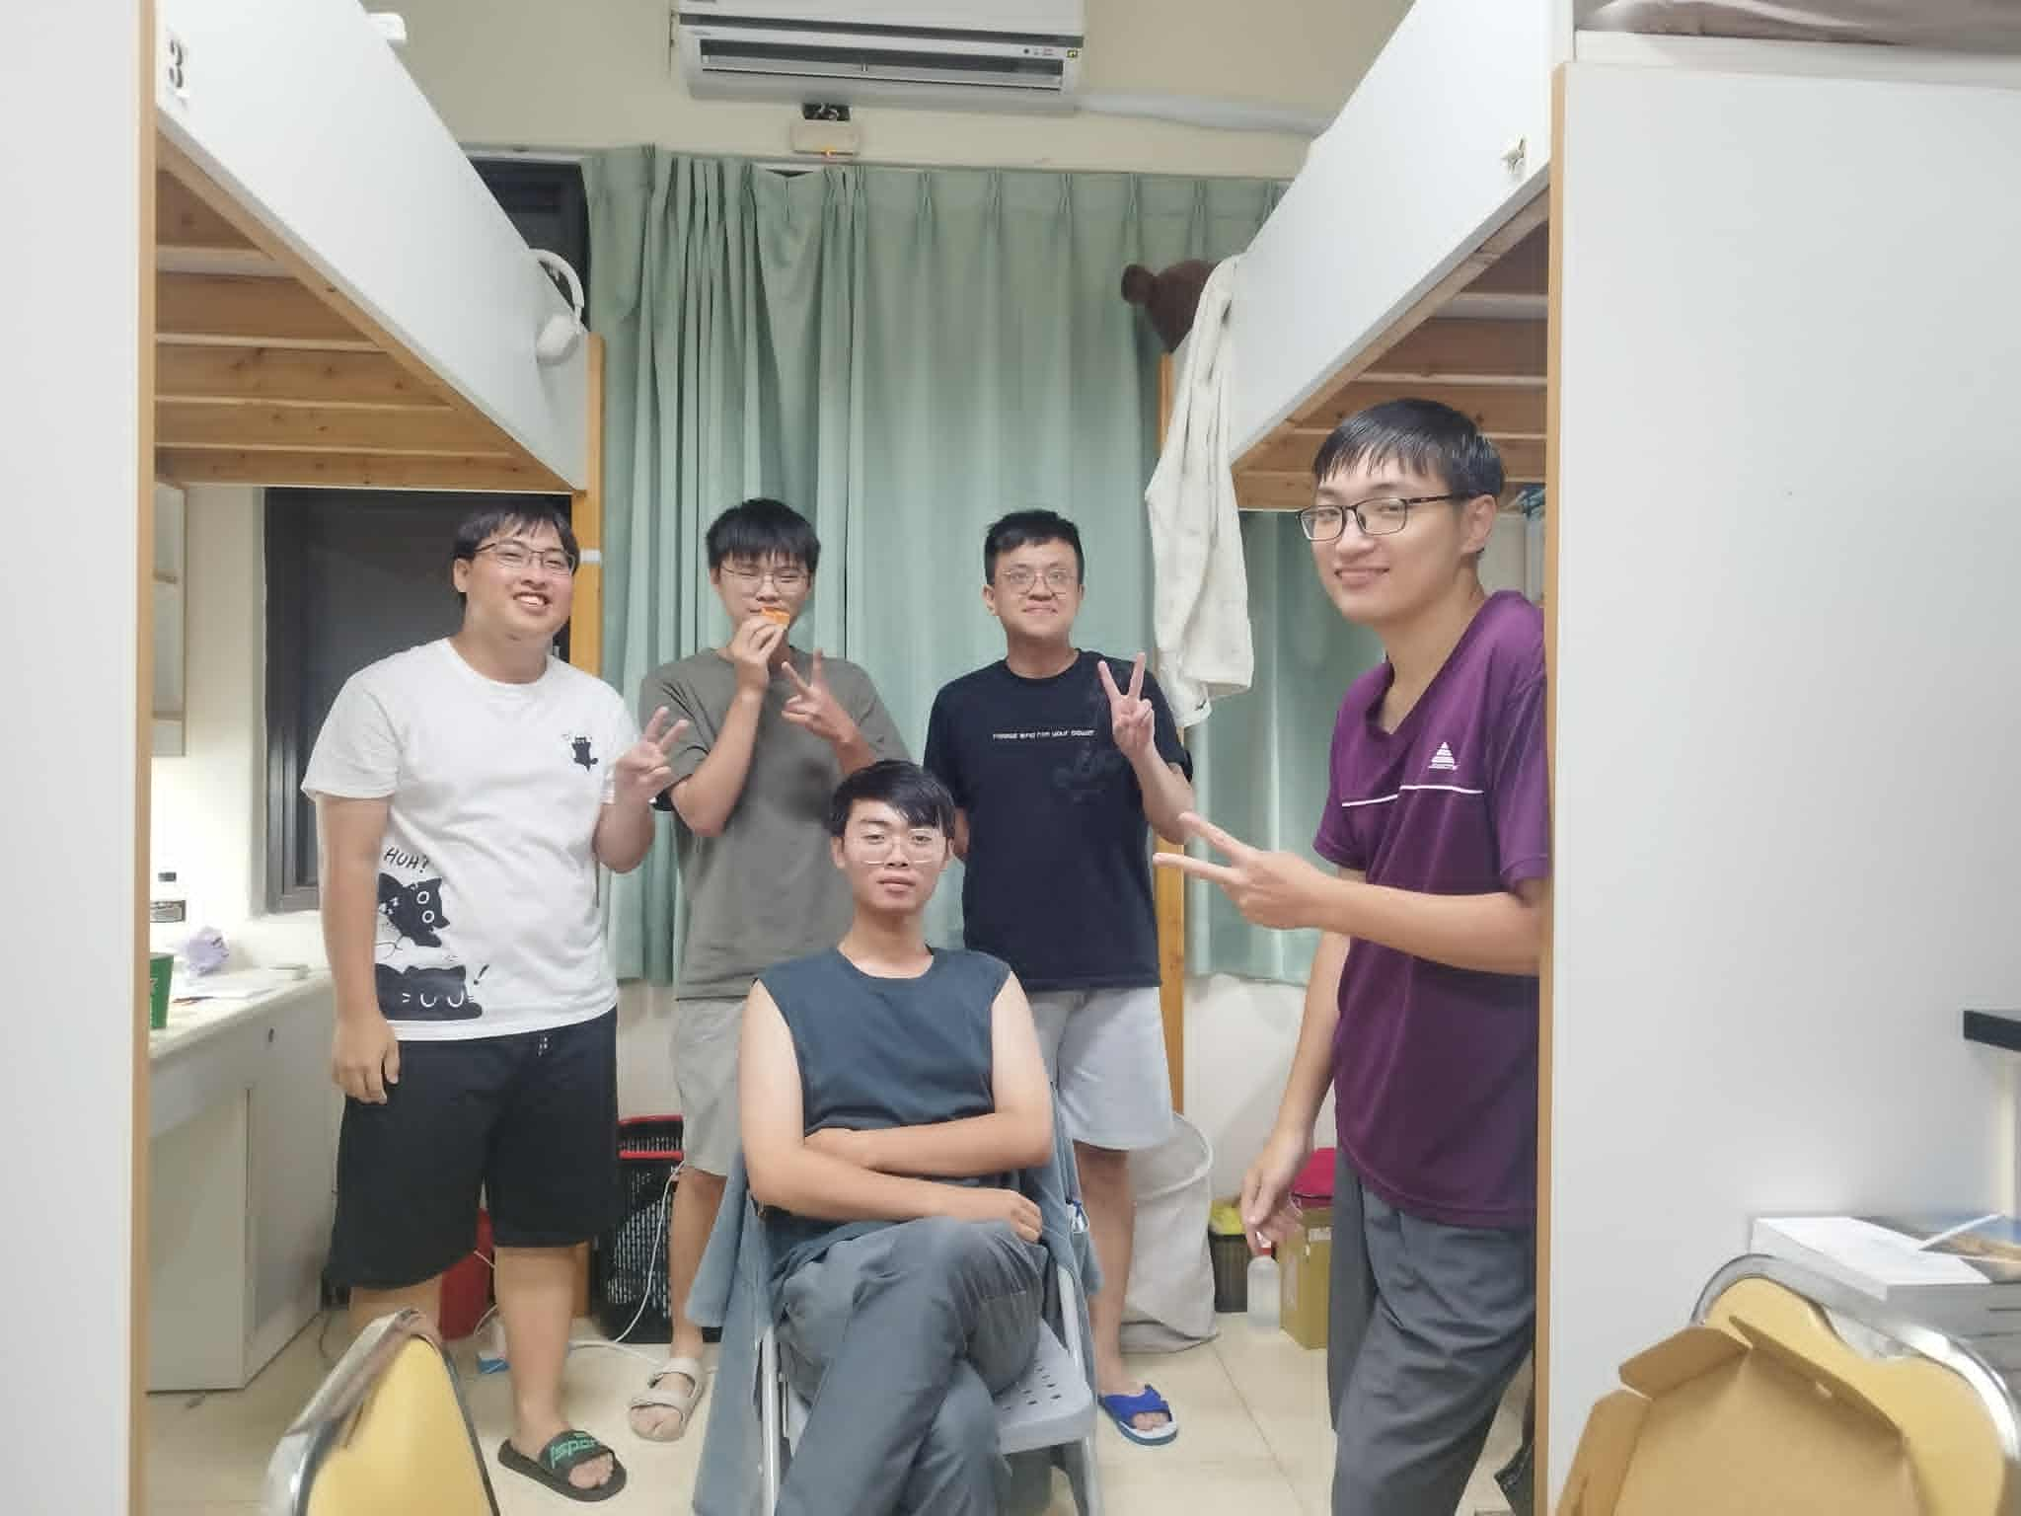
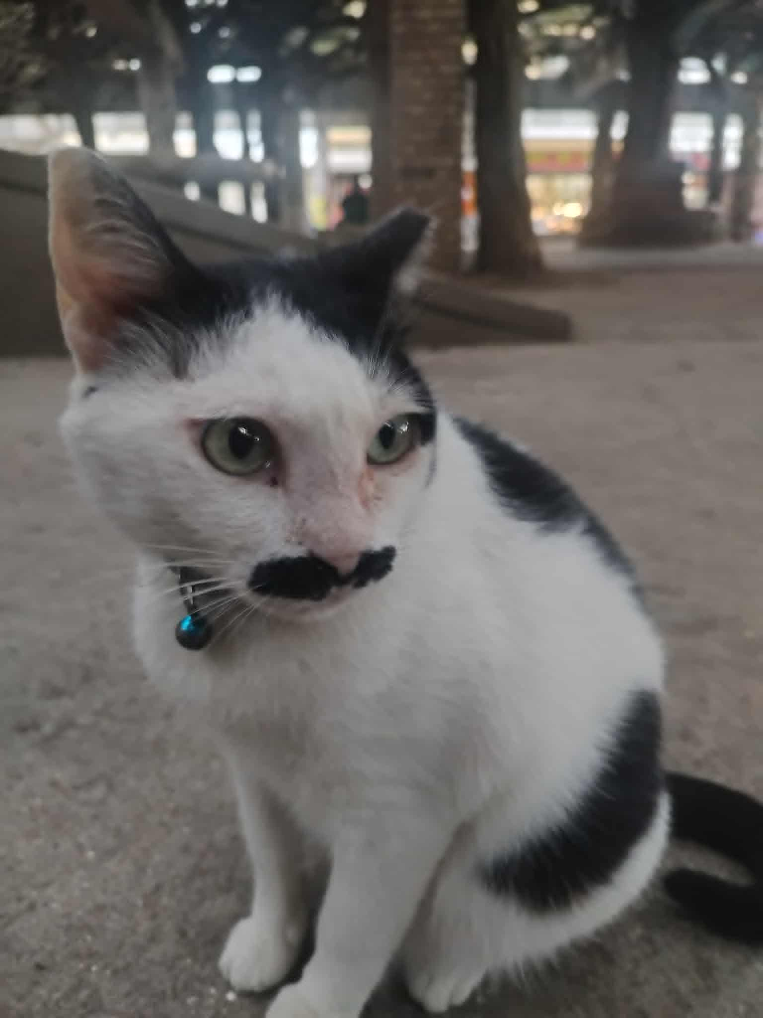
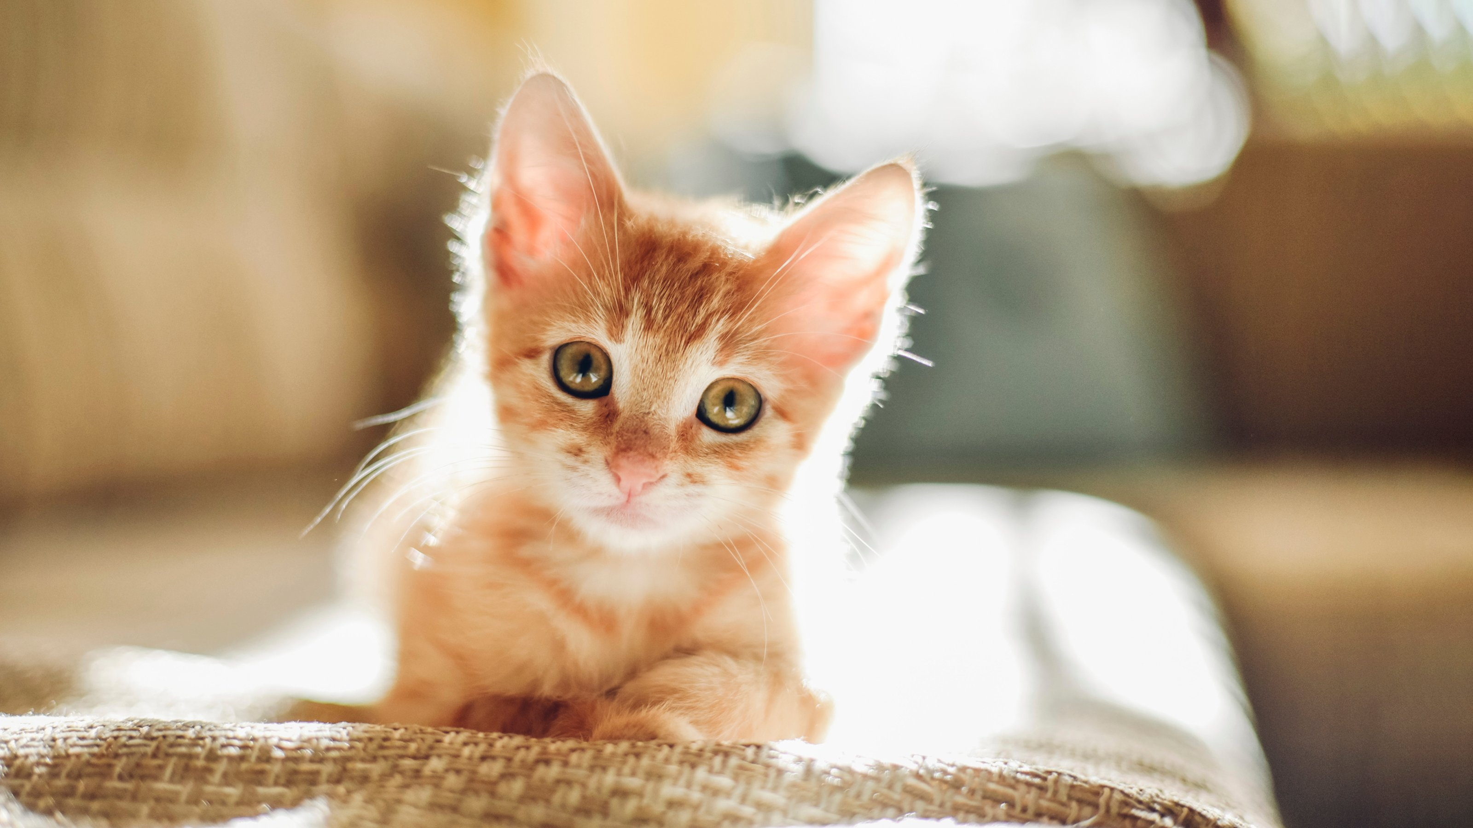
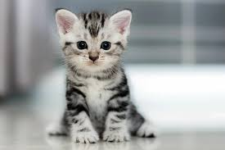
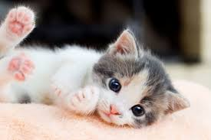
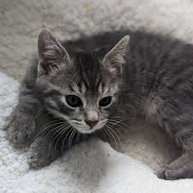
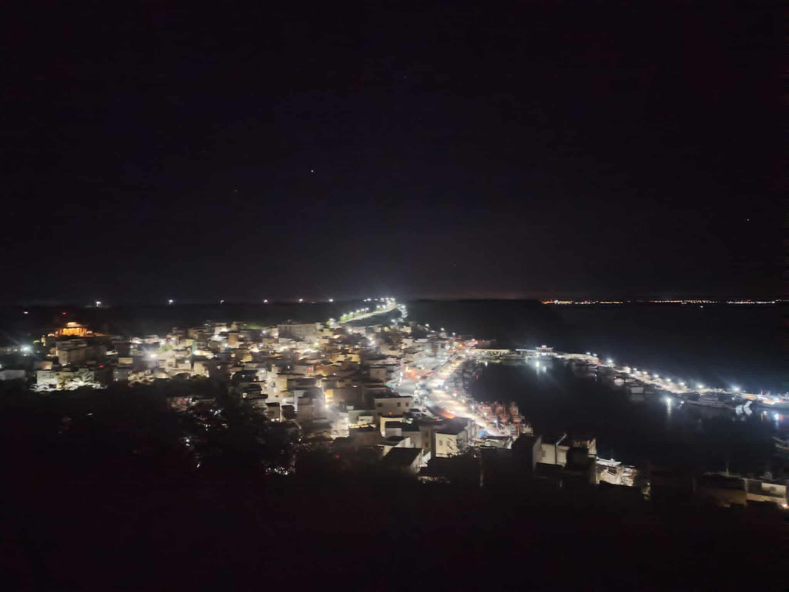
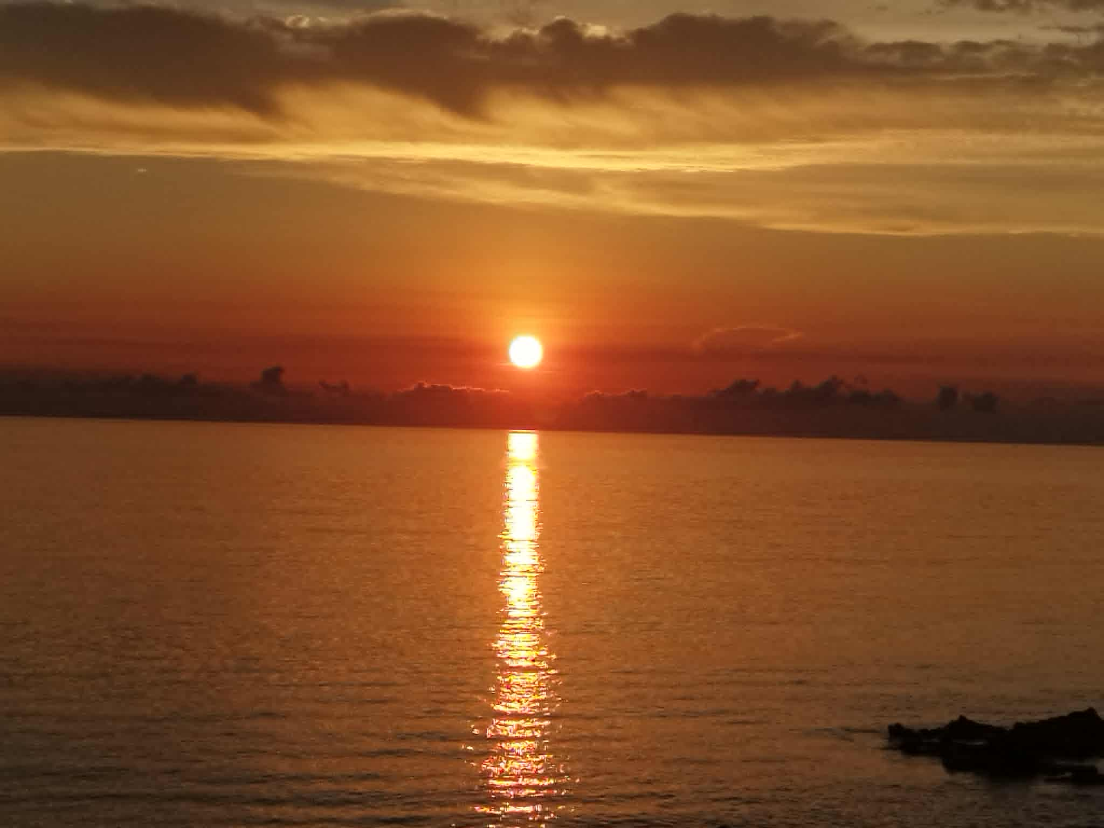
Can you adjust to life in Penghu?
I want say Yes. I can!
I saw a cat that looked like Hitler at Tongliang Baoan Palace.
F4 dormitory party
I went to Xiyu with a group of ↑ people at midnight
Finally, I watched the sunrise with them →
(My roommate doesn't want to show his face.)
(the most left one is my classmate)

Slide 6

FINISH~
Thank you for listening
Date 2025/09/27

