Slide 1
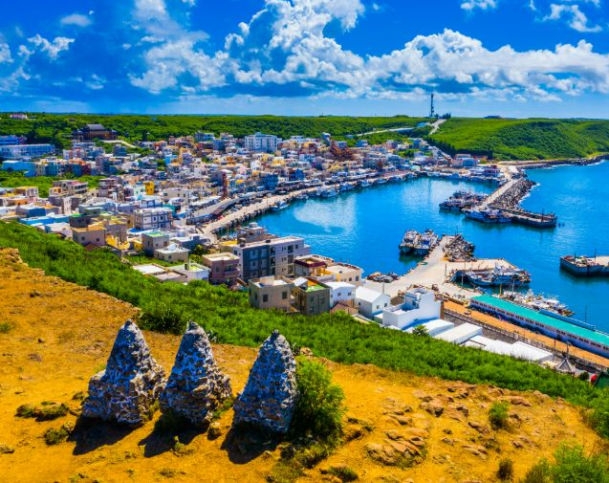
Penghu Independence! Long Live the Republic of Penghu!
資工一甲-1114405041-賴俋勳

Slide 2
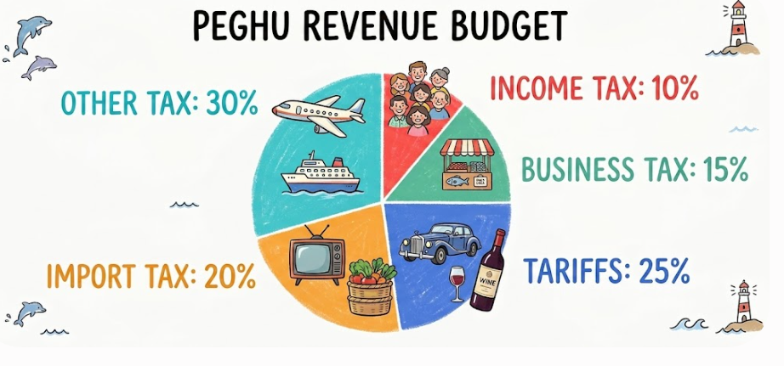
財政收入 (Revenue)
所得稅 (Income tax):10%
營業稅 (Business tax)：15%
進口稅 (Import tax)：20%
關稅 (Tariffs)： 25%
其它 (tourist tax, airport tax):30%
→Next page I will tell you why!
Gemini AI 生成圖片

Slide 3
財政收入 (Revenue)
所得稅 (Income tax):10%
Why:
Initially, income tax will be collected at a lower rate in the hope of retaining and attracting talent to Penghu.
營業稅 (Business tax)：15%
Why:
Low business tax helps local people start their own business. It will make Penghu's economy active

Slide 4
財政收入 (Revenue)
進口稅 (Import tax)：20%
Why:
Penghu is heavily reliant on imported food. High import taxes can protect local farmers and fishermen and encourage them to support domestically produced food.
關稅 (Tariffs)： 25%
Why:
Penghu does not make luxury goods. If rich people want to buy them from other countries, they must pay higher taxes to help our country grow.

Slide 5
財政收入 (Revenue)
Other Tax
Tourist Tax
We have too many tourists in Penghu. They must pay this tax to help us clean and protect our environment.
And other tax like water resource tax
Penghu's freshwater resources are very precious, and restaurants that consume large amounts of water must pay more taxes.

Slide 6
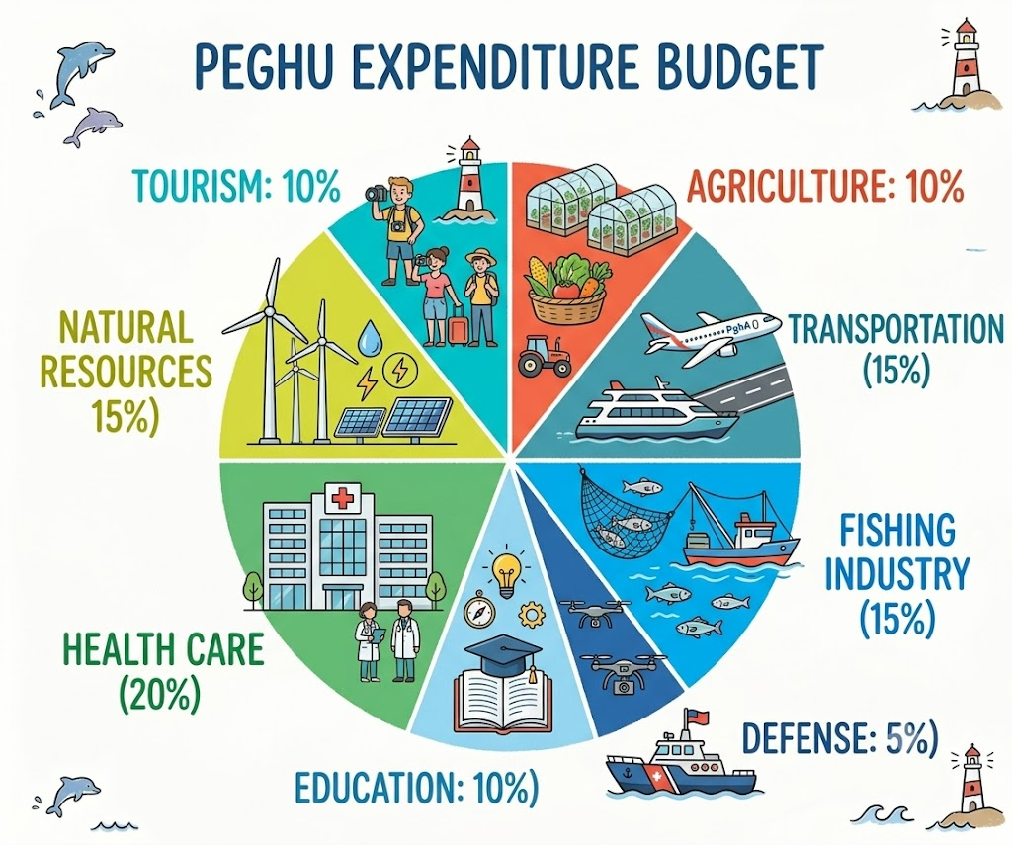
政府支出 (Expenditures)
農業 (Agriculture)10%
交通 (Transportation)15%
漁業 (Fishing Industry)15%
國防 (Defense)5%
教育(Education)10%
醫療 (Health Care)20%
自然資源 (Natural Resources)15%
觀光業 (Tourism)10%
Next page I will tell u why!
Gemini AI 生成圖片

Slide 7
政府支出 (Expenditures)
農業 (Agriculture)10%
How to use:
Modern greenhouses and money for young farmers.
Why: Penghu has poor soil and strong winds. Greenhouses can protect vegetables so we do not need to import all of our food.

Slide 8
政府支出 (Expenditures)
交通 (Transportation)15%
How to use:
Buying new ferries and starting our own "Penghu Airlines".
Why: We need our own airplanes and boats. This makes travel between islands and other countries much easier.

Slide 9
政府支出 (Expenditures)
漁業 (Fishing Industry)15%
How to use:
High-tech fish farming and sea protection.
Why:
There are fewer wild fish now because of overfishing. Fish farming can give us a lot of seafood to sell and protect the ocean.

Slide 10
政府支出 (Expenditures)
國防 (Defense) 5%
How to use:
Coast guard boats and drones to watch our sea.
Why:
For a new country, growing our economy is the top priority. We only need a small defense budget now. When we get richer, we can spend more to protect ourselves.

Slide 11
政府支出 (Expenditures)
教育(Education)10%
How to use:
Upgrading our local university (NPU) into an international school.
Why: We want to keep our young talent in Penghu and attract students from other countries to help develop our economy.

Slide 12
政府支出 (Expenditures)
醫療 (Health Care)20%
How to use:
Building a large modern hospital and hiring expert doctors from Taiwan.
Why:
To save seriously ill patients in Penghu, so they don't need to take emergency helicopters to Taiwan and miss the best time for treatment.

Slide 13
政府支出 (Expenditures)
自然資源 (Natural Resources)15%
How to use:
Building more desalination plants and wind farms.
Why: Penghu lacks fresh water but has plenty of wind. We need this money for drinking water and clean energy.

Slide 14
政府支出 (Expenditures)
觀光業 (Tourism)10%
How to use:
We will keep the Fireworks Festival and start a new Music Festival. By making a unique culture, we can attract tourists from all over the world.
Why: Tourism is our main economy. We must keep our old festivals and create new local culture to attract tourists. This will make them spend money and bring wealth into Penghu

Slide 15
The End. Tanks for your listening

