Slide 1
Diabetes Health Indicator
Ying Hong (yh3538)
Rohan Sheelvant (rns2167)
Ardrian Wong (aaw2179)
Liwen Zhu (lz2512)

Slide 2
About the Dataset
The Behavioral Risk Factor Surveillance System (BRFSS) is a health-related telephone survey collected annually by the CDC. The dataset comprises 253,680 survey responses to the CDC's BRFSS2015. The target variable ‘Diabetes’ has 2 classes. 0 is for non-diabetic and 1 is for prediabetic or diabetic. There is a class imbalance in this dataset. This dataset has 21 independent feature variables, including HighBP, HighChol, Smoker, BMI, Stroke, PhysActivity, HvyAlcoholConsump, Sex, Age, Income, etc.

Slide 3
Complex Features in the Dataset
GenHlth: Ordinal feature with values 1-5. The lower the number the better the health.
Education: Ordinal feature with values 1-6. The higher the value, the higher the level of education attained.
Income: Ordinal feature with values 1-8. The higher the value, the higher the level of income.
HvyAlcoholConsump: (adult men >=14 drinks per week and adult women>=7 drinks per week) 0 = no 1 = yes
Smoker: Binary feature, 1 if someone has smoked at least 100 cigarettes in their lifetime else 0
Age: Ordinal feature with 13 levels, 1 = 18-24, …, 9 = 60-64, …, 13=80 or older
MentlHlth: Numerical feature, with values 1-30 representing the number of days of poor mental health in the past 30 days.
PhysHlth: Numerical feature, with values 1-30 representing the number of days of physical illness or injury in the past 30 days.
For more information about the dataset’s features, visit this kaggle link.

Slide 4
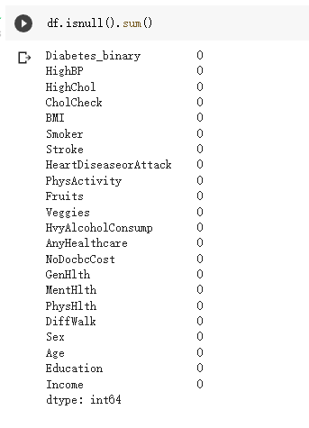
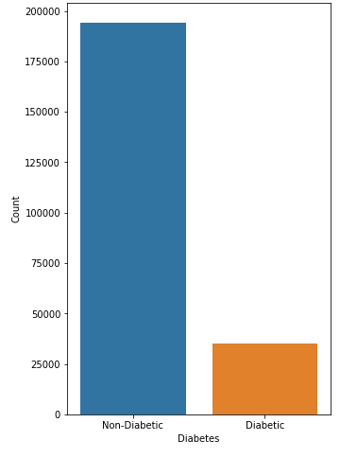

Data Exploration & Cleaning
Imbalanced data:
There are more non-diabetic samples than diabetic samples in the dataset. Thus, we need to change the data before finding the models. We will apply the Synthetic Minority Oversampling Technique (SMOTE) to learn from the minority samples.
Cleaning:
There are no missing values in the dataset. There are 24206 duplicate rows which will be removed.

Slide 5
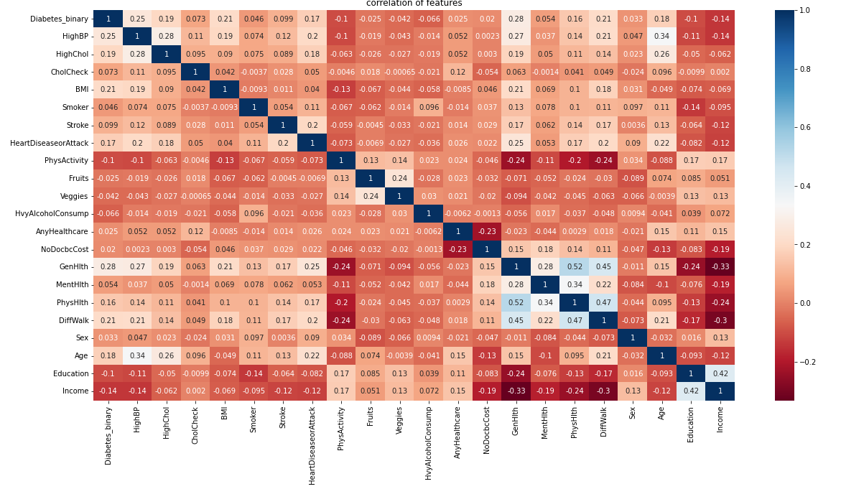
Correlation
There are several pairs of variables which are highly correlated to each others:
GenHlth & PhysHlth
GenHlth & Diffwalk
PhysHlth & Diffwalk

Slide 6
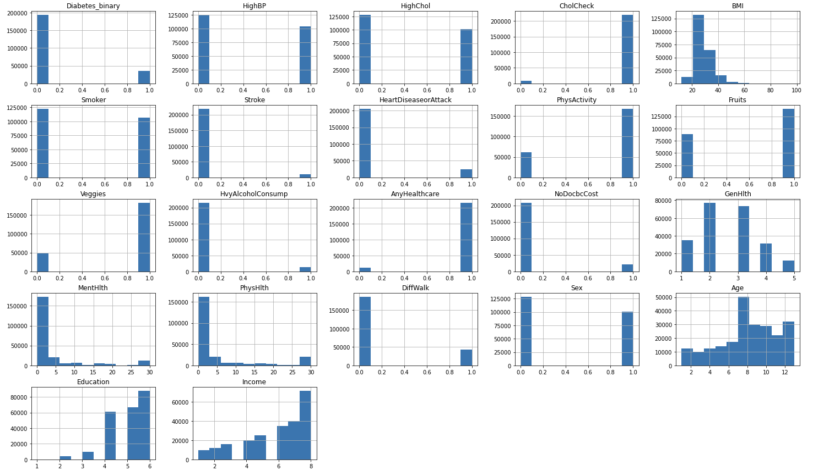
Distribution of features

Slide 7
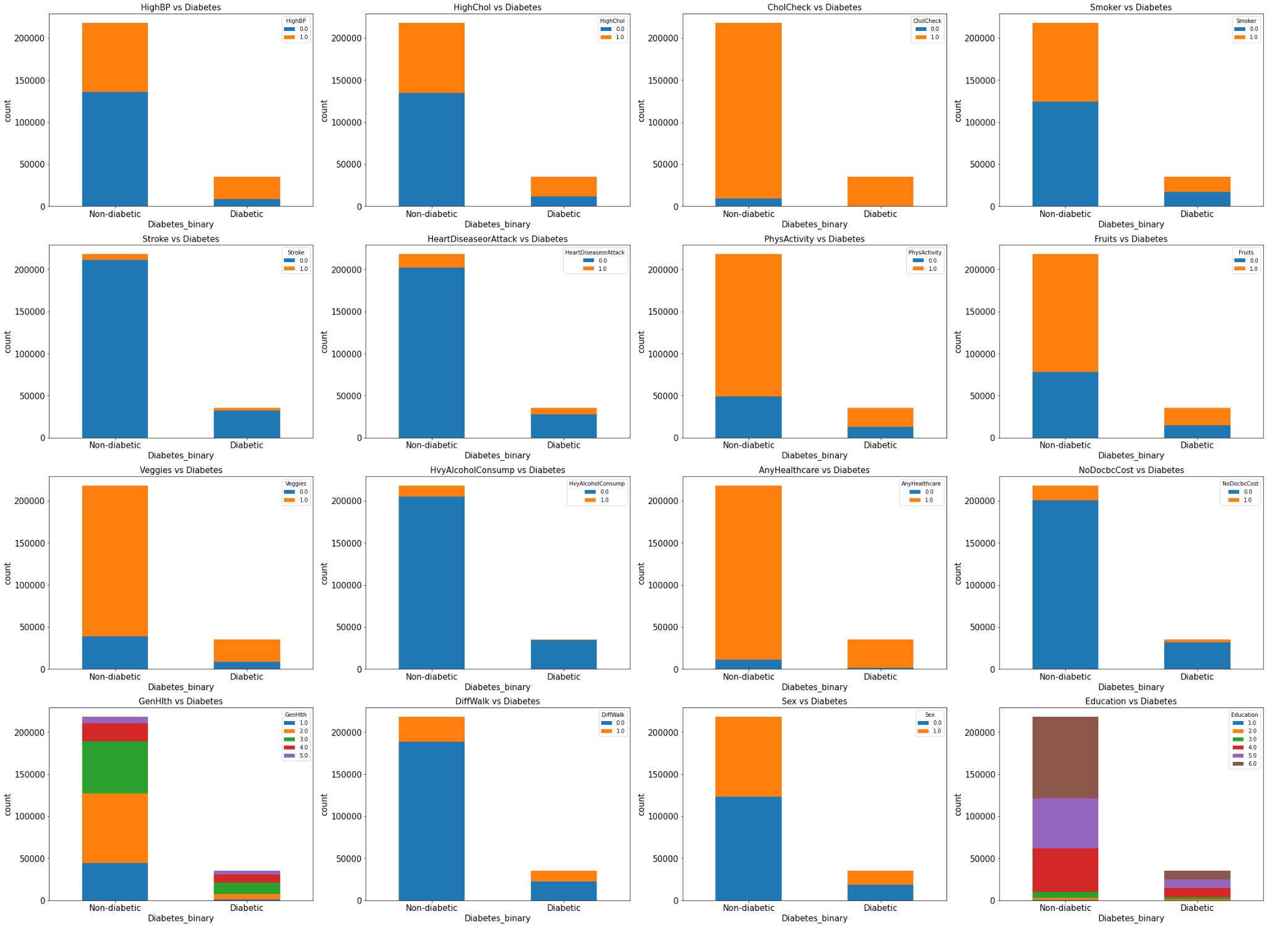
Feature Categories vs Diabetes
https://www.kaggle.com/datasets/alexteboul/diabetes-health-indicators-dataset

Slide 8
Insights from dataset
BMI is the only numerical feature in the dataset
MentHlth, PhysHlth, and DiffWalk have similar distributions, skew to the right, which strengthens that they are correlated to each other
Age, Education, and Income are skew to the right
Most of the binary features are imbalance except HighBP, HighChol, and Smoker
High blood pressure and high cholesterol are common among people with diabetes
Having a stroke Stroke or Heavy Alcohol Consumption don’t seem to be indicators of diabetes
Diabetes slightly more common in women
Smoking does not seem to be an indicator of having diabetes or not
Many people who have diabetes don’t have coronary heart disease

Slide 9
Evaluation
Since the dataset is imbalanced, we will use precision, recall, and F1 scores to evaluate the performance of our models. Recall score is the evaluation metric we will pay most attention to, since the cost of a False Negative is much higher than that of a False Positive. The F1 score is also an important metric because it tells us how well our model is able to learn both classes.

Slide 10
Machine Learning Techniques & Metrics
Models:
Logistics Regression
Support Vector Machine
Decision Tree Classifier
Random Forest
Neural Network
Metrics:
Precision, Recall, F1 score

Slide 11
Thanks for listening

