Slide 1
iGEM CLAREMONT-CA · 2026
Phagenomics
What decides which bacteria a phage can kill —
and what happened the four times we asked.
Bacteriophage Φ8 · Pseudomonas · California Botanic Garden soil
Notes:
We're iGEM Claremont-CA, a first-year team in California, and this is Phagenomics.
We work on one question: what decides which bacteria a phage can kill?

Slide 2
THE GAP WE WORK IN
Phage therapy's bottleneck is host range — and nobody can design it
Pseudomonas causes serious infections in immunocompromised patients and persistent crop disease in agriculture, and phage therapy is one of the alternatives people are betting on.
Each phage binds a specific receptor on a specific strain, and nobody can design that specificity yet, because we don't understand how a phage recognises its target in the first place.
So we didn't try to build a therapeutic. We tried to understand the recognition step any therapeutic would depend on.
2
Notes:
Pseudomonas causes serious infections in immunocompromised patients and persistent crop disease in agriculture, and phage therapy is one of the alternatives to antibiotics people are betting on. Its bottleneck is host range. Each phage binds a specific receptor on a specific strain, and nobody can design that specificity yet, because we don't understand how a phage recognises its target in the first place.
So we didn't try to build a therapeutic. We tried to understand the recognition step that any therapeutic would depend on. We went at it four times this season. Three of those four failed, and the failures are the useful part.

Slide 3
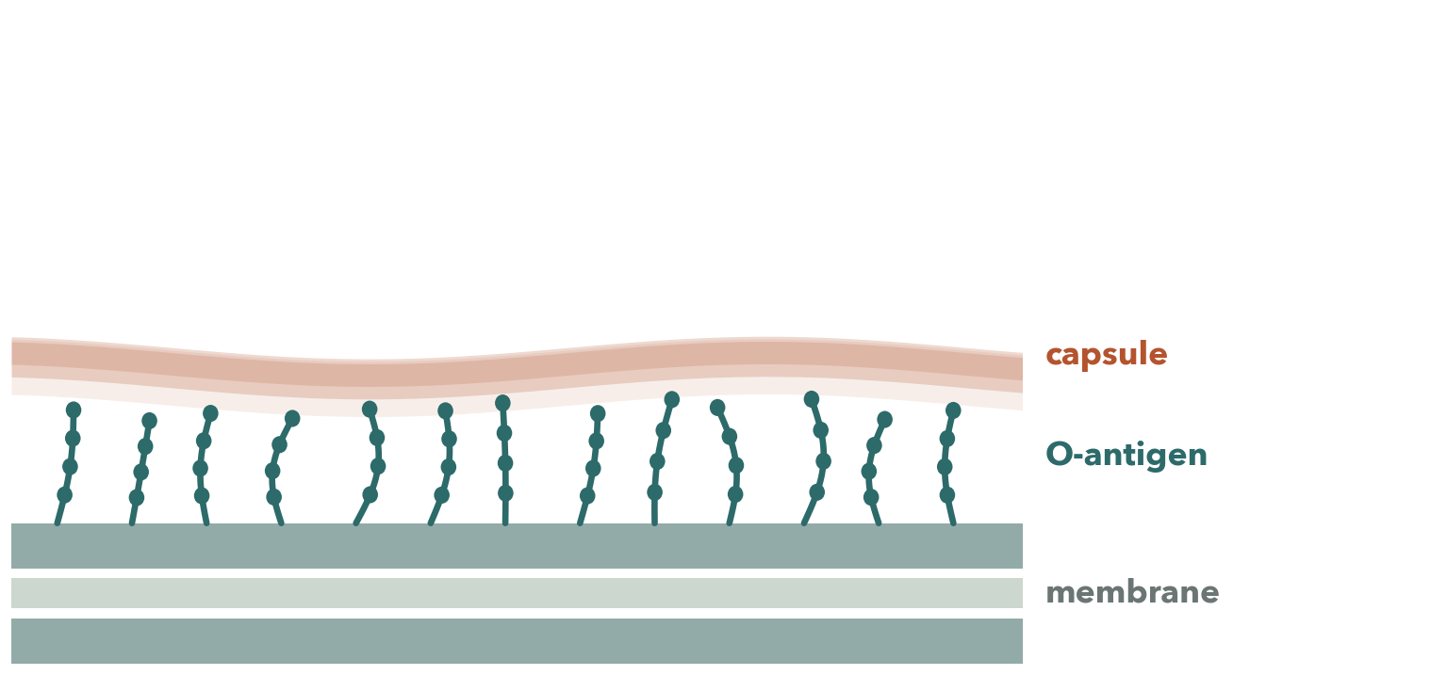
HOW A PHAGE GETS IN
3
Notes:
It gets decided at the very first step, before any DNA moves: the phage has to recognise the outside of the cell and stick to it.
And many bacteria don't present a bare protein surface. They wrap themselves in sugar — long chains called the O-antigen, and above those, in some species, a capsule. So the first thing a phage touches is a forest of sugar.
The tail spike is a depolymerase. It digests the sugar in front of it, opens a channel, reaches the membrane and injects.

Slide 4
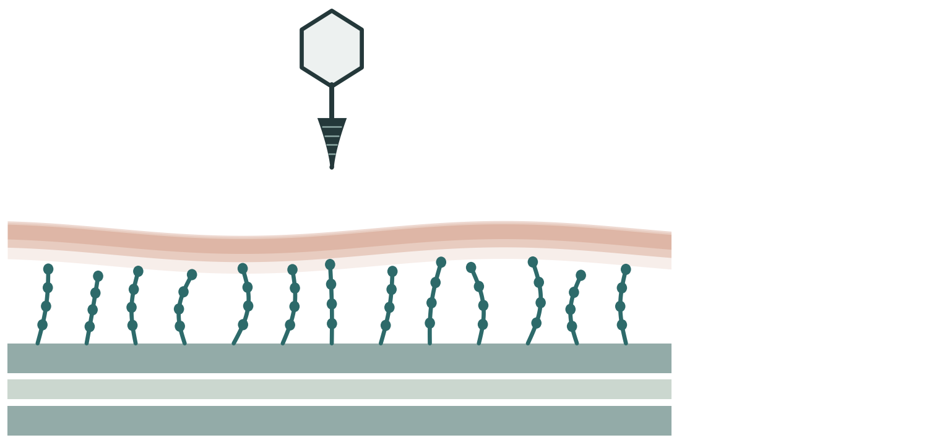
HOW A PHAGE GETS IN
4
Notes:
It gets decided at the very first step, before any DNA moves: the phage has to recognise the outside of the cell and stick to it.
And many bacteria don't present a bare protein surface. They wrap themselves in sugar — long chains called the O-antigen, and above those, in some species, a capsule. So the first thing a phage touches is a forest of sugar.
The tail spike is a depolymerase. It digests the sugar in front of it, opens a channel, reaches the membrane and injects.

Slide 5
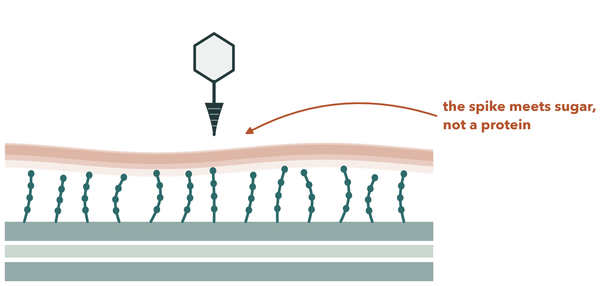
HOW A PHAGE GETS IN
5
Notes:
It gets decided at the very first step, before any DNA moves: the phage has to recognise the outside of the cell and stick to it.
And many bacteria don't present a bare protein surface. They wrap themselves in sugar — long chains called the O-antigen, and above those, in some species, a capsule. So the first thing a phage touches is a forest of sugar.
The tail spike is a depolymerase. It digests the sugar in front of it, opens a channel, reaches the membrane and injects.

Slide 6
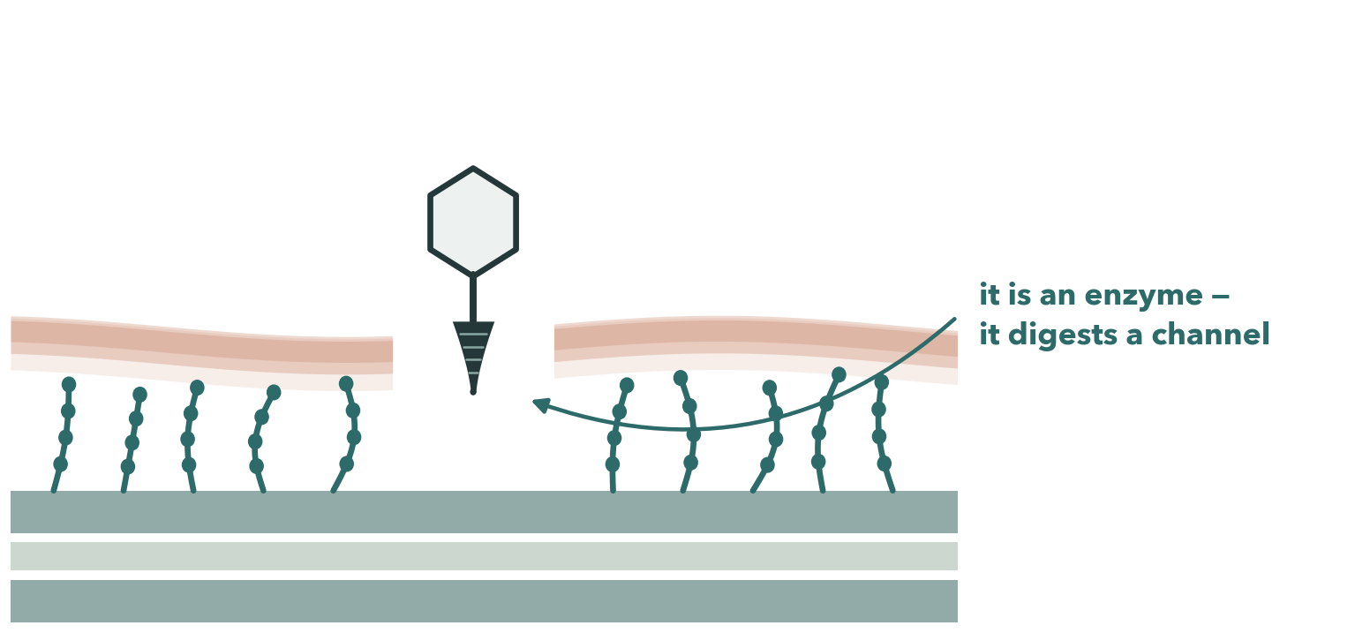
HOW A PHAGE GETS IN
6
Notes:
It gets decided at the very first step, before any DNA moves: the phage has to recognise the outside of the cell and stick to it.
And many bacteria don't present a bare protein surface. They wrap themselves in sugar — long chains called the O-antigen, and above those, in some species, a capsule. So the first thing a phage touches is a forest of sugar.
The tail spike is a depolymerase. It digests the sugar in front of it, opens a channel, reaches the membrane and injects.

Slide 7
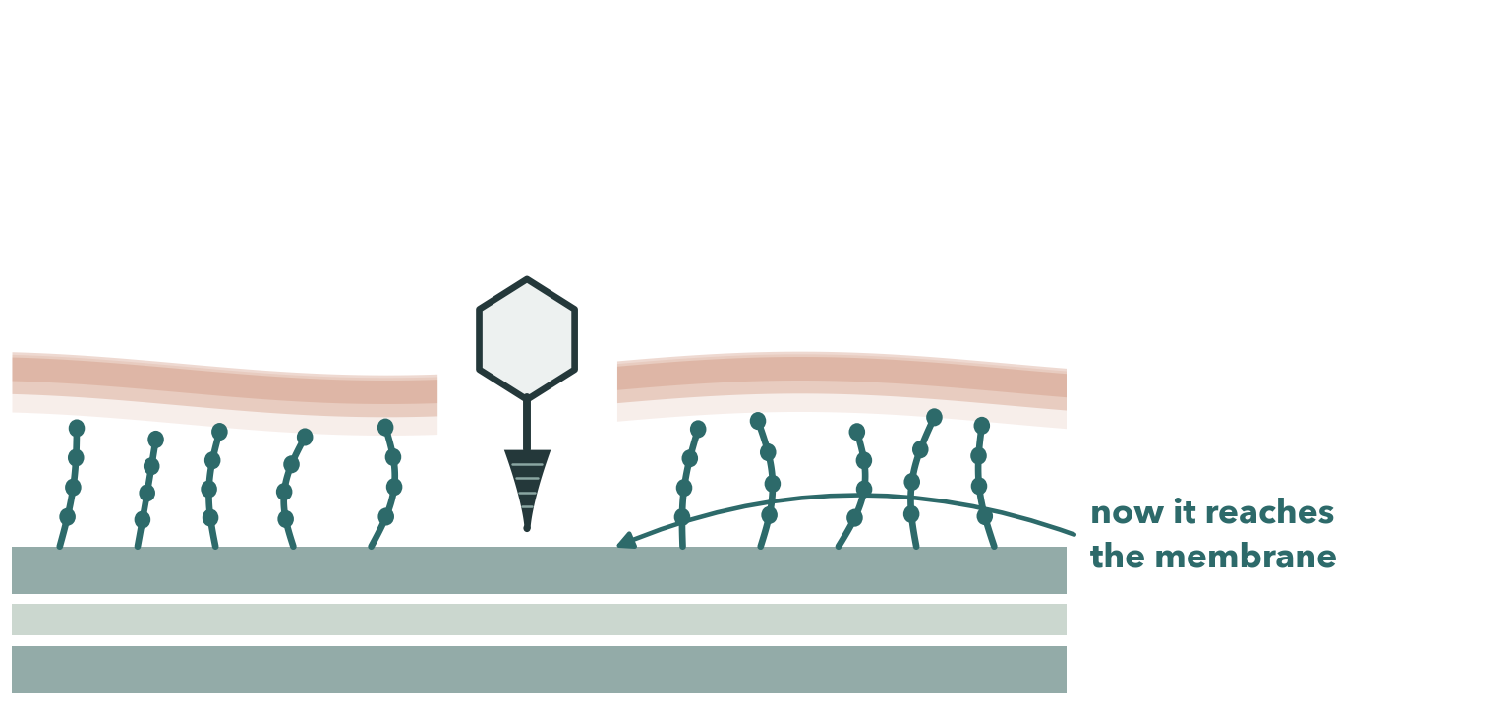
HOW A PHAGE GETS IN
7
Notes:
It gets decided at the very first step, before any DNA moves: the phage has to recognise the outside of the cell and stick to it.
And many bacteria don't present a bare protein surface. They wrap themselves in sugar — long chains called the O-antigen, and above those, in some species, a capsule. So the first thing a phage touches is a forest of sugar.
The tail spike is a depolymerase. It digests the sugar in front of it, opens a channel, reaches the membrane and injects.

Slide 8
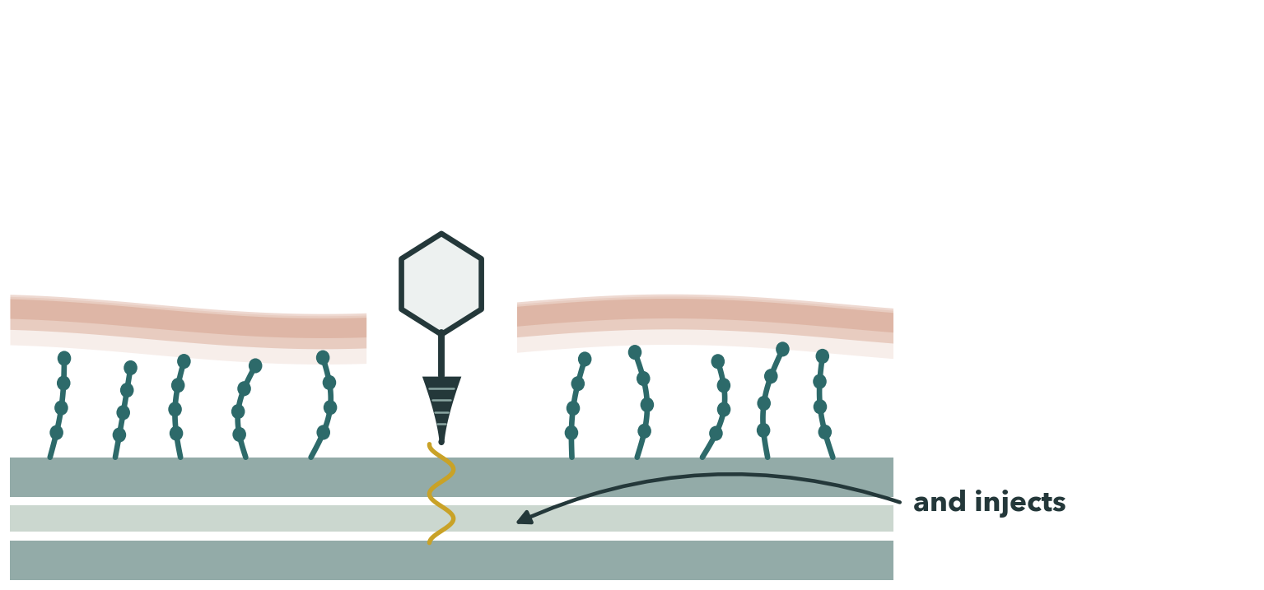
HOW A PHAGE GETS IN
8
Notes:
It gets decided at the very first step, before any DNA moves: the phage has to recognise the outside of the cell and stick to it.
And many bacteria don't present a bare protein surface. They wrap themselves in sugar — long chains called the O-antigen, and above those, in some species, a capsule. So the first thing a phage touches is a forest of sugar.
The tail spike is a depolymerase. It digests the sugar in front of it, opens a channel, reaches the membrane and injects.

Slide 9
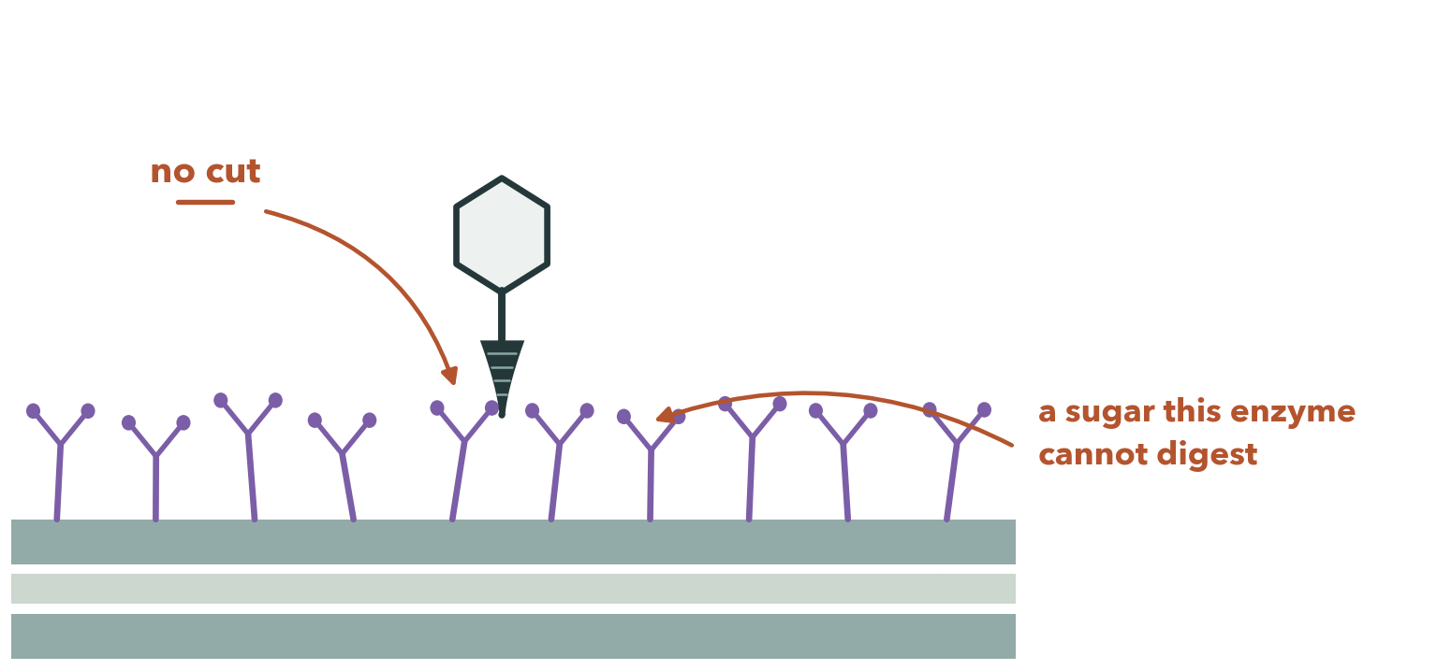
A DIFFERENT STRAIN
9
Notes:
Change the sugar, and the same phage never gets through. That is host range, and it is decided before infection even begins.

Slide 10
SO
Host range is decided at the sugar,
before infection begins.
Everything after the channel is ordinary infection. Everything before it is the question we worked on.
10
Notes:
Everything after this point is ordinary infection. Everything before it is host range.

Slide 11
WHERE THE PROJECT CAME FROM
An idea we dropped, and the abstraction we kept
Early on we talked to Professor Ran Libeskind-Hadas at Claremont McKenna, one of our advisors. He suggested we reconstruct an ancestral phage — a whole organism, inferred from its relatives.
We couldn't build one. But scale that down to a single enzyme and you can order it from a synthesis company.
That is what this project became.
11
Notes:
One thing belongs at the start, because it's why half of this project exists.
Early on we talked to Professor Ran Libeskind-Hadas at Claremont McKenna, one of our advisors. He suggested we reconstruct an ancestral phage — a whole organism, inferred from its relatives. We couldn't build one. But we realised that if we scaled the idea down from an organism to a single enzyme, we could order it from a synthesis company. That is what this project became.

Slide 12
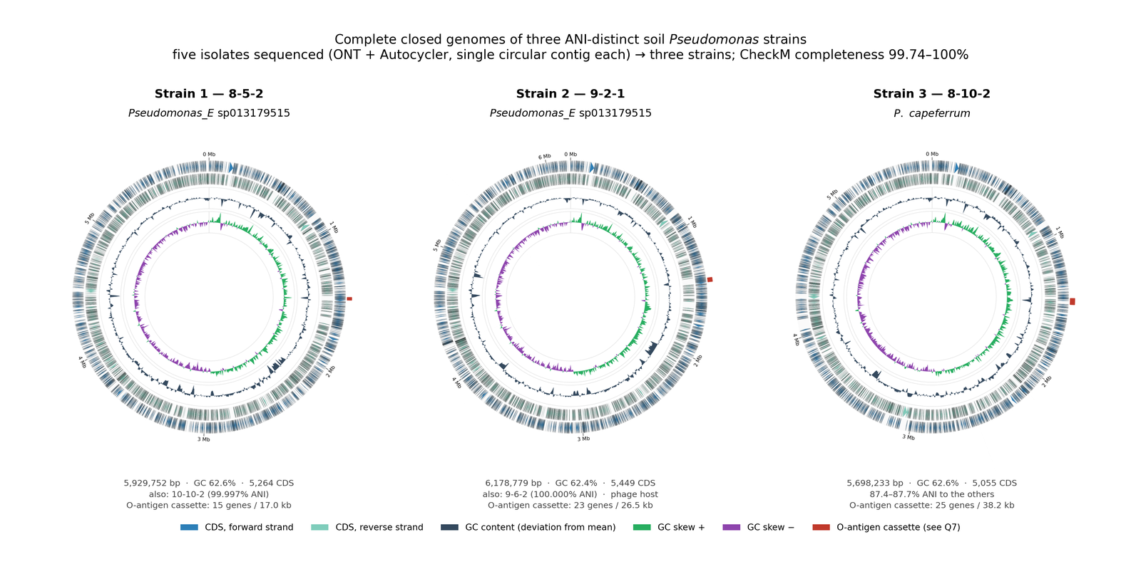
CALIFORNIA BOTANIC GARDEN · 19 MAY 2026
Five isolates, three strains, two built-in controls
Strain 1
8-5-2 · 10-10-2
99.997 % ANI
Strain 2
9-2-1 · 9-6-2
100.000 % ANI — the Φ8 host
Strain 3
8-10-2
a different species
Any difference we report between strains has to be bigger than the difference we can measure within one.
Genomes published in Microbiology Resource Announcements · doi 10.1128/mra.00793-26
12
Notes:
We collected soil from the California Botanic Garden on the nineteenth of May. From it we isolated five Pseudomonas strains, and we sequenced all five genomes — every one of them closed into a complete circle.
Those five collapse into three distinct strains. That leaves us with two pairs of near-identical isolates, and we use those pairs as an internal control all the way through.

Slide 13
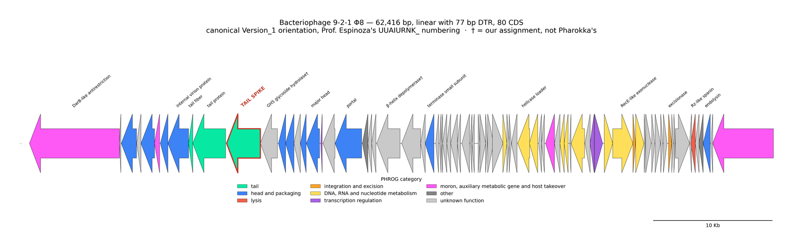
THE PHAGE
One phage, Φ8, that infects exactly one of the three
62,339 bp · circular · 80 coding sequences · no match in the phage database · effectively no genes in common with T7
13
Notes:
We also isolated a phage, which we call Phi-8, and it infects exactly one of the three strains. Sixty-two thousand, three hundred and thirty-nine base pairs, circular, eighty genes. No match anywhere in the phage database, and essentially no genes in common with T7. The architecture is familiar. The sequence isn't.

Slide 14
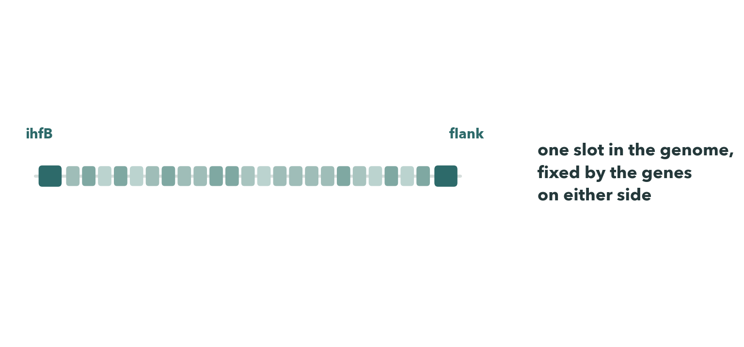
THE FIRST CLUE
14
Notes:
Then we went looking at the locus that builds the sugar coat. We anchored on the gene that flanks it in Pseudomonas, pulled the cassette out of all three strains, and clustered every protein in it.
We found the cassette sitting in the same slot in all three. The contents are unrelated: twenty-three genes in one strain, fifteen in another, twenty-five in the third, and of forty-five gene clusters only four are shared by every strain — all four generic sugar chemistry.

Slide 15
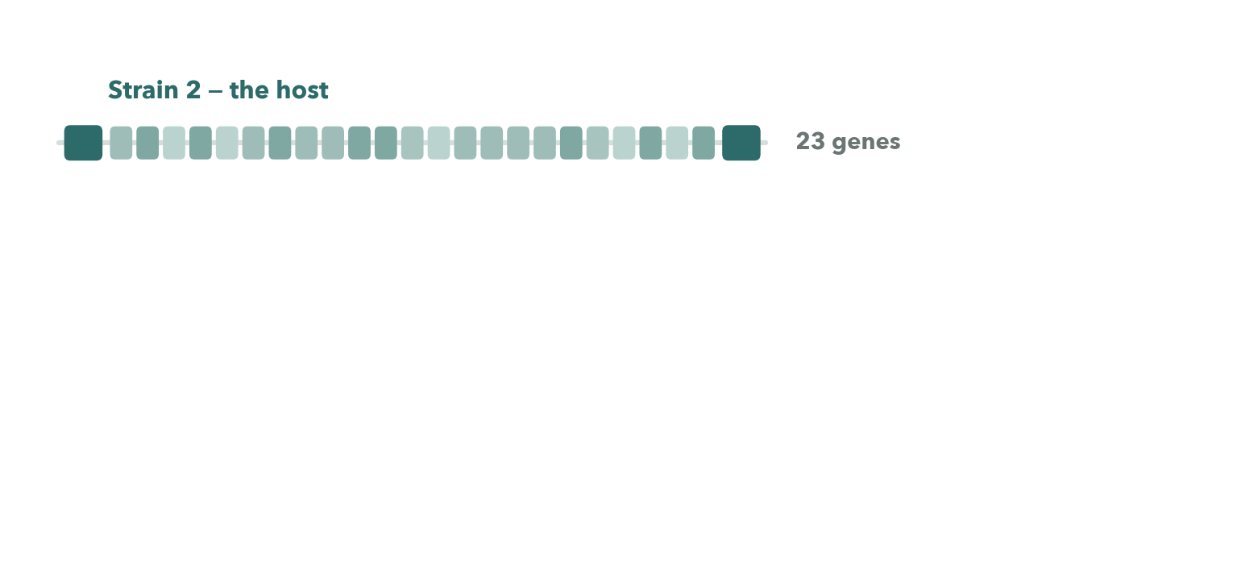
THE FIRST CLUE
15
Notes:
Then we went looking at the locus that builds the sugar coat. We anchored on the gene that flanks it in Pseudomonas, pulled the cassette out of all three strains, and clustered every protein in it.
We found the cassette sitting in the same slot in all three. The contents are unrelated: twenty-three genes in one strain, fifteen in another, twenty-five in the third, and of forty-five gene clusters only four are shared by every strain — all four generic sugar chemistry.

Slide 16
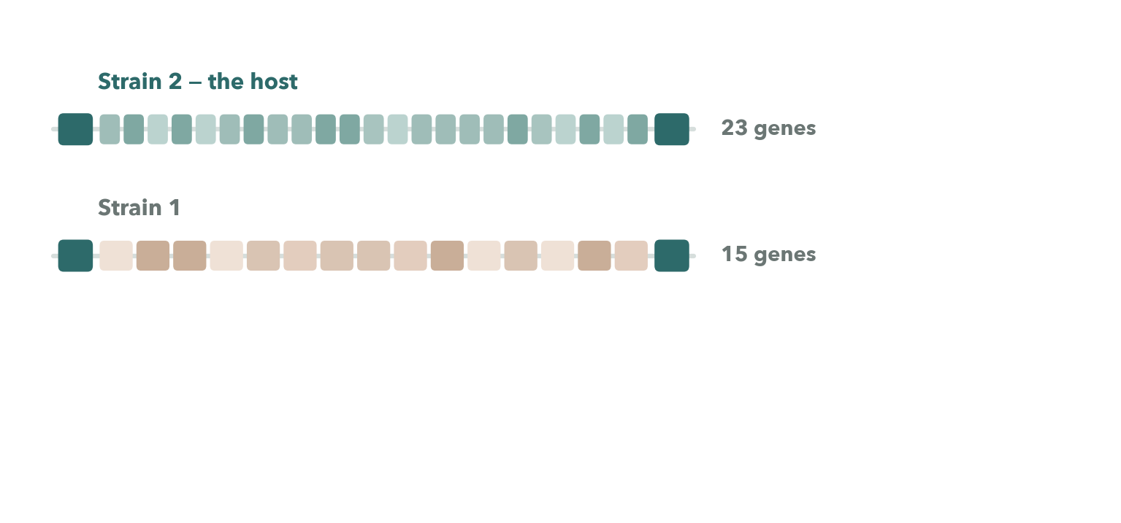
THE FIRST CLUE
16
Notes:
Then we went looking at the locus that builds the sugar coat. We anchored on the gene that flanks it in Pseudomonas, pulled the cassette out of all three strains, and clustered every protein in it.
We found the cassette sitting in the same slot in all three. The contents are unrelated: twenty-three genes in one strain, fifteen in another, twenty-five in the third, and of forty-five gene clusters only four are shared by every strain — all four generic sugar chemistry.

Slide 17
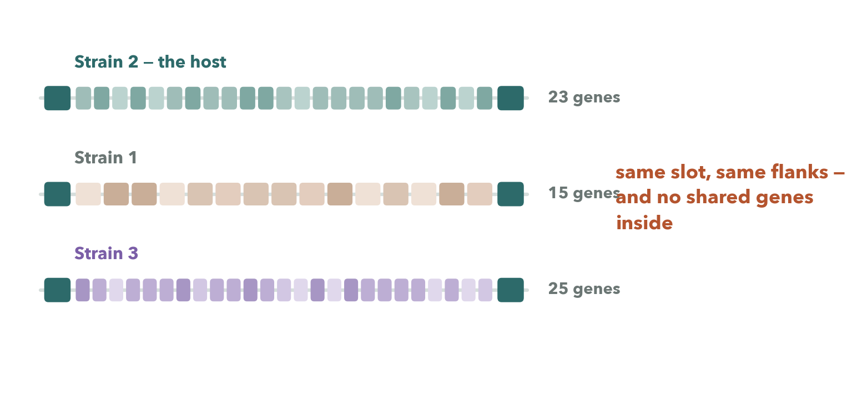
THE FIRST CLUE
17
Notes:
Then we went looking at the locus that builds the sugar coat. We anchored on the gene that flanks it in Pseudomonas, pulled the cassette out of all three strains, and clustered every protein in it.
We found the cassette sitting in the same slot in all three. The contents are unrelated: twenty-three genes in one strain, fifteen in another, twenty-five in the third, and of forty-five gene clusters only four are shared by every strain — all four generic sugar chemistry.

Slide 18
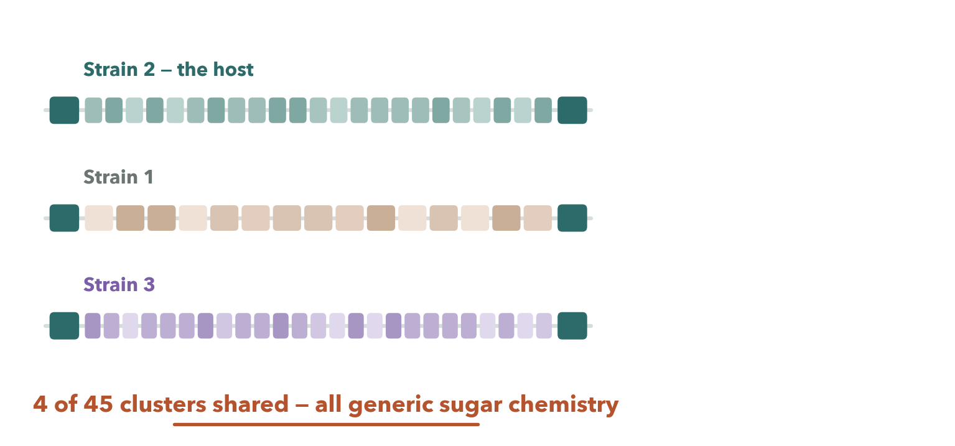
THE FIRST CLUE
18
Notes:
Then we went looking at the locus that builds the sugar coat. We anchored on the gene that flanks it in Pseudomonas, pulled the cassette out of all three strains, and clustered every protein in it.
We found the cassette sitting in the same slot in all three. The contents are unrelated: twenty-three genes in one strain, fifteen in another, twenty-five in the third, and of forty-five gene clusters only four are shared by every strain — all four generic sugar chemistry.

Slide 19
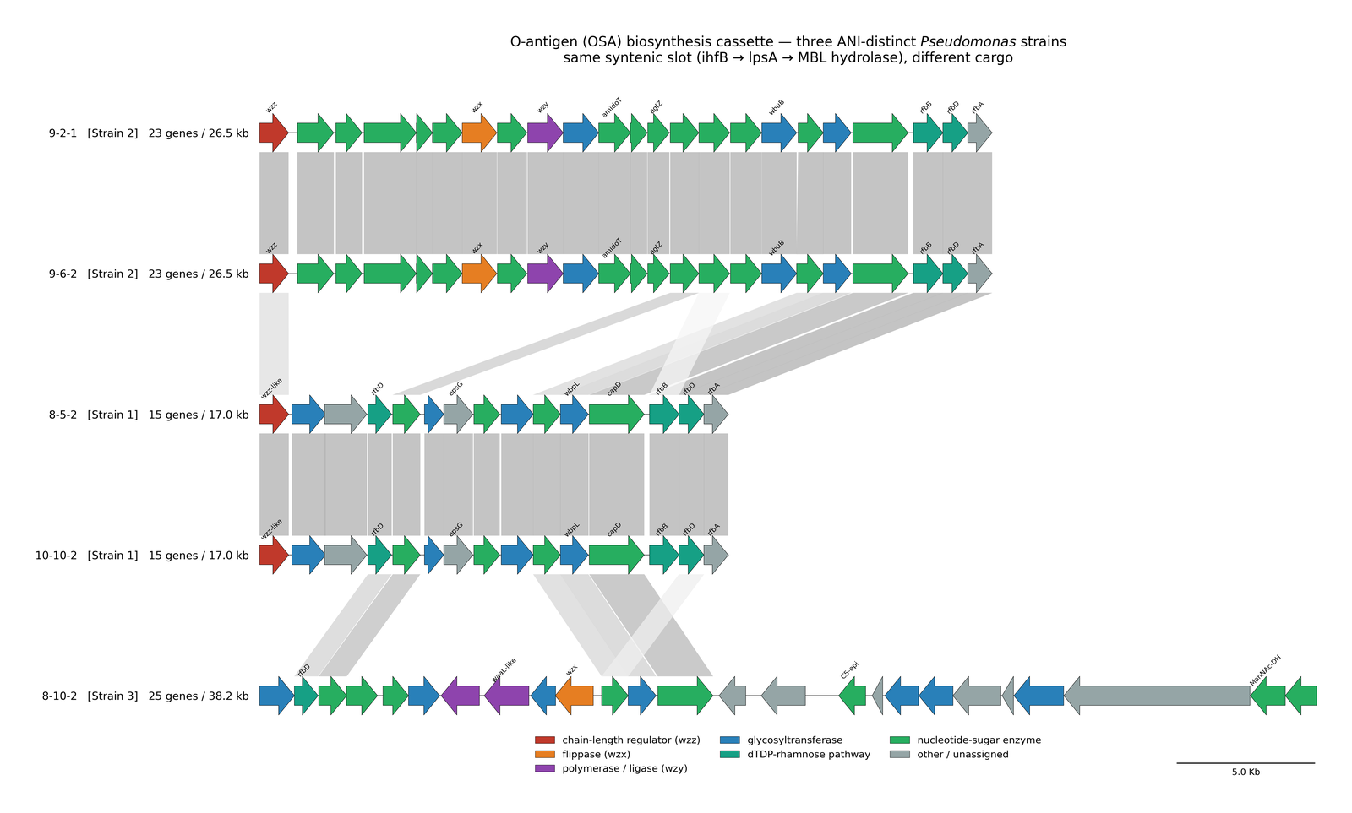
THE FIRST CLUE
The real cassettes, side by side
Located with ihfB as the upstream anchor; cassette proteins clustered with MMseqs2 at ≥ 30 % identity, ≥ 50 % coverage
19
Notes:
The near-identical pairs inside each strain match at a hundred percent across every cassette gene. Within a strain, zero variation. Between strains, almost total.
We also found that no database could have told us any of this. There is no serotype scheme for this group of species at all.

Slide 20
FIRST HYPOTHESIS
Three strains, three different sugar coats,
one phage that kills one of them.
So the sugar coat might be one of the main things setting what Φ8 can attack.
20
Notes:
So: three strains, three different sugar coats, one phage that kills one of them. That gave us our first hypothesis — that the sugar coat might be one of the main things setting what Phi-8 can attack.

Slide 21
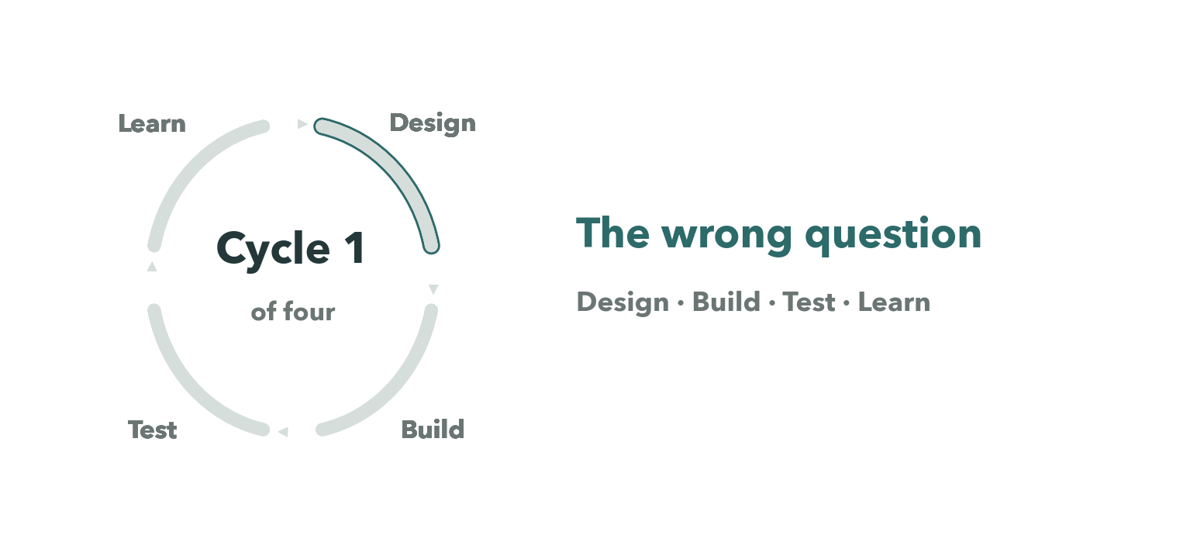
CYCLE 1 OF FOUR
21
Notes:
Cycle one — the wrong question. A full design, build, test and learn loop, retired by its own controls.

Slide 22
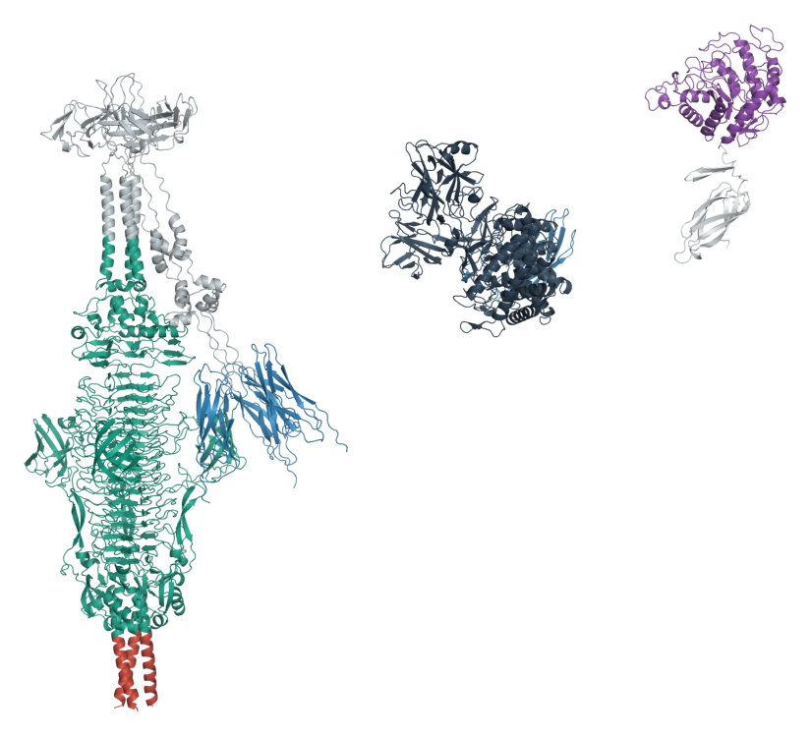
CYCLE 1 · DESIGN
We designed it around the wrong assumption
The textbook picture of attachment is a receptor-binding protein on the phage tail meeting a protein on the bacterial surface. Lock and key.
If you assume that, the obvious move is to work out which binding protein fits which receptor. So that is what we set out to predict.
If we had known the receptor was a sugar, we would never have run this.
22
Notes:
We designed the first cycle around the wrong assumption, and it's worth saying why it was the reasonable one.
The textbook picture of attachment is a receptor-binding protein on the phage tail meeting a protein on the bacterial surface. Lock and key. If you assume that, the obvious move is to work out which binding protein fits which receptor — so that is what we set out to predict.
If we had known the receptor was a sugar, we would never have run this. We thought it was a protein, so we went looking for a protein.

Slide 23
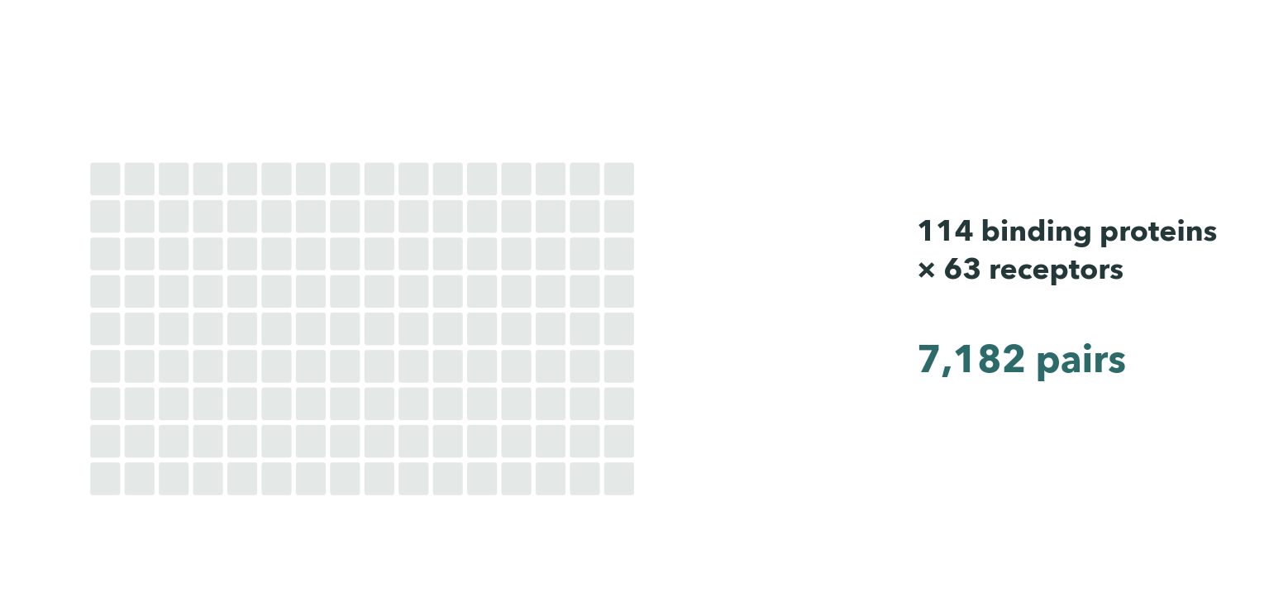
CYCLE 1 · BUILD AND TEST
23
Notes:
What we built was a screen. Four hundred and forty-one candidate receptors across all five isolates, collapsed into a hundred and forty-four clusters, then a hundred and fourteen binding proteins against sixty-three receptors — seven thousand, one hundred and eighty-two pairs, each folded as a complex and ranked by the interface score.
And the ranking looked perfectly reasonable. That's the trouble with this kind of output. It always looks reasonable.
So before we built anything on it, we ran nine control folds. T5's pb-five with FhuA scored zero point one three seven. The same receptor, scrambled, scored zero point one three six. None of our real binders separated from the controls.

Slide 24
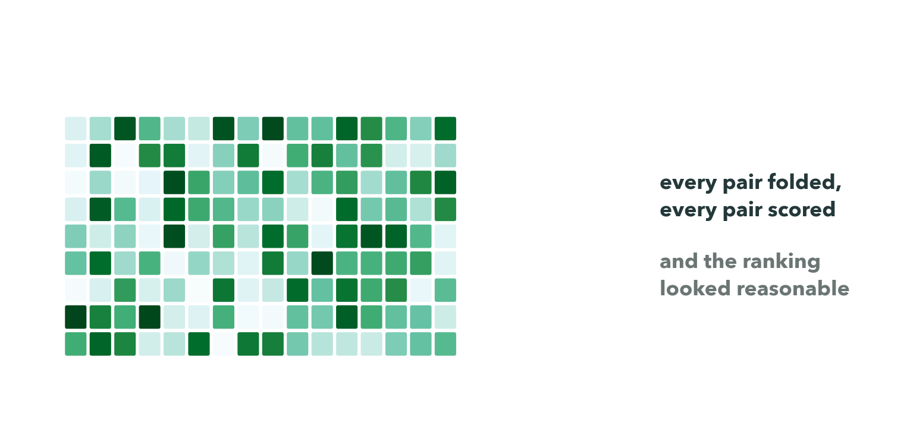
CYCLE 1 · BUILD AND TEST
24
Notes:
What we built was a screen. Four hundred and forty-one candidate receptors across all five isolates, collapsed into a hundred and forty-four clusters, then a hundred and fourteen binding proteins against sixty-three receptors — seven thousand, one hundred and eighty-two pairs, each folded as a complex and ranked by the interface score.
And the ranking looked perfectly reasonable. That's the trouble with this kind of output. It always looks reasonable.
So before we built anything on it, we ran nine control folds. T5's pb-five with FhuA scored zero point one three seven. The same receptor, scrambled, scored zero point one three six. None of our real binders separated from the controls.

Slide 25
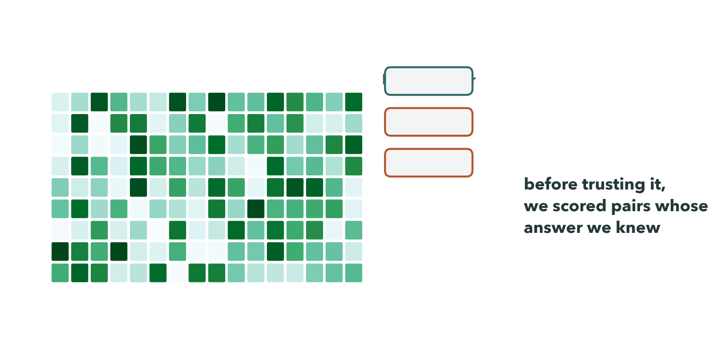
CYCLE 1 · BUILD AND TEST
25
Notes:
What we built was a screen. Four hundred and forty-one candidate receptors across all five isolates, collapsed into a hundred and forty-four clusters, then a hundred and fourteen binding proteins against sixty-three receptors — seven thousand, one hundred and eighty-two pairs, each folded as a complex and ranked by the interface score.
And the ranking looked perfectly reasonable. That's the trouble with this kind of output. It always looks reasonable.
So before we built anything on it, we ran nine control folds. T5's pb-five with FhuA scored zero point one three seven. The same receptor, scrambled, scored zero point one three six. None of our real binders separated from the controls.

Slide 26
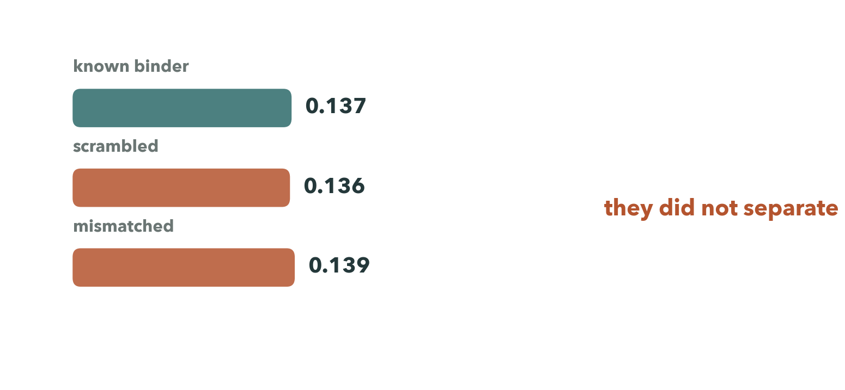
CYCLE 1 · BUILD AND TEST
26
Notes:
What we built was a screen. Four hundred and forty-one candidate receptors across all five isolates, collapsed into a hundred and forty-four clusters, then a hundred and fourteen binding proteins against sixty-three receptors — seven thousand, one hundred and eighty-two pairs, each folded as a complex and ranked by the interface score.
And the ranking looked perfectly reasonable. That's the trouble with this kind of output. It always looks reasonable.
So before we built anything on it, we ran nine control folds. T5's pb-five with FhuA scored zero point one three seven. The same receptor, scrambled, scored zero point one three six. None of our real binders separated from the controls.

Slide 27
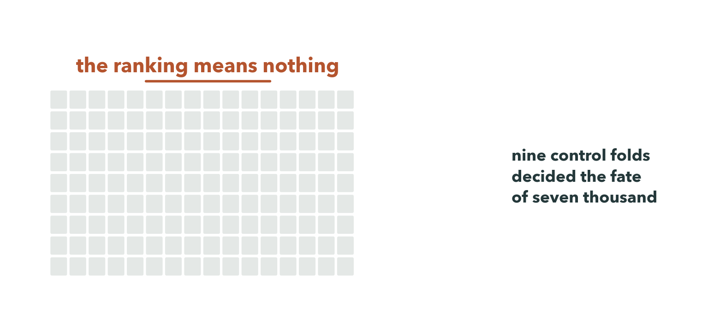
CYCLE 1 · BUILD AND TEST
27
Notes:
What we built was a screen. Four hundred and forty-one candidate receptors across all five isolates, collapsed into a hundred and forty-four clusters, then a hundred and fourteen binding proteins against sixty-three receptors — seven thousand, one hundred and eighty-two pairs, each folded as a complex and ranked by the interface score.
And the ranking looked perfectly reasonable. That's the trouble with this kind of output. It always looks reasonable.
So before we built anything on it, we ran nine control folds. T5's pb-five with FhuA scored zero point one three seven. The same receptor, scrambled, scored zero point one three six. None of our real binders separated from the controls.

Slide 28
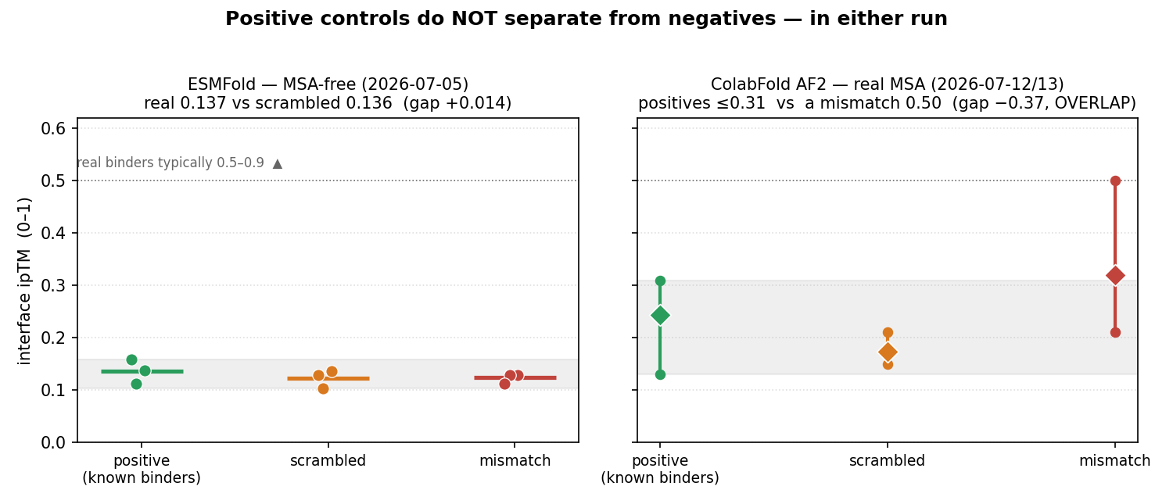
CYCLE 1 · TEST
The controls, in both tools
Under AlphaFold2 with real alignments the mismatched pair outscores every genuine binder. Scores tracked protein length at r = +0.60.
28
Notes:
We also plotted score against protein length, and found a correlation of plus nought point six. The screen was ranking proteins by size.
We assumed the tool was at fault, so we rebuilt the whole thing with real evolutionary alignments. It got worse. Under that one, the mismatched pair outscored the genuine binders.

Slide 29
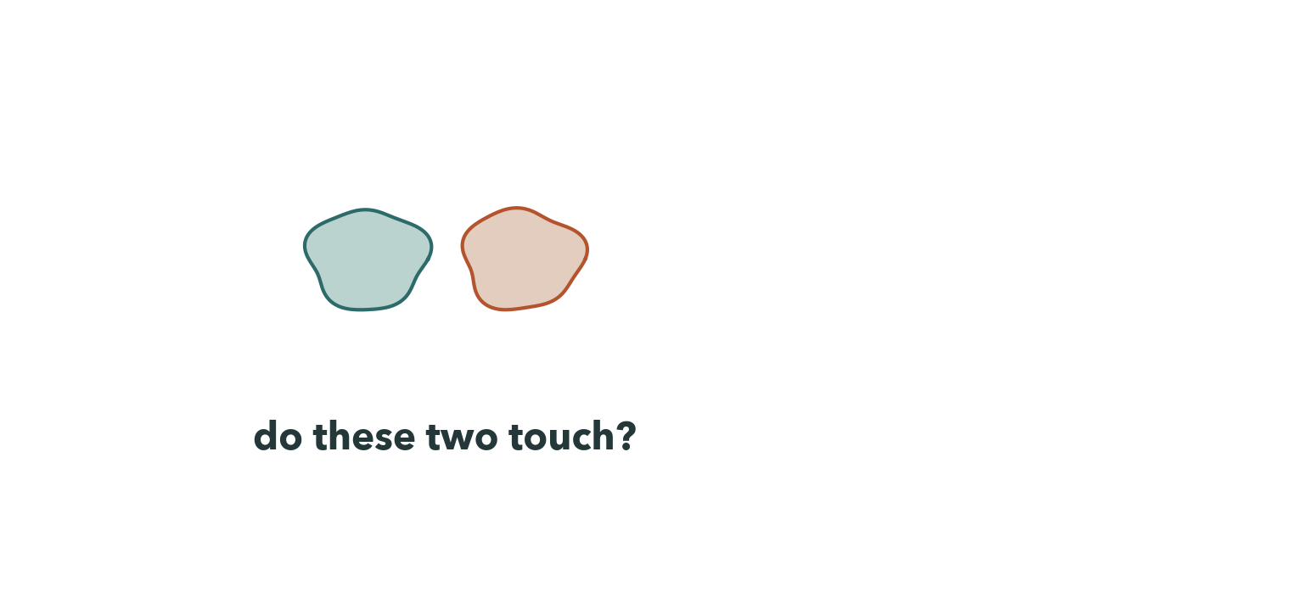
CYCLE 1 · LEARN — WHY IT CANNOT WORK
29
Notes:
What we learned is that the method cannot answer this question at all — and we can say exactly why.
These models don't simulate two proteins touching. They read evolution. They look across thousands of species for positions that change in step: if a residue on one side mutates, and a residue on the other mutates to match, those two are probably in contact.
And that signal only exists where two proteins have a shared history of co-adaptation. A phage protein and a bacterial protein have never co-adapted as a pair, so there is no history to read, and the interface score returns noise.

Slide 30
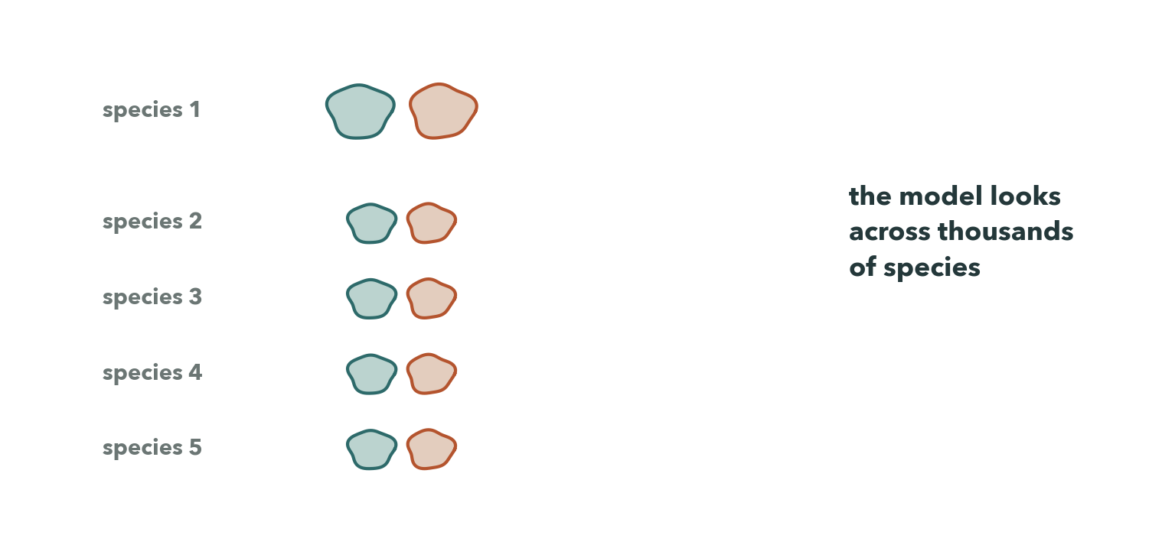
CYCLE 1 · LEARN — WHY IT CANNOT WORK
30
Notes:
What we learned is that the method cannot answer this question at all — and we can say exactly why.
These models don't simulate two proteins touching. They read evolution. They look across thousands of species for positions that change in step: if a residue on one side mutates, and a residue on the other mutates to match, those two are probably in contact.
And that signal only exists where two proteins have a shared history of co-adaptation. A phage protein and a bacterial protein have never co-adapted as a pair, so there is no history to read, and the interface score returns noise.

Slide 31
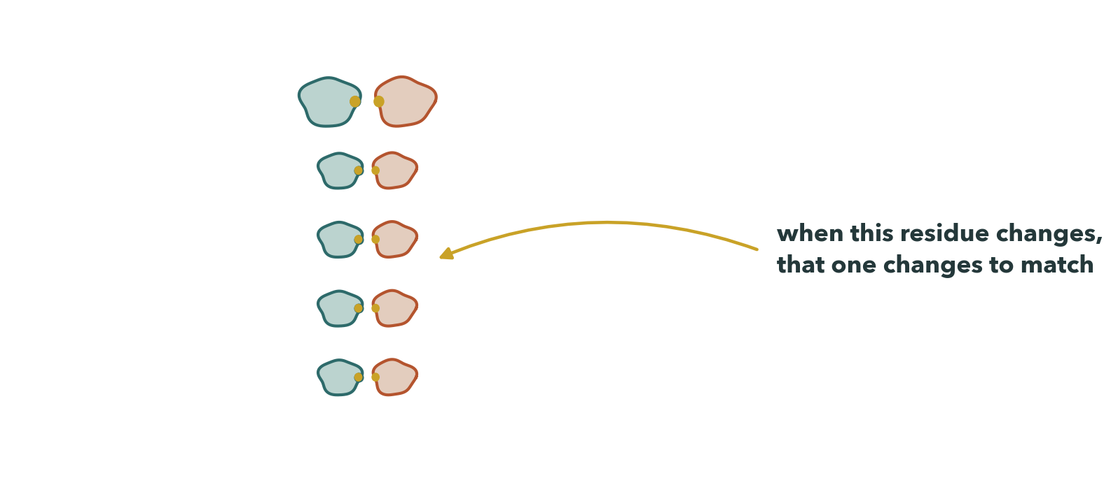
CYCLE 1 · LEARN — WHY IT CANNOT WORK
31
Notes:
What we learned is that the method cannot answer this question at all — and we can say exactly why.
These models don't simulate two proteins touching. They read evolution. They look across thousands of species for positions that change in step: if a residue on one side mutates, and a residue on the other mutates to match, those two are probably in contact.
And that signal only exists where two proteins have a shared history of co-adaptation. A phage protein and a bacterial protein have never co-adapted as a pair, so there is no history to read, and the interface score returns noise.

Slide 32
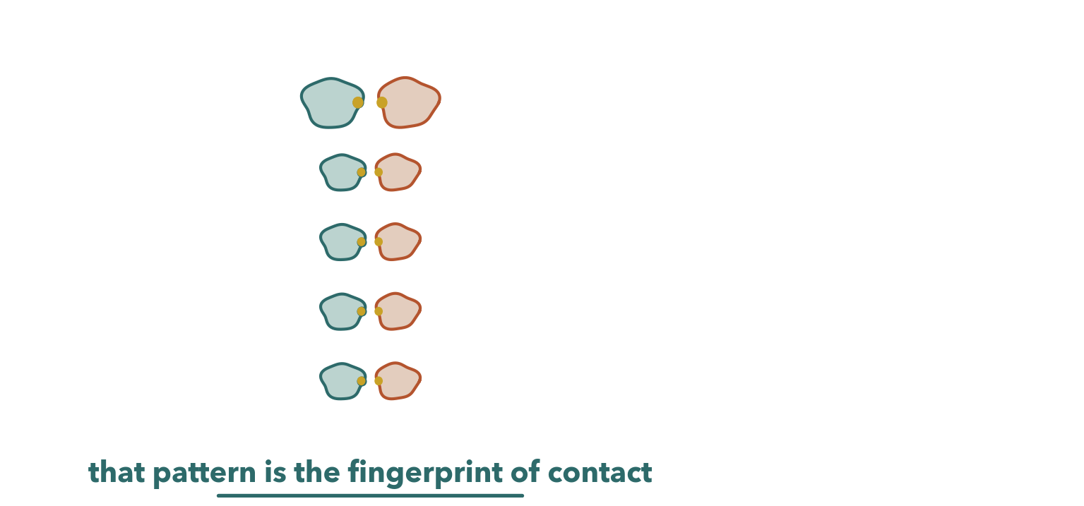
CYCLE 1 · LEARN — WHY IT CANNOT WORK
32
Notes:
What we learned is that the method cannot answer this question at all — and we can say exactly why.
These models don't simulate two proteins touching. They read evolution. They look across thousands of species for positions that change in step: if a residue on one side mutates, and a residue on the other mutates to match, those two are probably in contact.
And that signal only exists where two proteins have a shared history of co-adaptation. A phage protein and a bacterial protein have never co-adapted as a pair, so there is no history to read, and the interface score returns noise.

Slide 33
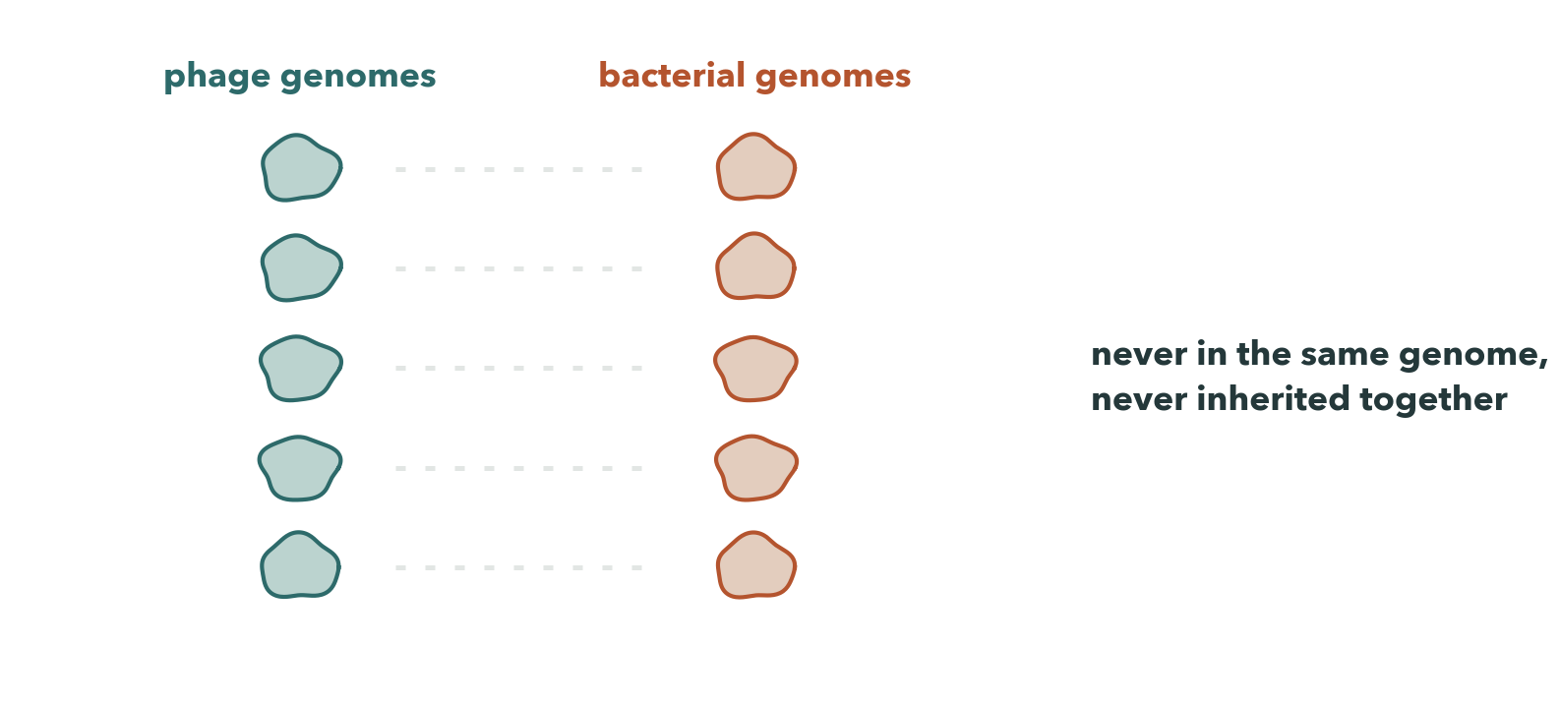
CYCLE 1 · LEARN — WHY IT CANNOT WORK
33
Notes:
What we learned is that the method cannot answer this question at all — and we can say exactly why.
These models don't simulate two proteins touching. They read evolution. They look across thousands of species for positions that change in step: if a residue on one side mutates, and a residue on the other mutates to match, those two are probably in contact.
And that signal only exists where two proteins have a shared history of co-adaptation. A phage protein and a bacterial protein have never co-adapted as a pair, so there is no history to read, and the interface score returns noise.

Slide 34
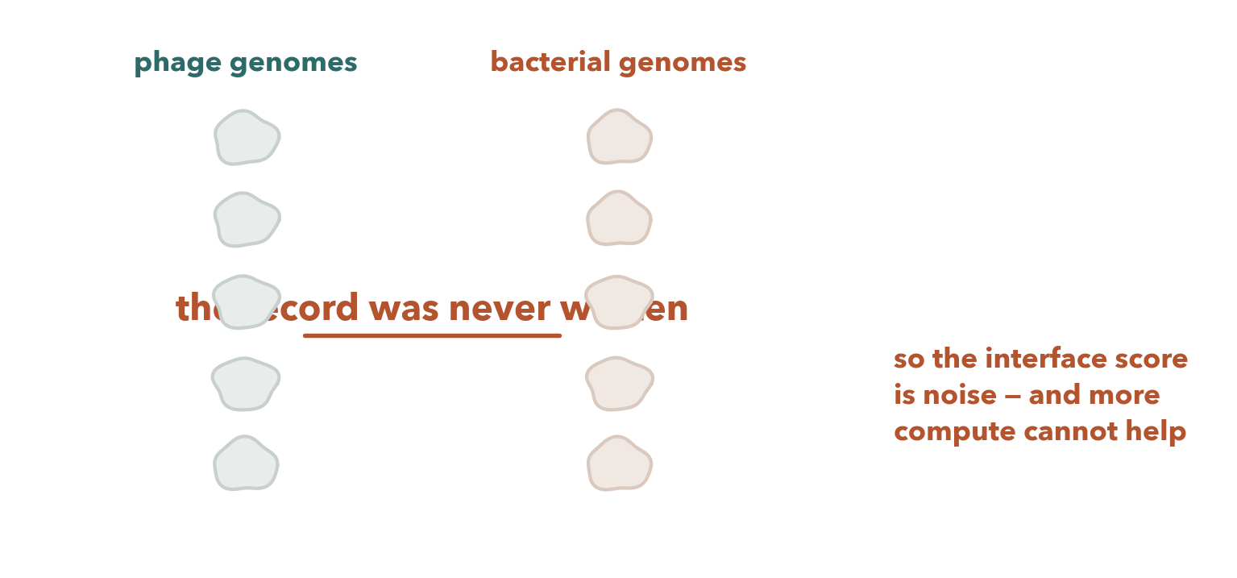
CYCLE 1 · LEARN — WHY IT CANNOT WORK
34
Notes:
What we learned is that the method cannot answer this question at all — and we can say exactly why.
These models don't simulate two proteins touching. They read evolution. They look across thousands of species for positions that change in step: if a residue on one side mutates, and a residue on the other mutates to match, those two are probably in contact.
And that signal only exists where two proteins have a shared history of co-adaptation. A phage protein and a bacterial protein have never co-adapted as a pair, so there is no history to read, and the interface score returns noise.

Slide 35
CYCLE 1 · LEARN
This was never a result about our proteins.
It is a property of the method.
Nine control folds decided the fate of seven thousand. We never ran the real screen.
35
Notes:
So this was never a result about our proteins. It's a property of the method, and more compute doesn't fix it. Nine control folds decided the fate of seven thousand, and we never ran the real screen.

Slide 36
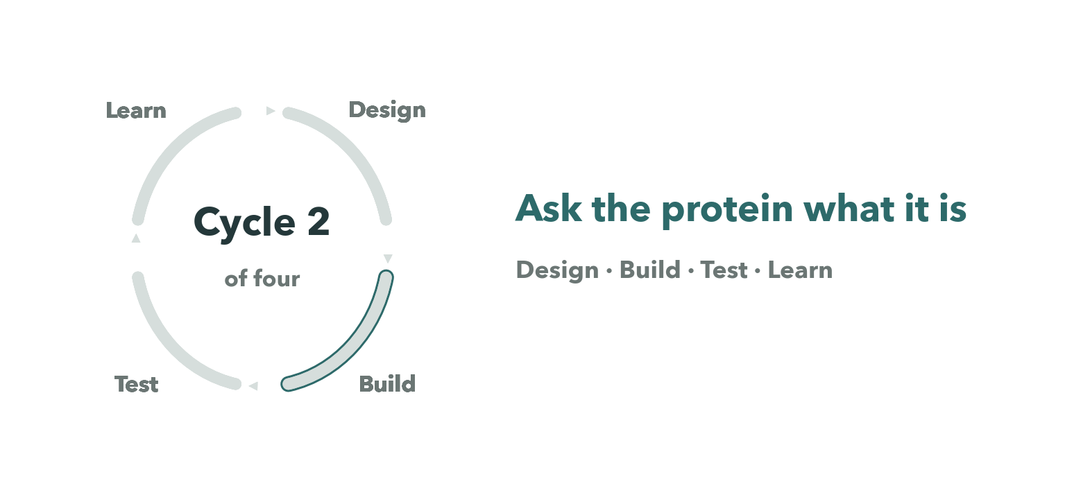
CYCLE 2 OF FOUR
36
Notes:
Cycle two — ask the protein what it is. Geometry instead of docking.

Slide 37
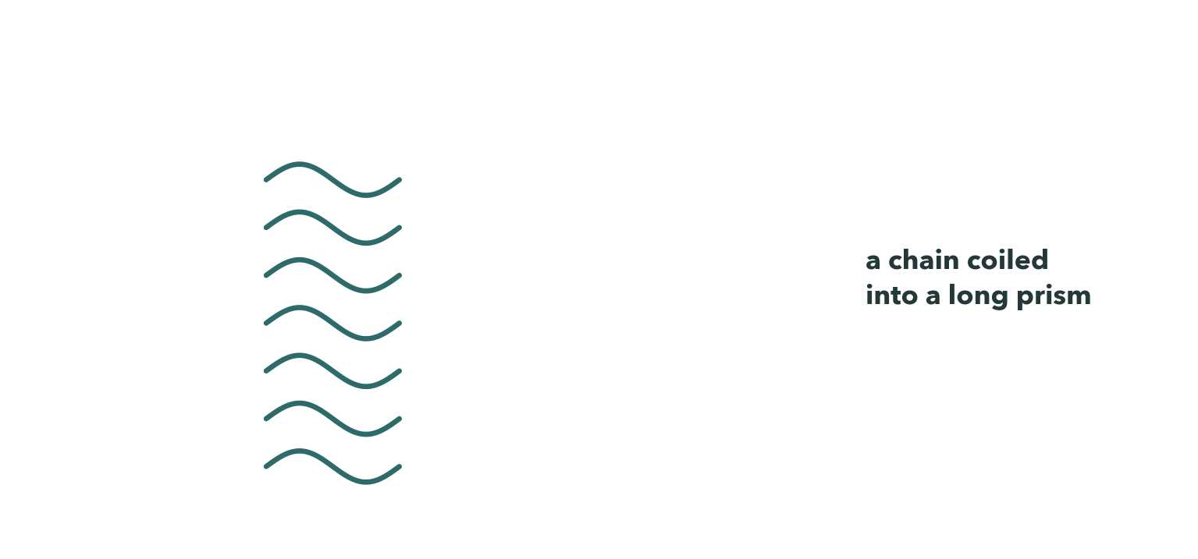
CYCLE 2 · A FOLD TEST WITH NO DATABASE
37
Notes:
For the second cycle we changed the question. If we couldn't ask what the tail spike binds, we could ask what it is.
A right-handed beta-helix is a chain coiled into a long prism, with its coils hydrogen-bonded in register. So if you take every backbone hydrogen bond, measure how far apart in sequence its two partners sit, and histogram those offsets, a beta-helix peaks at its coil period, somewhere between sixteen and twenty-six residues. An alpha-helix peaks at four. A beta-sandwich has no peak at all.
We chose that test rather than fell back on it. On a genome with no close relatives, a database can't contain the answer.

Slide 38
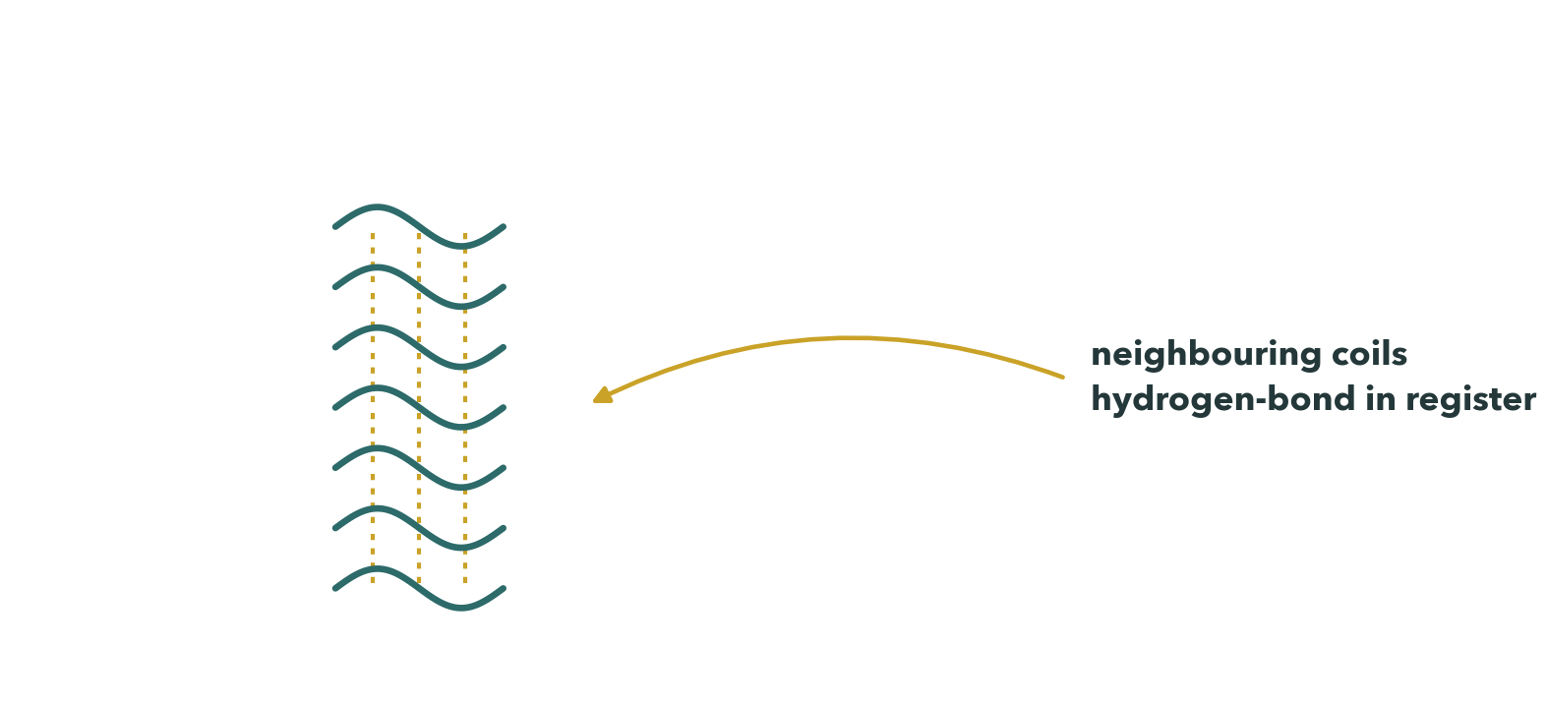
CYCLE 2 · A FOLD TEST WITH NO DATABASE
38
Notes:
For the second cycle we changed the question. If we couldn't ask what the tail spike binds, we could ask what it is.
A right-handed beta-helix is a chain coiled into a long prism, with its coils hydrogen-bonded in register. So if you take every backbone hydrogen bond, measure how far apart in sequence its two partners sit, and histogram those offsets, a beta-helix peaks at its coil period, somewhere between sixteen and twenty-six residues. An alpha-helix peaks at four. A beta-sandwich has no peak at all.
We chose that test rather than fell back on it. On a genome with no close relatives, a database can't contain the answer.

Slide 39
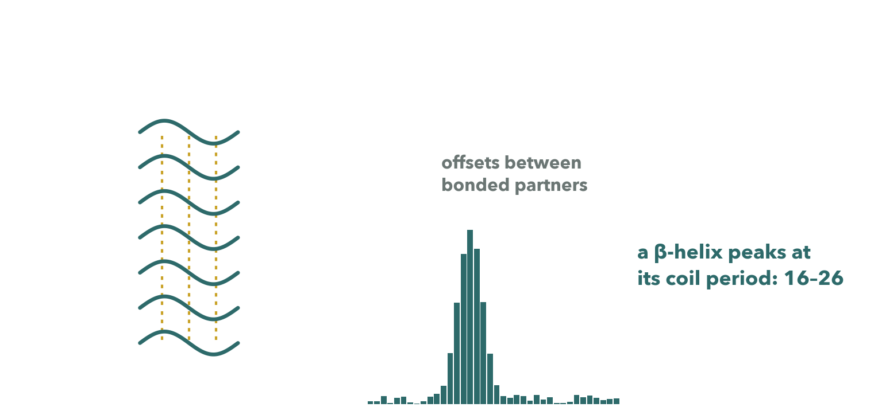
CYCLE 2 · A FOLD TEST WITH NO DATABASE
39
Notes:
For the second cycle we changed the question. If we couldn't ask what the tail spike binds, we could ask what it is.
A right-handed beta-helix is a chain coiled into a long prism, with its coils hydrogen-bonded in register. So if you take every backbone hydrogen bond, measure how far apart in sequence its two partners sit, and histogram those offsets, a beta-helix peaks at its coil period, somewhere between sixteen and twenty-six residues. An alpha-helix peaks at four. A beta-sandwich has no peak at all.
We chose that test rather than fell back on it. On a genome with no close relatives, a database can't contain the answer.

Slide 40
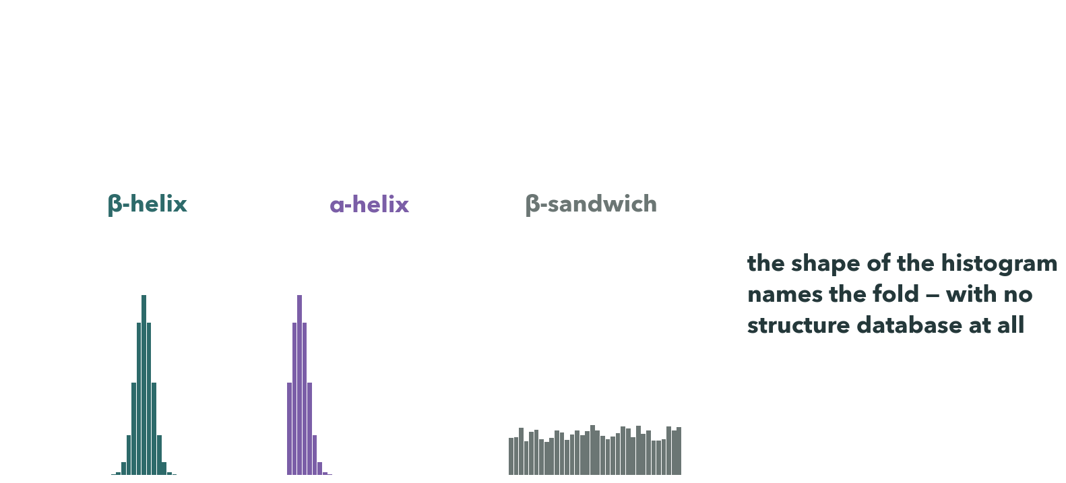
CYCLE 2 · A FOLD TEST WITH NO DATABASE
40
Notes:
For the second cycle we changed the question. If we couldn't ask what the tail spike binds, we could ask what it is.
A right-handed beta-helix is a chain coiled into a long prism, with its coils hydrogen-bonded in register. So if you take every backbone hydrogen bond, measure how far apart in sequence its two partners sit, and histogram those offsets, a beta-helix peaks at its coil period, somewhere between sixteen and twenty-six residues. An alpha-helix peaks at four. A beta-sandwich has no peak at all.
We chose that test rather than fell back on it. On a genome with no close relatives, a database can't contain the answer.

Slide 41
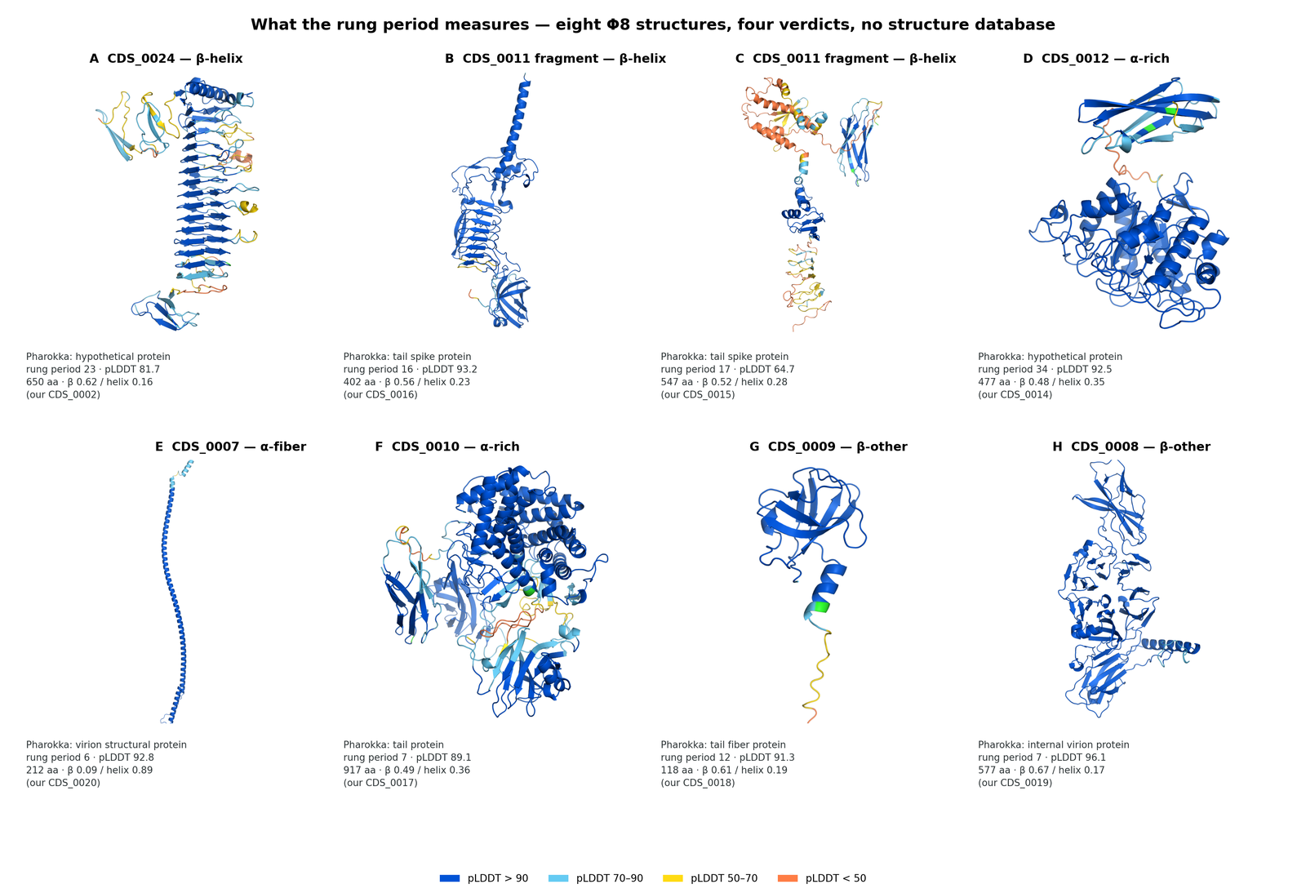
CYCLE 2 · TEST
Eight predicted structures, seven proteins — five of them turned down
CDS 11, the tail spike: classifier confidence 0.997, coil period 16–17. CDS 24, filed as “hypothetical”: 0.998 on a different period — a second depolymerase homology annotation had missed.
41
Notes:
What we tested was eight predicted structures covering seven proteins, and we classified each from its own backbone geometry.
Five of the seven came back negative, and the numbers they returned aren't noise: an alpha-helical fibre lands at six. The method says no, which is what makes it worth believing when it says yes.
It said yes twice.

Slide 42
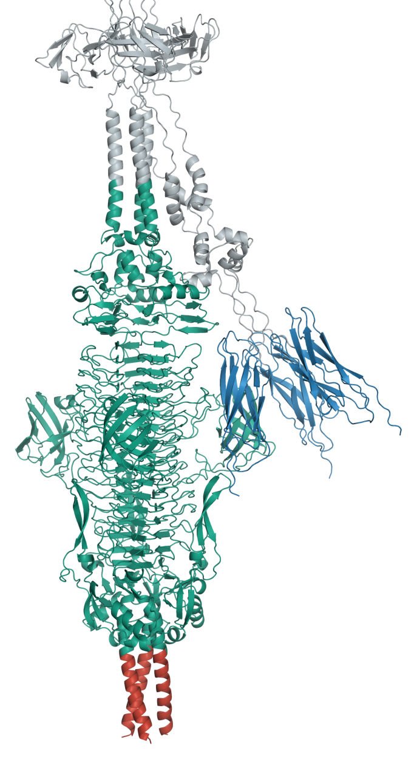
CYCLE 2 · THE SAME PROTEIN, THREE WAYS
The tail spike, whole
CDS 11 is 941 residues, and it hangs off the virion base.
42
Notes:
CDS 11 is nine hundred and forty-one residues and most of it isn't the enzyme. The first hundred and ten anchor it to the virion, and the next two hundred are a shaft that moves between every model we ran. The rigid trimeric body — from residue three hundred to the end — is the part that carries the chemistry. That's the fragment we expressed, and the one we submitted to the Registry.

Slide 43
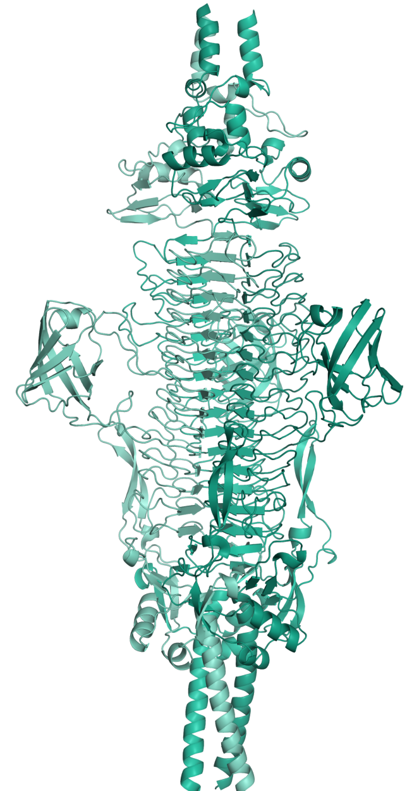
CYCLE 2 · THE SAME PROTEIN, THREE WAYS
Most of it isn't the enzyme
The first 110 residues anchor it. The next 200 are a shaft that moves between every model we ran.
43

Slide 44
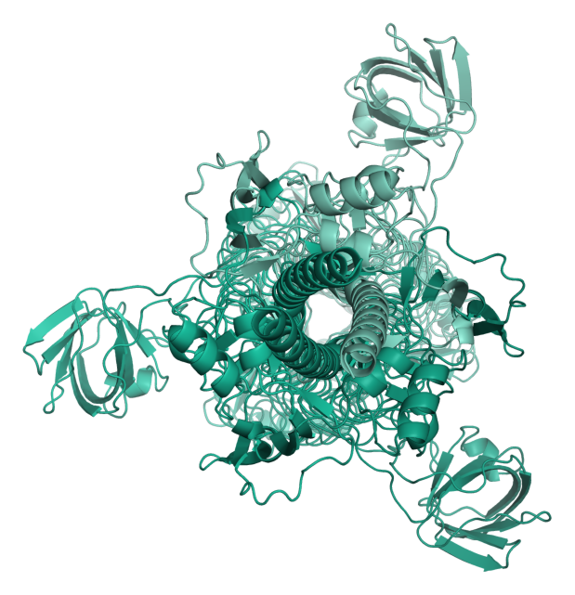
CYCLE 2 · THE SAME PROTEIN, THREE WAYS
The rigid trimeric body
From residue 300 to the end, agreeing between models to within one ångström. Submitted as BBa_26DKNAEC, residues 305–941.
44

Slide 45
CYCLE 2 · LEARN
The tail spike isn't a key.
It's a blade.
Enzymes that chew through long sugar chains look like this. You can recognise a wood plane by its shape without being told what it cuts — and the lock we had spent months looking for doesn't exist.
45
Notes:
That shape is a signature. Enzymes that chew through long sugar chains look like this, because a sugar chain is a thread and you need something that holds it straight while you cut. You can recognise a wood plane by its shape without being told what it cuts.
So the tail spike isn't a key. It's a blade — and the lock we had spent months looking for doesn't exist.
We weren't the only ones reading it that way. Our classifier flagged it, and our PI reached the same conclusion from his own structural search. Between us, we turned it into a hypothesis.

Slide 46
THE CENTRAL HYPOTHESIS
In bacteria that wrap themselves in sugar, the ceiling
on host range is set by what the depolymerase can digest —
not by which protein the tail binds.
And the narrow specificity we see today is a narrowed-down version of something broader further back. · Developed jointly with Prof. J. Cesar Ignacio Espinoza
46
Notes:
In bacteria that wrap themselves in sugar, the ceiling on host range is set by what the depolymerase can digest — not by which protein the tail binds. And the narrow specificity we see today is a narrowed-down version of something broader further back.

Slide 47
A PREDICTION WE CAN FALSIFY
If the tail spike reads Strain 2's sugar, Φ8 should fail on the other two
9-2-1 · 9-6-2
Strain 2
hosts of record
Why we aren't calling it confirmed
No no-phage control — a margin note on the page says only “need control”.
One isolate was never scored.
Two follow-up readouts were never written down.
10-10-2
Strain 1
no plaques
8-10-2
Strain 3
no plaques
Eighteen host isolates spotted against two pooled lysates, July 2026.
That is the direction the prediction makes.
47
Notes:
That hypothesis makes a prediction we can falsify. We tested that in July. We spotted eighteen host isolates against two pooled lysates, and the Strain 1 and Strain 3 representatives came back negative against both.
We're not calling it confirmed, and the reasons come from our own notebook rather than from a reviewer. The result is consistent with the prediction, and nothing contradicts it, but we haven't done the clean experiment.

Slide 48
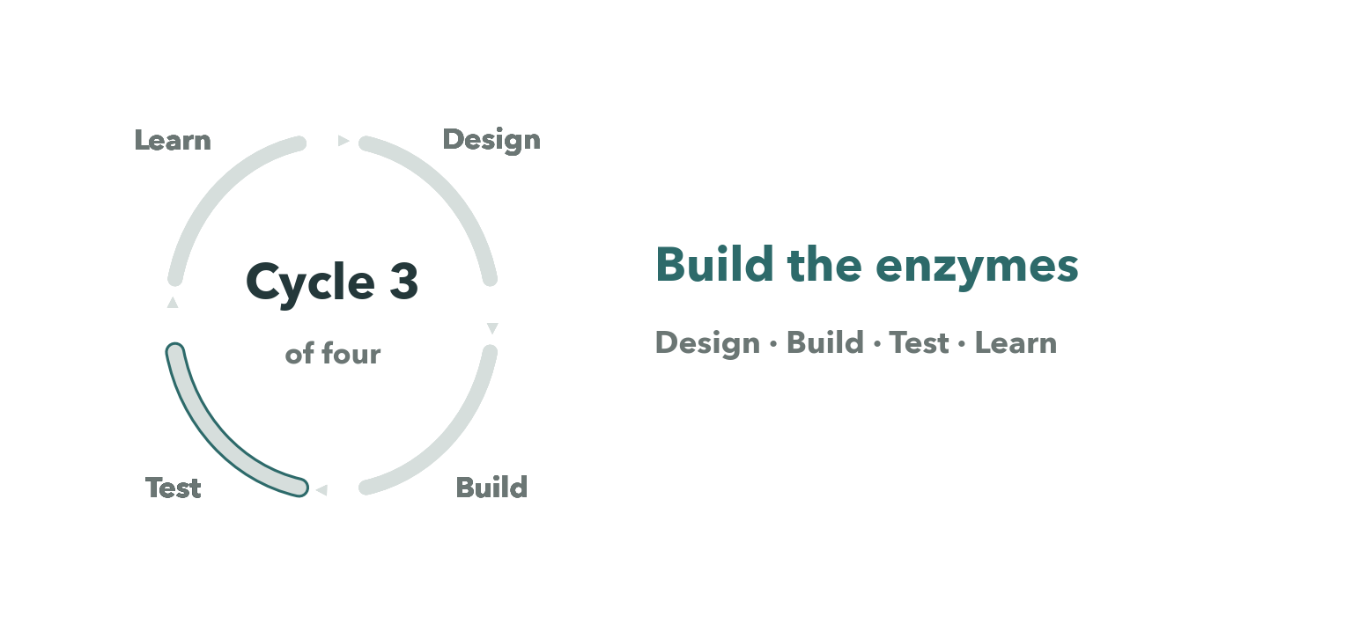
CYCLE 3 OF FOUR
48
Notes:
Cycle three — build the enzymes. Two lines run through it, and they are two different proteins.

Slide 49
CYCLE 3 · TWO LINES, TWO PROTEINS
CDS 11 — the tail spike
49

Slide 50
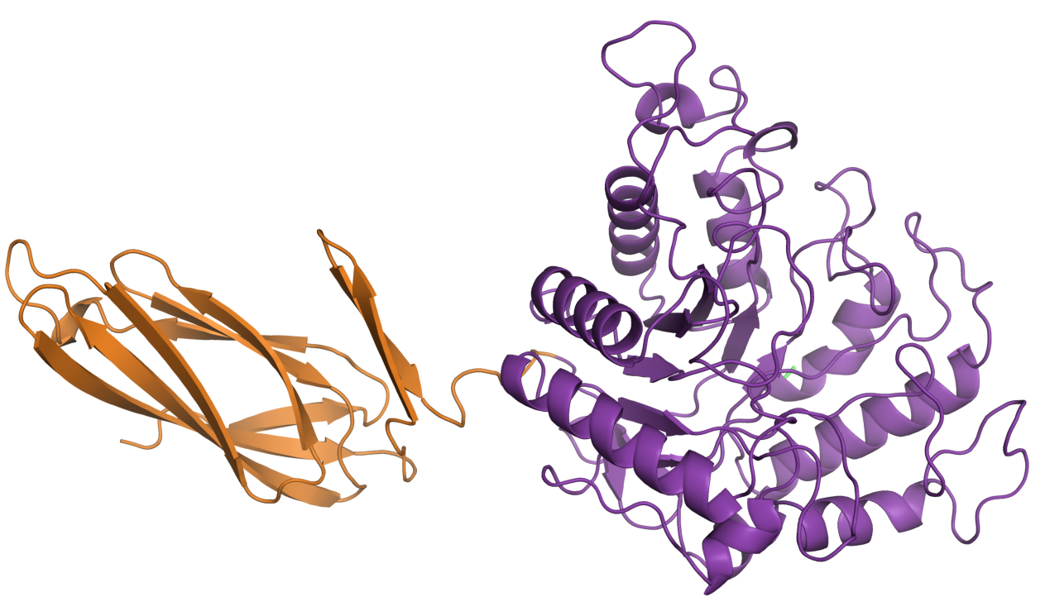
CYCLE 3 · TWO LINES, TWO PROTEINS
CDS 12 — a GH5 hydrolase
CDS 11 — the tail spike
A TIM barrel, not a β-helix. Its closest structural match is an endoglucanase caught with a short cellulose chain.
A separate protein — not a domain of the tail spike.
A right-handed β-helix, 941 residues.
This is the one that reads the host surface.
50
Notes:
Two enzymes sit in the tail module. CDS 11, the beta-helix, is the one that reads the host surface. And next to it CDS 12, a glycoside hydrolase from family five — a TIM barrel, not a beta-helix, whose closest structural match is an endoglucanase caught with a short cellulose chain. It is a separate protein, not a domain of the tail spike, and we have not established what it does inside the phage.

Slide 51
THE QUESTION A JUDGE WILL ASK
So why reconstruct ancestors of that one, and not of the tail spike?
A tree to reconstruct along
A third of the size
A synthesis allowance
CDS 12 has a thousand homologues. The tail spike is novel enough that we had no such tree.
362 residues against 941. We judged it the far better bet to express.
Four short constructs were affordable inside our sponsored allowance. Four long ones were not.
51
Notes:
So why did we reconstruct ancestors of that one, rather than of the tail spike we've just spent five minutes on? Three reasons, and none of them is that we got confused. CDS 12 has a thousand homologues in the databases, which is what you need to build a tree and reconstruct along it. CDS 12 is a third of the size, so we judged it the far better bet to express. And we were working inside a sponsored synthesis allowance, where four short constructs were affordable and four long ones were not.

Slide 52
AND WHAT THAT COSTS US
The ancestral panel tests the shape of the hypothesis
on an enzyme we could actually build — not on the one
that reads the receptor.
That's a real limitation, and it's ours, not a reviewer's.
52
Notes:
So our ancestral panel tests the shape of the hypothesis — whether an ancestral glycoside hydrolase has a broader substrate range than its descendant — on an enzyme we could actually build, rather than on the one that reads the receptor. That's a real limitation, and it's ours, not a reviewer's.

Slide 53
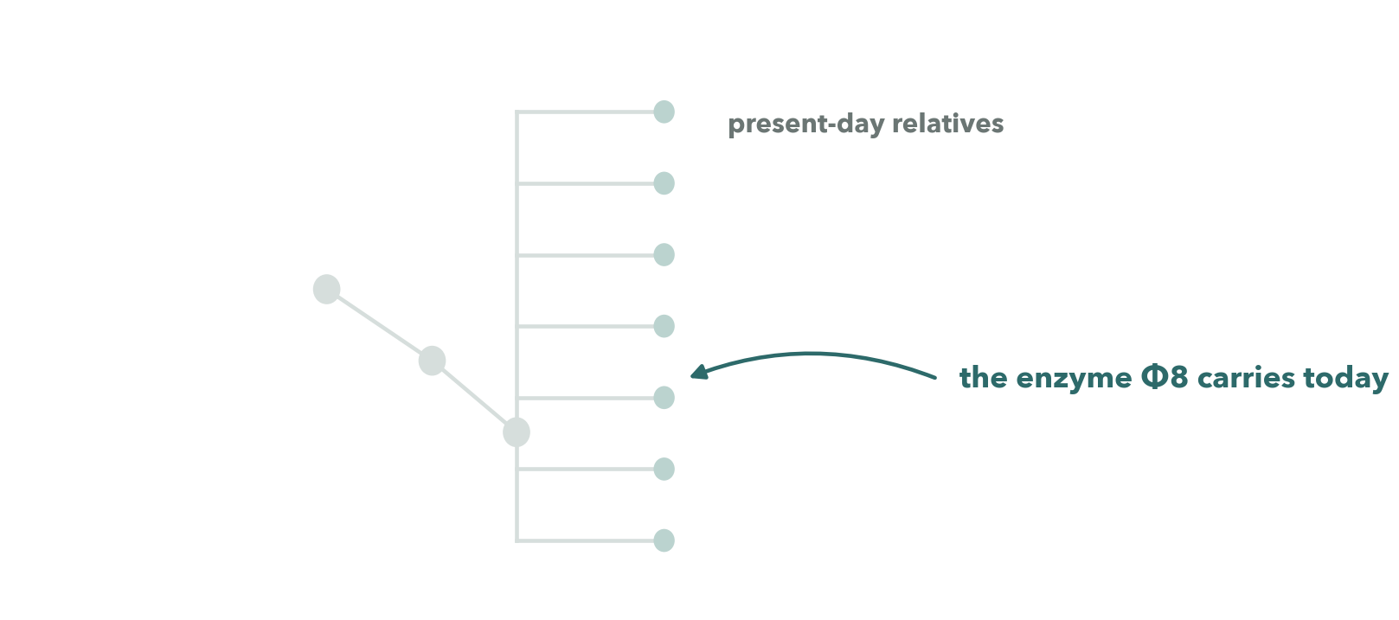
CYCLE 3 · BUILD — WALKING BACK UP THE TREE
53
Notes:
We worked out the direction with our PI, and he ran the alignment, the tree and the reconstruction on sequences we prepared. He reconstructed every node on the path from CDS 12 back to the root, nine hundred and ninety-eight of them, and we picked three to order as DNA.

Slide 54
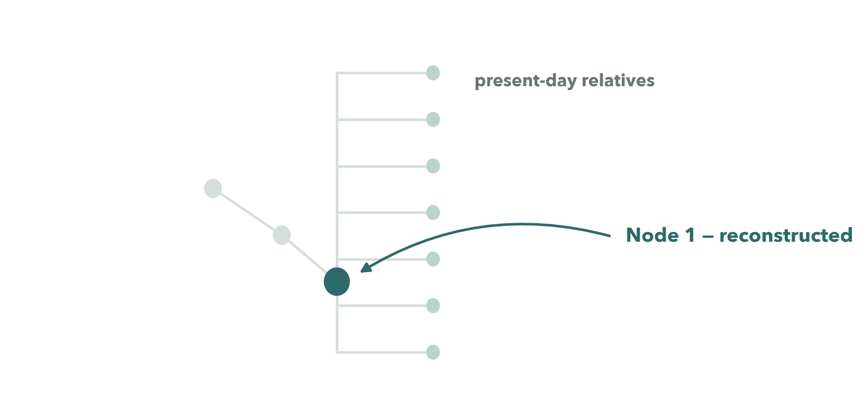
CYCLE 3 · BUILD — WALKING BACK UP THE TREE
54
Notes:
We worked out the direction with our PI, and he ran the alignment, the tree and the reconstruction on sequences we prepared. He reconstructed every node on the path from CDS 12 back to the root, nine hundred and ninety-eight of them, and we picked three to order as DNA.

Slide 55
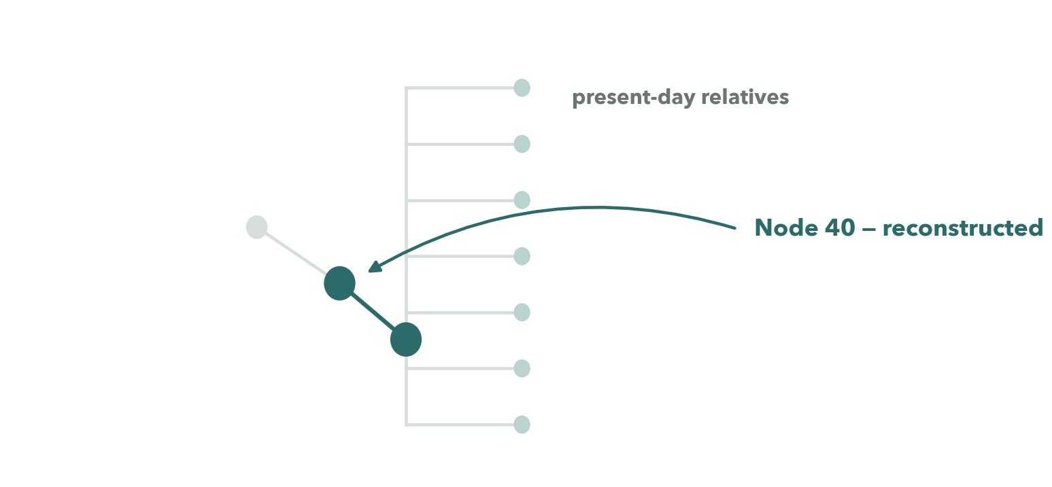
CYCLE 3 · BUILD — WALKING BACK UP THE TREE
55
Notes:
We worked out the direction with our PI, and he ran the alignment, the tree and the reconstruction on sequences we prepared. He reconstructed every node on the path from CDS 12 back to the root, nine hundred and ninety-eight of them, and we picked three to order as DNA.

Slide 56
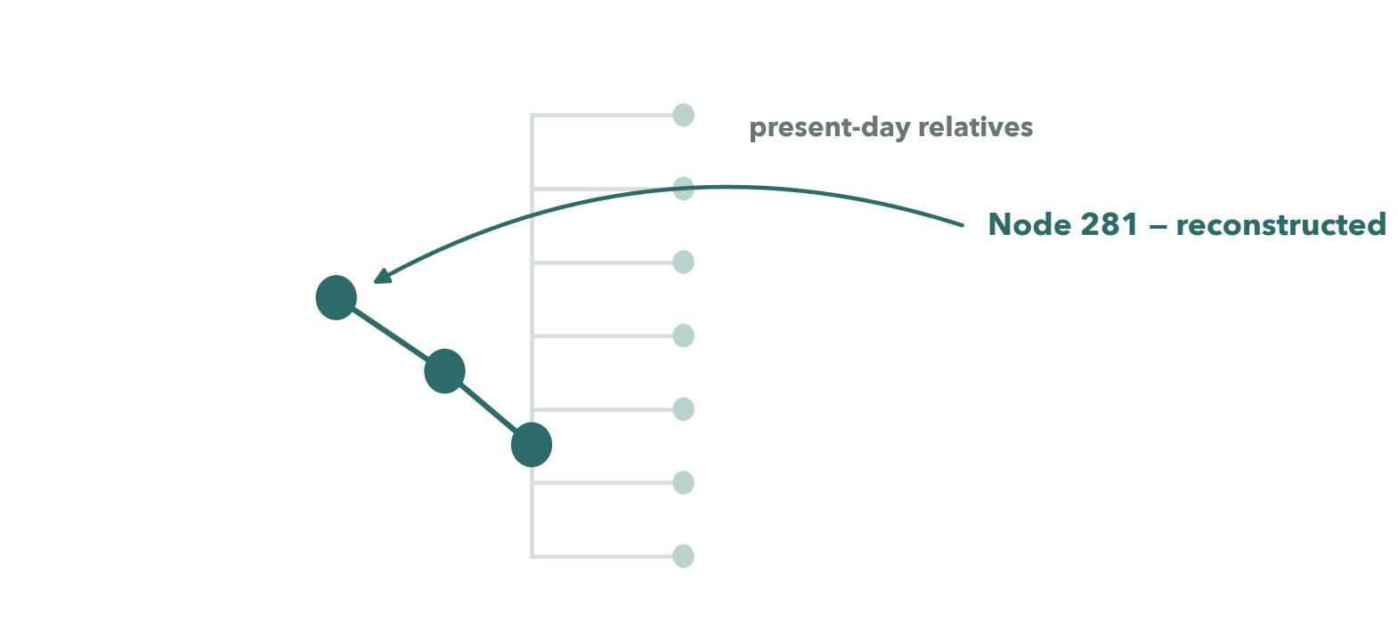
CYCLE 3 · BUILD — WALKING BACK UP THE TREE
56
Notes:
We worked out the direction with our PI, and he ran the alignment, the tree and the reconstruction on sequences we prepared. He reconstructed every node on the path from CDS 12 back to the root, nine hundred and ninety-eight of them, and we picked three to order as DNA.

Slide 57
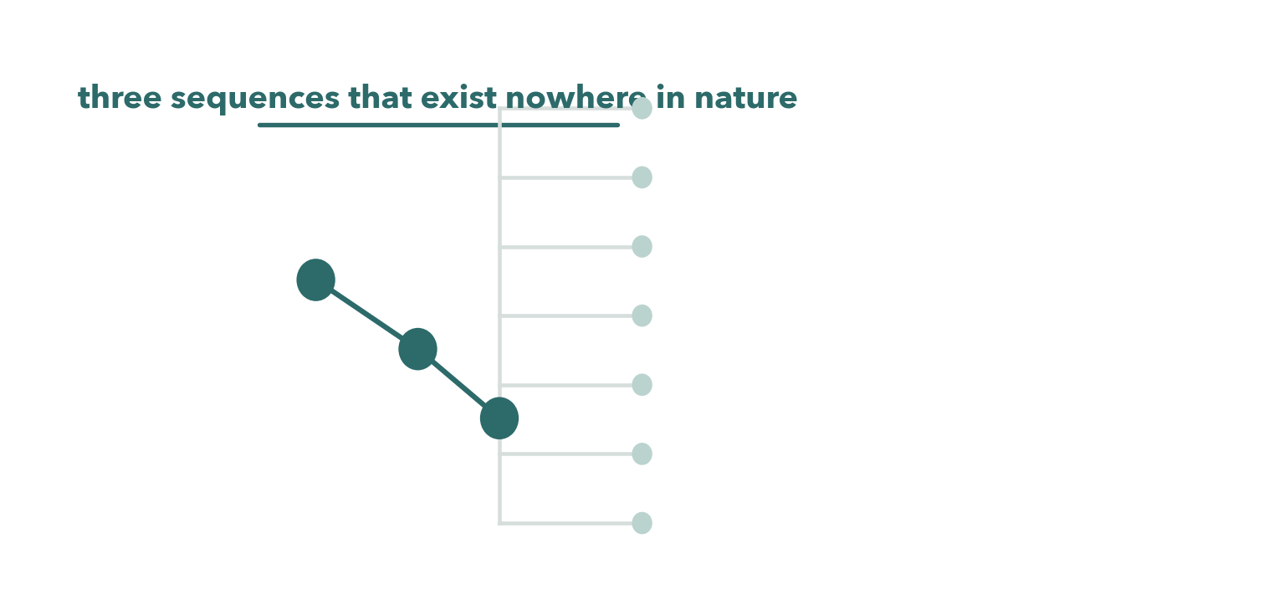
CYCLE 3 · BUILD — WALKING BACK UP THE TREE
57
Notes:
We worked out the direction with our PI, and he ran the alignment, the tree and the reconstruction on sequences we prepared. He reconstructed every node on the path from CDS 12 back to the root, nine hundred and ninety-eight of them, and we picked three to order as DNA.

Slide 58
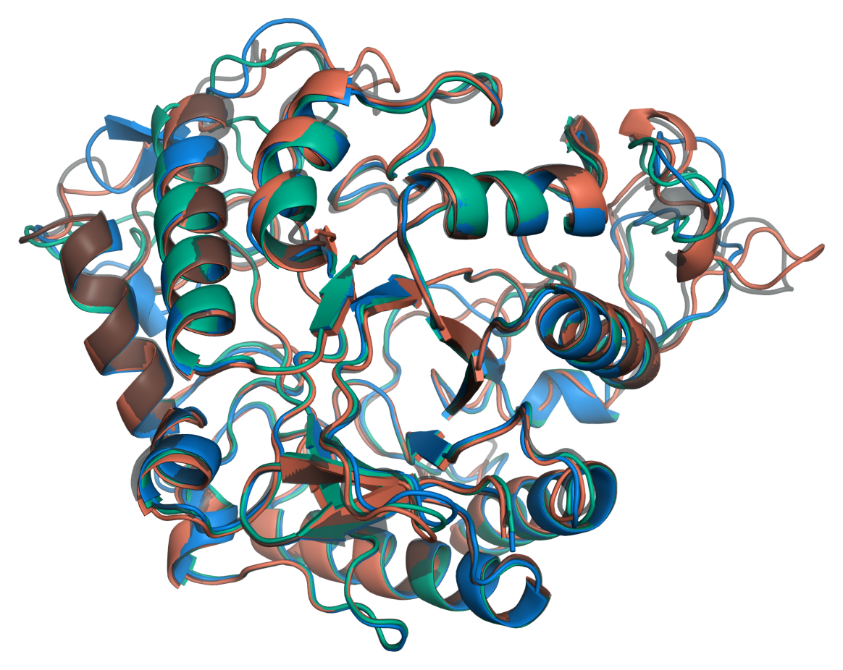
CYCLE 3 · BUILD
All four fold to the same TIM barrel
Six constructs in pET-28a with an N-terminal His-tag, from Twist — and all six are now published basic parts on the iGEM Registry, under CC0.
Three of them are sequences that exist nowhere in nature.
One warning: our first order was codon-optimised and our second wasn't. In an E. coli host, that bias is the first thing to suspect when a band doesn't appear.
58
Notes:
All six went into pET-28a with an N-terminal His-tag and were synthesised by Twist across two orders, and all six are now published basic parts on the iGEM Registry under a CC0 licence. Three of the six are those reconstructed ancestors — protein sequences that exist nowhere in nature. We think any team working on an enzyme family could take the same route to new parts, so we wrote the method out in full.
One warning we'd pass on, because it cost us: our first order was codon-optimised and our second wasn't.

Slide 59
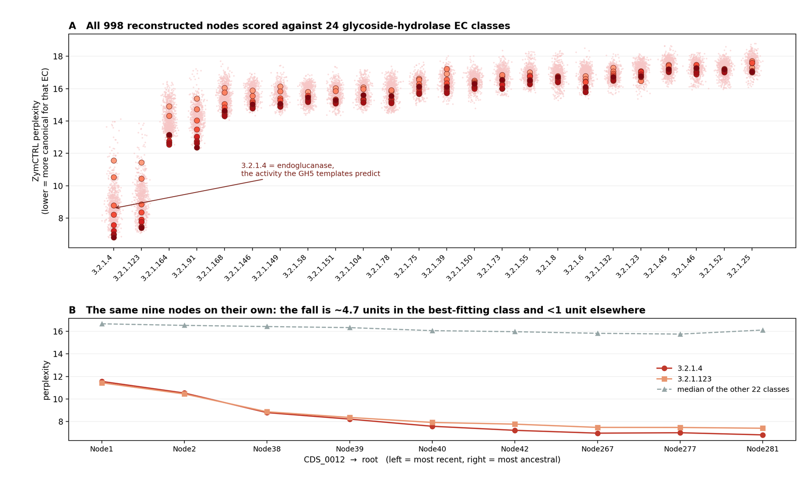
CYCLE 3 · WHAT THE MODEL SAID, AND ITS OWN CONTROL
Along the path to the root, the score improves steadily
The label it likes best is endo-1,4-β-glucanase — the same chemistry the structure points at.
Except it doesn't survive its own control. A reconstructed ancestor is consensus-like by construction, so it scores better under almost any label — and it does, in 21 of 24 classes.
Direction alone proves nothing. And perplexity isn't activity.
59
Notes:
Before any of them reached a bench, we asked a model what it thought. The label it likes best is endo-one-four-beta-glucanase — the same chemistry the structure points at. And along the path to the root the score improves steadily, which, read on its own, is our hypothesis coming true.
Except that it doesn't survive its own control. A reconstructed ancestor is consensus-like by construction, so it scores better under almost any label — and it does, in twenty-one of the twenty-four classes. Direction alone proves nothing.
And perplexity isn't activity.

Slide 60
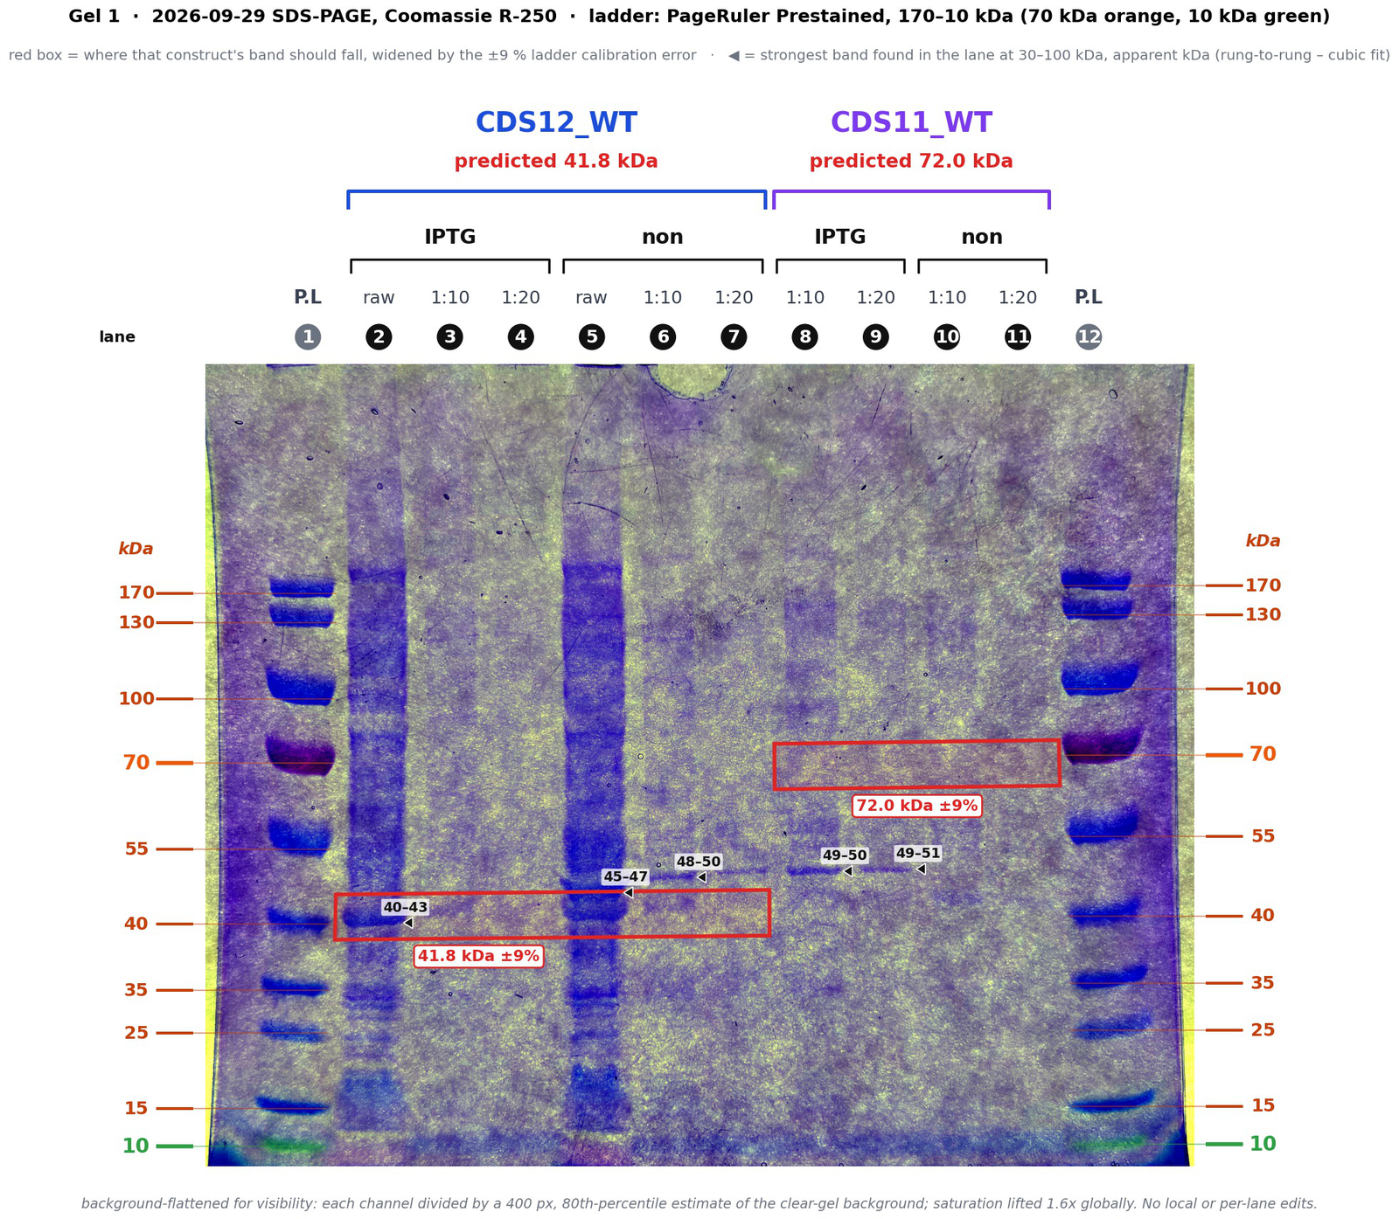
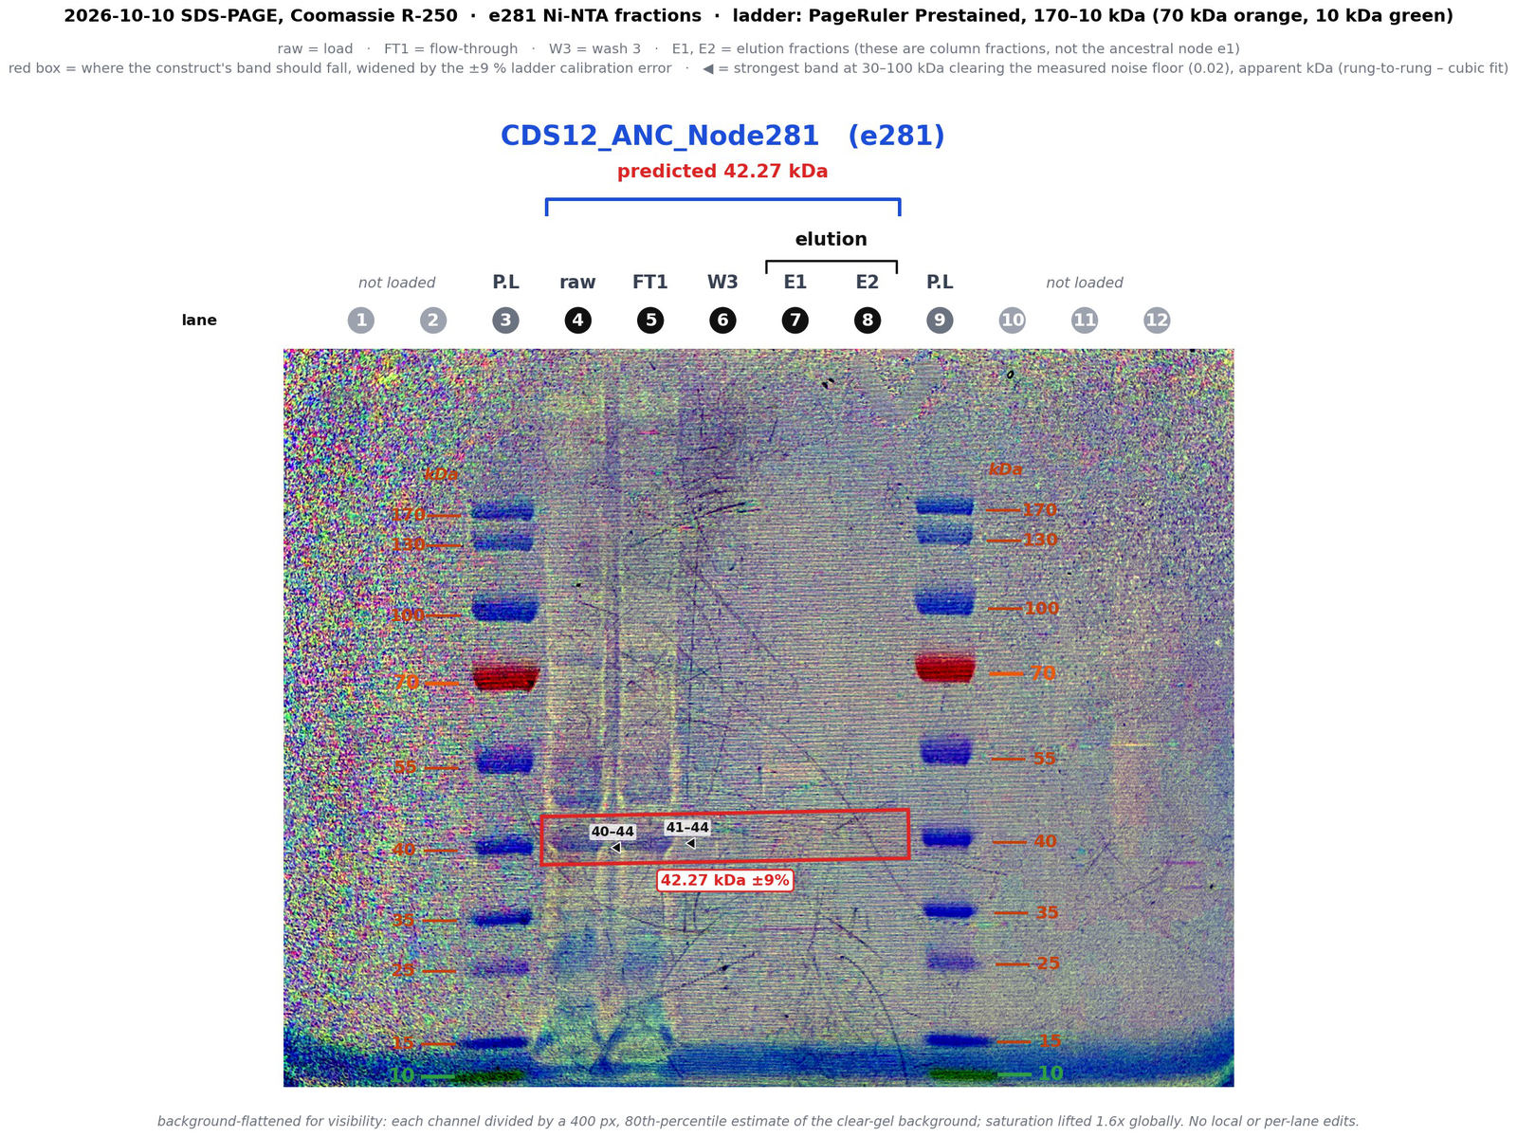
CYCLE 3 · TEST
Four rounds at the bench, and they didn't line up neatly
15 Sep
Two gels, four constructs, induced against uninduced — no detectable induction on either.
29 Sep
CDS 12 gives the first induction-dependent band at the right size.
1 Oct
Nickel columns on six constructs. The first ancestor eluted at its predicted mass — the only one that did. The tail spike eluted something, 29 kDa short.
10 Oct
Same column, second ancestor. Both elutions blank; the load and the flow-through carried the same band.
Empty-vector BL21 lane: absent in all eight protein assays
60
Notes:
We tested expression four times, and the rounds didn't line up neatly.
On October the first we ran nickel columns on six constructs, and one of them worked: the first ancestor eluted at its predicted mass, the only construct that did. The tail spike eluted something too, but twenty-nine kilodaltons short.
On October the tenth both elutions came off blank. We read that as a purification we had botched, and we were about to spend another week on it.

Slide 61
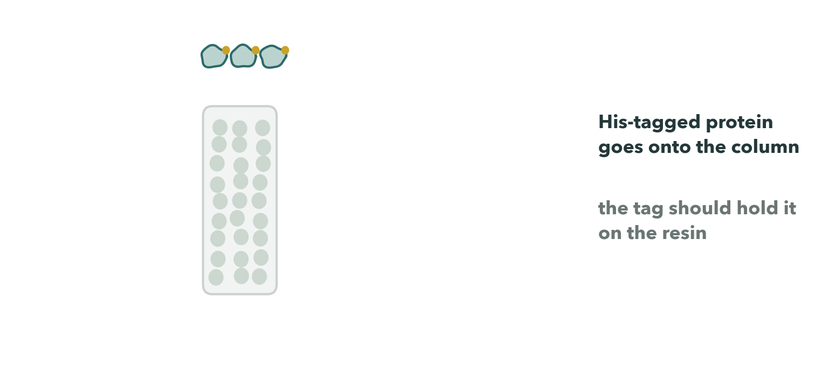
CYCLE 3 · WHERE THE COLUMN ACTUALLY FAILED
61
Notes:
A nickel column is supposed to hold a His-tagged protein on the resin while everything else washes past. Ours didn't hold it: the load and the flow-through carried the same band, and both elutions came off blank.

Slide 62

CYCLE 3 · WHERE THE COLUMN ACTUALLY FAILED
62
Notes:
A nickel column is supposed to hold a His-tagged protein on the resin while everything else washes past. Ours didn't hold it: the load and the flow-through carried the same band, and both elutions came off blank.

Slide 63

CYCLE 3 · WHERE THE COLUMN ACTUALLY FAILED
63
Notes:
A nickel column is supposed to hold a His-tagged protein on the resin while everything else washes past. Ours didn't hold it: the load and the flow-through carried the same band, and both elutions came off blank.

Slide 64

CYCLE 3 · WHERE THE COLUMN ACTUALLY FAILED
64
Notes:
A nickel column is supposed to hold a His-tagged protein on the resin while everything else washes past. Ours didn't hold it: the load and the flow-through carried the same band, and both elutions came off blank.

Slide 65

CYCLE 3 · WHY A GEL COULD NOT TELL US
65
Notes:
And this is the trap. Three completely different things — no protein made, protein made but insoluble, protein made and missed by the column — all give you the same blank lane. A gel cannot separate them.

Slide 66

CYCLE 3 · WHY A GEL COULD NOT TELL US
66
Notes:
And this is the trap. Three completely different things — no protein made, protein made but insoluble, protein made and missed by the column — all give you the same blank lane. A gel cannot separate them.

Slide 67

CYCLE 3 · WHY A GEL COULD NOT TELL US
67
Notes:
And this is the trap. Three completely different things — no protein made, protein made but insoluble, protein made and missed by the column — all give you the same blank lane. A gel cannot separate them.

Slide 68

CYCLE 3 · WHY A GEL COULD NOT TELL US
68
Notes:
And this is the trap. Three completely different things — no protein made, protein made but insoluble, protein made and missed by the column — all give you the same blank lane. A gel cannot separate them.

Slide 69

CYCLE 3 · LEARN — AN OUTSIDE VIEW CHANGED A RESULT
What stopped us wasn't an experiment. It was a conversation.
On 13 October we took it to Prof. Ilya Tolstorukov at Keck Graduate Institute. He wrote back before we met to say expression was his field and purification wasn't — and met us anyway.
He changed the question. Not why is nothing eluting, but is there anything there to elute.
Six days later the flow-through read 2.9× the negative control. The run had failed at capture, not at expression.
69
Notes:
What stopped us wasn't an experiment. It was a conversation.
On October the thirteenth we took the problem to Professor Ilya Tolstorukov at Keck Graduate Institute, who works on protein expression. He wrote back before we met to say he wasn't sure he was the right person — expression is his field, purification isn't — and he met us anyway. That turned out to be the point.
He changed the question. Not why is nothing eluting, but is there anything there to elute. He told us to check whether the protein was being made at all, with a dot blot against an anti-His antibody, before we touched the column again.
Six days later we ran that blot, and the flow-through from the second ancestor read two point nine times the negative control. So what we learned is that the protein had been there all along. It was made, it came off in the flow-through, and the run had failed at capture — not at expression.
We had spent a week debugging the last step of a workflow without checking that the first step worked, because the last step was the one visibly failing. That's the generalisable mistake, and one meeting fixed it.

Slide 70

CYCLE 3 · THE ASSAY THE WHOLE PROJECT POINTS AT
Does an enzyme, on its own, do anything to the sugar?
No visible lysis anywhere — including Φ8 on its own hosts — so the assay never read clearing. But counting colonies inside the drops gives a number: under the first ancestor, across seven strains, they fall to a median of 12 % of the plate's PBS control. Φ8's own median is 0 %.
Our PI reads that as activity. Before we do: the carry-over control was not run, and those dilutions later read at or below our dot blot's floor.
It is one plate.
70
Notes:
Then we ran the assay the whole project points at: does an enzyme, on its own, do anything to the sugar?
We read it on October the sixteenth. Under the first ancestor, across seven strains, colony counts fall to a median of twelve percent of the plate's PBS control. Phi-8's own median is zero.
Our PI reads that suppression as enzyme activity. We'd want more before we call it that ourselves, and there are two specific gaps.
It's the strongest activity signal we have, and it is one plate.

Slide 71
ONE GAP RUNS THROUGH ALL OF IT
Eight protein assays — seven gels and a dot blot —
and not one of them carries a lane of untransformed BL21.
We designed every round around a different variable instead. That control is on the bench now.
71
Notes:
And one gap runs through all of it. We have now run eight protein assays — seven gels and a dot blot — and not one of them carries a lane of untransformed BL21. We designed every round around a different variable instead. That control is on the bench now.

Slide 72

CYCLE 4 OF FOUR
72
Notes:
Cycle four — let the bacteria answer. Selection instead of prediction. Three cycles in, every guess about the receptor had come from the phage's side.

Slide 73

CYCLE 4 · TEST — CHECKED AT READ LEVEL
73
Notes:
In July we picked colonies from inside the plaque zone — cells still growing where the phage should have killed them — and in October we sequenced one from each host against its parent. There's no structure prediction anywhere in this loop.
A naive assembly comparison gave us sixteen to twenty-one differing sites, which means nothing on its own. So we took every candidate back to the raw reads: seventy sites, checked against the parent's reads and against an independent read set with completely different chemistry.
Exactly one survived — carried by two hundred and sixty-three of two hundred and sixty-four mutant reads and by none of the parent's.

Slide 74

CYCLE 4 · TEST — CHECKED AT READ LEVEL
74
Notes:
In July we picked colonies from inside the plaque zone — cells still growing where the phage should have killed them — and in October we sequenced one from each host against its parent. There's no structure prediction anywhere in this loop.
A naive assembly comparison gave us sixteen to twenty-one differing sites, which means nothing on its own. So we took every candidate back to the raw reads: seventy sites, checked against the parent's reads and against an independent read set with completely different chemistry.
Exactly one survived — carried by two hundred and sixty-three of two hundred and sixty-four mutant reads and by none of the parent's.

Slide 75

CYCLE 4 · TEST — CHECKED AT READ LEVEL
75
Notes:
In July we picked colonies from inside the plaque zone — cells still growing where the phage should have killed them — and in October we sequenced one from each host against its parent. There's no structure prediction anywhere in this loop.
A naive assembly comparison gave us sixteen to twenty-one differing sites, which means nothing on its own. So we took every candidate back to the raw reads: seventy sites, checked against the parent's reads and against an independent read set with completely different chemistry.
Exactly one survived — carried by two hundred and sixty-three of two hundred and sixty-four mutant reads and by none of the parent's.

Slide 76

CYCLE 4 · TEST
The one mutation, at read level
A missense change in a Stealth-family sugar phosphotransferase, inside a 30 kb cluster that builds and exports capsular polysaccharide. The other pick has no confirmed mutation at all.
76
Notes:
It sits inside a thirty-kilobase cluster that builds and exports capsular polysaccharide. The other pick has no confirmed mutation at all.

Slide 77

CYCLE 4 · LEARN
77
Notes:
What we learned disagrees with Cycle 2 — which is the whole reason we did it this way round. Cycle 2 told us the receptor is a sugar. Cycle 4 agrees it's a sugar, and disagrees about which one: it points at the capsule, with the O-antigen cassette intact.
Both can be true at once, because a capsule sits on top and can hide an intact O-antigen underneath it. We don't know which surface Phi-8 reads, so wherever the distinction matters we say surface polysaccharide and leave it there.
And the honest gap: we never confirmed those colonies were resistant. They were colonies in a plaque zone, which is suggestive and isn't the same thing.

Slide 78

CYCLE 4 · LEARN
78
Notes:
What we learned disagrees with Cycle 2 — which is the whole reason we did it this way round. Cycle 2 told us the receptor is a sugar. Cycle 4 agrees it's a sugar, and disagrees about which one: it points at the capsule, with the O-antigen cassette intact.
Both can be true at once, because a capsule sits on top and can hide an intact O-antigen underneath it. We don't know which surface Phi-8 reads, so wherever the distinction matters we say surface polysaccharide and leave it there.
And the honest gap: we never confirmed those colonies were resistant. They were colonies in a plaque zone, which is suggestive and isn't the same thing.

Slide 79

CYCLE 4 · LEARN
79
Notes:
What we learned disagrees with Cycle 2 — which is the whole reason we did it this way round. Cycle 2 told us the receptor is a sugar. Cycle 4 agrees it's a sugar, and disagrees about which one: it points at the capsule, with the O-antigen cassette intact.
Both can be true at once, because a capsule sits on top and can hide an intact O-antigen underneath it. We don't know which surface Phi-8 reads, so wherever the distinction matters we say surface polysaccharide and leave it there.
And the honest gap: we never confirmed those colonies were resistant. They were colonies in a plaque zone, which is suggestive and isn't the same thing.

Slide 80
CONTRIBUTION
Four things we're leaving behind — one is a failure
Two packaged tools
Six registered parts
A benchmark
The screen that failed
MIT licensed, on iGEM's GitLab. Gel densitometry, and the fold test from Cycle 2 — which also told a terminal repeat from a circular join, and changed our own answer about the genome.
Published under CC0 — three of them sequences that never existed, reconstructed from an alignment and a tree.
A machine-learning classifier found a depolymerase that homology annotation had filed as hypothetical. Run both, and reconcile the disagreements.
Published with the controls that caught it. Don't use interface scores to screen phage–host protein pairs.
80
Notes:
We're leaving four things behind, and one of them is a failure.

Slide 81
HUMAN PRACTICES · CALIFORNIA BOTANIC GARDEN · 19 OCTOBER 2026
We went back and asked. Most of what we'd assumed was wrong.
We expected to argue for biological control
We expected the objection to be ecological risk
The finding that costs us most
We didn't have to. They already suppress soil fungi by mulching.
It was whether the thing works. Copper on every blossom every four or five days, 86 acres, eight staff. The objection is arithmetic.
They have never had a sample come back positive for Pseudomonas. We isolated a soil phage and its environmental host — not a treatment for a disease this stakeholder has.
81
Notes:
Two days before our wiki froze, we went back to the garden the soil came from, and asked the people who manage it whether a treatment as strain-specific as ours would be any use to them.
We found that most of what we had assumed was wrong.
And here's the finding that costs us most. They have never had a sample come back positive for Pseudomonas.
[PLACE THE INTERVIEW CLIPS HERE — at least 20 seconds, as promised on the recording.]

Slide 82
AND WHAT THEY DO NEED
Something for bacteria inside the vascular system,
where nothing they have reaches.
Our strain doesn't solve that. But the question we worked on is the one you'd have to answer first. The strain is local. The question isn't.
82
Notes:
What they do need is something for bacteria inside the vascular system, where nothing they have reaches. Our strain doesn't solve that. But the question we worked on — what a tail spike reads on a cell surface, and how far you can predict that from a genome — is the one you'd have to answer first. The strain is local. The question isn't.

Slide 83
SAFETY AND SECURITY
One condition is still open — and it is host range, the subject of the whole project
What the committee asked
What we can say
Why we treat it as dual use
To show our reasoning that the work won't alter host range, virulence, or antibiotic resistance. We don't have full approval. The revision is being written.
Φ8 carries no virulence factors and no resistance genes across all eighty coding sequences. Our constructs are protein fragments in laboratory E. coli. Nothing here is a modified phage.
Understanding what sets the ceiling on host range is the same as knowing what would have to change to raise it.
83
Notes:
On safety: our institutional biosafety committee gave us conditional approval with one condition still open, and that condition is a question about host range — the subject of this entire project.
But understanding what sets the ceiling on host range is the same as knowing what would have to change to raise it, so we treat this as dual-use rather than arguing our way to a clean no.

Slide 84
WHERE WE ARE
Established · partly tested · open
Established
Partly tested
Open
Five bacterial genomes and a novel circular phage genome
Three unrelated sugar cassettes in one locus — with no serotype scheme in existence that could have told us
A tail spike that is a sugar-cutting enzyme, by two independent methods
A controlled negative result about interface prediction
One resistance mutation verified in the reads
That Φ8 won't infect the other two strains — the July assay pointed the right way, and carried no control
One ancestor purified at its predicted mass
Colony counts under it fall to 12 % of control — which our PI reads as activity, and we won't, until the carry-over control is run
A clean expression round, with the lane we keep not running
Whether the tail spike fragment is even full length
Which sugar layer the phage reads
Whether Φ8 is temperate
Depositing the genome, which we haven't done
84
Notes:
So let us say plainly where we are.
We have established five bacterial genomes and a novel circular phage genome; three unrelated sugar cassettes in the same locus; a tail spike that is a sugar-cutting enzyme by two independent methods; a controlled negative result; and one resistance mutation verified in the reads.
We have partly tested two things.
And we have left plenty open.

Slide 85
FOUR CYCLES, THREE OF THEM WRONG
Each one was wrong in a way that
told us where to go next.
If we could pass on one thing: put the cheap control
in front of the expensive experiment.
Nine folds told us what seven thousand couldn't, and one afternoon's dot blot told us what a week on a column hadn't.
iGEM Claremont-CA 2026 · Phagenomics · 2026.igem.wiki/claremont-ca
85
Notes:
Four cycles, three of them wrong, and each one wrong in a way that told us where to go next. If we could pass on one thing, it's this: put the cheap control in front of the expensive experiment. Nine folds told us what seven thousand couldn't, and one afternoon's dot blot told us what a week on a column hadn't.
[CREDITS CARD FOLLOWS — 30 seconds, no narration.]

