Slide 1
THE NEURO-SYMBOLIC CONCEPT LEARNER: INTERPRETING SCENES, WORDS, AND SENTENCES FROM NATURAL SUPERVISION
(2019 ICLR)

Slide 2
Content
Introduction
Method
Experiment
Conclusion

Slide 3
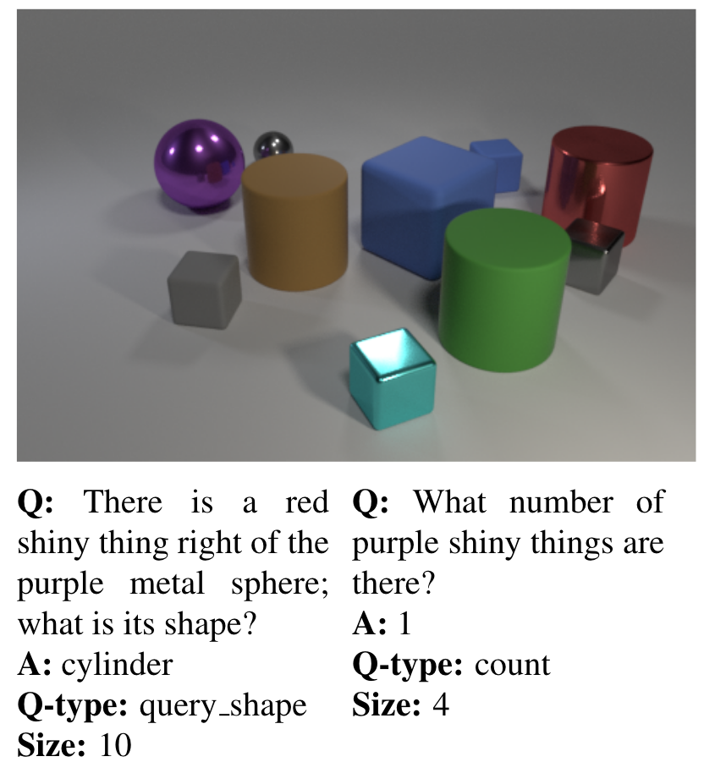
Introduction – Neural Symbolic
Neural + symbolic
Reasoning
Interpretability

Slide 4
Motivation – Neural-Symbolic Concept Learner(NS-CL)
Learn correspondence: object-based visual concepts & word semantics
Unravel compositional logic from complex questions
Realize interpretable, robust and accurate visual reasoning

Slide 5
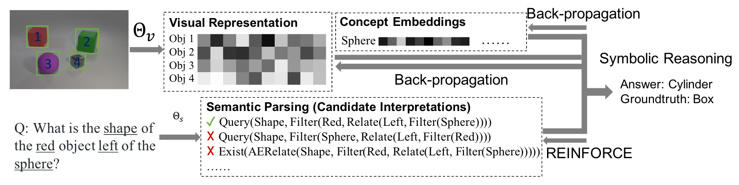
Method
Workflow: 3 modules
Neural-based perception module
Semantic parser: Q -> executable program
Symbolic program executor: Bridge neural & symbolic modules

Slide 6
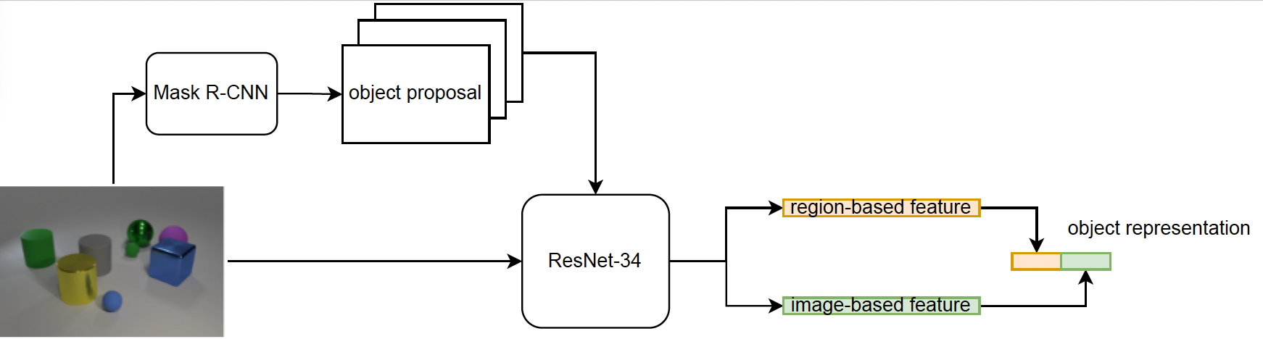
Method - Neural-based perception module
Object feature extraction
Notes:
Concatenation of img-based & region-based features: =full scene adds contextual info, to infer relative attributes, e.g. size or spatial position

Slide 7
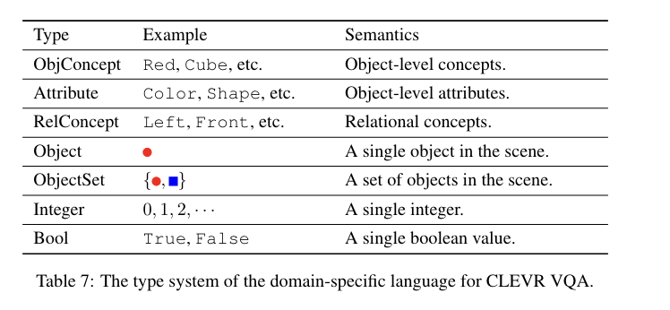
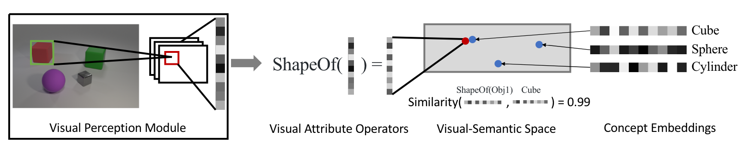
Method - Neural-based Perception Module
Concept quantization
Module / operators: neural-based
Cos-based

Slide 8
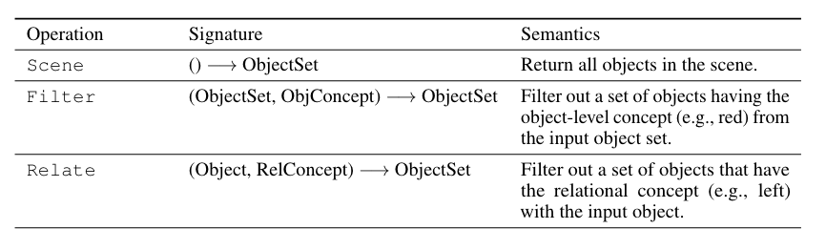
Method – Semantic Parsing Module
Translate question -> executable program
Representation
DSL-based
Hierarchy of primitive operation
Parts of Operations in DSL

Slide 9
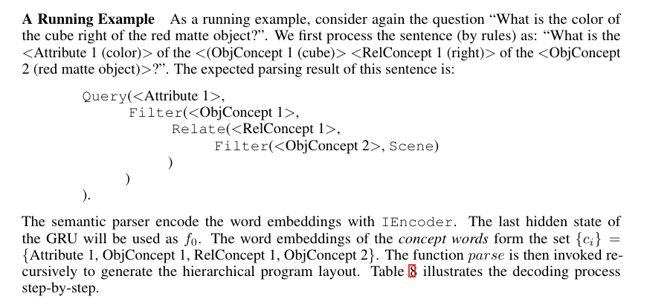
Example

Slide 10
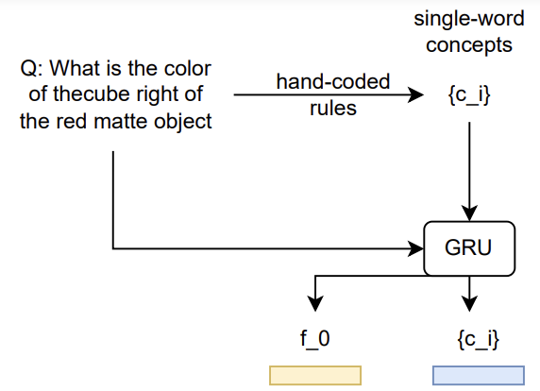
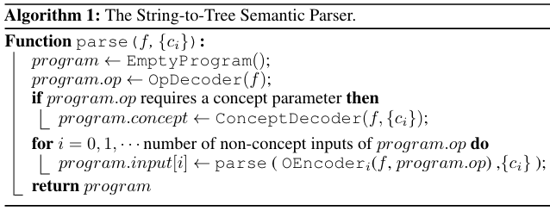
Method – Semantic Parsing Module
Programs (tree manner)
Initialization
Function “Parse”
Notes:
OpDecoder,ConceptDecoder: feed forward NN
Oencoder: GRU
Parse是一个函数，这个函数循环执行

Slide 11
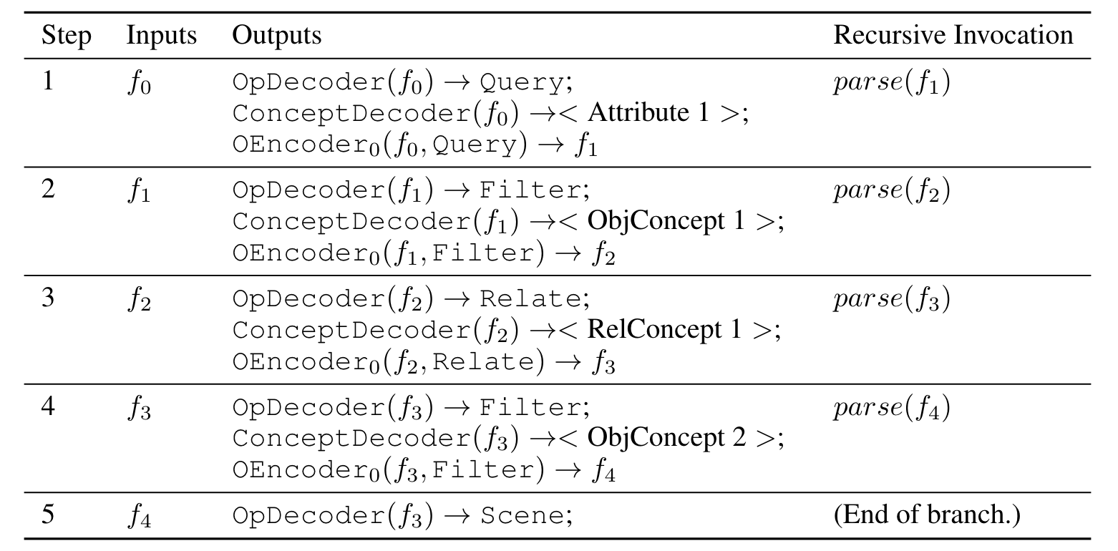
Example

Slide 12
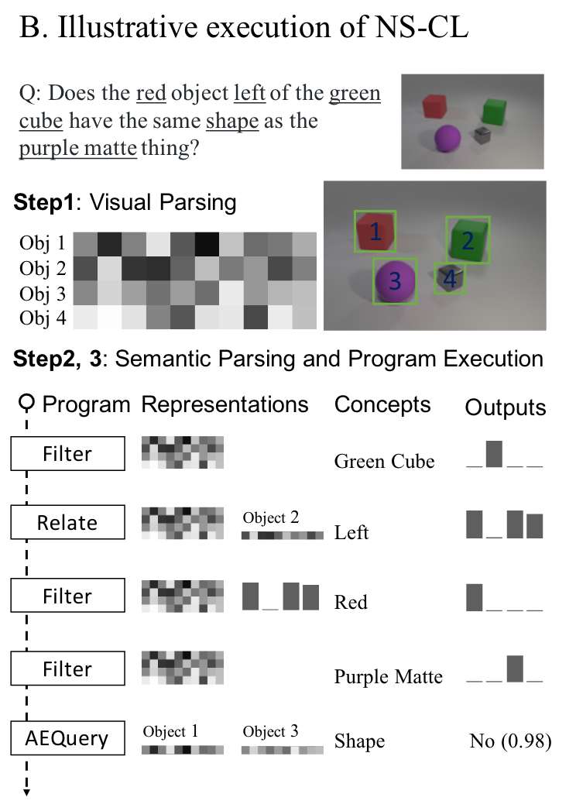
Method - Execution
3 Modules
Perception
Semantic Parsing
Execution
Training
BP
RL
Curriculum Learning

Slide 13
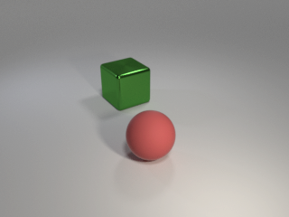

Execution - Example
Object
Detection
Visual Representation
1
Obj 1
Feature
Extraction
Obj 2
2
Concept
Concept Embeddings
red
......
Semantic
Parsing
Q: What’s the shape of the red object?
Program
Filter
Query
red
shape
Notes:
First, we focus on the learning of visual concepts via the neuro-symbolic reasoning. We assume that a latent program has been recovered by the semantic parsing module.

Slide 14
Neuro-Symbolic Reasoning
Visual Representation
1
Obj 1
Obj 2
2
Concept Embeddings
red
......
Q: What’s the shape of the red object?
Filter
Query
red
shape
Notes:
The perception module learns visual concepts based on the language description of the object being referred to. First, we focus on the learning of visual representations for objects and concept embeddings via the neuro-symbolic reasoning. We assume that a latent program has been recovered by the semantic parsing module.

Slide 15


Neuro-Symbolic Reasoning
General Representation Space
Visual Representation
Obj 1
1
Obj 1
Obj 2
Obj 2
2
Concept Embeddings
Color
Proj.
red
......
Color Space
Q: What’s the shape of the red object?
Filter
Query
Color(Obj 1)
red
shape
Color(Obj 2)
Notes:
Starting from the first filter_red operation, For each of the object in the scene, we use a small neural network to project its visual representation into a color space.
The concept red also corresponds to a vector embedding in the color space.

Slide 16
Neuro-Symbolic Reasoning
General Representation Space
Visual Representation
Obj 1
1
Obj 1
Obj 2
Obj 2
2
Concept Embeddings
red
......
Color Space
Q: What’s the shape of the red object?
red
Filter
Query
Color(Obj 1)
red
shape
Color(Obj 2)
Notes:
Starting from the first filter_red operation, For each of the object in the scene, we use a small neural network to project its visual representation into a color space.
The concept red also corresponds to a vector embedding in the color space.

Slide 17
Neuro-Symbolic Reasoning
General Representation Space
Visual Representation
Obj 1
1
Obj 1
Obj 2
Obj 2
2
Sim(Color(Obj1), red) = 0.1 ✗
Sim(Color(Obj2), red) = 0.9 ✓
Concept Embeddings
red
......
Color Space
Q: What’s the shape of the red object?
red
Filter
Query
Color(Obj 1)
red
shape
Color(Obj 2)
Notes:
We compare the cosine similarity between colors of objects and the vector embedding of red to classify objects. In this case, the second object will be classified as red.

Slide 18

Neuro-Symbolic Reasoning
General Representation Space
Visual Representation
Obj 1
1
Obj 1
Obj 2
Obj 2
2
Concept Embeddings
Shape
Proj.
red
......
Q: What’s the shape of the red object?
Shape Space
Filter
Query
red
shape
Shape(Obj 2)
Notes:
Thus, the second object will be selected as the input to the second query_shape operation.
Next, we extract the shape representation of the second object, and compare it with the vector embedding of different shapes in the dataset: cube, sphere, and cylinder.

Slide 19


Neuro-Symbolic Reasoning
General Representation Space
Visual Representation
Obj 1
1
Obj 1
Obj 2
Obj 2
2
cube
Concept Embeddings
sphere
red
cylinder
......
Q: What’s the shape of the red object?
Shape Space
Filter
Query
red
shape
sphere
cube
Shape(Obj 2)
cylinder
Notes:
Thus, the second object will be selected as the input to the second query_shape operation.
Next, we extract the shape representation of the second object, and compare it with the vector embedding of different shapes in the dataset: cube, sphere, and cylinder.

Slide 20
Neuro-Symbolic Reasoning
General Representation Space
Visual Representation
Obj 1
1
Obj 1
Obj 2
Obj 2
2
cube
✗
Concept Embeddings
sphere
✓
red
cylinder
✗
......
Sim(Shape(Obj2), cylinder) = 0.1
Q: What’s the shape of the red object?
Shape Space
Filter
Query
red
shape
sphere
cube
Shape(Obj 2)
cylinder
Notes:
Again, we compute the cosine similarity between the shape representation of the second object and the vector embeddings of different shapes to classify the shape of the object.
In this case, the object will be classified as a sphere, which answers the question correctly.

Slide 21
Neuro-Symbolic Reasoning
Back-propagation
Object
Detection
Visual Representation
1
Obj 1
Feature
Extraction
Obj 2
2
Concept Embeddings
Neuro-Symbolic Reasoning
red
......
Semantic
Parsing
Q: What’s the shape of the red object?
Filter
Query
red
shape
Sphere
Notes:
In the neuro-symbolic reasoning process, all operations are executed based on the similarity between object attributes and concepts, in the latent embedding spaces. Thus, the derived answer is fully differentiable with respect to the visual representations of objects as well as the concept embeddings. During training, we use the groundtruth answer as the supervision and a back-propagation process as the training algorithm.

Slide 22
Idea: Joint Learning of Concepts and Semantic Parsing
Object
Detection
Visual Representation
1
Obj 1
Feature
Extraction
Obj 2
2
Concept
Concept Embeddings
red
......
Semantic
Parsing
Q: What’s the shape of the red object?
Program
Filter
Query
red
shape
Notes:
We now look at how the learned visual concepts facilitate parsing sentences.

Slide 23
Concepts Facilitate Parsing New Sentences
Object
Detection
Visual Representation
1
Obj 1
Feature
Extraction
Obj 2
2
Neuro-Symbolic Reasoning
Concept Embeddings
Answer: Sphere ✓
Groundtruth: Sphere
red
......
Filter
Query
Semantic
Parsing
red
shape
Q: What’s the shape of the red object?
What’s the shape of the red object?
Filter
Same
Exist
red
shape
Any other thing of the same shape as the red object?
Notes:
Based on the visual representations and concept embeddings, the first program gives us the answer sphere, which is correct, compared with the groundtruth. Thus, the first candidate program will be marked as a positive example.

Slide 24
Concepts Facilitate Parsing New Sentences
Object
Detection
Visual Representation
1
Obj 1
Feature
Extraction
Obj 2
2
Neuro-Symbolic Reasoning
Concept Embeddings
Answer:
Groundtruth: Sphere
red
......
Filter
Query
Semantic
Parsing
red
shape
Q: What’s the shape of the red object?
What’s the shape of the red object?
Filter
Same
Exist
red
shape
Any other thing of the same shape as the red object?
Notes:
We also execute the second program.

Slide 25
Concepts Facilitate Parsing New Sentences
Object
Detection
Visual Representation
1
Obj 1
Feature
Extraction
Obj 2
2
Neuro-Symbolic Reasoning
Concept Embeddings
Answer: No ✗
Groundtruth: Sphere
red
......
Filter
Query
Semantic
Parsing
red
shape
Q: What’s the shape of the red object?
What’s the shape of the red object?
Filter
Same
Exist
red
shape
Any other thing of the same shape as the red object?
Notes:
The answer No is incorrect compared with the groundtruth answer to the original question. Thus, the second program will be marked as a negative example.

Slide 26
Concepts Facilitate Parsing New Sentences
Object
Detection
Visual Representation
1
Obj 1
Feature
Extraction
Obj 2
2
Neuro-Symbolic Reasoning
Concept Embeddings
red
......
REINFORCE
Filter
Query
Semantic
Parsing
red
shape
Q: What’s the shape of the red object?
What’s the shape of the red object?
Filter
Same
Exist
red
shape
Any other thing of the same shape as the red object?
Notes:
For each of the parsed program, we use the execution result compared with the groundtruth as the reward, and apply a REINFORCE algorithm to train the semantic parser.

Slide 27
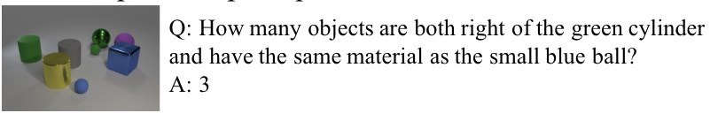
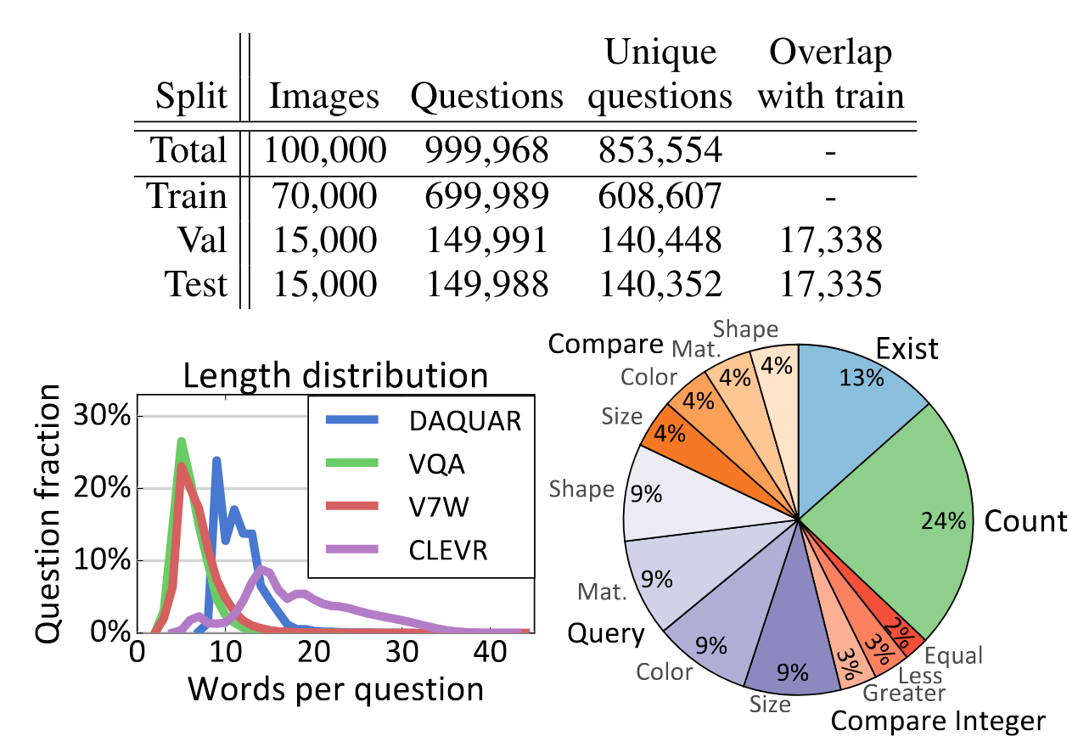
Experiment - Dataset
CLEVR
Motivation: Reason & VQA
Object and relationships
3 shapes
2 sizes
2 materials
8 colors
4 relationships
Scene
3 ~ 10 objecrts
Objects at least partially visible
Random light & camera positions
Notes:
scenes: simple, to focus on model reasoning skills

Slide 28
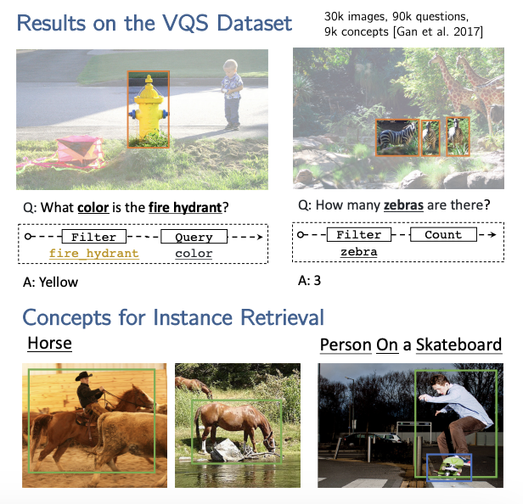
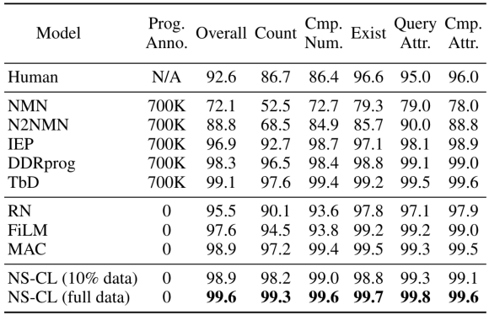
Experiment - Result
Notes:
High accuracy
Transfer to other dataset / task

Slide 29
Conclusion
Principles:
Explicit visual grounding of concepts with neuro-symbolic reasoning.
Joint learning of concepts and language with curriculum.
Advantages:
High accuracy and data efficiency.
Transfer learned concepts to other tasks.

