Slide 1
THE NEURO-SYMBOLIC CONCEPT LEARNER: INTERPRETING SCENES, WORDS, AND SENTENCES FROM NATURAL SUPERVISION
(2019 ICLR)

Slide 2
Introduction
Reasoning
Interpretability

Slide 3
Motivation
Learn correspondence between visual concepts and word semantics
Unreal compositional logic from complex questions

Slide 4
Method
DSL
Workflow
Neural-based perception module
Semantic parser: questiaon -> executable programs
Symbolic program executor

Slide 5
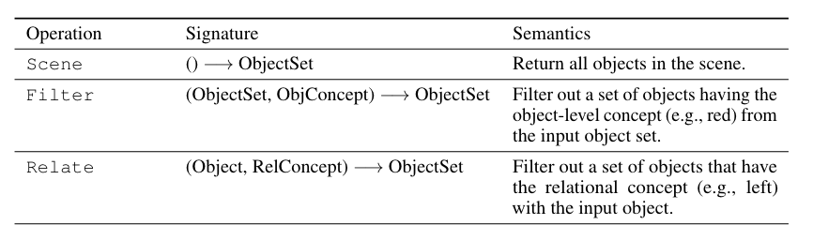
Operations in DSL

Slide 6
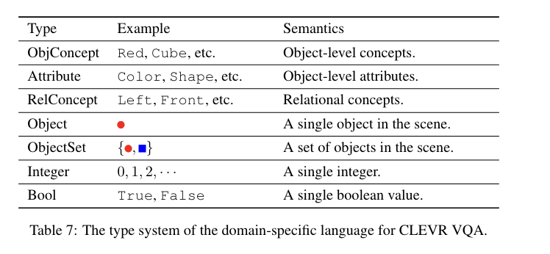
Concepts in DSL

Slide 7
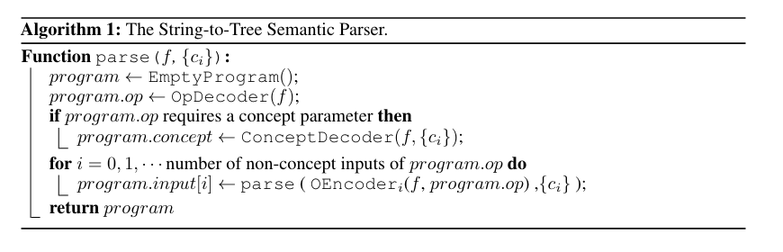
Programs in tree manner

Slide 8
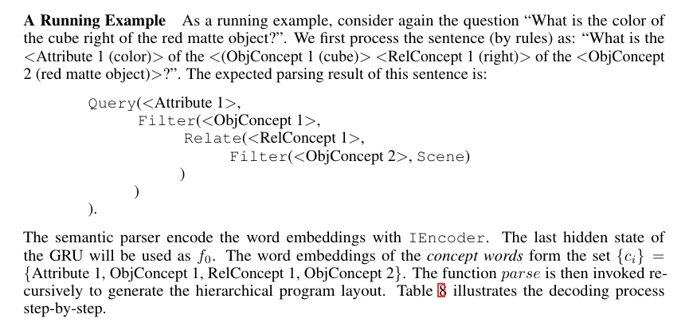
Example

Slide 9
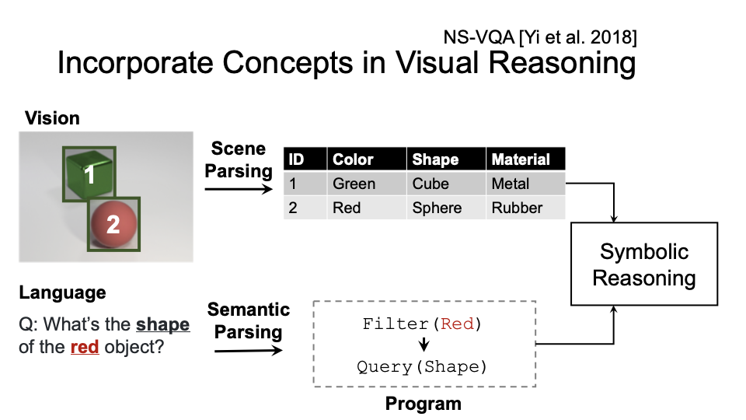

Slide 10
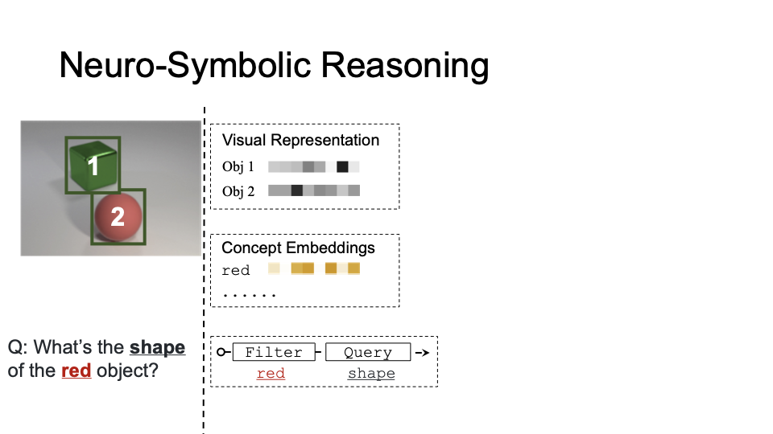

Slide 11
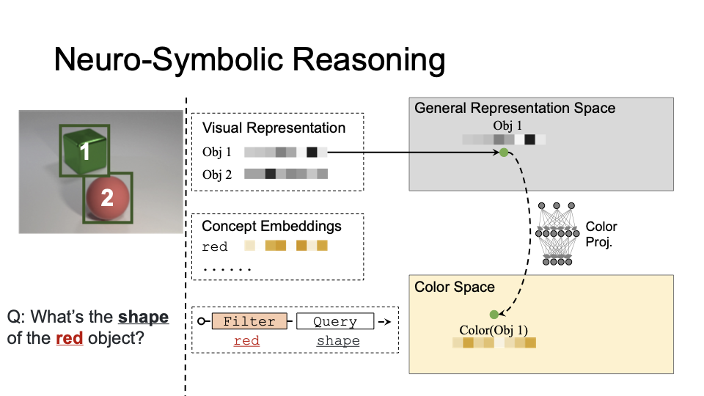
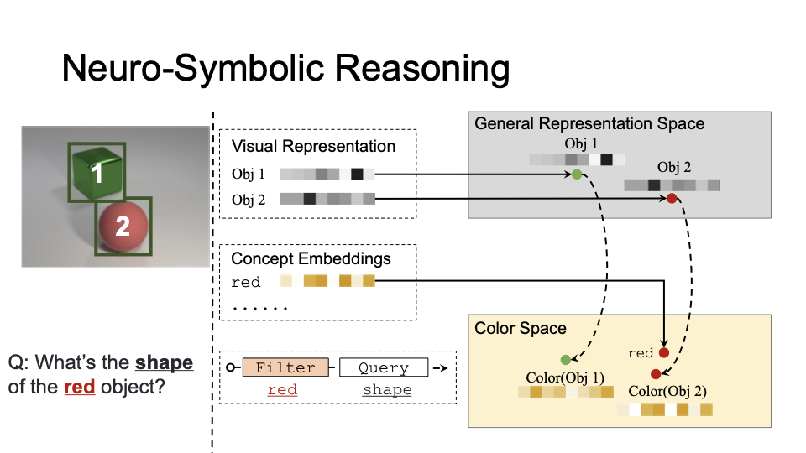

Slide 12
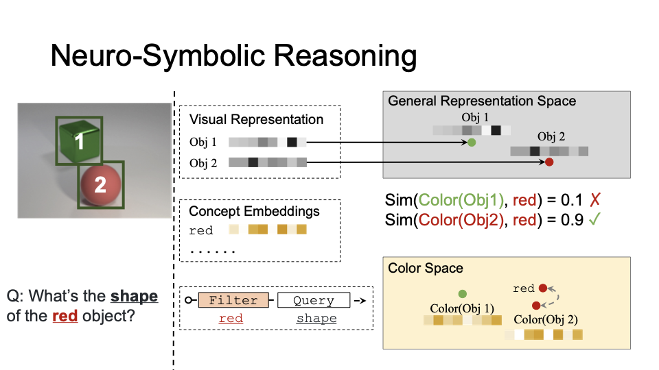

Slide 13
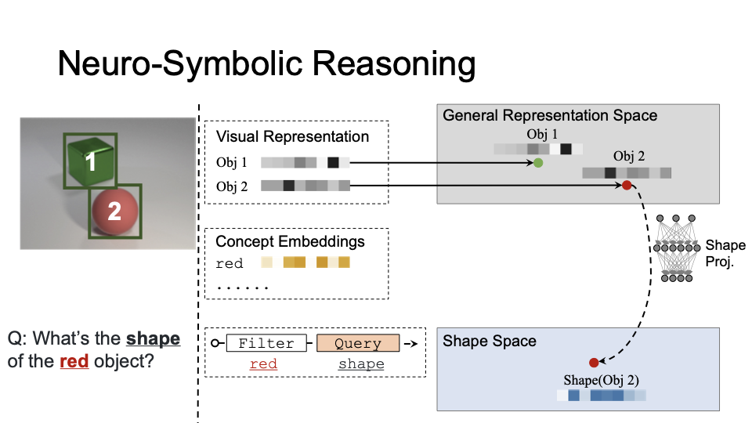

Slide 14
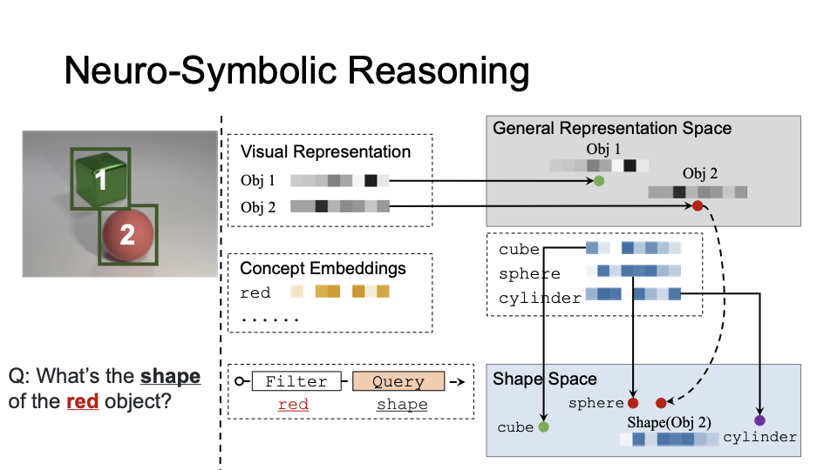

Slide 15
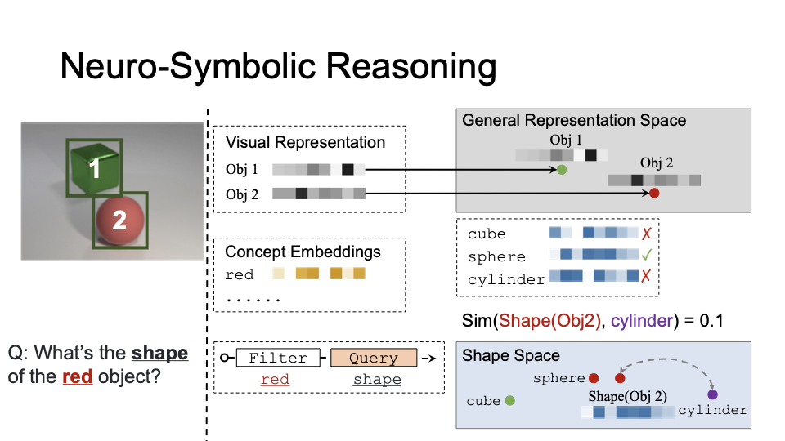

Slide 16
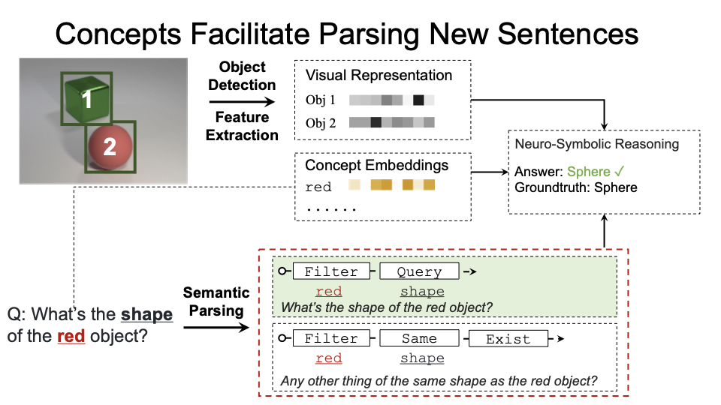

Slide 17
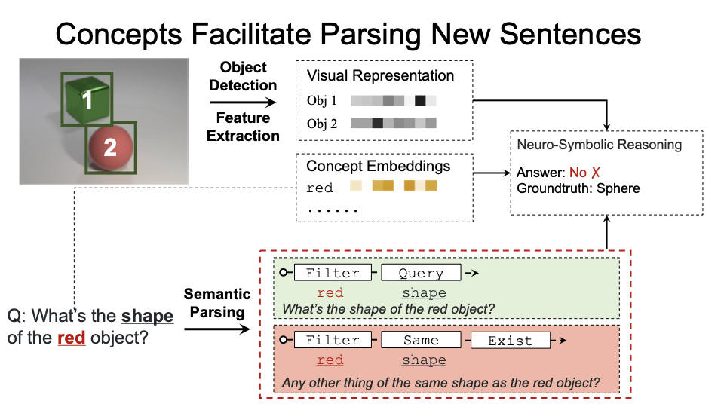

Slide 18
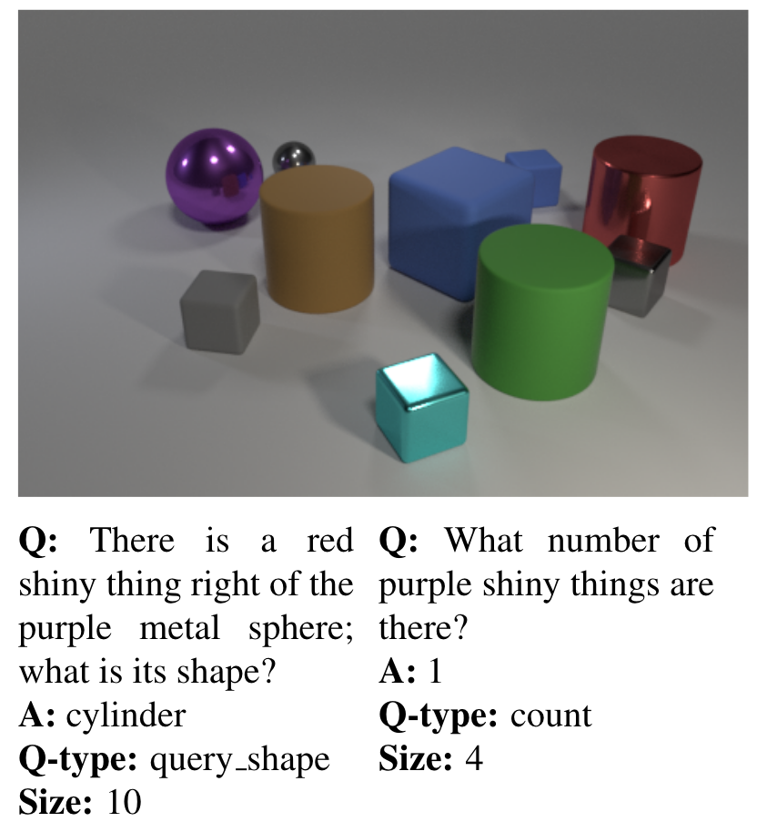
Dataset
CLEVR
Motivation: Reason & VQA
Object and relationships
3 shapes
2 sizes
2 materials
8 colors
4 relationships
Scene
3 ~ 10 objecrts
Objects at least partially visible
Random light & camera positions
Notes:
scenes: simple, to focus on model reasoning skills

Slide 19
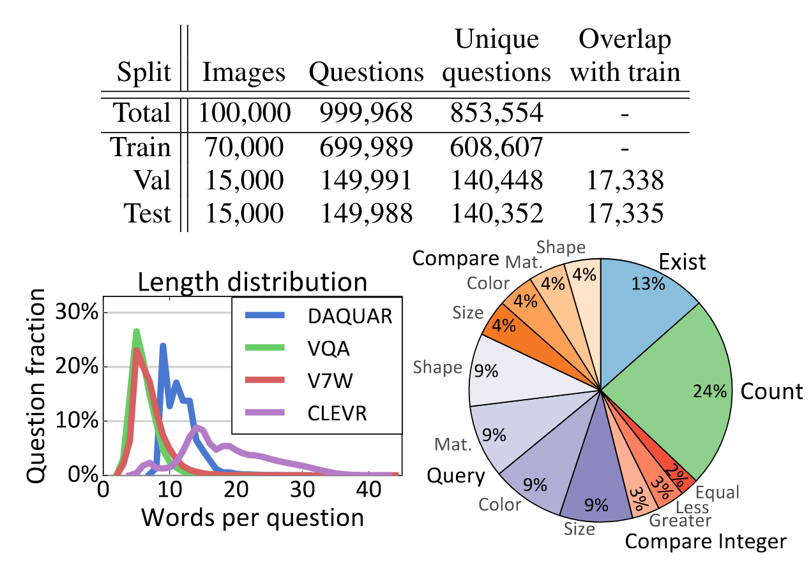
Experiment - Dataset
CLEVR
5 qustion type
2 image condition

