Slide 1

Document

Slide 2

Slide 1: Title Slide
Subtitle: Leveraging BERT, GPT, and T5 Models

Slide 3

Slide 2: Introduction
Objective: The main goal of this project is to develop an advanced AI system capable of understanding and generating accurate responses to user queries, thereby mimicking human-like interaction
Dataset: We use the Quora Question Answer Dataset, which consists of a large number of question-answer pairs
BERT : Known for its ability to understand the context of words in a sentence
GPT : Excels at generating coherent and contextually relevant text
T5 : Capable of converting text from one format to another, making it versatile for question-answering tasks
Key Focus: Our focus is on creating an AI system that can provide human-like responses, enhancing user interaction and providing accurate information retrieval

Slide 4

Slide 3: Data Exploration, Cleaning, and Preprocessing
Analyze Dataset: We begin by examining the structure and content of the dataset to understand its components and characteristics
Cleaning: We remove irrelevant information and handle any missing or duplicate data to ensure the dataset is clean and suitable for training
Tokenization: Breaking down text into individual tokens that the model can process
Stop Word Removal: Removing common words that do not contribute significantly to the meaning
Stemming and Lemmatization: Reducing words to their base or root form to ensure uniformity
Pandas: For data manipulation and analysis
NLTK : For preprocessing tasks like tokenization, stemming, and lemmatization
NumPy: For numerical operations and handling arrays

Slide 5

Slide 4: Model Selection
We fine-tuned bert-large-uncased-whole-word-masking-finetuned-squad for the question-answering task
The dataset was tokenized, and start and end positions of answers were calculated for training
We fine-tuned the gpt2 model to generate text relevant to the context of the questions
We fine-tuned t5-small to convert the input questions into corresponding answers effectively

Slide 6
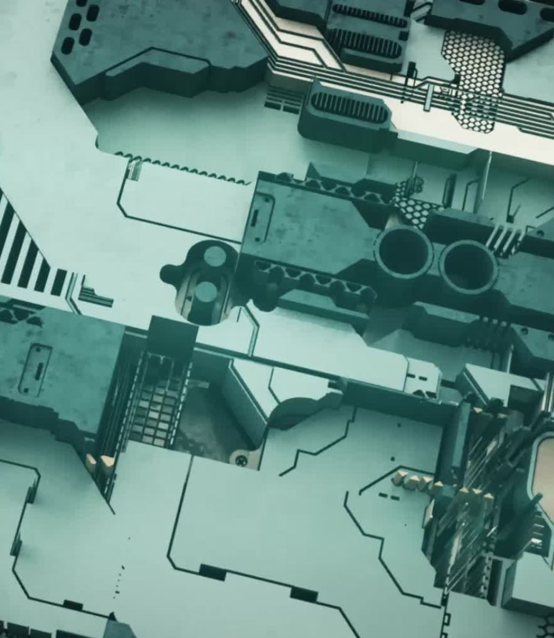
Slide 4: Model Selection
Library Used: We used the Hugging Face transformers library, which provides pre-trained models and easy-to-use interfaces for fine-tuning various NLP models

Slide 7
Slide 5: Model Training and Evaluation - BERT
Utilized Trainer and TrainingArguments from the transformers library
Configured batch size, learning rate, and number of epochs to optimize model performance
ROUGE : Measures the overlap of n-grams between the generated and reference texts
BLEU : Assesses the quality of text by comparing it to reference texts
F1-score: Combines precision and recall to provide a single performance metric
Torch : For building and training the model
Datasets library: For handling and processing the dataset efficiently

Slide 8

Slide 6: Model Training and Evaluation - GPT
Fine-tuned the gpt2 model with specific prompts to generate contextually accurate and coherent text
Text Coherence: Measures how logically connected the generated text is
Relevance: Assesses how relevant the generated text is to the input question
Context Accuracy: Evaluates the correctness of the generated text within the given context
Torch : For model training
Datasets library: For managing the dataset

Slide 9
Slide 7: Model Training and Evaluation - T5
Utilized Trainer and TrainingArguments from the transformers library
Fine-tuned t5-small to handle both question-answering and text generation tasks
ROUGE: Evaluates n-gram overlaps between generated and reference texts
BLEU: Assesses text quality by comparing it to reference texts
F1-score: Combines precision and recall for a single performance metric
Torch : For training the model
Datasets library: For dataset management

Slide 10

Slide 8: Visualization
Visualizations using Matplotlib, Seaborn, and Plotly to show how data is distributed across various features
Highlighting key features that contribute significantly to the model’s performance
Charts and graphs depicting accuracy, loss, and evaluation metrics to provide a clear view of model performance over training epochs

Slide 11

Slide 9: Insights and Recommendations
Model Performance Comparison: Detailed comparison of BERT, GPT, and T5 models in terms of their accuracy and relevance in question answering
Key Findings: Notable patterns and observations from data analysis and model evaluation
Model Improvement: Suggestions to enhance model performance, such as hyperparameter tuning, data augmentation, or model ensembling
Future Work: Potential areas for further research and development, such as incorporating additional datasets or exploring other advanced models

Slide 12

Slide 10: Technical Stack
Google Colab/Jupyter Notebook: For interactive coding and experimentation
Visualization Tools: Matplotlib, Seaborn, and Plotly for creating visual representations of data and model performance
Python: The core programming language used for development
Transformers Library: For accessing and fine-tuning pre-trained models
Torch : For building and training neural network models
Datasets Library: For efficient data handling and processing

Slide 13

Slide 11: Additional Tools and Libraries
Hugging Face Datasets: For loading and preprocessing the dataset

Slide 14
Slide 12: Results and Performance - BERT
Presented the fine-tuning results and performance metrics for the BERT model
Included examples of model outputs for various questions
ROUGE: Shows the n-gram overlaps between generated and reference texts
BLEU: Measures the quality of generated text
F1-score: Provides a balanced evaluation combining precision and recall

Slide 15
Slide 13: Results and Performance - GPT
Showed examples of text generation by the GPT model
Included performance metrics that highlight the model’s ability to generate coherent and contextually relevant text
Text Coherence: Evaluates the logical flow of generated text
Relevance: Assesses the alignment of generated text with the input question
Context Accuracy: Measures the correctness of the generated text within the context provided

Slide 16
Slide 14: Results and Performance - T5
Presented examples of question-answering and text generation by the T5 model
Included performance metrics to show the model’s effectiveness in handling both tasks
ROUGE: Evaluates the overlap of n-grams between generated and reference texts
BLEU: Measures the quality of generated text
F1-score: Combines precision and recall for a comprehensive evaluation

Slide 17
Slide 15: Conclusion
Recapped the project’s objectives, methods, and achievements
Highlighted the key results and the performance of the models
Successfully developed and fine-tuned three models for question-answering tasks
Achieved high performance in generating accurate and relevant responses
Suggested potential improvements and future research directions, such as exploring more advanced models or incorporating additional data sources

Slide 18

Slide 16: Q&A
Engage with the Audience: Open the floor for questions and discussions

