Slide 1
COMPUTER

Slide 2
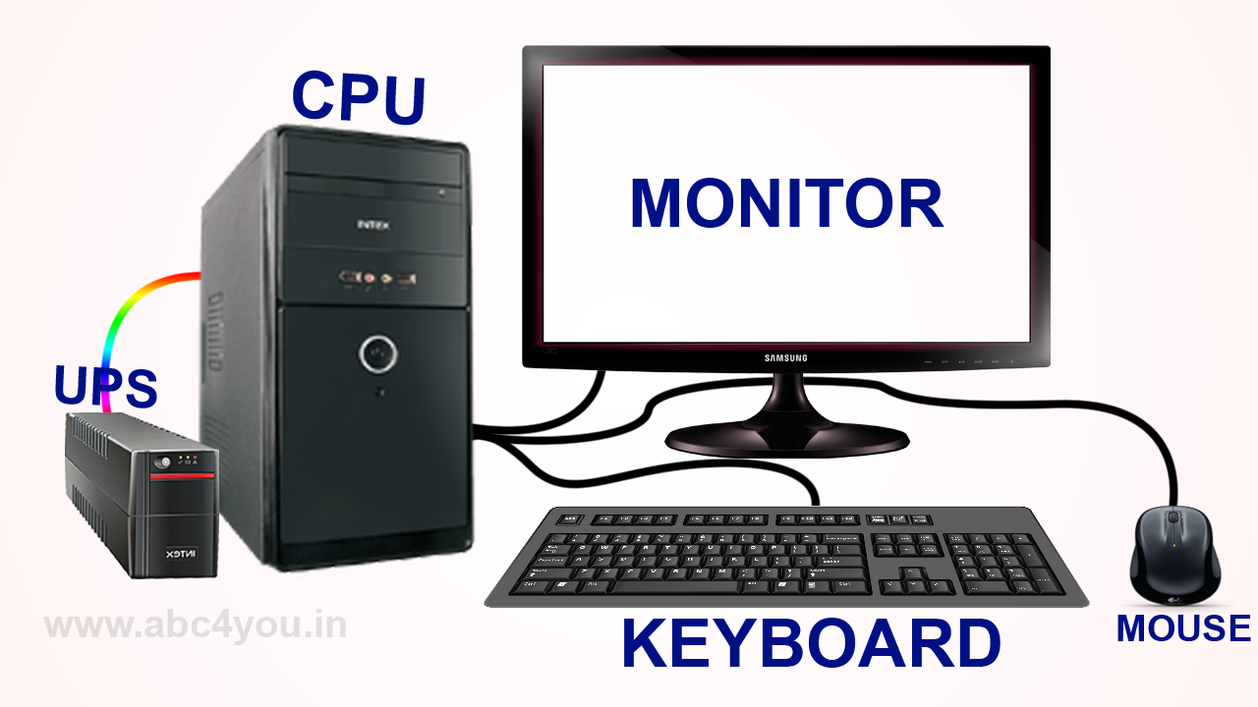
What is the Computer
A computer is a programmable device that stores, retrieves, and processes data. The term "computer" was originally given to humans (human computers) who performed numerical calculations using mechanical calculators, such as the abacus and slide rule. The term was later given to mechanical devices as they began replacing human computers. Today's computers are electronic devices that accept data (input), process that data, produce output, and store (storage) the results (IPOS).
Computer overview.
History of the computer.
How are computers used today?
What components make up a desktop computer?
What parts are needed for a computer to work?
Computer connections
Types of computers.
Who makes computers?

Slide 3
Computer overview
Today’s world is an information-rich world and it has become a necessity for everyone to know about computers. A computer is an electronic data processing device, which accepts and stores data input, processes the data input, and generates the output in a required format.
The purpose of this tutorial is to introduce you to Computers and its fundamentals.

Slide 4
Hardware & software

Slide 5
hardware
A computer's hardware consists of its physical parts, including its internal pieces and connected external devices. Hardware components perform a computer's tasks like calculating data, storing information, processing input, and providing output. Any part of a computer that you can physically touch is hardware.
All hardware devices, whether internal or external, include chips on a circuit board to perform a function. All hardware also requires a way to interface with the rest of the computer, usually by connecting to a port, socket, or wireless radio. After that, pieces of hardware will include other parts that help them fulfill their function, like buttons, sensors, protective cases, or even cooling fans to prevent overheating.

Slide 6
software
Every day, we rely on software to accomplish tasks, entertain ourselves, and connect with others. From mobile apps to complex computer systems, software is an integral part of our daily lives.
In this blog post, we’ll dive into the world of software, exploring its definition, types, and examples, and uncovering its fascinating history and the relationship between software and hardware. Ready to embark on this exciting journey? Let’s get started! At its core, software is a set of instructions or programs that perform specific tasks when given commands. These instructions tell the computer’s hardware, such as transistors and memory chips, what to do. Developing software involves a process called the software development lifecycle, which project managers use to outline tasks and ensure that the software meets users’ needs.
Programming software enables developers to create programs and applications, using programming languages that can range from high-level languages like Python to low-level machine code. Examples of software we use daily include Microsoft Word for word processing, Microsoft Excel for spreadsheets, and web browsers like Google Chrome for browsing the internet.

Slide 7
Operating system
and real-time systems, exist for many applications. Security-focused operating systems also exist. Some operating systems have low system requirements (e.g. light-weight Linux distribution). Others may have higher system requirements.
An operating system (OS) is system software that manages computer hardware and software resources, and provides common services for computer programs.
Time-sharing operating systems schedule tasks for efficient use of the system and may also include accounting software for cost allocation of processor time, mass storage, peripherals, and other resources.
For hardware functions such as input and output and memory allocation, the operating system acts as an intermediary between programs and the computer hardware,^{[1][2]} although the application code is usually executed directly by the hardware and frequently makes system calls to an OS function or is interrupted by it. Operating systems are found on many devices that contain a computer – from cellular phones and video game consoles to web servers and supercomputers.
In the personal computer market, as of September 2023, Microsoft Windows holds a dominant market share of around 68%. macOS by Apple Inc. is in second place (20%), and the varieties of Linux, including ChromeOS, are collectively in third place (7%).^{[3]} In the mobile sector (including smartphones and tablets), as of September 2023, Android's share is 68.92%, followed by Apple's iOS and iPadOS with 30.42%, and other operating systems with .66%.^{[4]} Linux distributions are dominant in the server and supercomputing sectors. Other specialized classes of operating systems (special-purpose operating systems),^{[5][6]} such as embedded

Slide 8
Different types of number system
As Numbers are not only the mere symbols on a page but there is much more significance of numbers. In the study of mathematics, numerous number systems exist, each with its own significance and applications. From the familiar decimal system we use daily to the intriguing worlds of binary, octal, and hexadecimal, these systems offer unique perspectives on numerical representation. In this article, we explore the concepts of number systems and also learn about these different number system types.
The number system includes different types of numbers for example prime numbers, odd numbers, even numbers, rational numbers, whole numbers, etc. These numbers can be expressed in the form of figures as well as words accordingly. For example, the numbers like 40 and 65 expressed in the form of figures can also be written as forty and sixty-five.
Based on the base value and the number of allowed digits, number systems are of many types. The four common types of Number systems are:
Decimal Number System
Binary Number System
Types of Number Systems
Octal Number System
Hexadecimal Number System
Decimal Number

Slide 9
types of computer
There are two bases on which we can define the types of computers. We will discuss the type of computers on the basis of size and data handling capabilities. We will discuss each type of computer in detail. Let’s see first what are the types of computers.
Super Computer
Mainframe computer
Mini Computer
Workstation Computer
Personal Computer (PC)
Server Computer
Analog Computer
Digital Computer
Hybrid Computer
Tablets and Smartphone

Slide 10


