Slide 1
DEPI GRADUATION PROJECT · 2026
MediCare Pro
Smart Healthcare Management System — a full-stack platform for patients, doctors, and administrators.
Ahmed Bakr · Ahmed Sabry · Ibrahim Mohamed · Ahmed Hany

Slide 2
PRESENTATION OUTLINE
Agenda
01
Foundations
02
Deep Dive & Showcase
01 Project Overview & Problem Statement 02 Objectives & Target Users 03 Main Features 04 Project Statistics 05 Tech Stack 06 System Architecture & Database
07 Security & Feature Breakdown 08 UI Showcase — All Modules 09 Demo Flow & Live Demo 10 Challenges & Solutions 11 Strengths & Future Enhancements 12 Team & Conclusion
2 / 29

Slide 3
WHAT IS MEDICARE PRO?
One platform. Every appointment, secured.
Connecting patients, doctors, and admins on one platform.
3 / 29

Slide 4
WHY MEDICARE PRO WAS BUILT
Problem Statement
Manual scheduling doesn't scale.
APPOINTMENT CONFLICTS
Phone-based scheduling leads to double-bookings and time clashes across clinics.
POOR COMMUNICATION
No direct digital channel between patients and doctors for updates or follow-ups.
Clinics relying on phone bookings face conflicts, poor visibility, and no central oversight.
NO DISCOVERY
Patients struggle to find verified specialists filtered by specialty and rating.
NO CENTRALIZATION
Scattered records make platform-wide monitoring and analytics impossible.
4 / 29

Slide 5
WHAT MEDICARE PRO AIMS TO ACHIEVE
Project Objectives
01
Digitize Healthcare — move phone bookings online.
02
Improve Communication — direct doctor-patient contact.
03
Reduce Conflicts — prevent automatic double-bookings.
04
Centralize Management — one platform, three roles.
05
Responsive UX — consistent experience on every device.
5 / 29

Slide 6
THREE DISTINCT ROLES
Target Users
01
Patients & Doctors
02
Administrators
Patients register, search and filter verified doctors, book and cancel appointments, pay securely, and leave reviews. Doctors register for approval, manage their weekly schedule, accept or complete appointments, and maintain their professional profile.
Administrators manage all users, approve doctor registrations, monitor every appointment platform-wide, and track revenue and system health through analytics dashboards.
6 / 29

Slide 7
CORE FUNCTIONALITIES OF THE PLATFORM
Main Features
Six core capabilities, one platform.
AUTHENTICATION
JWT tokens, bcrypt password hashing, protected routes, and role-based sessions.
DOCTOR DISCOVERY & BOOKING
Search by name or specialty, filter by rating, and book available time slots instantly.
Every feature is built around the three-role experience.
SCHEDULE & PRACTICE MANAGEMENT
Doctors configure weekly availability and slot duration, and accept or complete appointments.
ANALYTICS & REVIEWS
Admin revenue dashboards, appointment breakdowns, and a star-rating review system.
7 / 29

Slide 8
MEDICARE PRO BY THE NUMBERS
Project Statistics
📄
🔌
🗄️
27
34
7
Total Pages
REST API Routes
Database Tables
Patient, doctor, admin & public
41 endpoints across 8 modules
SQL Server, fully relational
👥
💳
🔐
3
✓
✓
User Roles
Stripe Integrated
JWT Secured
Patient · Doctor · Admin
Checkout, refunds & sync
Stateless, role-based auth
8 / 29

Slide 9










MODERN, INDUSTRY-STANDARD TECHNOLOGIES
Tech Stack
React 19
Vite
Node.js
Express.js
SQL Server
Stripe
JWT
Git
GitHub
Axios
Also powered by React Context API for global state and Bootstrap 5 for responsive styling.
9 / 29

Slide 10
HOW THE LAYERS CONNECT
System Architecture
The React frontend calls the Express API over authenticated REST requests, which reads/writes SQL Server and coordinates Stripe payments.
🔐 JWT Authentication
React + Vite
Context API
Axios
Express.js API
SQL Server
Stripe
UI Layer
State
HTTP Client
34 Routes
7 Tables
Payments
Frontend (React + Vite · Context API · Axios)
Backend (Express.js · SQL Server · Stripe)
10 / 29

Slide 11
SQL SERVER SCHEMA — KEY ENTITIES & RELATIONSHIPS
Database Design
Users
Doctors
Appointments
Payments
Refunds
Patient & Doctor roles
Doctor profile
Bookings
Stripe records
Cancellations
Reviews
DoctorAvailability
Ratings
Weekly slots
Patients and Doctors are both Users, distinguished by role. 7 tables · 6 views · 13 stored procedures · 2 triggers.
11 / 29

Slide 12
41 ENDPOINTS ACROSS 8 MODULES — 34 UNIQUE ROUTES
API Architecture
4
6
3
6
Authentication
Doctor
Patient / User
Appointments
Register, login, get & update profile
List, view, update, create, delete
Profile & user statistics
Book, list, update, cancel, delete
4
5
4
9
Availability
Payments
Reviews
Admin
Slots, weekly schedule, updates
Stripe checkout, verify, refund, history
Add, list, check, delete
Stats, revenue, approvals, management
12 / 29

Slide 13
ENTERPRISE-GRADE SECURITY FROM DAY ONE
Security
Security built in, not bolted on.
JWT AUTHENTICATION
Stateless, signed tokens with role claims secure every session.
PASSWORD HASHING
bcrypt with salt rounds — passwords are never stored in plain text.
Every layer of MediCare Pro enforces authentication and data protection.
PROTECTED ROUTES & RBAC
Frontend route guards and backend middleware isolate Patient, Doctor, and Admin access.
SECURE STRIPE PAYMENTS
Checkout sessions and idempotent verification keep every transaction safe.
13 / 29

Slide 14
WHAT EACH ROLE CAN DO
Features by User Role
One codebase, three purpose-built experiences.
Feature | Patient | Doctor | Admin
Doctor Discovery & Appointments | ✓ Search, book & cancel | ✓ Accept & complete | ✓ Monitor all
Payments & Refunds | ✓ Pay & view history | – | ✓ Manual refunds
Scheduling & Availability | ✓ View open slots | ✓ Set weekly hours | –
Reviews & Verification | ✓ Leave reviews | ✓ Get verified | ✓ Approve doctors
Analytics & User Management | – | – | ✓ Dashboards & users
14 / 29

Slide 15

BRAND IDENTITY
A Trusted Digital Health Mark
The MediCare Pro mark pairs a medical cross with a heartbeat pulse — a simple symbol of care and vitality. A dark, teal-accented interface carries that identity across every patient, doctor, and admin experience.
MediCare Pro logo
15 / 29

Slide 16
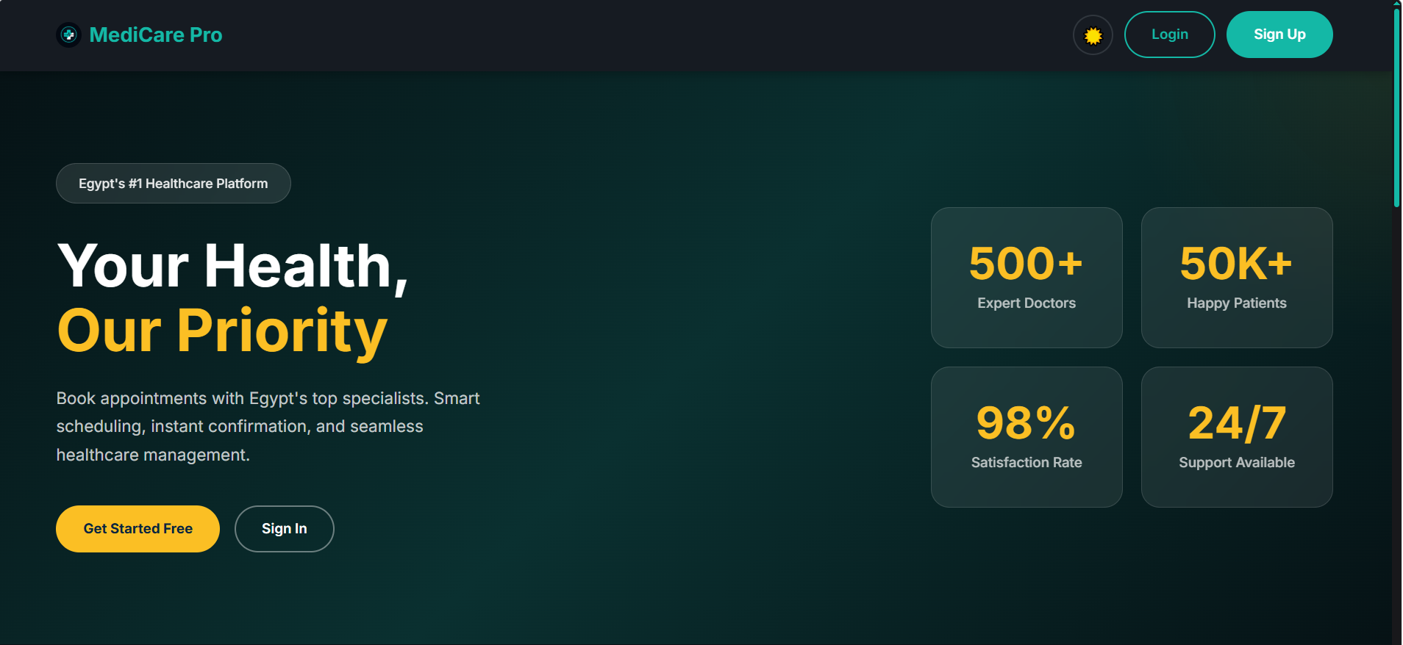

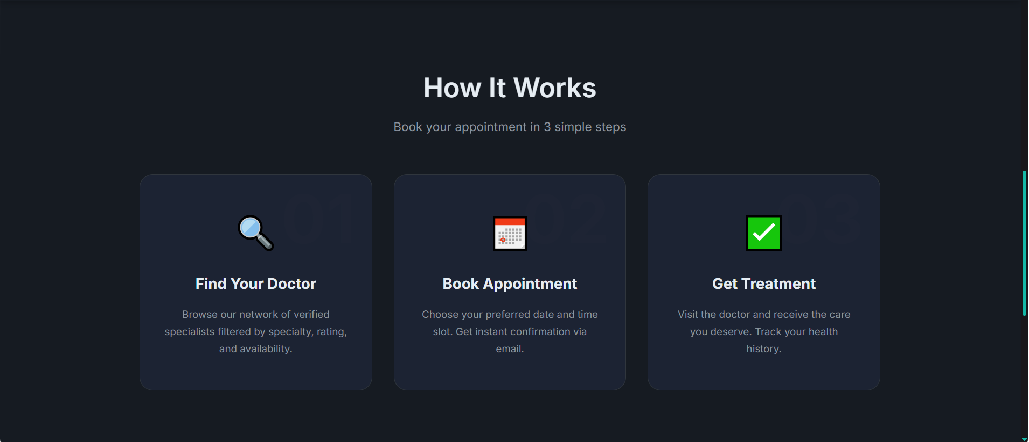

EGYPT'S #1 HEALTHCARE PLATFORM
UI Showcase — Landing Page
Hero Section
Medical Specialties
How It Works
Call to Action & Footer
16 / 29

Slide 17
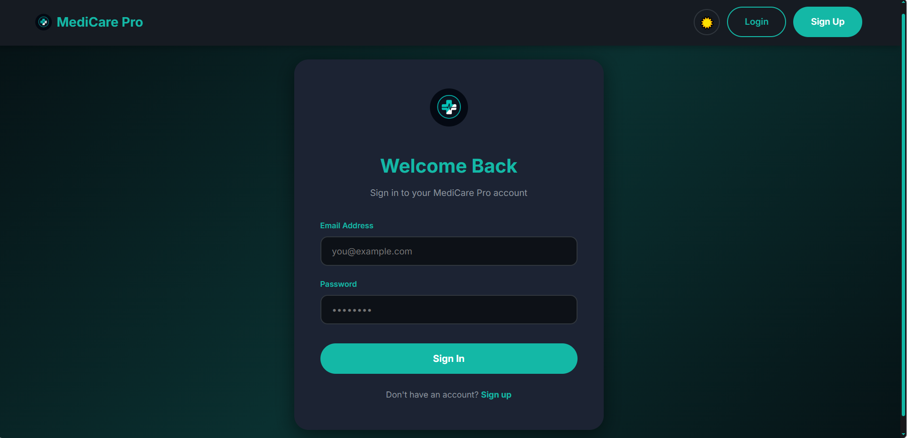
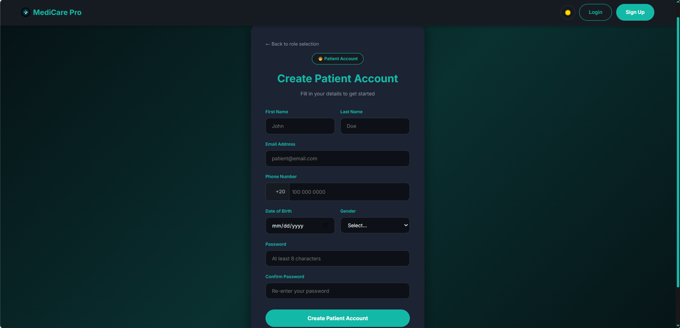
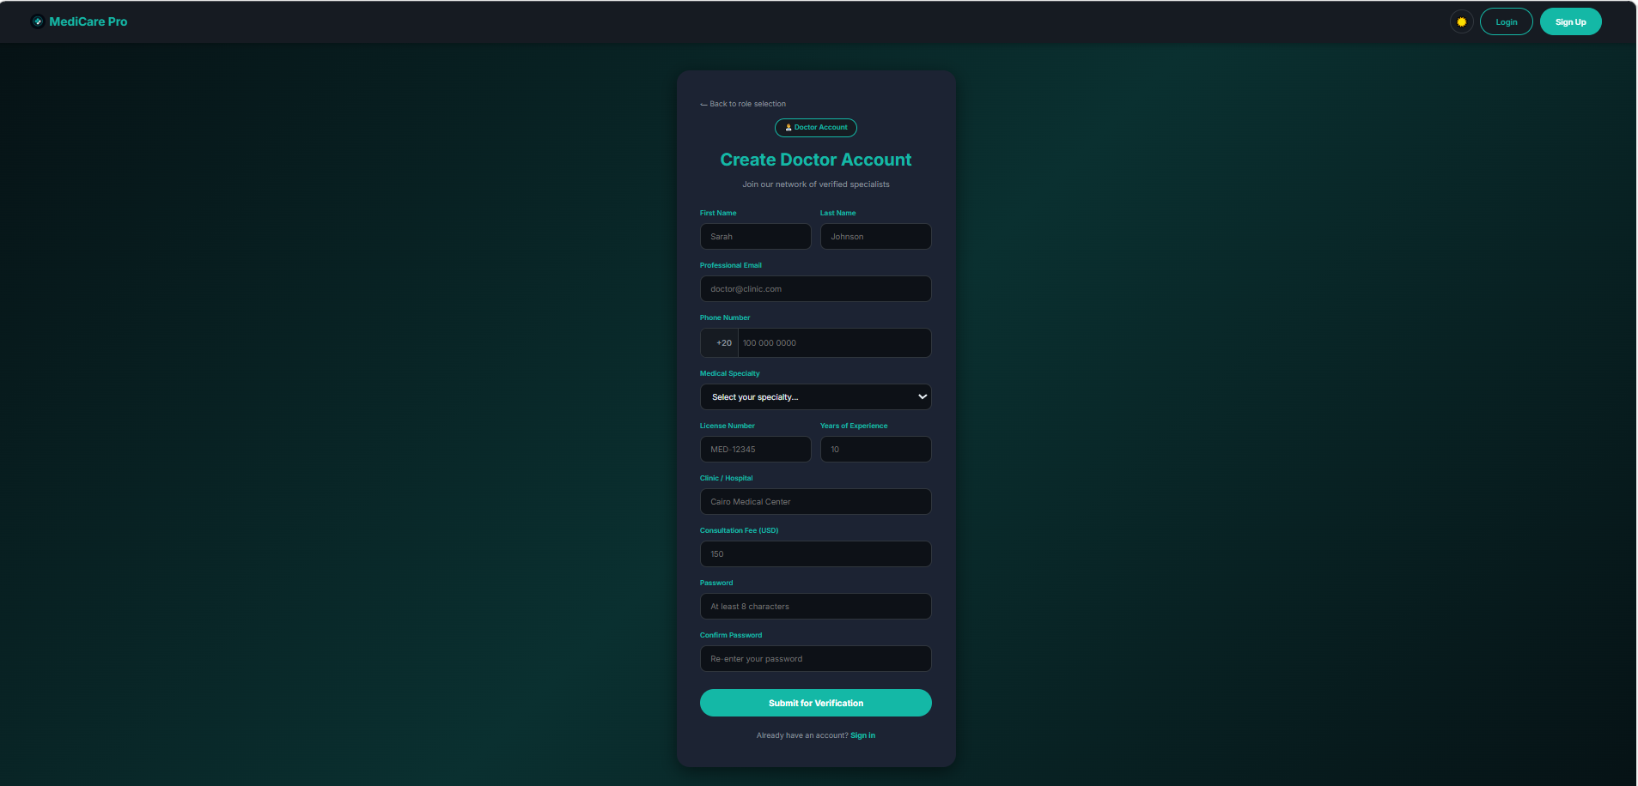
SECURE LOGIN & MULTI-STEP REGISTRATION
UI Showcase — Authentication
Login
Patient Sign Up
Doctor Sign Up
17 / 29

Slide 18
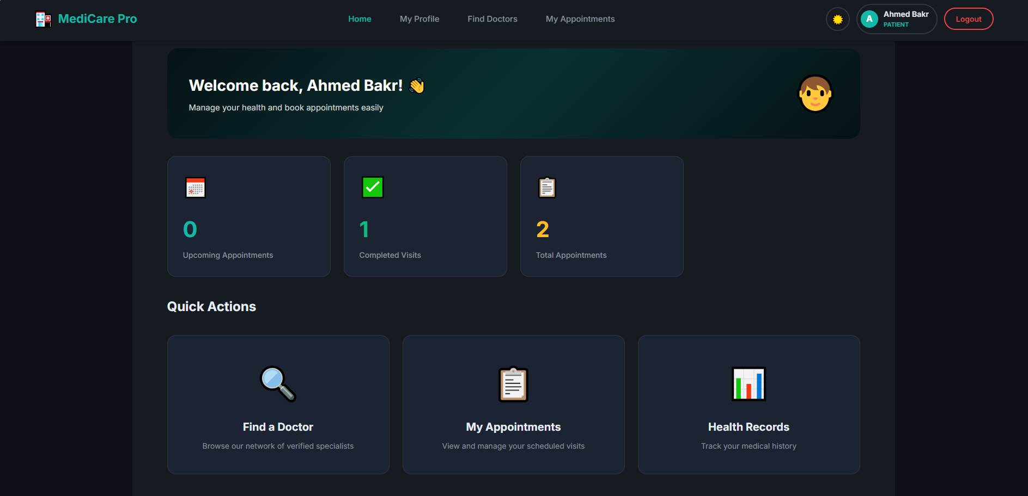
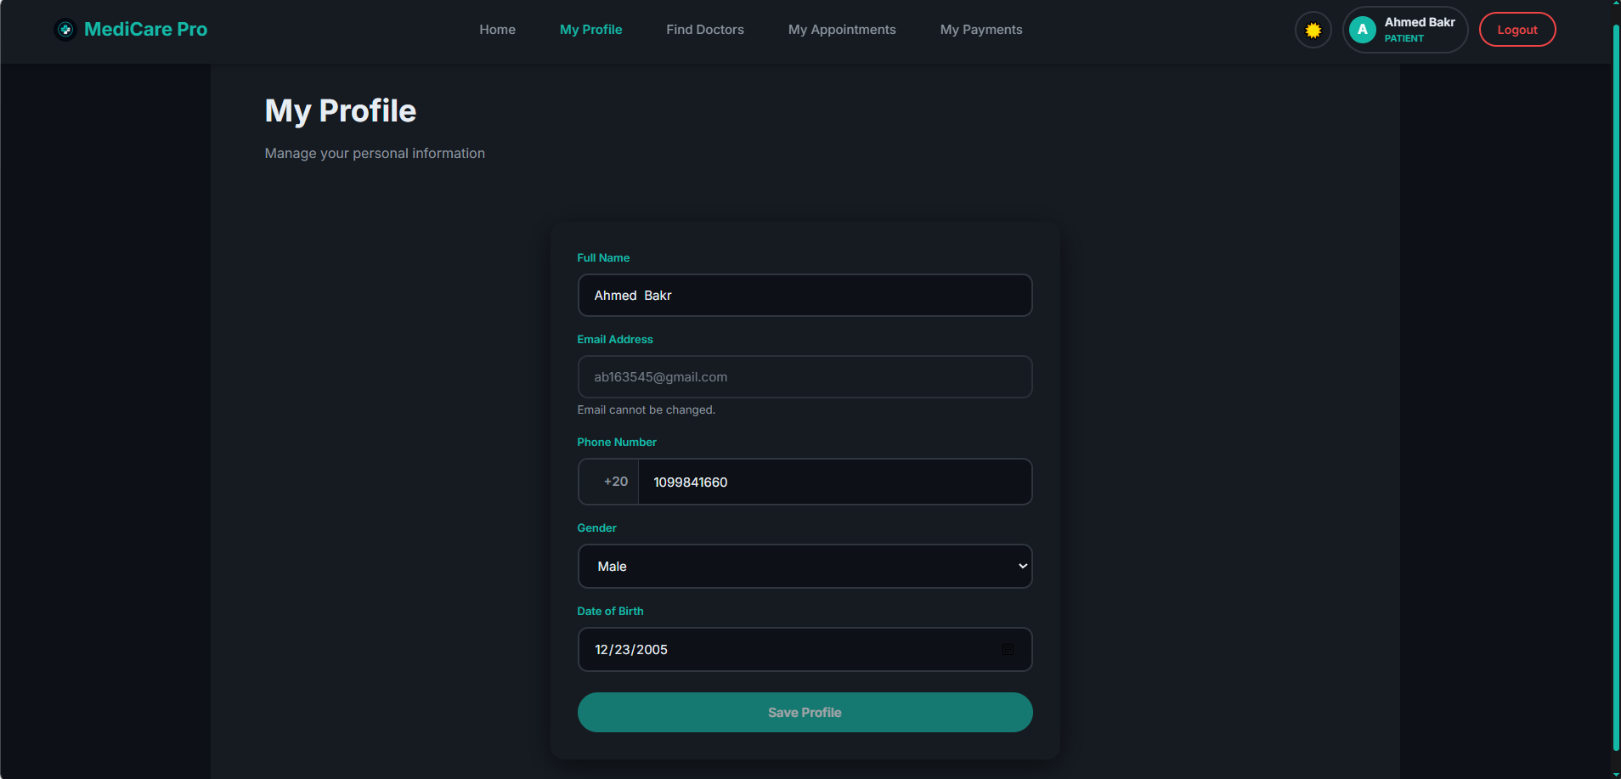
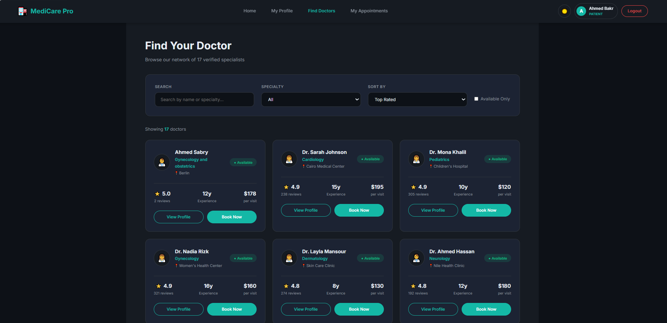
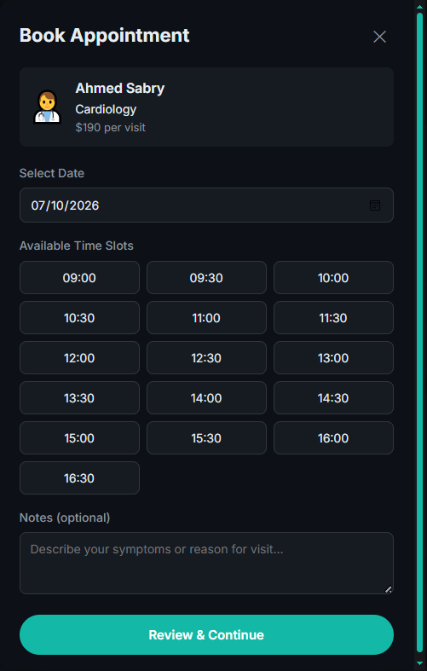
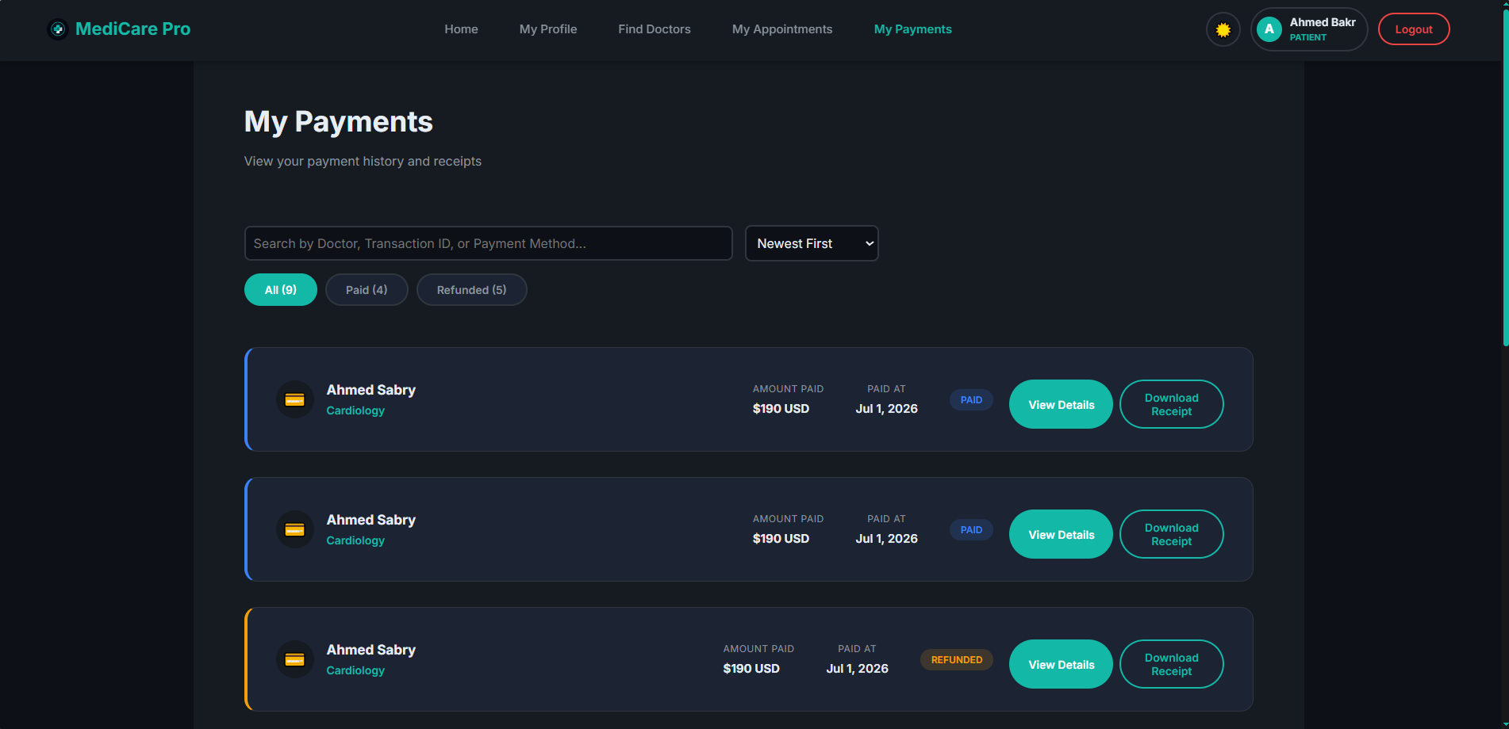
DASHBOARD, DISCOVERY, BOOKING & PAYMENTS
UI Showcase — Patient Module
Patient Home
My Profile
Find Doctors
Book Appointment
My Payments
18 / 29

Slide 19
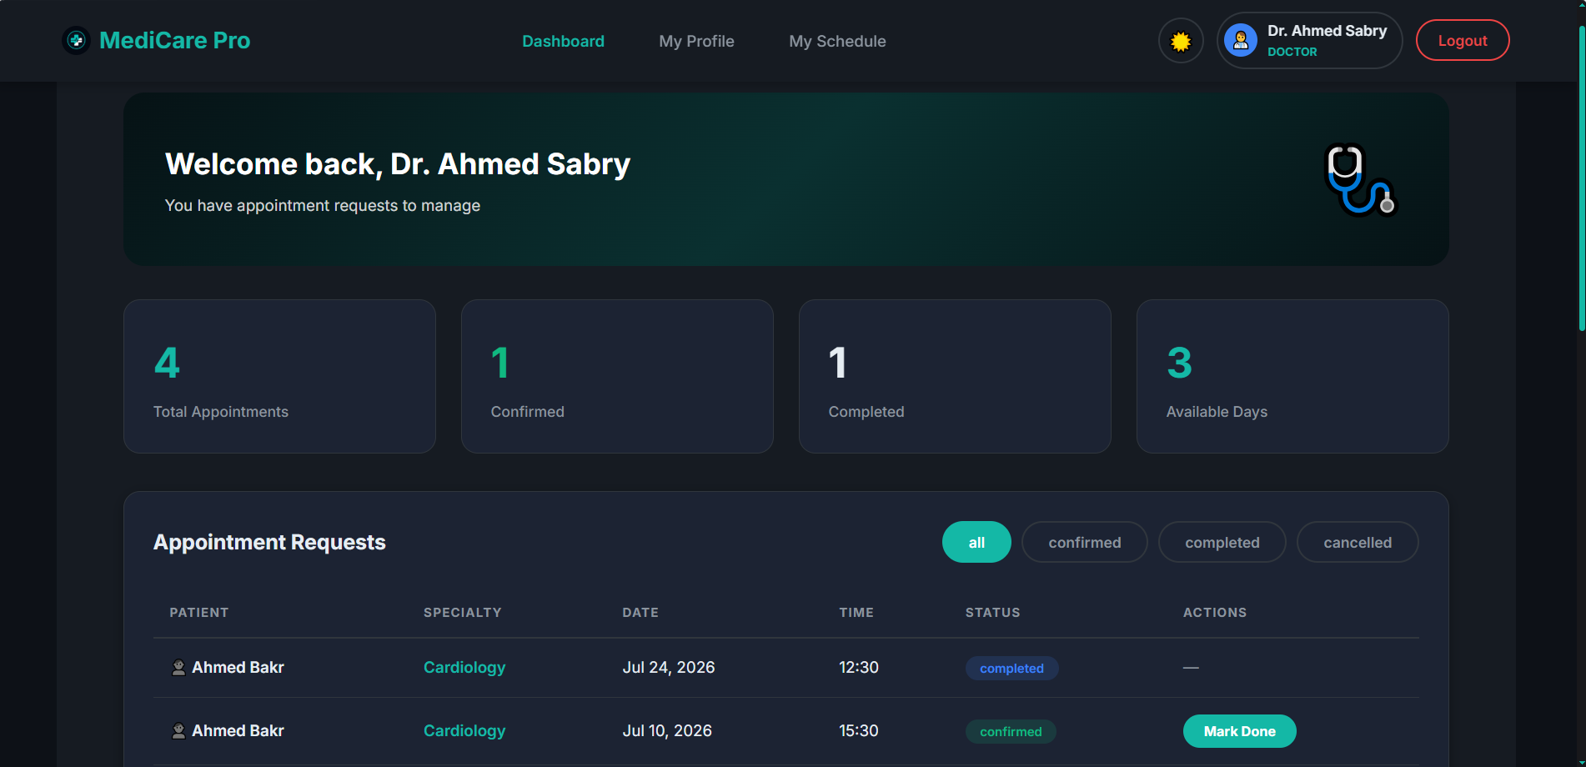
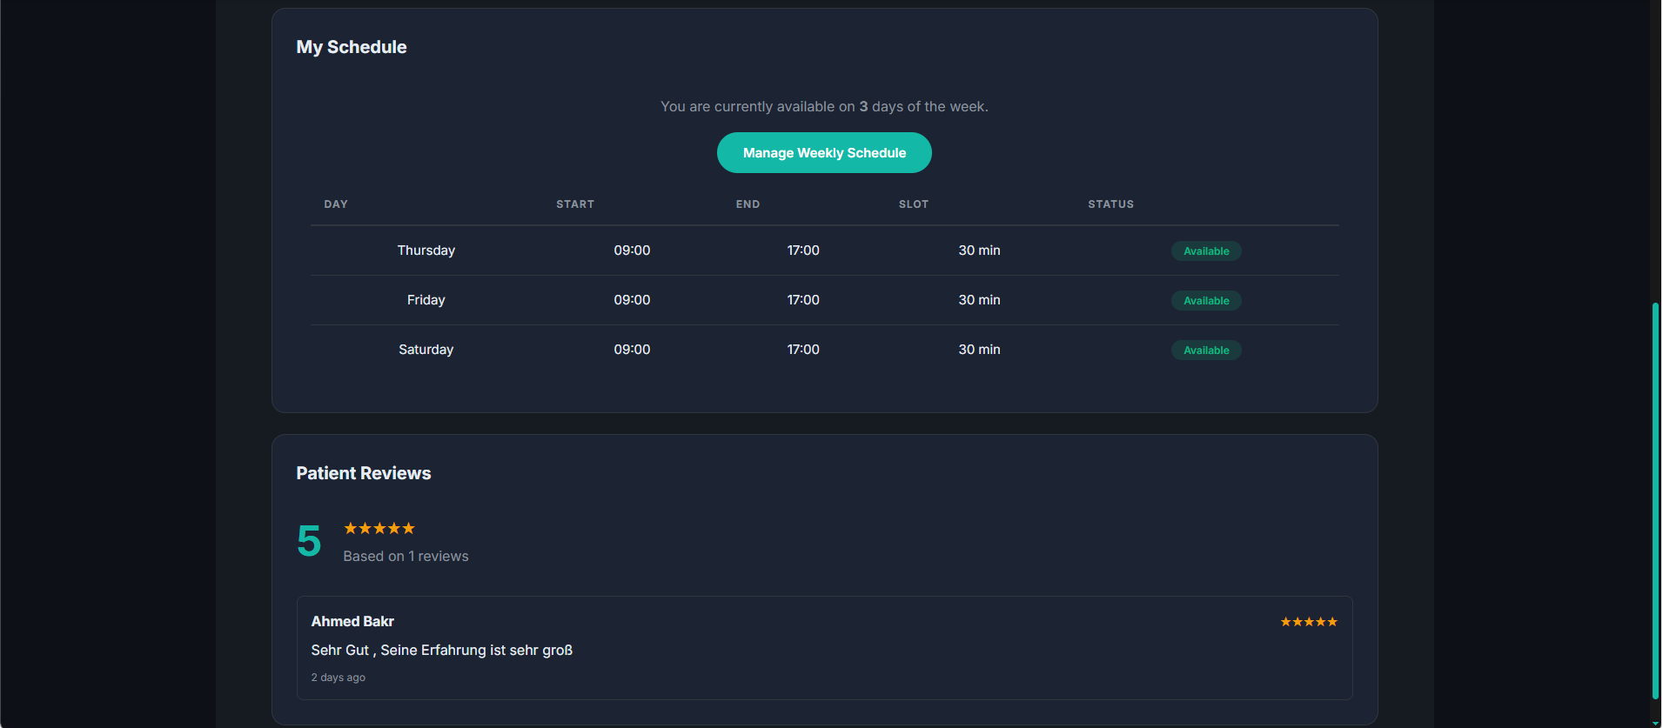
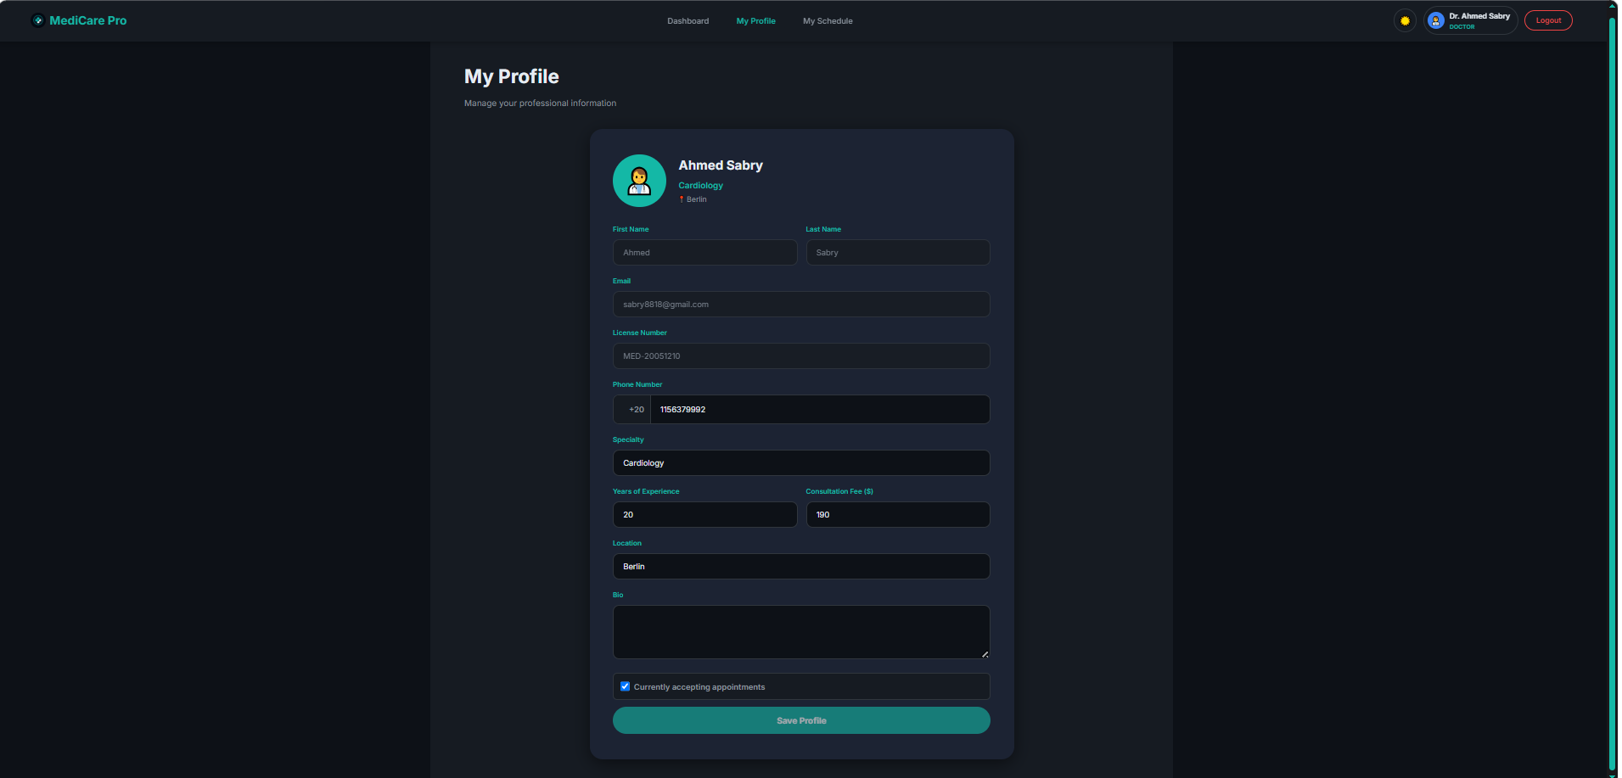
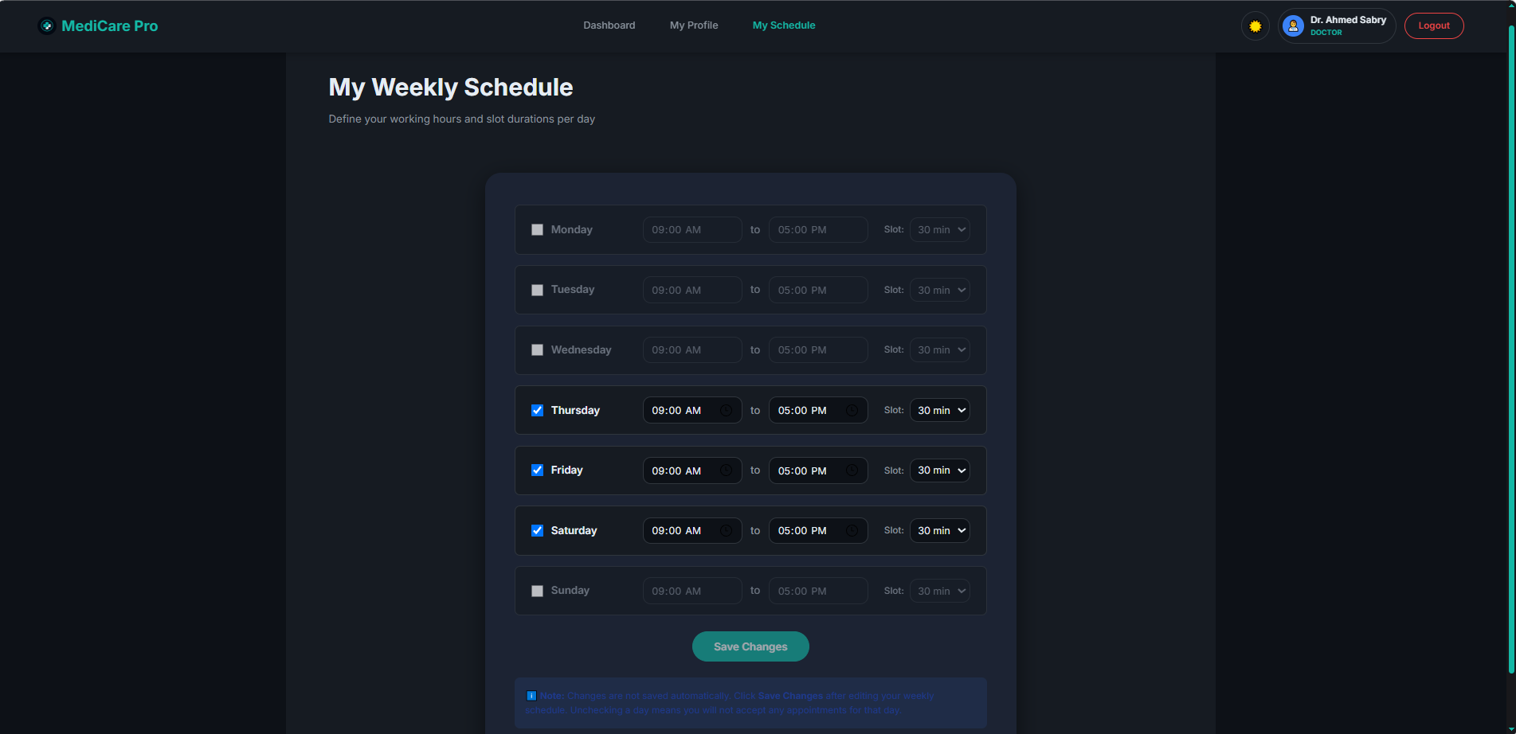
DASHBOARD, PROFILE & SCHEDULE MANAGEMENT
UI Showcase — Doctor Module
Dashboard — Requests
Schedule & Reviews
Professional Profile
Weekly Schedule Editor
19 / 29

Slide 20
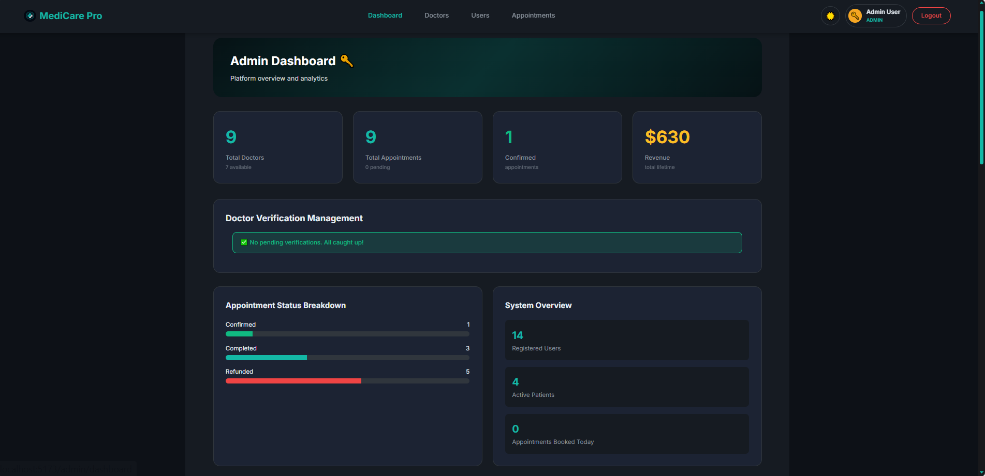
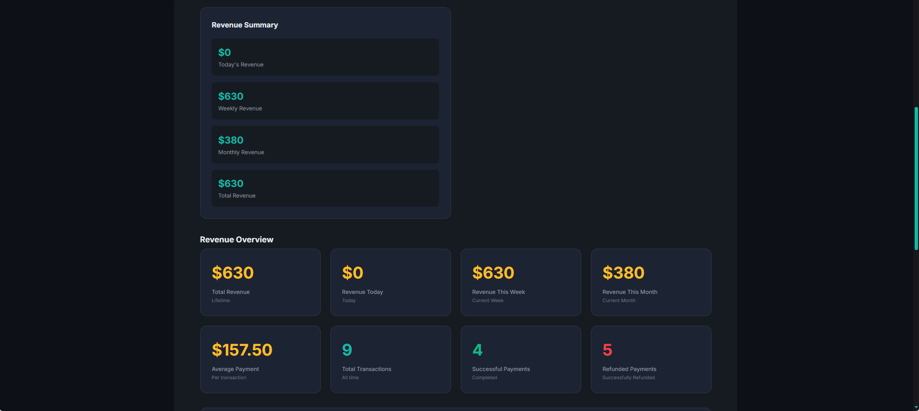
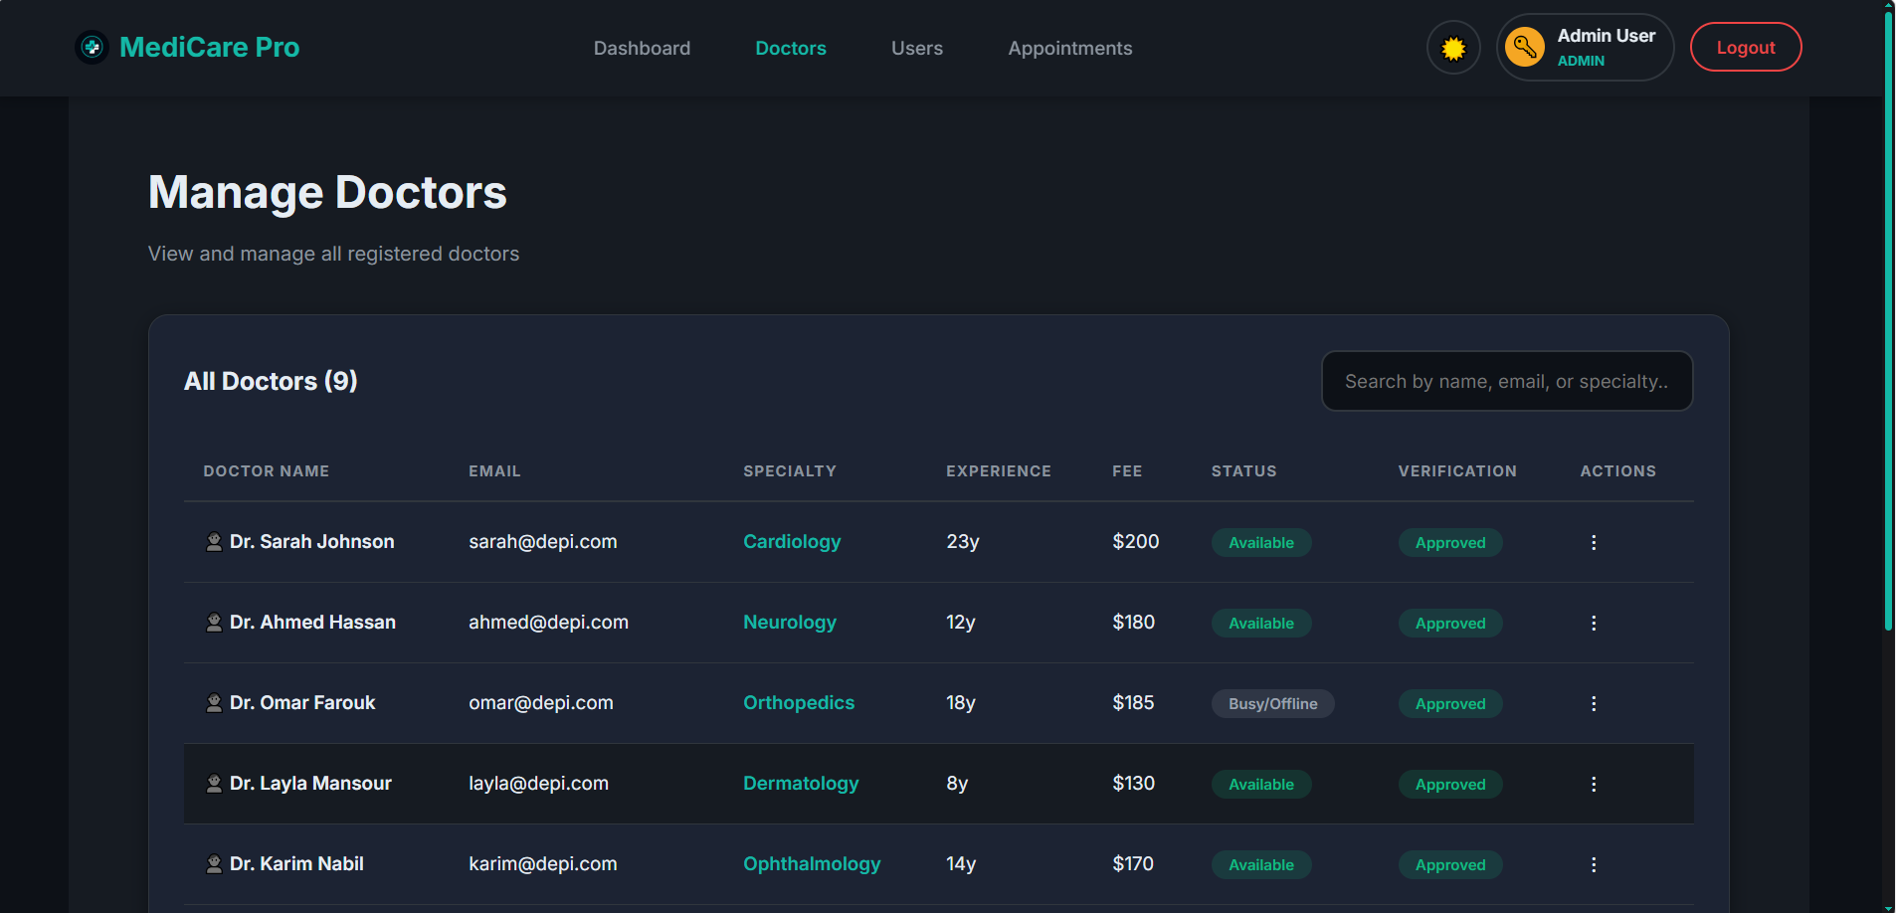
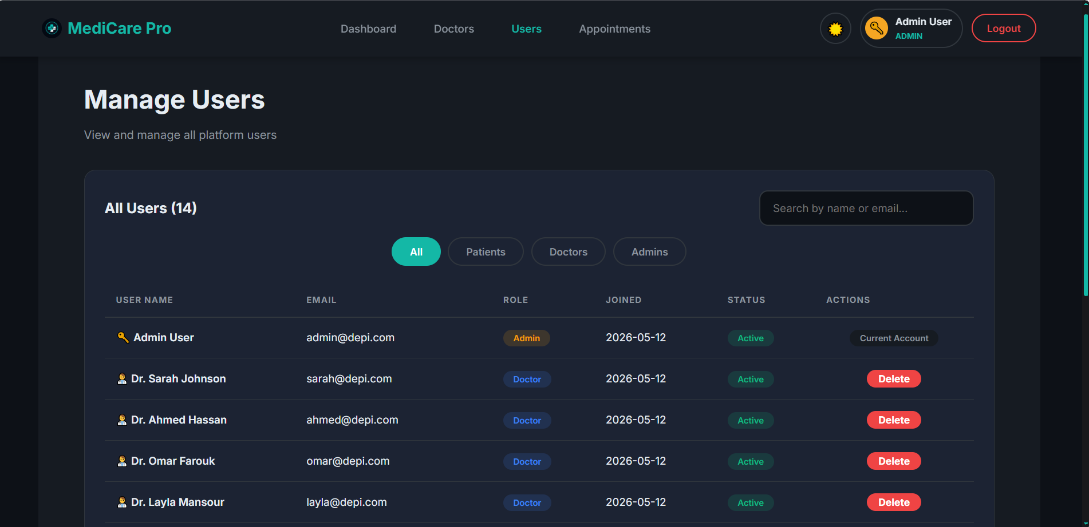
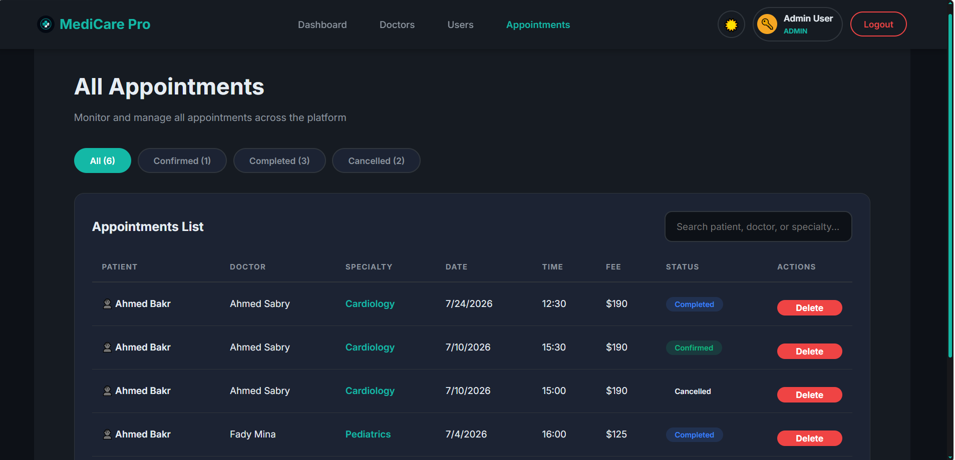
COMPLETE PLATFORM OVERSIGHT & REVENUE
UI Showcase — Admin Panel
Admin Overview
Revenue Summary
Manage Doctors
Manage Users
All Appointments
20 / 29

Slide 21
A COMPLETE USER JOURNEY — PART 1
Demo Flow — Getting Started
Landing
Sign Up
Login
Find Doctor
Book Visit
Discover MediCare Pro
Patient or Doctor
Secure JWT session
Search specialists
Pick date & slot
21 / 29

Slide 22
A COMPLETE USER JOURNEY — PART 2
Demo Flow — Booking to Review
Stripe Pay
Confirmed
Doctor View
Complete
Secure checkout
Booking verified
Accepts request
Visit + review
22 / 29

Slide 23
REAL ENGINEERING PROBLEMS, SOLVED
Challenges & Solutions
CHALLENGE
SOLUTION
Time Slot Collisions
→
Preventing double-bookings across concurrent requests.
✓ DB transactions validate every slot before it is booked.
Payment State Sync
→
Users could drop off mid-payment.
✓ Stripe Session IDs confirm payment before booking is created.
Orphaned Records
→
Deleting a user could break linked data.
✓ Soft deletes protect data integrity across every table.
Complex State Management
→
Three roles needed to share auth state.
✓ Context API & Axios interceptors centralize auth state.
23 / 29

Slide 24
WHAT SETS MEDICARE PRO APART
Project Strengths
01
Secure by design — JWT, bcrypt, and RBAC from day one.
02
A true multi-role platform with three dashboards.
03
Smart scheduling plus a live revenue analytics dashboard.
04
A modern stack — React, Vite, Node.js, and SQL Server.
24 / 29

Slide 25
PLANNED FEATURES FOR THE NEXT DEVELOPMENT PHASE
Future Enhancements
01
Coming Next
02
On the Roadmap
Doctor–Patient Chat — real-time messaging between doctors and patients. Video Consultation — real-time teleconsultation for remote visits. Notifications — email & SMS alerts for appointment reminders.
AI Doctor Matching — smart doctor suggestions based on symptoms & history. Medical Records — digital health records and prescription management. Mobile Application — native iOS & Android apps for on-the-go access.
25 / 29

Slide 26
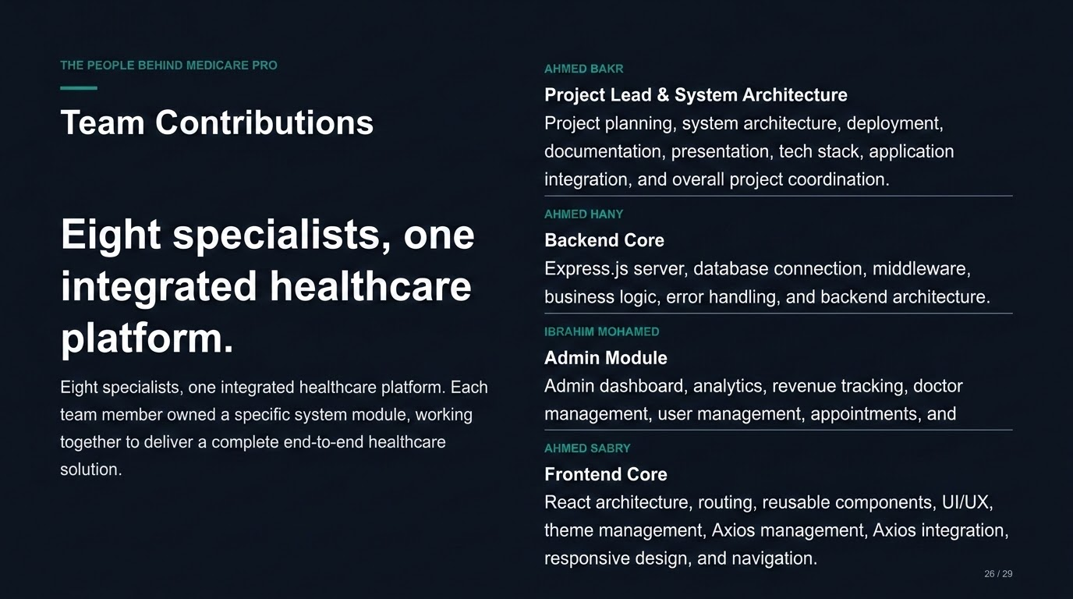

Slide 27
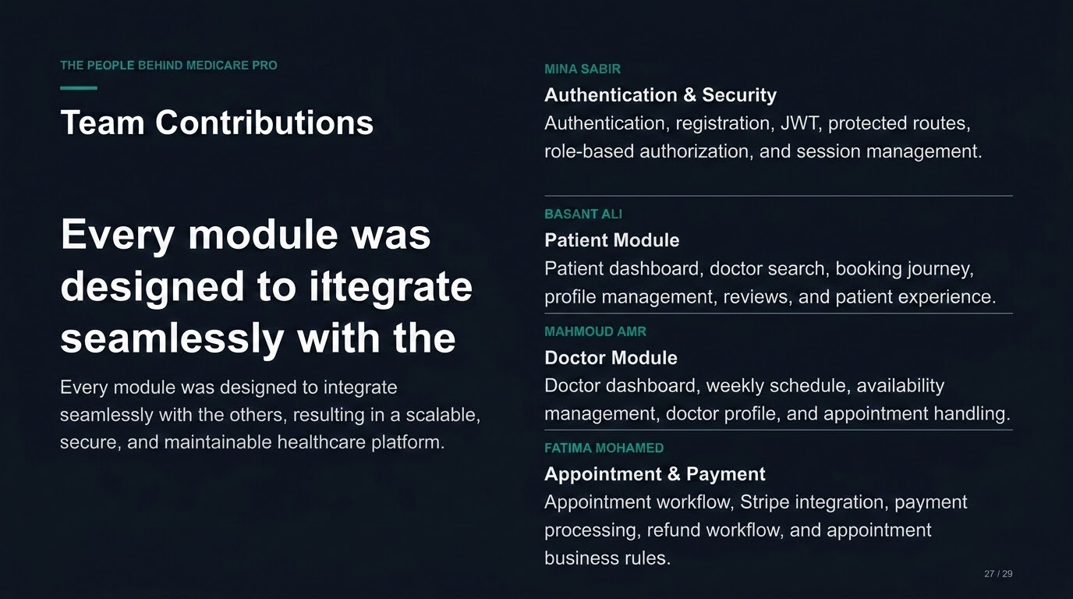

Slide 28
WHAT WE ACCOMPLISHED
Conclusion
01
Platform Capabilities
02
Business & Experience Wins
✓ Multi-Role Healthcare Platform ✓ Secure Authentication ✓ Role-Based Access Control ✓ Appointment Conflict Prevention
✓ Stripe Payment Integration ✓ Automatic Refund System ✓ Smart Appointment Scheduling ✓ Analytics Dashboard ✓ Responsive UI
27 / 29

Slide 29
PRESENTATION COMMITTEE WALKTHROUGH
Live Demo
A single continuous journey across all three roles, demonstrated live end to end.
Patient Login
Doctor Search
Book Appointment
Stripe Payment
Confirmation
Doctor Dashboard
Complete Visit
Patient Review
Admin Dashboard
Refund Workflow
28 / 29

Slide 30

MEDICARE PRO — SMART HEALTHCARE MANAGEMENT SYSTEM
Thank You
DEPI Graduation Project · 2026
github.com/A200B5/smart-healthcare-system
Ahmed Bakr · Ahmed Sabry · Ibrahim Mohamed · Ahmed Hany
Scan for GitHub repo
29 / 29

