Slide 1
WiFi Information
FOR YOUR COMPUTERS
SSID:
PWD:
FOR THE MXCHIP BOARDS (MUST BE 2.4GHZ)
SSID:
PWD:

Slide 2
Sign Up for the Azure Free Trial
http://azure.com/free
If you have issues:
Open a private browser session
Sign up for a new outlook.com email address (just for today)
Enroll in the free trial using the new outlook.com account
Use that account as you go through the workshop

Slide 3
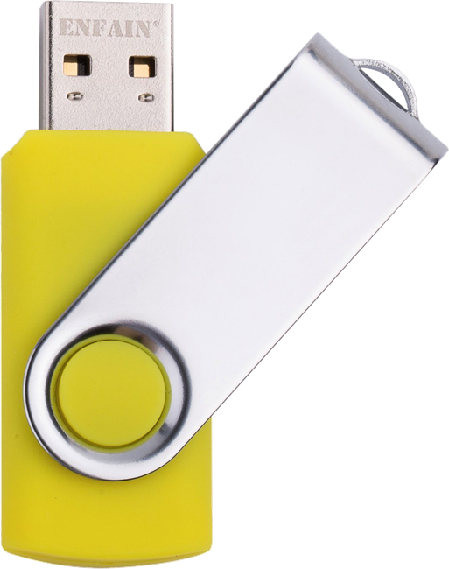
USB STICKs
There are USB Sticks being passed around.
Please copy, not move, the contents to your computer and pass the stick on to your neighbor. Make note of the folder where you copy the content to.
The FlySimExpress folder contains the hands-on labs.
PLEASE DO NOT TAKE THE USB STICKS!
We got to a lot of effort to make these, please help make them available to future attendees!

