Slide 1
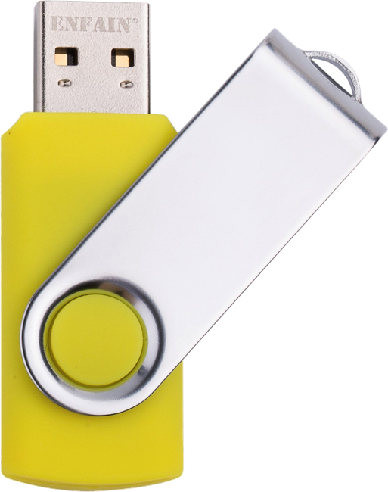
USB STICKs
There are Yellow USB Sticks being passed around.
Please copy, not move, the contents to your computer and pass the stick on to your neighbor.
PLEASE DO NOT TAKE THE USB STICKS!
We got to a lot of effort to make these, please help make them available to future attendees!

Slide 2
WiFi Information
You can connect your laptop to the following WiFi Network

Slide 3
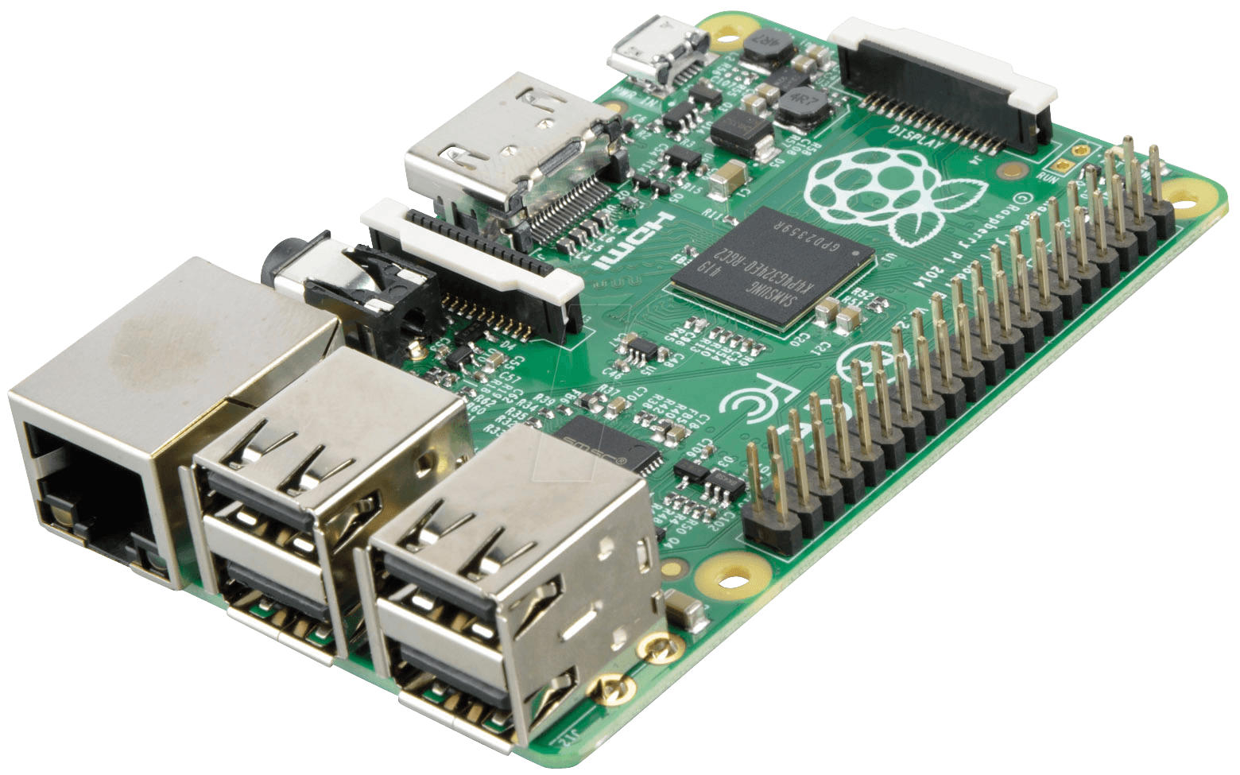
Complete the survey below
to enter to win
Raspberry Pi 3 Bundle
aka.ms/devfestsurvey

Slide 4
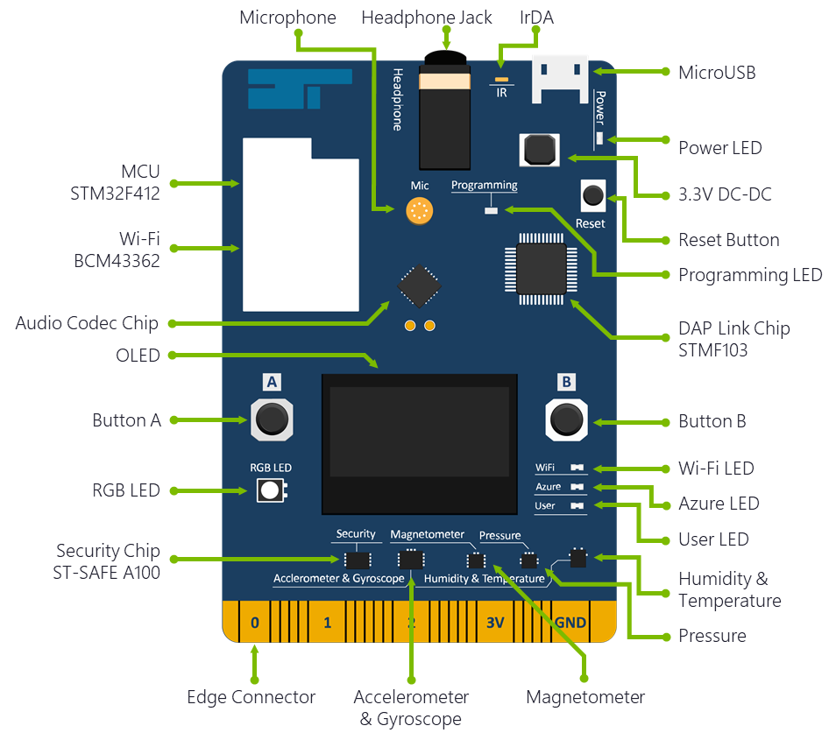
Microsoft Azure IoT Developer Kit Board
Lets you use hardware in your IoT Project prototypes without having to assemble microcontrollers and sensors and build circuits.
It provides security on board to demonstrate some hardware best practices
It let’s you focus on the value you want your IoT Solution to provide without getting mired down in the complexities of hardware.
Oh and you can deploy and debug code on the board using Visual Studio Code!
Learn more at http://aka.ms/devkit
Notes:
Specs

Slide 5
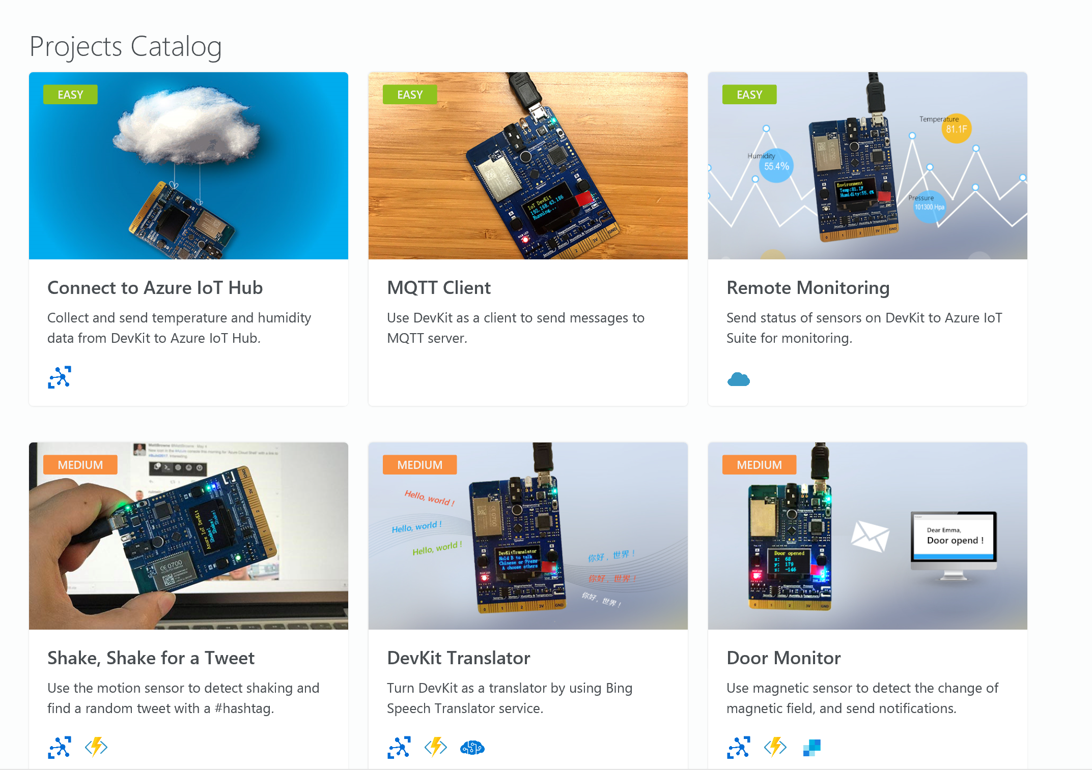
Lot’s of great projects documented

Slide 6
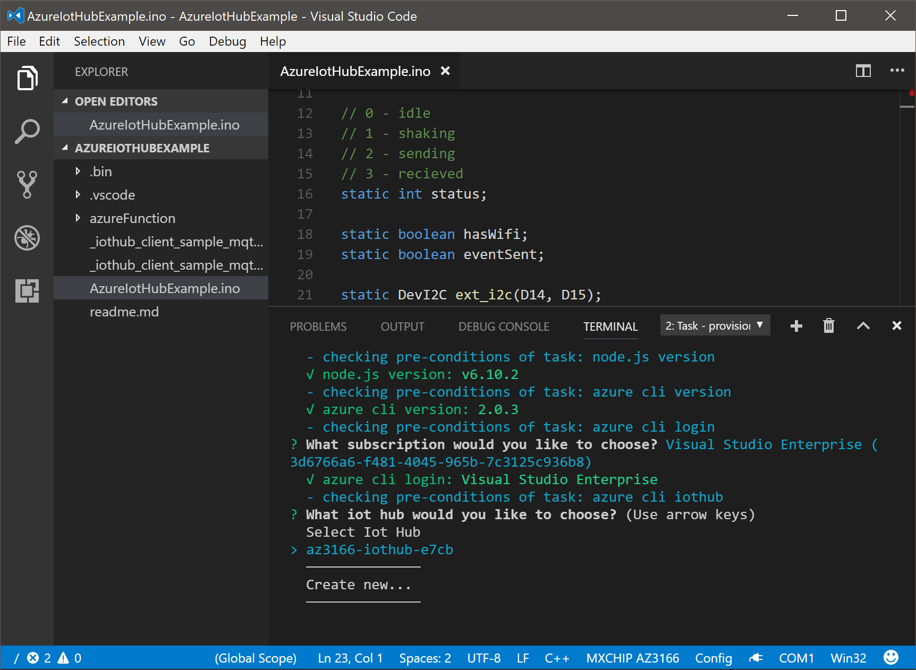


Developer Tools
Microsoft Azure
Visual Studio Code

Slide 7
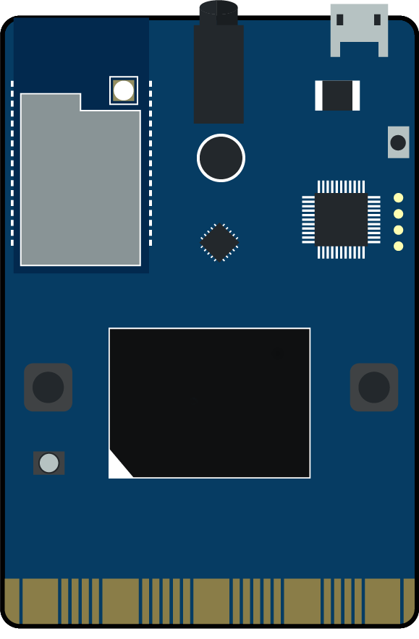
FlySimExpress Lab Architecture
Flight Data
Raw Data
flysim*iot IoT Hub
Raw Data
Flysim*functions FlySimIoTFlightData
flysim-shared-input-hub Event Hub
Flight Data
ATC UWP App
Flight Data
flysim*storage deviceState Table
Flight Data (All Aircraft)
Stream Analytics
Proximity Warnings
flysim-shared-output-hub Event Hub
Proximity Warnings
You Create
Presenter Creates

Slide 8
Full FlySim Lab Architecture
Flight Data
Raw Data
flysim-iothub-* IoT Hub
Raw Data
FlySimIoTFlightData Function
Flight Data
flysim Event Hub
flysim-shared-input-hub Event Hub
Flight Data
ATC UWP App
Translated Commands
Translated Commands
Flight Data
Flight Data (All Aircraft)
FlySim UWP Client App on Windows 10
Stream Analytics
Commands
Translated Commands
Translator Text API Cognitive Service
Proximity Warnings
Proximity Warnings
flysim-shared-output-hub Event Hub
Proximity Warnings
You Create
Presenter Creates
Optional resources in the full workshop (http://aka.ms/flysim)

Slide 9
Full FlySim Lab Architecture
Flight Data
Raw Data
flysim-iothub-* IoT Hub
Raw Data
FlySimIoTFlightData Function
Flight Data
flysim Event Hub
flysim-shared-input-hub Event Hub
Flight Data
ATC UWP App
Translated Commands
Flight Data
Translated Commands
Azure Storage Table
Flight Data
Flight Data (All Aircraft)
FlySim UWP Client App on Windows 10
Stream Analytics
Commands
Translated Commands
Translator Text API Cognitive Service
Proximity Warnings
Proximity Warnings
flysim-shared-output-hub Event Hub
Proximity Warnings
You Create
Presenter Creates
Optional resources in the full workshop (http://aka.ms/flysim)

Slide 10










Azure IoT Hub
Microsoft Azure
Custom Cloud Gateway
Management app
Device registry/Management
Monitoring
Send commands
Device
Custom Protocols
Applications
Companion apps
Dashboards
Controllers
…
Cloud protocol gateway sample
Client SDK
Device
AMQP, MQTT, HTTPS
IoT Hub
Client SDK
Device
Field Gateway
AMQP
CoAP, AllJoyn, OPC,…
Device
IoT Edge
Device
Field Gateway
Custom Cloud Gateway
OPC, HTTP, CoAP,…
Management app
Device registry/Management
Monitoring
Send commands
CoAP, AllJoyn, OPC, …
Device
VPN/ExpressRoute
Cloud protocol gateway sample
Client SDK

Slide 11



IoT Hub ABC
Device
IoT Hub
Device id
D2C receive endpoint
Event processing
(hot path)
D2C send endpoint
C2D queue
endpoint
Custom endpoints
Event processing
(hot and cold path)
Twin endpoint
Methods
endpoint
C2D send and feedback endpoints
Device management, device business logic,
Connectivity monitoring
Field GW /
Cloud GW
Device …
Twins endpoint
Device…
Devices Methods endpoint
Device …
Device identity management
Device provisioning and authorization
IoT Hub management

Slide 12
Complete the survey below
to enter to win
Raspberry Pi 3 Bundle
aka.ms/devfestsurvey

Slide 13

Resources
Docs.microsoft.com is the home for Microsoft technical documentation, API reference, code examples, quickstarts, and tutorials for developers and IT professionals.

Slide 14
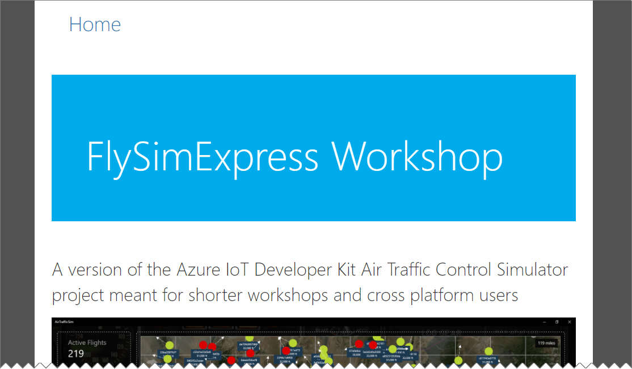
The Hands-On-Workshop
Open the “FlySimExpress/README.htm” from where you copied or extracted the workshop. Use the links at the bottom to get to the labs.

Slide 15
PRESENTER ONLY - Configure Shared Resources and ATC App
Flight Data
Raw Data
flysim*iot IoT Hub
Raw Data
Flysim*functions FlySimIoTFlightData
flysim-shared-input-hub Event Hub
Flight Data
ATC UWP App
Flight Data
flysim*storage deviceState Table
Flight Data (All Aircraft)
Use the Azure CLI
Use the existing ARM Template
Create the Azure Resources
Stream Analytics
Proximity Warnings
flysim-shared-output-hub Event Hub
Proximity Warnings
You Create
Presenter Creates

Slide 16
01 - Prepare the Azure IoT Development Kit Board
Flight Data
Raw Data
flysim*iot IoT Hub
Raw Data
Flysim*functions FlySimIoTFlightData
flysim-shared-input-hub Event Hub
Flight Data
ATC UWP App
Flight Data
flysim*storage deviceState Table
Flight Data (All Aircraft)
Connect the board to WiFi
Upgrade the Firmware on it
Install the DevKit on your workstation
Stream Analytics
Proximity Warnings
flysim-shared-output-hub Event Hub
Proximity Warnings
You Create
Presenter Creates

Slide 17
02 - Deploy and Verify Your Resources to Azure
Flight Data
Raw Data
flysim*iot IoT Hub
Raw Data
Flysim*functions FlySimIoTFlightData
flysim-shared-input-hub Event Hub
Flight Data
ATC UWP App
Flight Data
flysim*storage deviceState Table
Flight Data (All Aircraft)
Use the Azure CLI
Use the existing ARM Template
Create the Azure Resources
Stream Analytics
Proximity Warnings
flysim-shared-output-hub Event Hub
Proximity Warnings
You Create
Presenter Creates

Slide 18
03 - Deploy Your Function Code to Azure
Flight Data
Raw Data
flysim*iot IoT Hub
Raw Data
Flysim*functions FlySimIoTFlightData
flysim-shared-input-hub Event Hub
Flight Data
ATC UWP App
Flight Data
flysim*storage deviceState Table
Flight Data (All Aircraft)
Deploy the function code using git
Provide the connection to the presenters shared input hub
Stream Analytics
Proximity Warnings
flysim-shared-output-hub Event Hub
Proximity Warnings
You Create
Presenter Creates

Slide 19
03 - Deploy Your Function Code to Azure
Flight Data
Raw Data
flysim*iot IoT Hub
Raw Data
Flysim*functions FlySimIoTFlightData
flysim-shared-input-hub Event Hub
Flight Data
ATC UWP App
Flight Data
flysim*storage deviceState Table
Flight Data (All Aircraft)
Upload the code to the board
Start publishing data
Watch the data flow
Stream Analytics
Proximity Warnings
flysim-shared-output-hub Event Hub
Proximity Warnings
You Create
Presenter Creates

Slide 20
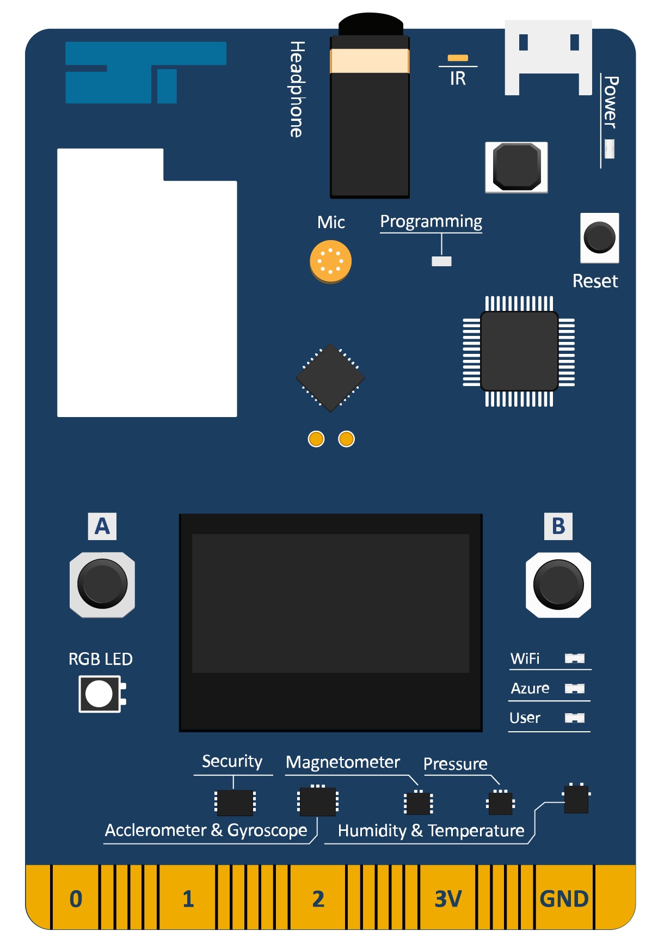
DevKit Board
GROUPED TEXT, LINES and PICTURE
SINGLE IMAGE
Microphone
Headphone Jack
IrDA
MicroUSB
Power LED
MCU
STM32F412
3.3V DC-DC
Wi-Fi
BCM43362
Reset Button
Programming LED
Audio Codec Chip
DAP Link Chip
STMF103
OLED
Button A
Button B
Wi-Fi LED
RGB LED
Azure LED
Security Chip
ST-SAFE A100
User LED
Humidity & Temperature
Pressure
Edge Connector
Accelerometer & Gyroscope
Magnetometer

