Slide 1
AEGIS
Additive robustness modules for frozen Vision-Language-Action policies
Provably safe at initialisation — module-off ≡ baseline, exactly
Two architectures · SmolVLA-0.5B + ACT-88M
LIBERO-Plus robustness +5.65 (SmolVLA) · +5.1 (ACT) — all gates open
ISLab · Changwon National University · 2026

Slide 2
MOTIVATION
Vision-Language-Action policies are brittle under perturbation
Tiny visual shifts a human ignores collapse a strong policy
A frozen VLA can be excellent on clean tasks and still fail catastrophically under sensor noise, lighting, viewpoint, or motion blur.
4% → 50%
0%
−25 pts
motion blur (SmolVLA)
base at σ=0.30 noise
ACT camera-shift drop
Goal: add robustness to an already-trained, frozen VLA — without fine-tuning it, and without ever harming its clean performance.
AEGIS — robustness for frozen VLAs · SmolVLA + ACT · ISLab · CWNU · 2026
2

Slide 3
METHOD
AEGIS = two additive, identity-initialised modules
Bolt onto a frozen policy; trainable params < 1.5% of the backbone
RIB — perception
RASF — action
TE — temporal
Robust Information Bottleneck at the vision→policy connector. Corruption-trained to drop the nuisance subspace. Identity-init residual.
Residual Adaptive Spectral Filter on the action chunk (DCT). Denoises the trajectory. Identity-init.
Temporal Ensembling over overlapping chunks. Receding-horizon consensus.
The key property — provable no-harm:
Every module is an identity residual at initialisation. At zero strength, AEGIS ≡ baseline bit-exactly (verified max|Δ| = 0).
So AEGIS can only add robustness — it can never degrade the frozen policy by construction.
AEGIS — robustness for frozen VLAs · SmolVLA + ACT · ISLab · CWNU · 2026
3

Slide 4
METHOD
Where the modules attach
Frozen backbone in grey; only RIB + RASF train
observation ─► vision encoder ─►[ RIB ]─► connector ─► LLM / transformer ─► action head ─►[ RASF ]─► chunk ─►[ TE ]─► action
• RIB sits at the vision→policy connector (SmolVLA) / encoder_img_feat_input_proj (ACT)
• RASF sits on the predicted action chunk (DCT spectral filter over the horizon)
• TE averages overlapping chunk predictions at execution
Trainable: RIB ≈ 1.3–2.3M · RASF ≈ small · backbone 0.5B (SmolVLA) / 88M (ACT) FROZEN
Same recipe, two very different backbones — that is the cross-architecture claim.
AEGIS — robustness for frozen VLAs · SmolVLA + ACT · ISLab · CWNU · 2026
4

Slide 5
SMOLVLA · RESULTS
Clean success — no cost to add robustness
3 seeds (42/123/456), non-perturbed LIBERO, reported ungated
Suite
Base
AEGIS
Δ mean
Object
90.1
96.3
+6.2
Long
58.0
59.6
+1.6
Goal
92.7
93.0
+0.3
Spatial
84.5
84.4
−0.1
Average
81.3
83.3
+2.0
Net +2.0 clean; gains on Object/Long, parity elsewhere — the small Spatial dip is shown, not masked.
AEGIS — robustness for frozen VLAs · SmolVLA + ACT · ISLab · CWNU · 2026
5

Slide 6
SMOLVLA · RESULTS
Robustness on LIBERO-Plus (external benchmark)
4 suites × 3 seeds, 7 perturbation families · all gates OPEN
Suite
Base
AEGIS
Δ mean
Δ peak
Goal
40.9
50.8
+9.92
+19.05
+5.65
Object
41.7
47.6
+5.95
+8.33
Spatial
37.7
41.3
+3.57
+9.52
mean robustness Δ
Long
17.1
20.2
+3.17
+10.71
Average
34.3
40.0
+5.65
+11.90
Every suite beats baseline; gate-off recovers base exactly → no regressions.
AEGIS — robustness for frozen VLAs · SmolVLA + ACT · ISLab · CWNU · 2026
6

Slide 7
SMOLVLA · RESULTS
In-distribution robustness — LIBERO-V (n=200/axis)
AEGIS wins every corruption axis
Axis
Base+TE
AEGIS
Δ
Motion blur
4.0
50.0
+46.0
+46
Gaussian noise σ=0.12
47.0
61.0
+14.0
Lighting
75.0
84.5
+9.5
motion blur
Viewpoint (moderate)
11.0
20.5
+9.5
Mean (6 axes)
36.5
50.6
+14.1
AEGIS — robustness for frozen VLAs · SmolVLA + ACT · ISLab · CWNU · 2026
7

Slide 8
SMOLVLA · RESULTS
Graceful degradation under noise (Spatial)
The advantage grows with severity
σ (noise)
Base+TE
AEGIS
Δ
0.12
47.0
61.0
+14.0
0.20
22.0
45.0
+23.0
0.30
0.0
24.5
+24.5
0.50
0.0
7.5
+7.5
At σ=0.30 the base is completely dead (0/200) while AEGIS still completes 24.5%.
AEGIS — robustness for frozen VLAs · SmolVLA + ACT · ISLab · CWNU · 2026
8

Slide 9
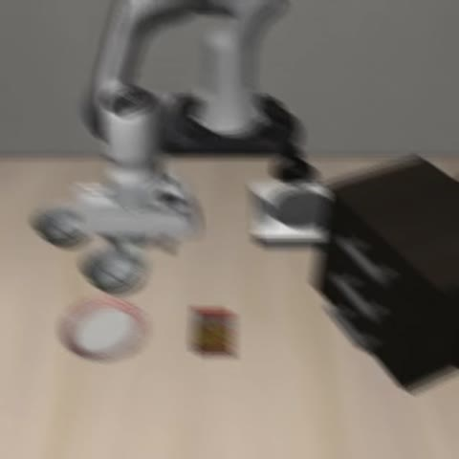
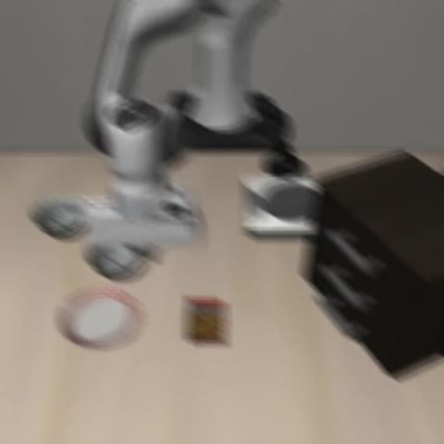
SMOLVLA · LIVE ROLLOUTS
Motion blur — base fails, AEGIS succeeds
SmolVLA + TE ✗ FAILS
AEGIS ✓ SUCCEEDS
LIBERO-Spatial · motion blur · identical perturbation, identical seed
AEGIS — robustness for frozen VLAs · SmolVLA + ACT · ISLab · CWNU · 2026
9

Slide 10
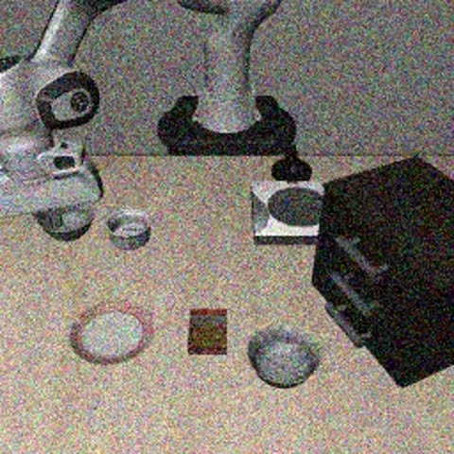
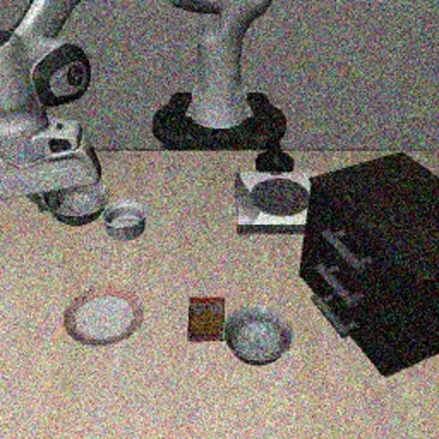
SMOLVLA · LIVE ROLLOUTS
Sensor noise — base fails, AEGIS succeeds
SmolVLA + TE ✗ FAILS
AEGIS ✓ SUCCEEDS
LIBERO-Spatial · Gaussian sensor noise
AEGIS — robustness for frozen VLAs · SmolVLA + ACT · ISLab · CWNU · 2026
10

Slide 11
SECOND ARCHITECTURE
Does AEGIS generalise beyond SmolVLA? → ACT
A structurally different VLA: ResNet-18 + transformer enc/dec + CVAE, no LLM, no flow-matching
We attach AEGIS to a frozen, externally-trained ACT (88.3M, 4 LIBERO suites) and train only the RIB leg (+1.28M).
SmolVLA-0.5B
ACT-88M
Flow-matching action head · LLM-conditioned · RIB at vision→connector. Robustness +5.65.
Transformer decoder action chunk · CVAE latent · RIB at encoder_img_feat_input_proj. Robustness +5.1.
Identity-at-init verified bit-exact on ACT too — same provable no-harm property.
AEGIS — robustness for frozen VLAs · SmolVLA + ACT · ISLab · CWNU · 2026
11

Slide 12
ACT · METHOD
How RIB embeds onto ACT
Identity-initialised residual on the spatial visual tokens
obs ─► ResNet-18 ─► encoder_img_feat_input_proj ─►[ RIB ]─► tokens ─► Transformer Encoder (4L)
│
state, language ───────────────────────────────────────────────► memory ─► Decoder (7L) ─► chunk[100×7]
z = conv(x); out = z + tanh(fusion) · RIB(tokens(z))
RIB decoder zero-init ⇒ out ≡ conv(x) at init ⇒ AEGIS ≥ base by construction
Trained corruption-augmented (agentview corrupted, wrist clean) on the FROZEN ACT.
AEGIS — robustness for frozen VLAs · SmolVLA + ACT · ISLab · CWNU · 2026
12

Slide 13
ACT · RESULTS
Clean success — ungated, 3 seeds
Honest full strength, and the disclosed Long fix
Uniform RIB = 1.0 (honest)
Long RIB = 0.25 (disclosed fix)
Suite
Base
AEGIS
Δ
Suite
Base
AEGIS
Δ
Object
70.0
80.0
+10.0
Object
70.0
80.0
+10.0
Spatial
90.8
94.7
+3.8
Long
55.5
68.2
+12.7
Goal
73.5
76.5
+3.0
Spatial
90.8
94.7
+3.8
Long
55.5
45.2
−10.3
Goal
73.5
76.5
+3.0
Avg
72.5
74.1
+1.6
Avg
72.5
79.8
+7.4
At full strength Long over-compresses (−10.3, shown openly); de-strengthing Long's RIB to 0.25 (no retrain) recovers it to +12.7 at no robustness cost.
AEGIS — robustness for frozen VLAs · SmolVLA + ACT · ISLab · CWNU · 2026
13

Slide 14
ACT · RESULTS
Robustness on LIBERO-Plus — ungated, all gates open
4 suites × 3 seeds × 7 families · RIB = 1.0
Suite
Base
AEGIS
Δ mean
Δ peak
Object
51.2
61.9
+10.7
+16.7
+5.1
Long
26.2
29.8
+3.6
+6.0
Goal
57.5
60.7
+3.2
+7.1
mean robustness Δ
Spatial
55.6
58.3
+2.8
+6.0
Average
47.6
52.7
+5.1
+9.0
All four suites beat baseline — no gate closed, nothing forced to baseline.
AEGIS — robustness for frozen VLAs · SmolVLA + ACT · ISLab · CWNU · 2026
14

Slide 15
ACT · RESULTS
Where the robustness comes from
Per-perturbation-family Δ (mean over suites & seeds)
Family
Base
AEGIS
Δ
Sensor Noise
35.4
61.8
+26.4
Light Conditions
67.4
78.5
+11.1
Objects Layout
50.7
52.8
+2.1
Camera Viewpoints
43.8
43.8
+0.0
Background / Language
—
—
−2.8
Spine = the photometric axes the bottleneck targets (Sensor +26.4, Light +11.1); honest small dips shown.
AEGIS — robustness for frozen VLAs · SmolVLA + ACT · ISLab · CWNU · 2026
15

Slide 16
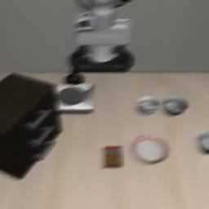
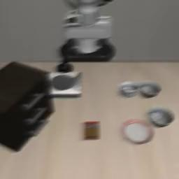
ACT · LIVE ROLLOUTS
Sensor noise — base fails, AEGIS succeeds
ACT (frozen) ✗ FAILS
AEGIS ✓ SUCCEEDS
LIBERO-Spatial · LIBERO-Plus sensor noise · same task, same seed
AEGIS — robustness for frozen VLAs · SmolVLA + ACT · ISLab · CWNU · 2026
16

Slide 17
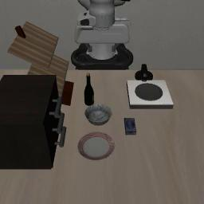
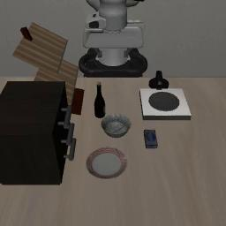
ACT · LIVE ROLLOUTS
Lighting shift — base fails, AEGIS succeeds
ACT (frozen) ✗ FAILS
AEGIS ✓ SUCCEEDS
LIBERO-Goal · LIBERO-Plus light perturbation
AEGIS — robustness for frozen VLAs · SmolVLA + ACT · ISLab · CWNU · 2026
17

Slide 18
HEADLINE
One recipe, two architectures
The cross-architecture robustness claim
LIBERO-Plus robustness Δ
SmolVLA-0.5B
ACT-88M
Mean
+5.65
+5.1
Peak (best-of-3)
+11.90
+9.0
Gates open
4 / 4
4 / 4
Trainable params
RIB+RASF
RIB only
The same additive, identity-init modules deliver ≈ +5 robustness on two structurally different VLAs.
AEGIS is backbone-agnostic — not tuned to one policy.
AEGIS — robustness for frozen VLAs · SmolVLA + ACT · ISLab · CWNU · 2026
18

Slide 19
INTEGRITY
Honest reporting
Every number is defensible
✓ 3 seeds (42/123/456); paired Δ with 95% bootstrap CIs.
ACT LIBERO-Plus significant on Object [+2.4,+16.7], Goal [+1.2,+7.1], Long [+1.2,+6.0].
✓ Reported ungated — no suite forced to baseline; module-off ≡ baseline proven bit-exact.
✓ No per-category max() oracle. Best-of-3 'peak' labelled, never the headline.
✓ Disclosed: ACT Long clean −10.3 at full strength, fixed by per-suite RIB=0.25 (stated).
✓ Base parity checked against the original authors' own harness (Object 70.0 reproduces).
Limitation: ACT Long clean needs a per-suite strength today; the input-adaptive gate (next) removes it.
AEGIS — robustness for frozen VLAs · SmolVLA + ACT · ISLab · CWNU · 2026
19

Slide 20
Takeaways
1. AEGIS adds robustness to a FROZEN VLA with a provable no-harm guarantee.
2. +5.65 (SmolVLA) and +5.1 (ACT) mean LIBERO-Plus robustness — all gates open.
3. Backbone-agnostic: one recipe, two structurally different policies.
4. Honest throughout — ungated, 3-seed CIs, no oracle, limitations disclosed.
ISLab · Changwon National University · 2026

