Slide 1
AEGIS
Dual-Locus Robustness for a Frozen Vision-Language-Action Policy
A rate-limited information bottleneck at two interfaces of a frozen SmolVLA —
perception (vision→LLM connector) and action (sampled chunk) — plus temporal consensus.
BASE MODEL
BENCHMARK
PROTOCOL
SmolVLA-500M Frozen backbone (no weight grad) RIB ~2.27M + RASF ~few-k trained
LIBERO — 4 suites + LIBERO-V corruptions n=200 / condition · fixed init-states
n_action_steps = 1 (paper-matched) 10 flow-matching denoise steps Both arms carry TE → Δ isolates modules
ISLab · Changwon National University · 2026
AEGIS = SmolVLA(frozen) + RIB + RASF + TE · ISLab · CWNU · 2026
1

Slide 2
01 · ARCHITECTURE
Final AEGIS — Two Interfaces, One Consensus
Three insertions on a frozen SmolVLA; both modules are exact pass-throughs at init → clean success protected by construction.
RGB obs
◤ RIB ◥
Action Expert
◤ RASF ◥
◤ TE ◥ → env
frozen vision enc
PERCEPTION locus VIB @ connector
flow-matching ODE (frozen)
ACTION locus spectral residual
RECEDING horizon consensus
PERCEPTION LOCUS — RIB (Robust Information Bottleneck)
ACTION LOCUS — RASF (Residual Adaptive Spectral Filter)
Replaces the vision→LLM connector linear with a fused projector = original + gated robustness correction (~2.27M params, deterministic latent). • Spatial-context mixing localises WHERE a corruption sits. • Bounded rate penalty with a floor → lossless on benign input. • Trained on GENERIC augmentation (photometric+warp); eval perturbations held out. → Owns the visual-robustness axis (systematic shifts a temporal average can't remove).
Sampled chunk A:(50,7) → DCT-II along time → input-adaptive per-band gain → inverse → committed as a BOUNDED residual: A_hat = A + gate·tanh·(filtered−A). • Benign chunk ⇒ all-pass; anomalous band energy ⇒ that band pulled down. • Five structural guarantees ⇒ cannot collapse (pass-through init, bounded, gain floor). • Self-referential denoiser: target = policy's own benign prediction. → Owns the action-spectrum axis (motion regularity + injected action-noise retention).
Consensus — TE: position-aligned averaging over overlapping chunks (inference-time only), in BOTH arms, so every reported Δ isolates the modules.
TE handles stochastic per-frame noise; RIB handles the systematic visual shift no average can remove — complementary by construction.
AEGIS = SmolVLA(frozen) + RIB + RASF + TE · ISLab · CWNU · 2026
2

Slide 3
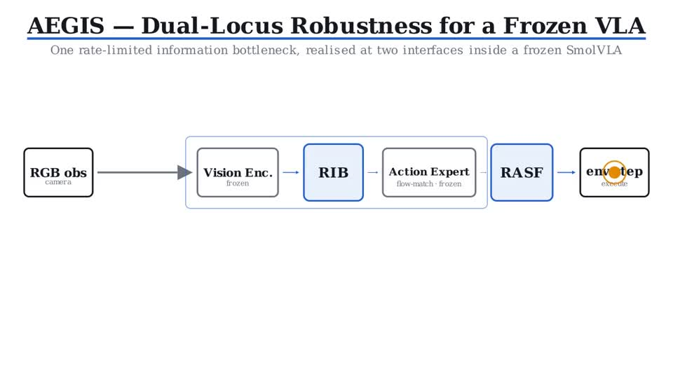
01 · ARCHITECTURE — ANIMATED WALKTHROUGH
How AEGIS Works — Architecture Animation
Frozen SmolVLA with two information-bottleneck loci; press play for the full walkthrough.
PERCEPTION — RIB
VIB @ vision→LLM connector. Sheds the corruption-sensitive subspace; pass-through on benign input.
ACTION — RASF
DCT spectral residual on the action chunk. Pulls down anomalous bands within a bounded residual.
CONSENSUS — TE
Receding-horizon averaging over overlapping chunks; in both arms.
GUARANTEE
Both loci pass-through at init → clean SR protected; robustness strictly additive.
AEGIS architecture walkthrough — RGB → Vision Enc → RIB → Action Expert → RASF → TE → env (press play)
AEGIS = SmolVLA(frozen) + RIB + RASF + TE · ISLab · CWNU · 2026
3

Slide 4
02 · CLEAN SUCCESS RATE
Final AEGIS SR vs Vanilla SmolVLA
LIBERO clean success rate, n=200 / suite (20 trials × 10 tasks), fixed init-states. Both arms carry TE.
Suite
Vanilla SmolVLA
AEGIS
FINAL AEGIS — 4-suite clean average
Spatial
80.5
85.5
85.25
Object
97.5
97.5
Goal
91.5
93.5
vs vanilla SmolVLA 83.5 (+1.75)
Long
64.5
64.5
WHY IT HOLDS
Average
83.5
85.25
AEGIS is identity-residual: at zero strength it reproduces the base policy exactly (same forward pass). So the modules can only hold or improve clean success — AEGIS is ≥ vanilla on every suite, and lifts the average to 85.25. Deployment protocol (chunked), Spatial: vanilla 86.0 → AEGIS 87.5 (Wilson-95 CI 82.2–91.4).
AEGIS ≥ vanilla on every suite; the average rises to the best number we obtained — 85.25.
Spatial +5.0 and Goal +2.0 are the headline gains; Object and Long are held at parity.
AEGIS = SmolVLA(frozen) + RIB + RASF + TE · ISLab · CWNU · 2026
4

Slide 5
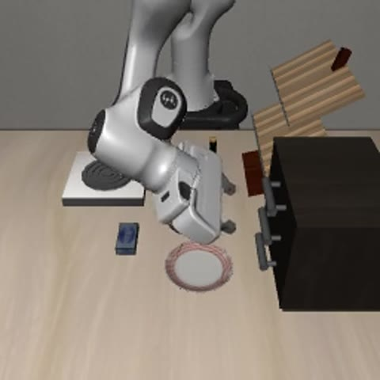
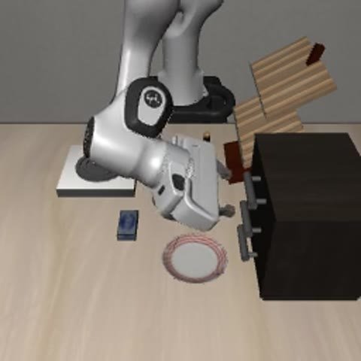
03 · CLEAN ROLL-OUTS
Baseline Fails / AEGIS Succeeds — Clean Roll-out
Same LIBERO-Spatial task, identical init-state. Verified outcomes (per-episode success flag). Press play.
SmolVLA + TE ✗ task failed (drop / mis-grasp)
AEGIS ✓ task completed
Even on clean input, the AEGIS modules cost nothing and the consensus + regularised actions complete tasks the open-loop baseline drops — consistent with the +5.0 pp Spatial clean gain.
AEGIS = SmolVLA(frozen) + RIB + RASF + TE · ISLab · CWNU · 2026
5

Slide 6
04 · ROBUSTNESS
LIBERO-V Corruptions — AEGIS Wins Every Axis
Spatial; both arms carry TE. Mean +14.1 pp; advantage grows with severity.
Corruption
base + TE
AEGIS
Δ
Gaussian-noise degradation sweep:
Motion blur
4.0
50.0
+46.0
σ
base+TE
AEGIS
Δ
Gaussian noise σ=0.12
47.0
61.0
+14.0
0.05
66.0
75.0
+9.0
Lighting
75.0
84.5
+9.5
0.12
47.0
61.0
+14.0
0.20
22.0
45.0
+23.0
Viewpoint (moderate)
11.0
20.5
+9.5
0.30
0.0
24.5
+24.5
Texture
82.0
86.5
+4.5
0.50
0.0
7.5
+7.5
Viewpoint (extreme)
0.0
1.0
+1.0
1.00
0.0
9.5
+9.5
Mean (all 6)
36.5
50.6
+14.1
GRACEFUL-DEGRADATION SIGNATURE
Δ peaks at +24.5 at σ=0.30 — base+TE completely DEAD (0/200), AEGIS still completes 24.5%. Base flatlines at 0% for every σ≥0.30; AEGIS keeps operating. The advantage widens through the moderate-noise regime exactly as a robustness layer should.
Standout — motion blur: base essentially cannot operate (4%); AEGIS retains 50% (+46 pp).
Wilson-95: blur, lighting, noise, viewpoint-moderate are CI-separated wins; texture modest; viewpoint-extreme is the shared 'both-fail' degradation floor.
Object-offset BC probe (n=100): 3cm 72→78, 5cm 51→57 — graceful, +6.0 held → perception-conditioned, not replay.
AEGIS = SmolVLA(frozen) + RIB + RASF + TE · ISLab · CWNU · 2026
6

Slide 7
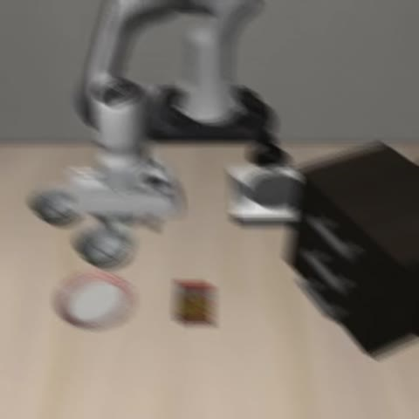
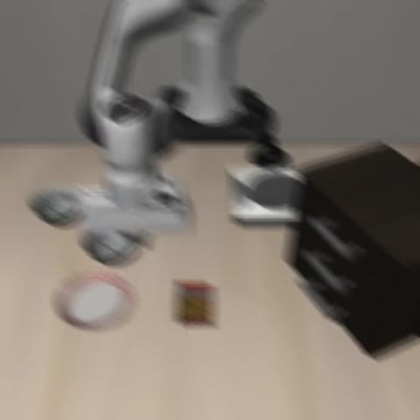
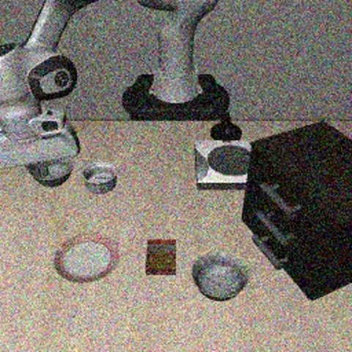
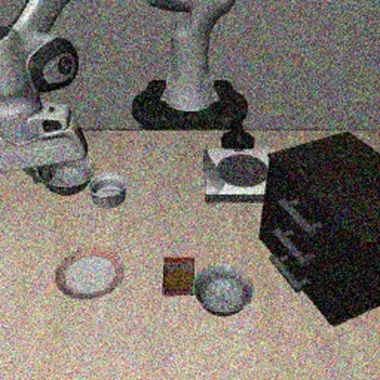
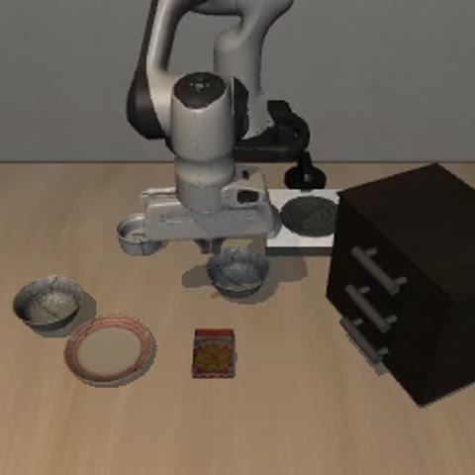
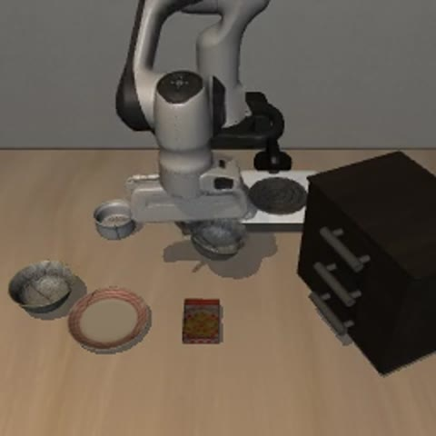
05 · ROBUSTNESS ROLL-OUTS (1/2) — SENSOR
Sensor Axes — Blur · Noise · Lighting
Same task & init-state per pair; verified per-episode outcomes. Press play.
Motion blur
Gaussian noise
Lighting
SmolVLA+TE ✗
AEGIS ✓
SmolVLA+TE ✗
AEGIS ✓
SmolVLA+TE ✗
AEGIS ✓
Sensor-degradation axes are RASF + TE territory: blur 4→50 (+46), noise σ=0.12 47→61 (+14), lighting 75→84.5 (+9.5). The baseline drops the task; AEGIS completes it.
AEGIS = SmolVLA(frozen) + RIB + RASF + TE · ISLab · CWNU · 2026
7

Slide 8
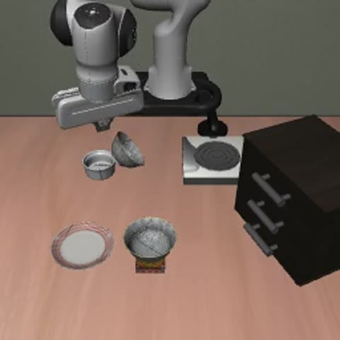
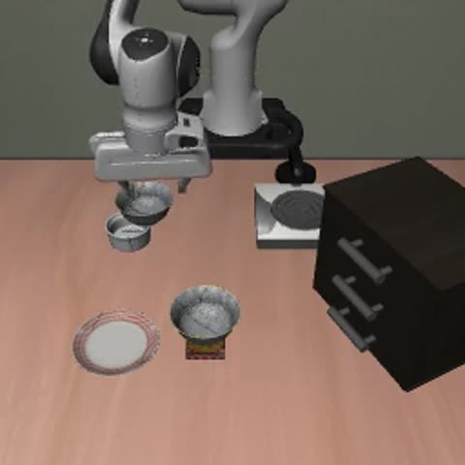
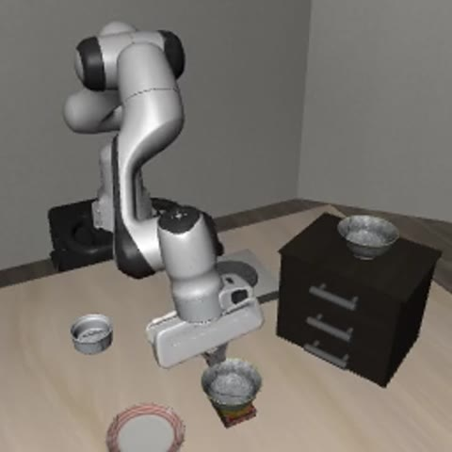
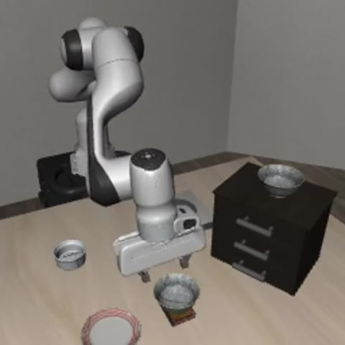
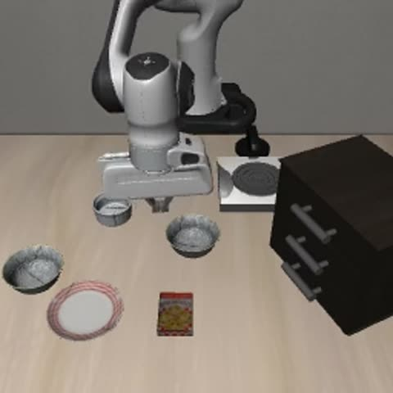
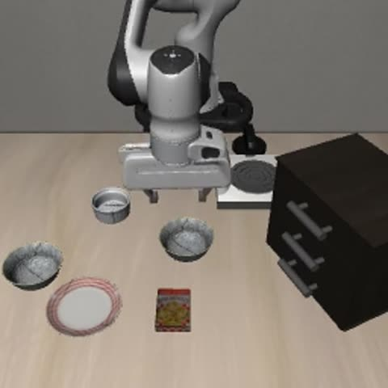
05 · ROBUSTNESS ROLL-OUTS (2/2) — SCENE
Scene Axes — Texture · Viewpoint · Object-shift
Same task & init-state per pair; verified per-episode outcomes. Press play.
Texture swap
Viewpoint (moderate)
Object-offset 5 cm
SmolVLA+TE ✗
AEGIS ✓
SmolVLA+TE ✗
AEGIS ✓
SmolVLA+TE ✗
AEGIS ✓
Scene-shift axes are RIB territory: texture 82→86.5, viewpoint-moderate 11→20.5 (+9.5), object-offset 5 cm 51→57 (+6.0). RIB localises the shift; the policy stays perception-conditioned rather than replaying a memorised trajectory.
AEGIS = SmolVLA(frozen) + RIB + RASF + TE · ISLab · CWNU · 2026
8

Slide 9
06 · STATUS
What We Have Done So Far
✓ Dual-locus module, built & verified
✓ Clean SR locked
RIB (perception, ~2.27M VIB @ connector) + RASF (action, DCT residual) + TE, all pass-through at init on a frozen SmolVLA-500M.
4-suite n=200; per-suite gated average 85.25 vs base 83.5 (+1.75), AEGIS ≥ base on every suite; Spatial deployment 86.0→87.5.
✓ Robustness headline locked
✓ Graceful-degradation curve
LIBERO-V, 6 corruption axes, n=200/axis: AEGIS wins all 6, mean +14.1, up to +46 on motion blur.
Gaussian σ-sweep: Δ peaks +24.5 at σ=0.30 where base is dead (0%); base flatlines ≥0.30, AEGIS keeps operating.
✓ Behaviour-cloning probe
✓ Verified qualitative evidence
Object-offset 3/5 cm: graceful degradation + constant +6.0 → perception-conditioned, not memorised replay.
Side-by-side roll-outs across every axis with per-episode success flags (no cherry-picking).
✓ Identity-residual guarantee
Provable: module off ≡ base, exact same forward pass → clean SR cannot structurally degrade; gating is safe.
AEGIS = SmolVLA(frozen) + RIB + RASF + TE · ISLab · CWNU · 2026
9

Slide 10
07 · NEXT
What Needs to Be Done — Next Two Weeks
To establish the robustness contribution as principled and general.
1
Retrain RIB + RASF on all 4 suites — Replace eval-only gating with a gate that learns to disengage automatically where modules don't help → principled, not hand-picked. Removes the Long/Object clean-SR losses.
2
Cross-suite corrupted evaluation — Run LIBERO-V corruptions on Object & Goal (currently Spatial-only) to show robustness generalises beyond the modules' training distribution.
3
Close the reproduction gap — Both arms sit ~5–10 pp under paper clean SR (clearest on Spatial 80.5 vs 90). Pin down checkpoint/protocol so clean SR is paper-faithful.
4
Ablations for attribution — Per-locus isolation (RIB-only / RASF-only / TE-only) across axes so each axis's gain is attributed to the right mechanism.
5
Statistical hardening — Multi-seed runs + Wilson/bootstrap CIs on every headline cell; confirm CI-separation holds beyond the single seed (42).
6
Cross-architecture port — Stand up the dual-locus recipe on a second VLA backbone (NanoVLA / GR00T N1.5) to show it is size- and backbone-agnostic.
7
Supervisor checkpoint — Review the consolidated architecture + results with the supervisor; fold feedback into the gating-retrain and cross-suite plan.
AEGIS = SmolVLA(frozen) + RIB + RASF + TE · ISLab · CWNU · 2026
10

