Slide 1
ROBOT LEARNING · FLOW-MATCHING POLICIES · CONTACT-RICH MANIPULATION
Impedance-Shaped Flow Matching
for VLA Policies
Making the action expert's flow-ODE drift a closed-loop impedance law — compliance becomes structural, not a downstream add-on.
IS Lab · Changwon National University Group presentation — Saturday, 2026-05-30

Slide 2
HOW WE GOT HERE · 1 / 2
We started somewhere else: Adjoint Attribution
Prior project: “Why attention explanations for flow-matching robot policies are provably wrong.” Use the adjoint sensitivity of the action-generating ODE as the principled attribution. Four bids for novelty:
HYPOTHESIS 1
HYPOTHESIS 2
HYPOTHESIS 3
HYPOTHESIS 4
Attention is “provably wrong”
Attention maps disagree with true ODE sensitivity.
Second-order / interaction adjoint
Go beyond first-order gradients — curvature & token interactions.
Adjoint-KL fine-tuning
Use the adjoint signal to fine-tune the policy (performance lever).
Test-time goal-steering
Steer generation along adjoint directions at inference.
The goal we set: genuine novelty + an improving number. Every one of these four was tested against that bar.
Impedance-Shaped Flow Matching for VLA Policies
2

Slide 3
HOW WE GOT HERE · 2 / 2
… and why we abandoned it
✗
Attention “provably wrong”
Confound. Attention vs adjoint actually agree on rank (Spearman +0.52, top-1 100%) once token granularity is matched.
✗
2nd-order interaction adjoint
Scale artifact. The 90–122× state-token curvature was an embedding-norm effect (state ≈7 vs image ≈3700, ~518×).
✗
Adjoint-KL fine-tuning
Null. +1.7 vs a proper control — inside the noise at n = 12.
✗
Test-time goal-steering
Net-negative. Helps free-space reach (37→75%) but collapses every contact task (push, window → 0%).
✓
One result survived (analysis-only): an interventional ground truth showed attention's modality ranking is the reverse of causal truth, and the adjoint's matches. Not the method/perf paper we wanted → abandoned.
Lesson kept: model-internal attributions evaporate under scale/granularity normalization. Validate the core object in isolation, clear a kill-gate before scaling, report numbers honestly.
Impedance-Shaped Flow Matching for VLA Policies
3

Slide 4
THE PIVOT
From explaining compliance to building it
If steering a trained flow policy collapses contact tasks, the problem isn't the explanation — the policy has no notion of physical compliance in how it generates motion.
So stop attributing behaviour after the fact. Build the right inductive bias into the generator itself.
BEFORE
Unstructured neural drift
Compliance bolted on downstream (external controller / F-T sensor), or merely explained post-hoc.
OURS
Drift IS an impedance law
A closed-loop mass–spring–damper attractor, end-to-end differentiable, baked into the flow ODE. No downstream controller.
→
Impedance-Shaped Flow Matching for VLA Policies
4

Slide 5
THE CONTRIBUTION
The one new object: an impedance-shaped flow drift
The flow-matching action expert's ODE velocity field is itself a 2nd-order closed-loop impedance law.
M, K, D
task-conditioned SPD matrices (mass / stiffness / damping), Cholesky-parameterized, predicted from features.
ȧ — velocity state
the flow is a 2nd-order augmented ODE, integrated semi-implicitly (symplectic Euler). The naive finite-difference form is unstable — the toy gate proved it first.
a_goal
an attractor (chunk target or a predicted attractor token) the drift is pulled toward.
End-to-end
fully differentiable. No downstream controller. No force/torque sensor at inference.
Impedance-Shaped Flow Matching for VLA Policies
5

Slide 6
POSITIONING
Why it's novel — and what it is not
CompliantVLA-adaptor
Predicts K, D from a VLM but feeds an EXTERNAL impedance controller wrapped around a frozen VLA.
Flow with the Force Field
Standard unstructured flow drift + a DOWNSTREAM passive impedance controller for compliance.
ACP / Diffusion-Impedance / DMP
Stiffness lives on the OUTPUT head or a DMP decoder — not in the generative drift.
Ours: the velocity field IS the impedance law
A closed-loop K/D/M attractor conditioned on features, embedded inside the action expert — end-to-end, no external controller, no F/T sensor. (The prior-art check confirms this intersection is unclaimed as of May 2026.)
Impedance-Shaped Flow Matching for VLA Policies
6

Slide 7
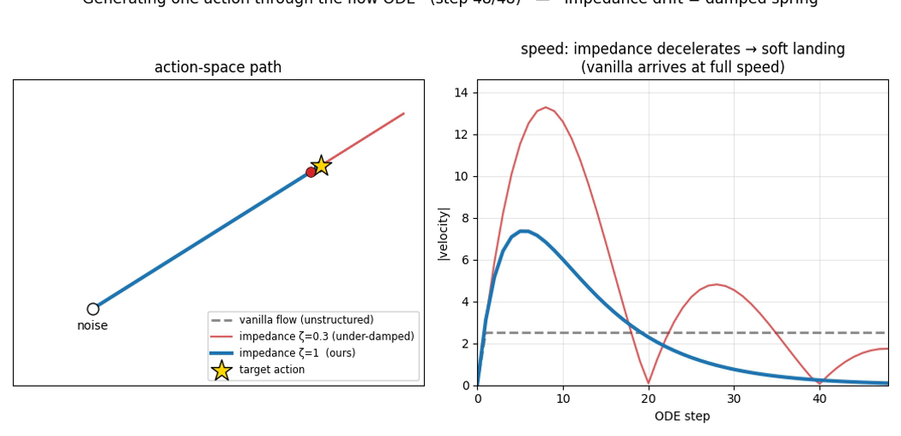
EXPLAINABLE SIMULATION · MECHANISM
How one action is generated through the flow ODE
▶
▶ click to play in Slide Show
Vanilla flow travels a straight, unstructured path and arrives at full speed. Impedance flow (ours) is a damped spring toward the predicted attractor — it decelerates to a soft landing.
ζ = 1 (ours, critically damped) is smooth; ζ = 0.3 overshoots — which is exactly why we enforce ζ ≥ 1 via D = 2ζ√K.
Impedance-Shaped Flow Matching for VLA Policies
7

Slide 8
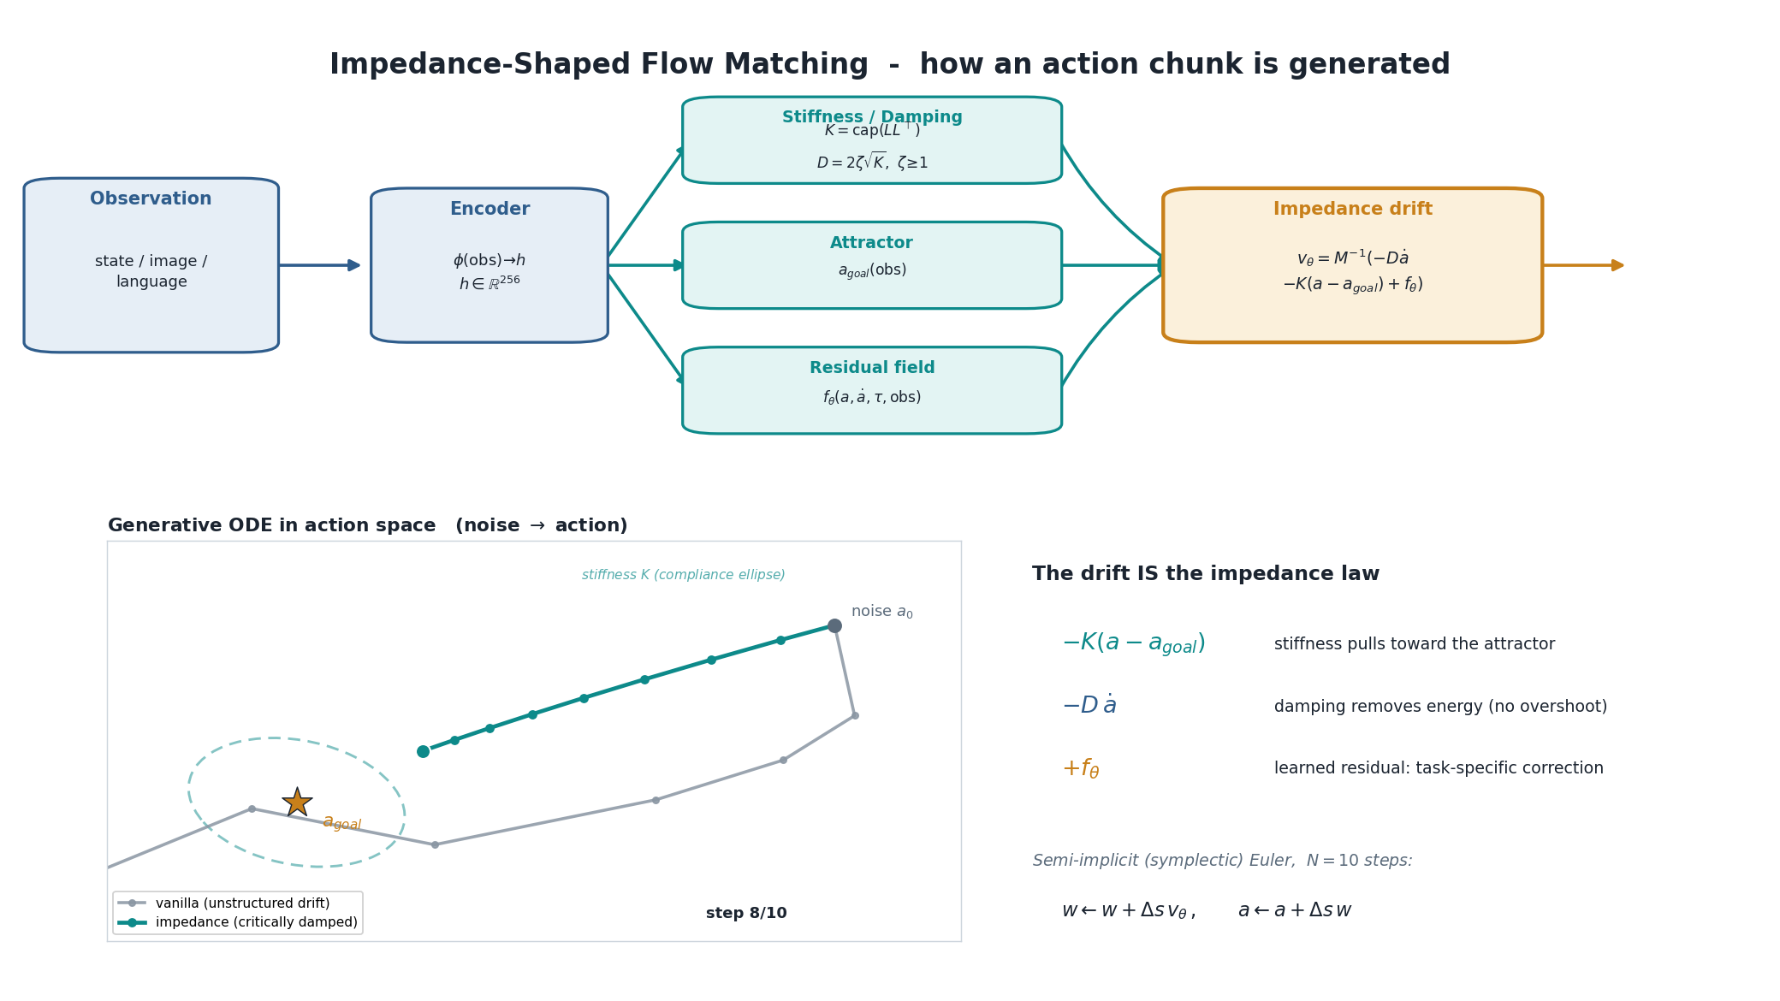
METHODOLOGY · END-TO-END PIPELINE
The full methodology, animated
▶
▶ click to play in Slide Show
Observation → features → predicted M, K, D & attractor → the action chunk is generated by integrating the impedance-shaped flow ODE (symplectic Euler) → executed closed-loop. No external controller, no F/T sensor.
Impedance-Shaped Flow Matching for VLA Policies
8

Slide 9
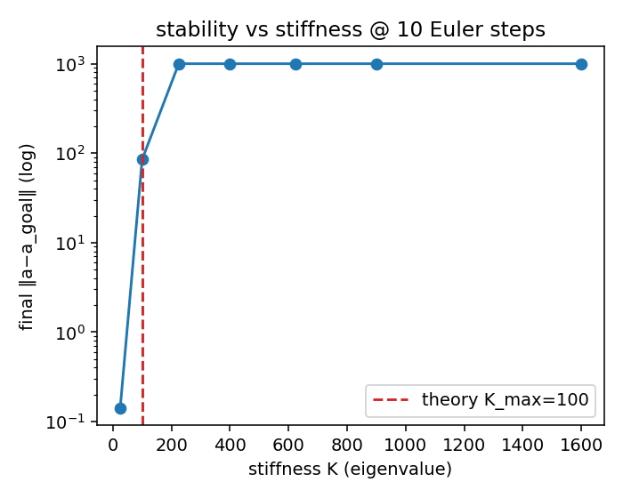
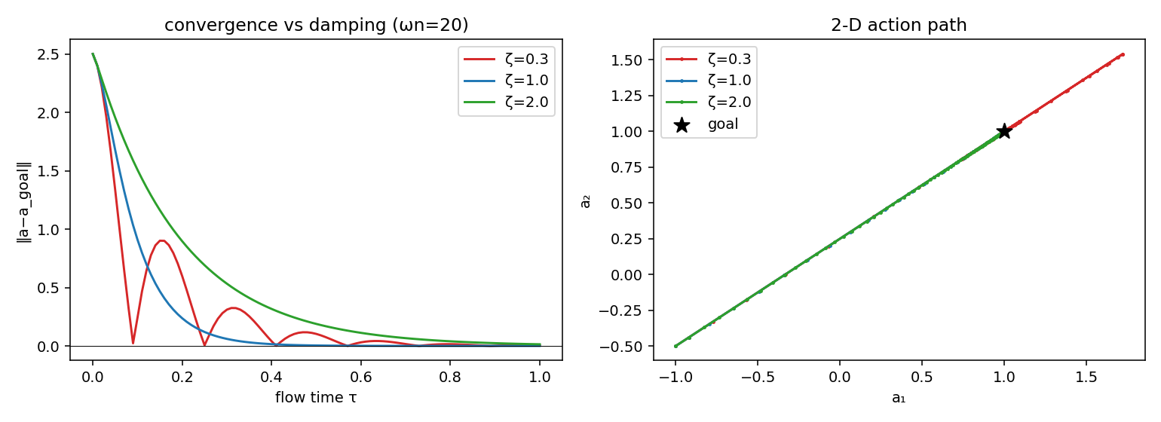
DE-RISKING · VALIDATE THE CORE IN ISOLATION
Toy gate — cleared before touching the model
✓ SPD heads verified
Cholesky M = LLᵀ + εI stays positive-definite.
✓ Damping-ratio control
ζ = 0.3 → 36% overshoot, ζ = 1 → clean, ζ = 2 → monotonic.
✓ Stability bound
at N Euler steps usable stiffness K ≲ (steps)² — the soft/compliant regime, which is what contact wants.
Impedance-Shaped Flow Matching for VLA Policies
9

Slide 10
STAGE-1 SETUP
A fair test: only the drift parameterization differs
Same everything
Compact state-conditioned flow policy. Vanilla vs impedance arm trained with an identical objective; only the ODE drift differs.
WHAT WE MEASURE
▪ Success rate
did the task complete
▪ Action jerk
2nd-difference of actions — smoothness
▪ Peak contact force
95th-pct of contact force — compliance
▪ Sample efficiency
metric vs # demonstrations
Param-matched
Both arms at ~400k parameters — the win is the structure, not capacity.
Honest protocol
3 seeds × 30 closed-loop eval episodes; no tuning toward a target.
Benchmark: MetaWorld full-state demos — peg-insert-side (tight-tolerance contact, the hard task) and door-open (easy-from-state control). ManiSkill2/3 contact suite is the next, primary benchmark.
Impedance-Shaped Flow Matching for VLA Policies
10

Slide 11
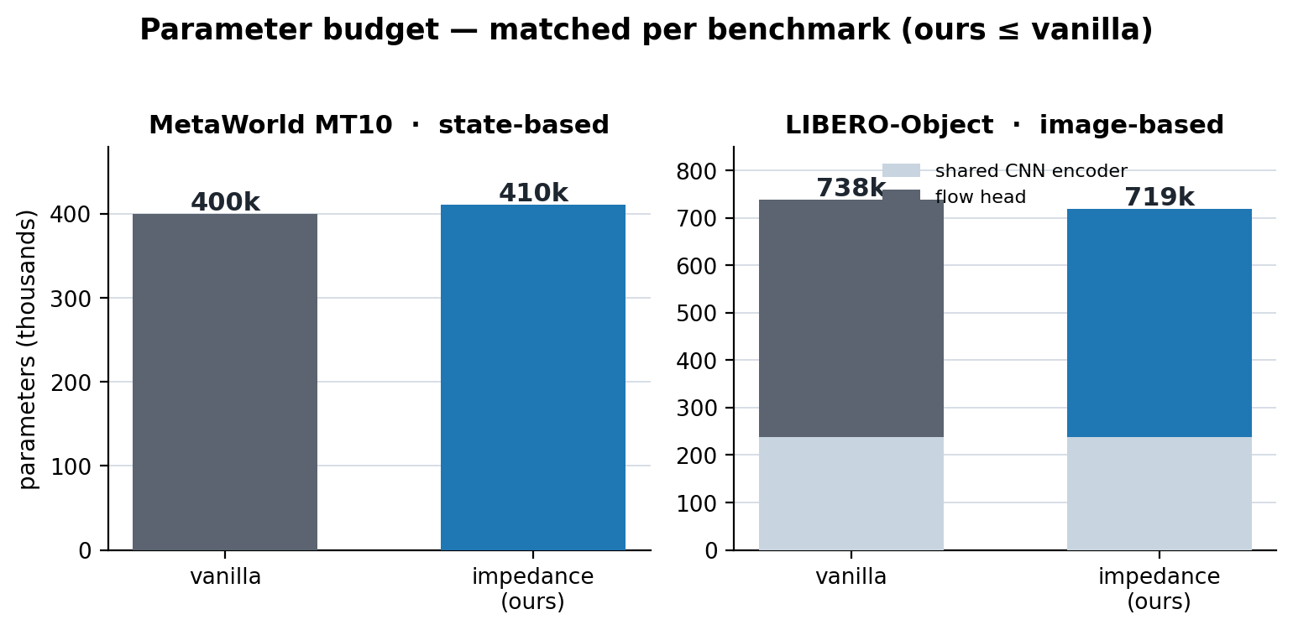
REPRODUCIBILITY
How the demo was trained — hyperparameters & parameter budget
Knob | MetaWorld MT10 | LIBERO-Object
Action chunk H / ODE steps | 16 / 10 | 16 / 10
Impedance hidden width | 256 | 256
Impedance caps k / d / ζ | 20 / 18 / 2 | 20 / 18 / 2
Impedance dims (rest = free flow) | 4 of 4 | 6 of 7 (gripper-exempt)
Learning rate / batch | 1e-3 / 256 | 1e-3 / 128
Epochs per arm·seed × seeds | 300 × 3 | 100 × 3
Demos per task | 50 | 50
Eval protocol | 10 rollouts/task | 20 episodes/task
Total epochs trained | 1,800 | 6,000
Param-matched by construction: the vanilla arm's hidden width is sized so its parameter count matches (or exceeds) the impedance arm — the only difference is the drift parameterization, not capacity.
Identical training objective (differentiable rollout-matching MSE + small jerk penalty), identical data, 3 seeds. MetaWorld is state-conditioned (no image encoder); LIBERO adds a shared 238.6k CNN encoder to both arms.
Impedance-Shaped Flow Matching for VLA Policies
11

Slide 12
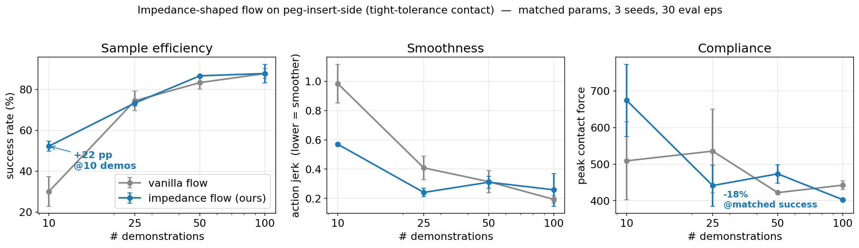
RESULT · PRIMARY TASK
peg-insert-side: a textbook sample-efficiency win
+22 pp
−42%
−18%
success @ 10 demos
(30% → 52%)
lower action jerk
at low data
peak contact force
@ matched success (n=25)
Impedance-Shaped Flow Matching for VLA Policies
12

Slide 13
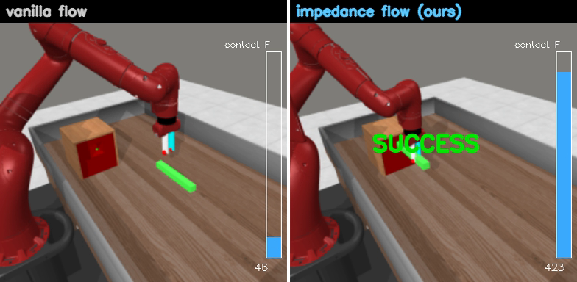
EXPLAINABLE SIMULATION · ROLLOUT
Impedance inserts where vanilla misses — 10 demos
▶
▶ click to play in Slide Show
MuJoCo peg-insert, identical seeds, both arms trained on just 10 demos (3 episodes shown). Impedance succeeds where vanilla fails.
Note: the live force gauge reads higher for impedance here precisely because it makes the insertion contact that vanilla misses — the −18% compliance number is the matched-success comparison on the previous slide.
Impedance-Shaped Flow Matching for VLA Policies
13

Slide 14
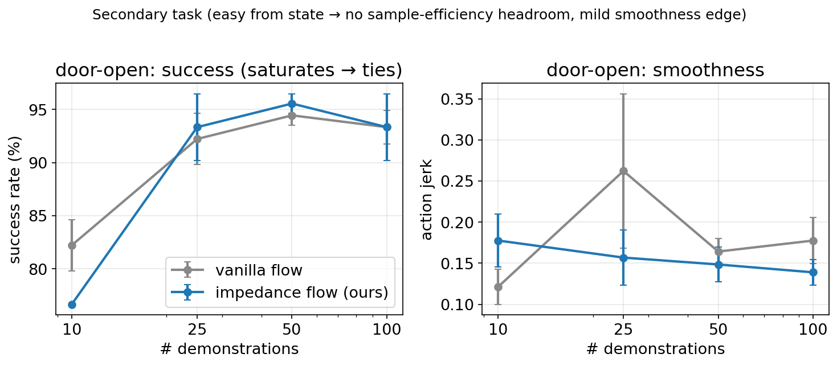
RESULT · SECONDARY TASK (HONEST SCOPE)
door-open saturates — so the prior is redundant there
WHY THIS MATTERS
Door-open is easy from state — vanilla already hits 82% at 10 demos. No sample-efficiency headroom → the two arms tie on success.
The impedance prior helps exactly where physics is the bottleneck (tight-tolerance insertion) and is harmlessly redundant where it isn't.
That is the honest, expected signature of a good structural prior — not a universal +X%.
Impedance-Shaped Flow Matching for VLA Policies
14

Slide 15
EVIDENCE
Stage-1 results at a glance
Setting | Success (van → imp) | Action jerk (van → imp) | Peak force (van → imp)
peg-insert · 10 demos | 30% → 52% (+22pp) | 0.99 → 0.57 (−42%) | 509 → 674
peg-insert · 25 demos | 74% → 73% (tie) | 0.41 → 0.24 (−41%) | 536 → 441 (−18%)
peg-insert · 100 demos | 88% → 88% (saturated) | 0.19 → 0.26 | 443 → 403
door-open · 100 demos | 93% → 93% (tie) | 0.18 → 0.14 (−22%) | 2202 → 2199
matched ~400k params · identical training objective · 3 seeds · 30 eval episodes.
Read: a big low-data gain that closes as data saturates (sample efficiency), smoother actions at low data, lower force at matched success — the structural prior helps where physics matters.
Impedance-Shaped Flow Matching for VLA Policies
15

Slide 16
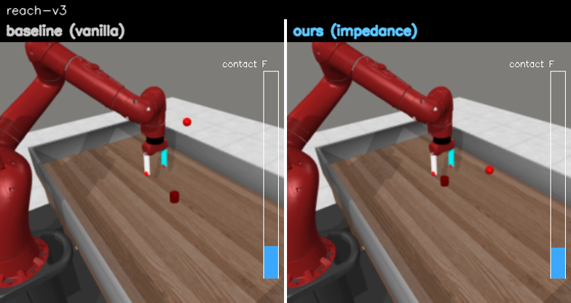
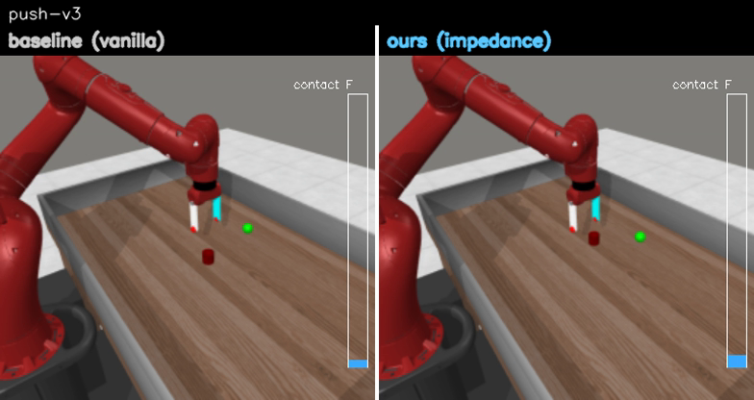
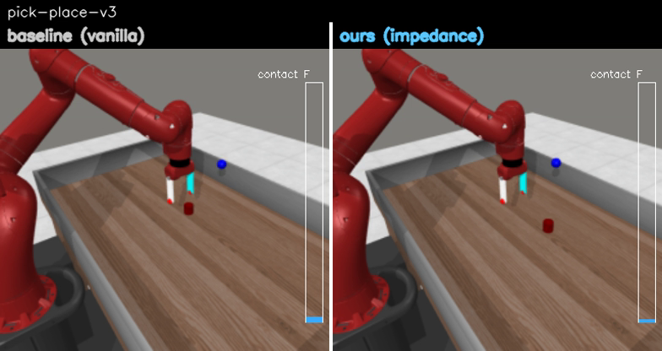
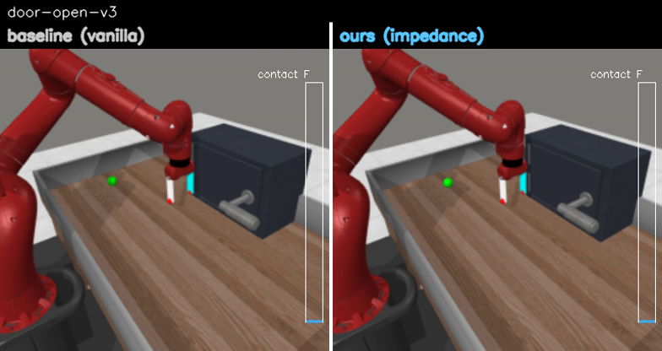
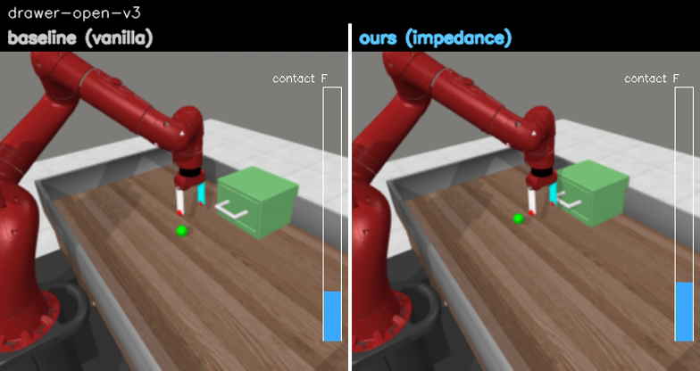
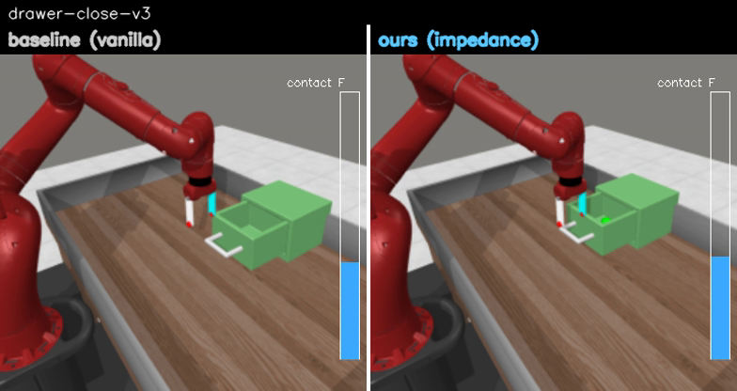
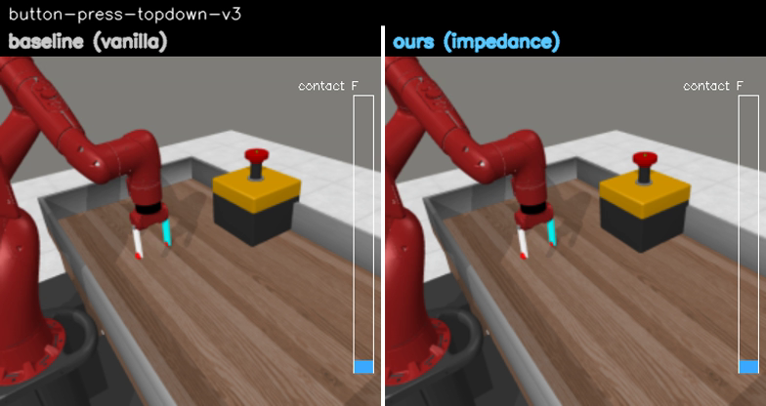
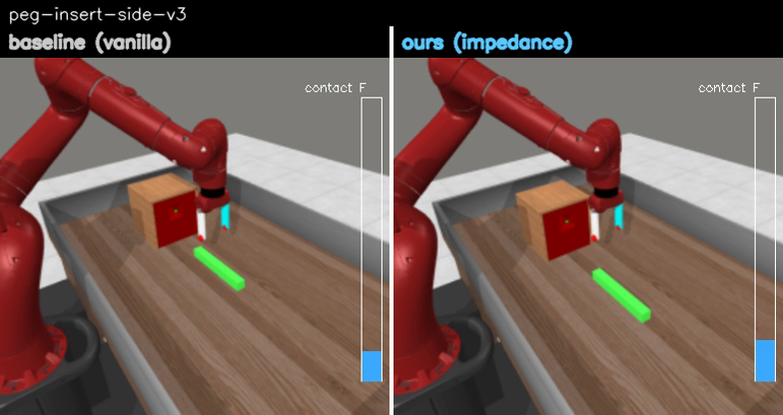
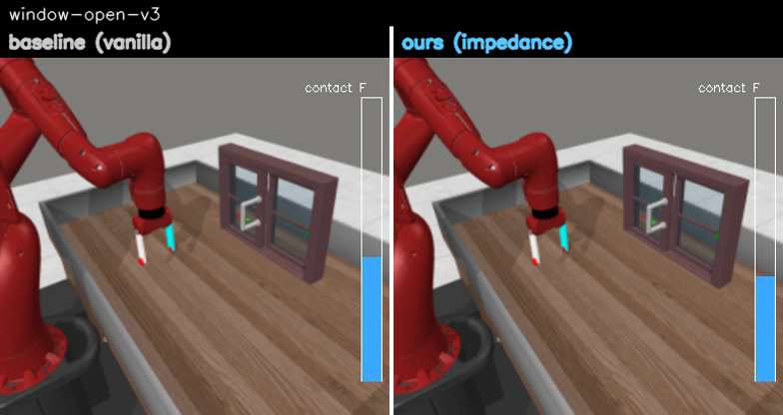
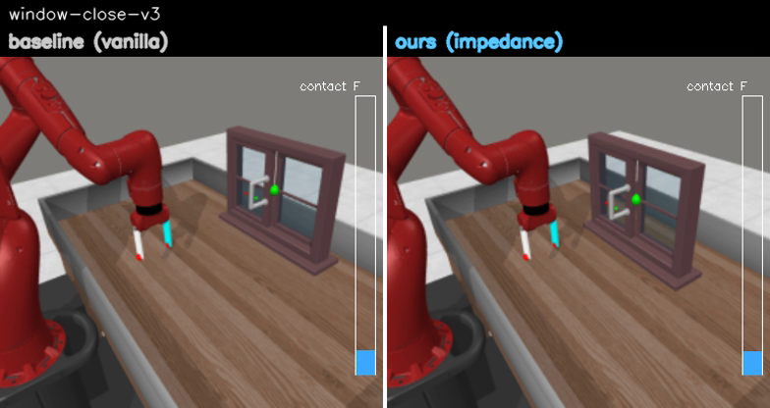
EXPLAINABLE SIMULATION · METAWORLD MT10
All 10 tasks — left: baseline (vanilla) | right: ours (impedance)
▶
▶
▶
▶
▶
reach
push
pick-place
door-open
drawer-open
▶
▶
▶
▶
▶
drawer-close
button-press
peg-insert-side
window-open
window-close
3 seeds × 10 rollouts/task. MT10 is largely saturated (8/10 tie at 100%) — the prior wins on the hard tasks (reach 83→100%, peg-insert 77→80%) and never meaningfully regresses. Mean 96.0% → 97.7%.
Impedance-Shaped Flow Matching for VLA Policies
16

Slide 17
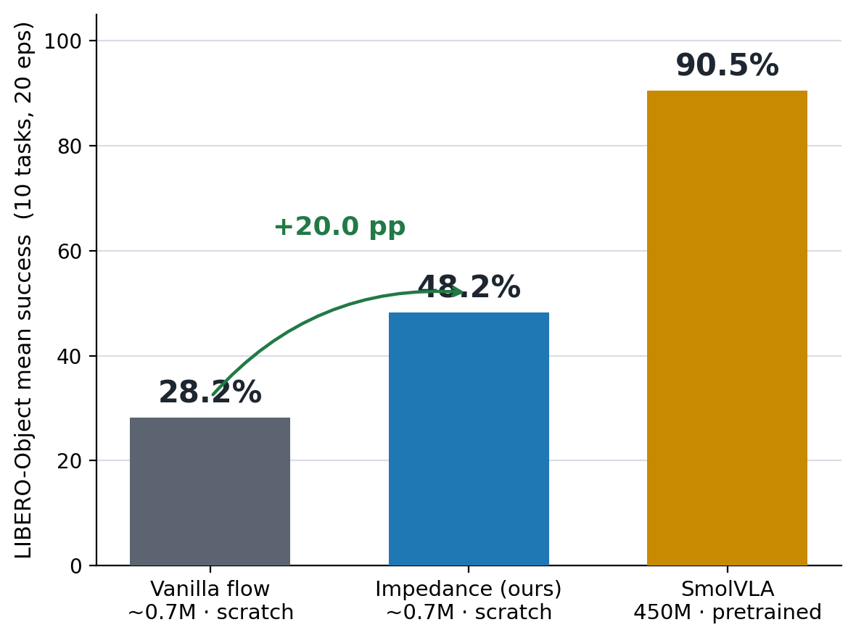
RESULT · GENERALIZATION TO PIXELS + CONTACT
It transfers to image-based contact tasks — with an honest real-scale anchor
+20.0 pp from the drift structure
LIBERO-Object, vision-based contact-rich pick-&-place. Vanilla 28.2% → impedance 48.2% at matched ~0.7M, from scratch (10 tasks × 3 seeds × 20 eps). Ours has fewer params and stabilizes seeds.
Real-scale anchor: SmolVLA 450M = 90.5%
The 42-pp gap is scale + 800k-trajectory pretraining + language + 2 cameras — the axes we deliberately removed, not the method losing.
Genuinely visuomotor — blinding the policy collapses it 80%→0% (not replay). And alphabet soup, SmolVLA's weakest (65%), is our arm's best (88%): the Stage-3 target.
Impedance-Shaped Flow Matching for VLA Policies
17

Slide 18
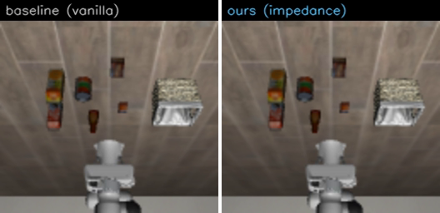
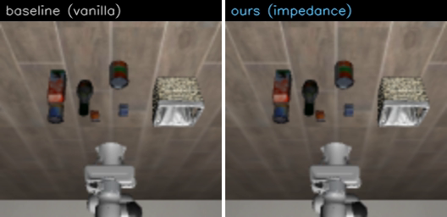
EXPLAINABLE SIMULATION · LIBERO-OBJECT
Watch it: impedance succeeds where vanilla fails
▶
▶
▶ click to play in Slide Show
▶ click to play in Slide Show
tomato sauce baseline 28% → ours 88%
alphabet soup baseline 37% → ours 88%
Each clip: left = baseline (vanilla flow) , right = ours (impedance) , same scene & seed. Ours makes a smooth, compliant approach and completes the place; vanilla fumbles or stalls. Blinding the policy collapses it 80%→0% — it is genuinely visuomotor, not replay.
Impedance-Shaped Flow Matching for VLA Policies
18

Slide 19
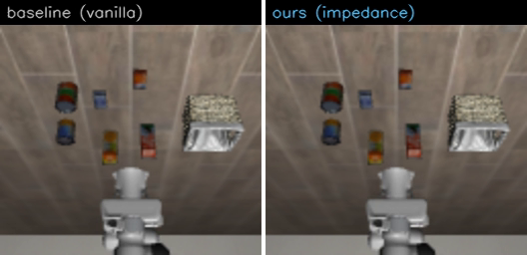
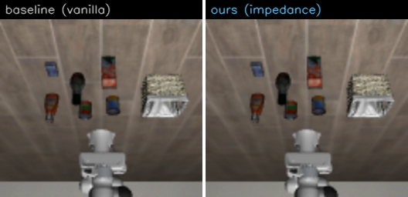
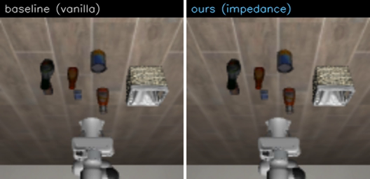
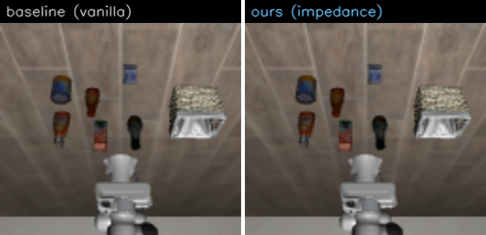
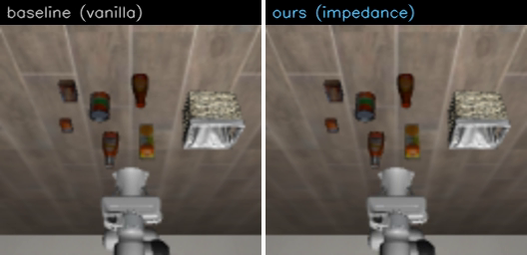
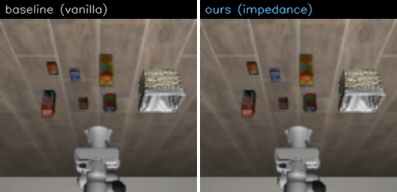
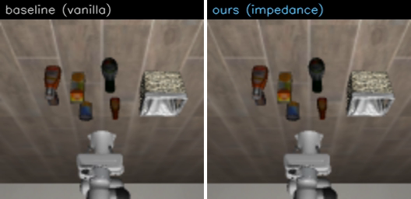
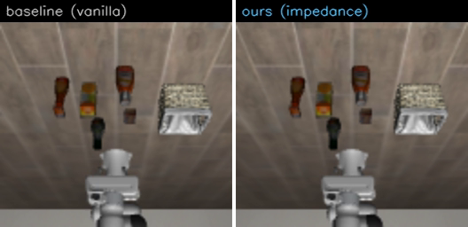
EXPLAINABLE SIMULATION · LIBERO-OBJECT
All 10 tasks — left: baseline (vanilla) | right: ours (impedance)
▶
▶
▶
▶
▶
alphabet soup
cream cheese
salad dressing
bbq sauce
ketchup
▶
▶
▶
▶
▶
tomato sauce
butter
milk
chocolate pudding
orange juice
3 seeds × 20 episodes/task, vision-based, randomized object location. Mean 28.2% → 48.2% (+20pp); biggest wins: alphabet soup 37→88, tomato sauce 28→88, salad dressing 15→62, butter 38→68.
Impedance-Shaped Flow Matching for VLA Policies
19

Slide 20
FUTURE WORK
From Stage-1 proof to a contact-rich VLA paper
Stage-2 · conditioning ablation
VLM-predicted M/K/D vs fixed; stiffness-output-only baseline — isolate what the structure buys.
1
Stage-3 · scale to SmolVLA
Port the impedance drift into the SmolVLA action expert with the full 2nd-order conditional flow matching.
2
Primary benchmark · ManiSkill2/3
PegInsertionSide, PlugCharger, TurnFaucet, AssemblyNut — reviewer-accepted contact suite. MetaWorld + LIBERO shown as transfer probes; ManiSkill is the primary contact target.
3
Efficiency angle · ODE steps
5 vs 10 integration steps — same accuracy, fewer steps = lower latency.
4
Credibility lever · real arm
Peg / USB insertion with a wrist F/T sensor.
5
Kill-gate: GO only if the ManiSkill contact subset shows ≥ +5pp over vanilla SmolVLA at matched params. Fail fast; report honestly.
Impedance-Shaped Flow Matching for VLA Policies
20

Slide 21
TAKEAWAYS
1
A genuinely new object
the flow-ODE drift made a closed-loop impedance law — not an external controller, not a post-hoc explanation. Prior-art-clear.
2
It works where it should
+22pp sample efficiency, −42% jerk, −18% force on tight-tolerance insertion — and +20pp on image-based LIBERO-Object contact tasks; redundant on easy/saturated tasks.
3
Earned by discipline
toy gate → param-matched Stage-1 → SmolVLA next. The lesson from the abandoned project, applied: validate, gate, report honestly.
Impedance-Shaped Flow Matching for VLA Policies · IS Lab, CWNU · 2026-05-30

