Slide 1
Holiday Horizons: Understanding Movement, Mobility & Air
Visualizing Holiday Effects on Travel & Environment
Team 9 – Nirmit Sachde, Ashmita Pal, Aakash Mehta

Slide 2
Project Flow
From Celebration to Impact
Holiday Insights
Before / On / After Holiday Dynamics
Public Holidays
Flights, Hotel Bookings, Public Transit Ridership, Air Quality (AQI)
Four Factors

Slide 3
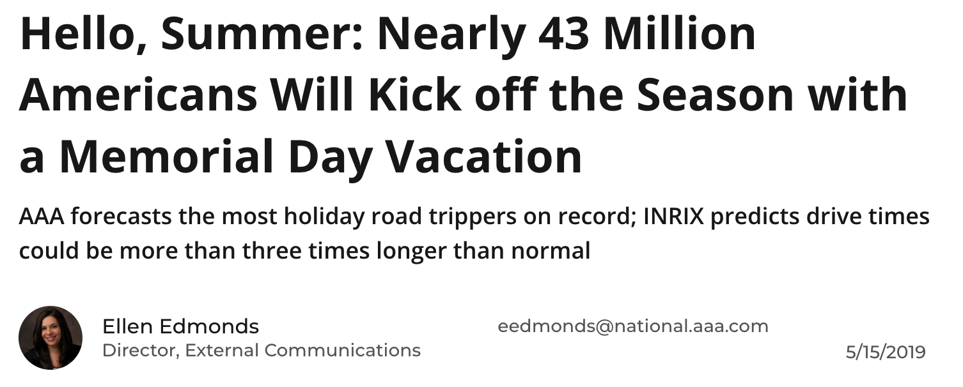
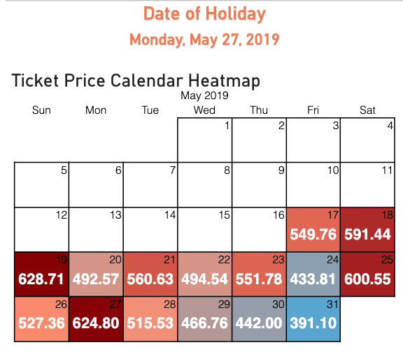
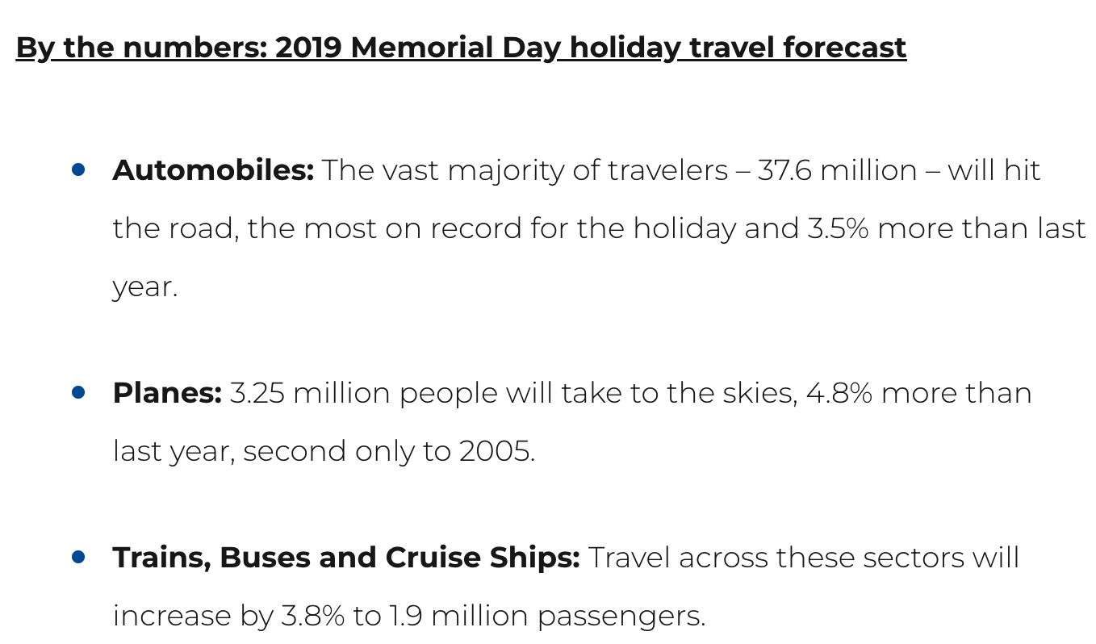
Insights – Flights and Public Holidays
U.S. average Domestic Fares for 2019: $355
- BTS
Memorial Day 2019 Spike:
Noticeable surge in average ticket prices on Memorial Day.
Indicates peak travel demand before the holiday impacting fares.

Slide 4


Insights – Flights and Public Holidays
The article stated that – “Domestic travel dates for the sale fares were valid between May 28 and June 1, 2019”. That is after the Memorial day holiday.
So, we can clearly see in out bar chart that despite having a higher ticket price average before Holiday, American Airlines has one of the lowest average ticket price after Holiday.

Slide 5
Insights – Hotels and Public Holidays
Hotel bookings saw a significant drop on Christmas Day, signaling that most travelers had already secured their accommodations in advance or chose not to travel on the holiday itself.
This behavior reflects a pattern where people either arrive early to celebrate or stay at home with family, resulting in lower same-day booking activity.

Slide 6

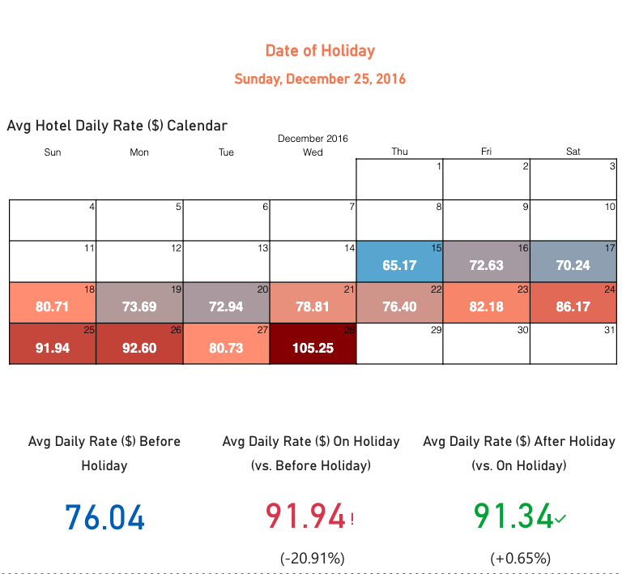
Insights – Hotels and Public Holidays
Despite the drop in bookings, hotel rates on Christmas Day were noticeably higher.
This surge in pricing likely stems from increased seasonal demand, limited availability, and the premium that hotels often apply during major holidays, regardless of booking volume.
Interestingly, even after the holiday passed, hotel prices remained elevated. This trend suggests a continuation of travel activity throughout the festive week, possibly driven by extended vacations, post-Christmas getaways, and early preparations for New Year celebrations.

Slide 7
Impact of Ridership on Public Holidays
Key Finding: Ridership consistently drops on weekends and public holidays.
Why?
Reduced commuter volume (work/school trips cease).
Transit agencies often run modified/reduced schedules.
Maintenance/track work frequently scheduled during these lower-demand periods.

Slide 8


Impact of Public Holidays AQI (PM2.5)
PM 2.5 - Particulate matter in the air, particles with a diameter of 2.5 micrometers or less.
Exposure to high levels of PM2.5 can cause respiratory problems, eye, nose, and throat irritation, and other adverse health effects.
Fireworks are known to emit high levels of PM2.5 and PM10 as well as metal air pollutants, all of which can contribute to negative health effects. Breathing high levels of fine particulate matter can lead to a wide variety of cardiovascular and respiratory health effects such as heart attacks, asthma aggravation, decreased lung function, coughing and difficulty breathing. Source: South Coast AQMD
An air quality study observed that fireworks also increase PM2.5 levels by as much as 370%

Slide 9
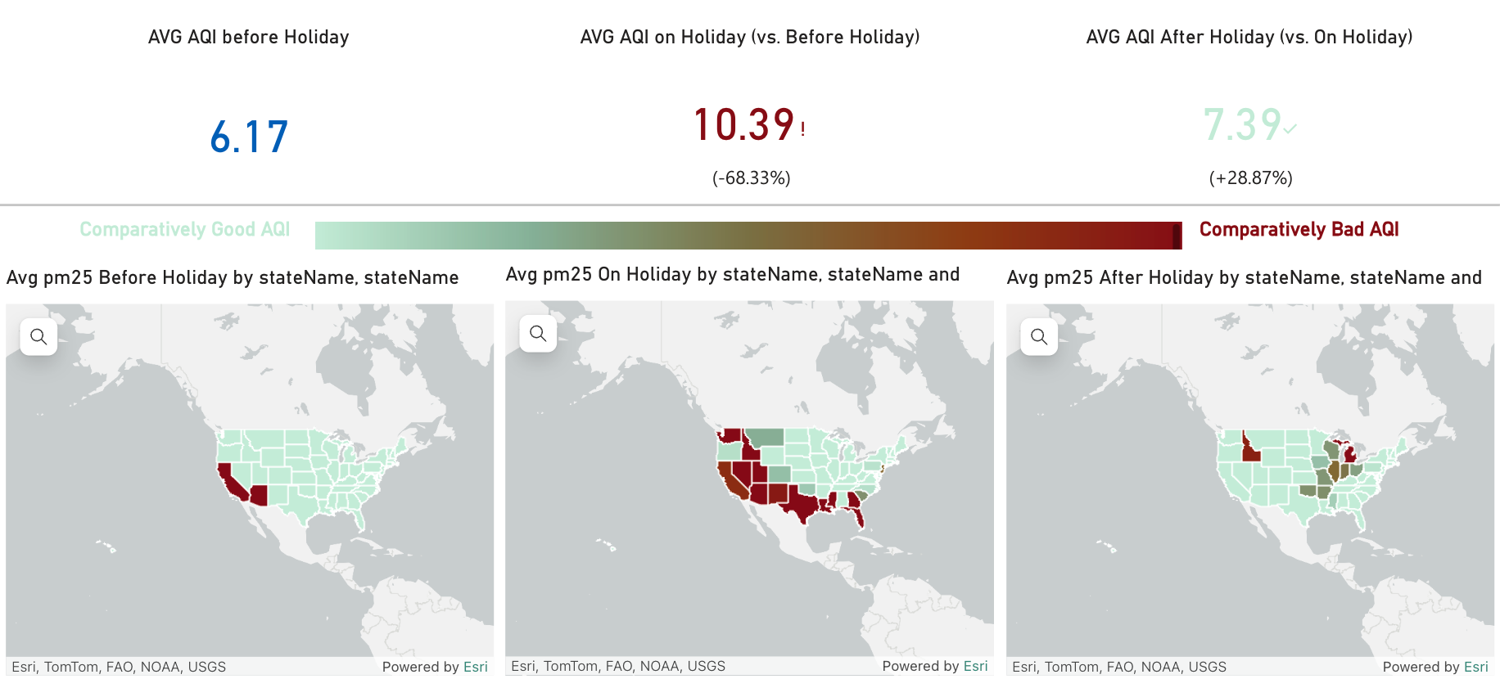
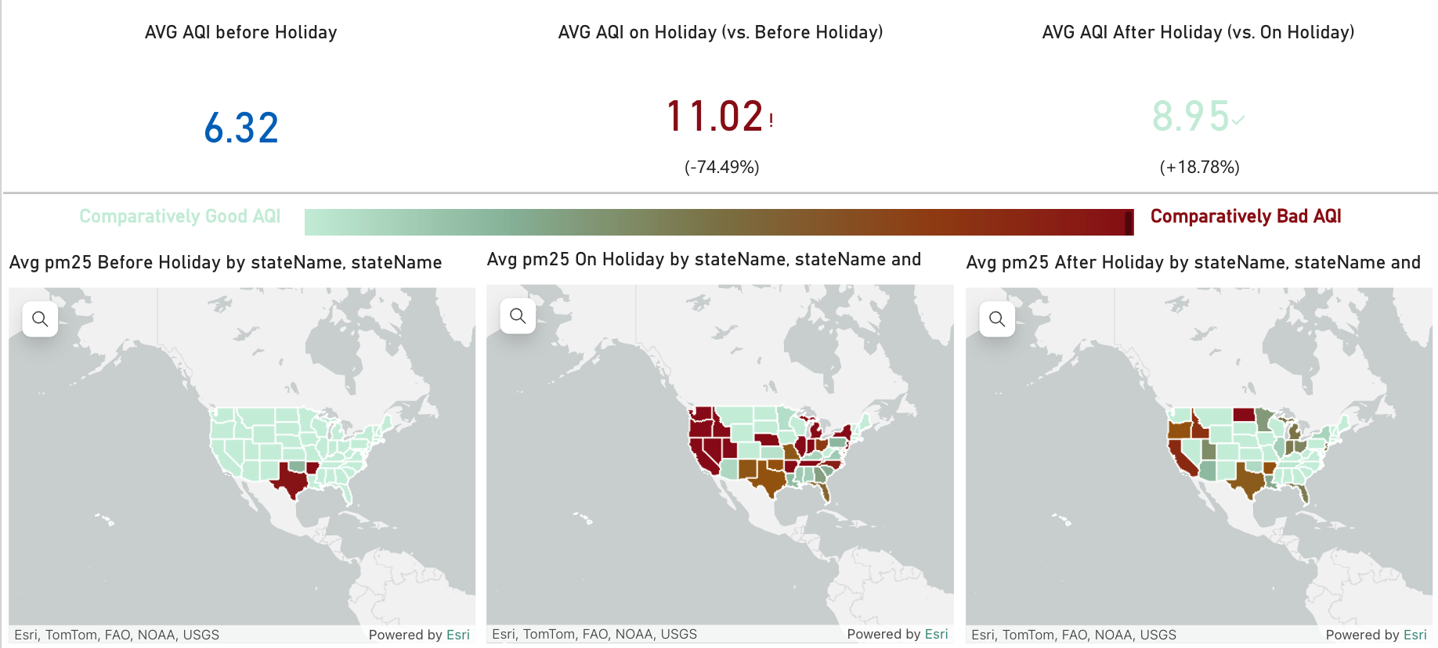
Impact of Public Holidays AQI (PM2.5)
New Year’s Day
Independence Day

Slide 10




Conclusion
Flights
Flight prices often rise before and during holidays due to high travel demand. Knowing this trend can help travelers book smarter and save money.
Hotels
Hotel bookings tend to stay steady or dip slightly on holidays, but prices usually spike due to high demand and limited availability.
Ridership
Ridership consistently dips on most weekends and holidays, but often spikes before or after holidays, showing increased public transport use around these periods.
Air Quality (PM2.5)
PM2.5 levels spike on U.S. holidays due to like fireworks. Notably, Independence Day and New Year’s Day show sharp increases in pollution.

Slide 11
Thanks!

