Slide 1
Climate Appendix
Weather File Review
Denver Intl AP · Atlanta-Hartsfield-Jackson Intl AP · Chicago OHare Intl AP · New York-Central Park Obs-Belvedere Castle · Rochester-Greater Rochester Intl AP · Houston-Bush Intercontinental AP · Seattle-Tacoma Intl AP

Slide 2
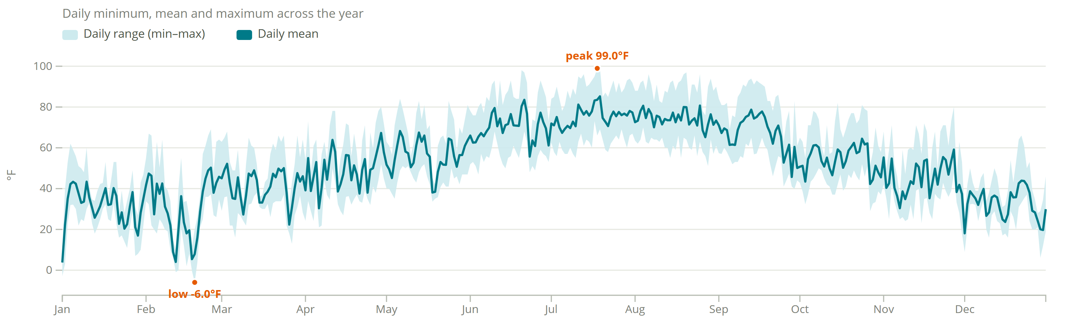
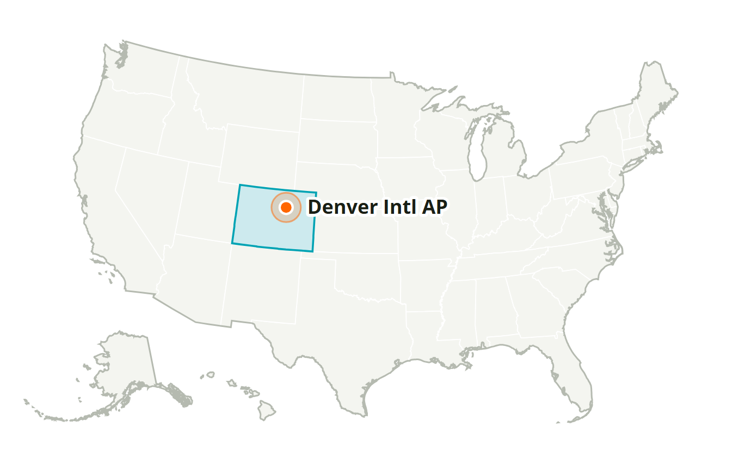
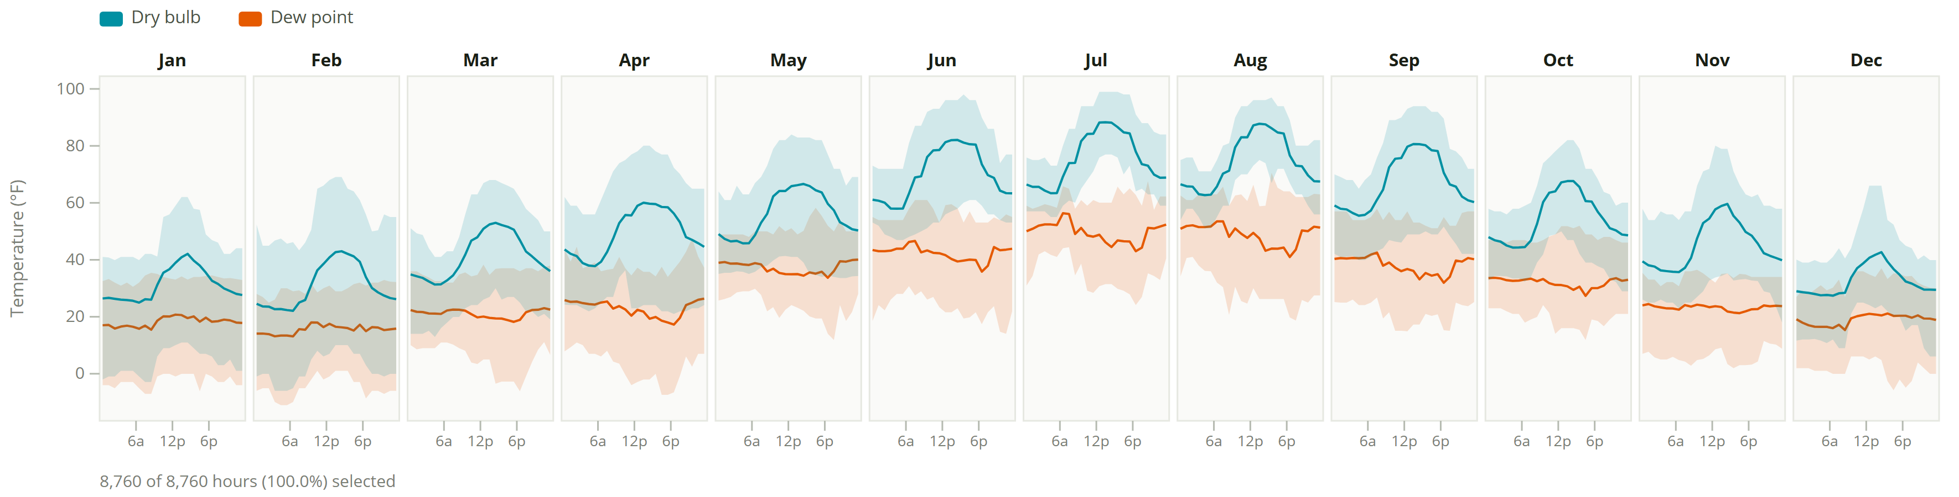
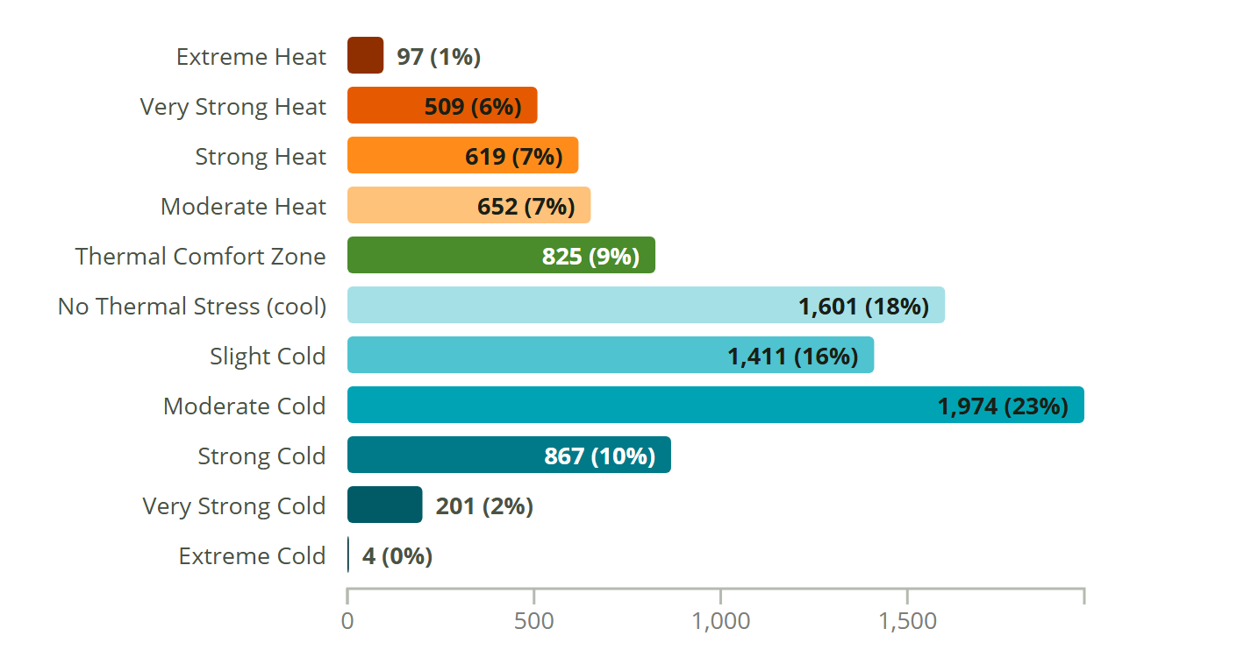
Denver Intl AP
CO, USA · SRC-TMYx · WMO 725650
Latitude: 39.833° N
Longitude: 104.658° W
Elevation: 5,414 ft
Time zone: UTC-7
State: Colorado
ASHRAE 5B · Cool - Dry
Köppen BSk
Semiarid Mid Latitude/Highlands

Slide 3
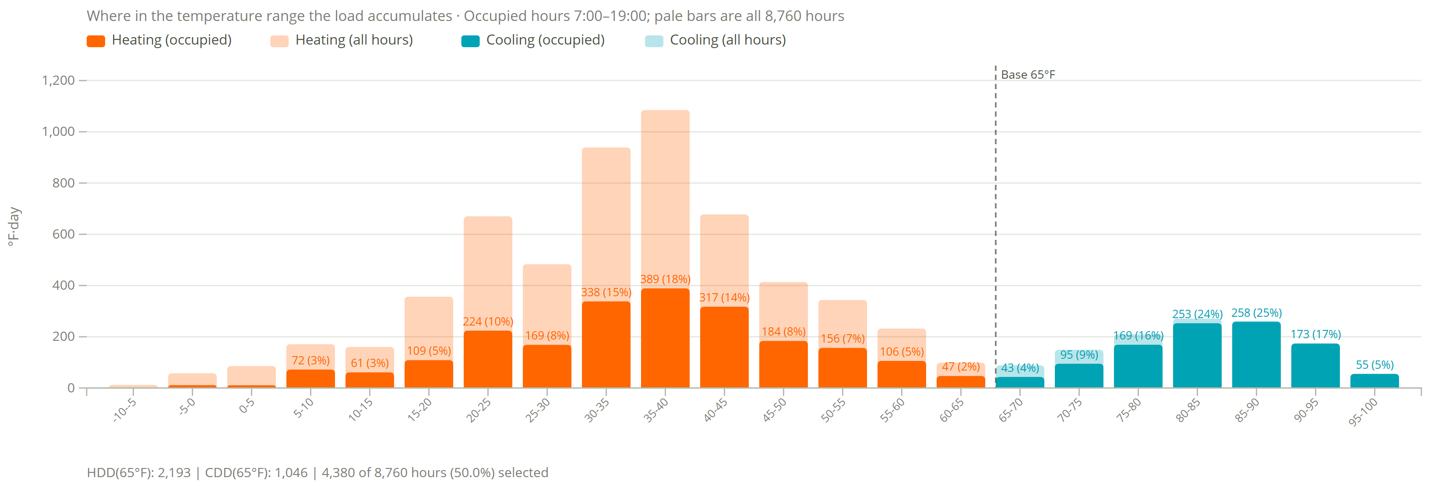
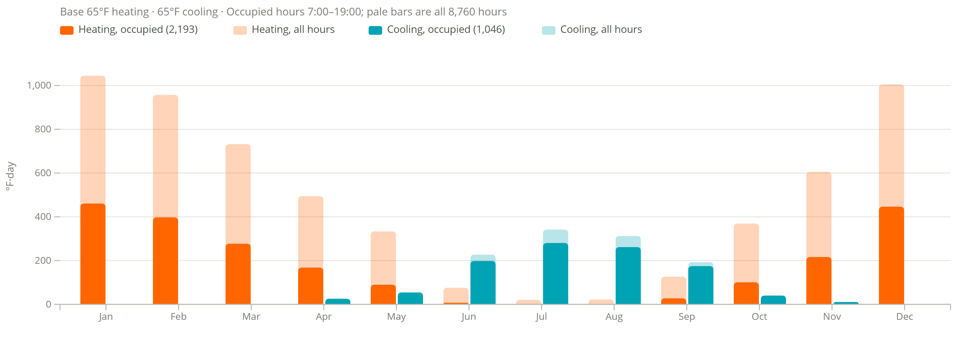
Degree Days
Denver Intl AP
2,193
heating degree days (°F·day, occupied)
5,786 all hours
1,046
cooling degree days (°F·day, occupied)
1,208 all hours
Assumptions
Base 65°F heating and cooling.
Occupied 7:00–19:00, 4,380 of 8,760 h (50%).
Filter shows 7am to 7pm occupied hours and transparent is all data

Slide 4
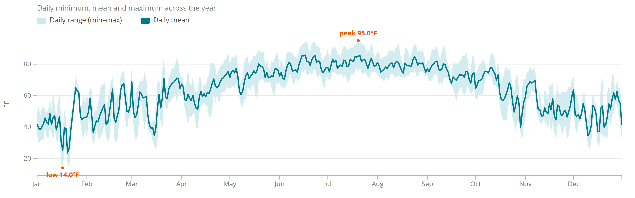
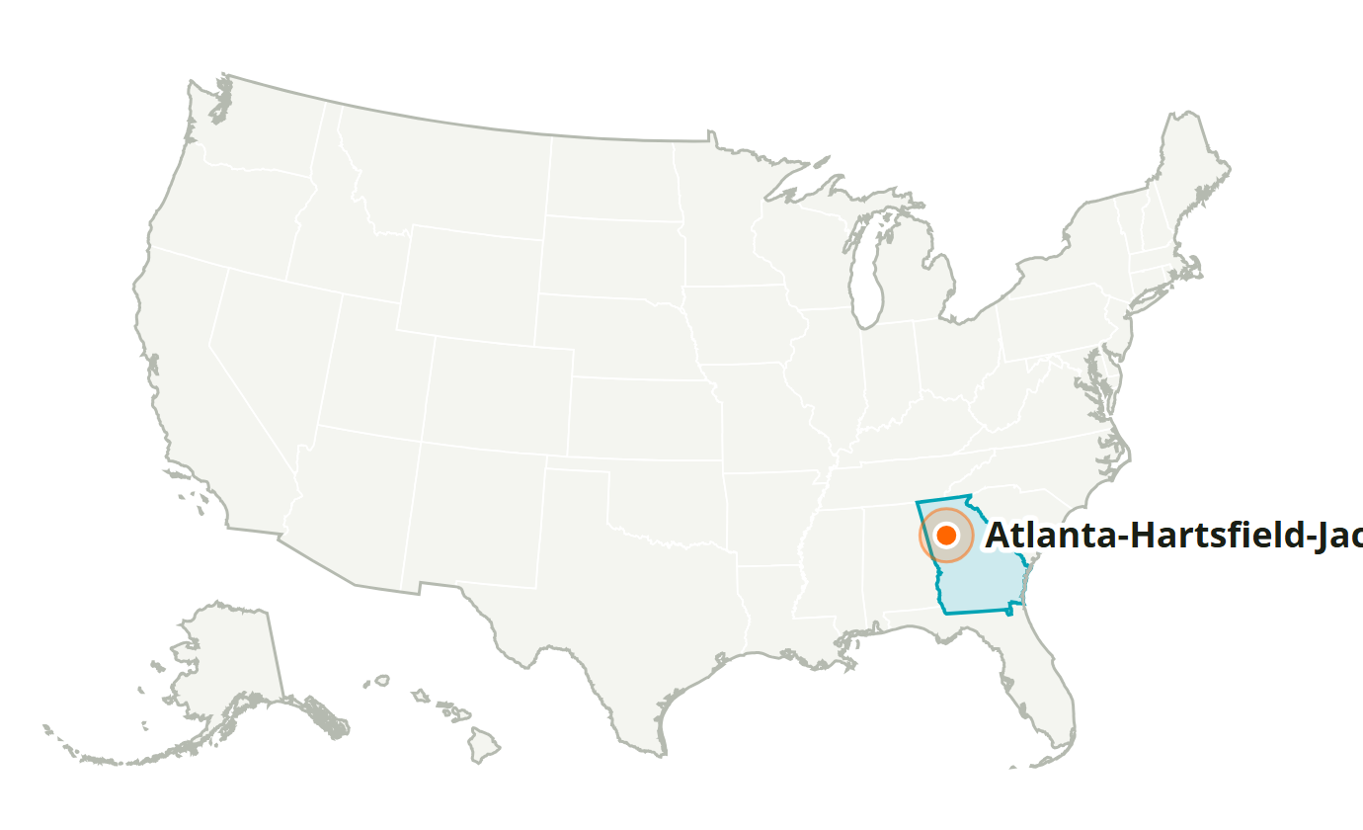
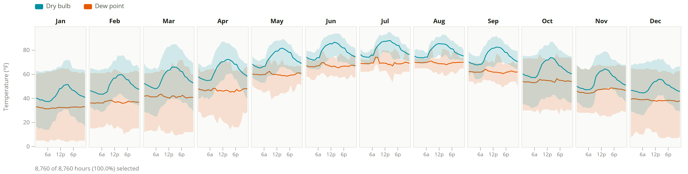
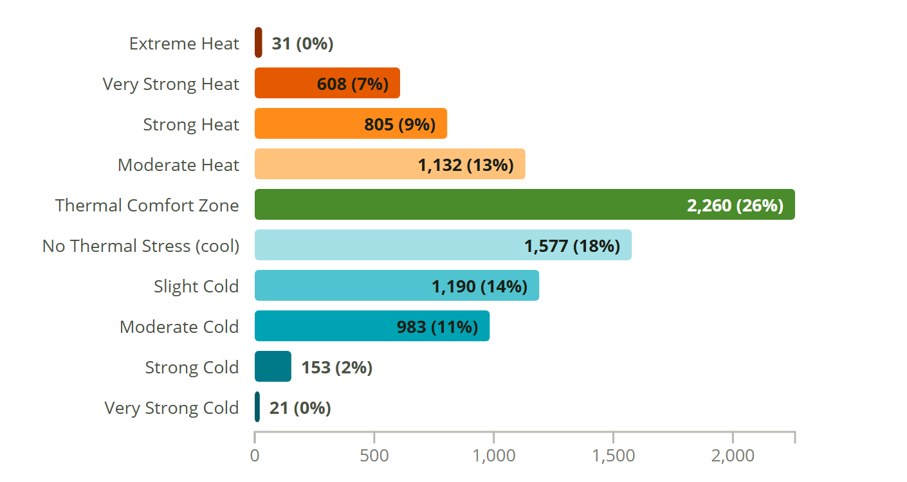
Atlanta-Hartsfield-Jackson Intl AP
GA, USA · SRC-TMYx · WMO 722190
Latitude: 33.630° N
Longitude: 84.442° W
Elevation: 1,010 ft
Time zone: UTC-5
State: Georgia
ASHRAE 3A · Warm - Humid
Köppen Cfa
Humid Subtropical (Warm Summer)

Slide 5
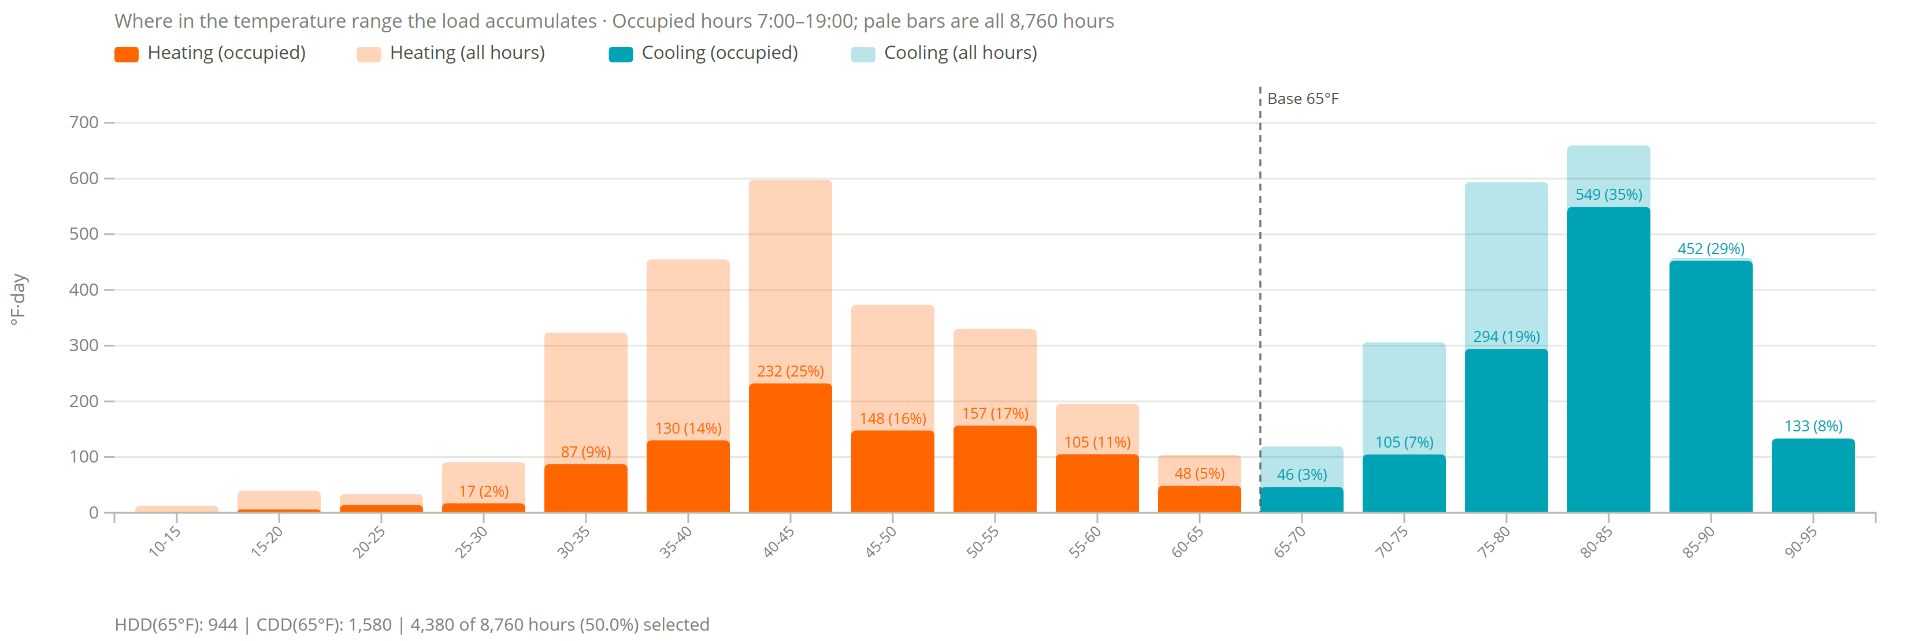
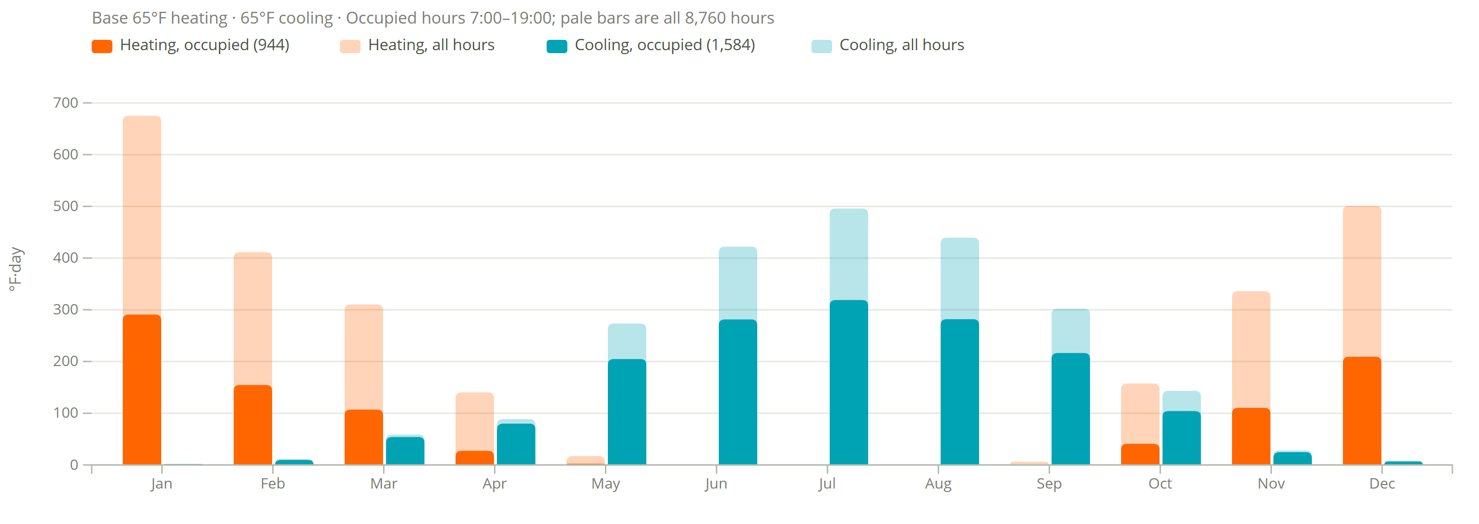
Degree Days
Atlanta-Hartsfield-Jackson Intl AP
944
heating degree days (°F·day, occupied)
2,555 all hours
1,584
cooling degree days (°F·day, occupied)
2,273 all hours
Assumptions
Base 65°F heating and cooling.
Occupied 7:00–19:00, 4,380 of 8,760 h (50%).
Filter shows 7am to 7pm occupied hours and transparent is all data

Slide 6
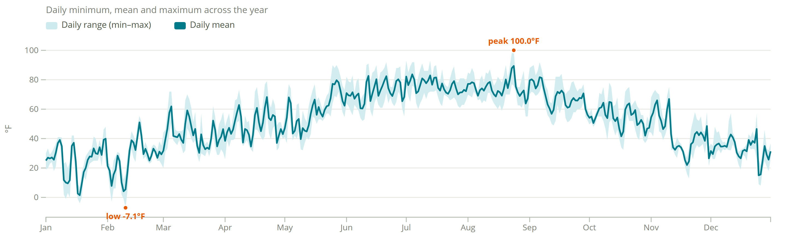
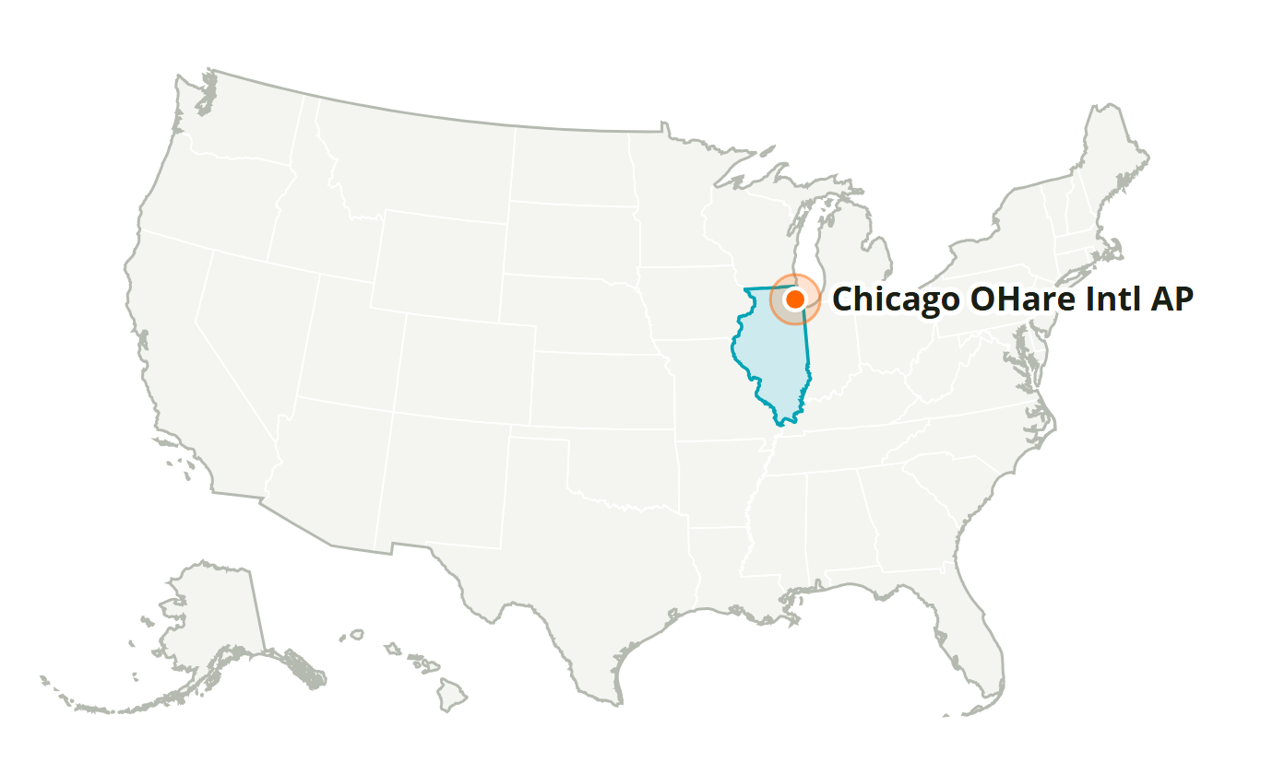
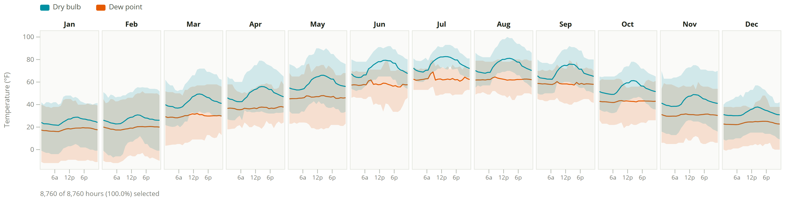
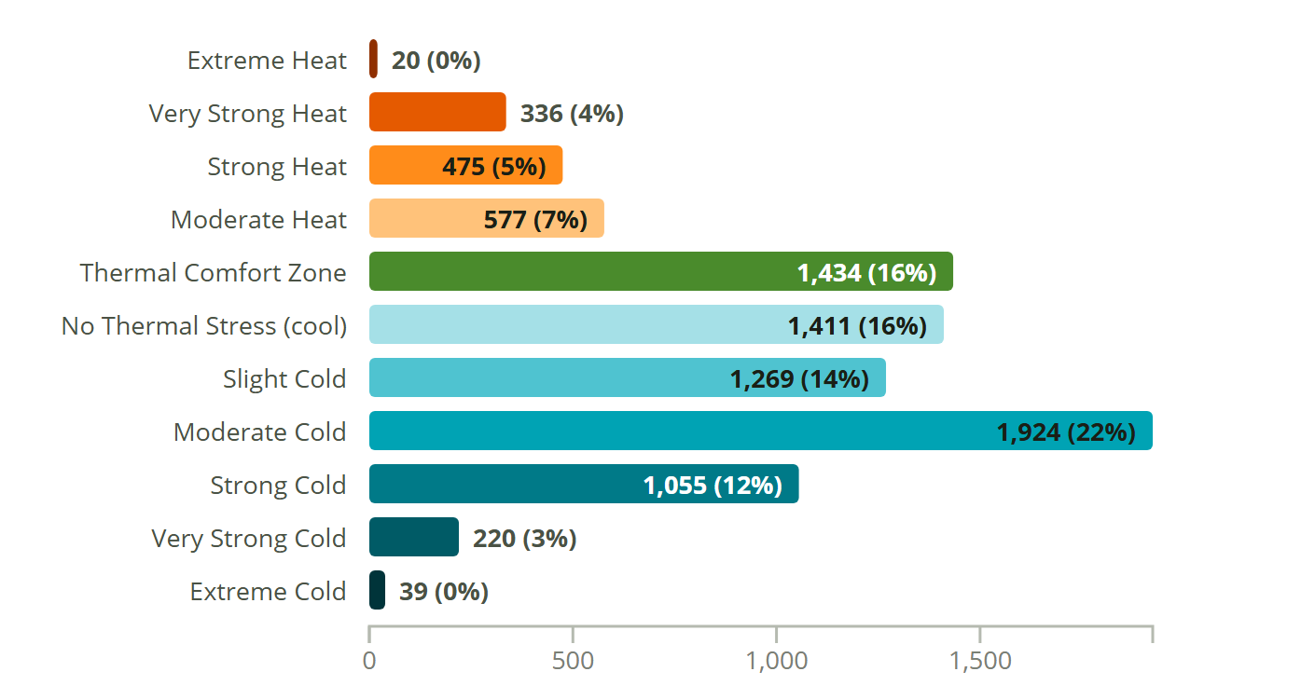
Chicago OHare Intl AP
IL, USA · SRC-TMYx · WMO 725300
Latitude: 41.960° N
Longitude: 87.932° W
Elevation: 662 ft
Time zone: UTC-6
State: Illinois
ASHRAE 5A · Cool - Humid
Köppen Dfa
Humid Continental (Warm Summer)

Slide 7
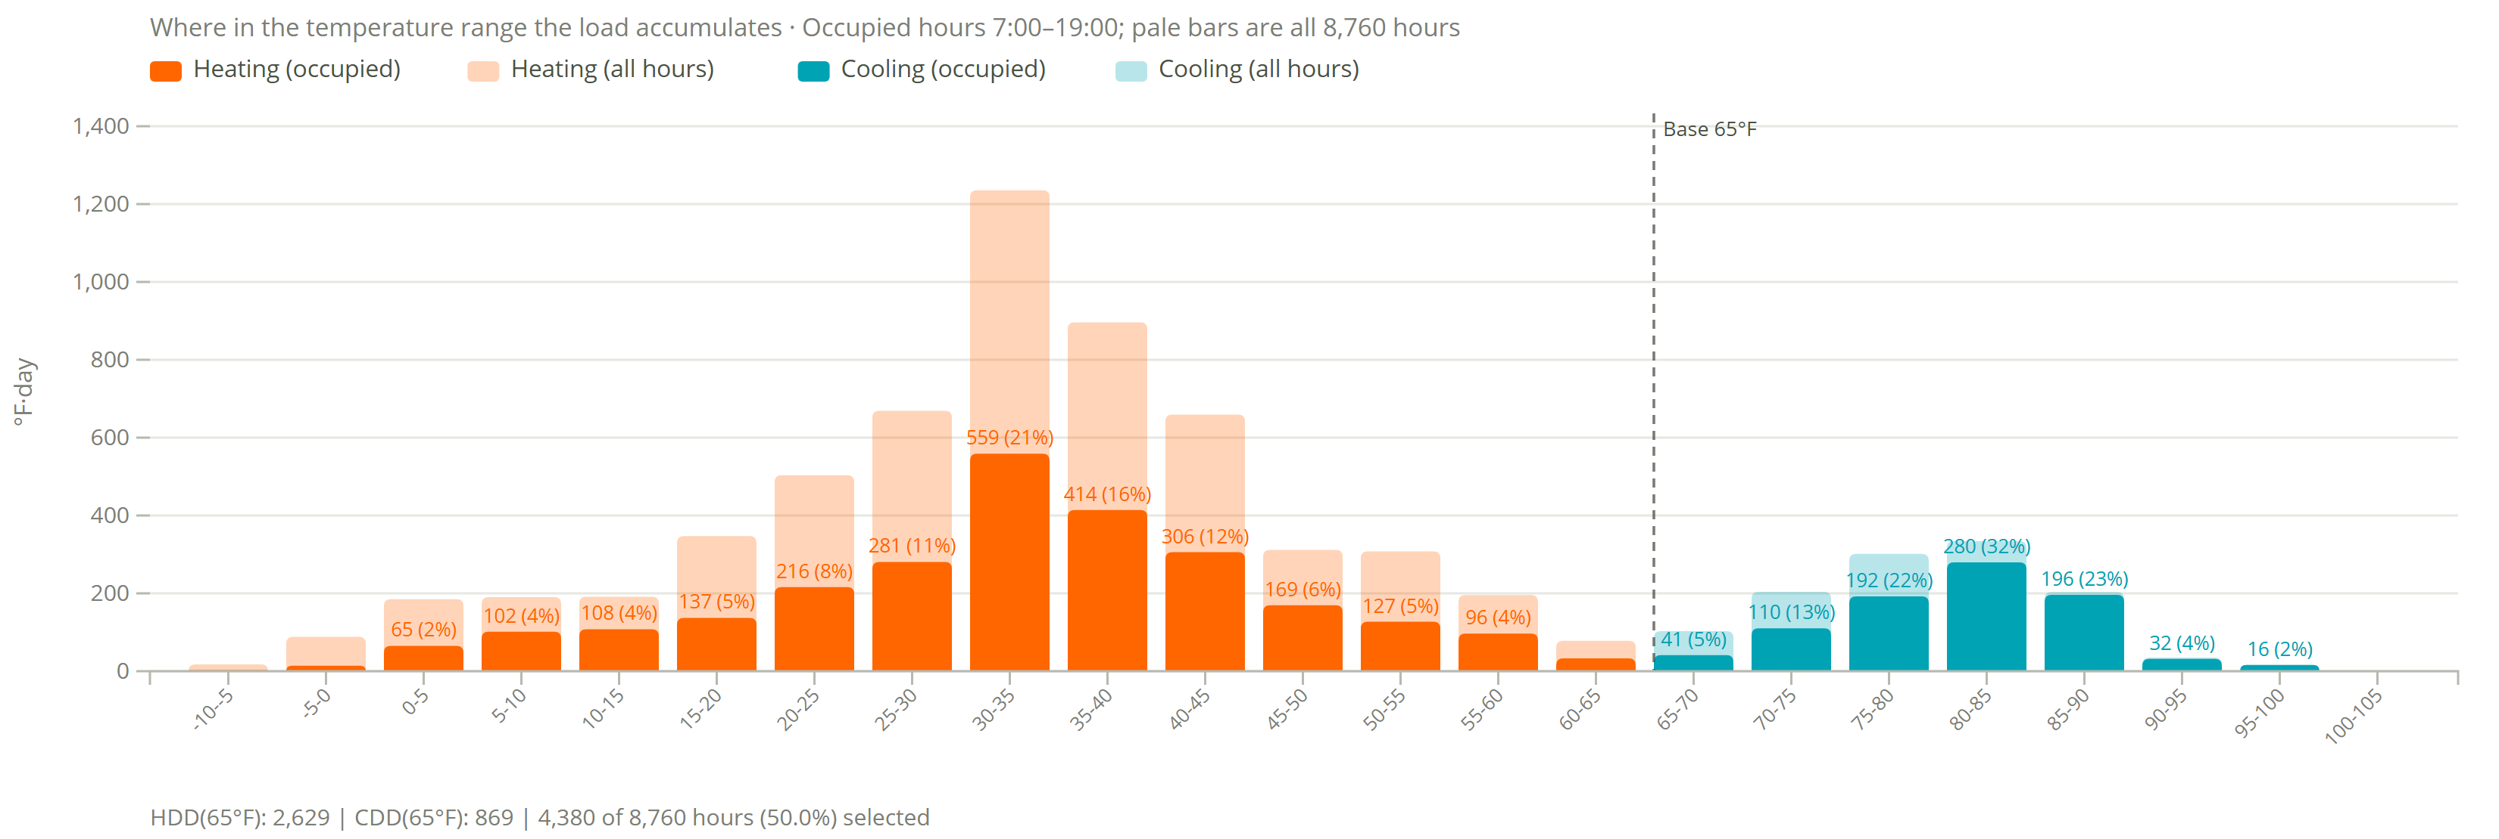
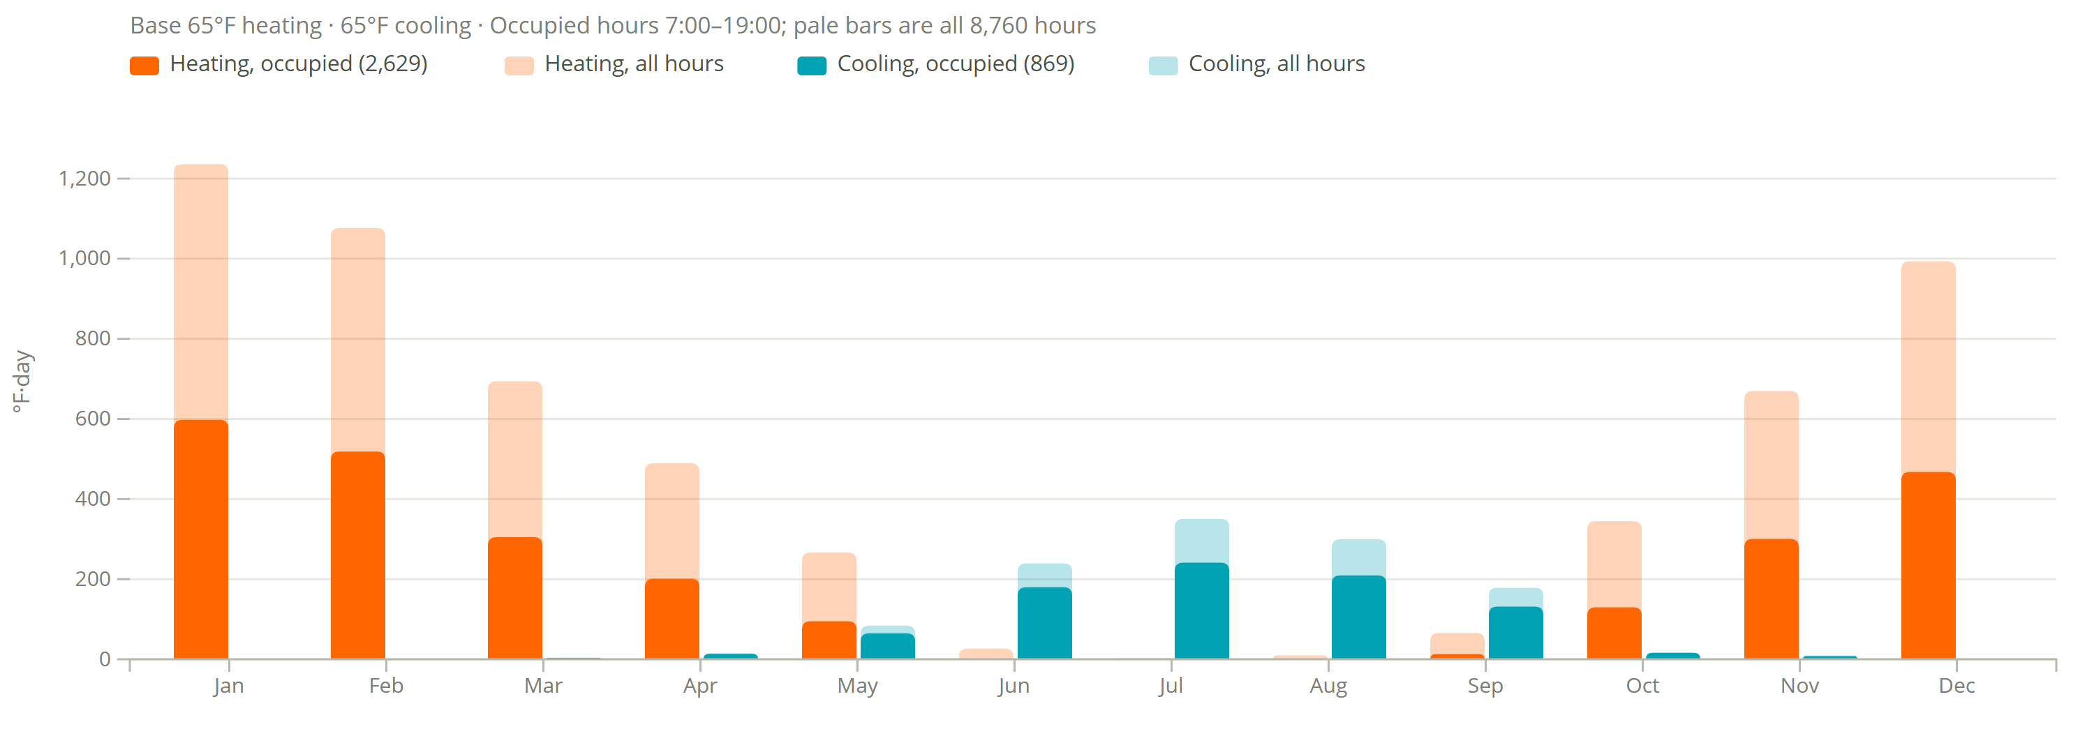
Degree Days
Chicago OHare Intl AP
2,629
heating degree days (°F·day, occupied)
5,877 all hours
869
cooling degree days (°F·day, occupied)
1,197 all hours
Assumptions
Base 65°F heating and cooling.
Occupied 7:00–19:00, 4,380 of 8,760 h (50%).
Filter shows 7am to 7pm occupied hours and transparent is all data

Slide 8
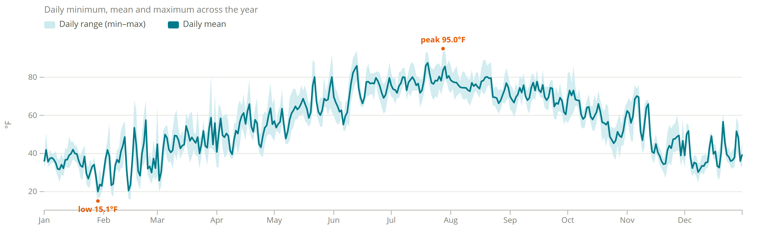
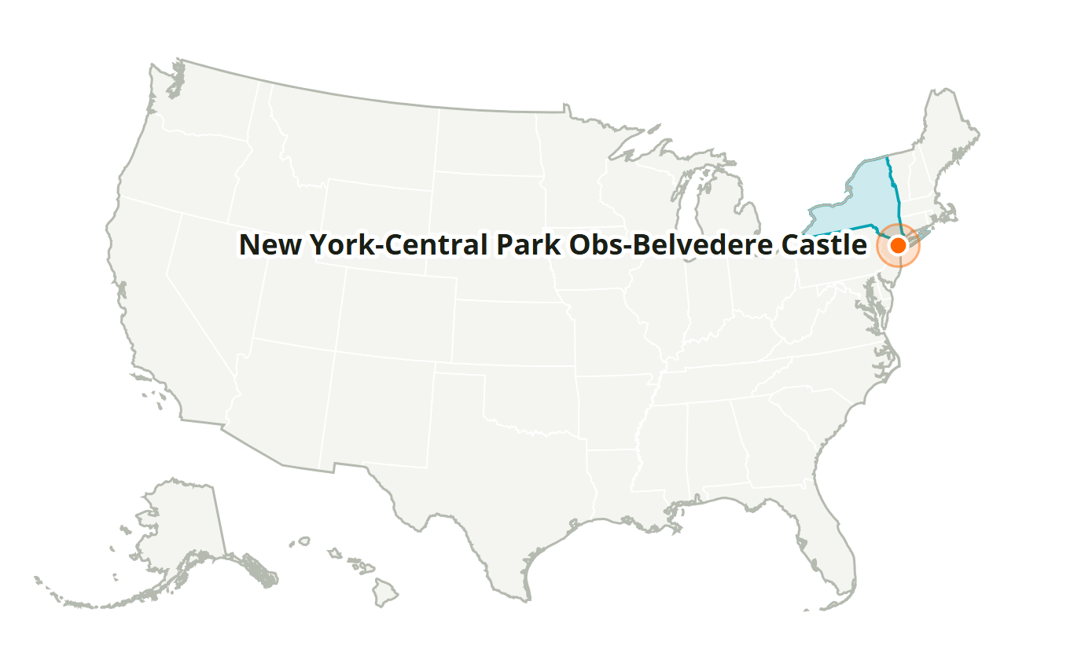
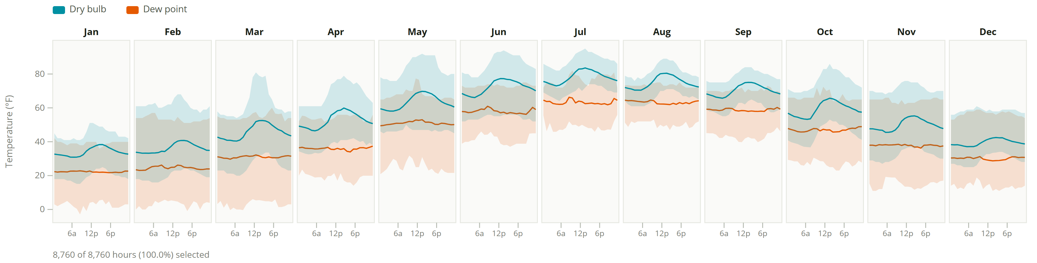
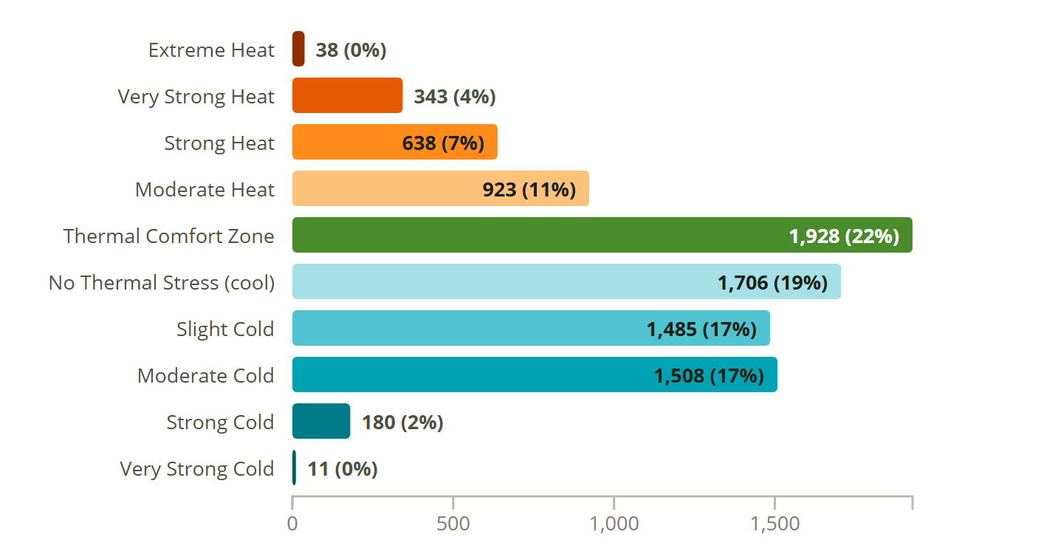
New York-Central Park Obs-Belvedere Castle
NY, USA · SRC-TMYx · WMO 725053
Latitude: 40.779° N
Longitude: 73.969° W
Elevation: 157 ft
Time zone: UTC-5
State: New York
ASHRAE 4A · Mixed - Humid
Köppen Cfa
Humid Subtropical/Humid Continental (Warm Summer)

Slide 9
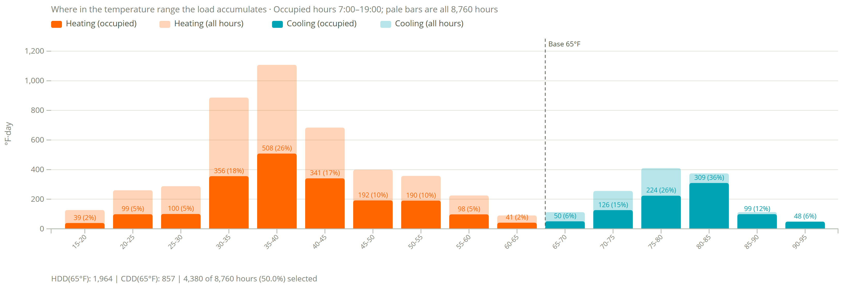
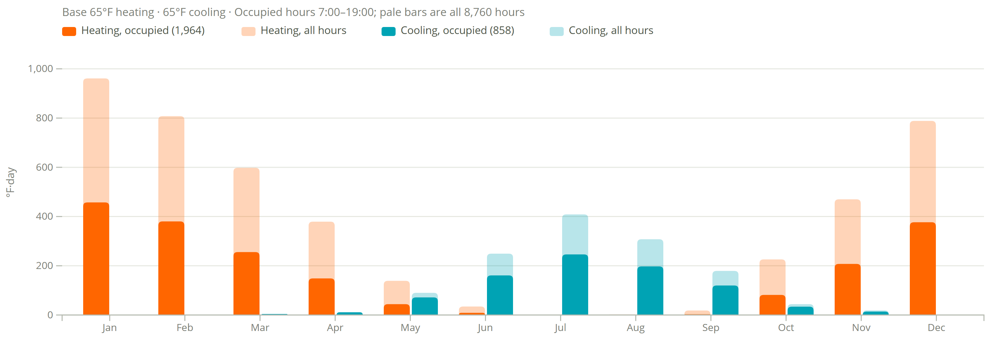
Degree Days
New York-Central Park Obs-Belvedere Castle
1,964
heating degree days (°F·day, occupied)
4,424 all hours
858
cooling degree days (°F·day, occupied)
1,313 all hours
Assumptions
Base 65°F heating and cooling.
Occupied 7:00–19:00, 4,380 of 8,760 h (50%).
Filter shows 7am to 7pm occupied hours and transparent is all data

Slide 10
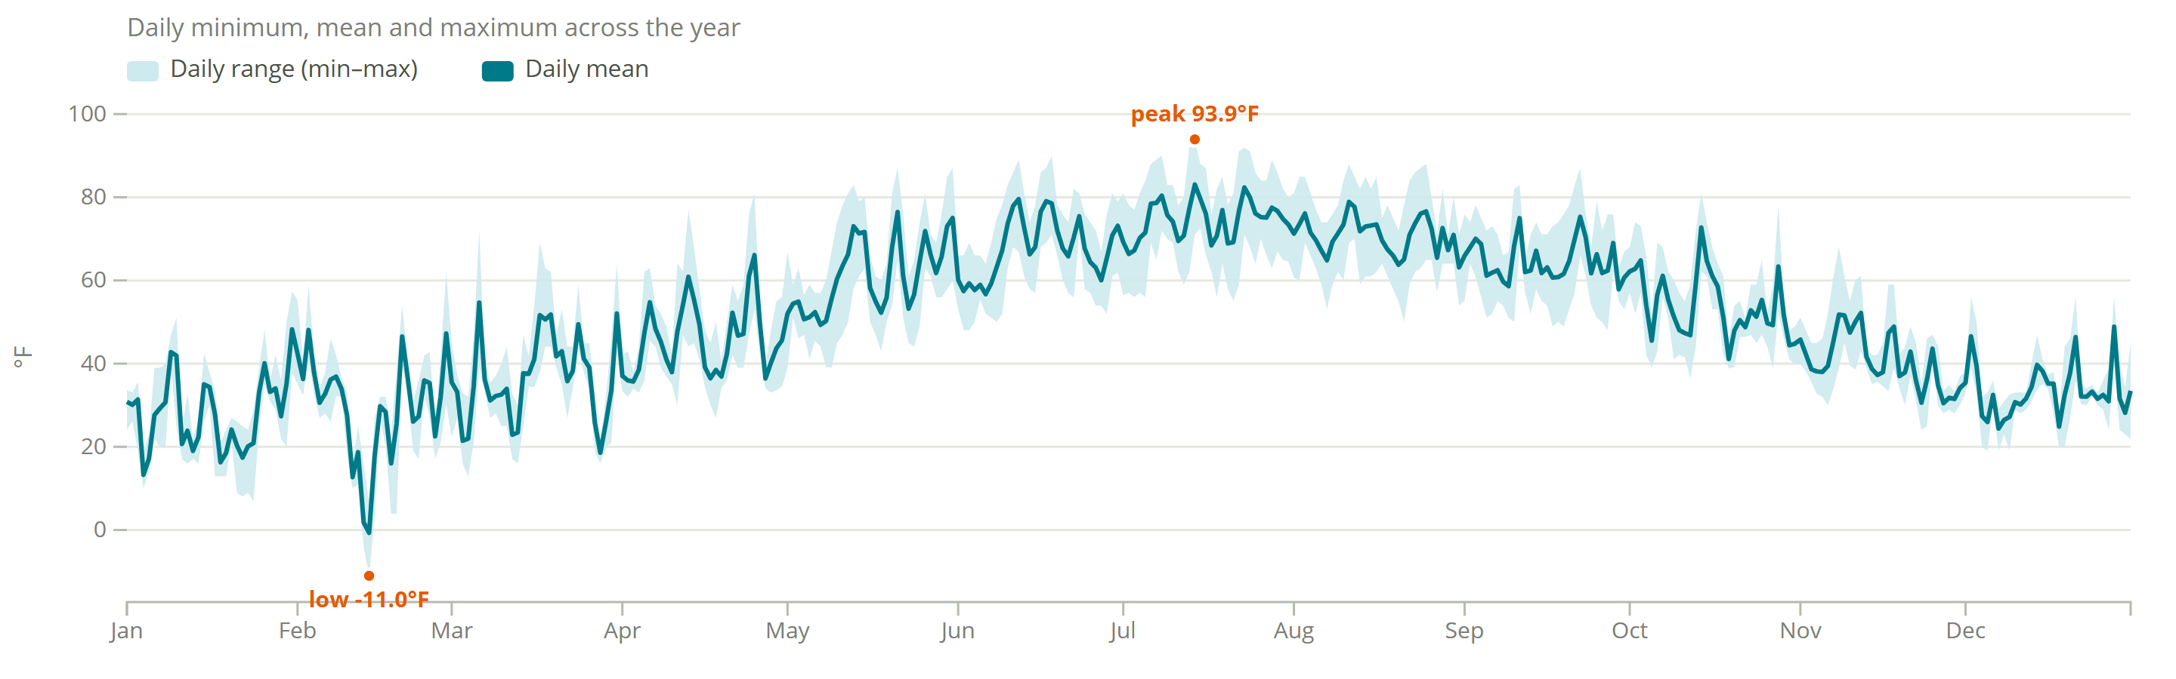
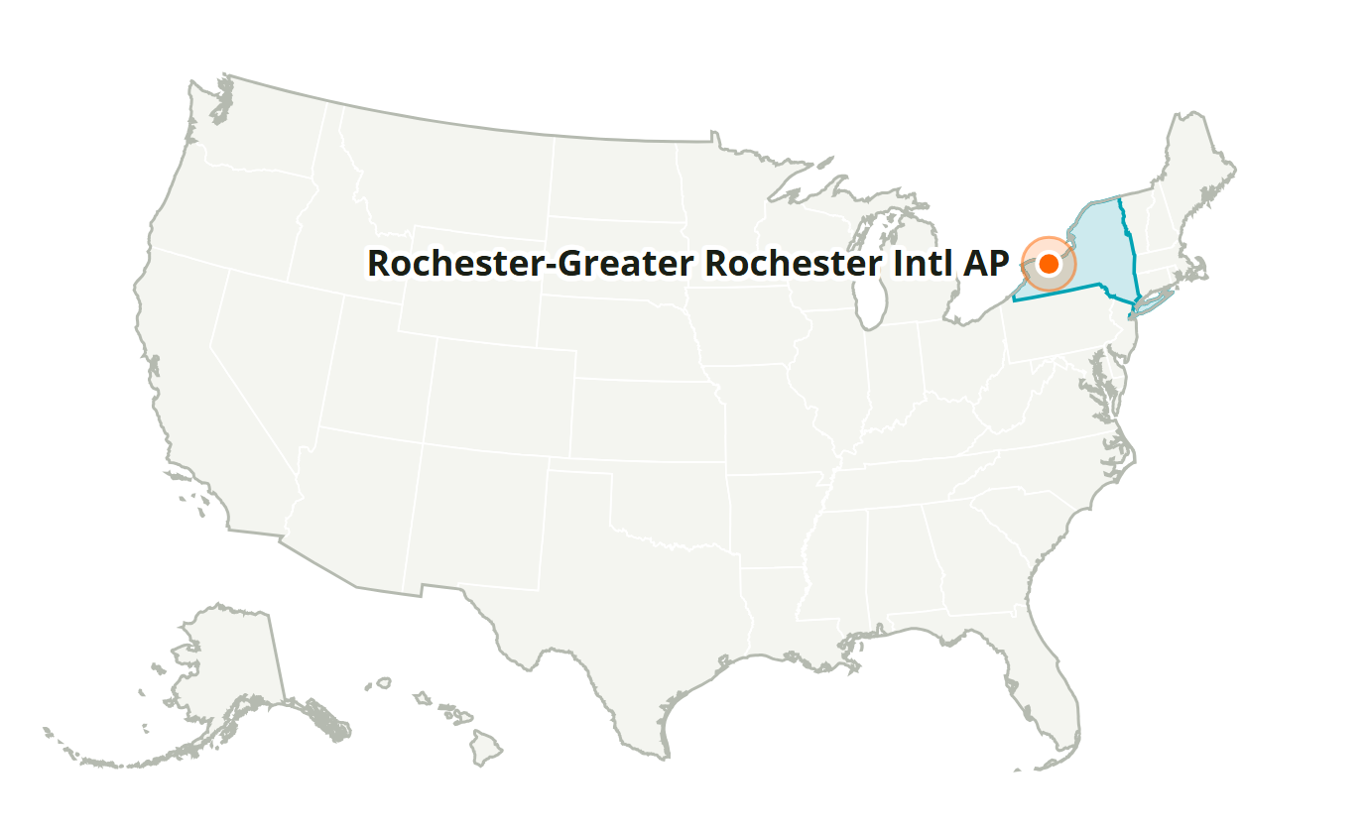
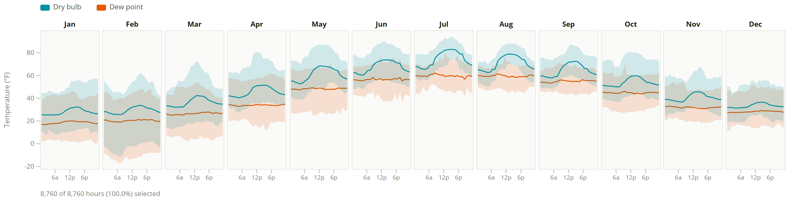
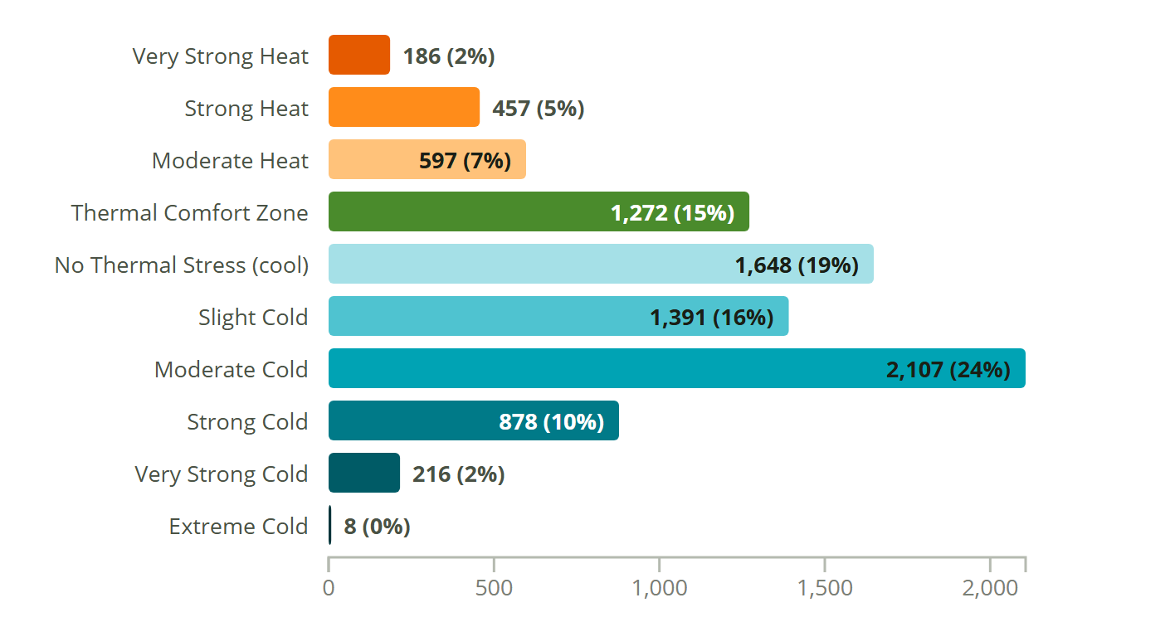
Rochester-Greater Rochester Intl AP
NY, USA · SRC-TMYx · WMO 725290
Latitude: 43.117° N
Longitude: 77.677° W
Elevation: 554 ft
Time zone: UTC-5
State: New York
ASHRAE 5A · Cool - Humid
Köppen Dfa
Humid Continental (Warm Summer)

Slide 11
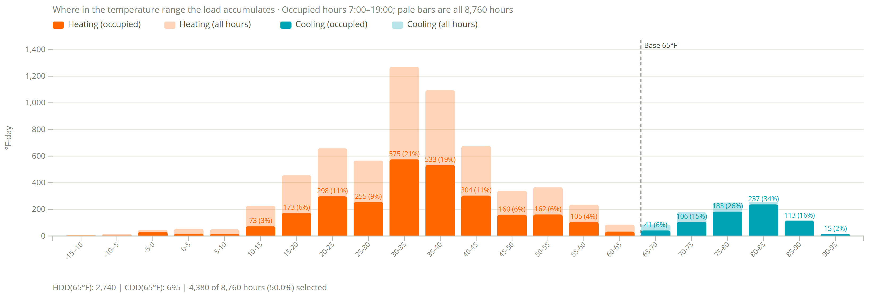
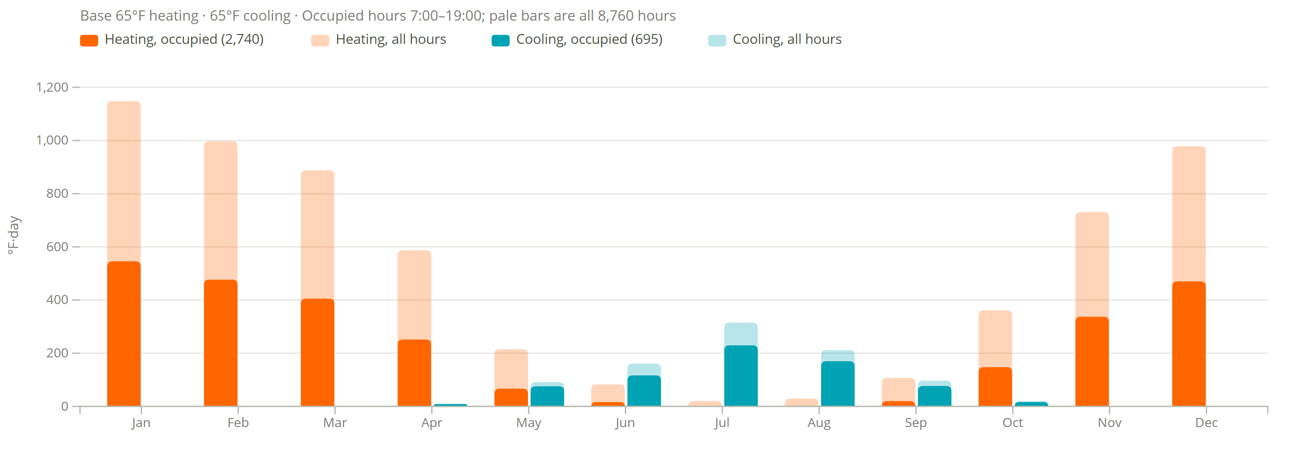
Degree Days
Rochester-Greater Rochester Intl AP
2,740
heating degree days (°F·day, occupied)
6,146 all hours
695
cooling degree days (°F·day, occupied)
906 all hours
Assumptions
Base 65°F heating and cooling.
Occupied 7:00–19:00, 4,380 of 8,760 h (50%).
Filter shows 7am to 7pm occupied hours and transparent is all data

Slide 12
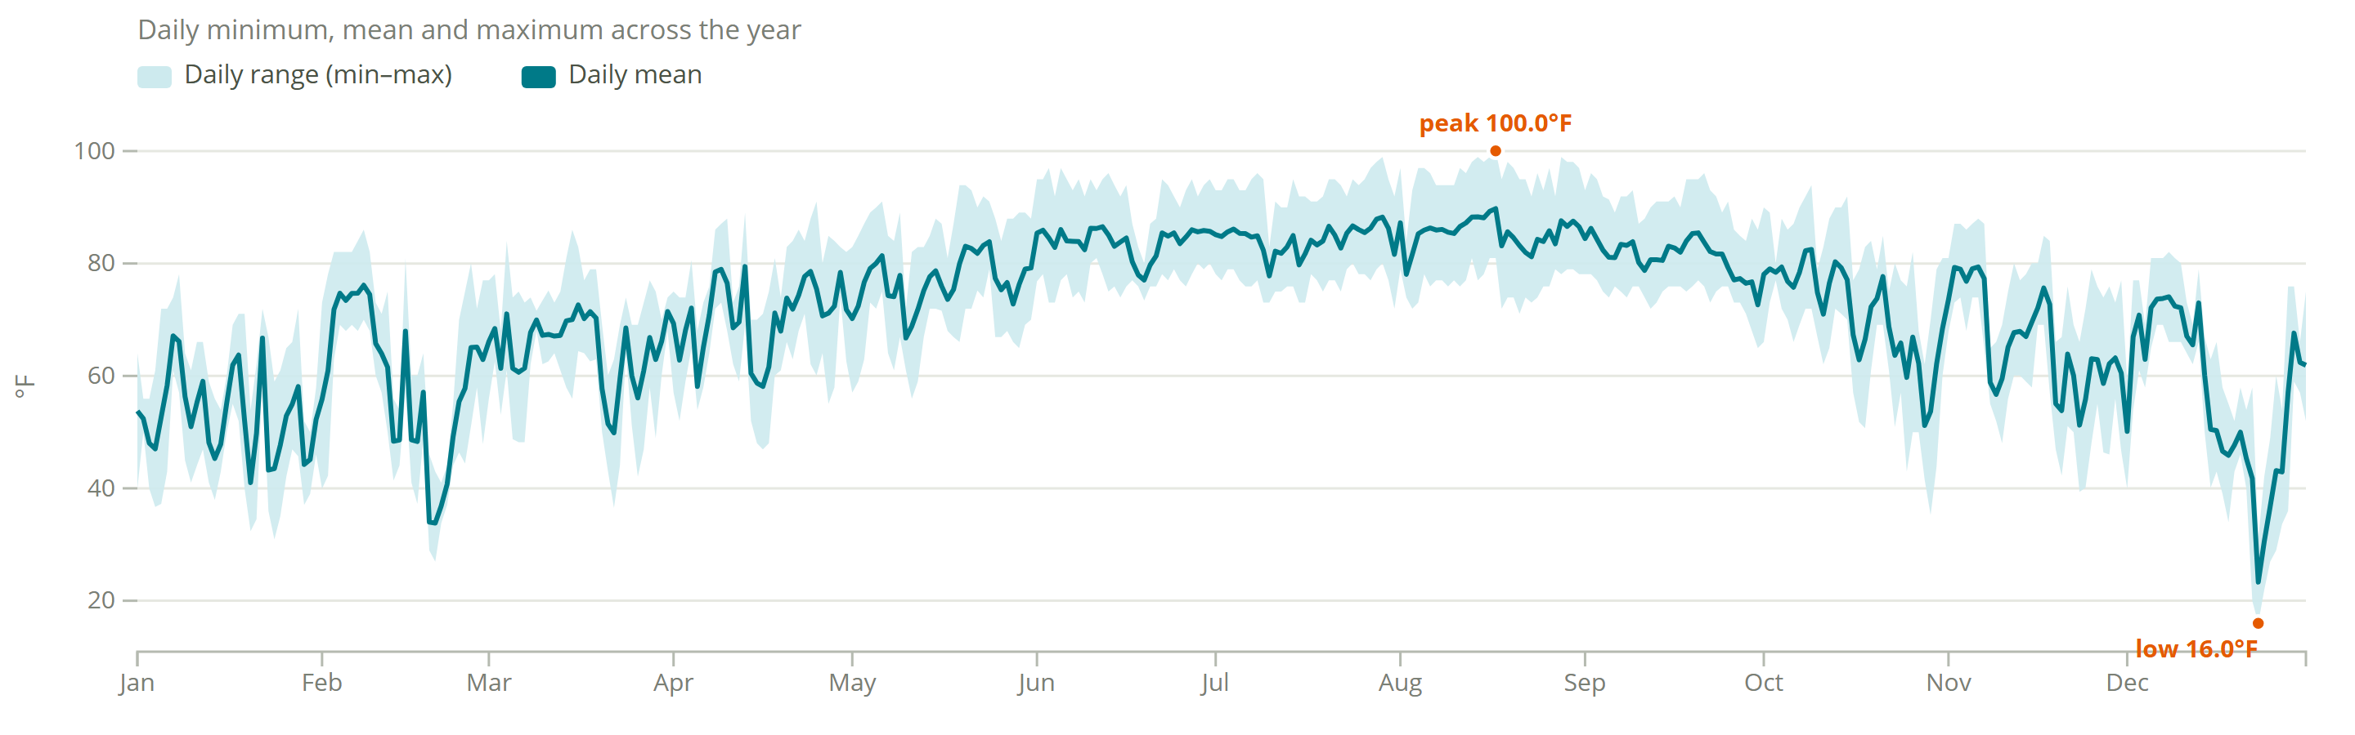
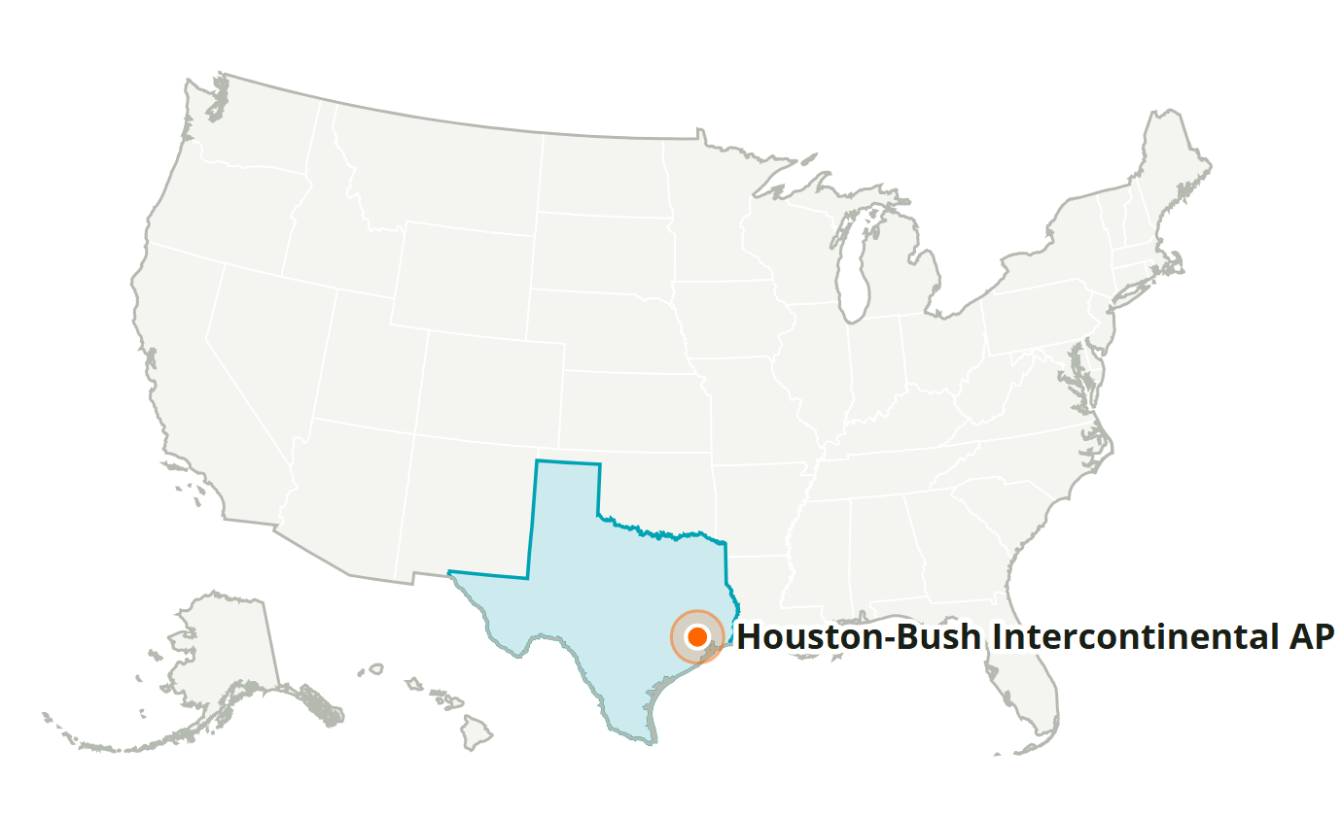
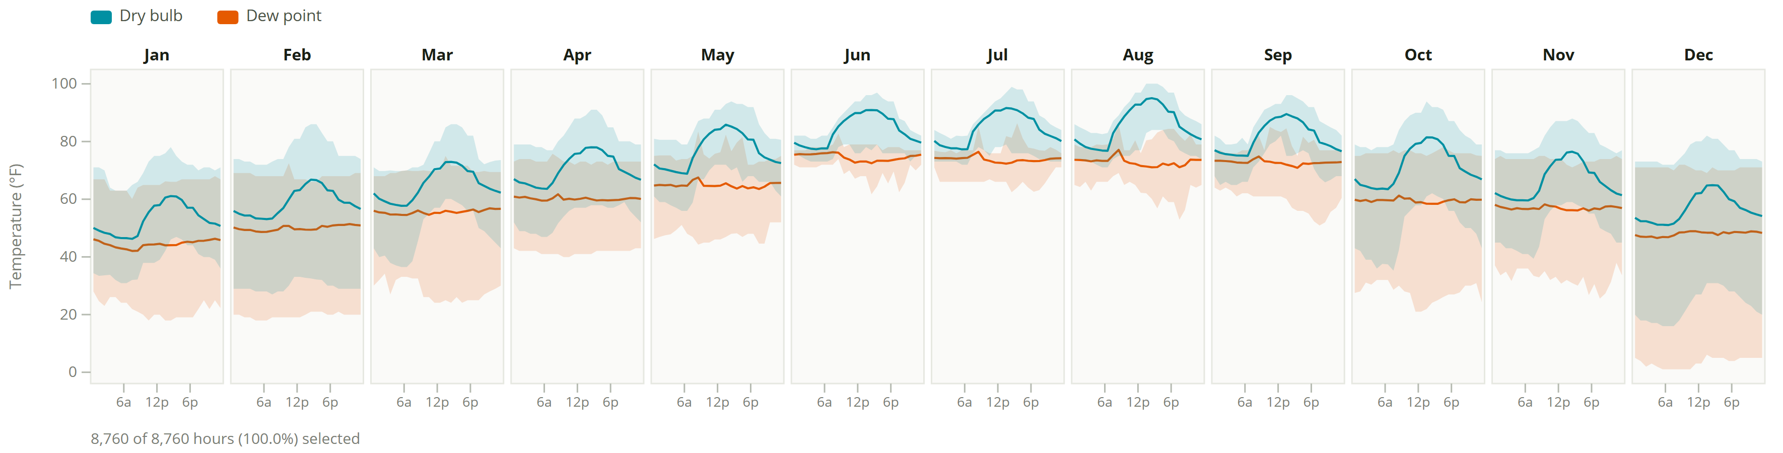
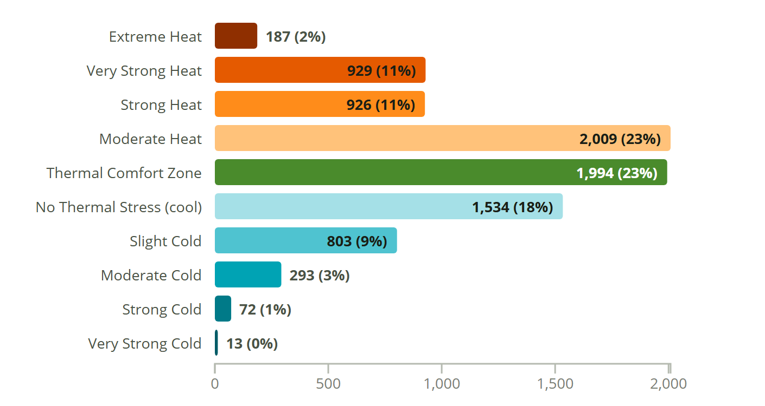
Houston-Bush Intercontinental AP
TX, USA · SRC-TMYx · WMO 722430
Latitude: 29.980° N
Longitude: 95.360° W
Elevation: 95 ft
Time zone: UTC-6
State: Texas
ASHRAE 2A · Hot - Humid
Köppen Cfa
Humid Subtropical (Warm Summer)

Slide 13
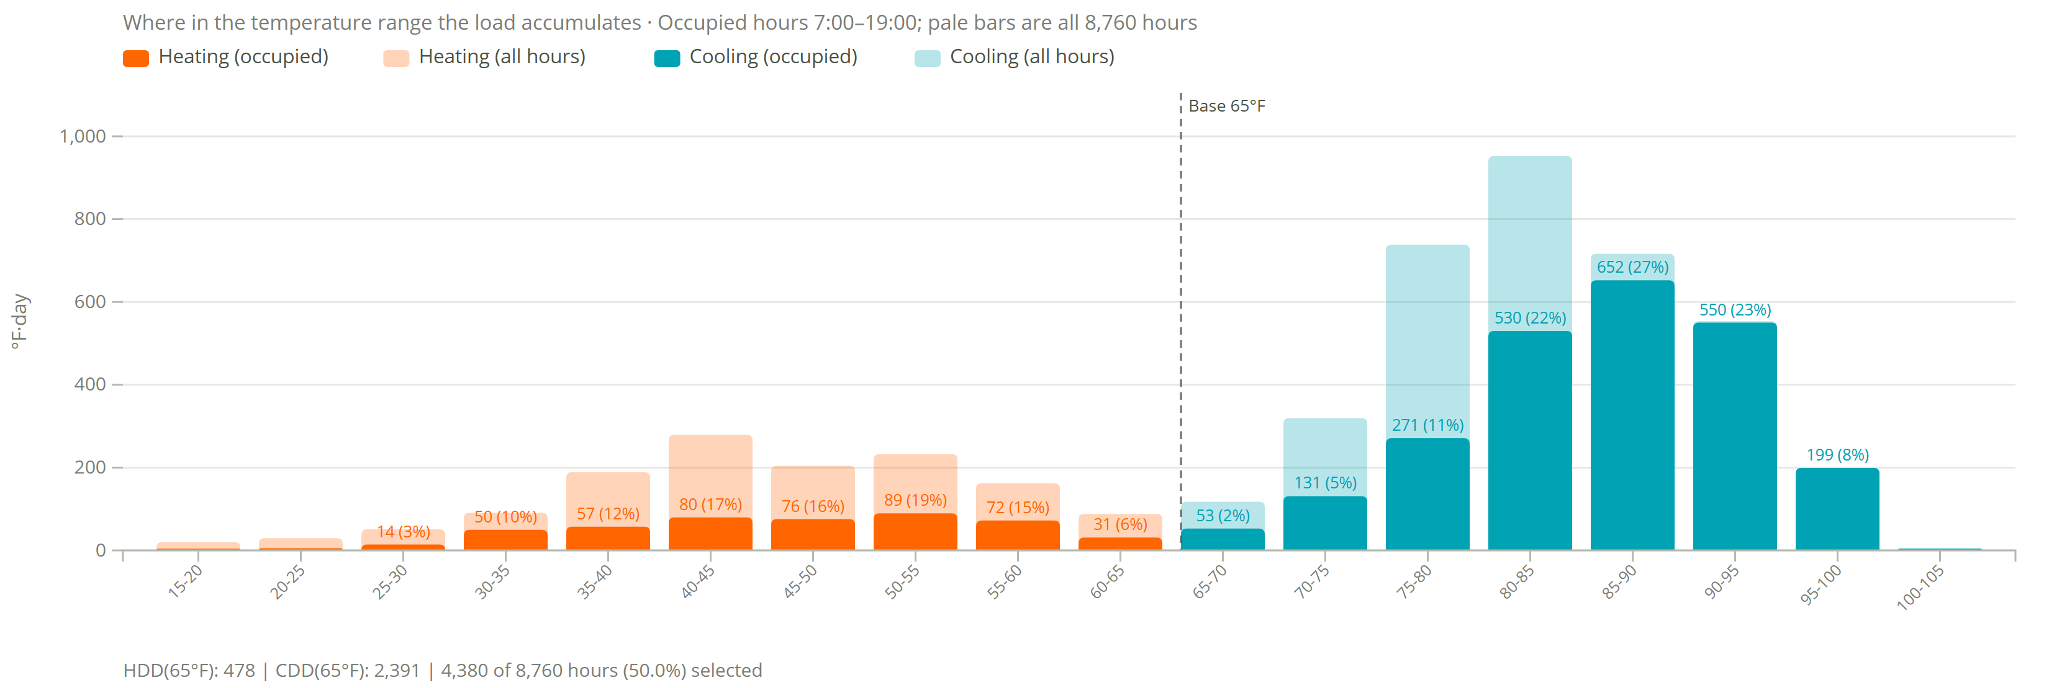
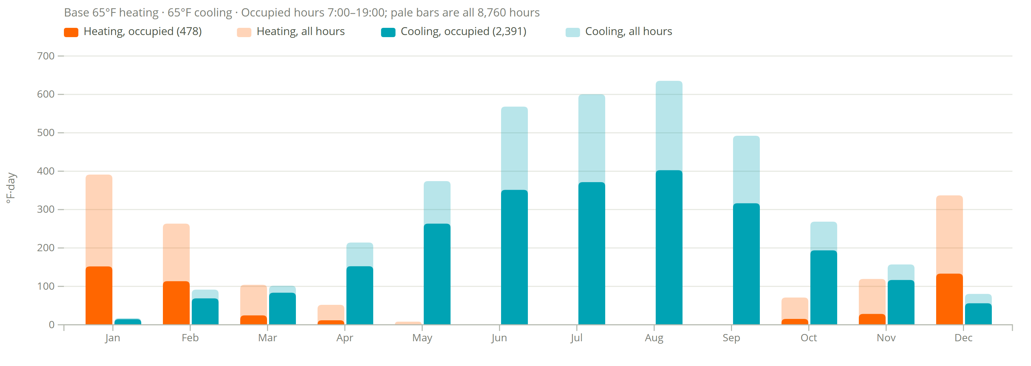
Degree Days
Houston-Bush Intercontinental AP
478
heating degree days (°F·day, occupied)
1,346 all hours
2,391
cooling degree days (°F·day, occupied)
3,601 all hours
Assumptions
Base 65°F heating and cooling.
Occupied 7:00–19:00, 4,380 of 8,760 h (50%).
Filter shows 7am to 7pm occupied hours and transparent is all data

Slide 14
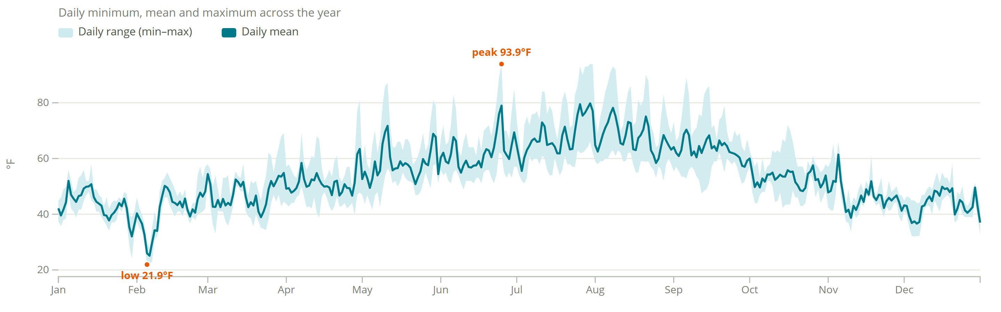
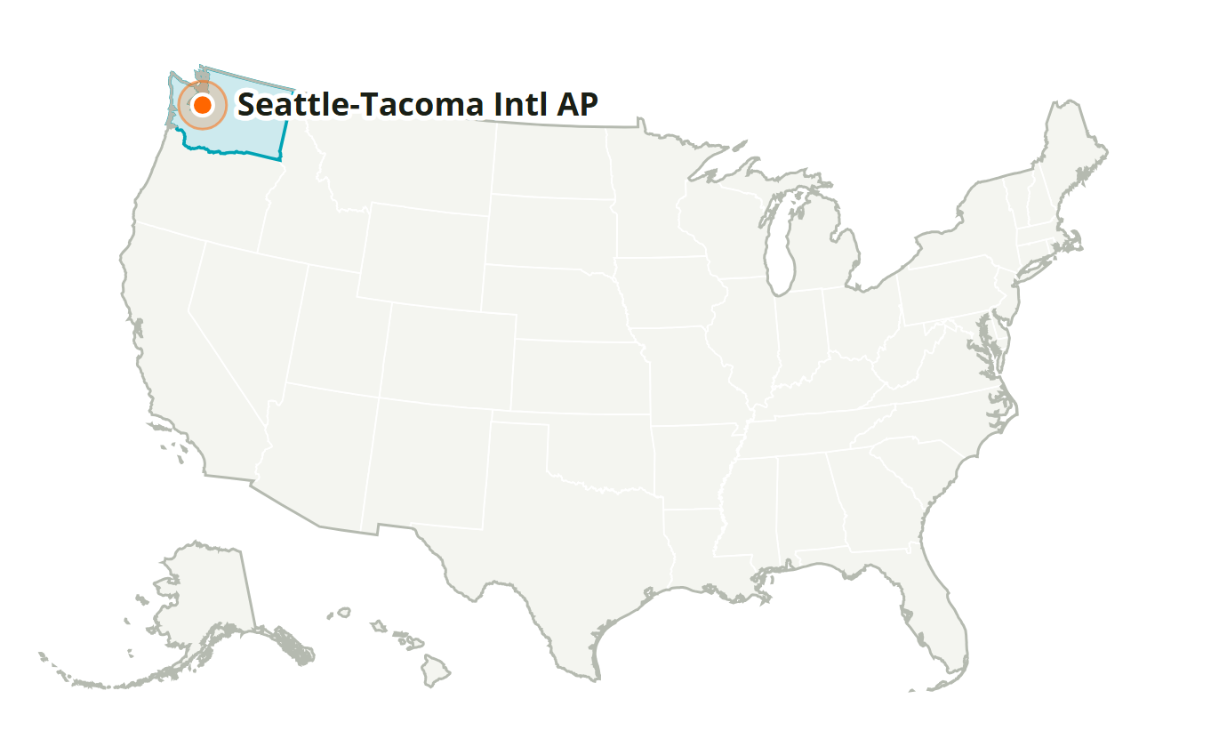
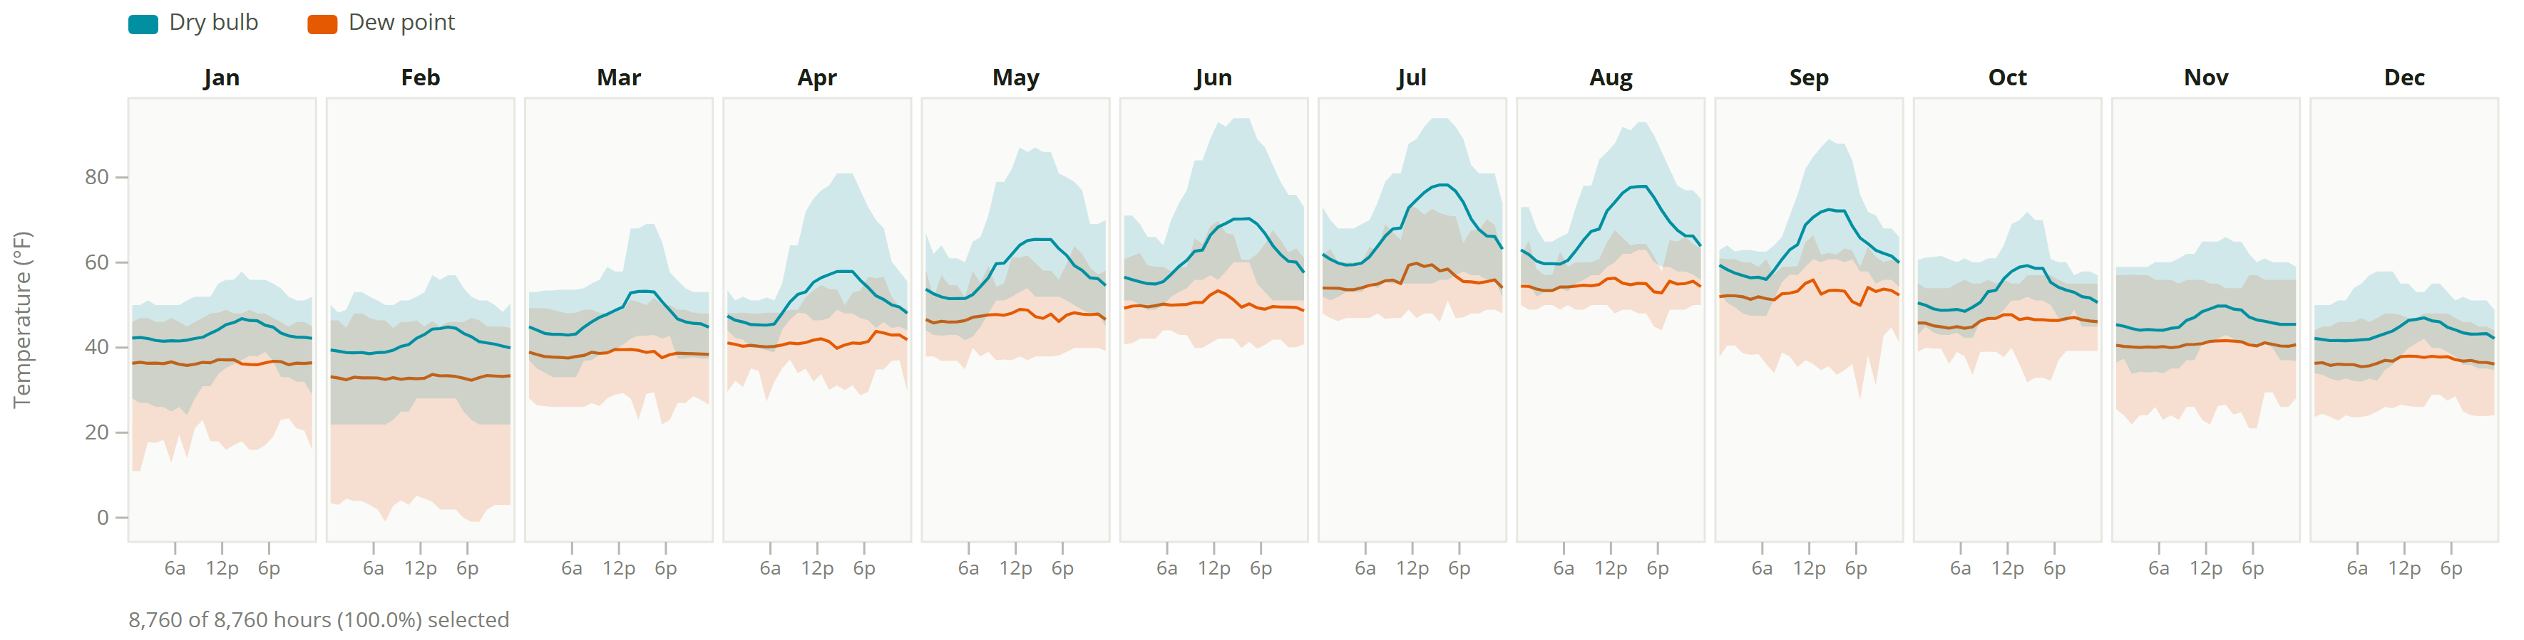
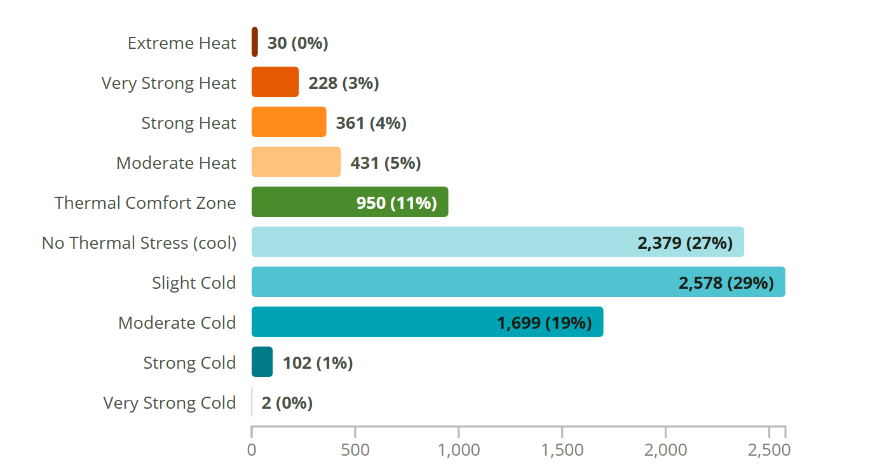
Seattle-Tacoma Intl AP
WA, USA · SRC-TMYx · WMO 727930
Latitude: 47.444° N
Longitude: 122.314° W
Elevation: 449 ft
Time zone: UTC-8
State: Washington
ASHRAE 4C · Mixed - Marine
Köppen Csb
Marine (Cool Summer)

Slide 15
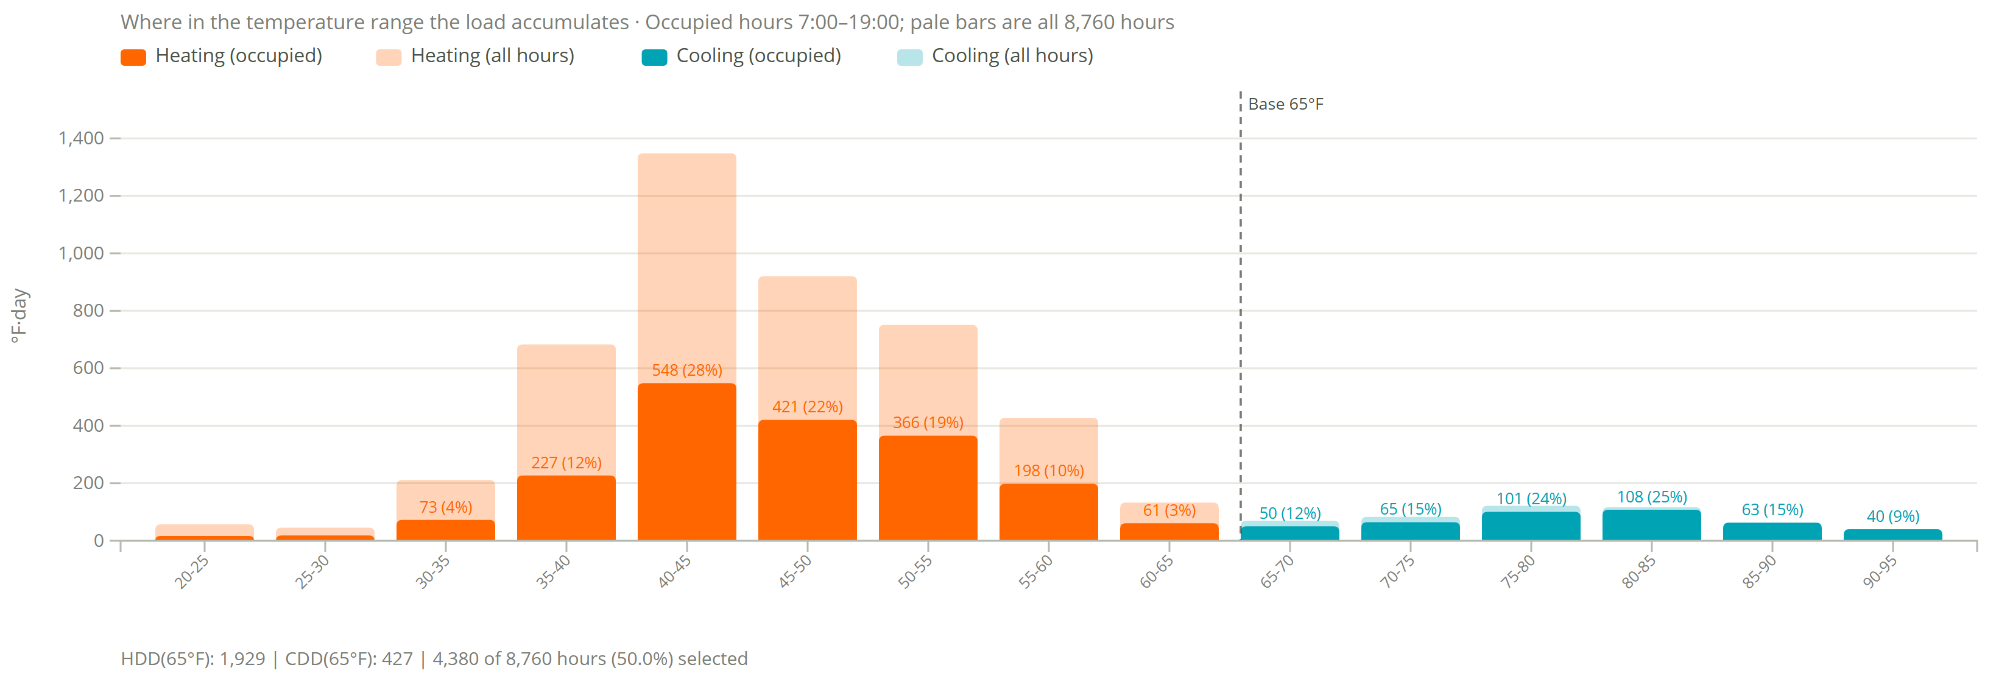
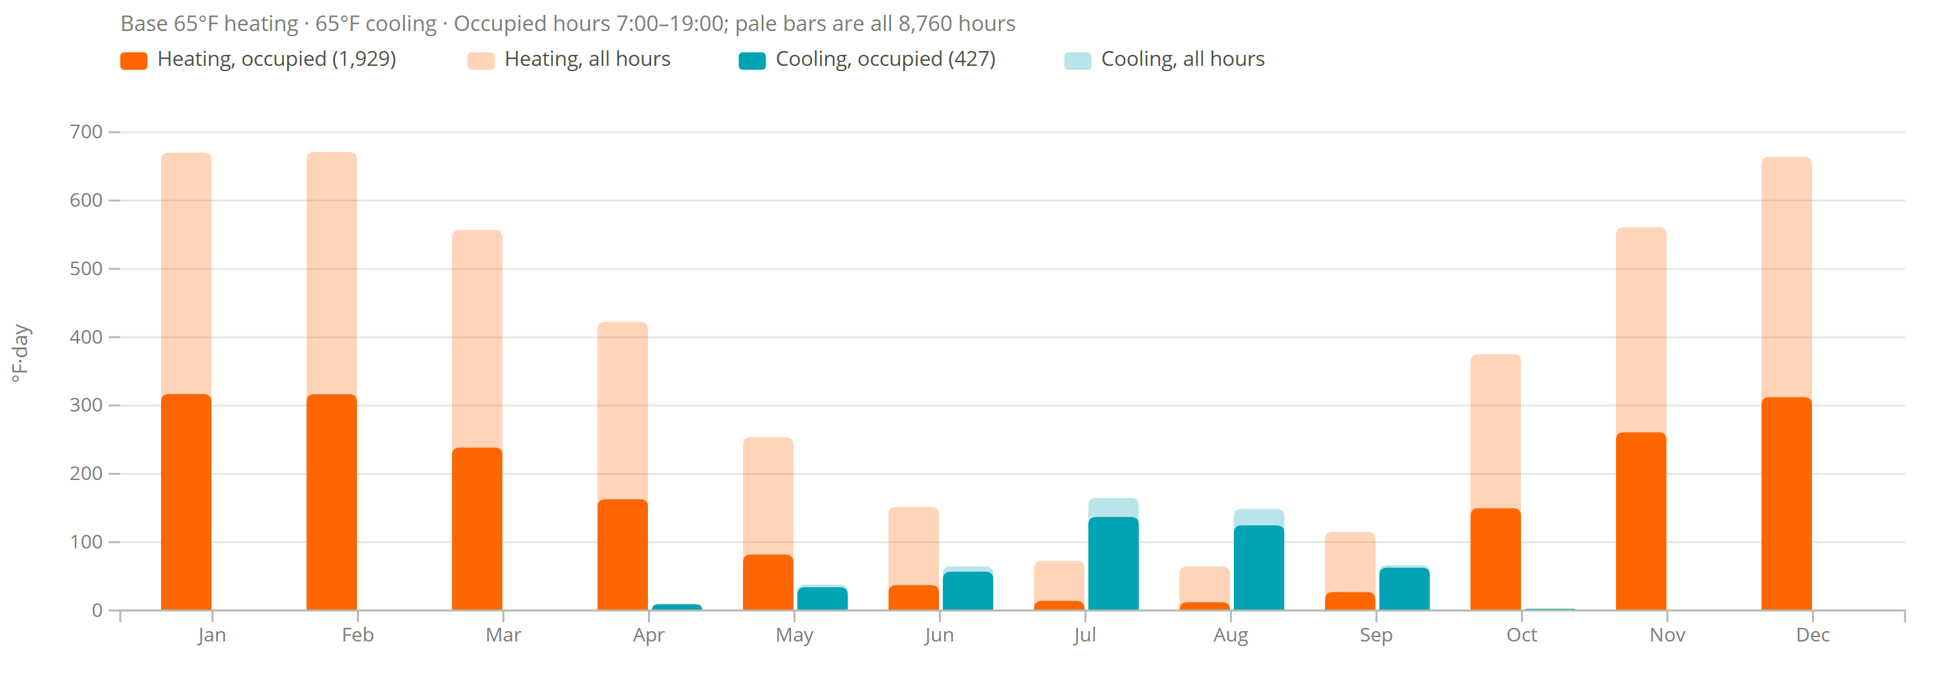
Degree Days
Seattle-Tacoma Intl AP
1,929
heating degree days (°F·day, occupied)
4,577 all hours
427
cooling degree days (°F·day, occupied)
495 all hours
Assumptions
Base 65°F heating and cooling.
Occupied 7:00–19:00, 4,380 of 8,760 h (50%).
Filter shows 7am to 7pm occupied hours and transparent is all data

