Slide 1
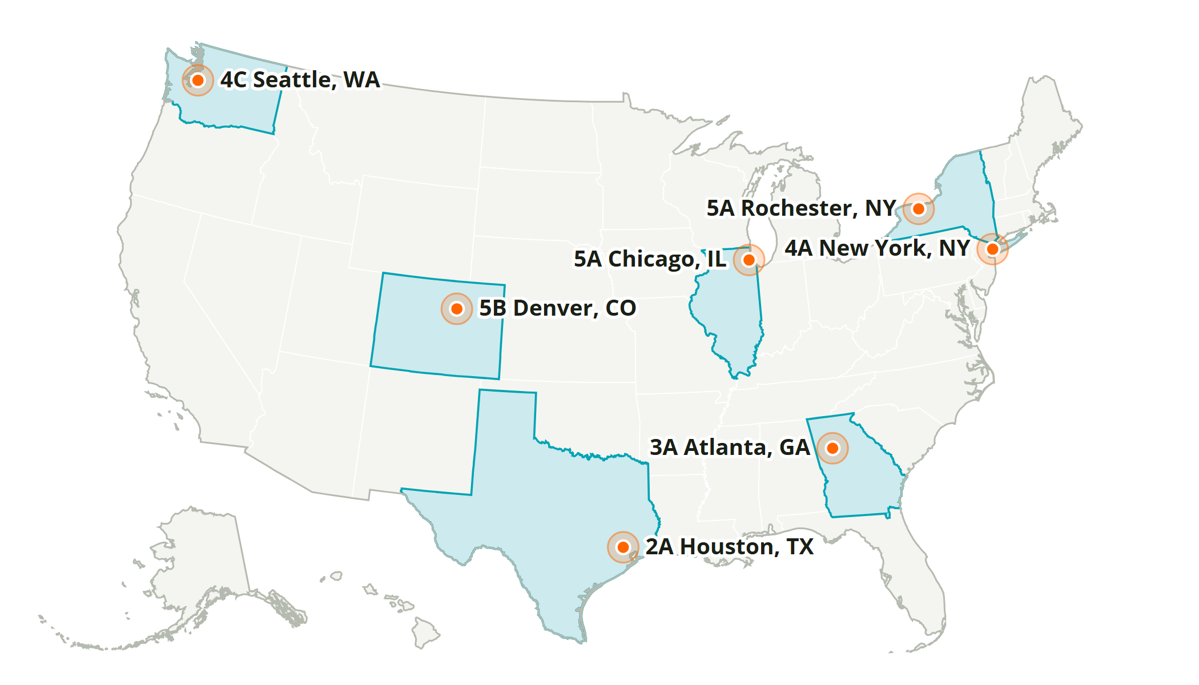
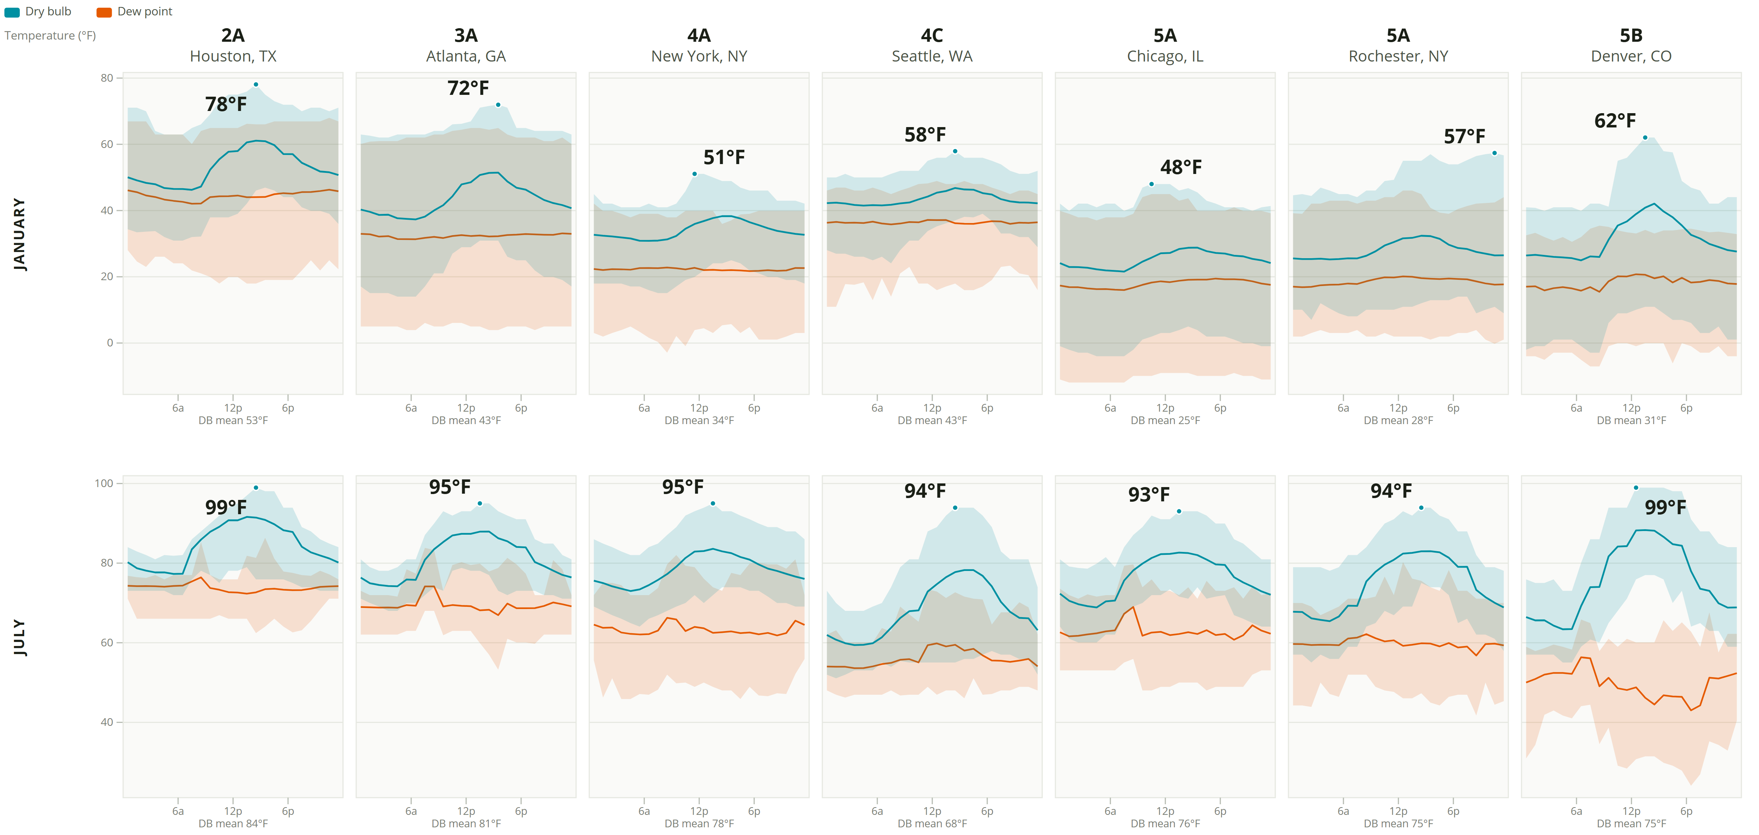
Typical Daily Temperature by ASHRAE Climate Zone
7 locations, January and July · dry bulb and dew point · hourly min–max envelope with the hourly mean · one temperature scale per month
ASHRAE 169 climate zones read from each weather file’s .stat, never computed: 2A Houston, TX, 3A Atlanta, GA, 4A New York, NY, 4C Seattle, WA, 5A Chicago, IL, 5A Rochester, NY, 5B Denver, CO. Source: weather_data, TMYx typical-year files.

Slide 2
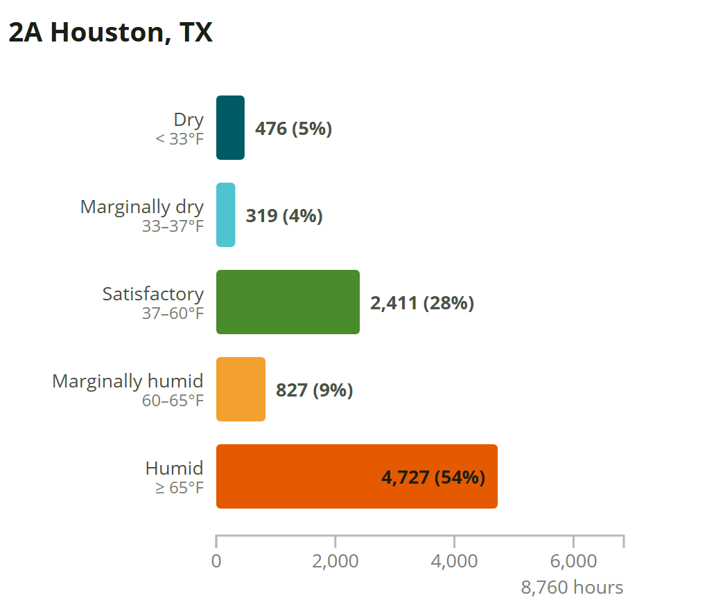
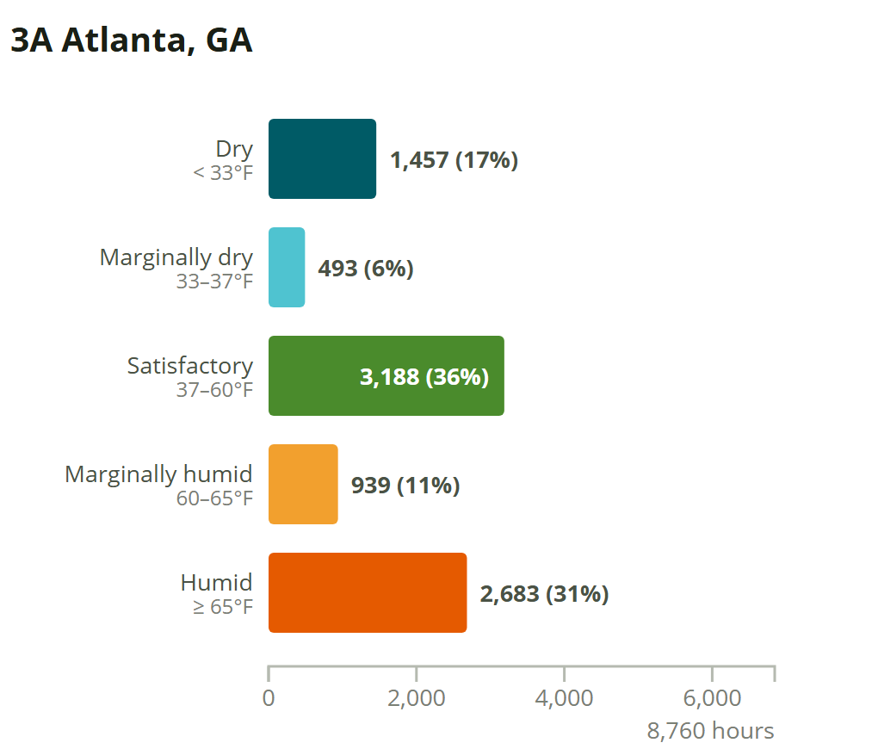
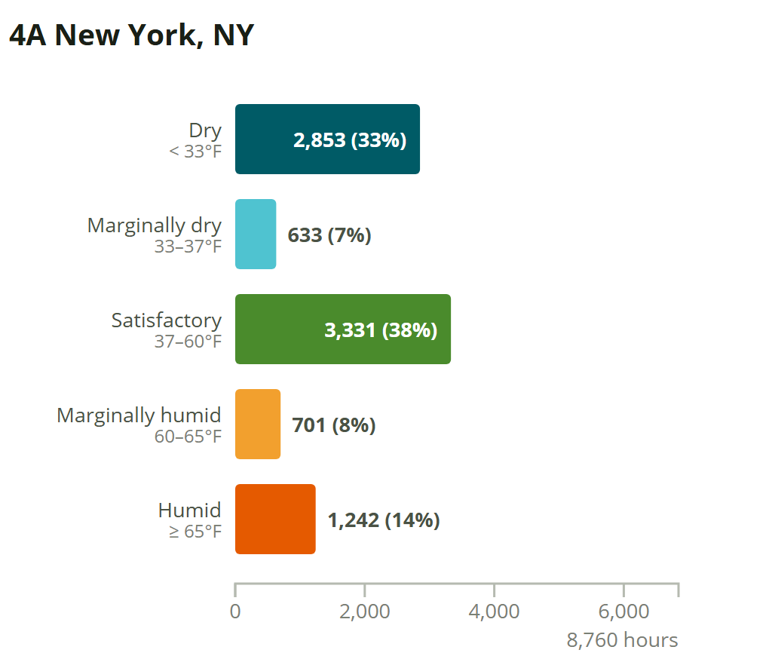
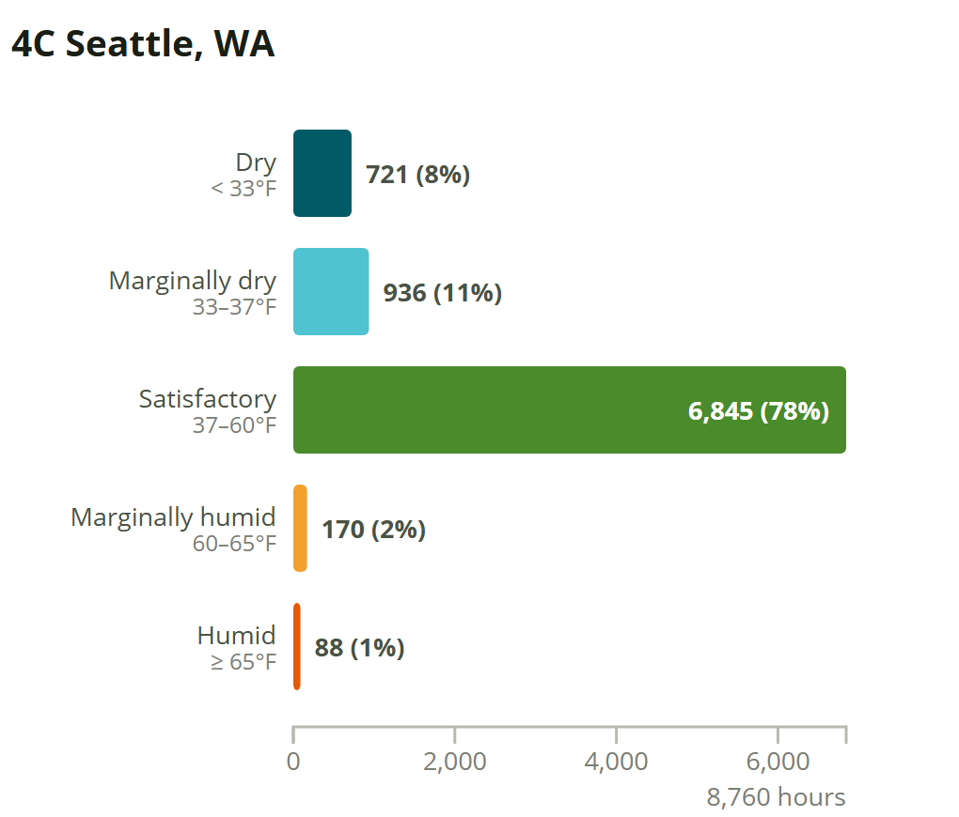
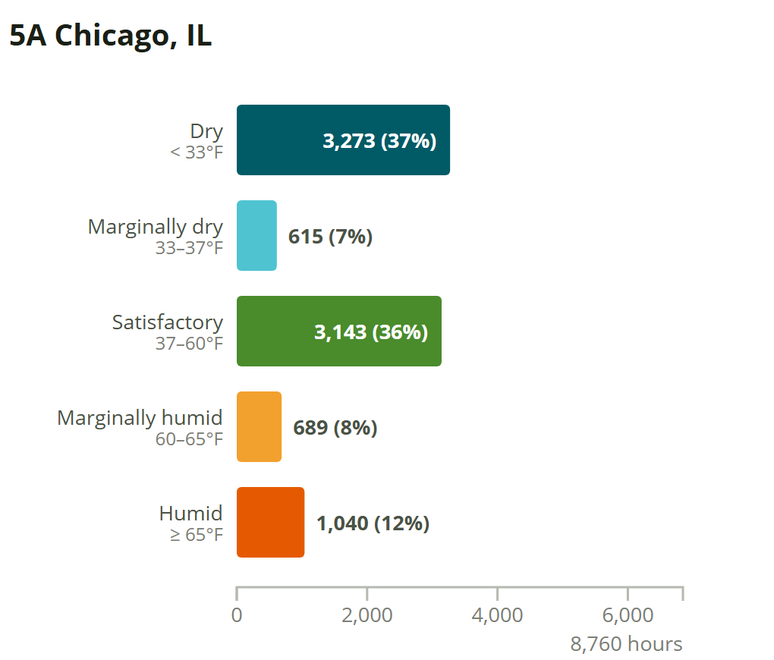
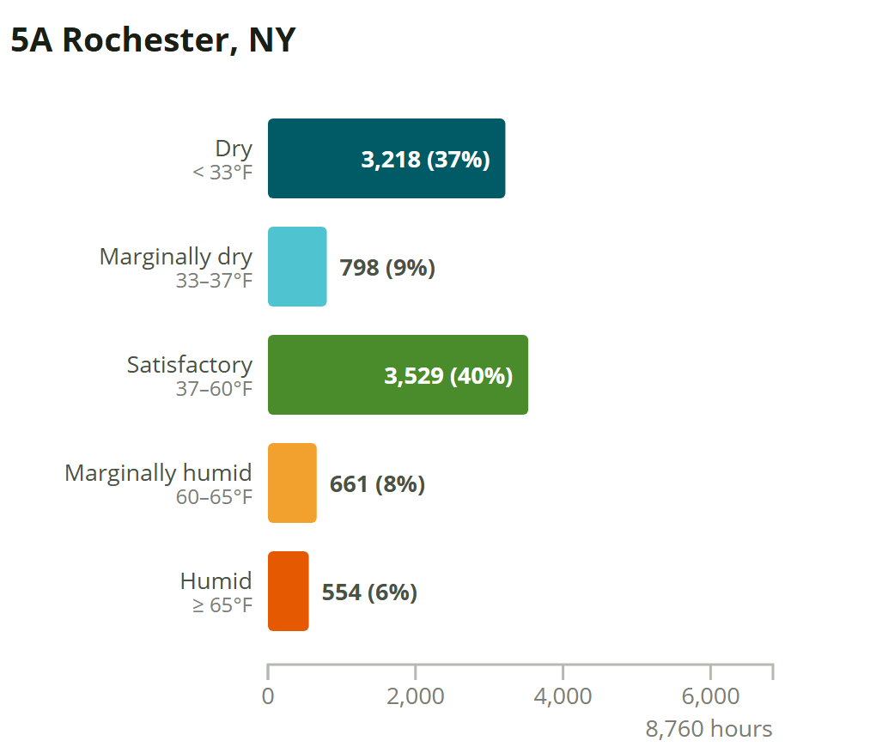
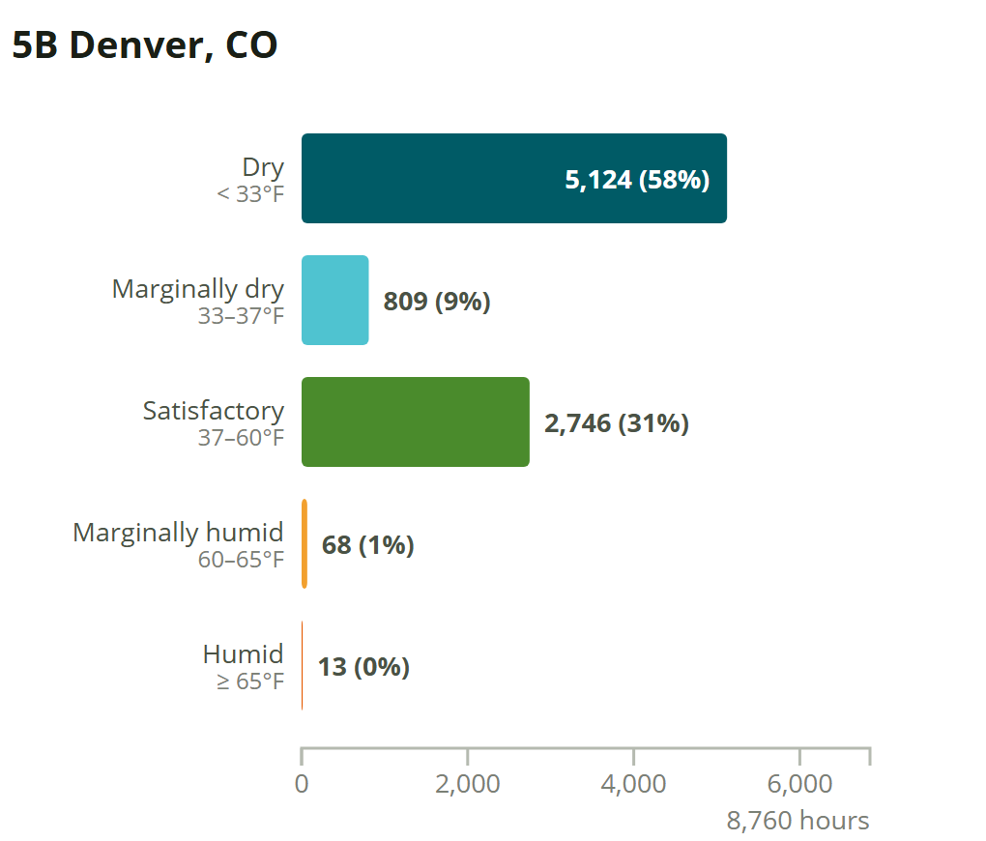
Outdoor Dew Point — Indoor Comfort Bands
RH thresholds transposed to dew point at 70°F indoors (dry side) and 75°F (humid side) · hours per year · every chart on the same hour scale, so bars compare across locations
Bands are the published indoor relative-humidity comfort thresholds transposed to dew point: sensible heating and cooling leave dew point unchanged, so the outdoor dew point is the zone dew point of a space on outdoor air with no dehumidification. Bounds are half-open, so all 8,760 hours land in exactly one band.

