Slide 1
Climate Analysis
Weather File Review
Bend Muni AP · Boise AP-Gowen Field ANGB · Denver Intl AP · Great Falls · Seattle-Tacoma Intl AP · Spokane Intl AP

Slide 2
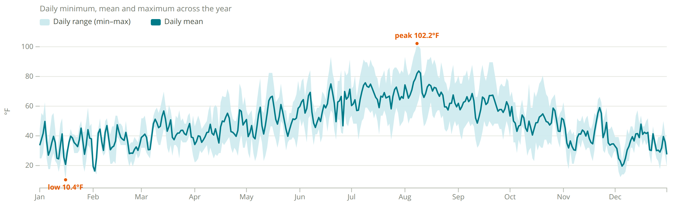
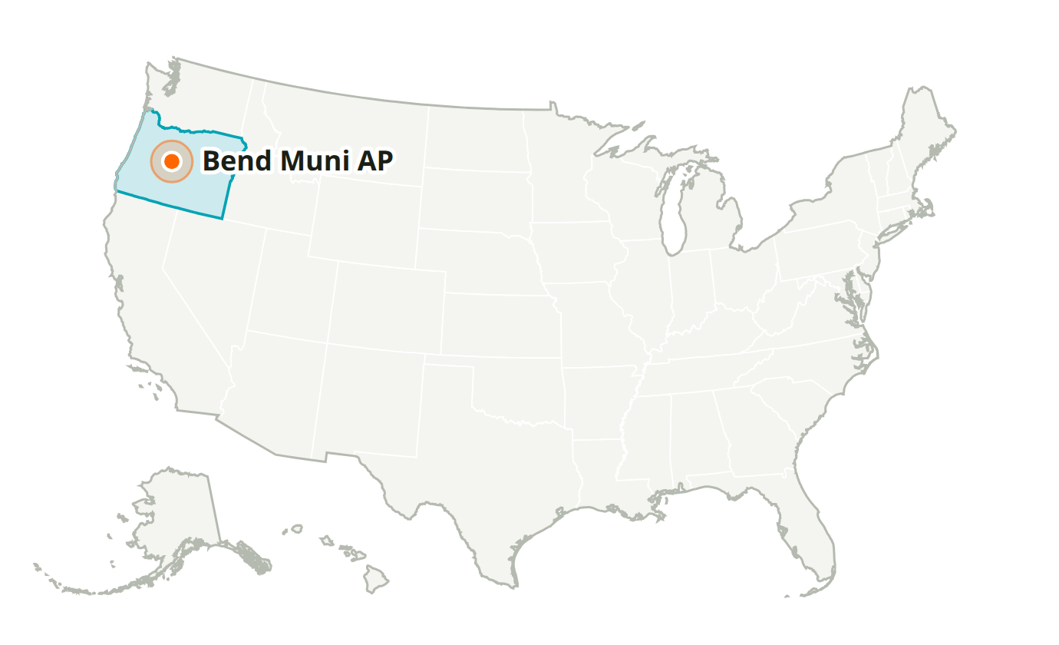
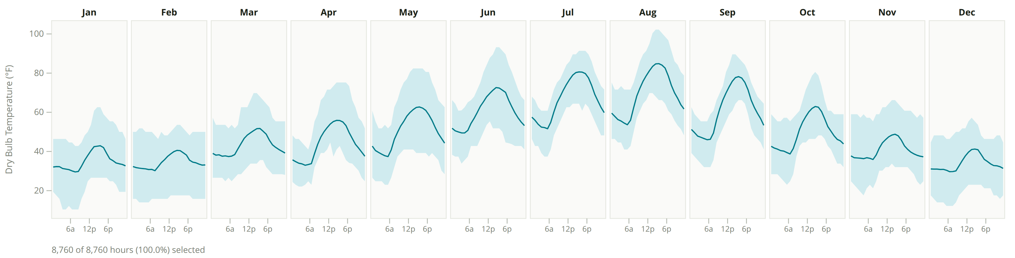
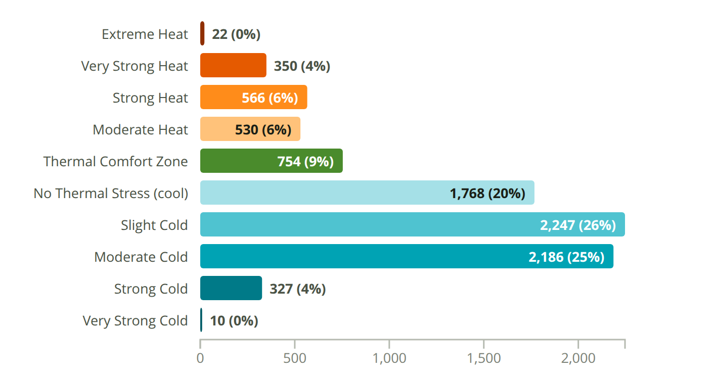
Bend Muni AP
OR, USA · Custom-720638 · WMO 720638
Latitude: 44.095° N
Longitude: 121.200° W
Elevation: 3,460 ft
Time zone: UTC-8
State: Oregon
ASHRAE 5C · Cool - Marine
Köppen BSk

Slide 3
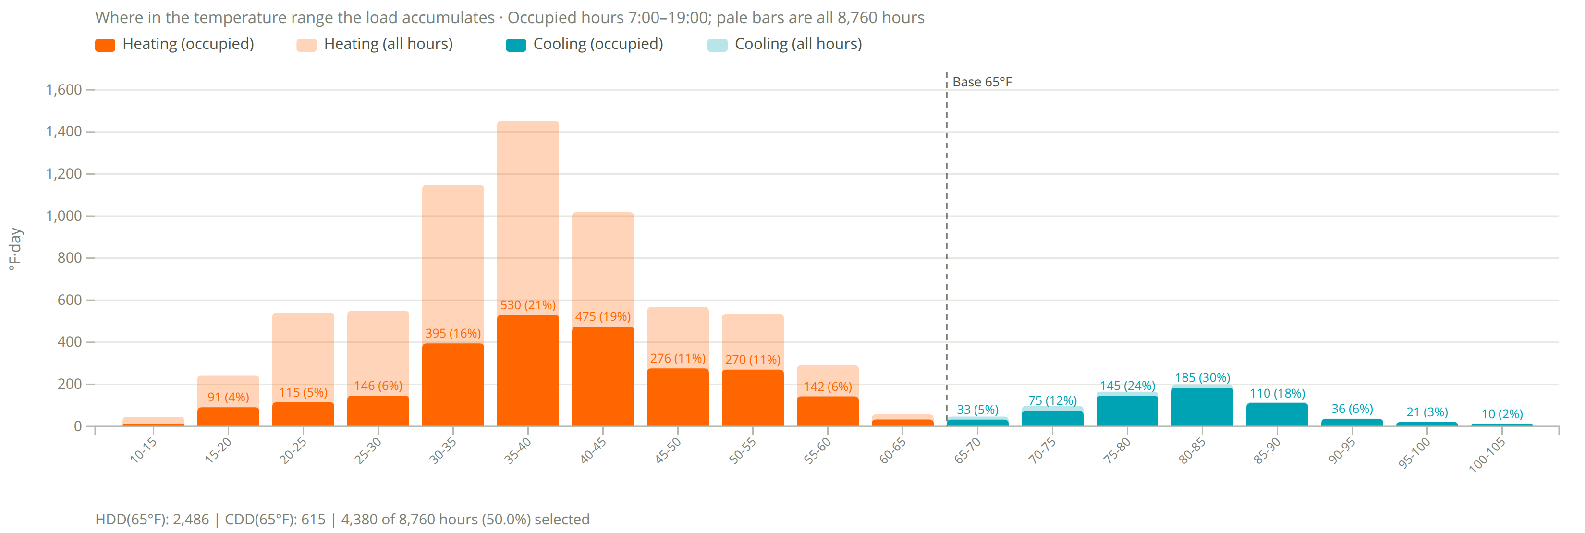
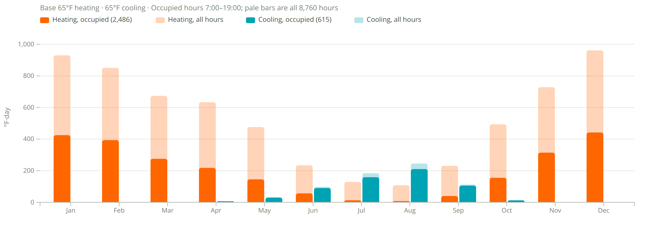
Degree Days
Bend Muni AP
2,486
heating degree days (°F·day, occupied)
6,449 all hours
615
cooling degree days (°F·day, occupied)
691 all hours
Assumptions
Base 65°F heating and cooling.
Occupied 7:00–19:00, 4,380 of 8,760 h (50%).
Filter shows 7am to 7pm occupied hours and transparent is all data

Slide 4
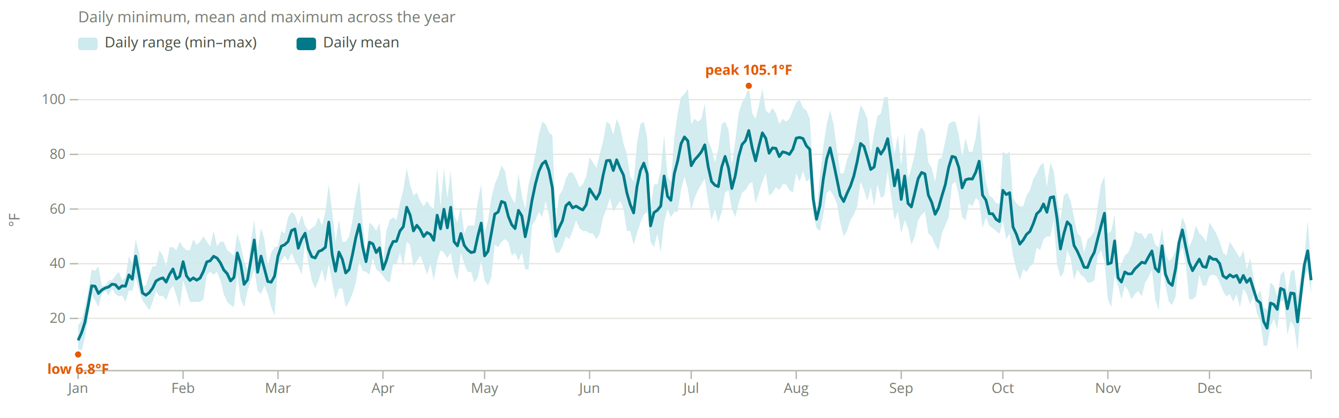
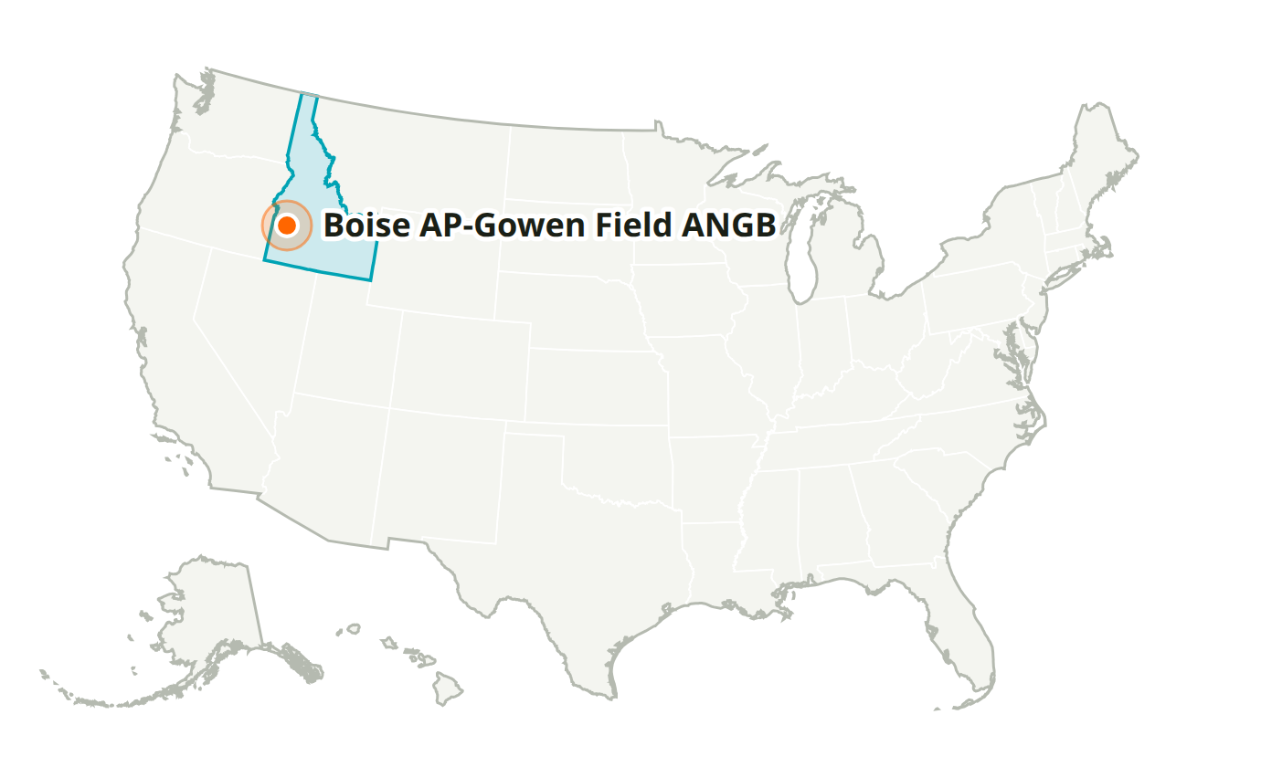
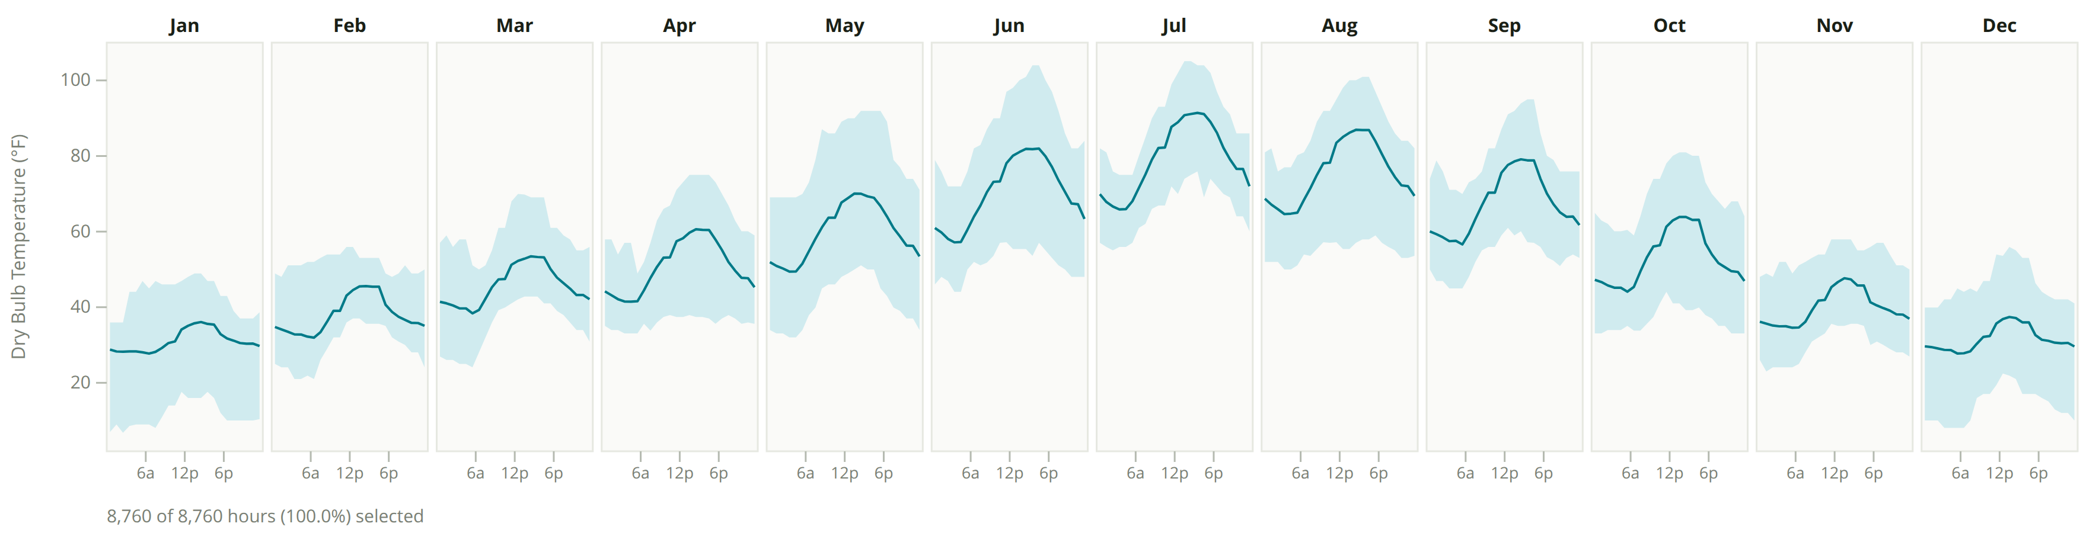
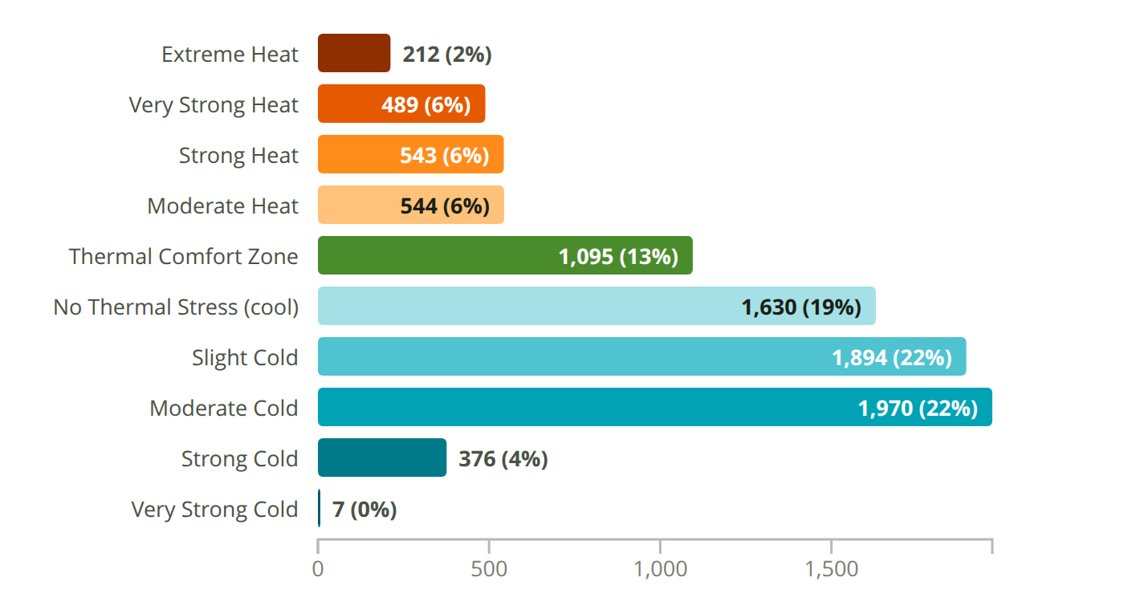
Boise AP-Gowen Field ANGB
ID, USA · Custom-726810 · WMO 726810
Latitude: 43.567° N
Longitude: 116.211° W
Elevation: 2,814 ft
Time zone: UTC-7
State: Idaho
ASHRAE 4B · Mixed - Dry
Köppen BSk
Semiarid Mid Latitude/Arid Subtropical/Highlands

Slide 5
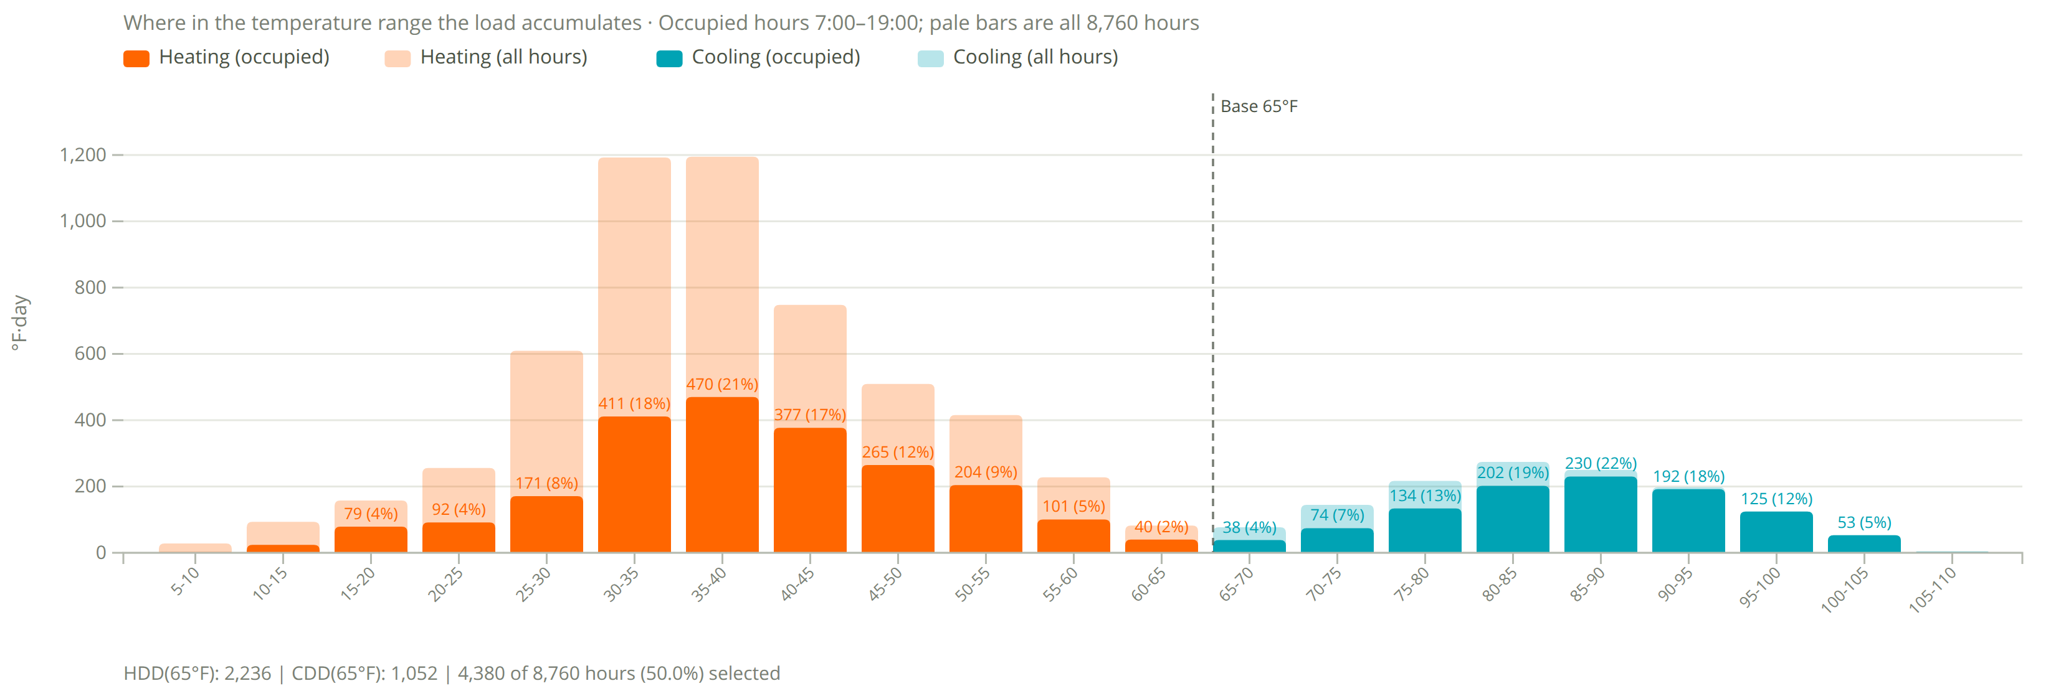
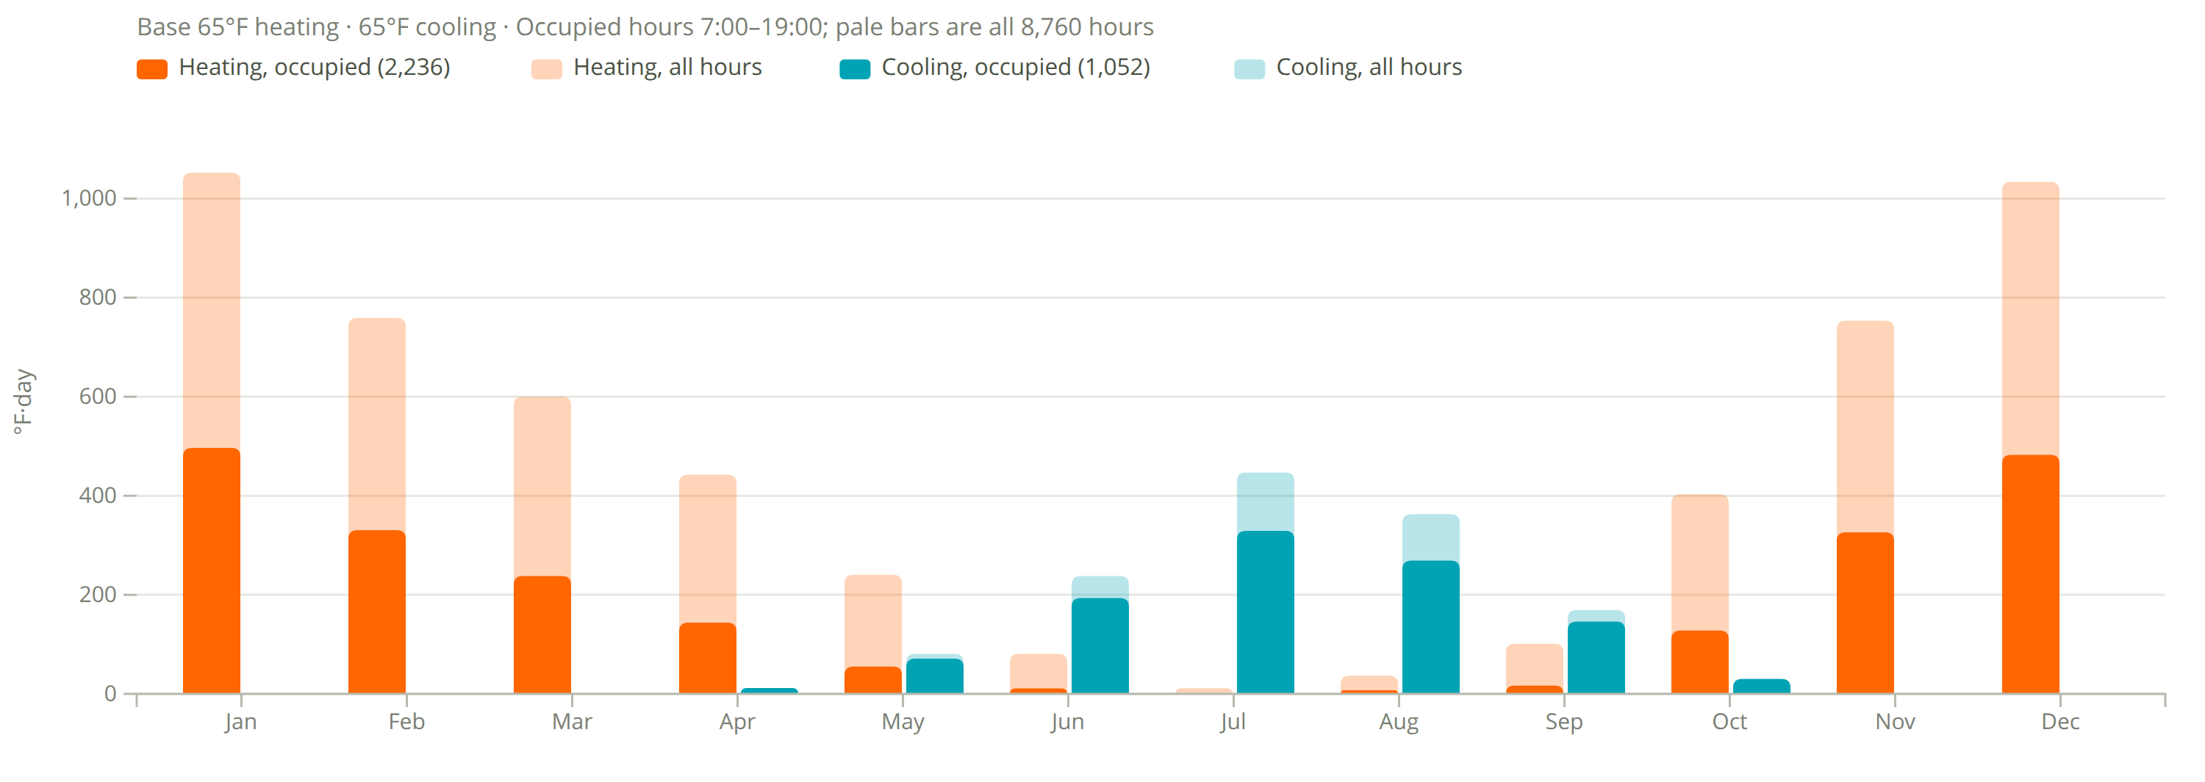
Degree Days
Boise AP-Gowen Field ANGB
2,236
heating degree days (°F·day, occupied)
5,514 all hours
1,052
cooling degree days (°F·day, occupied)
1,341 all hours
Assumptions
Base 65°F heating and cooling.
Occupied 7:00–19:00, 4,380 of 8,760 h (50%).
Filter shows 7am to 7pm occupied hours and transparent is all data

Slide 6
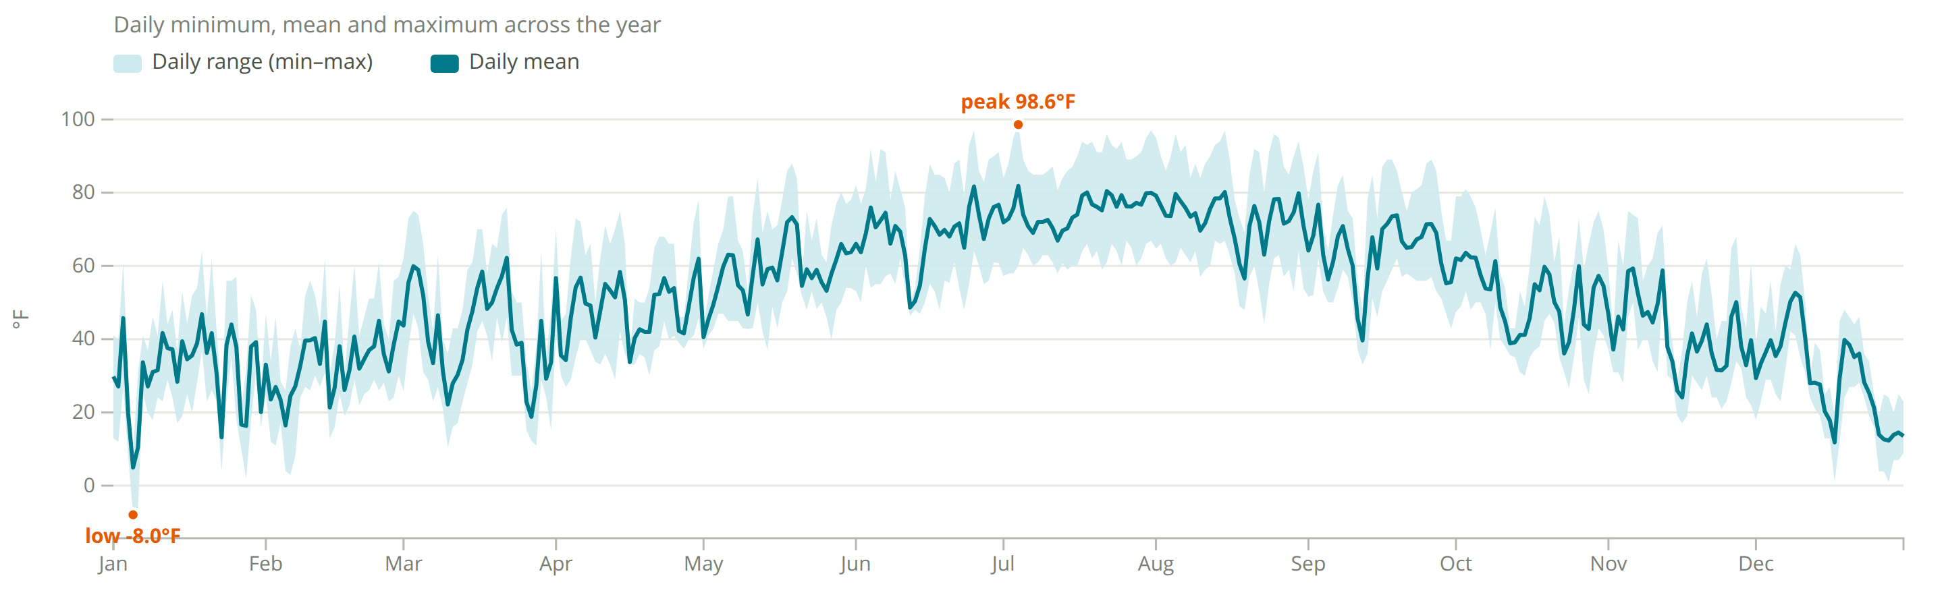
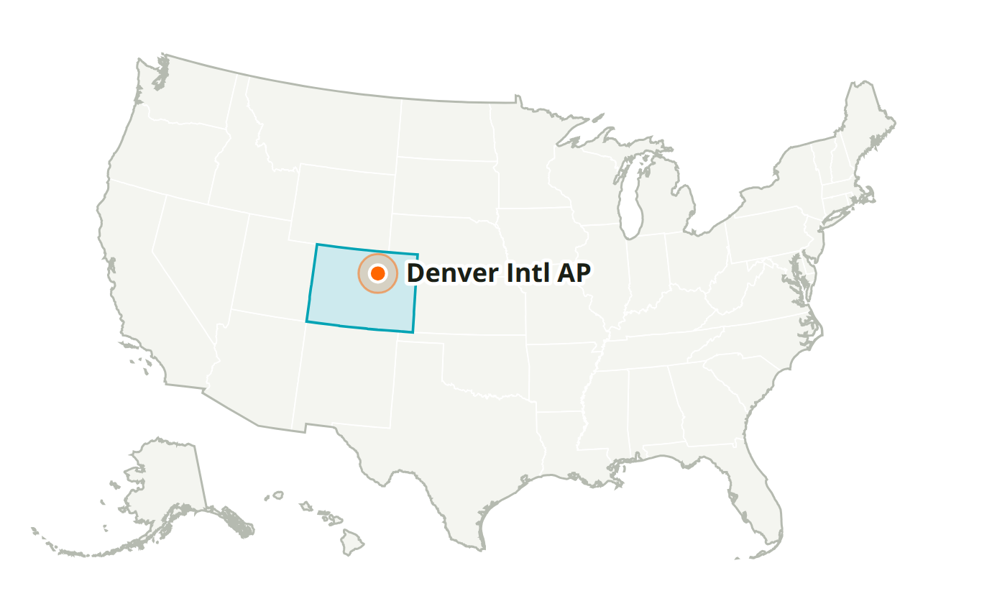
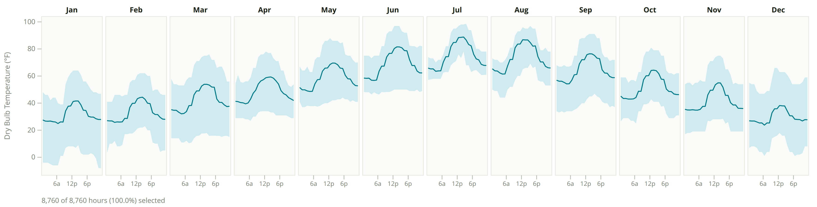
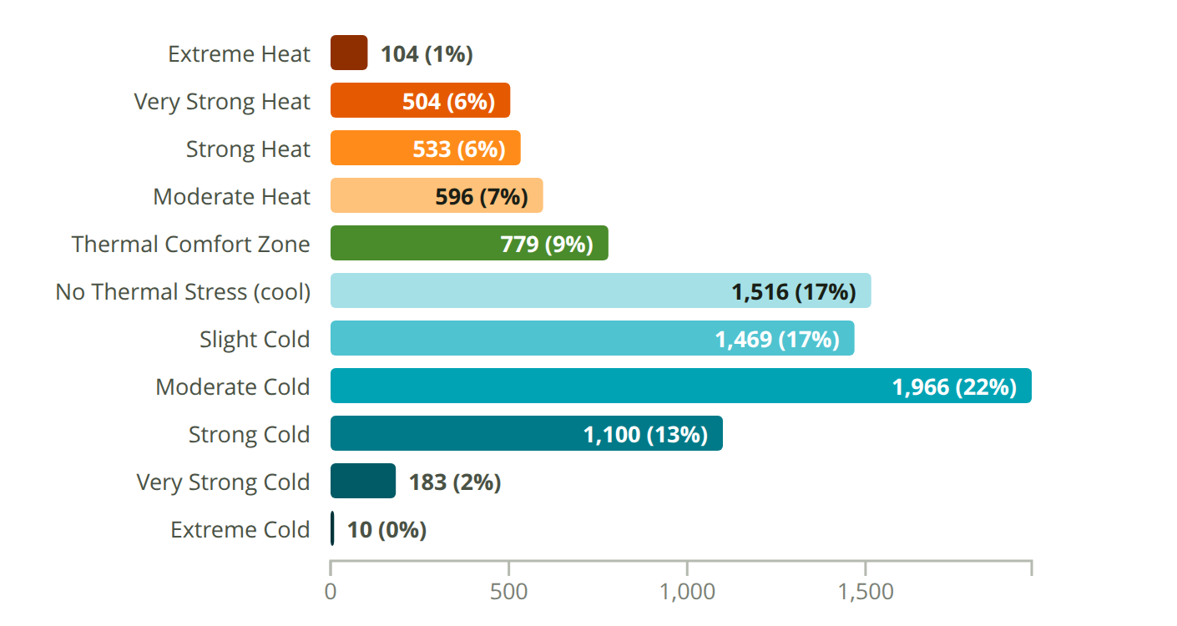
Denver Intl AP
CO, USA · Custom-725650 · WMO 725650
Latitude: 39.867° N
Longitude: 104.667° W
Elevation: 5,414 ft
Time zone: UTC-7
State: Colorado
ASHRAE 5B · Cool - Dry
Köppen BSk
Semiarid Mid Latitude/Highlands

Slide 7
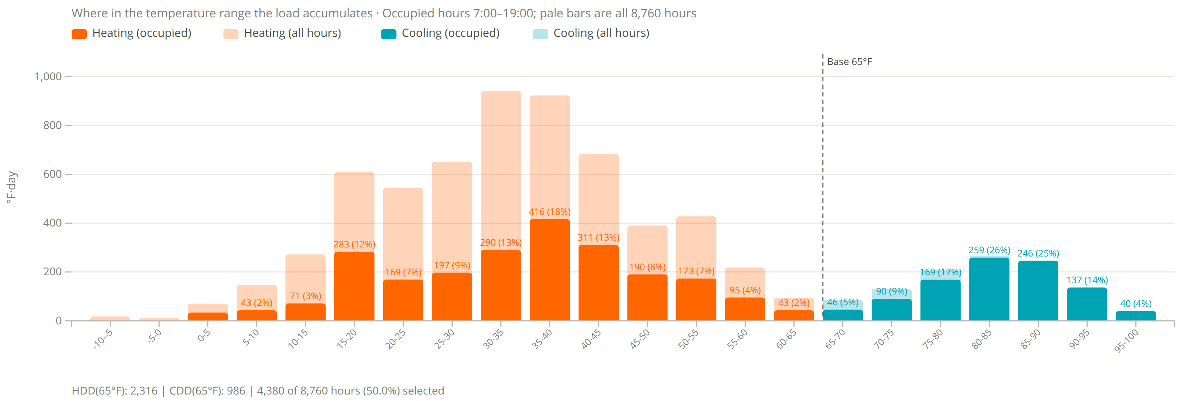
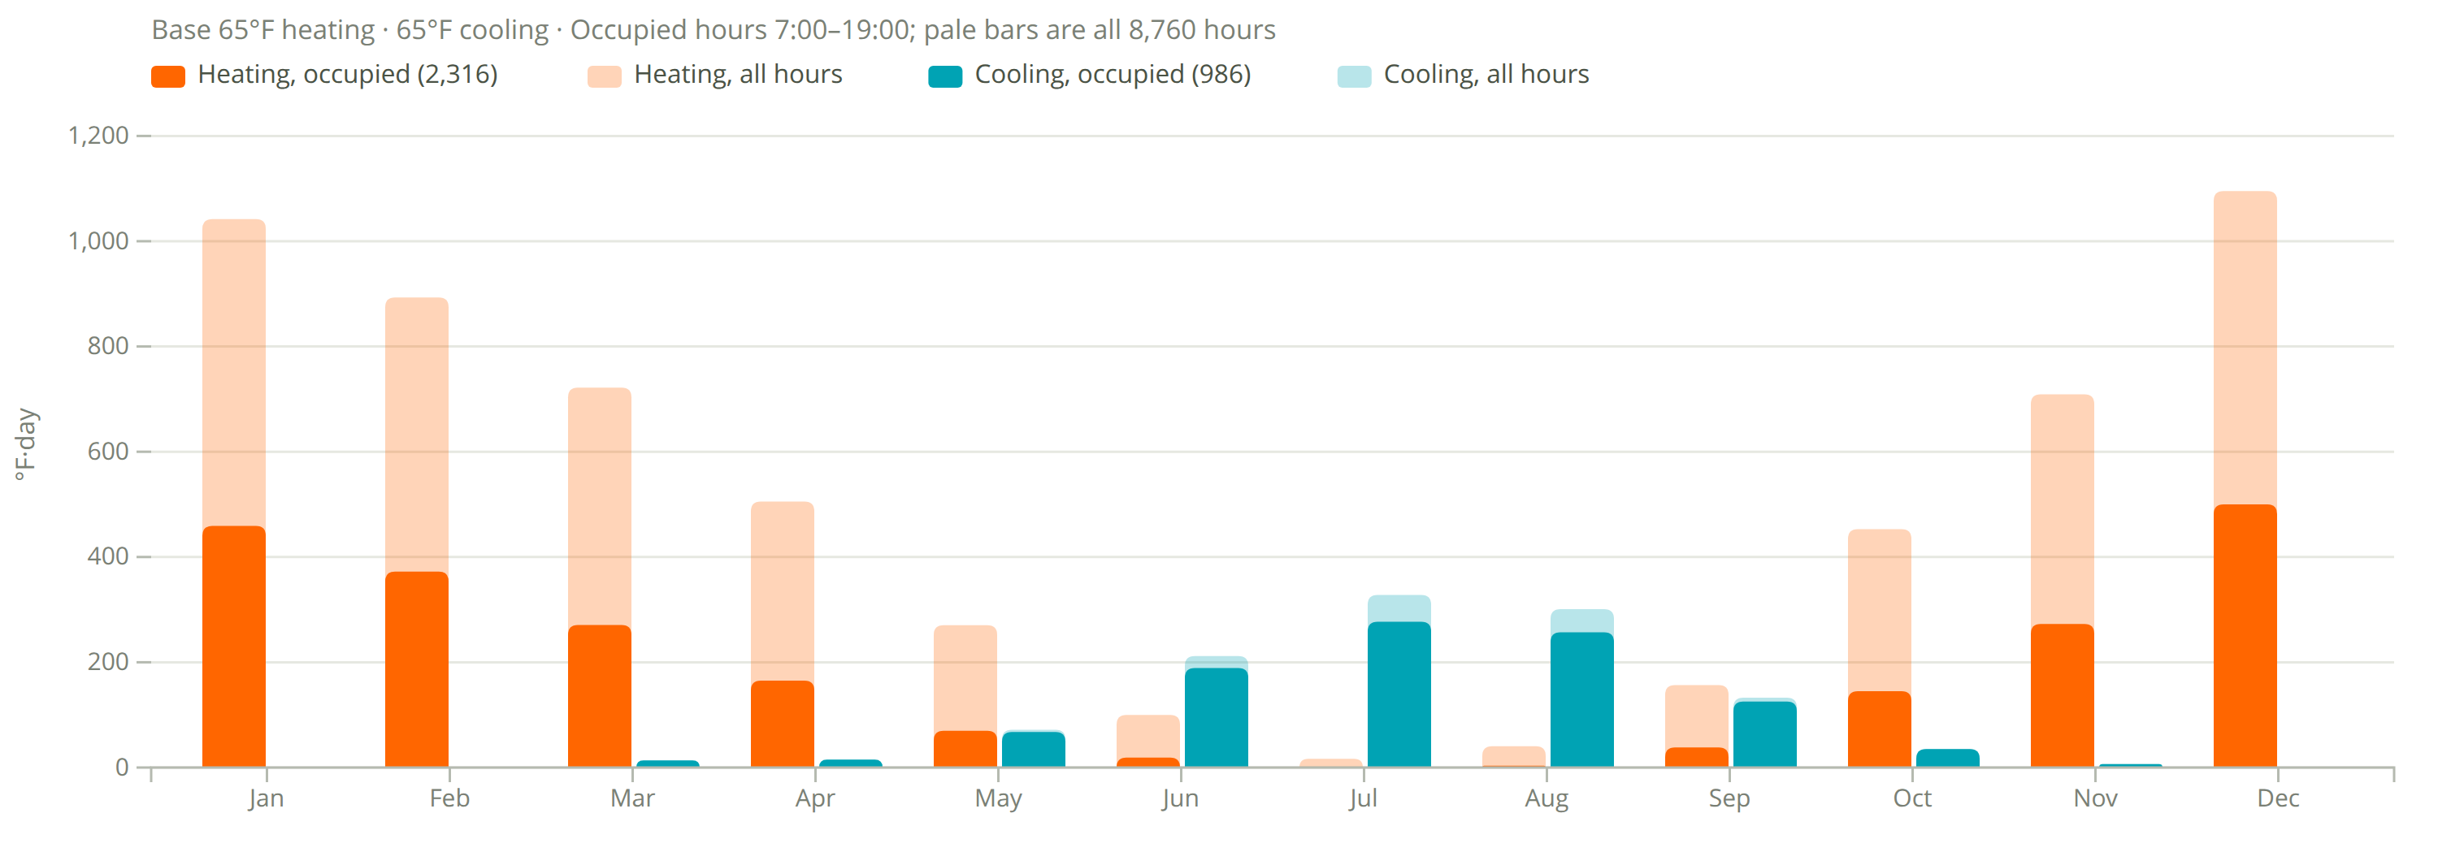
Degree Days
Denver Intl AP
2,316
heating degree days (°F·day, occupied)
6,004 all hours
986
cooling degree days (°F·day, occupied)
1,115 all hours
Assumptions
Base 65°F heating and cooling.
Occupied 7:00–19:00, 4,380 of 8,760 h (50%).
Filter shows 7am to 7pm occupied hours and transparent is all data

Slide 8
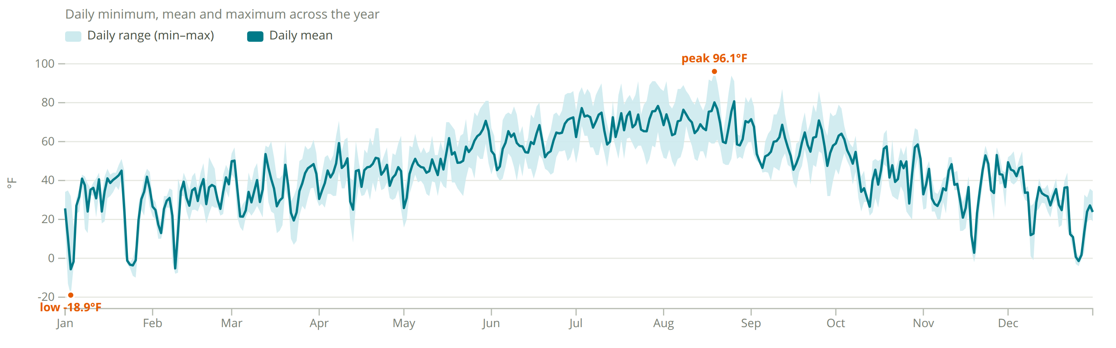
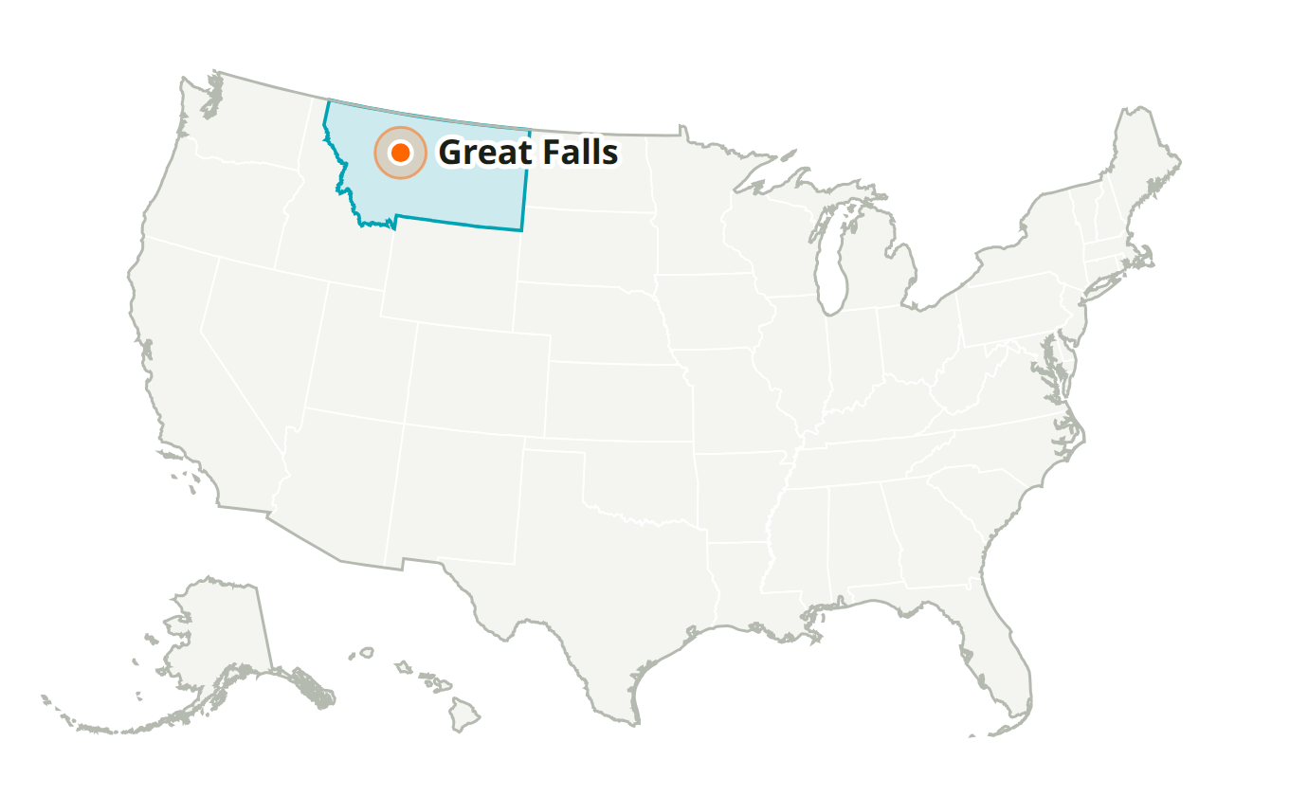
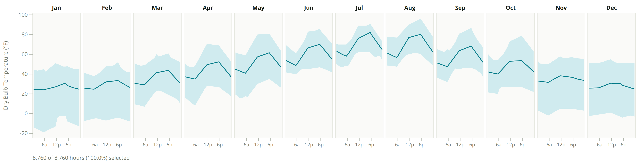
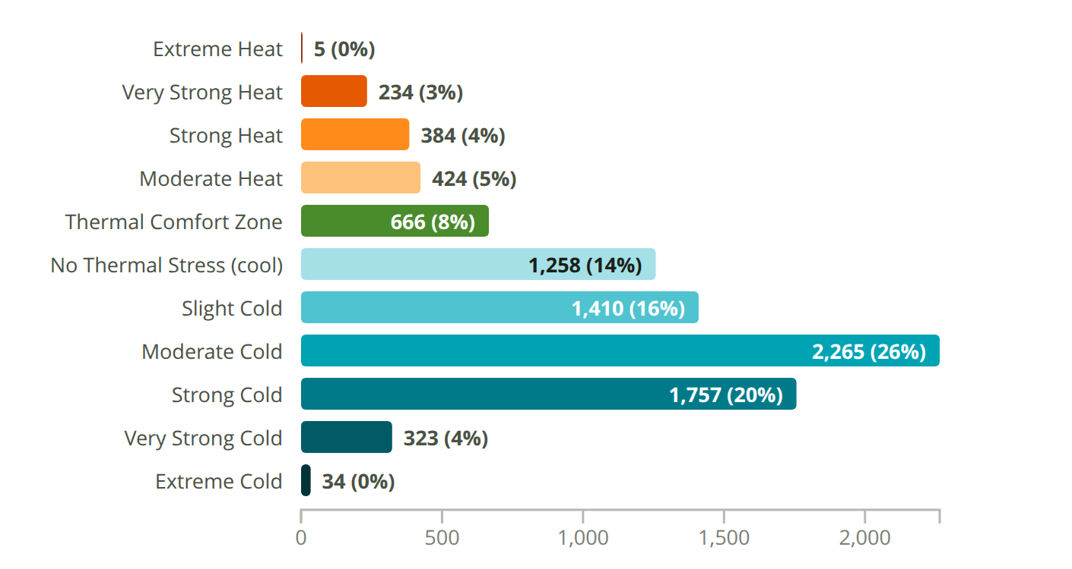
Great Falls
MT, USA · Custom-727760 · WMO 727760
Latitude: 47.461° N
Longitude: 111.385° W
Elevation: 3,709 ft
Time zone: UTC-7
State: Montana
ASHRAE 6B · Cold - Dry
Köppen BSk
Semiarid Mid Latitude/Highlands

Slide 9
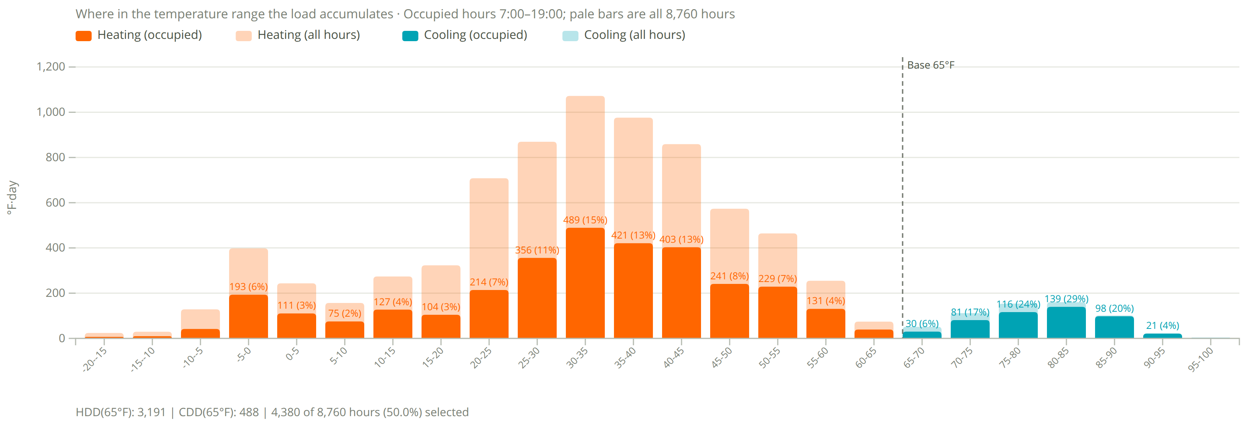
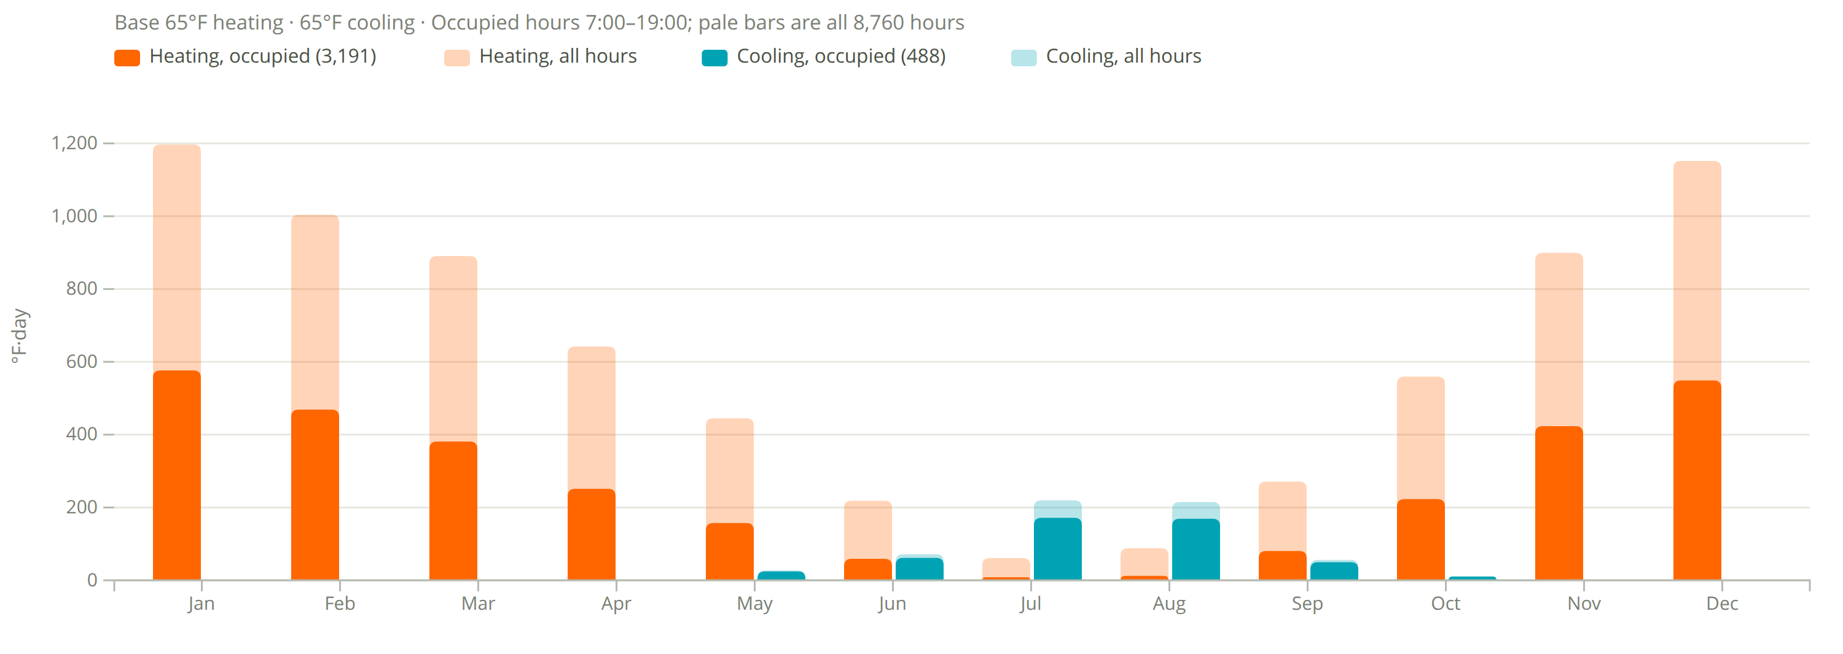
Degree Days
Great Falls
3,191
heating degree days (°F·day, occupied)
7,429 all hours
488
cooling degree days (°F·day, occupied)
603 all hours
Assumptions
Base 65°F heating and cooling.
Occupied 7:00–19:00, 4,380 of 8,760 h (50%).
Filter shows 7am to 7pm occupied hours and transparent is all data

Slide 10
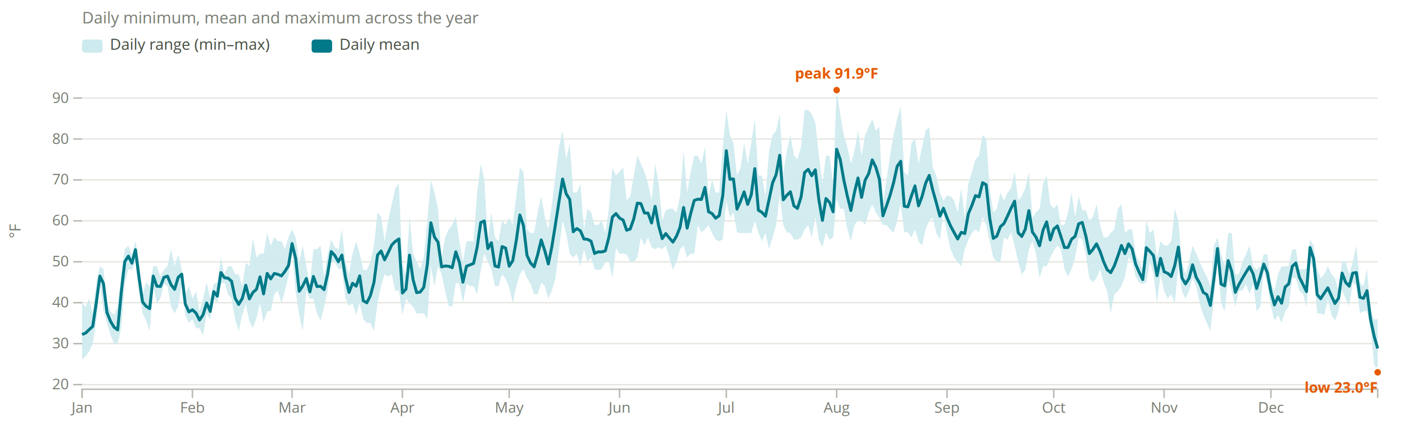
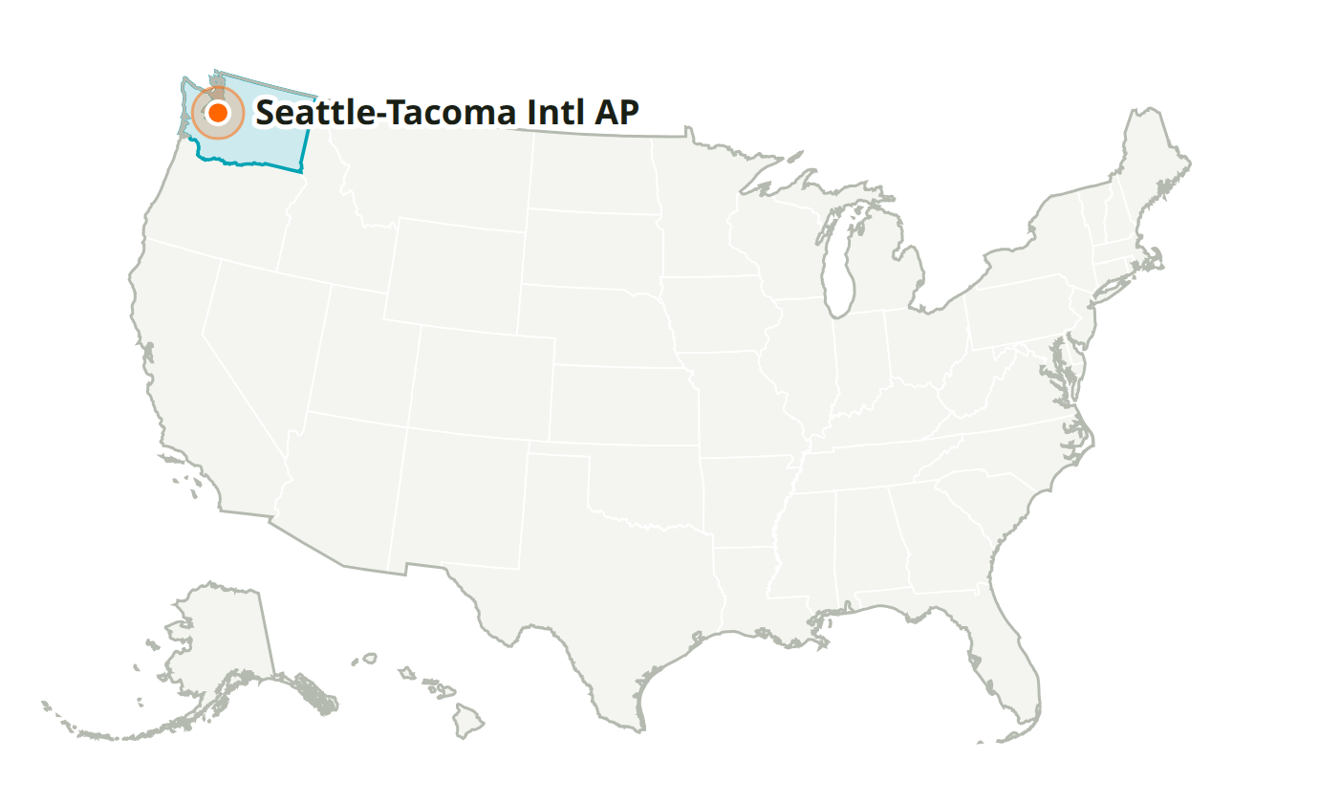
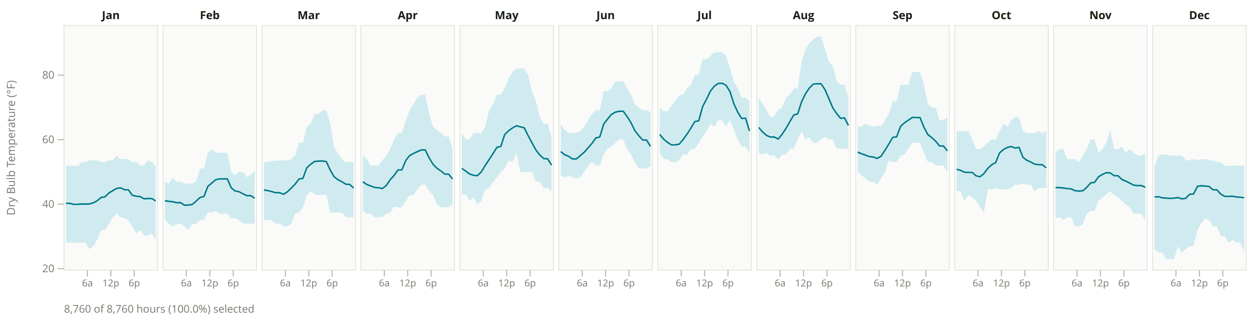
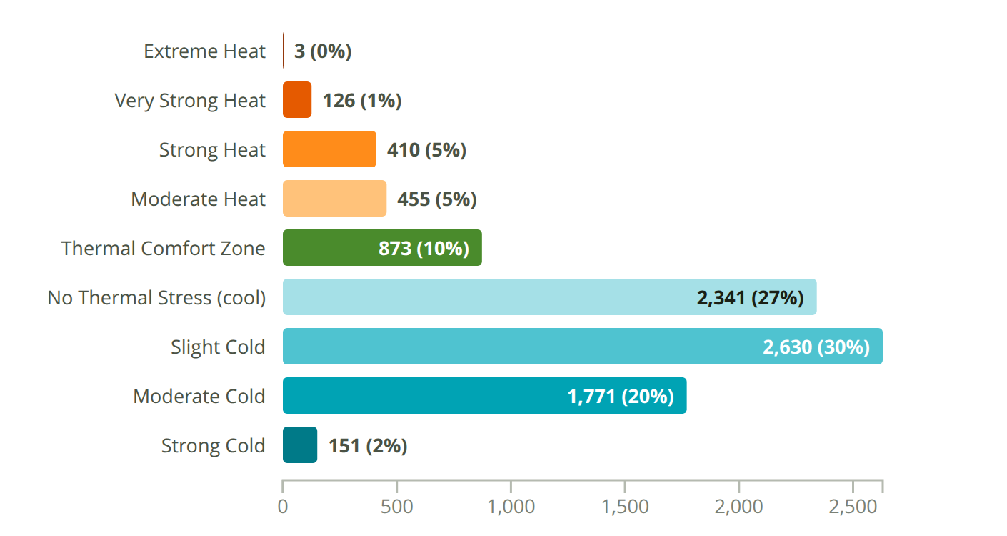
Seattle-Tacoma Intl AP
WA, USA · Custom-727930 · WMO 727930
Latitude: 47.450° N
Longitude: 122.300° W
Elevation: 449 ft
Time zone: UTC-8
State: Washington
ASHRAE 4C · Mixed - Marine
Köppen Csb
Marine (Cool Summer)

Slide 11
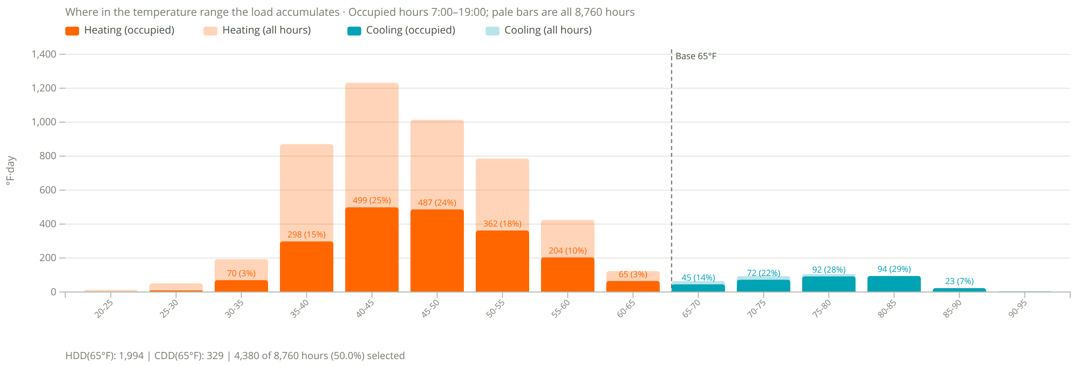
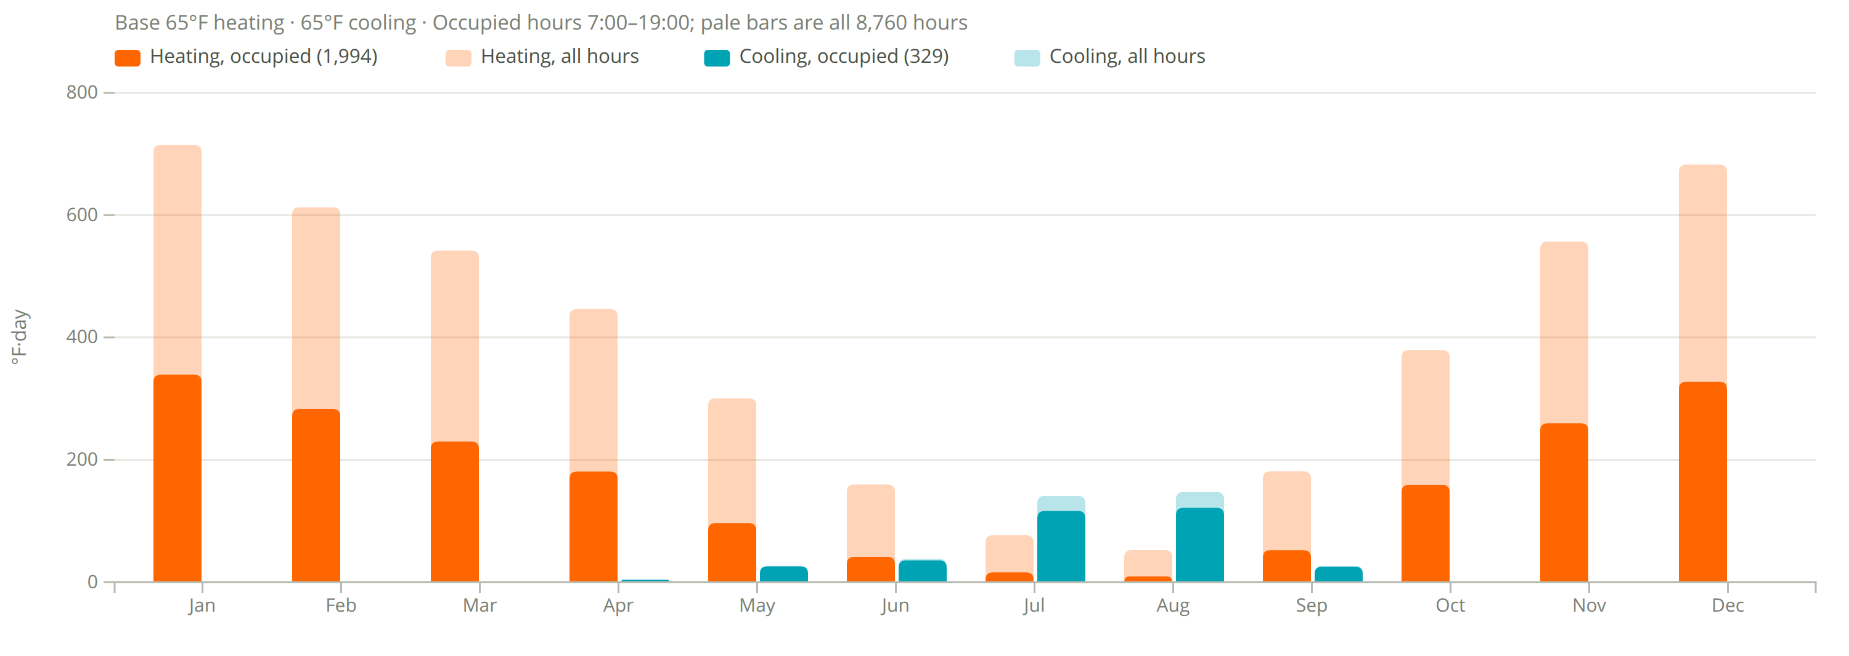
Degree Days
Seattle-Tacoma Intl AP
1,994
heating degree days (°F·day, occupied)
4,705 all hours
329
cooling degree days (°F·day, occupied)
384 all hours
Assumptions
Base 65°F heating and cooling.
Occupied 7:00–19:00, 4,380 of 8,760 h (50%).
Filter shows 7am to 7pm occupied hours and transparent is all data

Slide 12
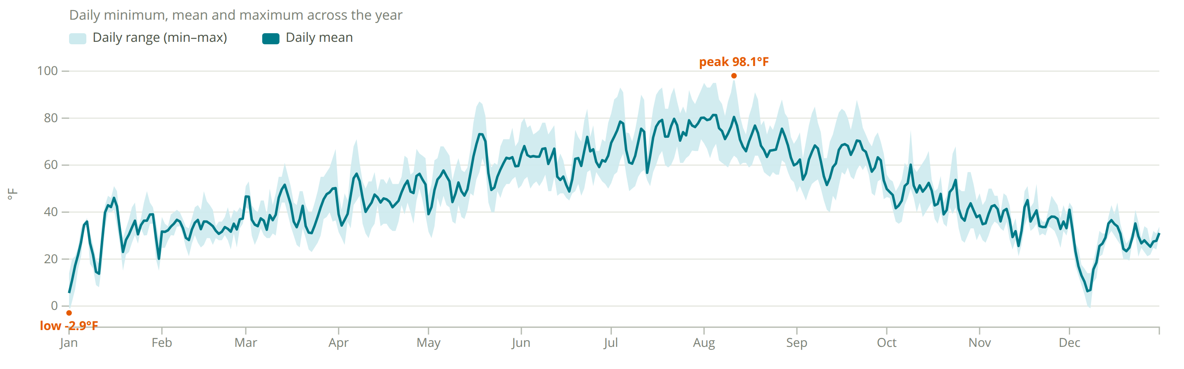
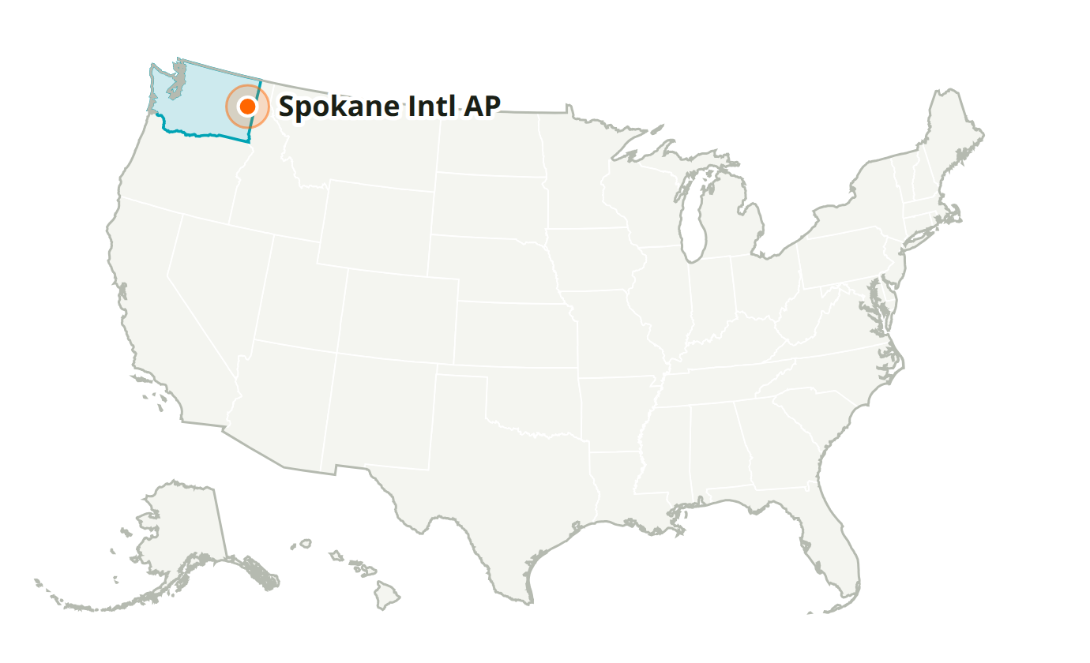
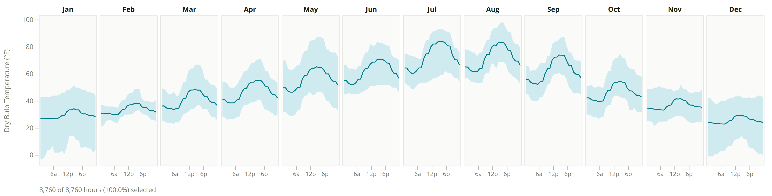
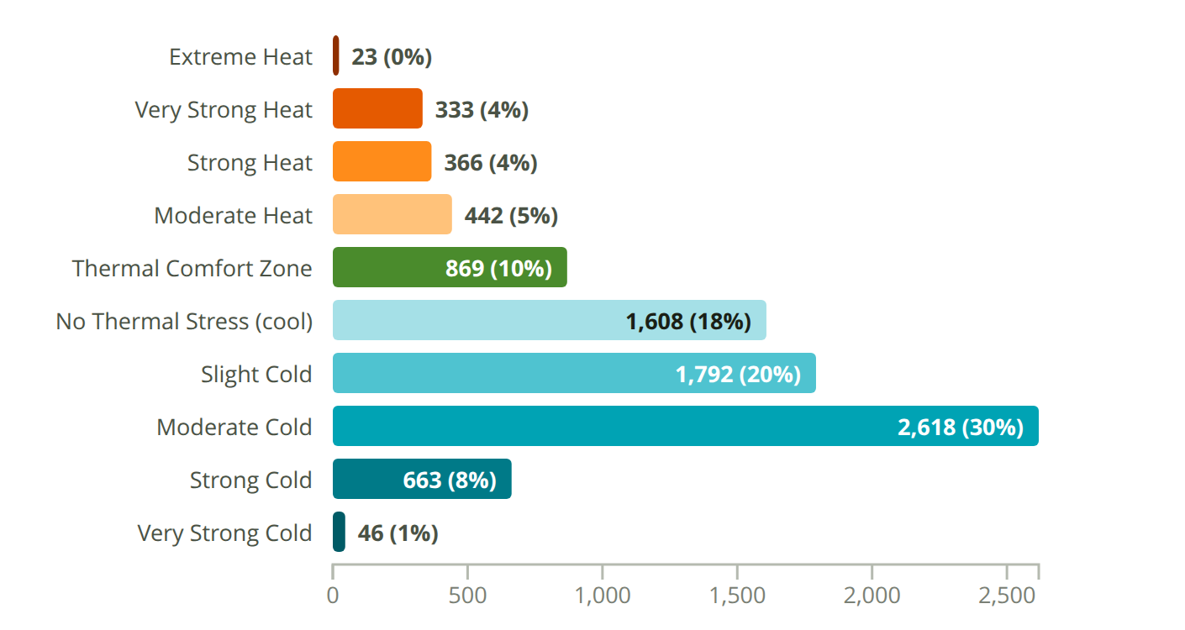
Spokane Intl AP
WA, USA · Custom-727850 · WMO 727850
Latitude: 47.633° N
Longitude: 117.533° W
Elevation: 2,353 ft
Time zone: UTC-8
State: Washington
ASHRAE 5A · Cool - Humid
Köppen Dsa

Slide 13
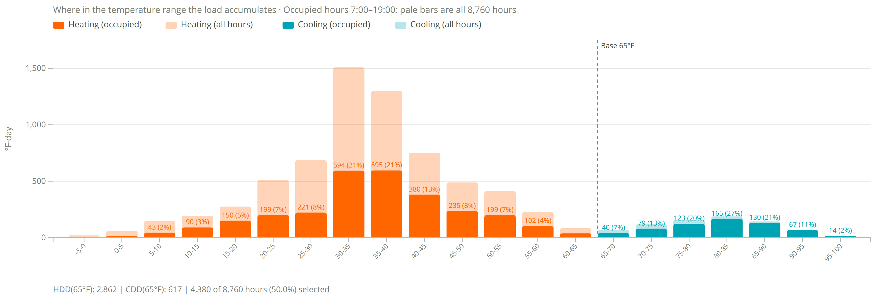
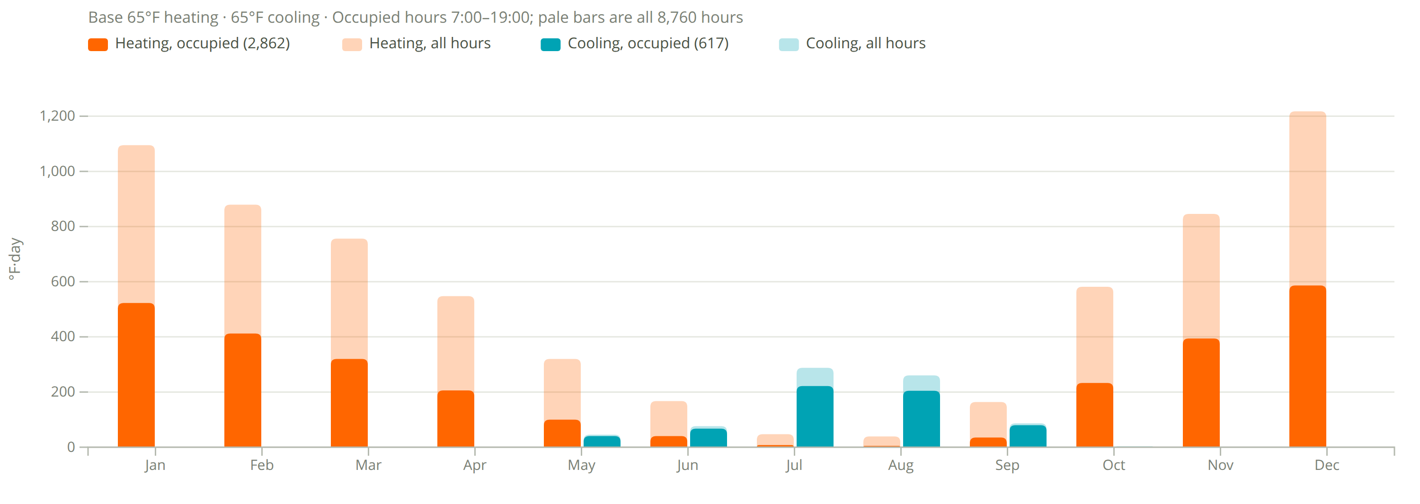
Degree Days
Spokane Intl AP
2,862
heating degree days (°F·day, occupied)
6,661 all hours
617
cooling degree days (°F·day, occupied)
761 all hours
Assumptions
Base 65°F heating and cooling.
Occupied 7:00–19:00, 4,380 of 8,760 h (50%).
Filter shows 7am to 7pm occupied hours and transparent is all data

