Slide 1
Climate Analysis
Weather File Review
Craters of the Moon Natl Monument

Slide 2
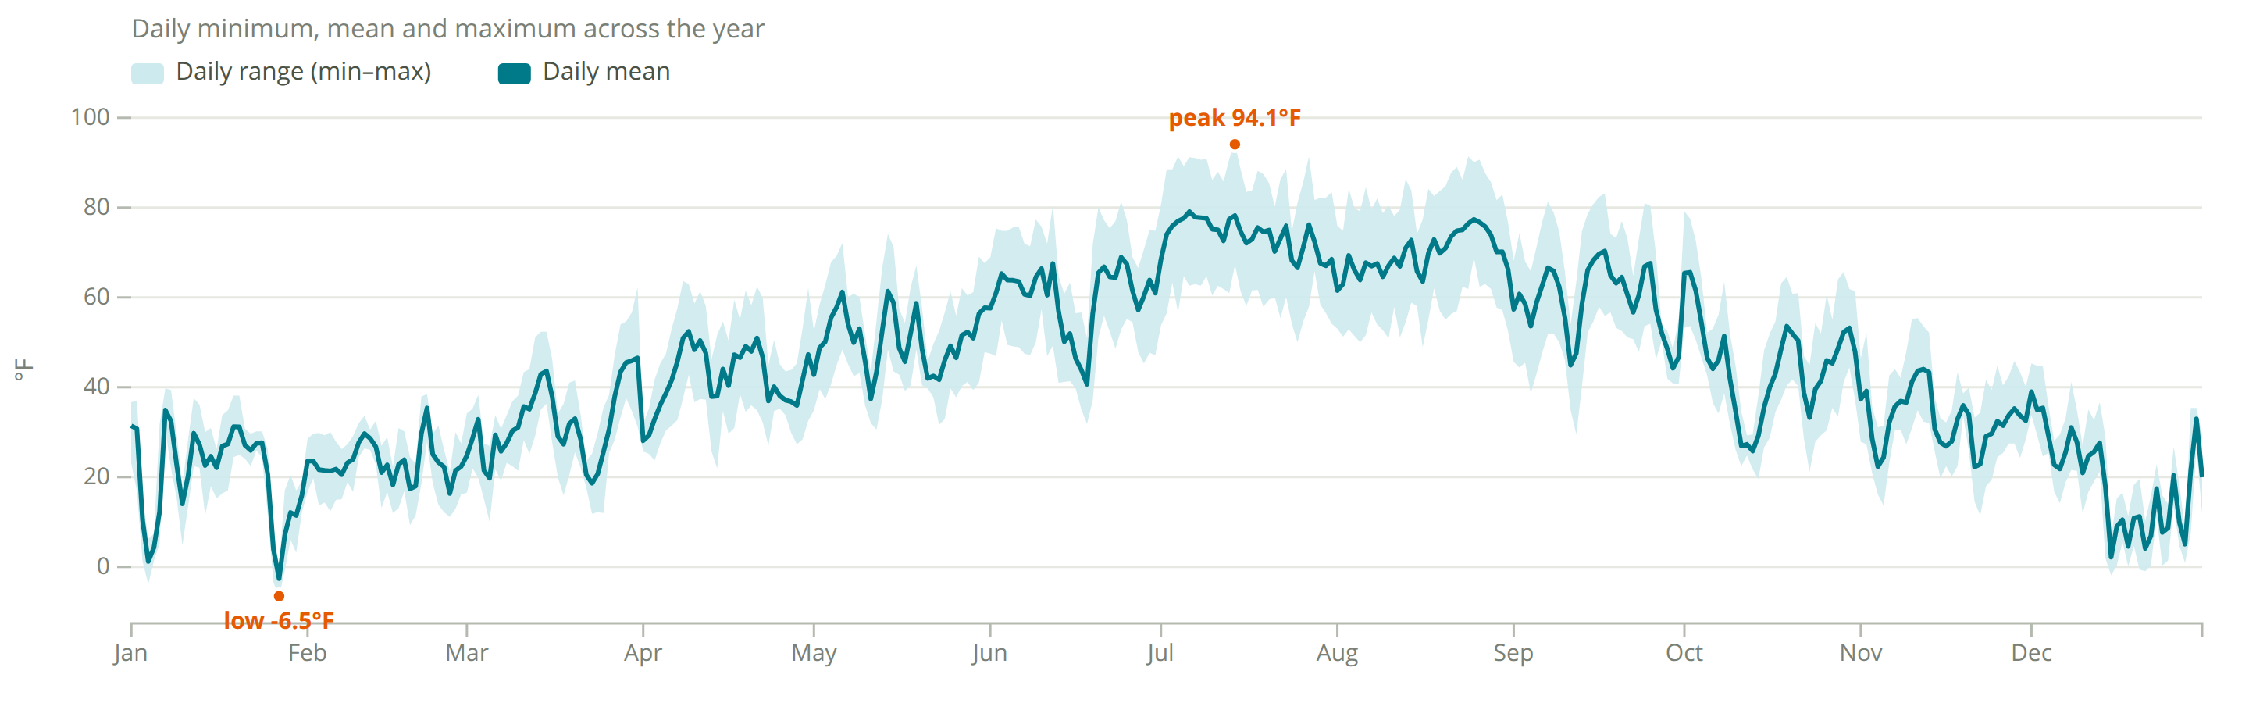
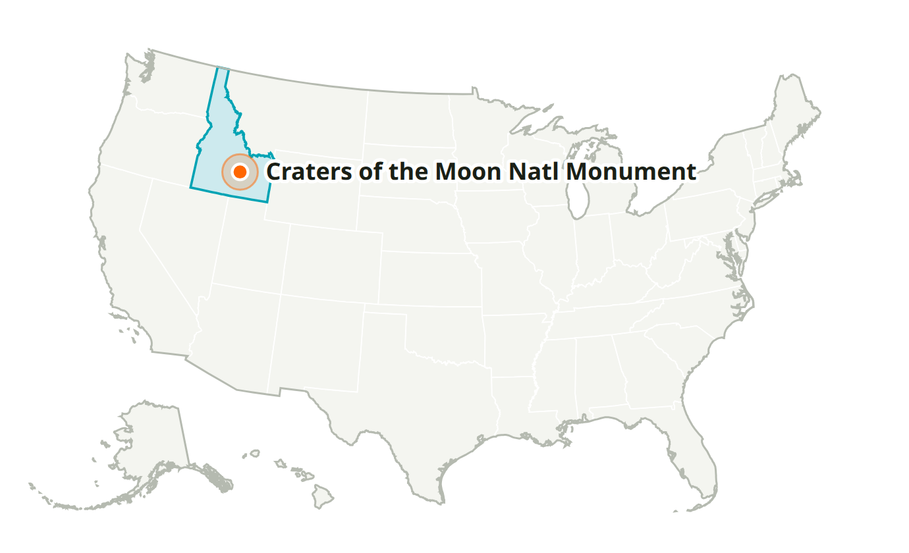
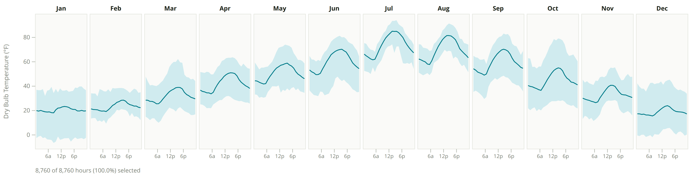
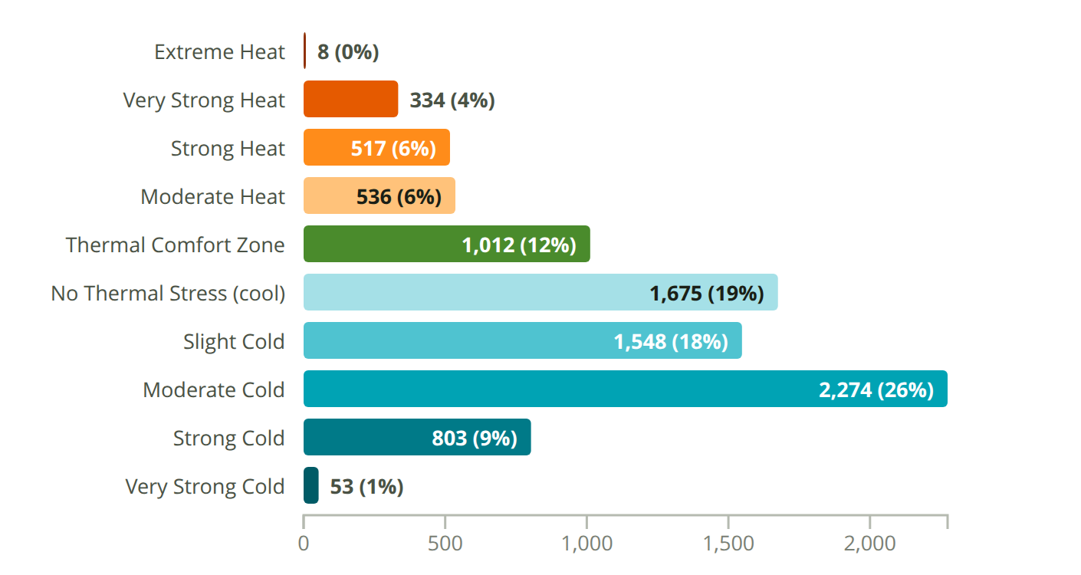
Craters of the Moon Natl Monument
ID, USA · Custom-725790 · WMO 725790
Latitude: 43.417° N
Longitude: 113.516° W
Elevation: 5,920 ft
Time zone: UTC-7
State: Idaho
ASHRAE 6A
Köppen Dfb — Cold - Humid
Humid Continental (Warm Summer/Cool Summer)

Slide 3
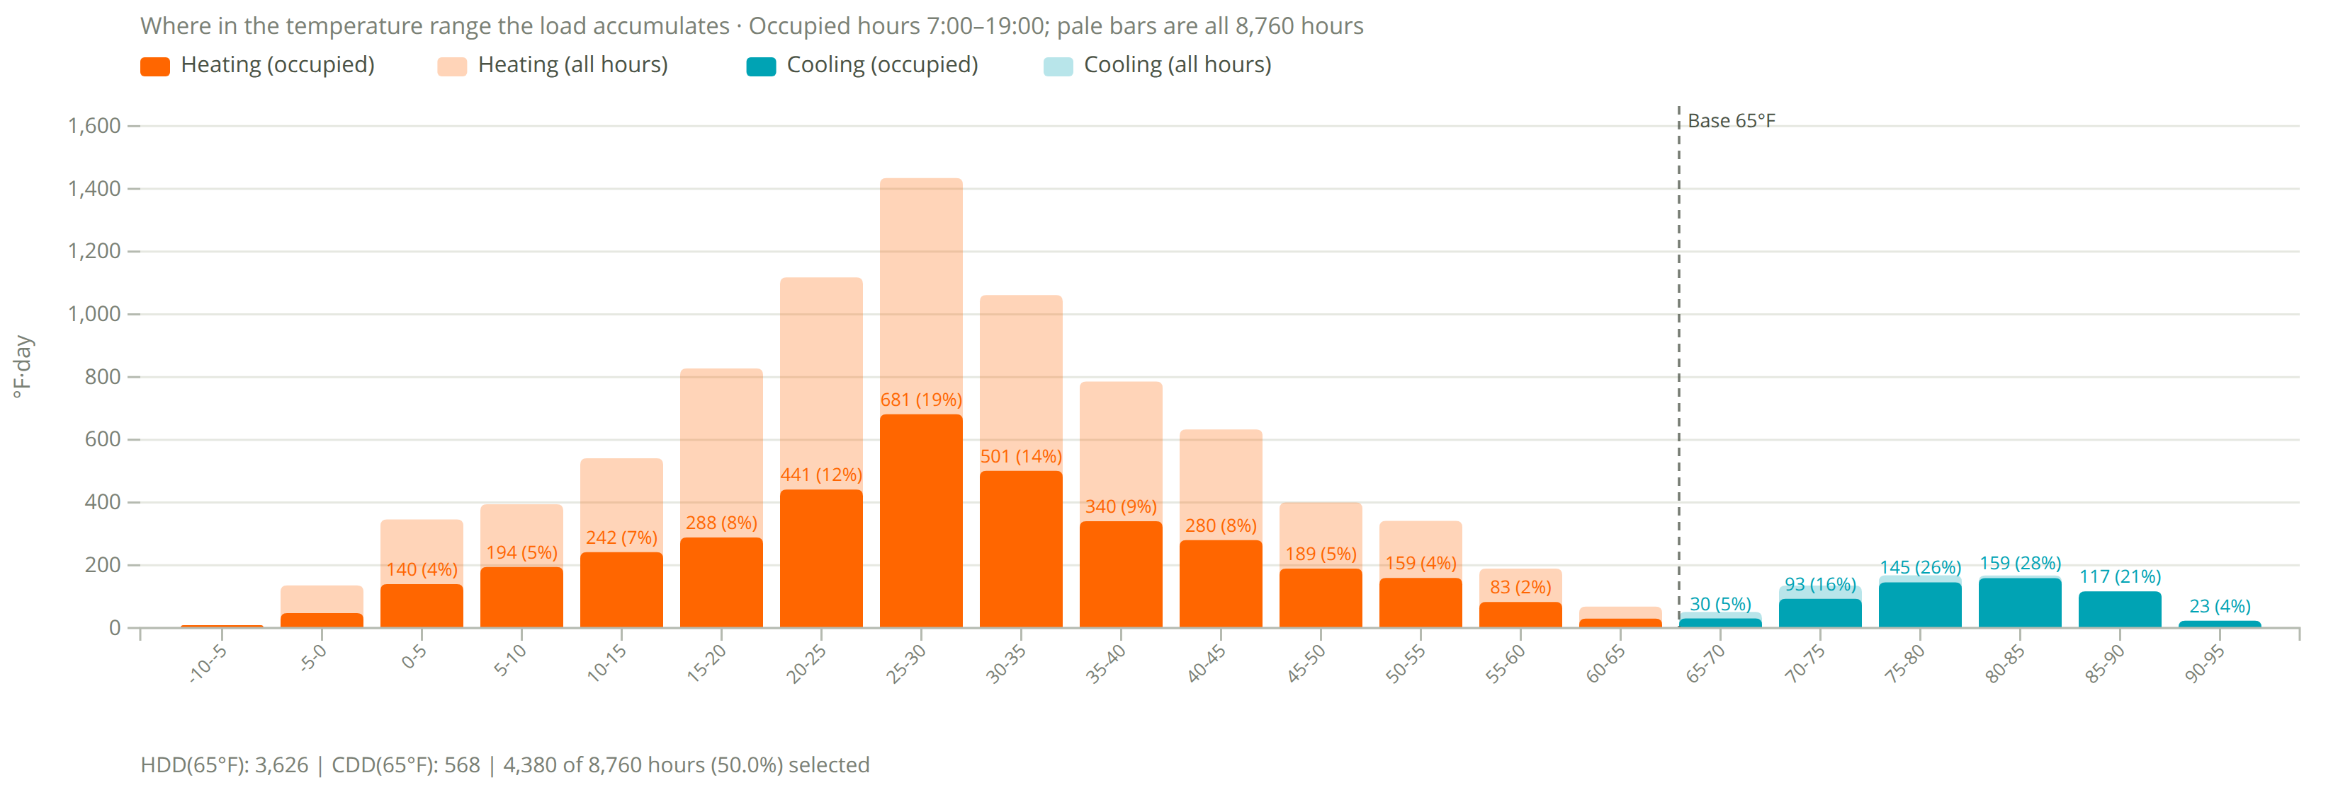
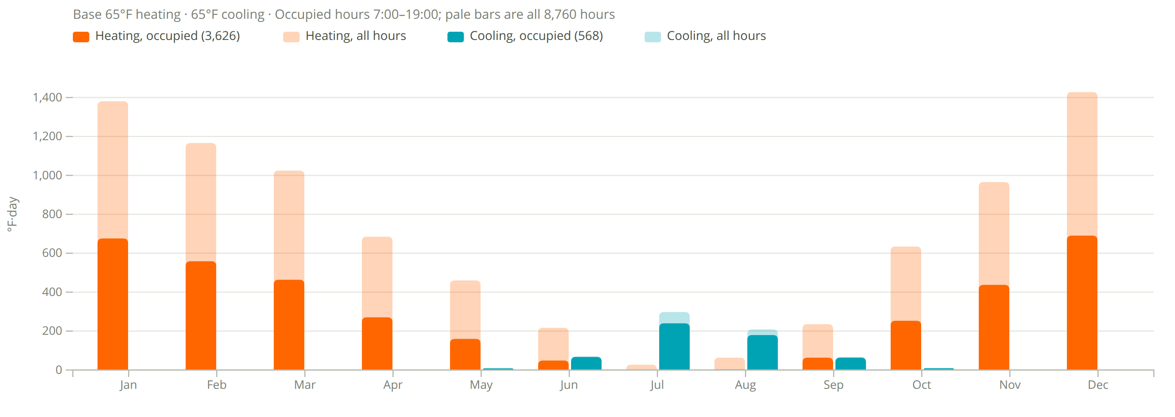
Degree Days
Craters of the Moon Natl Monument
3,626
heating degree days (°F·day, occupied)
8,287 all hours
568
cooling degree days (°F·day, occupied)
661 all hours
Assumptions
Base 65°F heating and cooling.
Occupied 7:00–19:00, 4,380 of 8,760 h (50%).
Filter shows 7am to 7pm occupied hours and transparent is all data

