Slide 1


Local Impact Workshop
Saturday 3:00 PM · IBM · Google · Baz
Notes:
LOCAL IMPACT SPONSOR WORKSHOP (Jenna), Saturday 3:00 PM
Run time: about 35 to 45 minutes, including hands-on time.
Welcome everyone. I'm Jenna Ritten: founding executive director of Compass Detroit, co-lead of GDG Detroit, and I lead developer advocacy for IBM's InnerSource ecosystem.
Goal of this session: by the time you leave, every person in this room has
1. A clear Local Impact problem and a person you're building for
2. An IBM account, a team on the IBM platform, and a plan for which IBM tools to use
3. Google Cloud credits claimed (they expire when the event ends)
4. A team repo in the A2Tech360 GitHub org with Baz reviewing your pull requests
5. A clear picture of how to submit and how you'll be judged
Laptops open. We'll do the setup steps together.
Everything in this deck lives in the starter kit: https://github.com/A2Tech360/a2tech360-hackathon

Slide 2

Today’s workshop
01
02
03
04
05
06
Compass Detroit
The Local Impact track
IBM: register, team, learn
Google Cloud credits
GitHub + Baz code review
What to submit
Notes:
AGENDA (30 seconds)
1. Who Compass Detroit is (2 min)
2. The Local Impact track and how judging works (8 min)
3. IBM: register, form your team, pick your tools, and where to learn (10 min, hands-on)
4. Google Cloud credits (5 min, hands-on; do this now, they expire after the event)
5. GitHub setup and Baz AI code review (5 min, hands-on)
6. How to submit and win (3 min)
Then Q&A and I'll walk the room.

Slide 3


Who we are
Compass Detroit unites Michigan’s STEAM communities.
A 501(c)(3) coalition since 2018 · Innovation Summits · Michigan DevFest + AI Hackathon · Hack Michigan · Scholarships
Join us: bit.ly/compass2026 · whatupdoe@compass-detroit.com
Notes:
COMPASS DETROIT (2 minutes)
Compass Detroit is a 501(c)(3) nonprofit I founded in 2018. We're a coalition that unites the professional and community organizations serving underrepresented communities in STEAM across Michigan.
What we do:
- Annual Innovation Summits for Black History Month, International Women's Day, Pride, and Latin Heritage Month
- Michigan DevFest + AI Hackathon and Hack Michigan, produced with GDG Detroit
- Scholarships that send community members to AfroTech, the NSBE Annual Convention, and STEM So(ul)cial
Why we sponsor the Local Impact track: the best technology in this region gets built when the people who have the problem are in the room. That's the whole idea of this track.
Get involved:
- Membership: https://bit.ly/compass2026
- Website: https://bit.ly/compass-detroit
- Run a community org? whatupdoe@compass-detroit.com

Slide 4


01
The Local Impact track
Notes:
SECTION 01: THE LOCAL IMPACT TRACK
The magnifying glass is the point of this section: before you write code, go find the real problem and the real person who has it.

Slide 5
Local Impact Track
Build something that makes life measurably better for people in Ann Arbor and Washtenaw County.
The one rule: talk to someone who has the problem. Judges will ask who you built it for, and “everyone” is the wrong answer.
Getting around: transit, parking, biking, the last mile
Main Street: help local businesses reach passersby
Showing up: connect volunteers, mentors, donors
Access: food, housing, benefits, childcare
Civic clarity: make local data and decisions legible
Belonging: help people find each other
Worksheet: tracks/local-impact.md
Notes:
LOCAL IMPACT TRACK BRIEF (4 minutes)
"Build something that makes life measurably better for people in Ann Arbor and Washtenaw County."
a2Tech360 spends ten days celebrating what this region invents. This is the part where we invent something.
Every problem worth solving here already belongs to somebody: riders waiting on a route that doesn't quite work, small businesses competing against everything online, nonprofits doing serious work on thin budgets, and students, newcomers, parents, makers, and longtime residents who could help each other if they knew how.
The only requirement: a specific person in this county could use what you build on Monday morning.
Directions, not a menu:
- Getting around: transit, parking, biking, and the last mile
- Main Street: helping local businesses reach the people already walking past them
- Showing up: connecting volunteers, mentors, and donors to the organizations that need them
- Access: food, housing, benefits, childcare, and the gap between a service existing and someone finding it
- Civic clarity: making local data, meetings, permits, and decisions legible to normal humans
- Belonging: helping people find each other and find what's happening
The one rule: ground it in something real. Talk to someone who has the problem. Judges will ask who you built this for, and "everyone" is the wrong answer.
Build requirements: Jaseci/Jac stack (at least 40% Jac), plus Google, IBM, or Baz tooling alongside it. Local Impact projects use Baz for code review.
ACTIVITY (3 minutes): open tracks/local-impact.md in the starter kit and fill in the first three lines of the problem-discovery worksheet: Who, What we heard, The problem in their words. Mentors will come around.

Slide 6
How you’ll be judged
IBM platform rubric: 25 points
Five criteria, 5 points each. Your score is the average of the judges’ scores.
Local Impact Grand Prize: local relevance, technical execution, and a path to exist after the weekend
Community Favorite: the room votes
Criterion | Pts | Ask yourself
Completeness | 5 | Is the proof of concept complete, with IBM tech clearly applied?
Creativity | 5 | Is the approach original and differentiated?
Design + usability | 5 | Could real users adopt it quickly?
Effectiveness | 5 | Does it solve a real priority, measurably?
Michigan impact | 5 | Does it keep value, jobs, and opportunity here?
Total | 25 | Average of judges’ scores
Notes:
JUDGING (3 minutes)
The IBM hackathon platform scores each submission on five criteria, 5 points each, 25 total. Final score is the average of the judges' scores.
1. Completeness and feasibility: How feasible is the solution? How fully planned? How complete is the proof of concept? How clear is the application of IBM technology?
2. Creativity and innovation: How unique and original is the approach to applying AI? Is it differentiated?
3. Design and usability: How good is the UX? How quickly could real users adopt it?
4. Effectiveness and efficiency: Does it address a high-priority issue within the theme? Measurable impact? Can it scale?
5. Michigan impact: keeping value, jobs, and opportunity in Michigan. Show a practical application solving a real Michigan challenge, clear business value, a working proof of concept, and strong storytelling that positions Michigan as a technology innovator.
Notice how well the Michigan impact criterion lines up with the Local Impact track. Build for a real person here and you score on both.
JacHacks judges on Devpost also look at: technical execution, use of Jac and Jaseci (by llm(), walkers, graph modeling), creativity, the presentation and demo, impact, and depth of agentic behavior.
Presentations are 5 minutes: 3 to 4 minutes presenting and 1 to 2 minutes of video demo.
Local Impact Grand Prize: the team whose project best combines local relevance, technical execution, and a plausible path to existing after the weekend.
Community Favorite: every participant votes.

Slide 7

02
IBM: register, team, learn
Notes:
SECTION 02: IBM (10 minutes, hands-on)
Four steps: register with IBMid, form your team on the IBM platform, pick your IBM tools, and use the Education tab to learn fast.

Slide 8

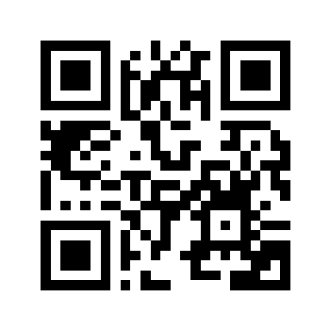
Step 1: Register with IBMid
ibm.biz/a2tech360 is your home for IBM cloud accounts, education, and teams.
1. Register or sign in with IBMid (university or company email).
2. Explore Details, My Team, Education, and Schedule.
3. When hacking opens, follow “Complete the hackathon” to get your team’s IBM Cloud account.
ibm.biz/a2tech360
Scan to register
Notes:
STEP 1: REGISTER WITH IBMid (hands-on, 3 minutes)
Scan the QR code or go to https://ibm.biz/a2tech360
1. Click "Register or sign in with IBMid." Use your existing IBMid tied to your university or company email, or create a new one.
2. Once registered, you'll see the hackathon site with tabs: Details, My Team, Education, Team building instructions, Schedule, and Reports.
3. When the hackathon is open, look for the "Complete the hackathon" page. It has step-by-step instructions for setting up the accounts you'll use, what to create, and how to submit on the IBM platform.
4. Your team gets a pre-configured IBM Cloud account. Every teammate receives a "Join now" email from IBM Cloud: accept the account notice, click Join Account, then Continue.
Tip: if you already have a personal IBM Cloud account on the same email, switch to the hackathon account (the "watsonx" account) from the account dropdown at the top right.
Submissions are due Sunday, Sept 27 at 12:00 PM.

Slide 9

Step 2: Form your IBM team
Pick a Team Lead
The creator is Lead and manages the submission.
Invite teammates
By email, or browse Invite Members.
Accept the invite
One team per person; all must register.
Create the team
My Team → Create a Team → name it → Create Team.
Need people?
Try Find Members or Find a Team (AI Assisted).
Notes:
STEP 2: FORM YOUR TEAM ON THE IBM PLATFORM (hands-on, 3 minutes)
Everyone on your team must be registered at ibm.biz/a2tech360. Each person can be on only one team and submit one project.
Team Lead (whoever creates the team is automatically the Lead, and manages the submission):
1. Go to My Team > Create a Team.
2. Enter a team name (4 to 64 characters). Optional: upload a team image you have permission to use, and add an "About your team" description.
3. Click Create Team.
Invite teammates, two ways:
- Know their email? My Team > Team Members > enter it in "Specify email" > Invite.
- Browse: My Team > Invite Members > search or filter > Invite.
Invitees get an email and an on-site notification. Once they accept, they're on the team.
Need teammates or a team?
- Find Members (AI Assisted): describe your team and needs; the AI suggests matches you can invite.
- Find a Team (AI Assisted): describe yourself and your interests; request to join.
- Join a Team: pick a team, click the plus icon on an open spot, send a short message to the Team Lead.
Leave a team any time with the red "Leave team" link.
Team size: 1 to 5 people. Solo is fine.
Plan to communicate with your team outside the IBM site (Discord works).

Slide 10
Step 3: Your IBM toolkit
Tool | What it does | Where to find it
IBM Bob | AI coding assistant (40 Bobcoins trial) | bob.ibm.com/trial
watsonx.ai + Granite | Prompt Lab and API for foundation models | dataplatform.cloud.ibm.com
watsonx Orchestrate | Build and deploy AI agents | Resource list → AI / ML
Cloudant | JSON database for app data | Resource list → Databases
Code Engine | Serverless deploys for your app | Resource list → Code Engine
Your credits | $100 per team account | Alerts at 25%, 50%, 80%
Notes:
STEP 3: YOUR IBM TOOLKIT (3 minutes)
None of these are required individually. Use what serves your project, and say how you used it in your submission; that's how you score on "clear application of IBM technology."
- IBM Bob: IBM's AI productivity assistant and the featured tool. Free trial at https://bob.ibm.com/trial?utm_source=hack-michigan. 40 Bobcoins for 30 days. Coordinate who on your team is signed in so you don't double-spend. Track usage at https://bob.ibm.com/admin/
- watsonx.ai + IBM Granite: Prompt Lab and API/SDK access. https://dataplatform.cloud.ibm.com/wx/home?context=wx, region Dallas. For code access: Developer access > project "watsonx Challenge Sandbox" > project ID, endpoint URL, and Create API key.
- watsonx Orchestrate: build and deploy agents and agentic workflows, no-code or with the ADK. IBM Cloud > Navigation menu > Resource list > AI / Machine Learning > watsonx-Hackathon Orchestrate.
- Cloudant: managed JSON document database (Lite plan). Resource list > Databases.
- Code Engine: serverless containers; builds from source. Resource list > watsonx-Hackathon Code Engine.
- Open source: Granite models on Hugging Face or Ollama, and the BeeAI agent framework, no cloud account needed.
Credits: each provisioned account gets $100 for watsonx.ai and Code Engine. Email alerts at 25%, 50%, and 80%. At 100% the account is deactivated within an hour. Accounts are deactivated after the hackathon, so export your projects.
Data rules: bring your own data. No personal information, client data, confidential data, or social media data. Keep a list of public sources.
Full guide: docs/ibm-setup.md in the starter kit.

Slide 11
Step 4: Learn fast on the Education tab
Meet IBM Bob
watsonx.ai + agents
watsonx Orchestrate
Meet Bob (9 min) and Build with Bob tech talk (21 min)
Bob courses on IBM SkillsBuild
watsonx.ai overview (6 min) and Prompt Lab (3 min)
Lab: ReAct agent with IBM Granite (30 min)
Get to know Orchestrate (6 min) and multi-agent guide (7 min)
ADK guide for Python agents (optional)
ibm.biz/a2tech360 → Education tab
Notes:
STEP 4: LEARN FAST (2 minutes)
On ibm.biz/a2tech360, open the Education tab.
Meet IBM Bob
- "Meet Bob: An AI-Powered IDE for Modern Software Development" (video, about 9 minutes)
- "Tech Talk and Demo: Build with Bob" (video, about 21 minutes)
- IBM SkillsBuild: https://skillsbuild.org/adult-learners and Bob courses at https://skillsbuild.org/learning-catalog?q=Bob&topic=ai
Meet IBM watsonx.ai
- Overview of watsonx.ai (about 6 minutes)
- Overview of watsonx.ai Prompt Lab (about 3 minutes)
- Lab: Implement a ReAct Design Pattern with IBM Granite (guided project, about 30 minutes). Great fit for the Agentic AI track too.
Meet IBM watsonx Orchestrate
- Get to know watsonx Orchestrate (article, about 6 minutes)
- Beginner's guide to multi-agent orchestration (article, about 7 minutes)
- Usher in the future of work with AI agents built for the enterprise (video, about 35 minutes)
- Guide to building agents and tools in Python with the Orchestrate ADK (article, about 1 hour; optional)
Suggestion: one teammate watches the Bob videos, one does the Prompt Lab overview, and you regroup in 20 minutes.

Slide 12


03
Google Cloud credits
Notes:
SECTION 03: GOOGLE CLOUD CREDITS (5 minutes, hands-on)
Everyone does this right now. The vouchers expire when the event ends.

Slide 13
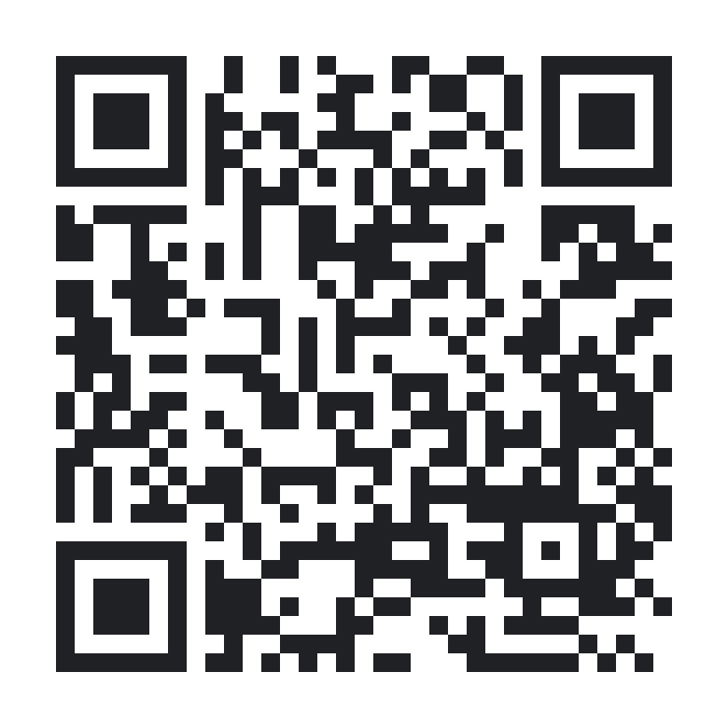
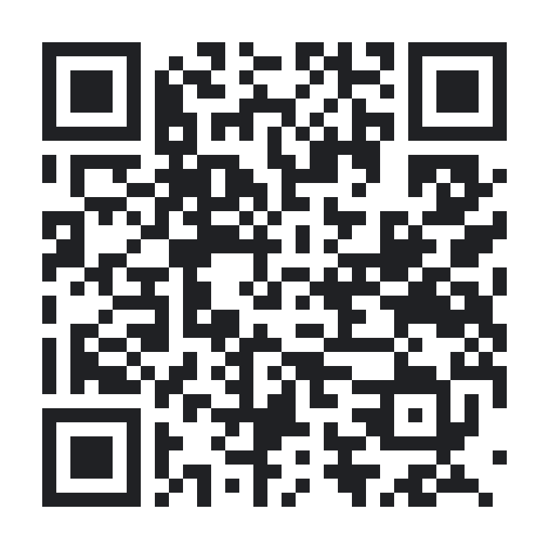
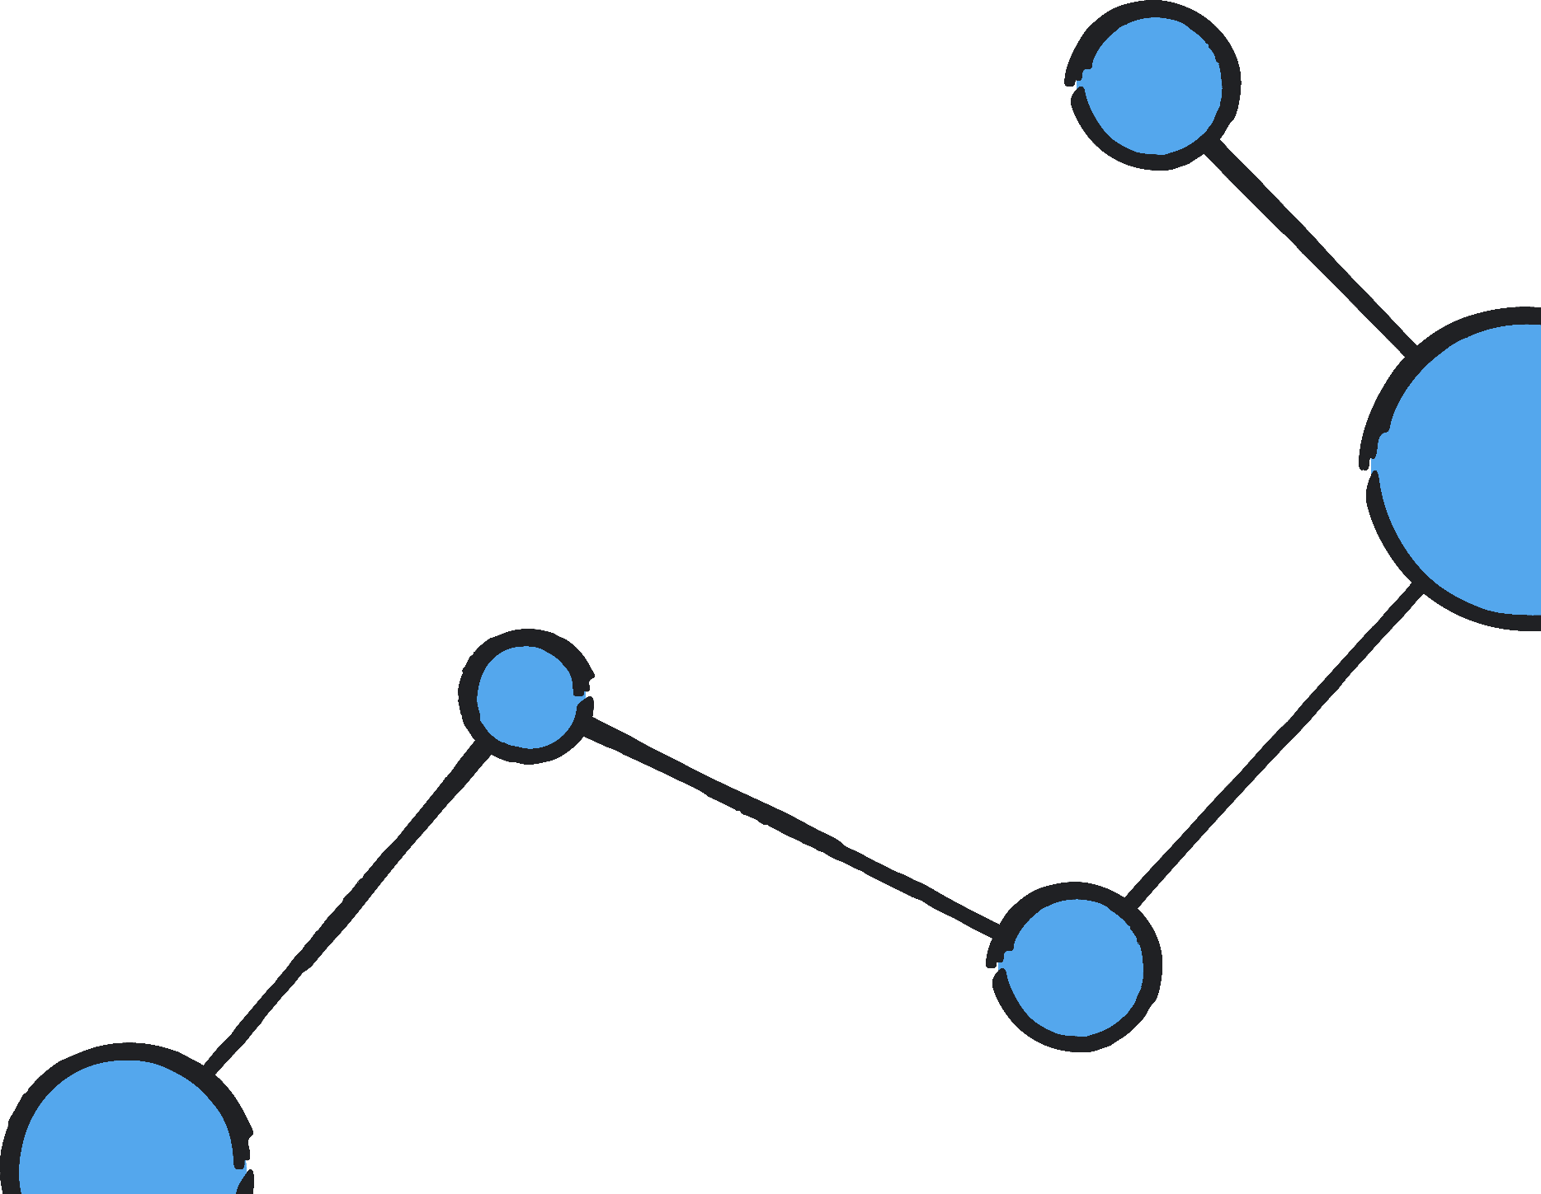
Claim $25 in Google Cloud credits
Claim them now: vouchers expire when the event ends.
1. Join the Google Group with a personal @gmail.com.
2. Open the credits link, sign in, claim your badge.
3. Verify on your phone, then wait 2–5 minutes.
4. Create a Cloud project on the credits billing account.
1. Join the group
groups.google.com/g/
a2tech360-hackathon
2. Claim credits
g.dev/credits/
a2tech360-hackathon-2
Stuck? CRED-101: use a personal Gmail. CRED-103: refresh or use mobile data.
Video walkthrough in repo
Notes:
GOOGLE CLOUD CREDITS (hands-on, 5 minutes)
Thanks to the Google Developer Groups North America team: $25 in Google Cloud credits per person, 250 vouchers. They must be claimed during the event and can't be saved for later. You need your phone for verification.
Step 1: Join the Google Group (required before you can claim)
- a2tech360-hackathon@googlegroups.com
- https://groups.google.com/g/a2tech360-hackathon
- Use a personal @gmail.com account, not school or work.
Step 2: Claim at https://g.dev/credits/a2tech360-hackathon-2
1. Scan the QR code or open the link.
2. Sign in with your personal Gmail and join the Google Developer Program.
3. Claim your badge and complete mobile verification.
4. Wait 2 to 5 minutes for the billing account to be created.
5. Open a new browser window signed in with the same Gmail.
6. Create a new Google Cloud project.
7. Confirm the project uses the credits billing account.
Troubleshooting:
- CRED-101 (Workspace account error): switch to a personal @gmail.com account.
- CRED-103 (verification issues): refresh, retry the security challenge, or switch to mobile data.
Video: https://www.youtube.com/watch?v=noshGMsPzEg
Important: these credits are NOT compatible with Google AI Studio billing. Use Gemini through Vertex AI in your Cloud project. Competing for Best of Google? Name the Google services you used in your write-up.

Slide 14

04
GitHub + Baz code review
Notes:
SECTION 04: GITHUB + BAZ (5 minutes, hands-on)
The starter kit, your team repo in the A2Tech360 org, and Baz reviewing every pull request.

Slide 15
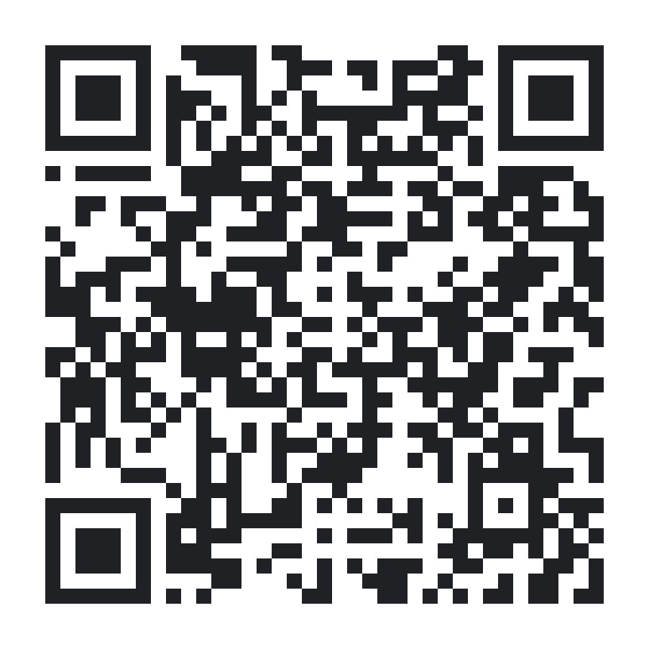
Get set up on GitHub
Use the starter kit for guides, then build in a team repo in the A2Tech360 org.
1. Open the starter kit and star it.
2. Create your team repo in the A2Tech360 org.
3. Make it public and add your teammates.
4. Open pull requests; Baz reviews them automatically.
Starter kit
github.com/A2Tech360/
a2tech360-hackathon
Also star jaseci-labs/jac
Notes:
GITHUB SETUP (hands-on, 3 minutes)
Starter kit: https://github.com/A2Tech360/a2tech360-hackathon
It has everything from this workshop: IBM, Google, and Baz guides, the Local Impact worksheet, the schedule, the submission checklist, the Official Rules and Hackathon Guide, and both slide decks.
1. Open the starter kit and star it.
2. Create your team's project repo in the A2Tech360 GitHub org (https://github.com/A2Tech360). Baz is already installed there, so it starts reviewing as soon as your repo exists.
3. Create your team's project repo inside the A2Tech360 org. It must be public for Devpost. Add teammates as collaborators.
4. Keep at least 40% of your code in Jac. Docs: https://jaclang.org
5. Commit early and often. Judges check that code was written during hacking hours.
6. Star https://github.com/jaseci-labs/jac (a Devpost requirement).
Jac and Jaseci resources from the JacHacks team (docs, Jac-GPT, Jaseci Discord, JacHammer) are in the starter/ folder of the starter kit.
Never commit API keys. Use a .env file and add it to .gitignore.
Questions: Discord #ask-an-organizer, https://discord.gg/Av2JKhVyA

Slide 16
Baz AI code review
Baz is installed on the A2Tech360 GitHub org. Every pull request gets an AI code review.
Required for Local Impact projects. Fewer demo-breaking bugs, and a clean history for judges.
1. Branch: git checkout -b feature/idea
2. Commit and push your work
3. Open a PR into main
4. Read Baz’s review, fix, push again
5. Merge small PRs often
Guide: docs/baz-code-review.md
Notes:
BAZ AI CODE REVIEW (2 minutes)
Baz is an AI code reviewer installed on the A2Tech360 GitHub org for this hackathon. Any pull request opened in an org repo gets an automatic review: likely bugs, risky changes, and suggestions, right in the PR.
Workflow:
1. Create a branch: git checkout -b feature/your-idea
2. Commit and push your work: git push -u origin feature/your-idea
3. Open a pull request into main
4. Read Baz's comments, fix what matters, push again; Baz re-reviews
5. Merge small PRs often so main is always demo-able
Why it matters: fewer demo-breaking bugs at 11:59 AM Sunday, a clean commit and PR history (judges verify code was written during hacking hours), and better code quality counts toward technical execution.
Baz is part of the Local Impact track's build requirements and available to every team.
Guide: docs/baz-code-review.md. Baz docs: https://docs.baz.co

Slide 17
What to submit
Local Impact teams submit at ibm.biz/a2tech360
1. Written problem and solution statements
2. How you used IBM and/or Google technologies
3. GitHub repo URL (A2Tech360 org preferred)
4. URL to a 1-minute recorded demo video
Everyone also submits on Devpost
5-minute presentations
3–4 min presentation
1–2 min video demo
Notes:
WHAT TO SUBMIT (3 minutes)
Local Impact teams submit four things on the IBM hackathon platform:
1. Written problem and solution statements. Who has the problem, what it is in their words, and what you built.
2. A statement of how you used IBM and/or Google technologies. Be specific: which tool, and what it does in your app (for example, "Granite on watsonx.ai summarizes city council minutes" or "Gemini on Vertex AI classifies requests").
3. The URL to your GitHub repo, preferably in the A2Tech360 GitHub org we provided (that's where Baz reviews your pull requests).
4. The URL to a 1-minute video of your recorded demo. Record it before Sunday morning so a flaky demo can't sink you.
The Team Lead submits these on the IBM platform: ibm.biz/a2tech360, "Complete the hackathon" page.
Presentations are 5 minutes:
- 3 to 4 minutes presenting: the person you built for, the problem, your solution, how IBM and/or Google power it, and why it matters for Michigan
- 1 to 2 minutes of video demo
At least one teammate must be present to present.
ALL participants, whatever track, also submit on Devpost: https://jachacks-a2tech.devpost.com/
- 9:00 AM Sunday: partial submission checkpoint (a draft is required to be judged)
- 12:00 PM Sunday: final submissions, hard deadline
- Devpost also asks for at least 40% Jac code, a JacHammer link, and a starred Jac repo (github.com/jaseci-labs/jac)
Local Impact teams: the same written statements, repo URL, and video URL work for both. Submit both by Sunday noon.
Presentation tips: lead with the person you built for, keep the video demo tight, say exactly which IBM and Google tools do what, and end with how it keeps value in Michigan.

Slide 18

Michigan DevFest
+ AI Hackathon
bit.ly/midevfest26
Nov 13–14 · Little Caesars HQ, Detroit
Code A2Tech360
Super early bird pricing · ends Sunday night
midevfest.com · Student tickets available
Notes:
MICHIGAN DEVFEST + AI HACKATHON 2026 (1 minute)
If this weekend lights you up, keep going. Michigan DevFest + AI Hackathon 2026 is November 13 and 14 at Little Caesars HQ in Detroit: Michigan's largest independent developer conference, produced by Compass Detroit with GDG Detroit.
- Friday: AI Hackathon
- Saturday: DevFest sessions on AI/ML, cloud, web, mobile, design, security, career growth, and more
Exclusive for this hackathon: super early bird pricing with code A2Tech360. It ends Sunday night, so grab it this weekend. Student tickets available.
Discount link (code applied): https://gdg.community.dev/events/details/google-gdg-detroit-presents-michigan-devfest-ai-hackathon-2026/?code=A2Tech360
Website: https://midevfest.com
Tickets: https://bit.ly/midevfest26

Slide 19
Questions? Let’s build.
Discord #ask-an-organizer · github.com/A2Tech360/a2tech360-hackathon
Notes:
Q&A AND WRAP (remaining time)
Recap of what everyone should have done:
1. A Local Impact problem and a real person you're building for
2. Registered at ibm.biz/a2tech360 and on a team
3. Google Cloud credits claimed
4. Team repo in the A2Tech360 org, with Baz reviewing PRs
Help all weekend:
- Discord #ask-an-organizer: https://discord.gg/Av2JKhVyA
- Starter kit: https://github.com/A2Tech360/a2tech360-hackathon
- Mentor check-in 5:00 PM today; final office hours 10:00 AM Sunday
I'll walk the room now. Flag me down.

