Slide 1


Local Impact Track
Build something a real person in Ann Arbor or Washtenaw County can use on Monday.
Sponsor workshop: 3:00 PM today
Notes:
LOCAL IMPACT TRACK (about 30 seconds)
The Local Impact track, sponsored by Compass Detroit: build something that makes life measurably better for people in Ann Arbor and Washtenaw County. The only requirement is that a specific person in this county could use what you build on Monday morning.
The one rule: talk to someone who has the problem. Judges will ask who you built it for, and "everyone" is the wrong answer.
Prizes: Local Impact Grand Prize, plus a Community Favorite that every participant votes on.
Everyone submits on Devpost. Local Impact teams also submit on the IBM hackathon platform (ibm.biz/a2tech360): written problem and solution statements, how you used IBM and/or Google technologies, your GitHub repo URL (preferably in the A2Tech360 GitHub org), and a URL to a 1-minute recorded demo video. Presentations are 5 minutes: 3 to 4 minutes presenting plus 1 to 2 minutes of video demo.
Jenna Ritten from Compass Detroit is leading the Local Impact sponsor workshop at 3:00 PM today with IBM, Google, and Baz. It covers the track, IBM setup and education, Google Cloud credits, and GitHub with Baz code review. Everyone is welcome, whatever track you pick.

Slide 2
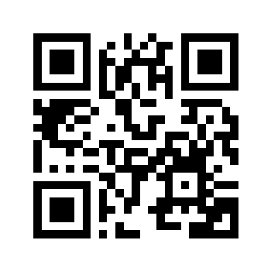
Register with IBM
ibm.biz/a2tech360
IBM Cloud, Bob, watsonx, education, and teams
ibm.biz/a2tech360
Notes:
REGISTER WITH IBM (about 30 seconds)
Scan the code or go to ibm.biz/a2tech360. Sign in with an IBMid using your university or company email.
That's where you get your team's IBM Cloud account with watsonx and IBM Bob, IBM's education and labs, and where you form your team. Do it now; it takes two minutes.
The Official Rules and the Hackathon Guide are in the starter kit.
More detail at the Local Impact sponsor workshop at 3:00 PM.

Slide 3
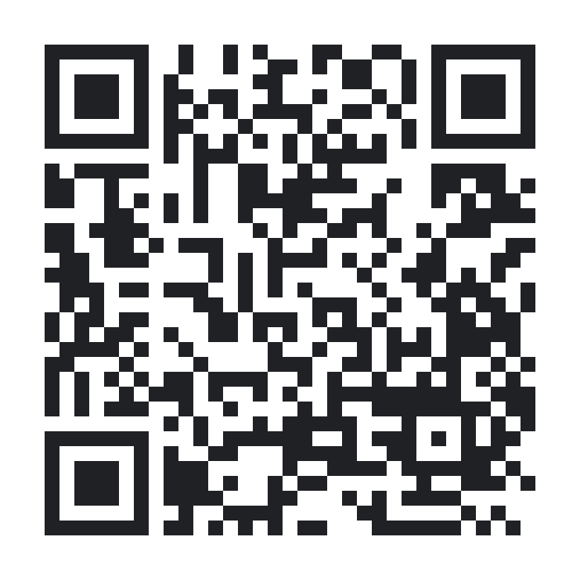
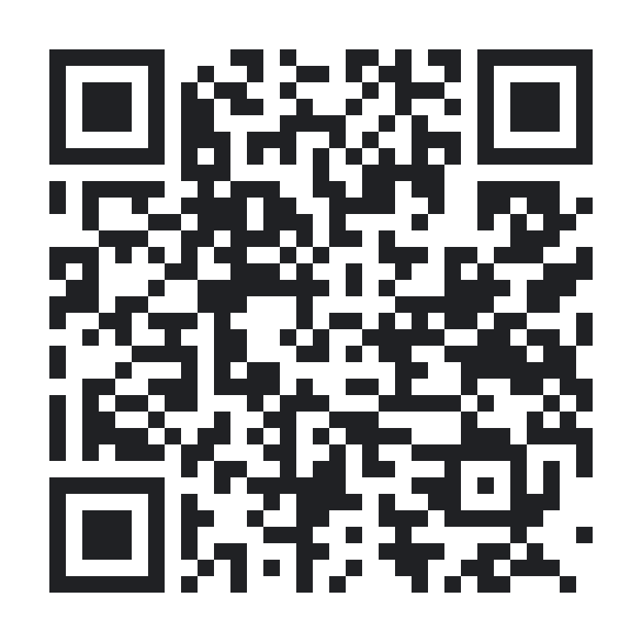
Google Cloud credits
$25 each. Claim today: they expire after the event.
Use a personal @gmail.com
1. Join the group
groups.google.com/g/
a2tech360-hackathon
2. Claim credits
g.dev/credits/
a2tech360-hackathon-2
Notes:
GOOGLE CLOUD CREDITS (about 45 seconds)
Thanks to Google Developer Groups: every hacker can claim $25 in Google Cloud credits. They must be claimed during the event; they can't be saved for later.
1. Join the Google Group first: groups.google.com/g/a2tech360-hackathon (a2tech360-hackathon@googlegroups.com)
2. Then claim at g.dev/credits/a2tech360-hackathon-2
Use a personal Gmail account, not school or work, and have your phone ready for verification. Takes 10 to 15 minutes. Note: these credits don't work with AI Studio billing; use Vertex AI.

Slide 4
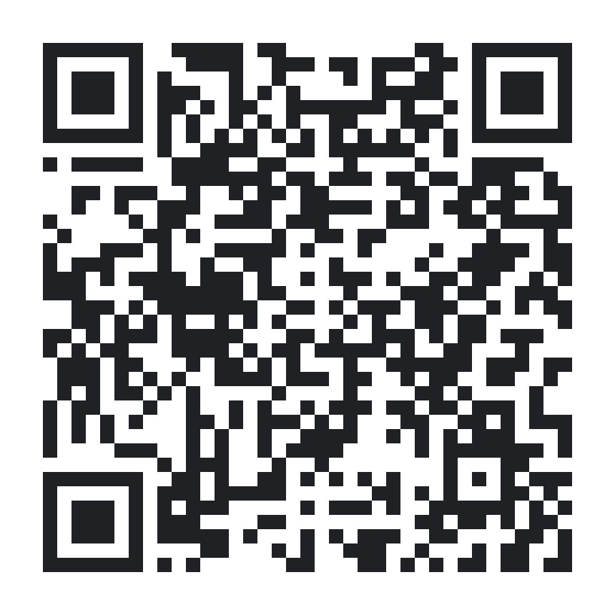
Starter kit
+ Baz
github.com/A2Tech360/a2tech360-hackathon
Schedule, setup guides, Jac resources, and checklist. Baz AI code review on every pull request in the A2Tech360 org.
github.com/A2Tech360/
a2tech360-hackathon
Notes:
STARTER KIT + BAZ (about 30 seconds)
The A2Tech360 Hackathon Starter Kit has everything you need: github.com/A2Tech360/a2tech360-hackathon. It has the schedule, IBM, Google, and Baz setup guides, Jac and Jaseci resources from the JacHacks team, the Local Impact track brief, the submission checklist, and the Discord link.
Baz, an AI code reviewer, is installed on the A2Tech360 GitHub org. Create your team repo in the A2Tech360 org and Baz reviews every pull request automatically. No setup needed.

Slide 5
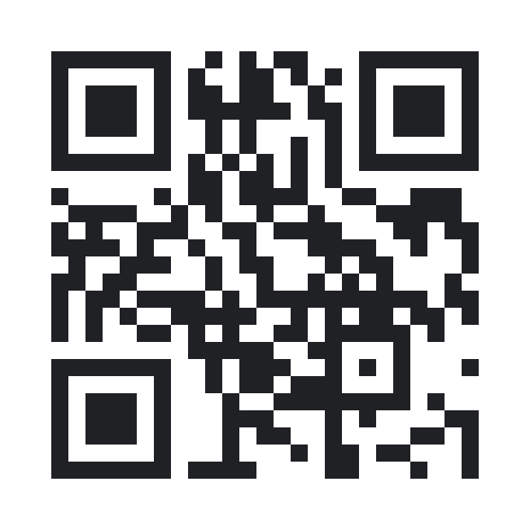
Michigan DevFest
+ AI Hackathon
Nov 13–14 · Little Caesars HQ, Detroit
Code A2Tech360
Super early bird pricing · ends Sunday night
bit.ly/midevfest26
midevfest.com · Student tickets available
Notes:
MICHIGAN DEVFEST + AI HACKATHON (about 20 seconds)
Keep building after this weekend: Michigan DevFest + AI Hackathon 2026 is November 13 and 14 at Little Caesars HQ in Detroit. AI Hackathon on Friday, DevFest sessions on Saturday.
Exclusive for JacHacks participants: super early bird pricing with code A2Tech360. It ends Sunday night. Student tickets are available.
Discount link (code applied): https://gdg.community.dev/events/details/google-gdg-detroit-presents-michigan-devfest-ai-hackathon-2026/?code=A2Tech360
Website: midevfest.com
Tickets: bit.ly/midevfest26

