Slide 1
In The name of Allah
Database Design

Slide 2
Companies
Id | ArName | EnName
Countries
Id | ArName | EnName

Slide 3
Employees
Id | Name | Picture | Telephone | Email | Rate | CompanyId | CountryId | IncludeDate

Slide 4
Tags
id | ArName | EnName
Projects
id | En + Ar Name | comoanyId | EmployeeId | TagsIds
 |  |  |  | 1, 3, 4

Slide 5
Account
id | name | picture | email | passwordHash | roleId
Roles
id | Name
1 | admin
2 | editor
3 | Arthur

Slide 6
Permissions
id | permission
1 | all
2 | post
3 | edit
4 | delete
RolePermissions
id | RoleId | permissionId
1 | 1 | 1
2 | 2 | 2, 3
3 | 3 | 2

Slide 7
Subscribers
id | name | email
Survey
id | questions | type | answer | answerOptions
1 |  | Q? |  | A, b, ….

Slide 8
FAQ
id | Question | Answer
Offers
id | offer | price | discount

Slide 9
Url’s sponsors
id | compayId | Urls | showTimes

Slide 10
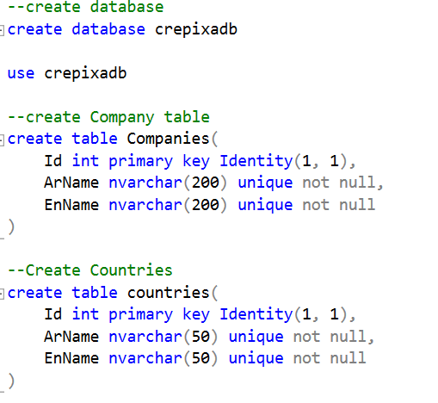

Slide 11
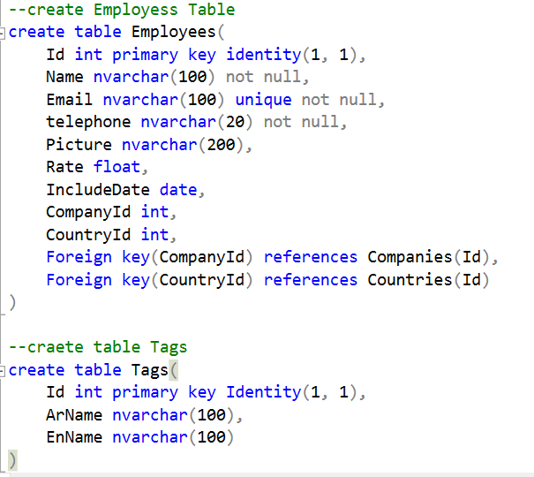

Slide 12
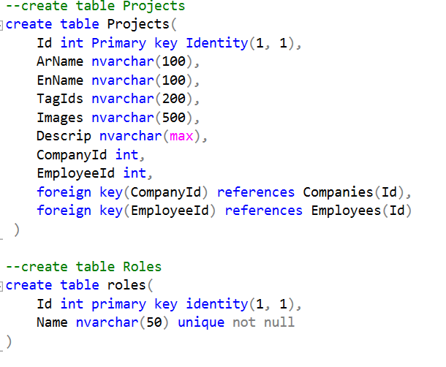

Slide 13
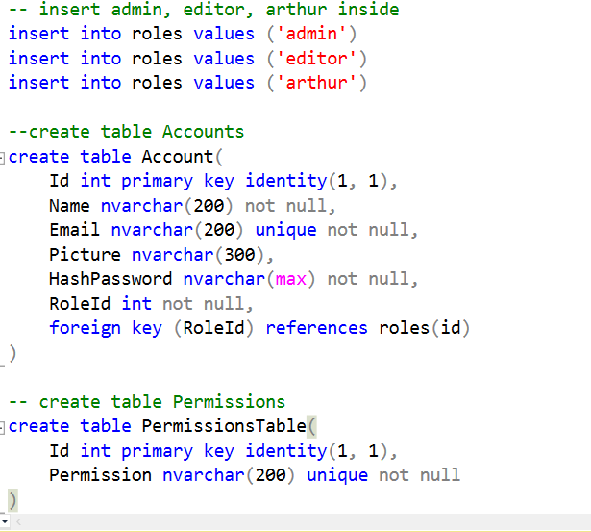

Slide 14
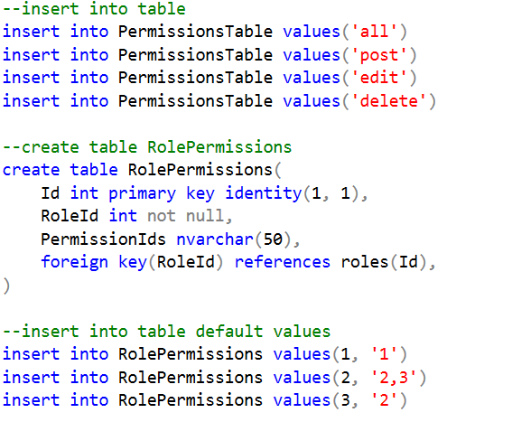

Slide 15
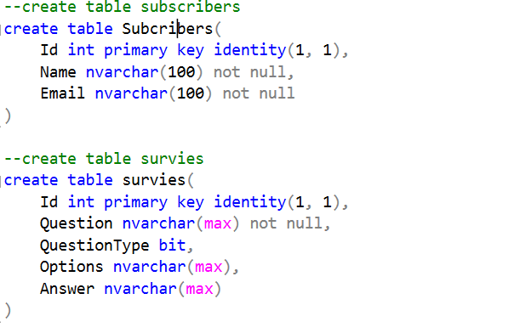

Slide 16
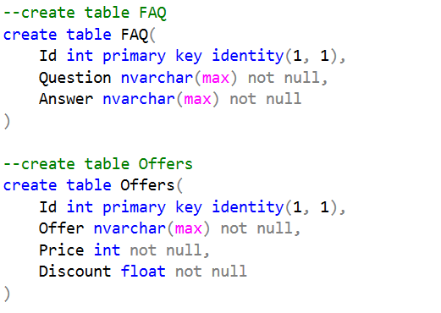

Slide 17
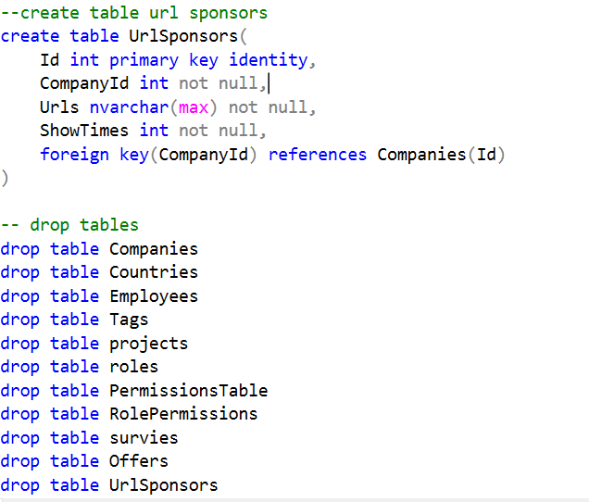

Slide 18
