Slide 1
In The name of Allah
Chat Snapshots

Slide 2
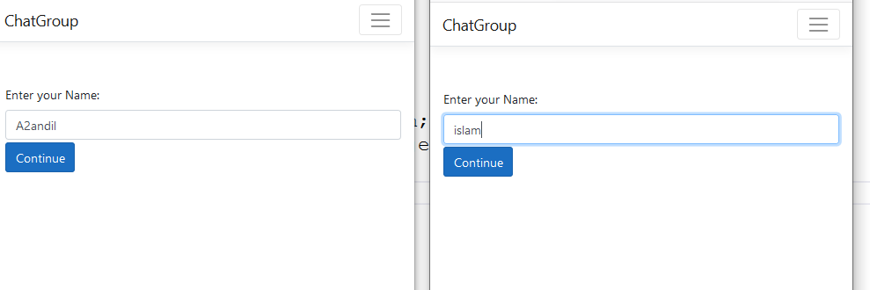

Slide 3
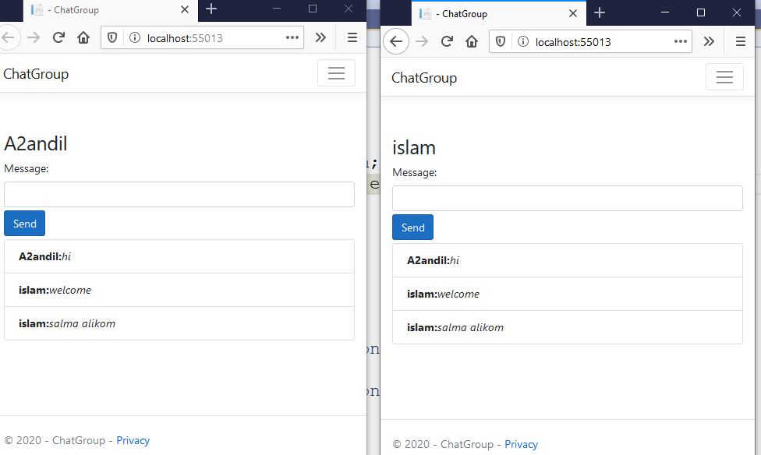

Slide 4


Slide 5
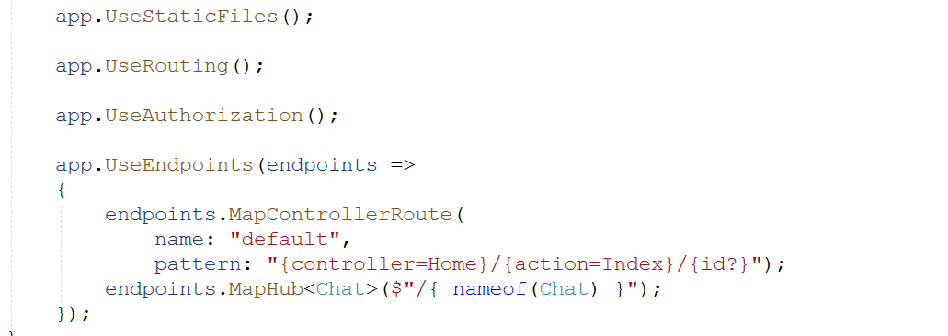

Slide 6


Slide 7
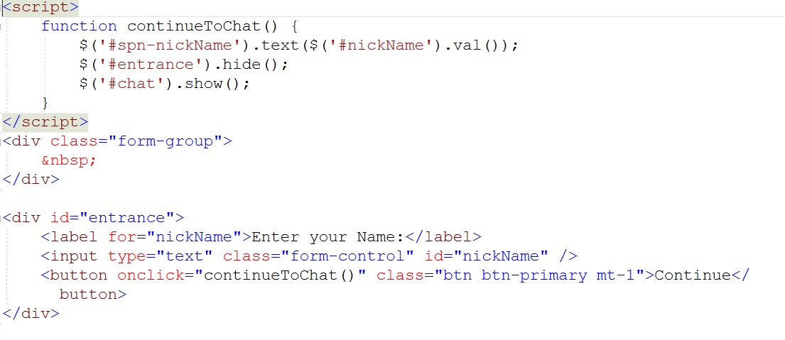

Slide 8
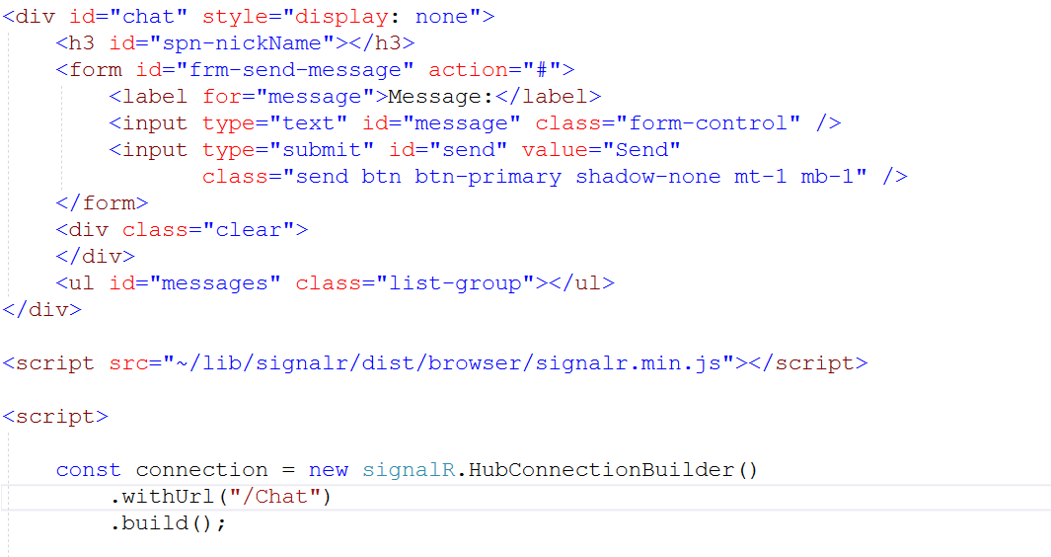
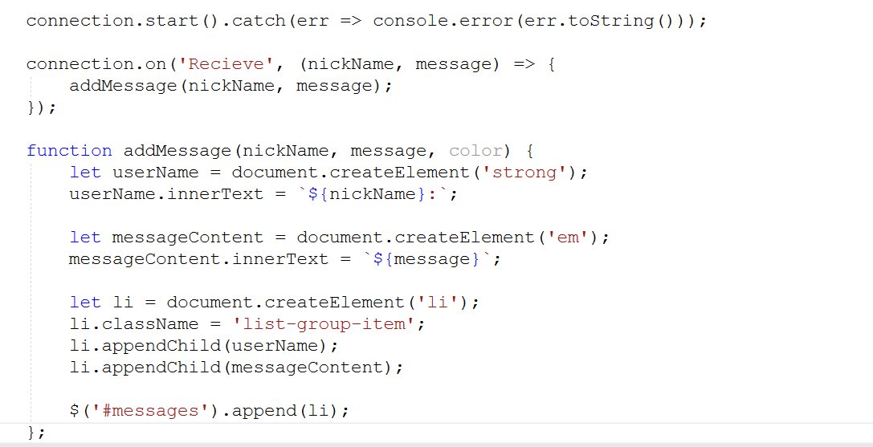

Slide 9


Slide 10
Some tips:
This is a prototype design will be changed.
Instead of insert username I will automatic from
database for any one have account.

