Slide 1
speak_native_smurfit

Slide 2
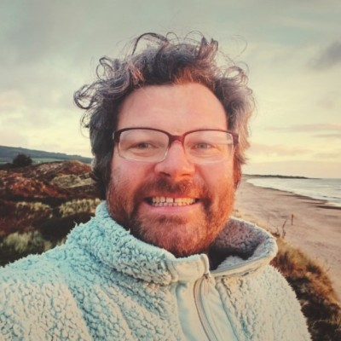
Who am I?
PhD on English spelling
English language teacher
Former Engineer of the Irish Siri voices
Travel writer
Des Wicklow#

Slide 3
Slide 2
Tell me about yourself.
Why do you want to work here.
What are your strengths.

