Slide 1
Literature Tools
Tom Kelly SYSKA 9 June 2015
Bibliometrics and Reference Management

Slide 2
Bibliometrics
Measures of Academic Literature

Slide 3
Bibliometrics
Journal metrics
Article metrics
Alternative metrics (Altmetrics)
Researcher metrics

Slide 4
Bibliometrics Usage
Funding
CV: Employment, Promotions
Publishing Strategy
Focus Literature Search
Disseminate Own Research
Journal Rank
Impact/wide audience
What colleagues read

Slide 5
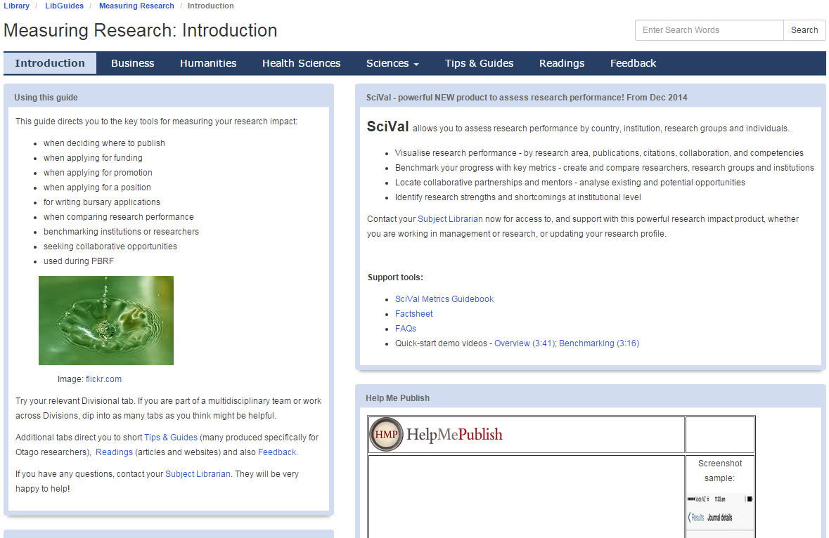
Measuring Research (Library Guide)
http://otago.libguides.com.ereserve.otago.ac.nz/c.php?g=171510&p=1131171

Slide 6
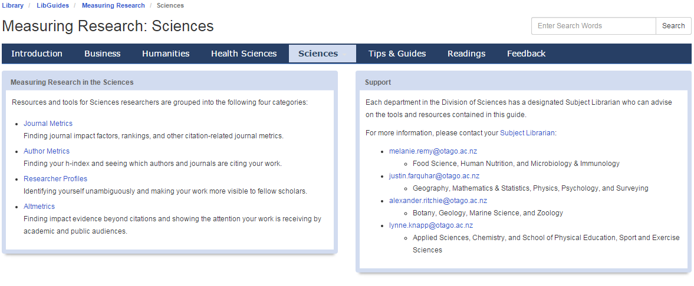
Measuring Research (Library Guide)
http://otago.libguides.com.ereserve.otago.ac.nz/c.php?g=171510&p=1131171

Slide 7
Journal Metrics
Impact Factor (Reuters, 1955)
Established measure of journal impact, dominant in academia (until recently)
Based on Web of Science: Journal Citation Reports (JCR)
Average No. Citations (over last 2 years)
Ranking/quartile (subject by IF) depends on field
http://admin-apps.webofknowledge.com.ereserve.otago.ac.nz/JCR/JCR
Scopus
Competing ‘contextual’ alternative (adjusted by field)
Based on Science Direct (bigger, more recent)
Scimago JR (SJR) Rank
IPP raw impact / publication
SNIP subject normalised impact / publication (over last 3 years)
http://www.scimagojr.com/ (Journal Rank, Compare Journals)
Measure quality of journals, find papers of general interest (e.g, Journal Club)

Slide 8





Metrics
Article metrics
Citation
Used for Journal Impact Factor
Measure of peer esteem, influence, validation
Supported by Web of Science (Reuters), Scopus (Elsevier), and Google Scholar (not reliable db)
Altmetrics
Researcher metrics
Number of publications/citations
h-index
number of papers (N) with at least N citations each
Depends on database and names published under (use one consistently)
Researcher IDs
Databases have different researcher IDs: WoS Researcher ID, Scopus Author ID, Otago MyResearch
Integrated with Open Researcher and Contributor ID (ORCID)

Slide 9
Bibliometrics - Caveats
Self-citation (journal/researcher/group)
Retraction
Journal impact is an average (most papers not cited)
Citation is not always quality or application (could be critique or controversy)
Research takes time for impact (older articles have more citations)
Highly cited papers may not be applied or well viewed in the future
Requires indexing in a database (database-specific)
Change over time

Slide 10
Bibliometrics - Caveats
Journal Ranking depends on database and field selection
Still need to think about relevance to field, e.g, is Bioinformatics a good statistics journal?
Competing companies with similar products
In practice researchers just use which metric makes them look better
Established high impact journals maintain the status quo
Open-access journals emerging
Different publishing models have different impact and ethics
Fields have different publishing culture
Co-authorship
Number of papers cited
Data or software provided

Slide 11
Alternatives: Altmetrics
Impact and quality of an article by online activity
Social media (twitter, facebook, Github, LinkedIn
Blogs
Newspapers (press coverage)
Mendeley readership: Shares, clicks, views, saves, downloads
http://www.altmetric.com (bookmarklet for Chrome/Firefox)
Promote online discussion, outreach, science communication, education, lay audience newspapers, government policy
More complete picture – does not claim to be better than existing pre-metrics
Available for use by publishers, researchers, and institutions
Publicity is not always good publicity (e.g., Wakefield paper)
Topics of general interest will get wider coverage (e.g., health/env research)
Whether we want emphasis on community value in research recognition is debatable

Slide 12
Reference Managers
Tools to Organise Literature, Automate Citation, and Referencing

Slide 13


Slide 14
Role of Reference Managers
Computerised library system to manage literature
Manage literature in assignments, article, and thesis writing
Collect and Store
Organise and Annotate
Cite and Share
Embed citations in documents
Import referencing styles for courses and journals
Generate bibliography

Slide 15
Functionality of Reference Managers
Import citations
Import/attach PDF files
Search personal library
Group/tag articles
Edit reference fields
Edit citation style
Export citation to document
Export Bibliography to document
Sync library to the web

Slide 16
Recommended Reference Systems
BibTex (Open-source)
Integrates with LaTeX
Exported by most reference managers and article websites
EndNote (Reuters)
Retail, subsidised by the university ($15 for personal computer)
Integrates with MS Word/PPT
Supported by the university: studentdesktop, library workshops, and support
Available for Mac/Windows
Mendeley
Similar functionality, cross-platform, free
Enables sharing papers and networking
Variety of alternatives available (most now have PDF storage and web integration)

