Slide 1
Enterprise Resource Planning and Supply Chain Management
Shaohong Fang
fangshaohong@hust.edu.cn

Slide 2
Reference
“Concepts in Enterprise Resource Planning”, Joseph A. Brady ( University of Delaware), Thomson Learning.
“SAP R/3 Business Blueprint Understanding Enterprise Supply Chain Management”, Thomas A. Curran, Higher Education Press.
ERP原理设计实施，罗鸿等编著

Slide 3
Contents
Chapter 1: Business Functions, Processes, and Date Requirements
Chapter 2: The Development of Enterprise Resource Planning System
Chapter 3: Marketing Information Systems and the Sales Order Process

Slide 4
Contents
Chapter 4: Production and Materials Management Information Systems
Chapter 5: Accounting and Finance
Chapter 6: Human Resource Management
Chapter 7: Supply Chain Management
Chapter 8: ERP Implementation
Project: Inventory Management

Slide 5
1 Business Functions, Processes, and Data Requirements
Name a business’s main functional areas of operation.
Differentiate a business process from a business function.
Identify the kinds of data that each main functional area produces.
Identify the kinds of data that each main functional area needs.
Define integrated information systems and state why the are important.

Slide 6
1.1 Functional Areas and business Processes
1.1.1 Functional areas of Operation
Each functional area comprises a variety of Business Functions
Marketing and Sales: Marketing, sales order processing, customer relationship management, customer support, sales forecasting, advertising.

Slide 7
Production and Materials Management: Purchasing, receiving, transportation/logistics, production scheduling, manufacturing, and plant maintenance
Accounting Finance: Financial accounting, cost allocation and control, planning and budgeting, and cash-flow management
Human Resources: Recruiting and hiring, training, payroll, and benefits

Slide 8
1.1.2 Business Processes
A Business Processes
is a collection of activities that takes one or more kinds of input and creates an output that is of value to the customer.
Inputs Process Outputs

Slide 9
Customer Order
Sales
Accounting
Purchasing
Production
Logistics
Material Order
A process view of business

Slide 10
Integrated information systems
Sharing data effectively and efficiently between and within functional areas leads to more efficient business processes.
Information systems can be designed so that accurate and timely data are shared between functional areas.

Slide 11
1.2 Functional Areas and Business Processes of a Very Small Business
A lemonade stand
1 Marketing and Sales
The functions within Marketing and Sales include developing products, determining pricing, promoting products to customers, and taking customers’ orders. It also helps to create a sales forecast that will be used to ensure the successful operation of the stand.

Slide 12
Production and Materials
Management
Functions within Production and Materials Management include making the lemonade and buying raw materials.

Slide 13
3 Accounting and Finance
Functions within Accounting and Finance include recording raw data about transactions, including sales, raw material purchases, payroll, and receipt of cash from customers. To determine the profitability of the lemonade stand and to support decision making.

Slide 14
4 Human Resources
Even in a simple business, employees must be found to support the Sales and Production functions. This implies a need to recruit, train, evaluate, and compensate employees.

Slide 15
1.3 Functional Area Information Systems
1. Marketing and Sales
Process sales order
Analysis sales trends
Determine product price

Slide 16
Marketing and Sales
Legal requirements
and job information
Customer
HR
Sales order
Hiring needs and
personnel information
Order status
Sales forecasts
and sales orders
M/S
Sales order
data
Product
availability data
and order status
P/MM
Cost/profit
analysis
A/F

Slide 17
2. Production and Materials Management
Long-range plans
Medium-range plans
Short-range plans

Slide 18
Production and Materials Management
Legal requirements
and job information
Raw materials
availability and
delivery
Suppliers
HR
Orders for raw
materials and
supplies
Hiring needs and
personnel information
Production
plans,materials,
and inventory
P/MM
Product
availability
data and
order status
Sales data and
manufacturing
cost analysis
A/F
Sales forecasts
and sales order
M/S

Slide 19
3. Accounting and Finance
Record the company’s transaction in
the books of account.
sales and payments
raw materials and payments
preparing reports

Slide 20
Accounting and Finance
Legal requirements
and job information,
payroll and benefit
expense data
Customer
HR
Payment
Invoices and
credit memos
Hiring needs and
personnel information
A/F
Sales data and
manufacturing
cost analysis
Cost/profit
analysis
Production plans,
materials, and
inventory data
Sales order
data
P/MM
M/S

Slide 21
4. Human Resources
To properly recruit new employees, HR need accurate forecasts of personnel needs.
What skills are needed to perform a particular job.
How much the company can afford to pay employees.

Slide 22
Human Resources
Hiring needs and
personnel information
A/F
Payroll and benefit/expense
data,legal requirements
and job information
Legal requirements
and job information
HR
Legal requirements
and job information,
Hiring needs
and personnel
information
P/MM
Hiring needs
and personnel
information
M/S

Slide 23
Summary
1. Four basic functional areas and its functions
M/S: sets product price, promotes products,
takes customer orders, and creates sales
forecasts.
P/MM: develops manufacturing plans, orders
raw materials from suppliers, receives the
raw material into the facility, manufactures
products, and ships products to customers.

Slide 24
Summary
A/F: records sales transactions, record
customers’ payments, records suppliers’
invoices and payments to suppliers, and
summarizes operational data in managerial
reports.
H/R: recruits, trains, compensates, and oversees the
evaluation of employees.
2. A functional area is served by an information system.

Slide 25
Summary
3. Employees working in one functional area need data
from those in other functional areas. Ideally, functional area information systems should be integrated, so shared data are accurate and timely.
4. Today business managers try to think in terms of
business process that integrate functional areas, in
order to promote efficiency and competitiveness.
ERP software allow all functional areas to use a single common database, so that accurate, real time
information is available.

Slide 26
C2 The Development of Enterprise Resource Planning Systems
Objectives
Identify the factors that led to the development of Enterprise Resource Planning(ERP) systems.
Describe the distinguishing characteristics of ERP software.
Discuss the pros and cons of implementing an ERP system.
Summarize ongoing developments in ERP.

Slide 27
C2 The Development of Enterprise Resource Planning Systems
Contents
2.1 The Evolution of Information Systems
2.2 ERP Software Emerges: SAP and R/3
2.3 Questions About ERP
2.4 The Continuing Evolution of ERP

Slide 28
2.1 The Evolution of Information Systems
Current ERP Systems evolved as a result of
1. The development of hardware and software
technology need to support the system
2. The development of a vision of integrated
information systems

Slide 29
2.1 The Evolution of Information Systems
Hardware:
faster computers, networked access,
and c/s architecture
Software:
database, software tools
The Manufacturing Roots of ERP
MRP: Materials Requirements Planning
MRP II: Manufacturing Resource Planning
EDI: Electronic data interchange
SCM: Supply-chain management

Slide 30
The development of a vision of integrated
information systems
Management’s Impetus to Adopt ERP
The difficult economic times in later 80s.
“Reengineering the Corporation:
a Manifesto for Business Revolution”
Michael Hammer, 1993

Slide 31
2.2 ERP Software Emerges: SAP and R/3
1. SAP Begins Developing Software Modules
Batch mode financial accounting package.
A standard, real-time financial accounting package.
Materials Management program.
Asset Accounting.(1977)
R/2 system.(1978)
Cost Accounting, Production Planning and Control,
Personnel Management, and Plant Maintenance.(80s)

Slide 32
2. SAP ‘s R/3 Release
Marketing
and Sales
Accounting
and Finance
Central Data
Production and
Materials
Management
Human
Resources

Slide 33
R/3 经营应用
ABAP/4 开发平台
R/3 基础软件或中间件
通用API
UNIX/Linux
Windows NT
OS/400
通用API
Oracle
SQl server
Adabas
Informix
DB2/6000
通用API
TCP/IP
RPC
FRC
通用API
Windows
Motif
OS/2 PM
Macintosh

Slide 34
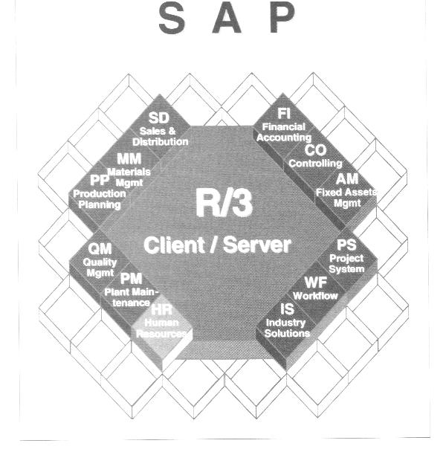

Slide 35
Modules within SAP’s R/3 integrated information
systems environment
SD-Sales and Distribution
MM- Materials Management
PP- Production Planning
QM- quality Management
PM- Plant Maintenance
HR- Human Resources
FI- Financial Accounting
CO- Controlling
AM- Asset Management
PS- Project System
WF- Workflow
IS- Industry Solutions

Slide 36
2.3 The Significance and Benefits of ERP
Software and Systems
1. ERP allows easier global integration
2. ERP not only integrates people and data, but it
also eliminates updating and repairing many
separate computer systems.
3. ERP allows management to manage operations,
not just monitor them

Slide 37
2.4 Questions About ERP
1.How much does an ERP Package Cost
2. Should every business buy an ERP Package
3. Is ERP software inflexible
4. What return can be expected from an ERP investment
5. How long does it take for most companies to see a return on an ERP investment
6. Why do some companies have more success with ERP than do others

Slide 38
2.5 The Continuing Evolution of ERP
1. Additional capabilities within ERP
Customer Resource Management packages
Decision support, management reporting, and
data mining.
Integrates the business with its dealers, vendors,
and customers
2. The Internet
mySAP.com
e-commerce

Slide 39
Summary
1. Several factors led to the development of ERP
The speed and power of computing hardware increased
exponentially, while cost and size decreased.
The early c/s architecture provided the conceptual
framework for multiple users sharing common data
Increasingly sophisticated software facilitated integration,
especially in two areas: Accounting/Finance and
Manufacturing Resource Planning
The growth of business size, complexity, and competition
made business managers yearn for more efficient and
competitive information systems.

Slide 40
2.SAP AG produced a complex, modular ERP program
called R/3. The software could integrate a company’s
entire business by using a common database that
linked all operations, allowing real-time data sharing
and streamlined operations.
3. Purchasing ERP software is expensive, time consuming
to implement, and requires significant employee training,
but the payoffs can be spectacular. For some companies,
however, the ROI may not be immediate or even calculable.
4. In the future, experts anticipate that ERP’s focus will
be on managing customer relationships, improving
planning and decision making, and linking operations
to the Internet.

Slide 41
Exercises
1.
Imagine that you have a job interview with the owner of a manufacturing company that employs about 300 people. The owner of the company has heard about ERP, but she hasn't done any research on it. She asks you, "Do you think we need an ERP system?" What would you say to her? What questions might you ask to help her think about ERP in her company? List your response and questions.
2
Using library resources or the Internet, report on (1) one company’s positive experience with implementing ERP and (2) one company’s disappointing experience.

Slide 42
C3 Marketing Information Systems and the Sales Order Process
Learning Objectives
Describe the un-integrated sales processes of Fitter Snacker, a fictitious company whose operations are used as an example.
Explain why un-integrated Sales and Marketing information systems lead to company-wide inefficiency, higher costs, lost profits, and customer dissatisfaction.
Discuss sales and distribution in SAP R/3 system, and explain how integrated data sharing increases company-wide efficiency.
Describe how SAP R/3 processes a standard sales order.
Describe the benefits of Customer Relationship Management software, a useful extension of ERP software.

Slide 43
C3 Marketing Information Systems and the Sales Order Process
Contents
3.1 Overview of Fitter Snacker
3.2 Problems with Fitter Snacker’s Sales Process
3.3 Sales and Distribution in ERP
3.4 A Standard Order in SAP R/3
3.5 Customer Relationship Management

Slide 44
3.1 Overview of Fitter Snacker
Productions:
NRG-A: Advanced Energy
NRG-B: Body Building Proteins
Ingredients: Vitamins and minerals, dry base mixture, and wet base mixture.
Sales:
Wholesale division: sells to middlemen.
Direct sales division:sells directly to large grocery stores, chain stores.
2% discount with paying in 10 days.

Slide 45
3.2 Problems with Fitter Snacker’s Sales Process
Three un-integrated information systems: the sales order system, the warehouse system, and the accounting system. Data shared by periodic file transfers and by paper printout.
12 Sales, 6 for each sales division, 4 work on road, and 2 work in office.
“Discretionary discounts”

Slide 46
Price quote
Sales Order
Sales
Pick, Pack, and Ship
Warehouse
Accounting
Invoice
Payment
Receiving
Fitter Snacker’s Sales Process
Returns

Slide 47
Sales Quotations and Orders
Prepare a handwritten quotations.
Fax quotations to the sales office.
Place an order, get a shipping date.
Check the customer’s credit status.
Enter the customer’s order.

Slide 48
Order Filling
Packing lists and shipping labels are printed twice a day.
FS bars are packed 24 to a display box,12 display box form a standard shipping case.
Picking
Packing
Shipping
Contact the sales

Slide 49
Accounting and Invoicing
Three times a week, sales clerks send the Accounting department the disk containing the sales order data for customer invoices.
Manually make adjustments for partial shipments and any other changes that occurred during the order process.

Slide 50
Payment and Returns
Payment
Confirm invoices
Payment
“During ” letter
Returns
Customers call FS to get a RMA number
Receiving returned material with its RMA number.
Accounting department credit the appropriate account.

Slide 51
3.3 Sales and Distribution in ERP
Sales Order Processing
Pre-Sales Activities
Inventory Sourcing
Payment
Delivery
Billing

Slide 52
Briefly describe four kinds of decisions made by Marketing managers
What products should we sell?
How are the products best promoted?
What price should we charge?
How should we distribute?

Slide 53
Pre-Sales Activities
A customer can get pricing information
An inquiry
A price quotation
Marketing activities
Tracking customer contacts
Maintain data of customer
Sales Order Processing
Collect customers’ information
Record items, prices, and quantities
Check the customer’s credit availability
Corrective action can be configured

Slide 54
Inventory Sourcing
Check the inventory records
Check the production planning records
Delivery
Releasing the documents that the warehouse will use to pick, pack, and ship orders.
Billing
Create an invoice.
Accounting
Payment
Accounting

Slide 55
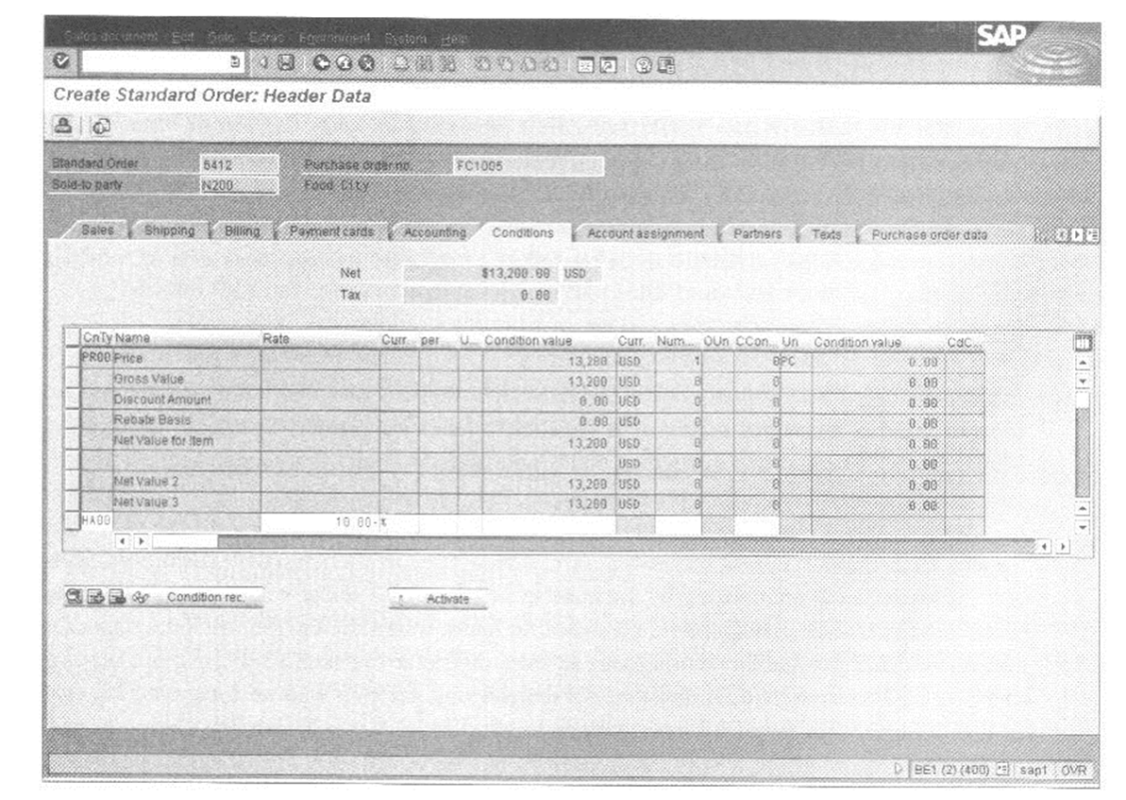
3.4 A Standard Order in SAP R/3
Taking an Order in SAP’s R/3

Slide 56
Data entry field and explanation:
Sold-to party, the seller’s code number for the customer.
Purch. Order no., the customer’s purchase order number, which is on the customer’s order form.
Req.deliv.date, Requested delivery date—the date the customer wants to receive the order.
Material, a code number for the inventory item ordered.
Order quantity, the number of units the customer ordered.

Slide 57
Customer Master Data
Material Master Data
Organizational Structures
Grouping customers and salespeople
Distribution Channel
Document flow
Document number
Delivery
Picking
Goods issue
Invoice
Accounting

Slide 58
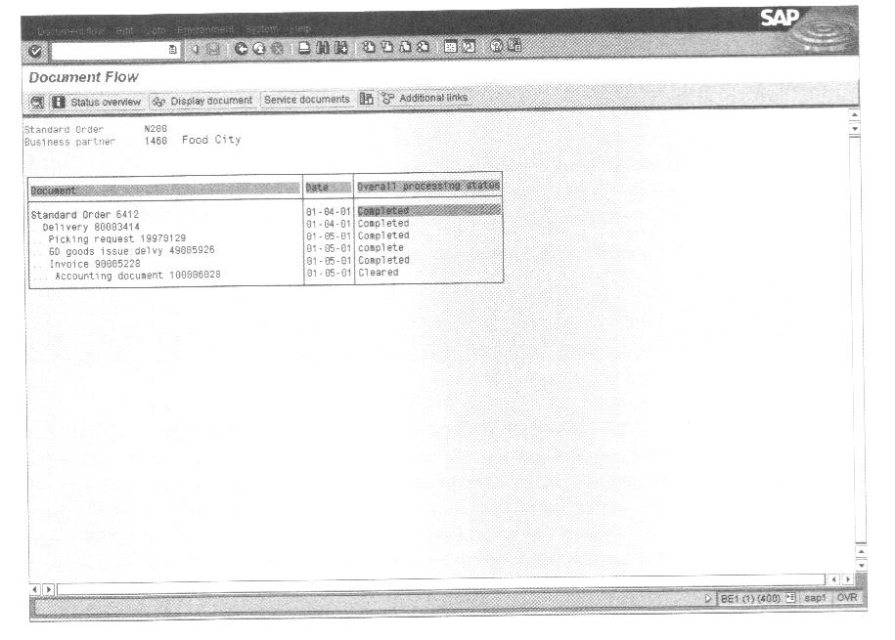

Slide 59
Discount Pricing in SAP
Integration of sales and accounting
Keep billing information up to date
Keep discounts report up to date

Slide 60
3.5 Customer Relationship Management
CRM as a corporate strategy
To determine each customer’s needs and then uses that knowledge to build a long-term relationship with each customer.
CRM as a set of activities
To segment customers by data warehouse and data mining.
One to One Marketing
Sales Force Automation
Sale Campaign Management Software
Marketing Encyclopedias
Call Center Automation

Slide 61
CRM needs ERP as a base
The benefits of CRM
Lower costs
Higher revenue
Improved strategy and performance measurement
Another look at CRM
CRM is a set of related marketing-oriented activities.
Dell Computer Corp.
BMG Music Services

Slide 62
Summary
Fitter Snacker’s un-integrated information systems are at the root of an inefficient and costly sales order process. Because information is not shared in real time, customers are asked to repeat initial sales order information. As an order is processed, invoicing also occur, presenting a poor company image to customers. Integrated ERP software would let FS avoid errors because all customer data are stored in a central database that is shared in real time by all company employees.
An ERP system such as SAP’s R/3 sees a sale as a cycle of related functions, including taking orders, setting prices, checking product availability, checking the customer’s credit line, arranging for delivery, billing the customer, and collecting payment. In R/3 all these transactions, or documents, are electronically linked, so tracking an order’s status (partial shipments, returns, partial payments, and so forth) is easily accomplished.

Slide 63
When an ERP system is installed, various configuration decisions are made. These decisions reflect management’s desires of how transactions should be recorded and later used for decision making. For example, the system can be configured to limit selling price discounts, thus avoiding unprofitable pricing.
An ERP system’s central database has master data tables for customers, suppliers, and inventory. The tables hold relatively permanent information about each subject.
Customer Relationship Management systems build on what ERP provides, in particular on the company’s common database. There are various kinds of CRM software, some available from ERP vendors and some from third-party software companies. CRM software can lead to operational savings, but most companies buy it because they feel that having better customer relationship will result in higher revenues.

Slide 64
C4 Production and Materials Management Information Systems
Learning Objectives
Describe the steps in the production planning process of a high-volume manufacturer such as Fitter Snacker.
Describe Fitter Snacker’s production and materials management problems.
Describe how a structured process for production and materials management planning enhances efficiency and decision making.
Describe how production planning data in an ERP system can be shared with suppliers to increase supply-chain efficiency.

Slide 65
C3 Marketing Information Systems and the Sales Order Process
Contents
4.1 Production Overview
4.2 The Production Planning Process
4.3 ERP in Supply-Chain Management

Slide 66
Managers in FS’s Production and Materials Management departments must answer three questions:
How many of each snack bar should we produce?
What quantities of raw materials should we order so we can meet that level of production?
When should we order raw materials?

Slide 67
4.1 Production Overview
There are three general approaches to production:
Make-to-stock
Make-to-order
Assemble-to-order
Fitter Snacker’s Manufacturing Process
Mixer
Snack Bar Line
Form Bake Pack
Raw
Material
Warehouse
Finished
Goods
Warehouse
Mixer
Mixer
Mixer

Slide 68
Fitter Snacker’s Production Sequence
Fitter Snacker’s Production Problems
Communications Problems
Marketing personnel do not share information with production personnel
When Production must meet an unexpected increase in demand,
Depleting warehouse inventories
Causing Shortages or a stock out of materials
Degrading performance of Production personnel
Invertory Problems
Accounting and Purchasing Problems

Slide 69
4.2 The Production Planning Process
Production planners follow three important principles:
Work from a sales forecast to create an ‘aggregate’ production plan for all products.
Break down the aggregate plan into more specific production plans for individual products and limited time periods
Use the production plan to determine raw material requirements.
The R/3 Approach to Production Planning

Slide 70
Sales Forecasting
Sales and Operations Planning
Demand Management
Detailed Scheduling
MRP
Production
Purchasing

Slide 71
The R/3 Approach to Production Planning
Sales Forecasting
Sales and Operations Planning
Demand Management
MRP and Purchasing/Materials Management
Detailed Scheduling

Slide 72
Fitter Snacker’s sales forecast for January through June

Slide 73
Fitter Snacker’s sales and operations plan for January through June

Slide 74
Fitter Snacker’s production plan for January: The first five weeks of production are followed by a day-by-day disaggregation of week 1

Slide 75
 | Quantity
Ingredient | NRG-A | NRG-B
Oats(lb.) | 300 | 250
Wheat germ (lb.) | 50 | 50
Cinnamon(lb.) | 5 | 5
Nutmeg(lb.) | 2 | 2
Cloves(lb.) | 1 | 1
Honey(gal.) | 10 | 10
Raisins(lb.) | 50
Protein Powder (lb.) |  | 50
Hazelnuts(lb.) |  | 30

Slide 76
The MRP record for Fitter Snacker, weeks 1 through 5

Slide 77
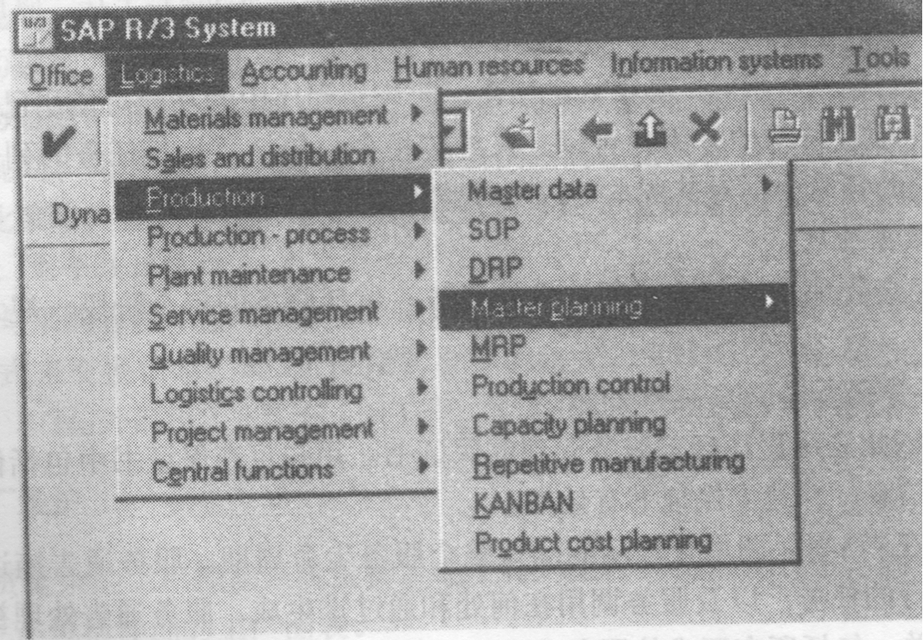

Slide 78
C5 Accounting and Finance
Learning Objectives
State and describe Accounting and finance functional area activities.
Identify and describe problems that arise in Accounting and Finance as a result of un-integrated information systems.
Describe how ERP systems can solve Accounting and Finance problems that arise in an un-integrated system.
Explain accounting and management-reporting benefits that from having an enterprise-wide information system.

Slide 79
C5 Accounting and Finance
Contents
5.1 Accounting and Finance Activities
5.2 Operational Decision-Making Problem: Credit
Management
5.3 Product Profitability Analysis
5.4 Management Reporting with ERP Systems
5.5 Topics

Slide 80
5.1 Accounting and Finance Activities
A company’s accounting system records data about the company’s business transactions and related events. The data are then used for these purposes:
Decision-makers throughout a company use accounting data to plan and manage day-to-day activities.
Managers use accounting data to make long-range operating forecasts.
Accountants summarize the data to generate a company’s financial statements and other reports.

Slide 81
Creating Financial Statements
Closing the books
Financial statements include:
The balance sheet: financial health
Cash held
Amounts owed to company by customer
Cost of raw materials and finished goods inventory
Long-term assert
Amounts owed to vendors
Amounts owed to banks
Amounts owed to other creditors
Amounts owed to owners

Slide 82
The income statement: profitability
Company’s sales
Cost of sales
The profit or loss for the period.
Using ERP for Accounting and Finance
Sales and distribution (SD) lets the user record sales.
Production Planning (PP) causes inventory production to be scheduled and recorded..
Materials Management (MM) controls purchasing and recording inventory.

Slide 83
Finance and accounting (FI) lets the user use the general-ledger accounts to close the books and generate financial statements. FI also allows control over accounts payable and accounts receivable, presumably on the assumption that accounting and Finance will collect money for the company and pay its bills.
Controlling (CO) lets the user track product cost accounting.
Human Resources (HR) lets the user generate and record the payroll.
Asset Management (AM) lets the user record fixed-asset purchases (plant and machinery) and the related depreciation.

Slide 84
5.2 Operational Decision-Making Problem: Credit Management
Industrial Credit Management
FS’s Credit-Management Procedures
Credit Management in SAP R/3
List price of the items ordered
Accounts receivable balance
Customer credit limit
The important credit-management feature is this: The company will not grant credit when it should deny it, and it will not deny credit when it should be granted.

Slide 85
5.3 Product Profitability Analysis
Problem: Inconsistent Record Keeping
ERP: Store their data in the same way in the same records.
Problem: Inaccurate Inventory-Costing Systems
Inventory Cost-Accounting Background
Direct costs
Indirect costs
Standard cost
Cost variances

Slide 86
ERP and Inventory Cost Accounting
Activity-Basted Costing and ERP
Problem: Companies with Subsidiaries
ERP: Currency Translation
ERP: Inter-company Transactions

Slide 87
5.4 Management Reporting with ERP Systems
Using Document Flow for Customer Service
Using Built-In Management-reporting and Analysis Tools
Data warehouse
SIS
LIS

Slide 88
5.5 Topics
Another Look at Financial Modules -- in a Service Organization
Another Look at Integrated Information systems -- in a Nonprofit Organization
Another Look at Training

Slide 89
SUMMARY
A company needs an accounting system to record transactions and generate financial statements. The accounting system should let the user summarize data in meaningful ways. The data can then be used to assist decision-makers in their day-to-day work and also in long-range planning.

Slide 90
2. With un-integrated information systems, accounting data might not be up to date, and this can cause problems when trying to make operational decisions, such as granting credit. Data can also be inaccurate because of weaknesses in un-integrated systems, and this problem can have an effect on decision-making and profitability.
3. Closing the books at the end of an accounting period can be difficult with an un-integrated IS, but it is relatively easy with an integrated IS.

Slide 91
4. Using a integrated IS and a common database to record accounting data has important inventory cost-accounting benefits. More precise record keeping is possible, and this can lead to more accurate product cost calculations. These, in turn, can help managers decide which products are profitable and which are not.
5. The use of an integrated system and a common database to record accounting data has important management-reporting benefits. The user has built in drill-down and query tools available as a result.

Slide 92
C6 Organization and Human Resource Management d Finance
Learning Objectives
State and describe human resource functional area activities.
Explain the main human resources processes, organizations, scenarios, and business objects in SAP R/3.
Understand the Event-driven Process Chain Methodology.
Understand the event, function, information object, control flow in recruitment process.

Slide 93
C6 Organization and Human Resource Management
Contents
6.1 Human resource activities.
6.2 Overview of Human Resource
Management in SAP R/3.
6.3 Event-driven Process Chain
Methodology.
6.4 Recruitment Process

Slide 94
6.1 Human resource activities
In many industries, such as business consulting or software development, the human assets typically exit the company every evening. Having modern and flexible human resource processes makes better use of these assets and can make the difference in whether a company thrives over time.

Slide 95
Human resource systems cover the following activities:
Human resource organizational management (job description, ergonomics, work-place assessment, salary/wage structure)
Personnel planning (labor market, requirements planning, recruitment planning, etc.)
Recruitment (internal job advertisements, temporary staff, external job advertisements, selection procedures, employment contracts)

Slide 96
Word-force planning and administration (introduction and training labor and social legislation, reorganization due to internal transfer, terminations, dismissals, retirement)
Personnel development (performance appraisal, employee-suggestion system, wage/salary policy)
Personnel training and further education (training of new employees, employee training program)
Social benefits (social facilities, leisure activities, employment protection)

Slide 97
6.2 Overview of Human Resource Management in SAP R/3

Slide 98
Organizational Units
Personnel area
Personnel sub-area
Employee group
Payroll accounting area
Supply Chain Scenarios
Recruitment
Personnel development
Business trip management
Training and event management
Payroll accounting
Human Resource
Management
Business Objects
Position
Person
Qualification
Business trip
Application
Business Process
Personnel selection
employee hiring
Salary adjustment
Career planning
Personnel development planning

Slide 99
6.3 Event-driven Process Chain Methodology

Slide 100
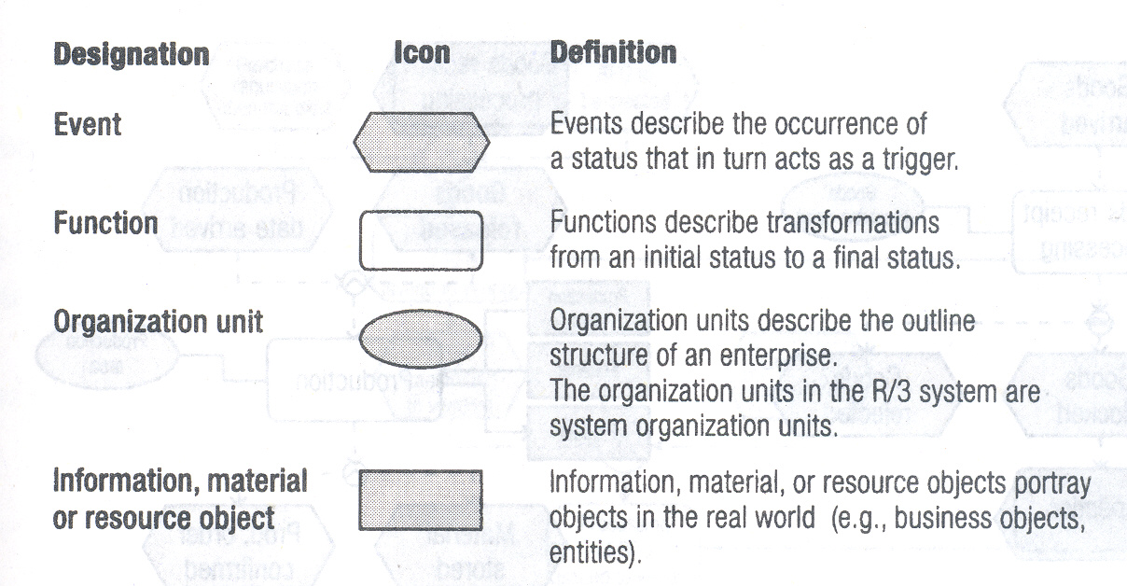
Process description language elements in EPC

Slide 101
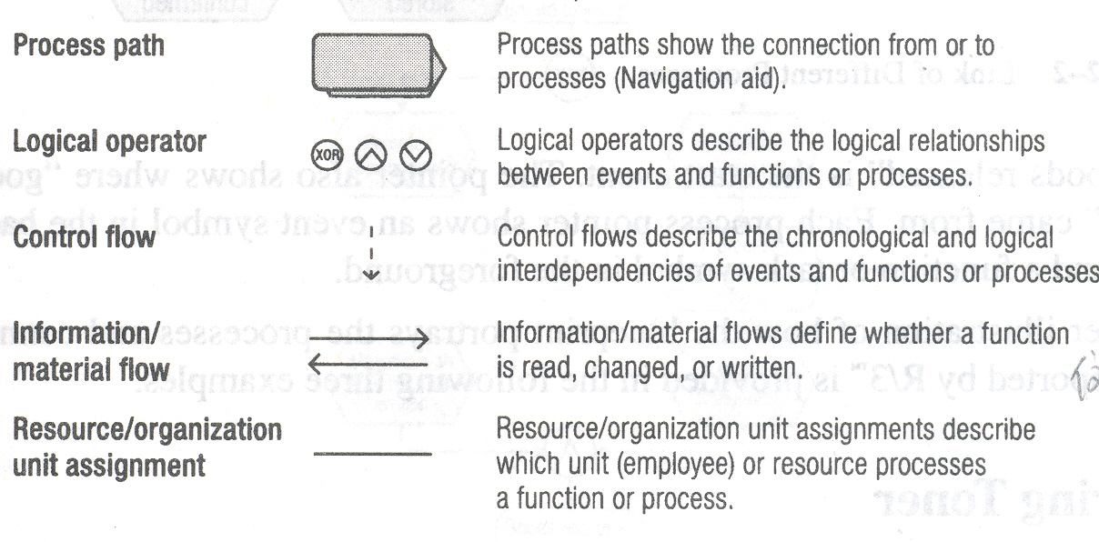

Slide 102
Key to elements of the EPC
Geometric shape designates EPC function.
Arrows made up of dotted lines show the flow of
business.
“Connecting operators” (AND, exclusive/OR, OR)
illustrate alternative or parallel flows of information
through the chain.
Arrows made up of solid lines indicate information is
input into a task or generated by that task.
Connecting lines show which task is assigned to which
organizational unit.

Slide 103
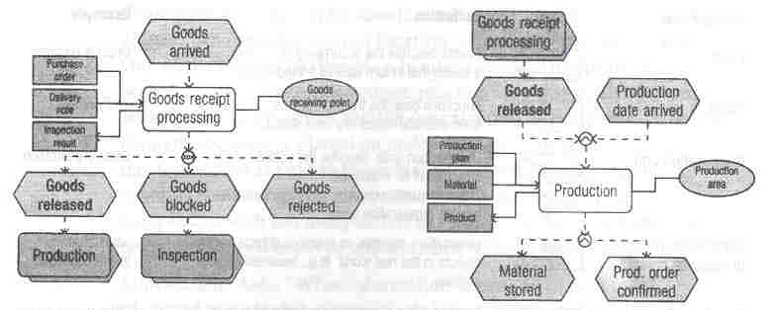

Slide 104
6.4 Recruitment Process
Receipt of
application
Personnel
advertising
Applicant pool
admin.
Personnel
selection
Contract
admin.
Infor.
system
Recruitment
Value chain: Recruitment

Slide 105
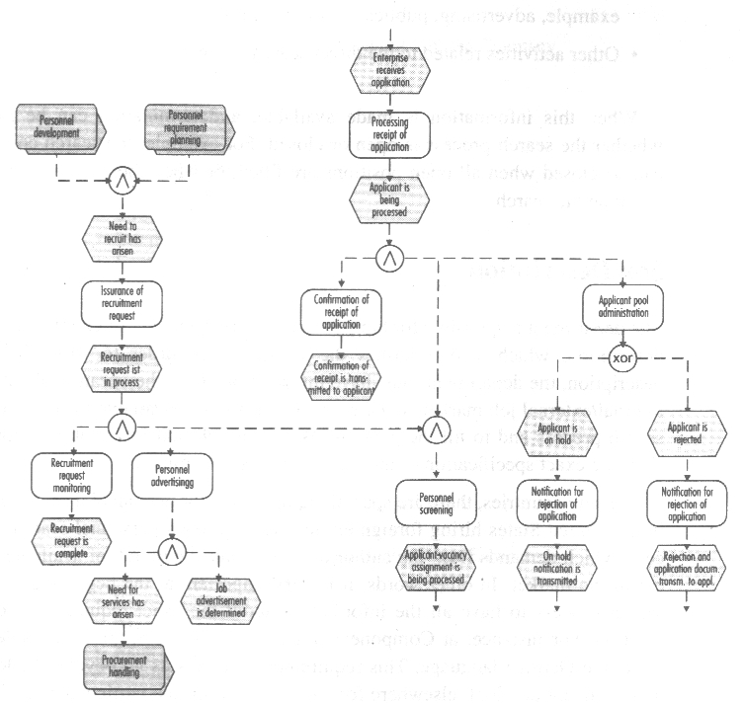

Slide 106
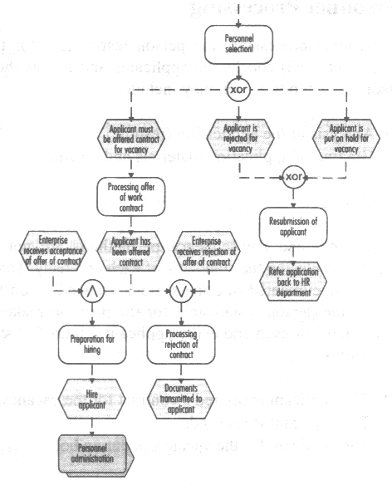

Slide 107
Recruitment Process
Creating a search:
When a company experiences the need for recruitment, a search contract is created in order to handle these needs and document the entire process.
Tracking the search process
The person responsible for the search will need the information followed:
The number of open and already filled search positions
The number of open positions for which a candidate has already been found
The amount of budget, and information about the activities, for example, advertising, publication of positions
Other activities related to the direct search process

Slide 108
Job Description
Information about the vacancy
Information about internal/external job market
Information about financial resources available to conduct the search process and to fill the position
Information about special requirements for personnel
Employee application processing
When a company receives an application, the data for the applicant and the application are entered into the R/3 system.
Confirming the application Receipt
The applicant receives a letter in which the company confirms the receipt of the application, printed regular mail, fax, email

Slide 109
Preliminary Personnel Choice
The company searches through the applicants for the vacant position and checks each applicant to see if he or she has the basic requirements to fill that position.
Basic requirements profile comparison
Secondary pool of candidates
Personnel Processing
The person responsible for the position checks the applicants and judges them by: analysis of the application, grading of application materials and resume, first interview, testing,
The results of the personnel choice is documented into the system. There three possibilities to applicant: offered a contract, rejected, or on hold.

Slide 110
Employment agreement offer processing
The qualified applicant will receive a written contractual offer from the company
Applicant status check
Preparation for employing the applicant
The acceptance of the contractual offer is documented, the employee’s department head is informed, and the applicant file is converted into a personnel file
Rejection of offer
If the applicant rejects the contractual offer, the event is recorded into the system, and the would-be boss is informed of the rejection. The applicant status is reset to rejected.

Slide 111
Applicant pool administration
All the applicants are administered in a central applicant pool
Putting an application on hold
An applicant would be considered for employment in the company at a later point in time, an offer can be made that allows the application to be placed on hold. The applicant receives a letter.
Rejection of application
The applicant is informed if and when the company decides that it cannot offer a position of employment.

Slide 112
Business analysis based Employee object
The Employee business object is used as a source of information for the following types of business analysis.
Employees who have entered and /of left the company, Family members, Birthday list, Education and training, Telephone directory, employees with powers of attorney, time spent in each pay scale area/type/group/level, reference personnel numbers, absence/attendance data, atts./absences for each employee, remuneration statements, payroll accounts, bank details, employee history report

