Slide 1
Behavior Analytics
Social Media Mining

Slide 2
Examples of Behavior Analytics
What motivates individuals to join an online group?
When individuals abandon social media sites, where do they migrate to?
Can we predict box office revenues for movies from tweets posted by individuals?

Slide 3
To answers these questions we need to analyze or predict behaviors on social media.
Individuals exhibit different behaviors in social media: as individuals
or as part of a broader collective behavior.
When discussing individual behavior, our focus is on one individual.
Collective behavior emerges when a population of individuals behave in a similar way with or without coordination or planning.

Slide 4
Our Goal
To analyze, model, and predict individual and collective behavior

Slide 5
Individual Behavior

Slide 6
Types of Individual Behavior
User-User (link generation) befriending, sending a message, playing games, following, inviting
User-Community: joining or leaving a community, participating in community discussions
User-Entity (content generation) writing a post, posting a photo

Slide 7
I. Individual Behavior Analysis

Slide 8
Community Membership in Social Media
Why do users join communities?
What factors affect the community-joining behavior of individuals?
We can observe users who join communities and determine the factors that are common among them
We require a population of users, a community C, and community membership information (i.e., users who are members of C).
Communities can be implicit: One can think of individuals buying a product as a community, and people buying the product for the first time as individuals joining the community.
To distinguish between users who have already joined the community and those who are now joining it, we need community memberships at two different times t1 and t2, with t2 > t1.
At t2, we determine users such as u who are currently members of the community, but were not members at t1. These new users form the subpopulation that is analyzed for community-joining behavior.

Slide 9
Community Membership in Social Media
Hypothesis: individuals are inclined toward an activity when their friends are engaged in the same activity.
A factor that plays a role in users joining a community is the number of their friends who are already members of the community.
In data mining terms, this translates to using the number of friends of an individual in a community as a feature to predict whether the individual joins the community (i.e., class attribute).
Number of Friends vs
Probability of Joining
a Community

Slide 10
Even More Features

Slide 11
Feature Importance Analysis
which feature can help best determine whether individuals will join or not?
We can use any feature selection algorithm. Feature selection algorithms OR
We can use a classification algorithm, such as decision tree learning
Most important Features are Ranked Higher

Slide 12
Decision Tree for Joining a Community
Are these features well-designed?
We can evaluate using classification performance metrics.

Slide 13
Behavior Analysis Methodology
An observable behavior: the behavior needs to be observable. E.g., accurately observing the joining of individuals (and possibly their joining times).
Features: design relevant data features (covariates) that may or may not affect (or be affected by) the behavior – [we need a domain expert for this step]
Feature-Behavior Association: Find the relationship between features and behavior. E.g., use decision Tree
Evaluation: the findings are due to the features and not to externalities. E.g., use classification accuracy
We can also use randomization tests
Or causality testing algorithms

Slide 14
Granger Causality
Consider a linear regression model
We can predict Y_{t+1} by using either Y_{1,} Y₂ … Y_{t} or a combination of X_{1,} X₂ … X_{t} and Y_{1,} Y₂ … Y_{t}.
If then X Granger Causes Y
(why is this not causality)

Slide 15
II. Individual Behavior Modeling

Slide 16
Individual Behavior Modeling
Models in Economics, Game Theory, and Network Science
We can use:
Threshold Models: We need to learn thresholds and weights
Then, Wij can be defined as the
fraction of times user i buys a product and user j buys the same product soon after that
When is soon?
Similarly, thresholds can be estimated by taking into account the average number of friends who need to buy a product before user i decides to buy it.
What if no friends / or friends don’t buy the same products? Then we can find the most similar individuals or items (similar to collaborative filtering methods)
Cacade Models

Slide 17
III. Individual Behavior Prediction

Slide 18
Individual Behavior Prediction
Most behaviors result in newly formed links in
social media.
It can be a link to a user, as in befriending behavior;
A link to an entity, as in buying behavior; or
A link to a community, as in joining behavior.
We can formulate many of these behaviors as a link prediction problem.

Slide 19
Link Prediction
Most behaviors result in newly formed links in
social media.
It can be a link to a user, as in befriending behavior;
A link to an entity, as in buying behavior; or
A link to a community, as in joining behavior.
We can formulate many of these behaviors as a link prediction problem.

Slide 20
Link Prediction - Setup
Link prediction assumes a graph G(V; E).
Let e(u,v) represent an interaction (edge) between nodes u and v, and let t(e) denote the time of the interaction.
Let G[t1,t2] represent the subgraph of G such that all edges are created between t1 and t2
i.e., for all edges e in this subgraph, t1 < t(e) < t2).
Now given four time stamps t11 < t12 < t21 < t22 a link prediction algorithm is given the subgraph G[t11,t12] (training interval) and is expected to predict edges in G[t21,t22] (testing interval).
We can only predict edges for nodes that are present during the training period
Let G(Vtrain; Etrain) be our training graph. Then, a link prediction algorithm generates a sorted list of most probable edges in

Slide 21
Link Prediction - Algorithms
Assign to every edge e(x,y)
Edges sorted by this value in decreasing order will create our ranked list of predictions
Note that any similarity measure between two nodes can be used for link prediction; therefore, methods discussed in Chapter 3 are of practical use here.
We will review some well-known methods
Node Neighborhood-Based Methods
Path-Based Methods

Slide 22
Computing Link Scores
Common Neighbors: the more common neighbors that two nodes share, the more similar they are
Jaccard Similarity: the likelihood of a node that is a neighbor of either x or y to be a common neighbor.

Slide 23
More Measures
Adamic-Adar:if two individuals share a neighbor and that neighbor is a rare neighbor, it should have a higher impact on their similarity.
Preferential Attachment: nodes of higher degree have a higher chance of getting connected to incoming nodes

Slide 24
Example
Compute the edge score for edge (5,7)

Slide 25
Path-Based Measures
Katz Measure:
denotes the number of paths of length l between x and y. is a constant that exponentially damps longer paths.
When small the measure reduces to common neighbor measure
It can be reformulated in Closed Form as

Slide 26
Path-Based Measures
Hitting Time and Commute Time: Consider a random walk that starts at node x and moves to adjacent nodes uniformly. Hitting time is the expected number of random walk steps needed to reach y starting from x.
a smaller hitting time implies a higher similarity; therefore, a negation can turn it into a similarity measure
If y is highly connected random walks are more likely to visit y
We can normalize it using the stationary probability

Slide 27
Hitting time is not symmetric, we can use commute time instead or its normalized version
Some other examples
Rooted PageRank: the stationary probability of y, when at each random walk run you can jump to x with probability P and to a random node with probability 1-P
SimRank: Recursive definition of similarity

Slide 28
Link Prediction - Evaluation
After one of the aforementioned measures is selected, a list of the top most similar pairs of nodes are selected.
These pairs of nodes denote edges predicted to be the most likely to soon appear in the network.
Performance (precision, recall, or accuracy) can be evaluated using the testing graph and by comparing the number of the testing graph’s edges that the link prediction algorithm successfully reveals.
Performance is usually very low, since many edges are created due to reasons not solely available in a social network graph.
So, a common baseline is to compare the performance with random edge predictors and report the factor improvements over random prediction.

Slide 29
Collective Behavior

Slide 30
Collective Behavior
First Defined by sociologist Robert Park
Collective Behavior: A group of individuals behaving in a similar way
It can be planned and coordinated, but often is spontaneous and unplanned
Examples:
Individuals standing in line for a new product release
Posting messages online to support a cause or to show support for an individual

Slide 31
I. Collective Behavior Analysis

Slide 32
Collective Behavior Analysis
We can analyze collective behavior by analyzing individuals performing the behavior
We can then put together the results of these analyses
The result would be the expected behavior for a large population
OR, we can analyze the population as a whole
Not very popular for analysis, as individuals are ignored
Popular for Prediction purposes

Slide 33
Collective Behavior Analysis
We can analyze collective behavior by analyzing individuals performing the behavior
We can then put together the results of these analyses
The result would be the expected behavior for a large population
OR, we can analyze the population as a whole
Not very popular for analysis, as individuals are ignored
Popular for Prediction purposes

Slide 34
Collective Behavior Analysis - Example
Users migrate in social media due to their limited time and resources
Sites are often interested in keeping their users, because they are valuable assets that help contribute to their growth and generate revenue by increasing traffic
Two types of migrations:
Site migration: For any user who is a member of two sites s1 and s2 at time ti, and is only a member of s2 at time tj > ti, then the user is said to have migrated from site s1 to site s2.
Attention Migration: For any user who is a member of two sites s1 and s2 and is active at both at time ti, if the user becomes inactive on s1 and remains active on s2 at time tj > ti, then the user’s attention is said to have migrated away from site s1 and toward site s2.

Slide 35
Collective Behavior Analysis - Example
Activity (or inactivity) of a user can be determined by observing the user’s actions performed on the site.
We can consider a user active in interval [t, t+X ], if the user has performed at least one action on the site during this interval. Otherwise, the user is considered inactive.
The interval could be measured at different granularity, such as days,
weeks, months, and years.
It is common to set = 1 month.
We can analyze migrations of individuals and then measure the rate at which the population of these individuals is migrating across sites.
We can use the methodology for individual behavior analysis

Slide 36
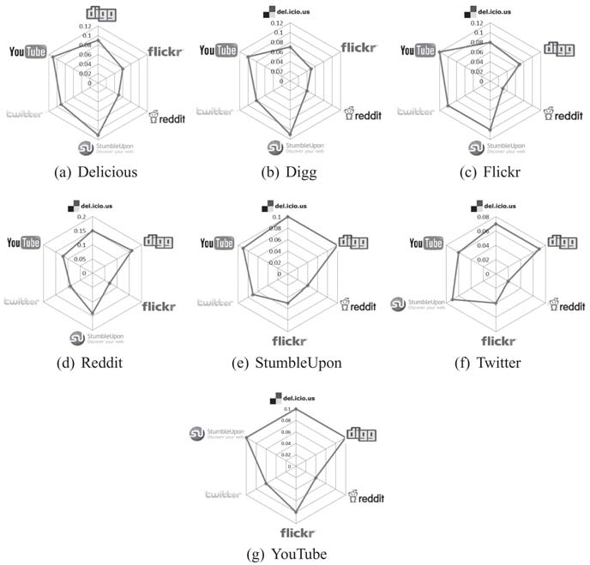
The Observable Behavior
Sites migrating is rarely observed, while attention migration is clearly observable.
We need to take multiple steps to observe it:
Users are required to be identified on multiple networks
Huan.liu1 on Facebook is Liuhuan on Twitter

Slide 37
Features
User Activity: more active users are less likely to migrate
e.g., number of tweets, posts, photos
User Network Size: a user with more social ties (i.e., friends) in a social network is less likely to move
e.g., number of friends
User Rank: A user with high status in a network is less likely to move to a new one where he or she must spend more time getting established.
e.g., centrality scores
External rank: your citations, how many have referred to your article, ...

Slide 38


Feature-Behavior Association
Given two snapshots of a network, we know if users migrated or not.
Let vector indicate whether any of our n users have migrated or not.
Let be the features collected (activity, friends, rank) for any one of these users at time stamp t.
The correlation between features X and labels Y can be computed via logistic regression.
How can we verify that this correlation is not random?

Slide 39
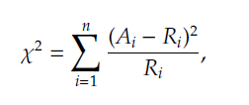
Evaluation Strategy
To verify if the correlation between features and the migration behavior is not random
we can construct a random set of migrating users and compute X_Random and Y_Random for them as well
Find the correlation between these random variables (e.g., regression coefficients) and it should be significantly different from what we obtained using real-world observations
We can use Chi-square test for significance testing

Slide 40
II. Collective Behavior Modeling

Slide 41
Collective Behavior Modeling
Collective behavior can be conveniently modeled using some of the techniques discussed in Chapter 4, “Network Models”.
We want models that can mimic characteristics observable in the population.
In network models, node properties rarely play a
role; therefore, they are reasonable for modeling collective behavior.

Slide 42
III. Collective Behavior Prediction

Slide 43
Collective Behavior Prediction
From previous chapters, we could use
Linear Influence Model (LIM)
Epidemic Models
Collective behavior can be analyzed either in terms of individuals performing the collective behavior or based on the population
as a whole.
It is more common to consider the population as a whole
when predicting collective behavior, we are interested in predicting the intensity of a phenomenon, which is due to the collective behavior of the population (e.g., how many of them will vote?)
we can utilize a data mining approach where features that describe the population well are used to predict a response variable (i.e., the intensity of the phenomenon).
A training-testing framework or correlation analysis is used to determine the generalization and the accuracy of the predictions.

Slide 44
Predicting Box Office Revenue for Movies
Set the target variable that is being predicted. In this case, it is the revenue that a movie produces.
The revenue is the direct result of the collective behavior of going to the theater to watch the movie.
Determine the features in the population that may affect the target variable.
Predict the target variable using a supervised learning approach, utilizing the features determined in step 2.
Measure performance using supervised learning evaluation.
the average hourly number of tweets related to the movie for each of the seven days
prior to the movie opening (seven features) and the number of opening theaters for the movie (one feature).
The predictions using this approach are closer to reality than that of the Hollywood Stock Exchange (HSX), which is the gold standard for predicting revenues for movies

Slide 45

Generalizing the Idea
Target variable y
Some feature A that quantifies the attention
Some feature P that quantifies the publicity
Train a regression model

