Slide 1
Introduction
Social Media Mining

Slide 2
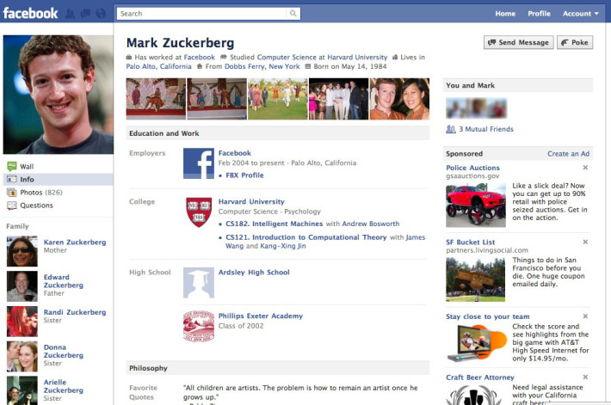
Facebook
How does Facebook use your data?
Where do you think Facebook can use your data?

Slide 3
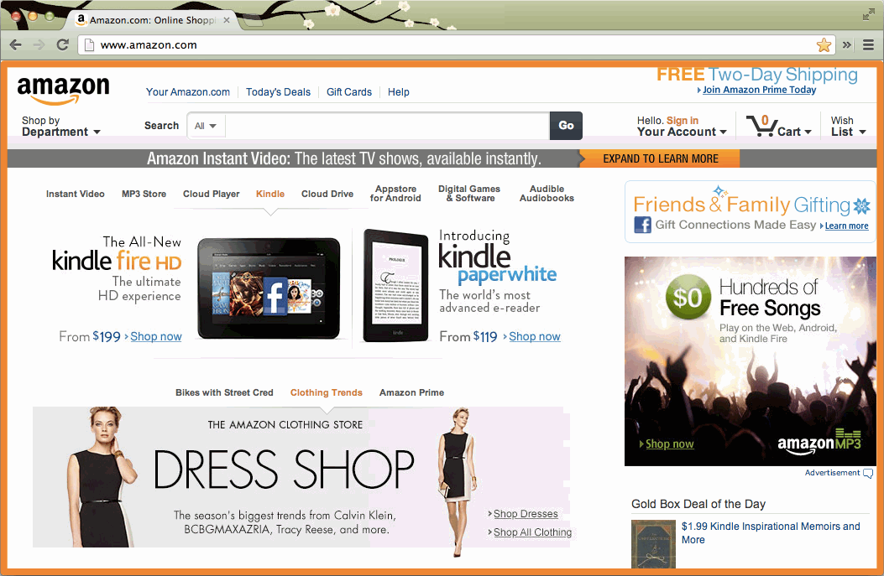
Amazon

Slide 4
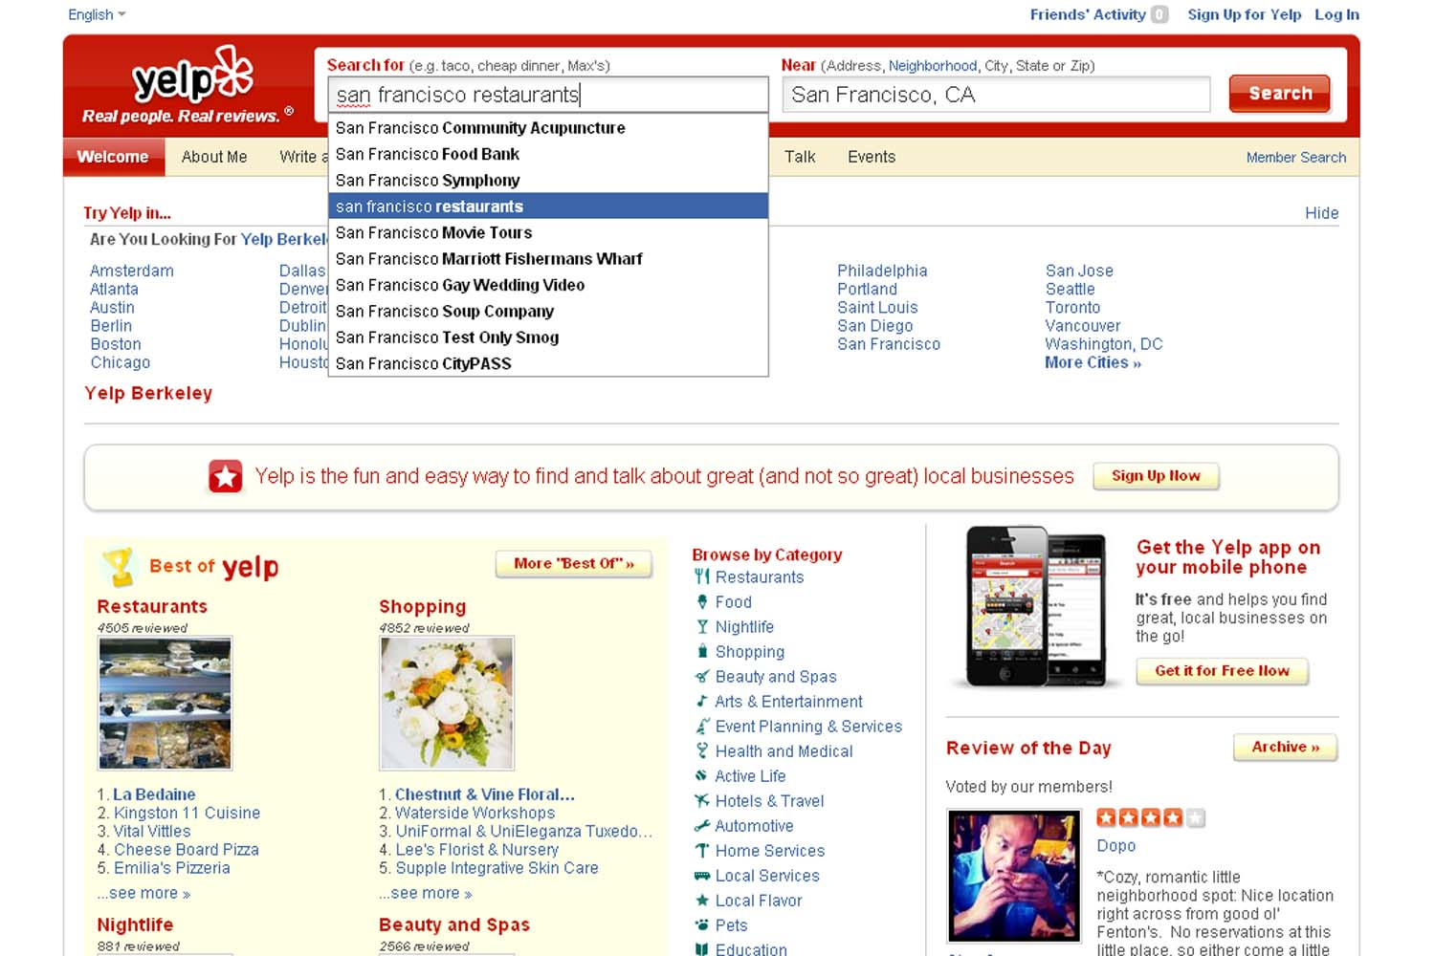
Yelp

Slide 5
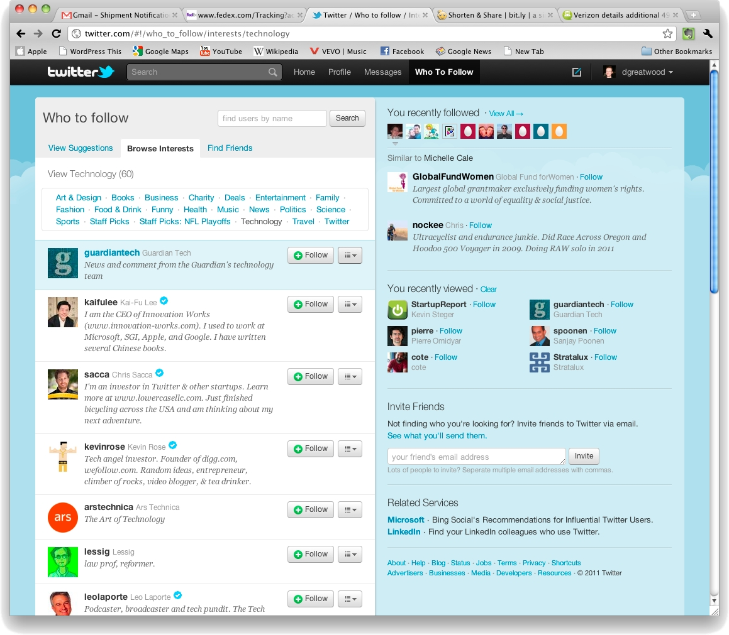
Twitter

Slide 6
Objectives of Our Course
Understand social aspects of the Web
Social Theories + Social media + Mining
Learn how to collect, clean, and represent social media data
How to measure important properties of social media and simulate social media models
Find and analyze communities in social media
Understanding friendships in social media, perform recommendations, and analyze behavior
Study or ask interesting research issues
e.g., start-up ideas
Learn representative algorithms and tools

Slide 7
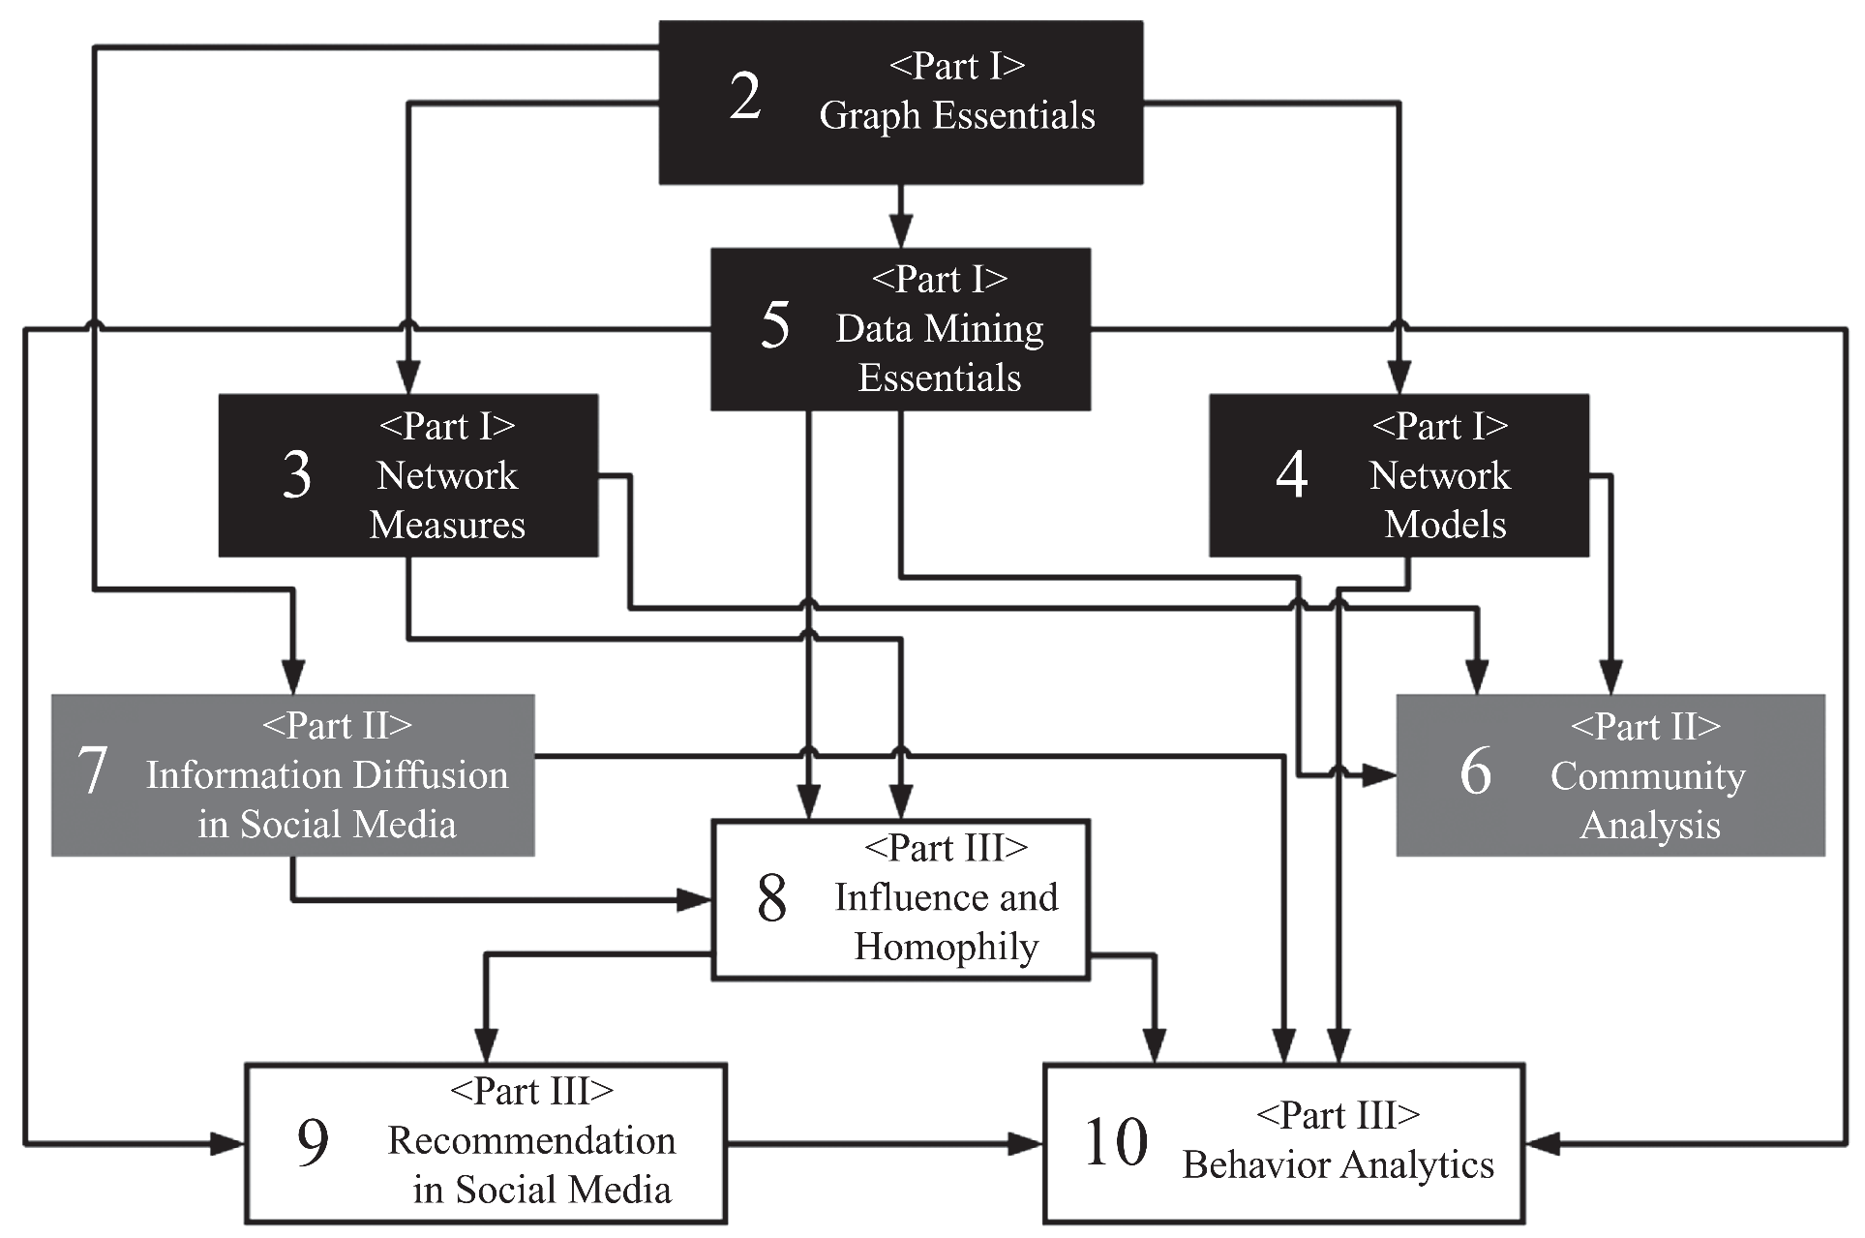
Overview – Dependency Graph

Slide 8
Social Media

Slide 9
Definition
Social Media is the use of electronic and Internet tools for the purpose of sharing and discussing information and experiences with other human beings in more efficient ways.

Slide 10
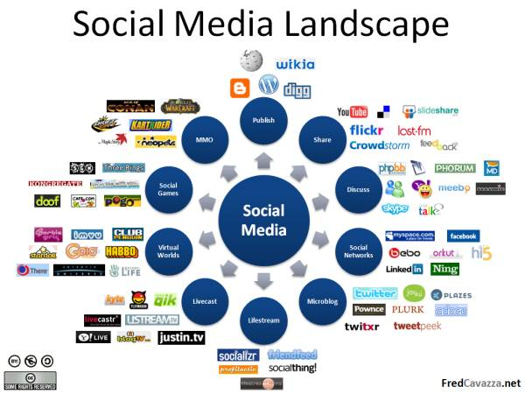
Notes:
Image Source: http://www.fredcavazza.net/2008/06/09/social-media-landscape/

Slide 11
Social Media Mining is the process of representing, analyzing, and extracting meaningful patterns from social media data

Slide 12
Social Media Mining Challenges
Big Data Paradox
Social media data is big, yet not evenly distributed.
Often little data is available for an individual
Obtaining Sufficient Samples
Are our samples reliable representatives of the full data?
Noise Removal Fallacy
Too much removal makes data more sparse
Noise definition is relative and complicated and is task-dependent
Evaluation Dilemma
When there is no ground truth, how can you evaluate?

