Slide 1
Network Measures
Social Media Mining

Slide 2

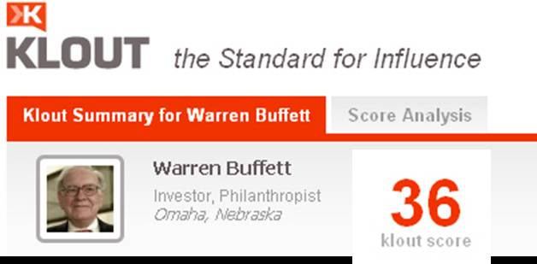
Klout

Slide 3
Why Do We Need Measures?
Who are the central figures (influential individuals) in the network?
What interaction patterns are common in friends?
Who are the like-minded users and how can we find these similar individuals?
To answer these and similar questions, one first needs to define measures for quantifying centrality, level of interactions, and similarity, among others.

Slide 4
Centrality
Centrality defines how important a node is within a network.

Slide 5

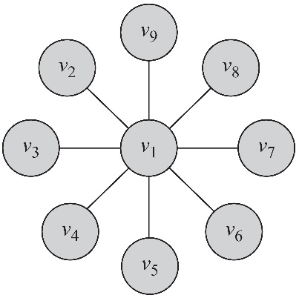
Degree Centrality
The degree centrality measure ranks nodes with more connections higher in terms of centrality
d_{i} is the degree (number of adjacent edges) for vertex v_{i}
In this graph degree centrality for vertex v₁ is d₁ = 8 and for all others is d_{j} = 1, j ≠ 1

Slide 6
Degree Centrality in Directed Graphs
In directed graphs, we can either use the in-degree, the out-degree, or the combination as the degree centrality value:
d^{out}_{i} is the number of outgoing links for vertex v_{i}

Slide 7
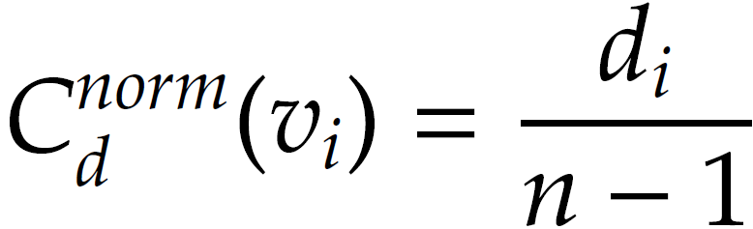
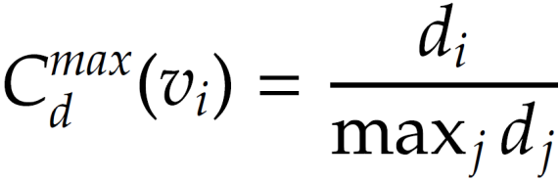
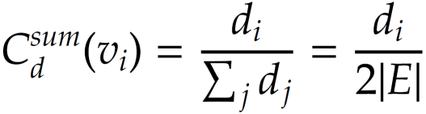
Normalized Degree Centrality
Normalized by the maximum possible degree
Normalized by the maximum degree
Normalized by the degree sum

Slide 8
Eigenvector Centrality
Having more friends does not by itself guarantee that someone is more important, but having more important friends provides a stronger signal
Eigenvector centrality tries to generalize degree centrality by incorporating the importance of the neighbors (undirected)
For directed graphs, we can use incoming or outgoing edges
C_{e}(v_{i}): the eigenvector centrality of node v_{i}
λ: some fixed constant

Slide 9

Eigenvector Centrality, cont.
Let ^{T}
➔
This means that C_{e} is an eigenvector of adjacency matrix A and λ is the corresponding eigenvalue
Which eigenvalue-eigenvector pair should we choose?

Slide 10
Eigenvector Centrality, cont.

Slide 11
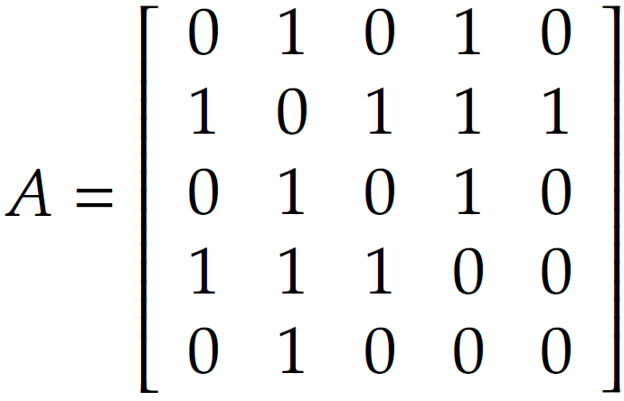
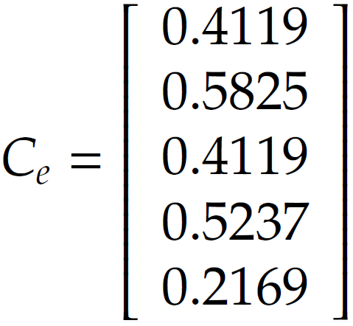
Eigenvector Centrality: Example
λ = (2.68, -1.74, -1.27, 0.33, 0.00)
Eigenvalues Vector
λ_{max} = 2.68

Slide 12
Katz Centrality
A major problem with eigenvector centrality arises when it deals with directed graphs
Centrality only passes over outgoing edges and in special cases such as when a node is in a weakly connected component centrality becomes zero even though the node can have many edge connected to it
To resolve this problem we add bias term β to the centrality values for all nodes

Slide 13
Katz Centrality, cont.
Controlling term
Bias term
Rewriting equation in a vector form
vector of all 1’s
Katz centrality:

Slide 14
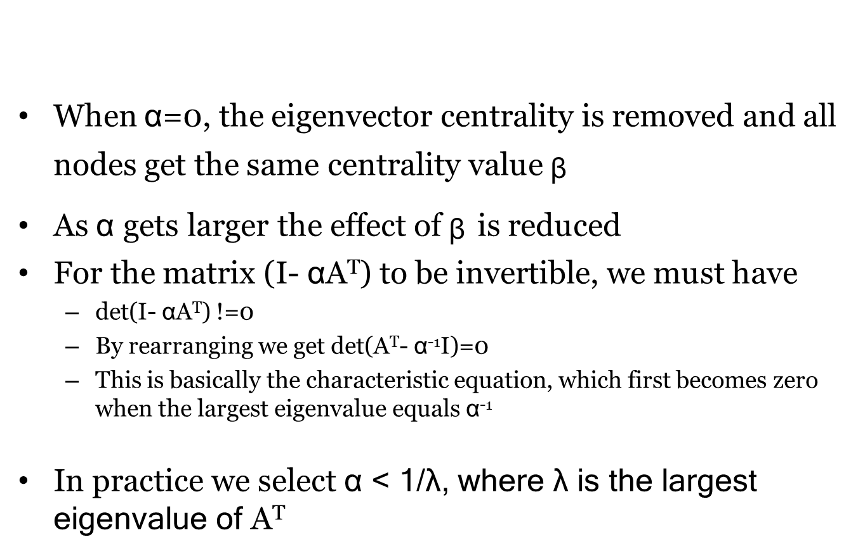
Katz Centrality, cont.
When $α$=0, the eigenvector centrality is removed and all nodes get the same centrality value ᵦ
As $α$gets larger the effect of ᵦ is reduced
For the matrix (I- $α$A^{T}) to be invertible, we must have
det(I- $α$A^{T}) !=0
By rearranging we get det(A^{T}- $α$⁻¹I)=0
This is basically the characteristic equation, which first becomes zero when the largest eigenvalue equals $α$⁻¹
In practice we select $α$< 1/λ, where λ is the largest eigenvalue of A^{T}

Slide 15

Katz Centrality Example
The Eigenvalues are -1.68, -1.0, 0.35, 3.32
We assume $α$=0.25 < 1/3.32 ᵦ=0.2

Slide 16
PageRank
Problem with Katz Centrality: in directed graphs, once a node becomes an authority (high centrality), it passes all its centrality along all of its out-links
This is less desirable since not everyone known by a well-known person is well-known
To mitigate this problem we can divide the value of passed centrality by the number of outgoing links, i.e., out-degree of that node such that each connected neighbor gets a fraction of the source node’s centrality

Slide 17
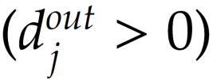

PageRank, cont.
What if the degree is zero?

Slide 18

PageRank Example
We assume $α$=0.95 and ᵦ=0.1

Slide 19


Betweenness Centrality
Another way of looking at centrality is by considering how important nodes are in connecting other nodes
the number of shortest paths from vertex s to t – a.k.a.
information pathways
the number of shortest paths from s to t that pass through v_{i}

Slide 20
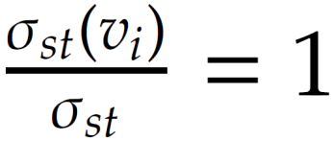
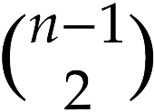
Normalizing Betweenness Centrality
In the best case, node v_{i} is on all shortest paths from s to t, hence,
Therefore, the maximum value is 2
Betweenness centrality:

Slide 21
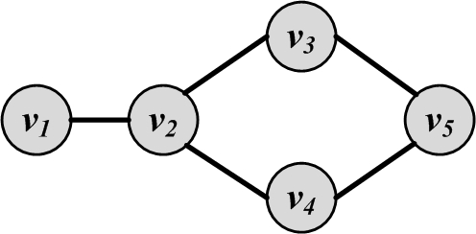
Betweenness Centrality Example

Slide 22
Closeness Centrality
The intuition is that influential and central nodes can quickly reach other nodes
These nodes should have a smaller average shortest path length to other nodes
Closeness centrality:

Slide 23
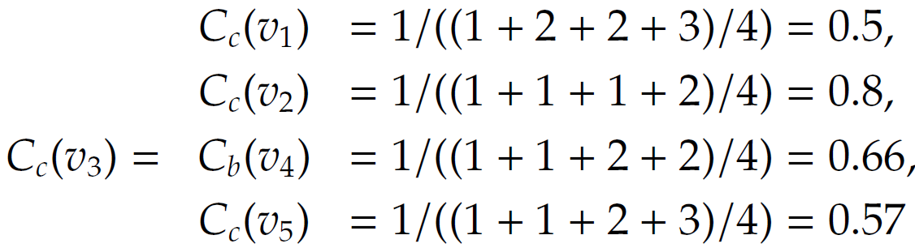
Compute Closeness Centrality

Slide 24
Group Centrality
All centrality measures defined so far measure centrality for a single node. These measures can be generalized for a group of nodes.
A simple approach is to replace all nodes in a group with a super node
The group structure is disregarded.
Let S denote the set of nodes in the group and V-S the set of outsiders

Slide 25
Group Centrality
Group Degree Centrality
We can normalize it by dividing it by |V-S|
Group Betweeness Centrality
We can normalize it by dividing it by 2

Slide 26
Group Centrality
Group Closeness Centrality
It is the average distance from non-members to the group
One can also utilize the maximum distance or the average distance

Slide 27
Group Centrality Example
Consider S={v2,v3}
Group degree centrality=3
Group betweenness centrality = 3
Group closeness centrality = 1

Slide 28
Transitivity and Reciprocity

Slide 29
Transitivity
Mathematic representation:
For a transitive relation R:
In a social network:
Transitivity is when a friend of my friend is my friend
Transitivity in a social network leads to a denser graph, which in turn is closer to a complete graph
We can determine how close graphs are to the complete graph by measuring transitivity

Slide 30
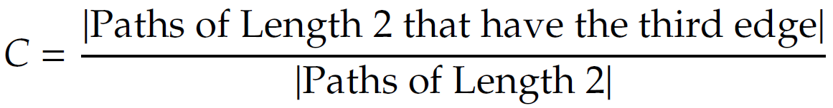
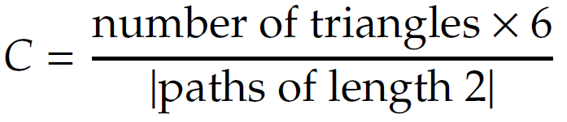
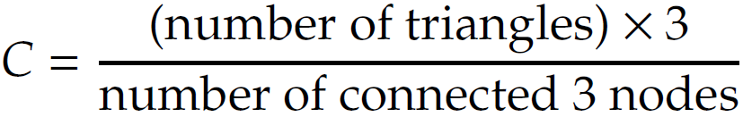
[Global] Clustering Coefficient
Clustering coefficient analyzes transitivity in an undirected graph
We measure it by counting paths of length two and check whether the third edge exists
When counting triangles, since every triangle has 6 closed paths of length 2:
In undirected networks:

Slide 31
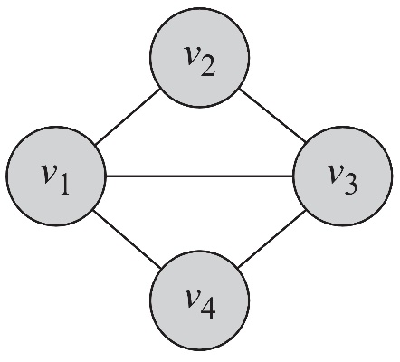
[Global] Clustering Coefficient: Example

Slide 32
Local Clustering Coefficient
Local clustering coefficient measures transitivity at the node level
Commonly employed for undirected graphs, it computes how strongly neighbors of a node v (nodes adjacent to v) are themselves connected
In an undirected graph, the denominator can be rewritten as:

Slide 33
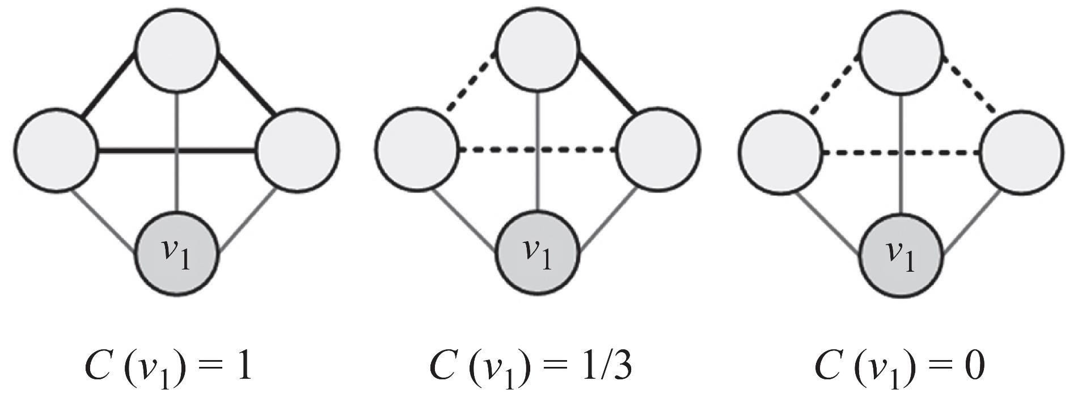
Local Clustering Coefficient: Example
Thin lines depict connections to neighbors
Dashed lines are the missing connections among neighbors
Solid lines indicate connected neighbors
When none of neighbors are connected C=0
When all neighbors are connected C=1

Slide 34
Reciprocity
If you become my friend, I’ll be yours
Reciprocity is a more simplified version of transitivity as it considers closed loops of length 2
If node v is connected to node u, u by connecting to v, exhibits reciprocity

Slide 35
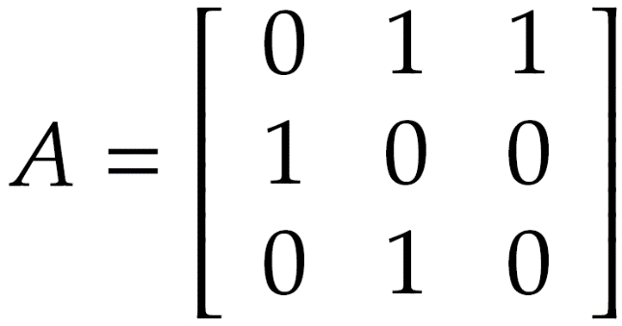
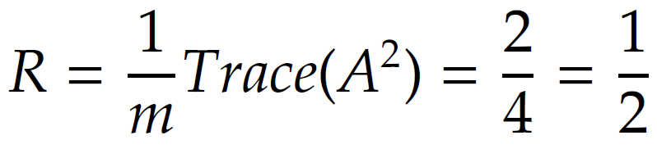
Reciprocity: Example
Reciprocal nodes: v₁, v₂

Slide 36
Balance and Status
Measuring stability based on an observed network

Slide 37
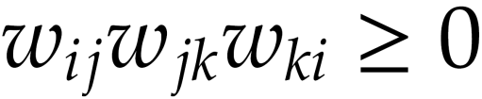
Social Balance Theory
Social balance theory discusses consistency in friend/foe relationships among individuals. Informally, social balance theory says friend/foe relationships are consistent when
In the network
Positive edges demonstrate friendships (w_{ij}=1)
Negative edges demonstrate being enemies (w_{ij}=-1)
Triangle of nodes i, j, and k, is balanced, if and only if
w_{ij} denotes the value of the edge between nodes i and j

Slide 38
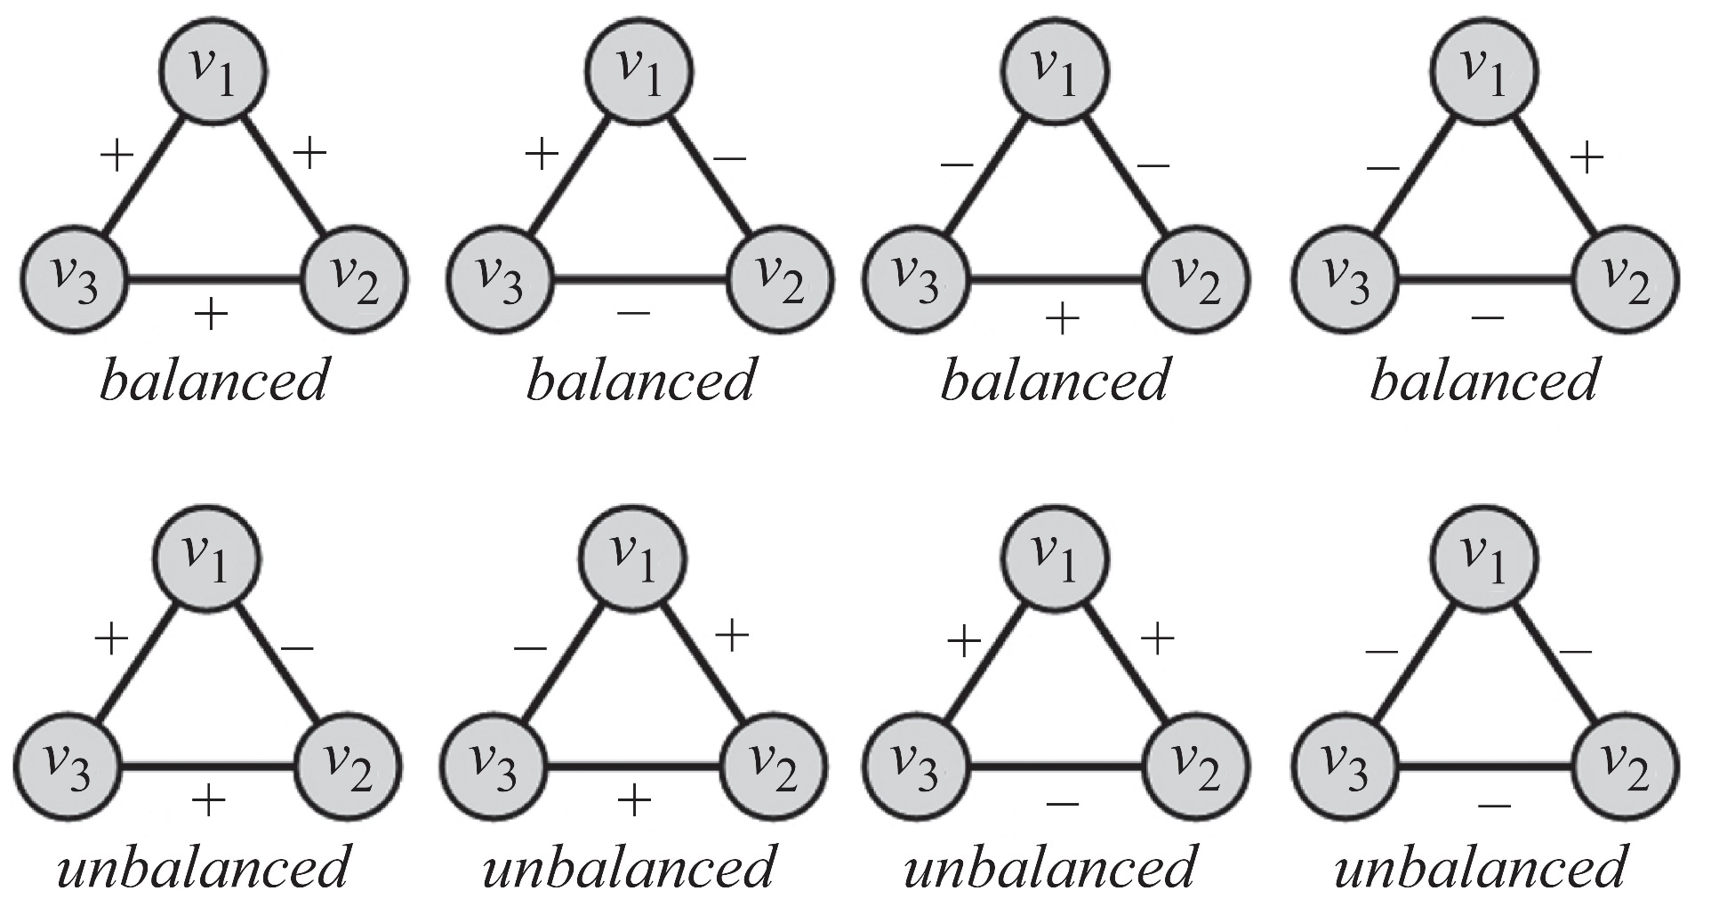
Social Balance Theory: Possible Combinations
For any cycle if the multiplication of edge values become positive, then the cycle is socially balanced

Slide 39
Social Status Theory
Status defines how prestigious an individual is ranked within a society
Social status theory measures how consistent individuals are in assigning status to their neighbors

Slide 40
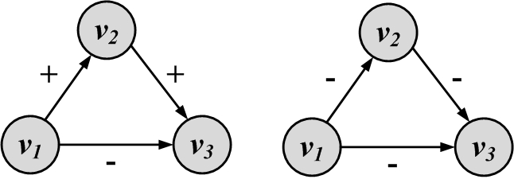
Social Status Theory: Example
Unstable configuration
Stable configuration
A directed ‘+’ edge from node X to node Y shows that Y has a higher status than X and a ‘-’ one shows vice versa

Slide 41
Similarity
How similar are two nodes in a network?

Slide 42
Structural Equivalence
In structural equivalence, we look at the neighborhood shared by two nodes; the size of this neighborhood defines how similar two nodes are.
For instance, two brothers have in common sisters, mother, father, grandparents, etc. This shows that they are similar, whereas two random male or female individuals do not have much in common and are not similar.

Slide 43
Structural Equivalence: Definitions
Vertex similarity
In general, the definition of neighborhood N(v) excludes the node itself v.
Nodes that are connected and do not share a neighbor will be assigned zero similarity
This can be rectified by assuming nodes to be included in their neighborhoods
Jaccard Similarity:
Cosine Similarity:

Slide 44
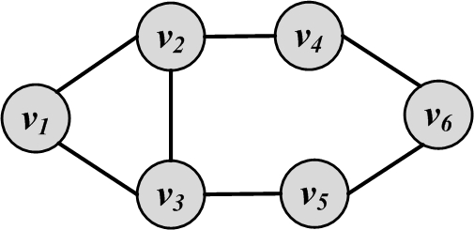
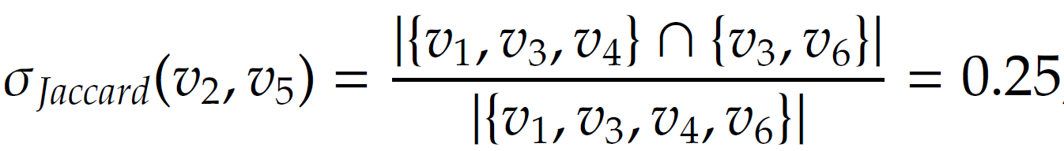
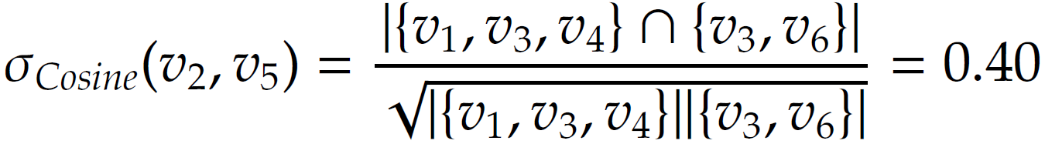
Similarity: Example

Slide 45
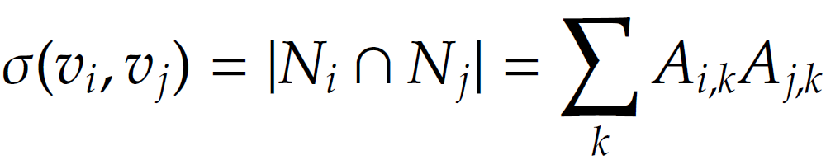
Normalized Similarity
Comparing the calculated similarity value with its expected value where vertices pick their neighbors at random
For vertices i and j with degrees d_{i} and d_{j} this expectation is d_{i}d_{j}/n

Slide 46
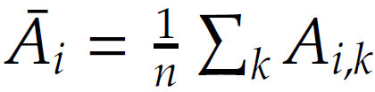
Normalized Similarity, cont.

Slide 47

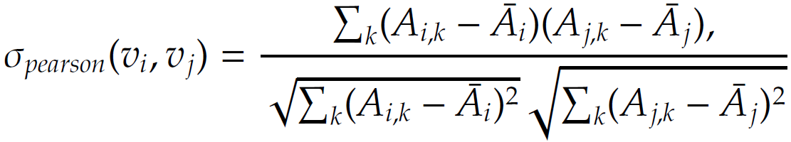
Normalized Similarity, cont.
Covariance between A_{i} and A_{j}
Covariance can be normalized by the multiplication of
Standard deviations:
Pearson correlation coefficient:
σ ∈ [-1,1]

Slide 48
Regular Equivalence
In regular equivalence, we do not look at neighborhoods shared between individuals, but how neighborhoods themselves are similar
For instance, athletes are similar not because they know each other in person, but since they know similar individuals, such as coaches, trainers, other players, etc.

Slide 49
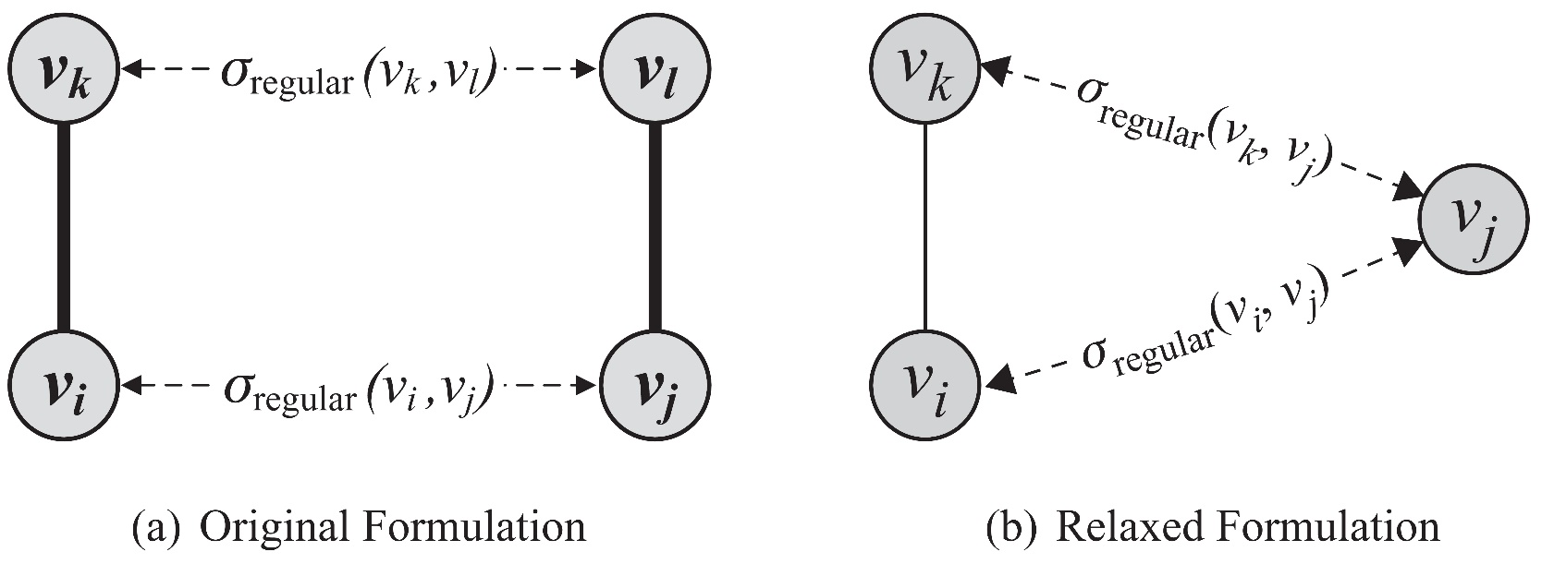
Regular Equivalence
v_{i}, v_{j} are similar when their neighbors v_{k} and v_{l} are similar
The equation (left figure) is hard to solve since it is self referential so we relax our definition using the right figure

Slide 50
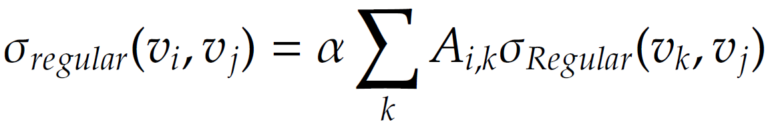
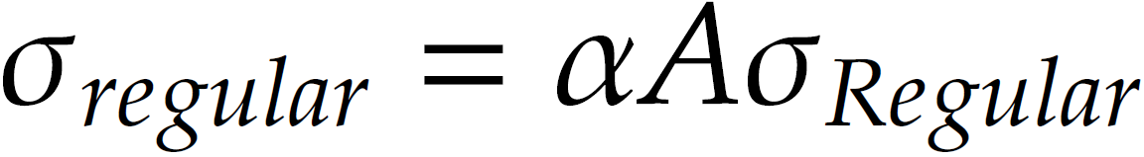
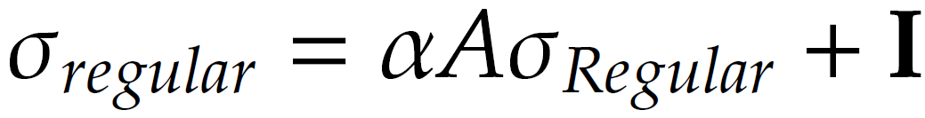
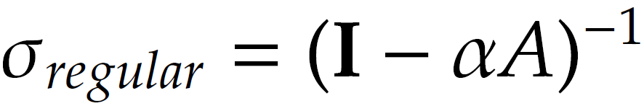
Regular Equivalence
v_{i}, v_{j} are similar when v_{j} is similar to v_{i}’s neighbors v_{k}
In vector format
A vertex is highly similar to itself, we guarantee this by adding an identity matrix to the equation

Slide 51
Regular Equivalence
v_{i}, v_{j} are similar when v_{j} is similar to v_{i}’s neighbors v_{k}
In vector format
A vertex is highly similar to itself, we guarantee this by adding an identity matrix to the equation

Slide 52
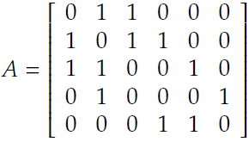
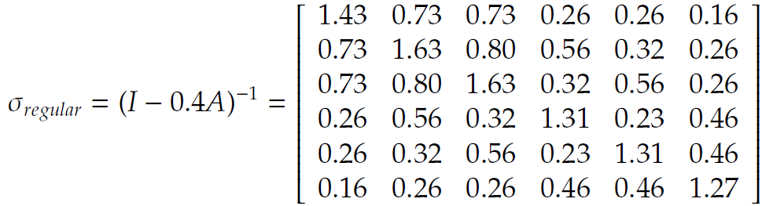
Regular Equivalence: Example
The largest eigenvalue of A is 2.43
Set α = 0.4 < 1/2.43
Any row/column of this matrix shows the similarity to other vertices
We can see that vertex 1 is most similar (other than itself) to vertices 2 and 3
Nodes 2 and 3 have the highest similarity

