Slide 1
Network Models
Social Media Mining

Slide 2
Why should I use network models?
In may 2011, Facebook had 721 millions users. A Facebook user at the time had an average of 190 users -> a total of 68.5 billion friendships
What are the principal underlying processes that help initiate these friendships
How can these seemingly independent friendships form this complex friendship network?
In social media there are many networks with millions of nodes and billions of edges.
They are complex and it is difficult to analyze them

Slide 3
So, what do we do?
We design models that generate, on a smaller scale, graphs similar to real-world networks.
Hoping that these models simulate properties observed in real-world networks well, the analysis of real-world networks boils down to a cost-efficient measuring of different properties of simulated networks
Allow for a better understanding of phenomena observed in real-world networks by providing concrete mathematical explanations; and
Allow for controlled experiments on synthetic networks when real-world networks are not available.
These models are designed to accurately model properties observed in real-world networks

Slide 4
Properties of Real-World Networks
Power-law Distribution, High Clustering Coefficient, Small Average Path Length

Slide 5
Degree Distribution

Slide 6
Degree Distribution
Consider the distribution of wealth among individuals. Most individuals have average capitals, whereas a few are considered wealthy. In fact, we observe exponentially more individuals with average capital than the wealthier ones.
Similarly, consider the population of cities. Often, a few metropolitan areas are densely populated, whereas other cities have an average population size.
In social media, we observe the same phenomenon regularly when measuring popularity or interestingness for entities.

Slide 7
Degree Distribution
Many sites are visited less than a 1,000 times a month whereas a few are visited more than a million times daily.
Social media users are often active on a few sites whereas some individuals are active on hundreds of sites.
There are exponentially more modestly priced products for sale compared to expensive ones.
There exist many individuals with a few friends and a handful of users with thousands of friends
(Degree Distribution)

Slide 8
Power Law Distribution
When the frequency of an event changes as a power of an attribute -> the frequency follows a power-law
Let p(k) denote the fraction of individuals having degree k.
b: the power-law exponent and its value is typically in the range of [2, 3]
a: power-law intercept

Slide 9
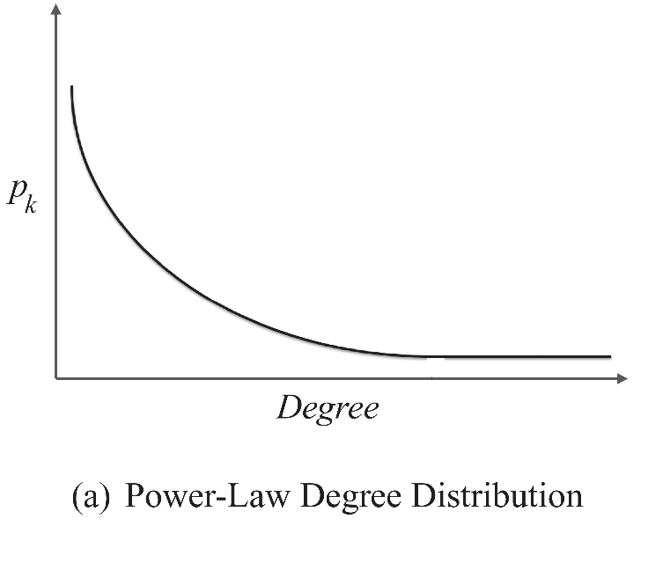

Power Law Distribution
Many real-world networks exhibit a power-law distribution.
Power laws seem to dominate in cases where the quantity being measured can be viewed as a type of popularity.
A power-law distribution implies that small occurrences are common, whereas large instances are extremely rare
A typical shape of a power-law distribution
Log-Log plot

Slide 10
Power-law Distribution: Test
Test whether a network exhibits a power-law distribution
Pick a popularity measure and compute it for the whole network. For instance, we can take the number of friends in a social network
Compute p(k), the fraction of individuals having popularity k.
Plot a log-log graph, where the x-axis represents ln k and the y-axis represents ln p(k).
If a power-law distribution exists, we should observe a straight line
The results can be inaccurate

Slide 11
Power-Law Distribution: Real-World Networks
Networks with power-law degree distribution are often called scale-free networks

Slide 12
Clustering Coefficient

Slide 13
Clustering Coefficient
In real-world networks, friendships are highly transitive, i.e., friends of an individual are often friends with one another
These friendships form triads -> high average [local] clustering coefficient
In May 2011, Facebook had an average clustering coefficient of 0.5 for individuals who had 2 friends.

Slide 14
Average Path Length

Slide 15
The Average Shortest Path
In real-world networks, any two members of the network are usually connected via short paths. In other words, the average path length is small
Six degrees of separation:
Stanley Milgram In the well-known small-world experiment conducted in the 1960’s conjectured that people around the world are connected to one another via a path of at most 6 individuals
Four degrees of separation:
Lars Backstrom et al. in May 2011, the average path length between individuals in the Facebook graph was 4.7. (4.3 for individuals in the US)

Slide 16
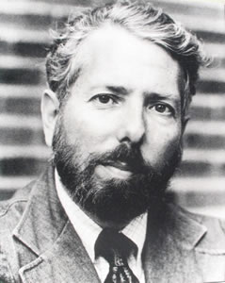
Stanley Milgram’s Experiments
Random people from Nebraska were asked to send a letter (via intermediaries) to a stock broker in Boston
S/he could only send to someone with whom they were on a first-name basis
Among the letters that reached the target, the average path length was six.
Stanley Milgram (1933-1984)
Notes:
Image source: http://psychology.wikia.com/wiki/File:Stanley_Milgram.jpg

Slide 17
Random Graphs

Slide 18
Random Graphs
We start with the most basic assumption on how friendships are formed.
Random Graph’s main assumption:
Edges (i.e., friendships) between nodes (i.e., individuals) are formed randomly.

Slide 19

Random Graph Model – G(n,p)
We discuss two random graph models
Formally, we can assume that for a graph with a fixed number of nodes n, any of the edges can be formed independently, with probability p. This graph is called a random graph and we denote it as G(n, p) model.
This model was first proposed independently by Edgar Gilbert and Solomonoff and Rapoport.
C(n, 2) or is # of combinations of two objects from a set of n objects

Slide 20
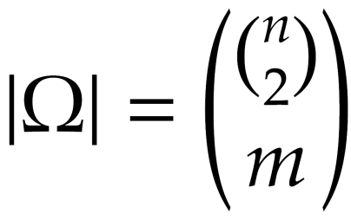
Random Graph Model - G(n,m)
Another way of randomly generating graphs is to assume both number of nodes n and number of edges m are fixed. However, we need to determine which m edges are selected from the set of possible edges
Let denote the set of graphs with n nodes and m edges
There are |Ω| different graphs with n nodes and m edges
To generate a random graph, we uniformly select one of the |Ω| graphs (the selection probability is 1/|Ω|)
This model proposed first by Paul Erdos and Alfred Renyi

Slide 21
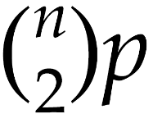
Modeling Random Graphs, Cont.
In the limit (when n is large), both models (G(n, p) and G(n, m)) act similarly
The expected number of edges in G(n, p) is
We can set and in the limit, we should get similar results.
Differences:
The G(n, m) model contains a fixed number of edges
The G(n, p) model is likely to contain none or all possible edges

Slide 22
Expected Degree
The expected number of edges connected to a node (expected degree) in G(n, p) is c=(n - 1)p
Proof:
A node can be connected to at most n-1 nodes (or n-1 edges)
All edges are selected independently with probability p
Therefore, on average, (n - 1)p edges are selected
C=(n-1)p or equivalently,

Slide 23
Expected Number of Edges
The expected number of edges in G(n, p) is p
Proof:
Since edges are selected independently, and we have a maximum edges, the expected number of edges is p

Slide 24
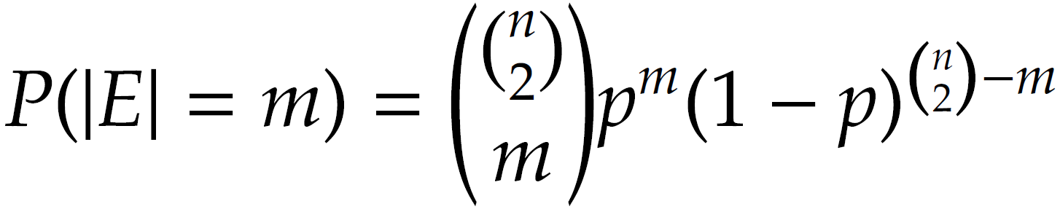
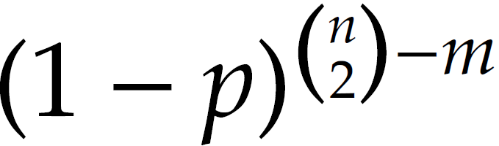
The probability of Observing m edges
Given the G(n, p) process, the probability of observing m edges is binomial distribution
Proof:
m edges are selected from the possible edges.
These m edges are formed with probability p^{m} and other edges are not formed (to guarantee the existence of only m edges) with probability

Slide 25
Evolution of Random Graphs
For a demo:
http://www.cs.purdue.edu/homes/dgleich/demos/erdos_renyi/er-150.gif
Create your own demo:
http://www.cs.purdue.edu/homes/dgleich/demos/erdos_renyi/

Slide 26
The Giant Component
In random graphs, when nodes form connections, after some time, a large fraction of nodes get connected, i.e., there is a path between any pair of them.
This large fraction forms a connected component, commonly called the largest connected component or the giant component.
In random graphs:
p = 0 ➔ the size of the giant component is 0
p = 1 ➔ the size of the giant component is n

Slide 27
The Giant Component
Probability (p) | 0.0 | 0.055 | 0.11 | 1.0
Average node degree (c) | 0.0 | 0.8 | ~1 | n-1 = 9
Diameter | 0 | 2 | 6 | 1
Giant component size | 0 | 4 | 7 | 10
Average path length | 0.0 | 1.5 | 2.66 | 1.0

Slide 28
Phase Transition
The point where diameter value starts to shrink in a random graph is called the Phase Transition.
In a random graph, phase transition happens when average node degree, c = 1, or when p = 1/(n-1)
At the point of Phase Transition, the following phenomena are observed:
The giant component that just started to appear, starts grow, and
The diameter that just reached its maximum value, starts decreasing.

Slide 29
Why c=1?
Consider a random graph with expected node degree c.
In this graph, consider any connected set of nodes S and
consider the complement set S’ =V-S
For the sake of our proof, we assume that S << S’.
Given any node v in S, if we move one hop (edge) away from v, we visit approximately c nodes. Following the same argument, if we move one hop away from nodes in S, we visit approximately |S|c nodes. Assuming S is small, the nodes in S only visit nodes in S’ and when moving one hop away from S, the set of nodes “guaranteed to be connected” gets larger by a factor c.
In the limit, if we want this connected component to become the largest component, then after traveling n hops we must have

Slide 30
Properties of Random Graphs

Slide 31
Degree Distribution
When computing degree distribution, we estimate the probability of observing P(dv = d) for node v
For a random graph generated by G(n,p) this probability is
This is a binomial degree distribution. In the limit this will become the Poisson degree distribution

Slide 32
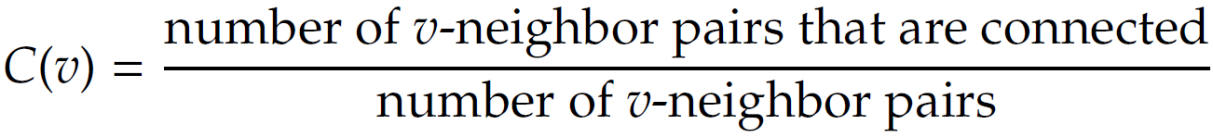
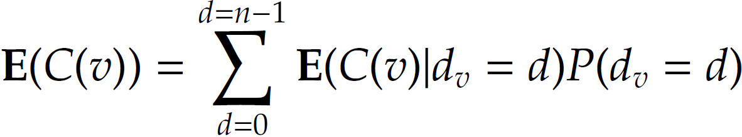
Expected Local Clustering Coefficient
The expected local clustering coefficient for node v of a random graph generated by G(n, p) is p
Proof:
v can have different degrees depending on the random procedure so the expected value is,

Slide 33
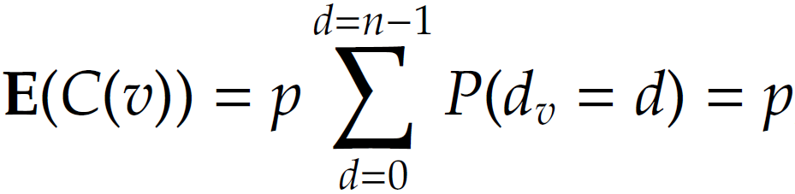
Expected Local Clustering Coefficient, Cont.

Slide 34
Global Clustering Coefficient
The global clustering coefficient of a random graph generated by G(n, p) is p
Proof:
The global clustering coefficient of any graph defines the probability of two neighbors of the same node that are connected.
In a random graph, for any two nodes, this probability is the same and is equal to the generation probability p that determines the probability of two nodes getting connected

Slide 35
The Average Path Length
The average path length in a random graph is

Slide 36
Modeling Real-World Networks with Random Graphs
Compute the average degree c, then compute p, by using: c/(n-1)= p, then generate the random graph
How good is the model?
random graphs perform well in modeling the average path lengths; however, when considering the transitivity, the random graph model drastically underestimates the clustering coefficient.

Slide 37
Real-World Networks and Simulated Random Graphs
Notes:
Sources?

Slide 38
Small-World Model

Slide 39
Small-world Model
Small-world Model also known as the Watts and Strogatz model is a special type of random graphs with small-world properties, including:
Short average path length and;
High clustering.
It was proposed by Duncan J. Watts and Steven Strogatz in their joint 1998 Nature paper

Slide 40
Small-world Model
In real-world interactions, many individuals have a limited and often at least, a fixed number of connections
In graph theory terms, this assumption is equivalent to embedding individuals in a regular network.
A regular (ring) lattice is a special case of regular networks where there exists a certain pattern on how ordered nodes are connected to one another.
In particular, in a regular lattice of degree c, nodes are connected to their previous c/2 and following c/2 neighbors. Formally, for node set , an edge exists between node i and j if and only if
Notes:
Average sp - l

Slide 41
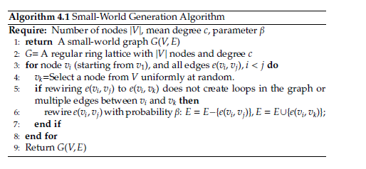
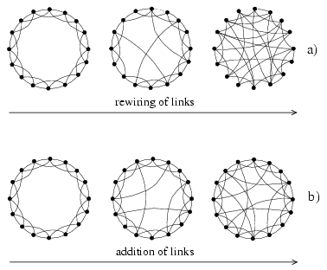
Constructing Small World Networks
As in many network generating algorithms
Disallow self-edges
Disallow multiple edges
Notes:
Image source: Watts, D. J.; Strogatz, S. H. (1998). "Collective dynamics of 'small-world' networks"

Slide 42
Small-World Model Properties

Slide 43
Degree Distribution
The degree distribution for the small-world model is
In practice, in the graph generated by the small world model, most nodes have similar degrees due to the underlying lattice.

Slide 44
Regular Lattice and Random Graph: Clustering Coefficient and Average Path Length
Regular Lattice:
Clustering Coefficient (high):
Average Path Length (high): n/2c
Random Graph:
Clustering Coefficient (low): p
Average Path Length (ok!) : ln |V|/ ln c

Slide 45
What happens in Between?
Does smaller average path length mean smaller clustering coefficient?
Does larger average path length mean larger clustering coefficient?
Through numerical simulation
As we increase p from 0 to 1
Fast decrease of average distance
Slow decrease in clustering coefficient

Slide 46
Change in Clustering Coefficient and Average Path Length as a Function of the Proportion of Rewired Edges
Exact analytical solution
No exact analytical solution
1% of links rewired
10% of links rewired
Notes:
When p = 0, it is a regular lattice – l(0) and C(0) average path length and clustering coefficient for a lattice.

Slide 47
Clustering Coefficient for Small-world model with rewiring
The probability that a connected triple stays connected after rewiring consists of two parts
The probability that none of the 3 edges were rewired is (1-p)³
The probability that other edges were rewired back to form a connected triple is very small and can be ignored
Clustering coefficient
p

Slide 48
Modeling Real-World Networks with the Small-World Model
Given a real-world network in which average
degree c and clustering coefficient C is given, we set C(p) = C and determine (=p) using equation
Given , c, and n (size of the real-world network), we can simulate the small-world model.

Slide 49
Real-World Network and Simulated Graphs

Slide 50
Preferential Attachment Model

Slide 51
Preferential Attachment: An Example
Networks:
When a new user joins the network, the probability of connecting to existing nodes is proportional to the nodes’ degree
Distribution of wealth in the society:
The rich get richer

Slide 52
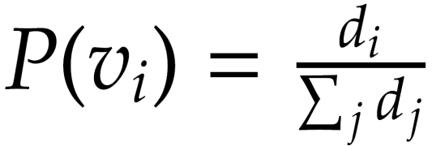
Constructing Scale-free Networks
Graph G(V₀, E) is given
For any new node v to the graph
Connect v to a random node v_{i} ∈ V₀, with probability

Slide 53
Properties of the Preferential Attachment Model

Slide 54
Properties
Degree Distribution:
Clustering Coefficient:
Average Path Length:

Slide 55
Modeling Real-World Networks with the Preferential Attachment Model
Similar to random graphs, we can simulate real-world networks by generating a preferential attachment model by setting the expected degree m (see Algorithm 4.2 – Slide 52)

Slide 56
Real-World Networks and Simulated Graphs

