Slide 1
Data Mining Essentials
Social Media Mining

Slide 2
Introduction
Data production rate has been increased dramatically (Big Data) and we are able store much more data than before
E.g., purchase data, social media data, mobile phone data
Businesses and customers need useful or actionable knowledge and gain insight from raw data for various purposes
It’s not just searching data or databases
The process of extracting useful patterns from raw data is known as Knowledge Discovery in Databases (KDD).

Slide 3
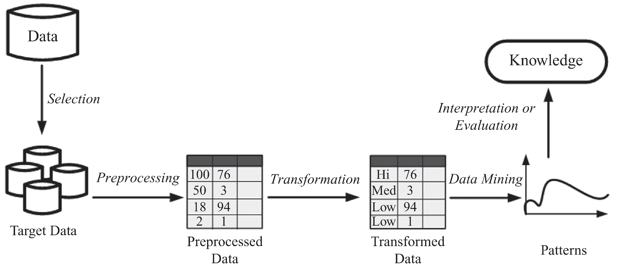
KDD Process

Slide 4
Data Mining
The process of discovering hidden patterns in large data sets
It utilizes methods at the intersection of artificial intelligence, machine learning, statistics, and database systems
Extracting or “mining” knowledge from large amounts of data, or big data
Data-driven discovery and modeling of hidden patterns in big data
Extracting implicit, previously unknown, unexpected, and potentially useful information/knowledge from data

Slide 5
Data

Slide 6
Data Instances
In the KDD process, data is represented in a tabular format
A collection of properties and features related to an object or person
A patient’s medical record
A user’s profile
A gene’s information
Instances are also called points, data points, or observations
Feature Value
Class Attribute
Data Instance:
Features ( Attributes or measurements)
Class Label

Slide 7
Data Instances
Predicting whether an individual who visits an online book seller is going to buy a specific book
Continues feature: values are numeric values
Money spent: $25
Discrete feature: Can take a number of values
Money spent: {high, normal, low}
Unlabeled
Example
Labeled
Example

Slide 8
Data Types + Permissible Operations (statistics)
Nominal (categorical)
Operations: Mode (most common feature value), Equality Comparison
E.g., {male, female}
Ordinal
Feature values have an intrinsic order to them, but the difference is not defined
Operations: same as nominal, feature value rank
E.g., {Low, medium, high}
Interval
Operations: Addition and subtractions are allowed whereas divisions and multiplications are not
E.g., 3:08 PM, calendar dates
Ratio
Operations: divisions and multiplications are are allowed
E.g., Height, weight, money quantities

Slide 9
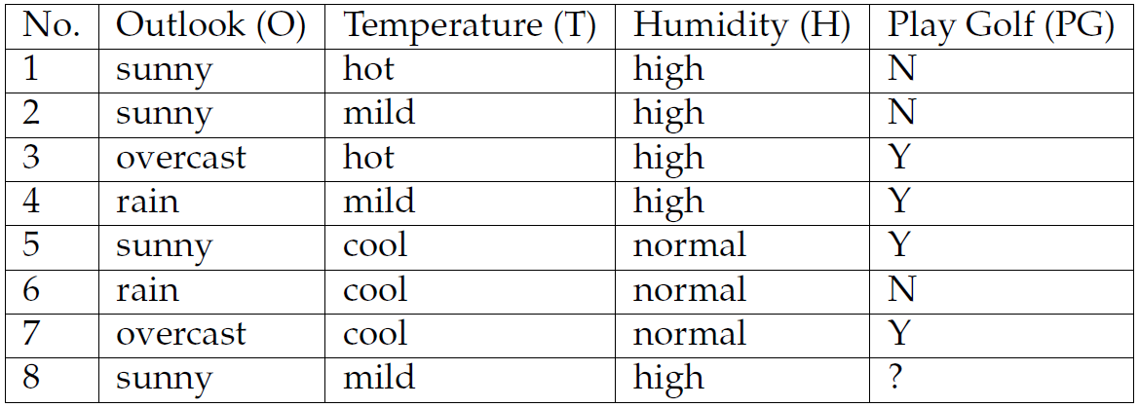
Sample Dataset
outlook | temperature | humidity | windy | play
sunny | 85 | 85 | FALSE | no
sunny | 80 | 90 | TRUE | no
overcast | 83 | 86 | FALSE | yes
rainy | 70 | 96 | FALSE | yes
rainy | 68 | 80 | FALSE | yes
rainy | 65 | 70 | TRUE | no
overcast | 64 | 65 | TRUE | yes
sunny | 72 | 95 | FALSE | no
sunny | 69 | 70 | FALSE | yes
rainy | 75 | 80 | FALSE | yes
sunny | 75 | 70 | TRUE | yes
overcast | 72 | 90 | TRUE | yes
overcast | 81 | 75 | FALSE | yes
rainy | 71 | 91 | TRUE | no
Interval
Ratio
Ordinal
Nominal
Notes:
Weather dataset

Slide 10
Text Representation
The most common way to model documents is to transform them into sparse numeric vectors and then deal with them with linear algebraic operations
This representation is called “Bag of Words”
Methods:
Vector space model
TF-IDF

Slide 11
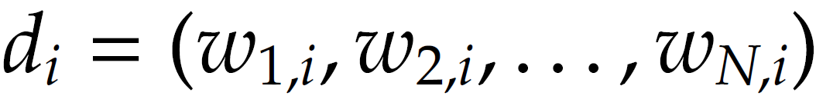
Vector Space Model
In the vector space model, we start with a set of documents, D
Each document is a set of words
The goal is to convert these textual documents to vectors
d_{i} : document i, w_{j,i} : the weight for word j in document i
we can set it to 1 when the word j exists in document i and 0 when it does not. We can also set this weight to the number of times the word j is observed in document i

Slide 12
Vector Space Model: An Example
Documents:
d1: data mining and social media mining
d2: social network analysis
d3: data mining
Reference vector:
(social, media, mining, network, analysis, data)
Vector representation:
 | analysis | data | media | mining | network | social
d1 | 0 | 1 | 1 | 1 | 0 | 1
d2 | 1 | 0 | 0 | 0 | 1 | 1
d3 | 0 | 1 | 0 | 1 | 0 | 0

Slide 13
TF-IDF (Term Frequency-Inverse Document Frequency)
tf-idf of term t, document d, and document corpus D is calculated as follows:
is the frequency of word j in document i
The total number of documents in the corpus
The number of documents where the term j appears

Slide 14
TF-IDF: An Example
Consider the words “apple” and “orange” that appear 10 and 20 times in document 1 (d1), which contains 100 words.
Let |D| = 20 and assume the word “apple” only appears in document d1 and the word “orange” appears in all 20 documents

Slide 15
TF-IDF : An Example
Documents:
d1: social media mining
d2: social media data
d3: financial market data
TF values:
TFIDF

Slide 16
Data Quality
When making data ready for data mining algorithms, data quality need to be assured
Noise
Noise is the distortion of the data
Outliers
Outliers are data points that are considerably different from other data points in the dataset
Missing Values
Missing feature values in data instances
To solve this problem: 1) remove instances that have missing values 2) estimate missing values, and 3) ignore missing values when running data mining algorithm
Duplicate data

Slide 17
Data Preprocessing
Aggregation
It is performed when multiple features need to be combined into a single one or when the scale of the features change
Example: image width , image height -> image area (width x height)
Discretization
From continues values to discrete values
Example: money spent -> {low, normal, high}
Feature Selection
Choose relevant features
Feature Extraction
Creating new features from original features
Often, more complicated than aggregation
Sampling
Random Sampling
Sampling with or without replacement
Stratified Sampling: useful when having class imbalance
Social Network Sampling

Slide 18
Data Preprocessing
Sampling social networks:
starting with a small set of nodes (seed nodes) and sample
(a) the connected components they belong to;
(b) the set of nodes (and edges) connected to them directly; or
(c) the set of nodes and edges that are within n-hop distance from them.

Slide 19
Data Mining Algorithms
Supervised Learning Algorithm
Classification (class attribute is discrete)
Assign data into predefined classes
Spam Detection, fraudulent credit card detection
Regression (class attribute takes real values)
Predict a real value for a given data instance
Predict the price for a given house
Unsupervised Learning Algorithm
Group similar items together into some clusters
Detect communities in a given social network

Slide 20
Supervised Learning

Slide 21
Classification Example
Learning patterns from labeled data and classify new data with labels (categories)
For example, we want to classify an e-mail as "legitimate" or "spam"

Slide 22
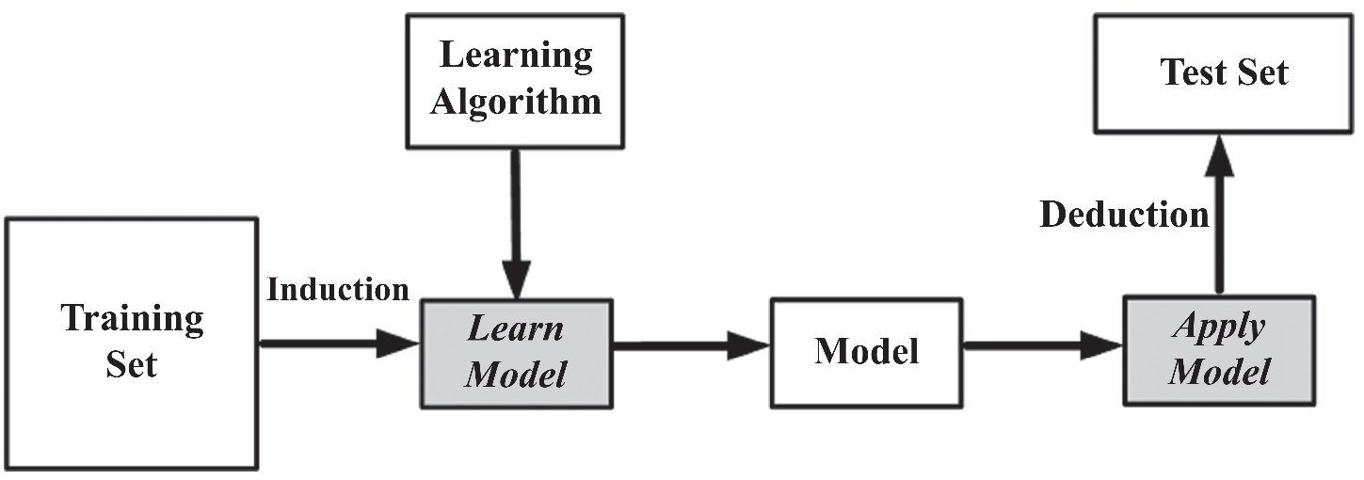
Supervised Learning: The Process
We are given a set of labeled examples
These examples are records/instances in the format (x, y) where x is a vector and y is the class attribute, commonly a scalar
The supervised learning task is to build model that maps x to y (find a mapping m such that m(x) = y)
Given an unlabeled instances (x’,?), we compute m(x’)
E.g., spam/non-spam prediction

Slide 23
A Twitter Example

Slide 24
Supervised Learning Algorithm
Classification
Decision tree learning
Naive Bayes Classifier
K-nearest neighbor classifier
Classification with Network information
Regression
Linear Regression
Logistic Regression

Slide 25
Decision Tree
A decision tree is learned from the dataset (training data with known classes) and later applied to predict the class attribute value of new data (test data with unknown classes) where only the feature values are known

Slide 26
Decision Tree: Example
Class Labels
Learned Decision Tree 1
Learned Decision Tree 2

Slide 27
Decision Tree Construction
Decision trees are constructed recursively from training data using a top-down greedy approach in which features are sequentially selected.
After selecting a feature for each node, based on its values, different branches are created.
The training set is then partitioned into subsets based on the feature values, each of which fall under the respective feature value branch; the process is continued for these subsets and other nodes
When selecting features, we prefer features that partition the set of instances into subsets that are more pure. A pure subset has instances that all have the same class attribute value.

Slide 28
Decision Tree Construction
When reaching pure subsets under a branch, the decision tree construction process no longer partitions the subset, creates a leaf under the branch, and assigns the class attribute value for subset instances as the leaf’s predicted class attribute value
To measure purity we can use [minimize] entropy. Over a subset of training instances, T, with a binary class attribute (values in {+,-}), the entropy of T is defined as:
p₊ is the proportion of positive examples in D
p₋ is the proportion of negative examples in D

Slide 29
Entropy Example
Assume there is a subset T, containing 10 instances. Seven instances have a positive class attribute value and three have a negative class attribute value [7+, 3-]. The entropy measure for subset T is
In a pure subset, all instances have the same class attribute value and the entropy is 0. If the subset being measured contains an unequal number of positive and negative instances, the entropy is between 0 and 1.

Slide 30
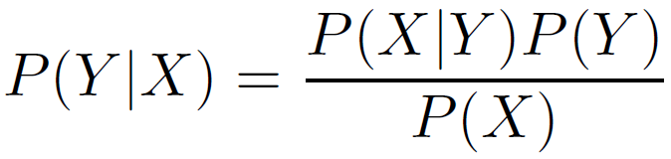
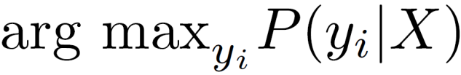
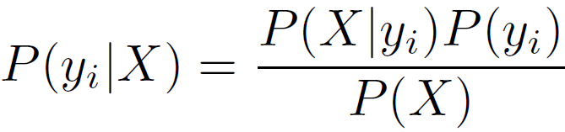
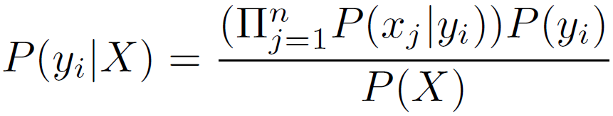

Naive Bayes Classifier
For two random variables X and Y, Bayes theorem states that,
class variable
the instance features
Then class attribute value for instance X
We assume that features are independent given the class attribute

Slide 31
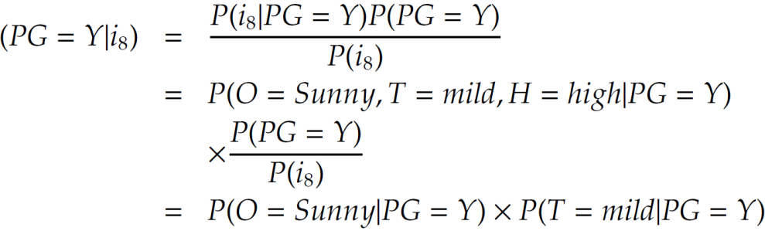
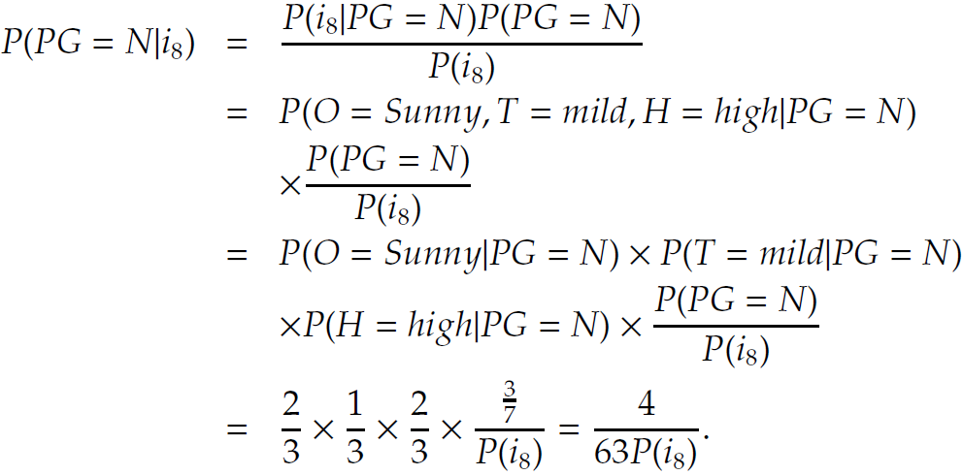
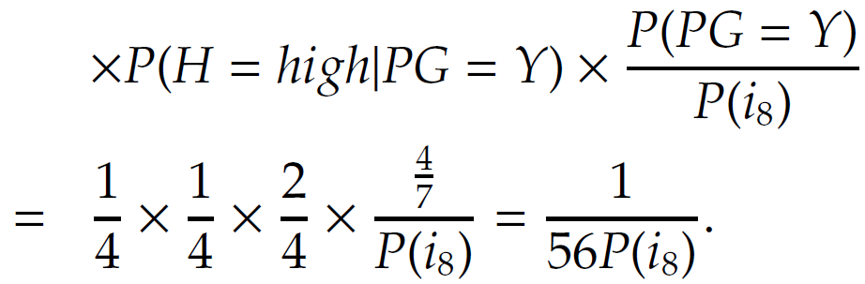
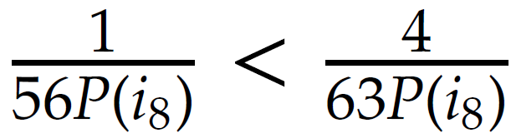

NBC: An Example

Slide 32
Nearest Neighbor Classifier
k-nearest neighbor or kNN, as the name suggests, utilizes the neighbors of an instance to perform classification.
In particular, it uses the k nearest instances, called neighbors, to perform classification.
The instance being classified is assigned the label (class attribute value) that the majority of its k neighbors are assigned
When k = 1, the closest neighbor’s label is used as the predicted label for the instance being classified
To determine the neighbors of an instance, we need to measure its distance to all other instances based on some distance metric. Commonly, Euclidean distance is employed

Slide 33
K-NN: Algorithm

Slide 34
K-NN example
When k=5, the predicted label is: triangle
When k=9, the predicted label is: square

Slide 35
Classification with Network Information
Consider a friendship network on social media and a product being marketed to this network.
The product seller wants to know who the potential buyers are for this product.
Assume we are given the network with the list of individuals that decided to buy or not buy the product. Our goal is to predict the decision for the undecided individuals.
This problem can be formulated as a classification problem based on features gathered from individuals.
However, in this case, we have additional friendship information that may be helpful in building better classification models

Slide 36
Let y_i denote the label for node i. We can assume that

Slide 37
Weighted-vote Relational-Neighbor (wvRN)
To find the label of a node, we can perform a weighted vote among its neighbors
Note that we need to compute these probabilities using some order until convergence [i.e., they don’t change]

Slide 38
wvRN example

Slide 39
Regression

Slide 40
Regression
In regression, the class attribute takes real values – In classification, class values or labels are categories
y ≈ f(X)
Class attribute(Dependent variable)
y ∈ R
Features (Regressors)
x₁, x₂, …, x_{m}
Regression finds the relation between y and the vector (x₁, x₂, …, x_{m})

Slide 41

Linear Regression
In linear regression, we assume the relation between the class attribute y and feature set x to be linear
where w represents the vector of regression coefficients
The problem of regression can be solved by estimating w and ε using the provided dataset and the labels y
The least squares is often used to solve the problem

Slide 42
Solving Linear Regression Problems
The problem of regression can be solved by estimating w and ε using the dataset provided and the labels y
“Least squares” is a popular method to solve regression problems

Slide 43
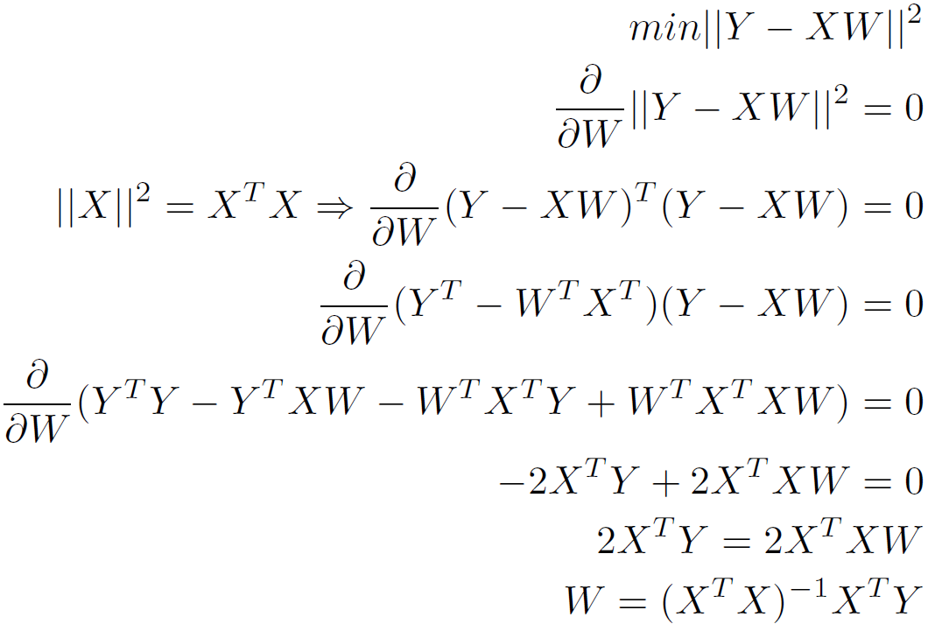
Least Squares
Find W such that minimizing ǁY - XWǁ² for regressors X and labels Y

Slide 44
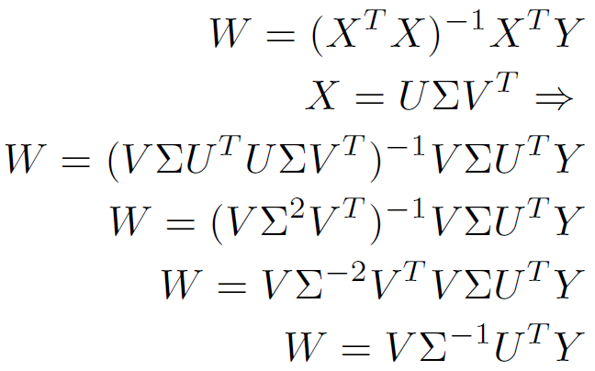
Least Squares

Slide 45
Evaluating Supervised Learning
To evaluate we use a training-testing framework
A training dataset (i.e., the labels are known) is used to train a model
the model is evaluated on a test dataset.
Since the correct labels of the test dataset are unknown, in practice, the training set is divided into two parts, one used for training and the other used for testing.
When testing, the labels from this test set are removed. After these labels are predicted using the model, the predicted labels are compared with the masked labels (ground truth).

Slide 46
Evaluating Supervised Learning
Dividing the training set into train/test sets
divide the training set into k equally sized partitions, or folds, and then using all folds but one to train and the one left out for testing. This technique is called leave-one-out training.
Divide the training set into k equally sized sets and then run the algorithm k times. In round i, we use all folds but fold i for training and fold i for testing. The average performance of the algorithm over k rounds measures the performance of the algorithm. This robust technique is known as k-fold cross validation.

Slide 47
Evaluating Supervised Learning
As the class labels are discrete, we can measure the accuracy by dividing number of correctly predicted labels (C) by the total number of instances (N)
Accuracy = C/N
Error rate = 1 – Accuracy
More sophisticated approaches of evaluation will be discussed later

Slide 48
Evaluating Regression Performance
The labels cannot be predicted precisely
It is needed to set a margin to accept or reject the predictions
For example, when the observed temperature is 71 any prediction in the range of 71±0.5 can be considered as correct prediction

Slide 49
Unsupervised Learning

Slide 50
Unsupervised Learning
Unsupervised division of instances into groups of similar objects
Clustering is a form of unsupervised learning
The clustering algorithms do not have examples showing how the samples should be grouped together (unlabeled data)
Clustering algorithms group together similar items

Slide 51
Measuring Distance/Similarity in Clustering Algorithms
The goal of clustering:
to group together similar items
Instances are put into different clusters based on the distance to other instances
Any clustering algorithm requires a distance measure
The most popular (dis)similarity measure for continuous features are Euclidean Distance and Pearson Linear Correlation

Slide 52
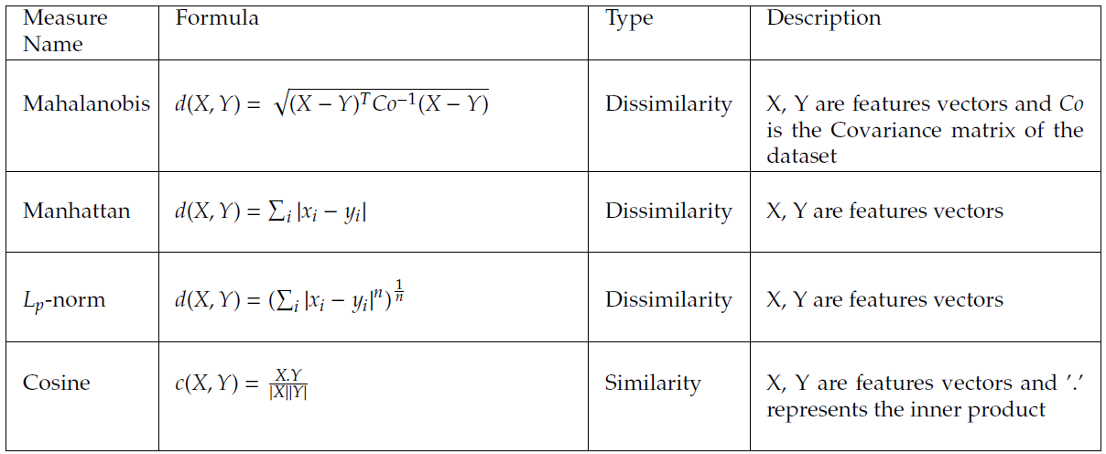
Similarity Measures: More Definitions
Once a distance measure is selected, instances are grouped using it.

Slide 53
Clustering
Clusters are usually represented by compact and abstract notations.
“Cluster centroids” are one common example of this abstract notation.
Partitional Algorithms
Partition the dataset into a set of clusters
In other words, each instance is assigned to a cluster exactly once and no instance remains unassigned to clusters.
k-Means

Slide 54
k-means for k=6

Slide 55
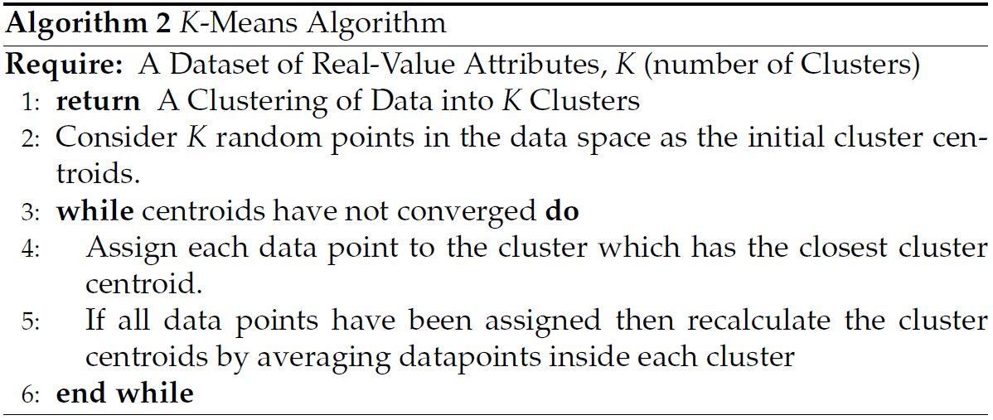
k-Means
The algorithm is the most commonly used clustering algorithm and is based on the idea of Expectation Maximization in statistics.

Slide 56
When do we stop?
Note that this procedure is repeated until convergence.
The most common criterion to determine convergence is to check whether centroids are no longer changing.
This is equivalent to clustering assignments of the data instances stabilizing.
In practice, the algorithm execution can be stopped when the Euclidean distance between the centroids in two consecutive steps is bounded above by some small positive

Slide 57
k-Means
As an alternative, k-means implementations try to minimize an objective function. A well-known objective function in these implementations is the squared distance error:
where is the jth instance of cluster i, n(i) is the number of instances in cluster i, and ci is the centroid of cluster i.
The process stops when the difference between the objective function values of two consecutive iterations of the k-means algorithm is bounded by some small value .

Slide 58
k-Means
Finding the global optimum of the k partitions is computationally expensive (NP-hard).
This is equivalent to finding the optimal centroids that minimize the objective function
However, there are efficient heuristic algorithms that are commonly employed and converge quickly to an optimum that might not be global.
running k-means multiple times and selecting the clustering assignment that is observed most often or is more desirable based on an objective function, such as the squared error.

Slide 59
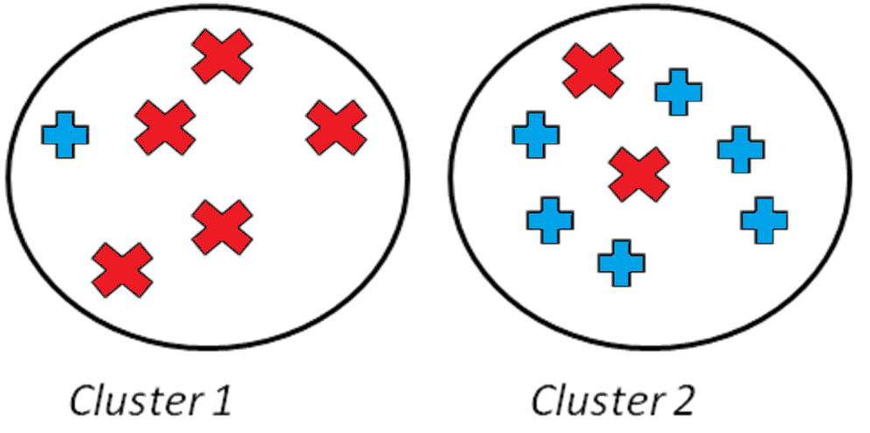
Evaluating the Clusterings
When we are given objects of two different kinds, the perfect clustering would be that objects of the same type are clustered together.
Evaluation with ground truth
Evaluation without ground truth

Slide 60
Evaluation with Ground Truth
When ground truth is available, the evaluator has prior knowledge of what a clustering should be
That is, we know the correct clustering assignments.
We will discuss these methods in community analysis chapter

Slide 61
Evaluation without Ground Truth
Cohesiveness
In clustering, we are interested in clusters that exhibit cohesiveness.
In cohesive clusters, instances inside the clusters are close to each other.
Separateness
We are also interested in clusterings of the data that generates clusters that are well separated from one another

Slide 62
Cohesiveness
Cohesiveness
In statistical terms, this is equivalent to having a small standard deviation, i.e., being close to the mean value.
In clustering, this translates to being close to the centroid of the cluster

Slide 63
Separateness
Separateness
We are also interested in clusterings of the data that generates clusters that are well separated from one another
In statistics, separateness can be measured by standard deviation.
Standard deviation is maximized when instances are far from the mean.
In clustering terms, this is equivalent to cluster centroids being far from the mean of the entire dataset

Slide 64
Separateness Example
In general we are interested in clusters that are both cohesive and separate -> Silhouette index

Slide 65
Silhouette Index
The silhouette index combines both cohesiveness and separateness.
It compares the average distance value between instances in the same cluster and the average distance value between instances in different clusters.
In a well-clustered dataset, the average distance between instances in the same cluster is small (cohesiveness) and the average distance between instances in different clusters is large (separateness).

Slide 66
Silhouette Index
For any instance x that is a member of cluster C
Compute the within-cluster average distance
Compute the average distance between x and instances in cluster G that is closest to x in terms of the average distance between x and members of G

Slide 67
Silhouette Index
Clearly we are interested in clusterings where a(x)<b(x)
Silhouette can take values between [-1,1]
The best case happens when for all x,
a(x)=0, b(x)>a(x)

Slide 68
Silhouette Index - Example

