Slide 1
Community Analysis
Social Media Mining

Slide 2
Social Community
A real-world community is a body of individuals with common economic, social, or political interests/characteristics, often living in relative proximity.（社群定义）

Slide 3
Social Media Communities（社交媒体社群）
A basic community comes to existence when likeminded users on social media form a link and start interacting with each other. （相似、联系、交互）
Any formation of a community requires
1) a set of at least two nodes sharing some interest and
2) interactions with respect to that interest.
Two types of groups in social media
Explicit Groups: formed by user subscriptions
Implicit Groups: implicitly formed by social interactions
(individuals calling Canada from the United States) -> the phone operator considers them one community for marketing purposes
We may see group, cluster, cohesive subgroup, or module in different contexts instead of “community”（其它称呼）

Slide 4
Examples of Explicit Social Media Communities
Facebook
Facebook has groups and communities. In both, users can post messages and images, can comment on other messages, can like posts, and can view activities of other users
Google+
Circles in Google+ represent communities
Twitter
Communities form as lists. Users join lists to receive information in the form of tweets
LinkedIn
LinkedIn provides Groups and Associations. Users can join professional groups where they can post and share information related to the group

Slide 5
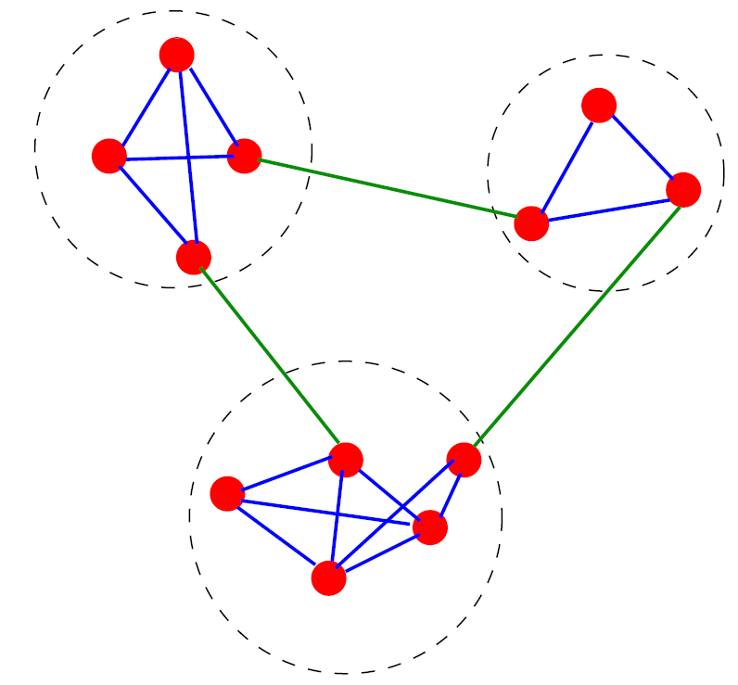
Communities: An Example
A simple graph with three communities, enclosed by the dashed circles
Source: S. Fortunato / Physics Reports 486 (2010) 75–174

Slide 6
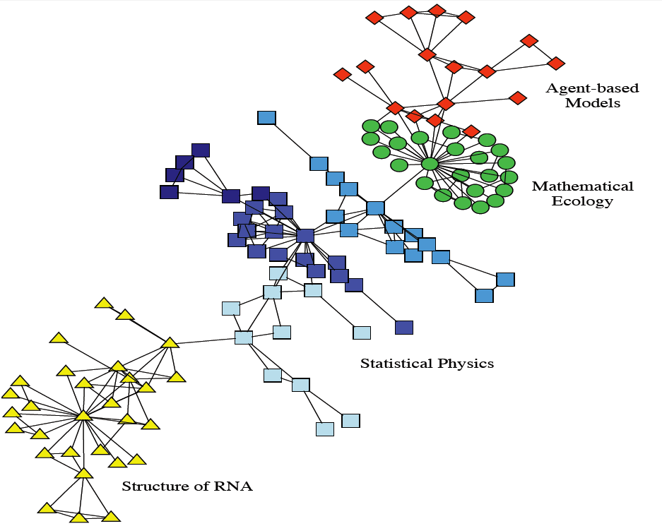
Real-world Communities: Scientists’ Collaboration Network（科学家协作网络）
Collaboration network between scientists working at the Santa Fe Institute.
The colors indicate high level communities and correspond to research divisions of the institute
Source: S. Fortunato / Physics Reports 486 (2010) 75–174

Slide 7
What Is Community Analysis?（社群分析）
Community detection
Discovering implicit communities
Community evolution
Studying temporal evolution of communities
Community evaluation
Evaluating Detected Communities

Slide 8
Community Detection

Slide 9
Definition
Community Detection is the process of finding clusters (‘‘communities’’) of nodes with strong internal connections and weak connections between different clusters（社群发掘定义）
An ideal decomposition of a large graph is into completely disjoint communities (groups of particles) where there are no interactions between different communities.（无重叠）
In practice, the task is to find a partition into communities which are maximally decoupled.（最大解耦）

Slide 10
Why Detecting Communities is Important?
Zachary‘s karate club:（空手道俱乐部）
Zachary observed 34 members of a karate club over two years. During the course of observation, the club members split into two groups because of the disagreement between the administrator of the club and the club’s instructor (highlighted nodes), and the members of one group left to start their own club

Slide 11
Why Community Detection?
A community can be considered as a summary of a group of nodes in the whole network, thus easy to visualize and understand.（网络构成）
Sometimes, a community can reveal some properties without releasing the individuals’ privacy information.（隐私保护）

Slide 12
Community Detection vs. Clustering
Most clustering algorithms can be used for community detection（聚类算法）
In general the difference is in having link information（链接信息）
Clustering algorithms works on the distance or similarity matrix
k-means
Network data tends to be “discrete”, leading to algorithms using the graph property directly
k-clique, quasi-clique, vertex-betweenness, edge-betweenness etc.
Graph clustering algorithms are more proper than traditional clustering algorithms（图的聚类算法更合适）

Slide 13
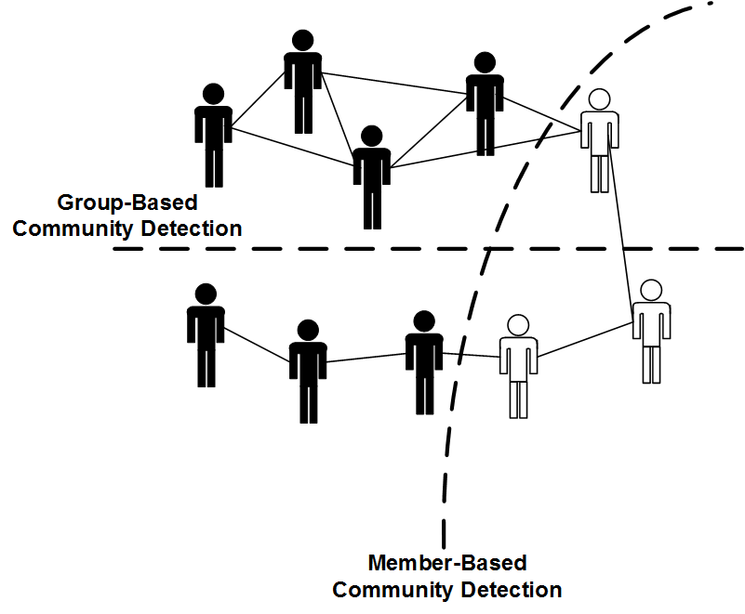
Community Detection Algorithms

Slide 14
Member-Based Community Detection

Slide 15
Member-Based Community Detection
Methods that concentrate on properties of nodes and in most cases assume that nodes with similar characteristics represent a community（关注节点属性）
Node Characteristics:
Degree: node with same (or similar) degree are in one community
cliques
Reachability: nodes that are close (small shortest path) are in the same community
k-clique, k-club, and k-clan
Similarity: similar nodes are in the same community

Slide 16
Node-Degree
Clique: a maximum complete subgraph in which all nodes are adjacent to each other（定义）
To find communities, we can search for
the maximum clique (the one with the largest number of vertices) or for
all maximal cliques (cliques that are not subgraphs of a larger clique; i.e., cannot be expanded further)
Both problems are NP-hard!
Thus, we can
For sufficiently small networks or subgraphs use brute force
Add some constraints such that the problem is relaxed and polynomially solvable
Use cliques as the seed or core of a larger community

Slide 17
Brute Force（蛮力法）
For each vertex v_{x}, we try to find the maximal clique that contains node v_{x}
The brute-force algorithm becomes impractical for large networks.
For a complete graph of only 100 nodes, the algorithm will generate at least 2⁹⁹ -1 different cliques starting from any node in the graph

Slide 18
Brute Force
We can improve performance:
by pruning specific nodes and edges. （去掉一些节点）
If the cliques being searched for are of size k or larger, we can simply assume that the clique, if found, should contain nodes that have degrees equal to or more than k -1
We can first prune all nodes (and edges connected to them) with degrees less than k-1
Due to the power-law distribution of node degrees, many nodes exist with small degrees (1, 2, etc.). Hence, for a large enough k many nodes and edges will be pruned

Slide 19
Brute Force
Even with pruning, there are intrinsic properties with cliques that make them a less desirable means for finding communities.
Cliques are rarely observed in the real world.（实际上很少存在）
For instance, consider a clique of 1,000 nodes
It has 999*1000/2 = 499,500 Edges
Removing one edge breaks the cliques (less than 0.0002%)
We can either
relax the clique structure or （降低结构要求）
use cliques as a seed or core of a community

Slide 20
Relaxing Cliques
k-plex
In a clique of size k, all nodes have the degree of k-1
In a k-plex, all nodes have a minimum degree that is not necessarily k-1.
For a set of vertices V, the structure is called a k-plex if we have
d_{v} is the the degree of v in the induced subgraph ( the number of nodes in set V that are connected to v)

Slide 21
K-plex example
A k-plex is maximal if it is not contained in a larger k-plex (i.e., with more nodes)
Finding the maximum k-plex is still NP-hard
In practice it is easier to due to smaller search space

Slide 22
Using Cliques as a seed of Community
Clique Percolation Method (CPM):
Input
A parameter k, and a network
Procedure
Find out all cliques of size k in the given network
Construct a clique graph.
Two cliques are adjacent if they share k-1 nodes
These connected components in the clique graph form a community

Slide 23
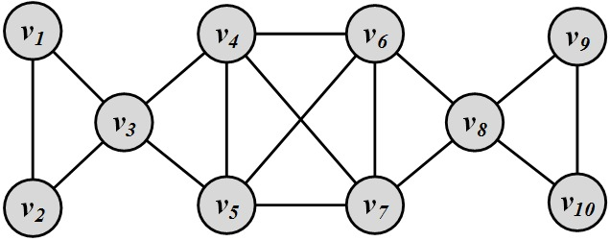
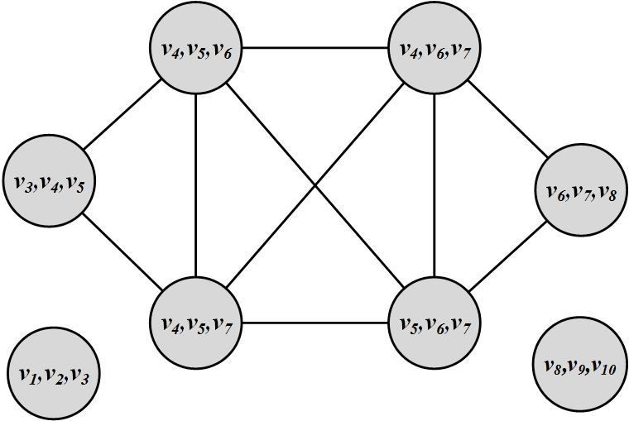
Clique Percolation Method: Example
Cliques of size 3:
{1, 2, 3}, {3, 4,5}, {4, 5, 7}, {4,5, 6}, {4,6,7}, {5,6, 7}, {6, 7, 8}, {8,9,10}
Communities:
{1, 2, 3} {8,9,10}
{3,4, 5, 6, 7, 8}

Slide 24
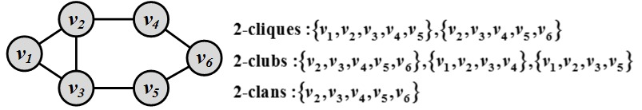
Node-Reachability（可抵达）
Any node in a group should be reachable in k hops
k-Clique: a maximal subgraph in which the largest geodesic distance between any nodes <= k
k-Club: it follows the same definition as k-clique with an additional constraint that nodes on the shortest paths should be part of the subgraph
k-Clans: it is a k-clique where for all shortest paths within the subgraph the distance is equal or less than k. All k-clans are k-cliques, but not vice versa.

Slide 25
Node Similarity（节点相似性）
Similar nodes (or most similar nodes) are assumed to be in the same community
Apply k-means or similarity-based clustering to nodes
Vertex similarity is defined in terms of the similarity of their neighborhood（邻居相似性）
Structural equivalence: two nodes are structurally equivalent iff they are connected to the same set of actors（结构等价：邻接节点相同）
similarity is based on the overlap between the neighborhood of the vertices.
A simple measure of vertex similarity can be defined as
For large networks, this value can increase rapidly, because nodes may share many neighbors. Generally, similarity is attributed to a value that is bounded and usually in the range [0, 1].
We normalize it!

Slide 26
Vertex Similarity: Normalization（正规相似性）
Jaccard Similarity
Cosine similarity

Slide 27
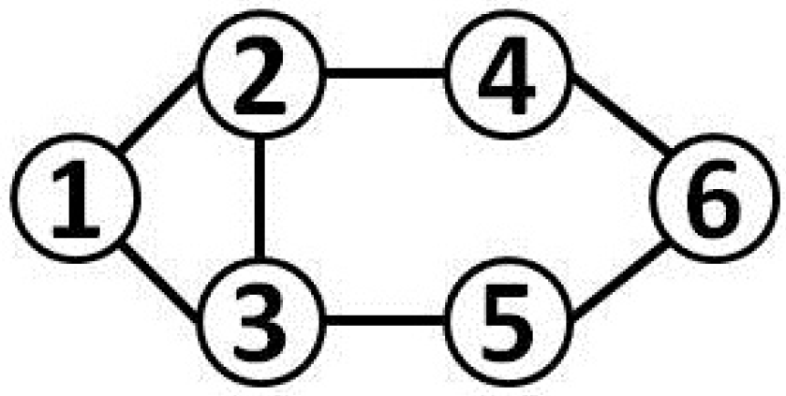
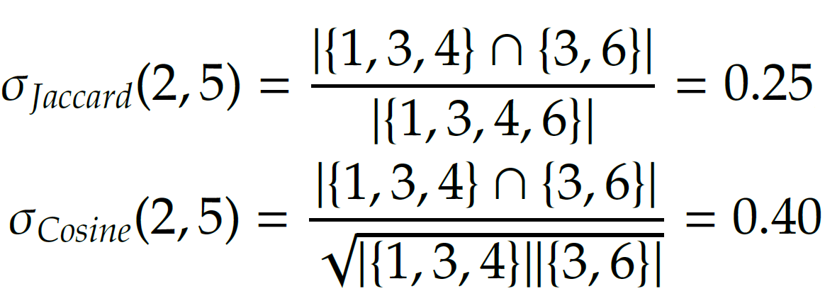
Vertex Similarity: Example

Slide 28
Group-Based Community Detection

Slide 29
Group-Based Community Detection
In group-based community detection, the global network information and topology is considered to determine communities（考虑整个网络结构）
We search for communities that are:
Balanced -> spectral clustering
Robust -> k-connected graphs
Modular -> Modularity Maximization
Dense -> Quasi-cliques
Hierarchical -> Hierarchical clustering

Slide 30
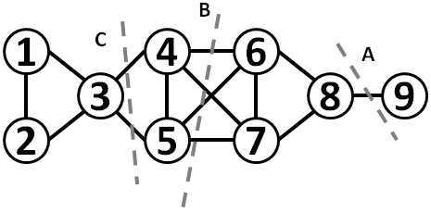
Balanced Communities: Spectral Clustering（谱聚类）
Graph clustering can be used for community detection
Most interactions are within group whereas interactions between groups are few
community detection → a minimum cut problem（最小切割问题）
Cut: a partitioning (cut) of the graph into two (or more) sets (cutsets).
The size of the cut is the number of edges that are being cut and the summation of weights of edges that are being cut in a weighted graph.
Minimum cut (min-cut): is a cut such that the size of the cut is minimized.
Cut B has size 4
A is the minimum cut

Slide 31
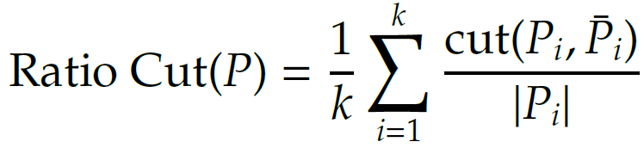
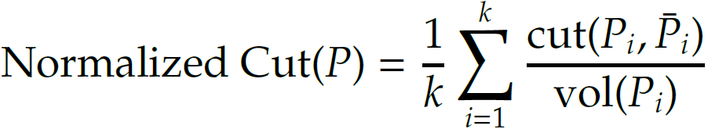
Ratio Cut & Normalized Cut（两种切割）
Minimum cut often returns an imbalanced partition, with one set being a singleton
Change the objective function to consider community size

Slide 32
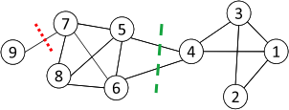



Ratio Cut & Normalized Cut: Example
For partition in red:
For partition in green:
Both ratio cut and normalized cut prefer a balanced partition
Notes:
From Lei Tang’s Slides

Slide 33
Spectral Clustering
Both ratio cut and normalized cut can be reformulated in matrix format（两种切割，表达为矩阵形式）
Let X_{ij} =1 when node i is member of community j and 0, otherwise
Let be the diagonal degree matrix
Then the ith entry on the diagonal of X^{T}AX represents the number of edges that are inside community i.
Similarly, the ith element on the diagonal of X^{T}DX represents the number of edges that are connected to members of community i.
The ith element on the diagonal of X^{T}(D-A)X represents the number of edges that are in the cut that separates community i from all other nodes.
The ith diagonal element of X^{T}(D-A)X is equivalent to

Slide 34
Spectral Clustering
So ratio cut is

Slide 35
Spectral Clustering
Both ratio cut and normalized cut can be reformulated as
Spectral relaxation:
is a diagonal degree matrix
Optimal solution:
is the top eigenvectors with the smallest eigenvalues

Slide 36
Because we performed spectral relaxation, the matrix obtained is not integer valued
To recover X from we can run k-means on

Slide 37
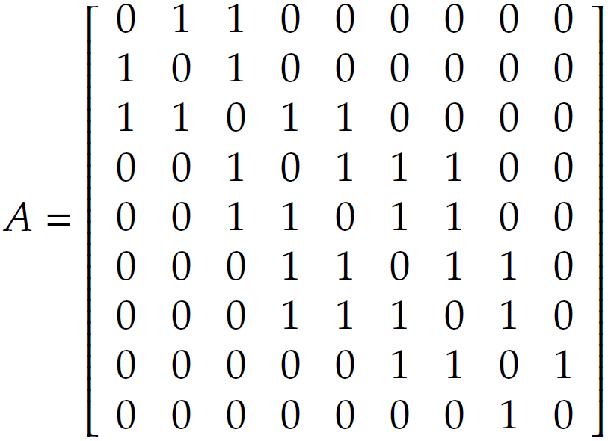
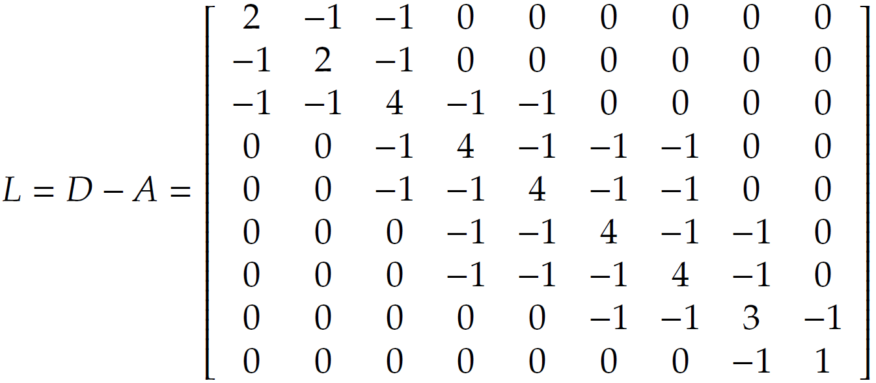
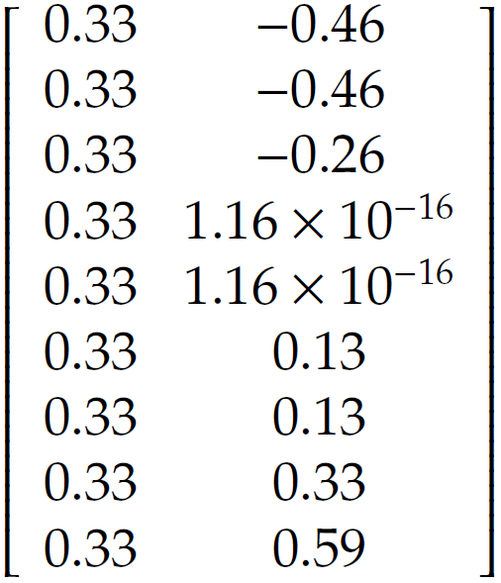
Spectral Clustering: Example (k=2)
D = diag(2, 2, 4, 4, 4, 4, 4, 3, 1)
Eigenvectors
Notes:
The 1st eigenvector is discarded

Slide 38
Robust Communities（鲁棒社群）
The goal is find subgraphs robust enough such that removing some edges or vertices does not disconnect the structure（移除节点或边对连接性的影响）
A k-vertex connected graph:
k is the minimum number of nodes needed to removed to disconnect the graph, (there exist at least k independent paths between any pair of nodes)
Similar concept: k-edge connected graph
need to remove k edges to disconnect the graph
A complete graph of size n is a unique (n) connected graph and a cycle is a 2-connected graph（完全图和圆）

Slide 39
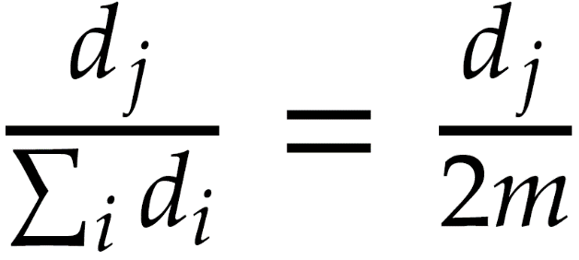
Modular Communities: Modularity Maxmization
Consider a graph G(V, E), |E| = m where the degrees are known beforehand, however, edges are not
Consider two vertices v_{i} and v_{j} with degrees d_{i} and d_{j}.
Now what is an expected number of edges between these two nodes?
For any edge going out of v_{i} randomly the probability of this edge getting connected to vertex v_{j} is

Slide 40
Modularity Maximization: Main Idea（模块性）
Given a degree distribution, we know the expected number of edges between any pairs of vertices
We assume that real-world networks should be far from random. Therefore, the more distant they are from this randomly generated network, the more structural they are（假设现实网络是非随机的）
Modularity defines this distance and modularity maximization tries to maximize this distance（定义）

Slide 41
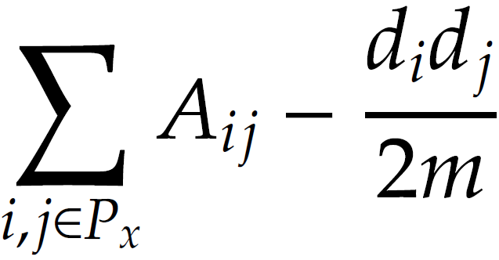
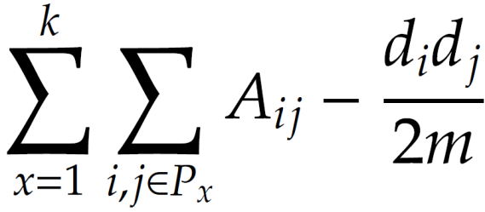
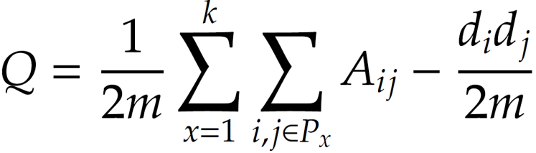
Normalized Modularity（正规模块性）
Consider a partitioning of the data, P = (P₁, P₂, P₃, …, P_{k})
For partition P_{x}, this distance can be defined as
This distance can be generalized for k partitions
The normalized version of this distance is defined as Modularity

Slide 42
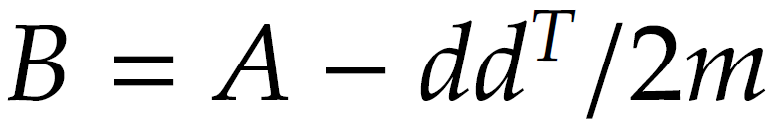
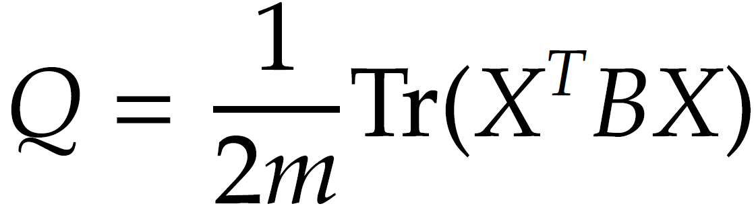
Modularity Maximization（矩阵描述）
Modularity matrix
d ∈ R^{n*1} is the degree vector for all nodes
Reformulation of the modularity
Similar to Spectral clustering, we relax X to be orthogonal.
Then, the optimal solution is the top k eigenvectors of B.
Similar to spectral clustering, to recover the original X, we can run k-means on the orthogonal matrix
In Modularity the top k eigenvalues have to be positive for this to work!

Slide 43
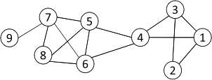
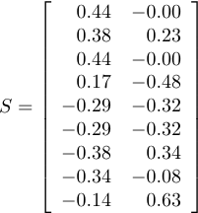
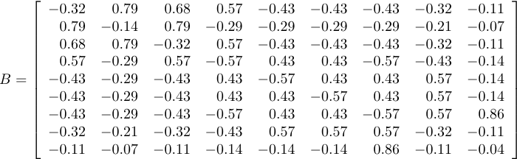
Modularity Maximization: Example
Two Communities:
{1, 2, 3, 4} and {5, 6, 7, 8, 9}
k-means
Modularity Matrix

Slide 44
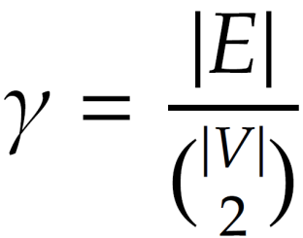
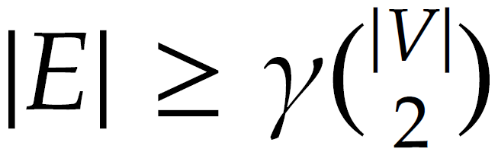
Dense Communities: γ-dense（密度社群）
The density of a graph defines how close a graph is to a clique
A subgraph G(V, E) is a γ-dense (or quasi-clique) if
A 1-dense graph is a clique
Quasi-cliques can be searched for using the brute –force method discussed before

Slide 45
Hierarchical Communities: Hierarchical Clustering（层次聚类）
All methods discussed up till now have considered communities at a single level.
In reality, communities may have hierarchies. Each community can have sub/super communities.
Hierarchical clustering deals with this scenario and generates community hierarchies.
Initially n actors are considered as either 1 or n communities in hierarchical clustering
These communities are gradually merged or split (agglomerative or divisive hierarchical clustering algorithms)（两个方向）

Slide 46
Hierarhical Community Detection
Goal: build a hierarchical structure of communities based on network topology
Allow the analysis of a network at different resolutions（允许不同粒度分析网络）
Representative approaches:
Divisive Hierarchical Clustering
Agglomerative Hierarchical clustering

Slide 47
Divisive Hierarchical Clustering
Divisive clustering（分割法）
Partition nodes into several sets
Each set is further divided into smaller ones
Network-centric partition can be applied for the partition
One particular example:
Girvan-Newman Example: recursively remove the “weakest” links within a “community” to be found
Find the edge with the weakest link
Remove the edge and update the corresponding strength of each edge
Recursively apply the above two steps until a network is discomposed into a desired number of connected components.（去掉最弱连接）
Each component forms a community

Slide 48
Edge Betweenness
To determine weakest links, the algorithm uses edge betweenness.（如何找最弱连接）
Edge betweenness is the number of shortest paths that pass along with the edge（定义）
Edge betweenness measures the “bridgeness” of an edge between two communities
The edge with high betweenness tends to be the bridge between two communities.

Slide 49
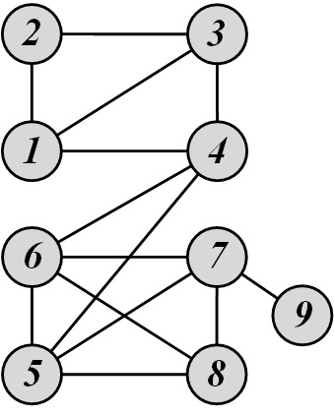
Edge Betweenness: Example
The edge betweenness of e(1, 2) is 6/2 + 1 = 4, as all the shortest paths from 2 to {4, 5, 6, 7, 8, 9} have to either pass e(1, 2) or e(2, 3), and e(1,2) is the shortest path between 1 and 2

Slide 50
The Girvan-Newman Algorithm
Calculate edge betweenness for all edges in the graph.
Remove the edge with the haighest betweenness.
Recalculate betweenness for all edges aected by the edge removal.
Repeat until all edges are removed.

Slide 51
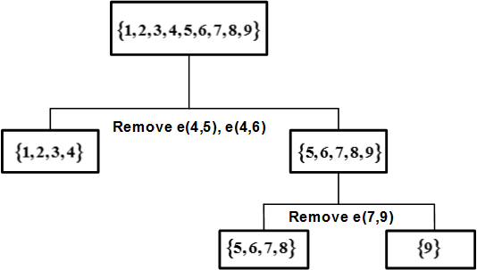
Edge Betweenness Divisive Clustering: Example
Initial betweenness value
the first edge that needs to be removed is e(4, 5) (or e(4, 6))
By removing e(4, 5), we compute the edge betweenness once again; this time, e(4, 6) has the highest betweenness value: 20.
This is because all shortest paths between nodes {1,2,3,4} to nodes {5,6,7,8,9} must pass e(4, 6);
therefore, it has betweenness 4*5 = 20.

Slide 52
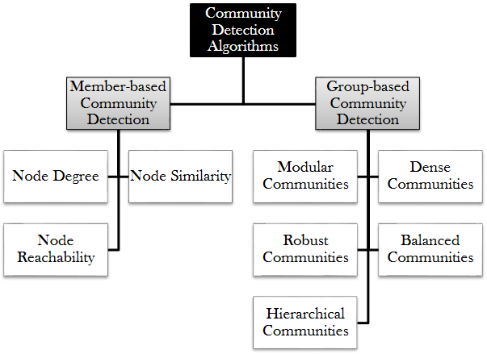
Community Detection Algorithms（社群发掘总结）

Slide 53
Community Evolution

Slide 54
Network and Community Evolution（网络和社群演化）
How does a network change over time?
How does a community change over time?
What properties do you expect to remain roughly constant?
What properties do you expect to change?
For example,
Where do you expect new edges to form?
Which edges do you expect to be dropped?

Slide 55
How Networks Evolve?

Slide 56
Network Growth Patterns（网络生长模型）
Network Segmentation
Graph Densification
Diameter Shrinkage

Slide 57
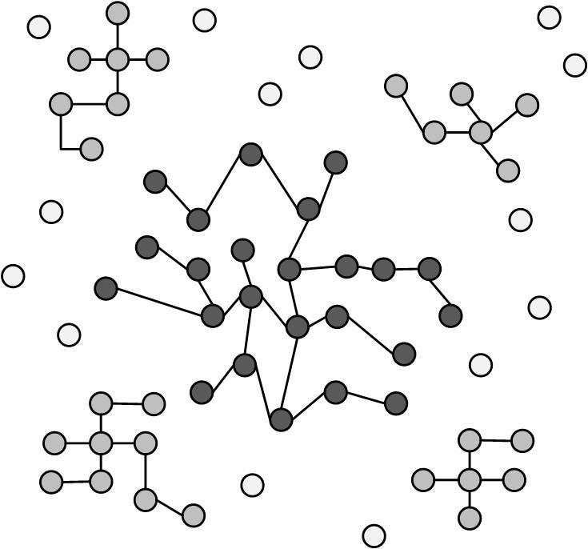
Network Segmentation（网络分化）
Often, in evolving networks, segmentation takes place, where the large network is decomposed over time into three parts
Giant Component: As network connections stabilize, a giant component of nodes is formed, with a large proportion of network nodes and edges falling into this component.
Stars: These are isolated parts of the network that form star structures. A star is a tree with one internal node and n leaves.
Singletons: These are orphan nodes disconnected from all nodes in the network.

Slide 58
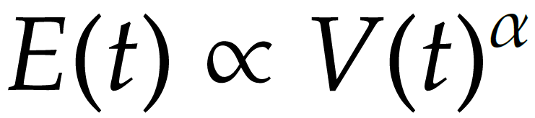
Graph Densification
The density of the graph increases as the network grows
The number of edges increases faster than the number of nodes does
Densification exponent: 1 ≤ α ≤ 2:
α =1: linear growth – constant out-degree
α =2: quadratic growth – clique
E(t) and V(t) are numbers of edges and nodes respectively at time t

Slide 59
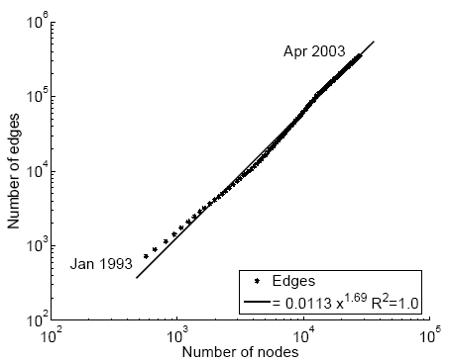
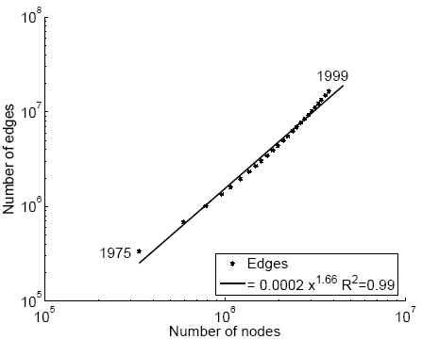
Densification in Real Networks
E(t)
E(t)
1.69
1.66
V(t)
V(t)
Physics Citations
Patent Citations
Notes:
Source: Leskovec et al. KDD 2005

Slide 60
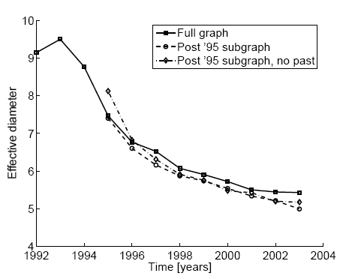
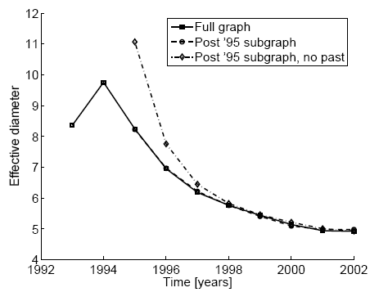
Diameter Shrinking（直径收缩）
In networks diameter shrinks over time
ArXiv citation graph
Affiliation Network

Slide 61
How Communities Evolve?

Slide 62
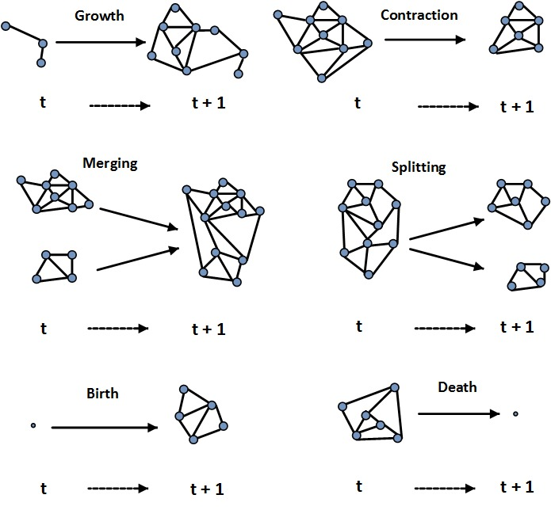
Community Evolution（社群演化）
Communities also expand, shrink, or dissolve in dynamic networks

Slide 63
Community Evaluation

Slide 64
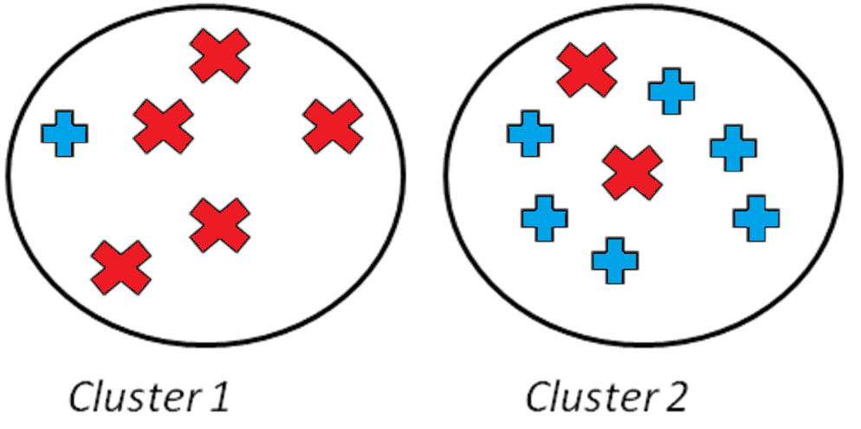
Evaluating the Communities（评估社群）
When we are given objects of two different kinds, the perfect communities would be that objects of the same type are in the same community.
Evaluation with ground truth（有真相）
Evaluation without ground truth（无真相）

Slide 65
Evaluation with Ground Truth
When ground truth is available, we have at least partial knowledge of what communities should look like.
We are given the correct community (clustering) assignments.
Measures（评判测度）
Precision and Recall, or F-Measure
Purity
Normalized Mutual Information (NMI)
Notes:
TP – the intersection of the two oval shapes; TN – the rectangle minus the two oval shapes; FP – the circle minus the blue part; FN – the blue oval minus the circle. Accuracy = (TP+TN)/(TP+FP+FN+FN); Precision = TP/(TP+FP); Recall = TP/(TP+FN)

Slide 66
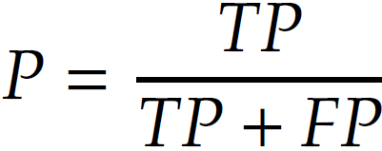
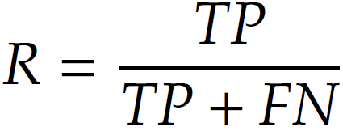


Precision and Recall
$\text{Precision}\text{ =}$ $\frac{\text{Relevant} \text{and} \text{retrieved}}{\text{Retrieved}}$
$\text{Recall}\text{ =}$ $\frac{\text{Relevant} \text{and} \text{retrieved}}{\text{Relevant}}$
True Positive (TP) :
when similar points are assigned to the same communities
This is considered a correct decision.
True Negative (TN) :
when dissimilar points are assigned to different communities
This is considered a correct decision
False Negative (FN) :
when similar points are assigned to different communities
This is considered an incorrect decision
False Positive (FP) :
when dissimilar points are assigned to the same communities
This is considered an incorrect decision

Slide 67

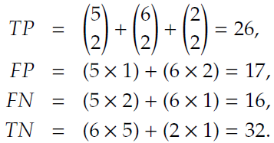


Precision and Recall: Example 1
Notes:
TP+FP = C(6,2) + C(8,2) = 15+28 = 43; FP counts the wrong pairs within each cluster; FN counts the similar pairs but wrongly put into different clusters; TN counts dissimilar pairs in different clusters

Slide 68
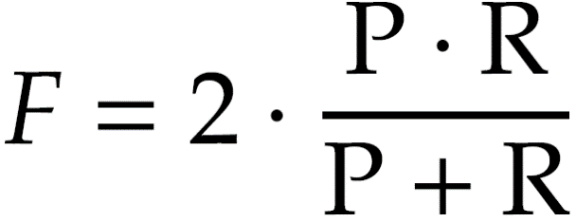
F-Measure
Either P or R measures one aspect of the performance, to integrate them into one measure, we can use the harmonic mean of precision of recall
For the example earlier, F = 0.60

Slide 69


Purity（纯度）
In purity, we assume the majority of a community represents the community
Hence, we use the label of the majority against the label of each member to evaluate the algorithm
The purity is then defined as the fraction of instances that have labels equal to the community’s majority label
Purity can be easily tampered; consider points being singleton communities (of size 1) or very large communities.
In both cases, purity does not make much sense.
where k is the number of communities, N is the total number of nodes, L_{j} is the set of instances with label j in all communities, and C_{i} is the set of members in community i.
Notes:
N – the total number of data points.

Slide 70
Mutual Information（共有信息）
Mutual information (MI) describes the amount of information that two random variables share.
In other words, by knowing one of the variables, MI measures the amount of uncertainty reduced regarding the other variable.
L and H are labels and found communities;
n_{h} and n_{l} are the number of data points in community h and with label l, respectively;
n_{h,l} is the number of nodes in community h and with label l; and n is the number of nodes

Slide 71
Normalizing Mutual Information（正规共有信息）
Mutual information is unbounded
To address this issue, we can normalize mutual information
We know that,
H(.) is the entropy function

Slide 72
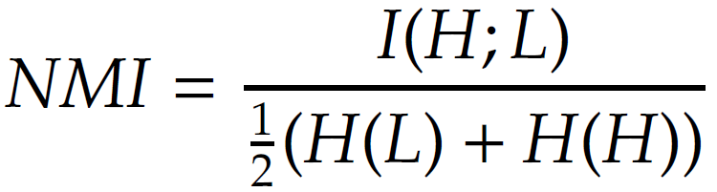
Normalized Mutual Information
Normalized Mutual Information
We can also define it as
Note that MI<1/2(H(H)+H(L)

Slide 73
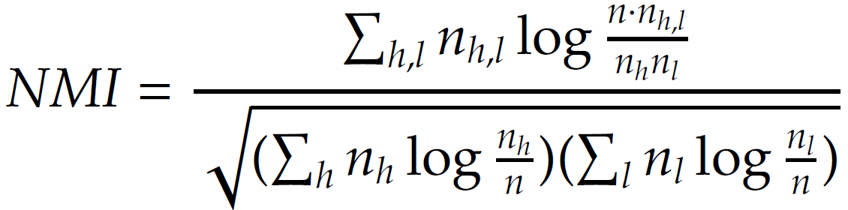
Normalized Mutual Information
where l and h are known (with labels) and found communities, respectively
n_{h} and n_{l} are the number of data points in the community h and l, respectively,
n_{h,l} is the number of points in community h and labeled l,
n is the size of the dataset
NMI values close to one indicate high similarity between communities found and labels
Values close to zero indicate high dissimilarity between them

Slide 74
Evaluation without Ground Truth（无真相）
Evaluation with Semantics
A simple way of analyzing detected communities is to analyze other attributes (posts, profile information, content generated, etc.) of community members to see if there is a coherency among community members
The coherency is often checked via human subjects.
With mechanical Turk
To help analyze these communities, one can use word frequencies. By generating a list of frequent keywords for each community, human subjects determine whether these keywords represent a coherent topic.
Evaluation Using Clustering Quality Measures
Use clustering quality measures (SSE)
Use more than two community detection algorithms and compare the results and pick the algorithm with better quality measure

