Slide 1
Information Diffusion in Social Media
Social Media Mining
社交媒体信息传播

Slide 2
Definition
In February 2013, during the third quarter of Super Bowl XLVII, a power outage stopped the game for 34 minutes.
Oreo, a sandwich cookie company, tweeted during the outage: “Power out? No Problem, You can still dunk it in the dark”.
The tweet caught on almost immediately, reaching nearly 15,000 retweets and 20,000 likes on Facebook in less than 2 days.
A simple tweet diffused into a large population of individuals.
It helped the company gain fame with minimum budget in an environment where companies spent as much as 4 million dollars to run a 30 second ad during the super bowl.
This is an example of Information Diffusion.（信息传播）

Slide 3
Information diffusion is studied in a plethora of sciences.
We discuss methods from fields such as sociology, epidemiology, and ethnography, which can help social media mining.
Our focus is on techniques that can model information diffusion.（传播模型）
Information diffusion: process by which a piece of information (knowledge) is spread and reaches individuals through interactions.
Notes:
Plethora:众多

Slide 4
Information Diffusion
Sender(s). A sender or a small set of senders that initiate the information diffusion process;（发送者）
Receiver(s). A receiver or a set of receivers that receive diffused information. Commonly, the set of receivers is much larger than the set of senders and can overlap with the set of senders; and（接收者）
Medium. This is the medium through which the diffusion takes place. For example, when a rumor is spreading, the medium can be the personal communication between individuals（媒介）

Slide 5
Information Diffusion Types
We define the process of interfering with information diffusion
by expediting, delaying, or even stopping diffusion as Intervention
Notes:
Expediting:加速

Slide 6
Herd Behavior 羊群效应
Network is observable
Only public information is available

Slide 7
Herd Behavior Example
Consider people participating in an online auction. （在线拍卖）
In this case, individuals can observe the behavior of others by monitoring the bids that are being placed on different items.
Individuals are connected via the auction’s site where they can not only observe the bidding behaviors of others, but can also often view profiles of others to get a feel for their reputation and expertise. （拍卖的场景）
In these online auctions, it is common to observe individuals participating actively in auctions, where the item being sold might otherwise be considered unpopular.
This is due to individuals trusting others and assuming that the high number of bids that the item has received is a strong signal of its value. In this case, Herd Behavior has taken place.（其他拍卖人员的引导作用）

Slide 8
Herd Behavior: Popular Restaurant Experiment（餐馆选择）
Assume you are on a trip in a metropolitan area that you are less familiar with.
Planning for dinner, you find restaurant A with excellent reviews online and decide to go there.
When arriving at A, you see A is almost empty and restaurant B, which is next door and serves the same cuisine, almost full.
Deciding to go to B, based on the belief that other diners have also had the chance of going to A, is an example of herd behavior

Slide 9
Herd Behavior: Milgram’s Experiment（Milgram’s 实验）
Stanley Milgram asked one person to stand still on a busy street corner in New York City and stare straight up at the sky.
About 4% of all passersby stopped to look up.
When 5 people stand on the sidewalk and look straight up at the sky, 20% of all passersby stopped to look up.
Finally, when a group of 18 people look up simultaneously, almost 50% of all passersby stopped to look up.
Notes:
From Easley & Kleinberg, 2010
补图描述
9

Slide 10
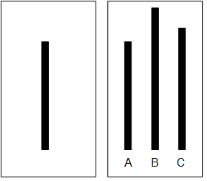
Herd Behavior: Solomom Asch’s Experiment
In one experiment, he asked groups of students to participate in a vision test where they were shown two cards, one with a single line segment and one with 3 lines, and the participants were required to match line segments with the same length.
Each participant was put into a group where all other group members were collaborators with Asch. These collaborators were introduced as participants to the subject.
Asch found that in control groups with no pressure to conform, only 3% of the subjects provided an incorrect answer.
However, when participants were surrounded by individuals providing an incorrect answer, up to 32% of the responses were incorrect.
（实验结果）

Slide 11

Herding: Elevator Example
http://www.youtube.com/watch?v=zNNz0yzHcwg

Slide 12
Herd Behavior
Herd behavior describes when a group of individuals performs actions that are highly correlated without any plans
Main Components of Herd Behavior
A method to transfer behavior among individuals or to observe their behavior
A connection between individuals
（羊群效应的主要构成）
Examples of Herd Behavior
Flocks, herds of animals, and humans during sporting events, demonstrations, and religious gatherings

Slide 13
Network Observability in Herb Behavior
In herd behavior, individuals make decisions by observing all other individuals’ decisions
In general, herd behavior’s network is close to a complete graph where nodes can observe at least most other nodes and they can observe public information（相互可见）
For example, they can see the crowd

Slide 14
Designing a Herd Behavior Experiment
There needs to be a decision made.
In our example, it is going to a restaurant
Decisions need to be in sequential order;
Decisions are not mindless and people have private information that helps them decide; and
No message passing is possible. Individuals don’t know the private information of others, but can infer what others know from what is observed from their behavior.
（羊群实验设计应满足的条件）

Slide 15
Herding: Urn Experiment
There is an urn in a large class with three marbles in it
During the experiment, each student comes to the urn, picks one marble, and checks its color in private.
The student predicts majority blue or red, writes her prediction on the blackboard, and puts the marble back in the urn.
Students can’t see the color of the marble taken out and can only see the predictions made by different students regarding the majority color on the board
B
B
R
R
R
B
50%
50%

Slide 16
Urn Experiment: First and Second Student
First Student:
Board: -
Observed: B → Guess: B
-or-
Observed: R → Guess: R
Second Student:
Board: B
Observed: B → Guess: B
-or-
Observed: R → Guess: R/B (flip a coin)

Slide 17
Urn Experiment: Third Student
If board: B, R
Observed: B → Guess: B, or
Observed: R → Guess: R
If board: B, B
Observed: B → Guess: B, or
Observed: R → Guess: B (Herding Behavior)
The forth student and onward
Board: B,B,B
Observed: B/R → Guess: B

Slide 18
Bayes’s Rule in the Herding Experiment
Each student tries to estimate the conditional probability that the urn is majority-blue or majority-red, given what she has seen or heard（概率分析）
She would guess majority-blue if:
From the setup of the experiment we know:
Pr[majority-blue | what she has seen or heard] > 1/2
Pr[majority-blue] = Pr[majority-red]=1/2
Pr[blue|majority-blue] = Pr[red|majority-red]=2/3

Slide 19
Bayes’s Rule in the Herding Experiment
Pr[majority-blue|blue] = Pr[blue|majority-blue] * Pr[majority-blue] / Pr[blue]
Pr[blue] = Pr[blue|majority-blue] * Pr[majority-blue]
+ Pr[blue|majority-red ] * Pr[majority-red ]
= 2/3 * 1/2 + 1/3 * 1/2 = 1/2
Pr[majority-blue|blue] = (2/3 * ½)/(1/2)
So the first student should guess “blue” when she sees “blue”
The same calculation holds for the second student

Slide 20
Bayes’s Rule in the Herding Experiment: Third Student
Pr[majority-blue|blue, blue, red] =
Pr[blue, blue, red|majority-blue] * Pr[majority-blue] / Pr[blue, blue, red]
Pr[blue, blue, red|majority-blue] = 2/3 * 2/3 * 1/3 = 4/27
Pr[blue, blue, red] = Pr[blue, blue, red|majority-blue] * Pr[majority-blue]
+ Pr[blue, blue, red|majority-red ] * Pr[majority-red ]
= (2/3 * 2/3 * 1/3) * 1/2 + (1/3 * 1/3 * 2/3) * 1/2 = 1/9
Pr[majority-blue|blue, blue, red] = (4/27 * 1/2) / (1/9) = 2/3
So the third student should guess “blue” even when she sees “red”
All future students will have the same information as the third student

Slide 21
Urn Experiment

Slide 22
Herding Intervention（干预）
In herding, the society only has access to public information. Herding may be intervened by releasing private information which was not accessible before
The little boy in “The Emperor’s New Clothes” story intervenes the herd by shouting “he's got no clothes on”

Slide 23
Herding Intervention
Milgram Experiment: To intervene the herding effect, we need one person to tell the herd that there is nothing in the sky（天空中没有任何东西）

Slide 24
How Does Intervention Work?
When a new piece of private information releases, the herd reevaluate their guesses and this may create completely new results（非公开信息）
The Emperor’s New Clothes
When the boy gives his private observation, other people compare it with their observation and confirm it
This piece of information may change others guess and ends the herding effect
In general, intervention is possible by providing private information to individuals not previously available. Consider an urn experiment where individuals decide on majority red over time. Either
1) a private message to individuals informing them that the urn is majority blue or
2) writing the observations next to predictions on the board stops the herding and changes decisions.

Slide 25
Information Cascade 信息级联
In the presence of a network
Only local information is available

Slide 26
Information Cascade
In social media, individuals commonly repost content posted by others in the network. This content is often received via immediate neighbors (friends).
An Information Cascade occurs as information propagates through friends（通过关联的朋友传递信息）
An information cascade is defined as a piece of information or decision being cascaded among a set of individuals, where
1) individuals are connected by a network and （个体关联形成网络）
2) individuals are only observing decisions of their immediate neighbors (friends). （邻接节点）
Therefore, cascade users have less information available to them compared to herding users, where almost all information about decisions are available.
In cascading, local information is available to the users, but in herding the information about the population is available.

Slide 27
Underlying Assumptions for Cascade Models（模型假设）
The network is represented using a directed graph. Nodes are actors and edges depict the communication channels between them. A node can only influence nodes that it is connected to;（有向图）
Decisions are binary - nodes can be either active or inactive. An active nodes means that the node decided to adopt the behavior, innovation, or decision;（节点：活动或非活动）
A node, once activated, can activate its neighboring nodes; and（活动节点可以激活非活动节点）
Activation is a progressive process, where nodes change from inactive to active, but not vice versa. （反之则不可以）

Slide 28
Independent Cascade Model (ICM)
Independent Cascade Model is a sender centric model of cascade（发送者为中心的级联模型）
In this model each node has one chance to activate its neighbors
Considering nodes that are active as senders and nodes that are being activated as receivers, （活动节点：发送者；被激活节点：接收者）
The linear threshold model concentrates on the receiver (to be discussed later).（针对接收者）
The independent cascade model concentrates on the sender（针对发送者）

Slide 29
Independent Cascade Model (ICM)
In Independent Cascade Model, the node that is activated at time t, has one chance, at time step t + 1, to activate its neighbors
Let v be an active node at time t, for any neighbor w of it, there’s a probability p_{vw} that node w gets activated at time t + 1. （t+1时刻的激活概率）
A node v activated at time t has a single chance of activating its neighbors and that activation can only happen at t + 1

Slide 30
ICM Algorithm

Slide 31
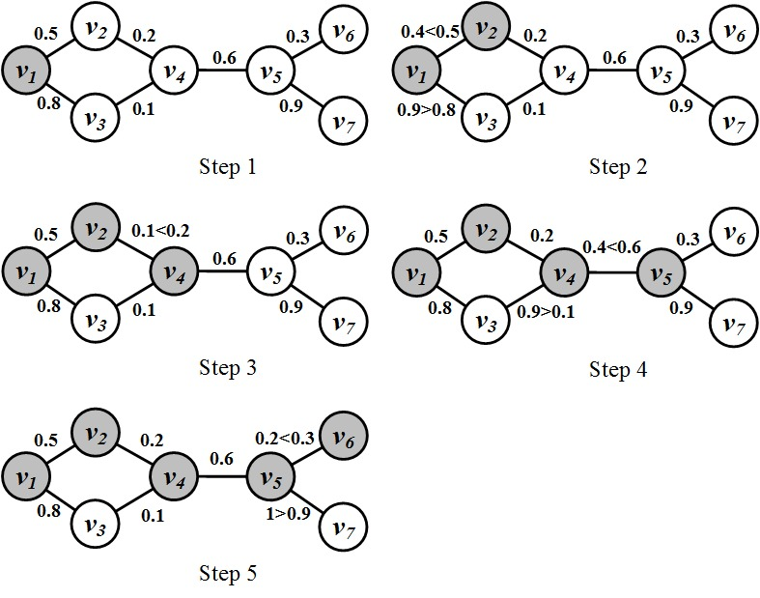
Independent Cascade Model: An Example

Slide 32
Maximizing the Spread of Cascades
极大化级联传播

Slide 33
Maximizing the spread of cascades
Maximizing the Spread of Cascades is the problem of ﬁnding a small set of nodes in a social network such that their aggregated spread in the network is maximized（极大化目标：节点集，传播效应极大化）
Applications
Product marketing
Influence

Slide 34
Problem Setting
Given
A limited budget B for initial advertising (e.g., give away free samples of product)
Estimating spread between individuals
Goal
To trigger a large spread (e.g., further adoptions of a product)（目标：传播/影响极大化）
Question
Which set of individuals should be targeted at the very beginning?

Slide 35
Maximizing the Spread of Cascade: Example
We need to pick k nodes such that maximum number of nodes are activated（找出k个顶点，使之激活最多节点）

Slide 36
Maximizing the Spread of Cascade
1
0
Select one seed
2
1
0
5
Select two seeds
0
2
3
4

Slide 37
Problem Statement
Spread of node set S: f(S)
An expected number of active nodes, if set S is the initial active set
Problem:
Given a parameter k (budget), find a k-node set S to maximize f(S)
A constrained optimization problem with f(S) as the objective function（优化问题，f(S)优化函数）
Notes:
the spread of a set of nodes A: the expected number of active nodes at the end of the process.

Slide 38
f(S): Properties
Non-negative (obviously)：非负性
Monotone: :单调性
Submodular:
Let N be a finite set
A set function is submodular iff

Slide 39
Some Facts Regarding this Problem
Bad News
For a submodular function monotone non-negative f, finding a k-element set S for which f(S) is maximized is an NP-hard optimization problem（NP-hard优化问题）
It is NP-hard to determine the optimum for influence maximization for both independent cascade model and linear threshold model (to be introduced in next chapter).（另类问题都是NP-hard）
Good News
We can use Greedy Algorithm（贪婪算法）
Start with an empty set S
For k iterations:
Add node v to S that maximizes f(S +v) - f(S).
How good (or bad) it is?（理论精度）
Theorem: The greedy algorithm is a (1 – 1/e) approximation.
The resulting set S activates at least (1- 1/e) > 63% of the number of nodes that any size-k set S could activate.

Slide 40
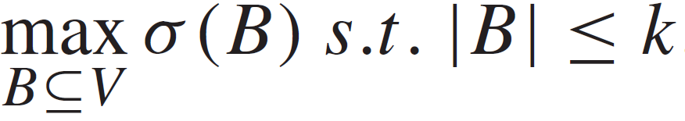
Cascade Maximization: A Greedy approach
Maximizing the cascade is a NP-hard problem but it is proved that the greedy approaches gives a solution that is at least 63 % of the optimal.
Given a network and a parameter k, which k nodes should be selected to be in the activation set B in order to maximize the cascade in terms of the total number of active nodes?（级联最大化：节点数目）
Let σ(B) denote the expected number of nodes that can be activated by B, the optimization problem can be formulated as follows:

Slide 41
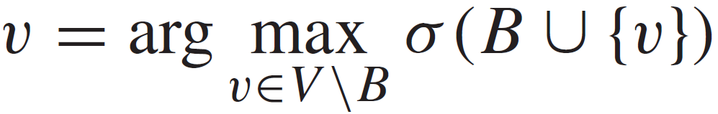
Cascade Maximization: A Greedy Approach
The Algorithm
Start with B = Ø
Evaluate σ(v) for each node, and pick the node with maximum σ as the first node v1 to form B = {v1}
Select a node which will increase σ(B) most if the node is included in B. （贪婪策略）
Essentially, we greedily find a node v ∈ V \B such that

Slide 42
Diffusion of Innovations
The network is not observable （网络不可见）
Only public information is observable（公共信息可见）

Slide 43
Diffusion of Innovation
an innovation is “an idea, practice, or object that is perceived as new by an individual or other unit of adoption”（innovation的定义）
The theory of diffusion of innovations aims to answer why and how these innovations spread. It also describes the reasons behind the diffusion process, individuals involved, as well as the rate at which ideas spread.（关注的问题）

Slide 44
Innovation Characteristics
For an innovation to be adopted, various qualities associated with different parts of the process need to be present
Observability, （可见性）
The degree to which the results of an innovation are visible to potential adopters
Relative Advantage（相对优势）
The degree to which the innovation is perceived to be superior to current practice
Compatibility（兼容性）
The degree to which the innovation is perceived to be consistent with socio- cultural values, previous ideas, and/or perceived needs
Triability（可使用性）
The degree to which the innovation can be experienced on a limited basis
Complexity（复杂性）
The degree to which an innovation is difficult to use or understand.

Slide 45
Diffusion of Innovations Models
First model was introduced by Gabriel Tarde in the early 20th century

Slide 46
The Iowa Study of Hybrid Corn Seed
Ryan and Gross studied the adoption of hybrid seed corn by farmers in Iowa（杂交玉米种子使用）
Despite the fact that the use of new seed could lead to an increase in quality and production, the adoption by Iowa farmers was slow
The hybrid corn was highly resistant to diseases and other catastrophes such as droughts
However, farmers did not adopt it due to its high price and its inability to reproduce (e.g., new seeds have to be purchased from the seed provider)

Slide 47
The Iowa Study of Hybrid Corn Seed, contd.
farmers received information through two main channels: （信息渠道）
mass communications from companies selling the seeds (information)
interpersonal communications with other farmers. (influence)
They argued that adoption depended on a combination of both. They also observed that the adoption rate follows an S-shaped curve and that there are 5 different types of adopters based on the order that they adopt the innovations, namely:
1) Innovators (top 2.5%),
2) Early Adopters (13.5%),
3) Early Majority (34%),
4) Late Majority (34%), and
5) Laggards (16%).

Slide 48
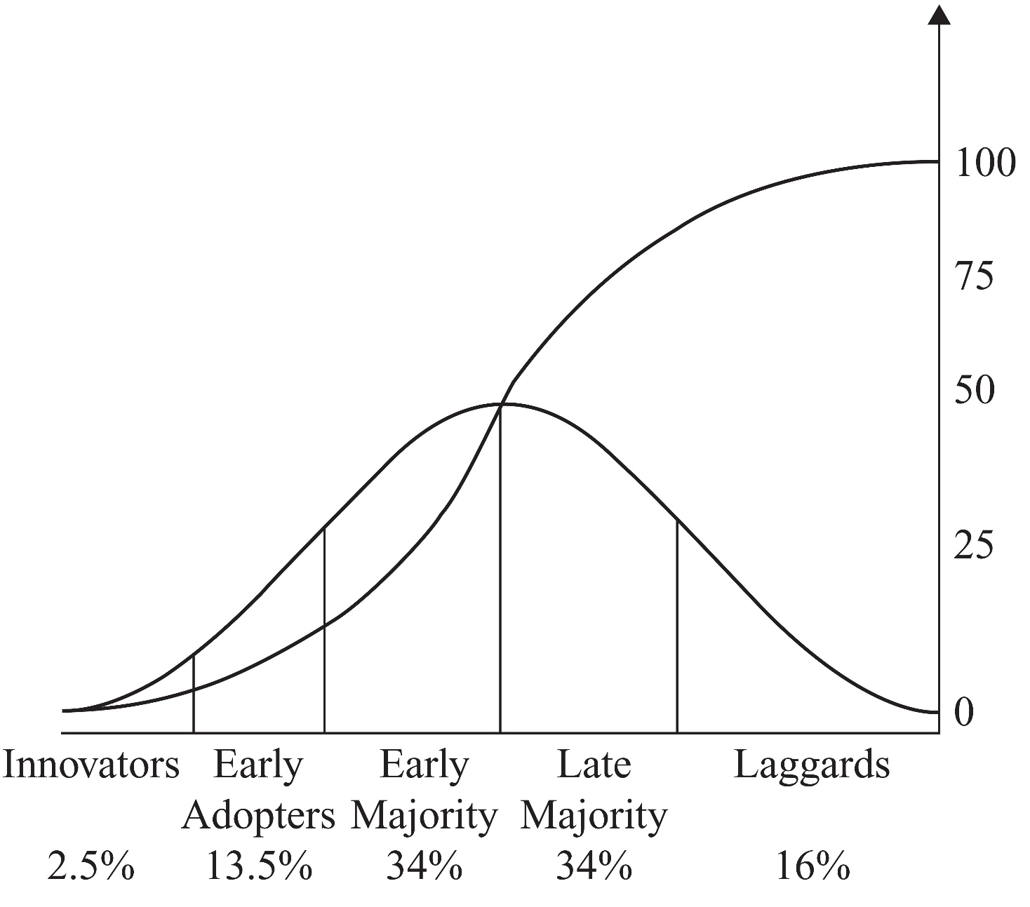
Adopter Categories
Cumulative Adoption Rate
Adoption Rate

Slide 49
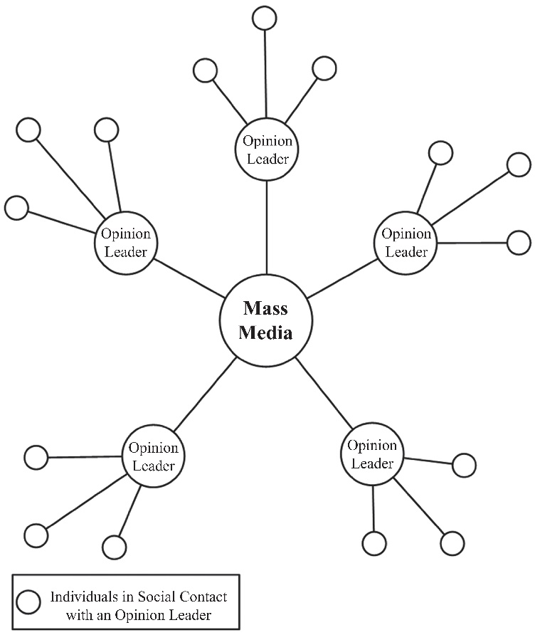
Two-Step (multiple-step) Flow Model of Diffusion
According to the two-step flow model, most information comes from mass media, which is then directed toward influential figures called opinion leaders. （信息领袖）
These leaders then convey the information (or form opinions) and act as hubs for
other members of the
society（OL-Hubs）

Slide 50
Rogers: Diffusion of Innovations: The Process
Awareness（认知）
The individual becomes aware of the innovation, but her information regarding the product is limited
Interest （兴趣）
The individual shows interest in the product and seeks more information
Evaluation（评估）
The individual tries the product in his mind and decides whether or not to adopt it
Trial（尝试）
The individual performs a trial use of the product
Adoption（采用）
The individual decides to continue the trial and adopts the product for full use

Slide 51
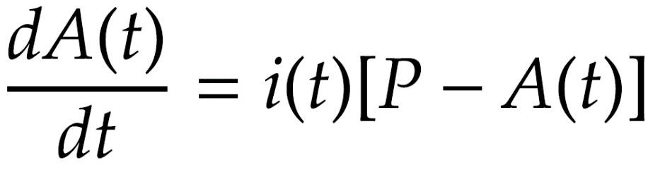
Modeling Diffusion of Innovations
This diffusion of innovation model describes the rate at which the number of adopters changes in terms of time:（采纳人员数目的变化速度）
A(t) is the total population that adopted the innovation
i(t) denotes the coefficient of diffusion corresponding to the innovativeness of the product being adopted （系数）
P is the total number of potential adopters (till time t)
The rate depends on how innovative the product is （与产品的创新程度有关）
The rate affects the potential adopters that have not yet adopted the product.（影响还没有采用新产品的人）

Slide 52
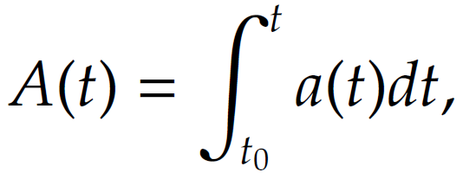

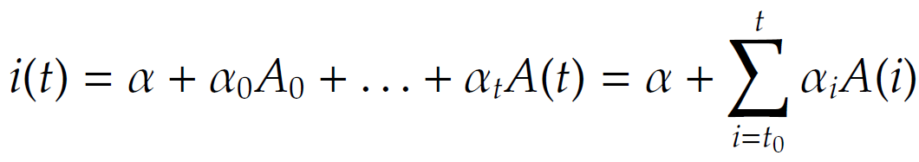
Information Diffusion: Mathematical Model
the adopters at time t
Defining the diffusion coefficient by defining i(t) as a function of number of adopters A(t), (A₀: the number of adopters at time t₀)（系数定义）

Slide 53
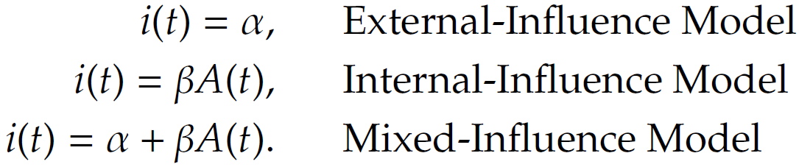
Diffusion Models
Three models of diffusion:（不同系数，不同模型）
α: Innovativeness factor of the product（产品的创新性）
β: Imitation factor（模仿性）

Slide 54
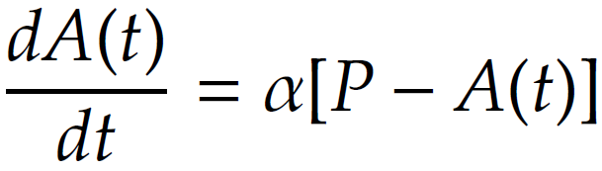

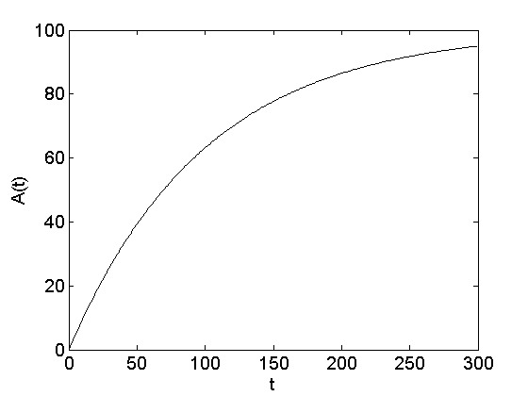
External-Influence Model
The adoption rate is a function that depends on external entities, i(t) = α
The number of adopters increases exponentially and then saturates near P.

Slide 55
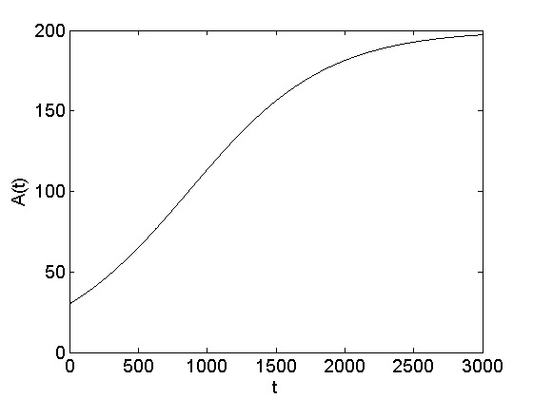
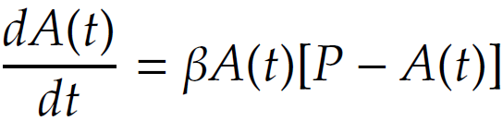
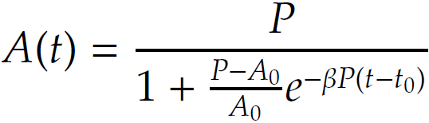
Internal-Influence Model
The adoption rate is a function that depends only on the number of already activated individuals , i(t) = βA(t)

Slide 56
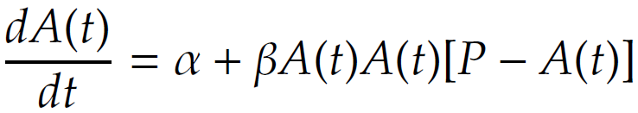
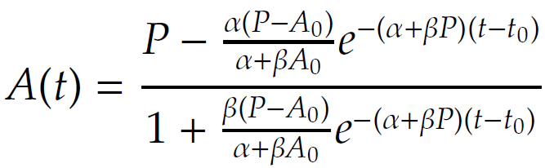
Mixed-Influence Model
The adoption rate is a function that depends on both the number of already activated individuals and external forces, i(t) = α + βA(t)

Slide 57
Diffusion of Innovation: Intervention干预
Limiting the distribution of the product or the audience that can adopt the product. （降低影响范围）
Reducing interest in the product being sold. For instance, the company can inform adopters of the faulty status of the product. （降低兴趣）
Reducing interactions within the population. Reduced interactions result in less imitations on product adoptions and a general decrease in the trend of adoptions. （减少人员之间的交互）

Slide 58
Epidemics

Slide 59
Epidemics
Epidemics describes the process by which diseases spread. This process consists of（组成要素）
A pathogen (the disease being spread),
A population of hosts (humans, animals, plants, etc.)
A spreading mechanism (breathing, drinking, sexual activity, etc.)

Slide 60
Comparing Epidemics and Cascades
Unlike information cascades and herding and similar to diffusion of innovations models, epidemic models assume an implicit network and unknown connections between individuals. （无明显知道的网络）
This makes epidemic models more suitable when we are interested in global patterns, such as trends and ratios of people getting infected, and not in who infects whom.（关注趋势和速率，而非个体）

Slide 61
How to Analyze Epidemics?
Contact Network（接触网络）
look at how hosts contact each other and devise methods that describe how epidemics happen in networks.
A contact network is a graph where nodes represent the hosts and edges represent the interactions between these hosts. For instance, in the case of the HIV/AIDS, edges represent sexual interactions, and in the case of influenza, nodes that are connected represent hosts that breathe the same air.
Fully-mixed
Analyze only the rates at which hosts get infected, recover, etc. and avoid considering network information
The models discussed here will assume:（假设）
No contact network information is available（无接触网络）
The process by which hosts get infected is unknown（感染过程不清楚）

Slide 62
SI Model: Definition
In this model the susceptible individuals get infected and once infected they will never get cured
Susceptible（可感染状态）
When an individual is in the susceptible state, he or she can potentially get infected by the disease.
Infected（感染状态）
An infected individual has the chance of infecting susceptible parties

Slide 63
Notations
N: size of the crowd（人数）
S(t): number of susceptible individuals at time t （可感染人数）
s(t) = S(t)/N
I(t): number of infected individuals at time t（已感染人数）
i(t) = I(t)/N
β: Contact probability（接触概率）
if β = 1 everyone comes to contact with everyone else
if β = 0 no one meets another individual
N = S(t) + I(t)

Slide 64
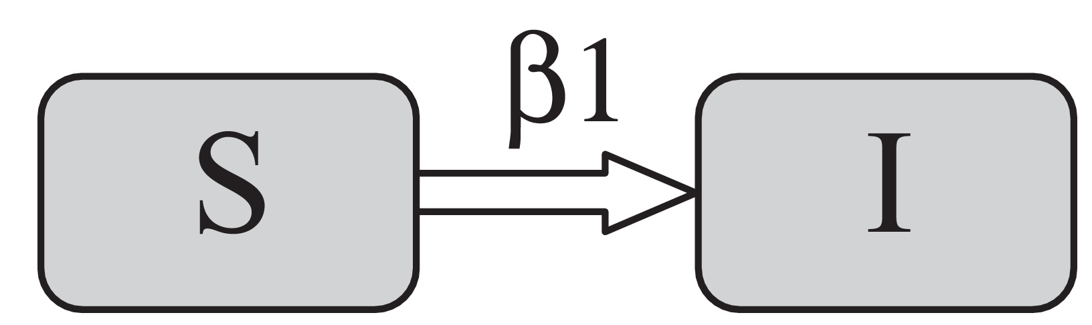
SI Model
At each time stamp, an infected individual will meet βN people on average and will infect βS of them
Since I are infected, βIS will be infected in the next time step

Slide 65
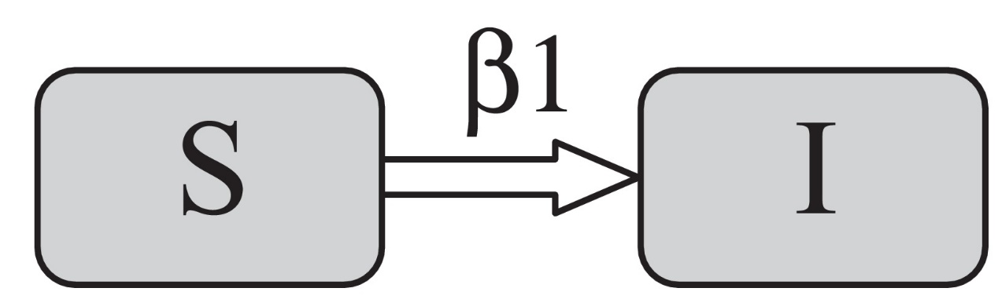
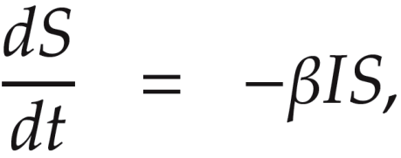
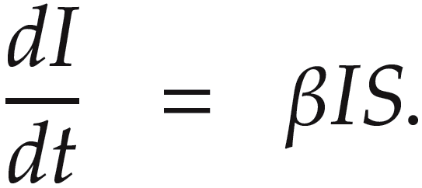
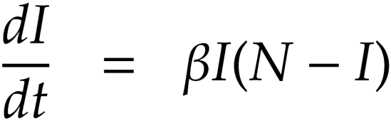
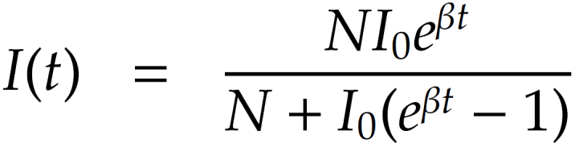
SI Model: Equations
(S + I = N)
I₀ is the number of individuals infected at time 0
Notes:
B1 or BI?

Slide 66
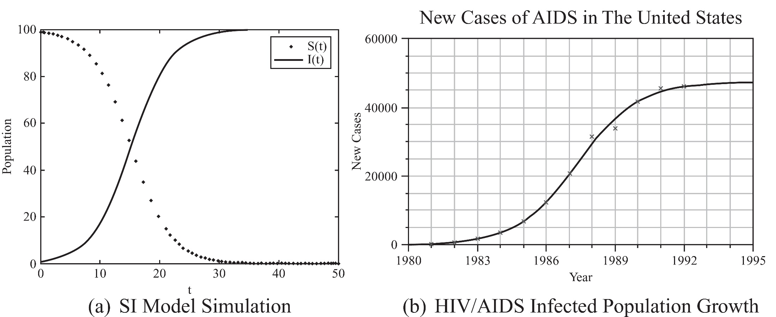
SI Model: Example
Logistic growth function compared to the HIV/AIDS growth in the United States

Slide 67
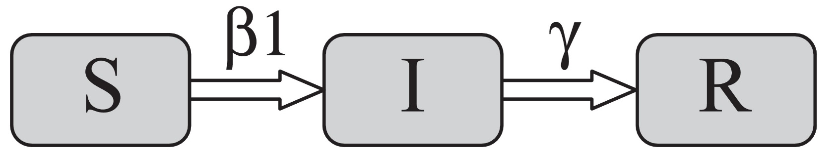
SIR Model
In the SIR model, in addition to the I and S states, a recovery state R is present.（恢复状态）
In the SIR model, individuals get infected, then some recover.
Once hosts recover (or are removed) they can no longer get infected and are not susceptible any longer.（一旦复原，则不再感染）
Notes:
\beta is the contact probability

Slide 68
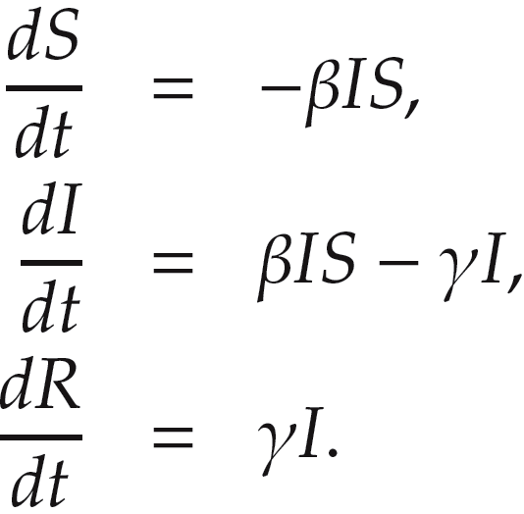
SIR Model, Equations
I + S + R = N
γ defines the recovering probability of an infected individual at a time stamp（康复系数）

Slide 69

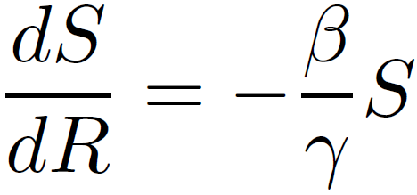
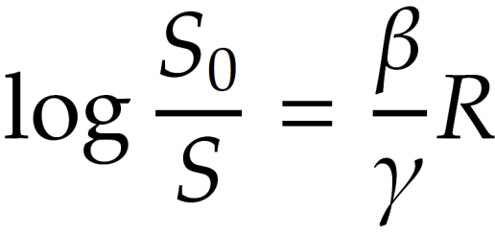
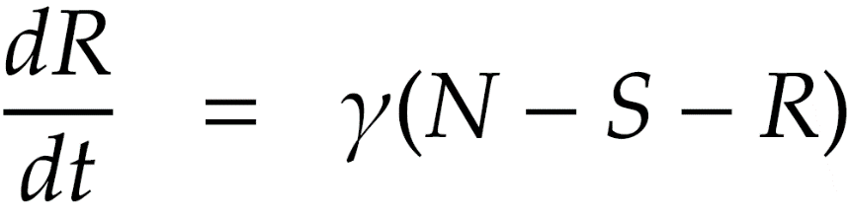
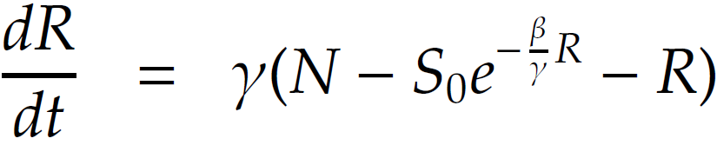
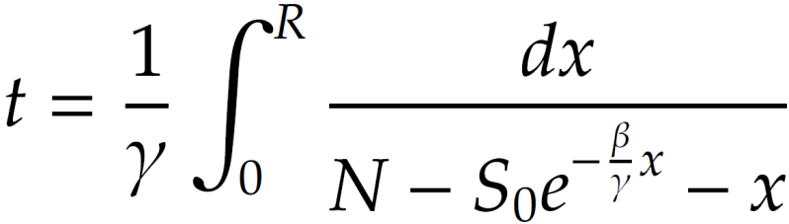
SIR Model, Equations, Cont.
(R₀ = 0)
There is no closed form solution for this integration and only numerical approximation is possible. （无解析解，数值求解）

Slide 70
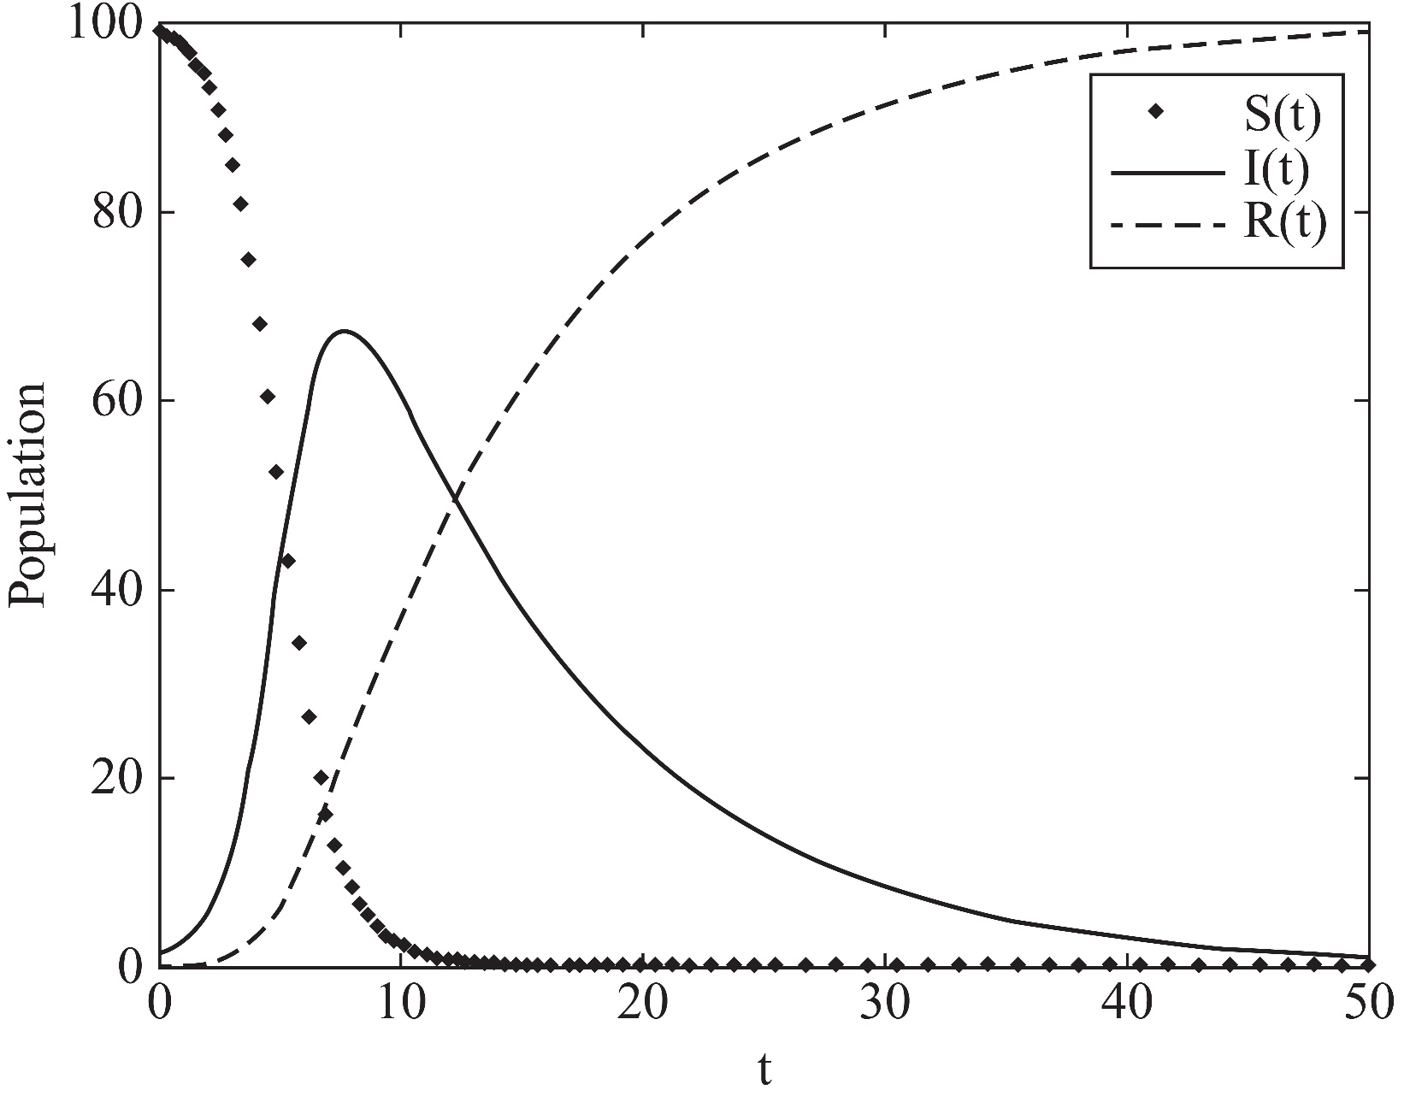
SIR Simulation

Slide 71
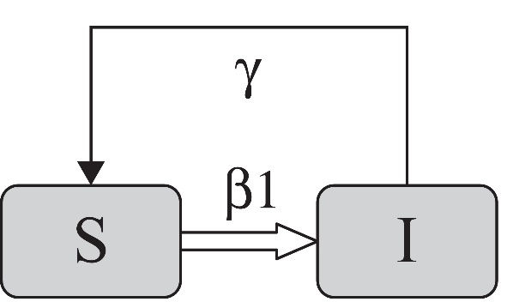
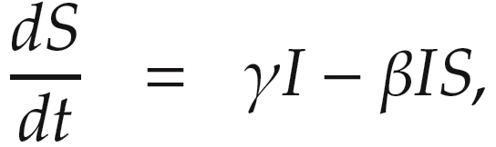
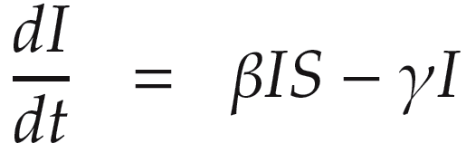
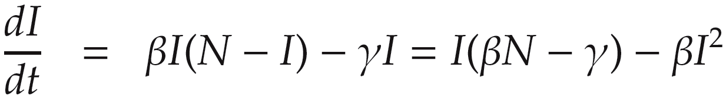
SIS Model
The SIS model is the same as the SI model with the addition of infected nodes recovering and becoming susceptible again（可再感染）

Slide 72
SIS Model
When βN <= γ:
the first term will be at most zero or negative hence the whole term becomes negative and therefore, in the limit, the value I(t) will decrease exponentially to zero
When βN > γ:
We will have a logistic growth function like the SI model

Slide 73
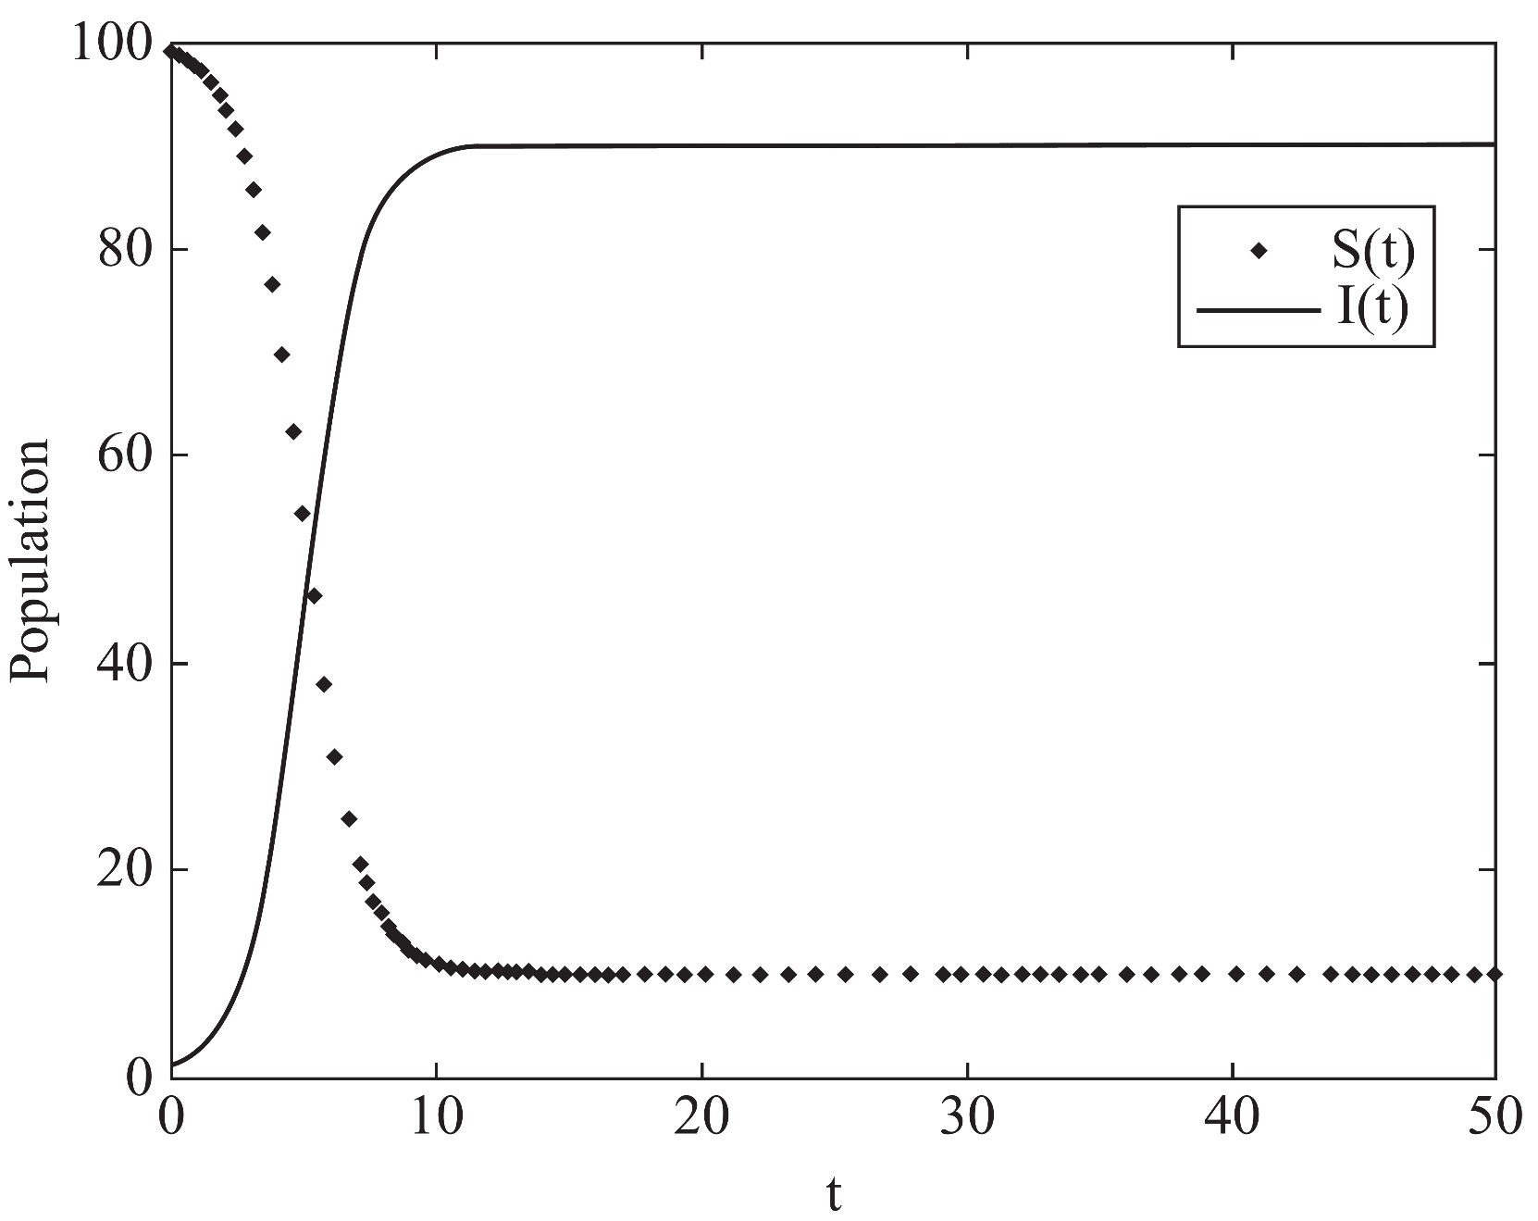
SIS Model Simulation

Slide 74
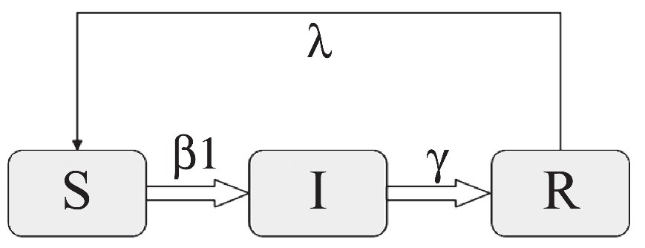
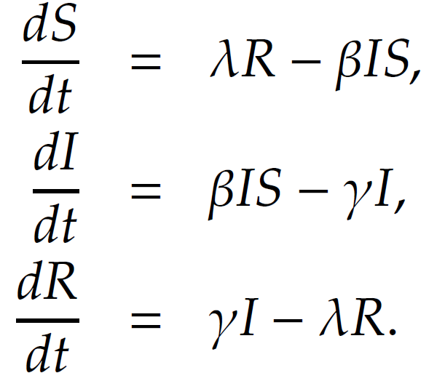
SIRS Model
The individuals who have recovered will lose immunity after a certain period of time and will become susceptible again（可再感染）
Like the SIR, model this model has no closed form solution, so numerical integration can be used

Slide 75
Epidemic Intervention（干预）
Suppose that we have a susceptible society and want to prevent more spread by vaccinating the most vulnerable individuals（阻断感染的价值节点）
How to find the most vulnerable individuals?（如何找到？）
Randomly pick some nodes and ask them who is the most vulnerable from their point of view, then vaccinate those individuals!
Notes:
by Nicholas A. Christakis

Slide 76
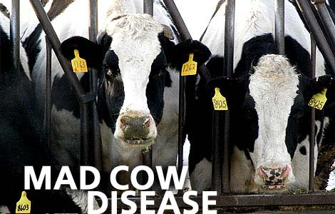
Epidemic Intervention: Mad-cow disease
Jan. 2001
First case observed in UK
Feb. 2001
43 farms infected
Sep. 2001
9000 farms infected
How to stop the disease:
Banned movement
Killed millions of animals

Slide 77
Epidemic Intervention: Network Effect
In the mad-cow disease case, we have weak ties, （弱关系）
Animals being bought and sold
Soil from tourists, etc.
To protect:
Make contagion harder
Remove weak ties (e.g., mad cows)

